Slide 1

Towards correct high-performance database backend
Saalik Hatia - Annette Bieniusa - Carla Ferreira - Gustavo Petri - Marc Shapiro
Notes:
We want to start from simple model and build

Slide 2

What is a database ?
Store data
Retrieve data
Share data
Database
Alice
Bob
Notes:
I will start by talking about databases.
What is a database:
A database is used to store data from users
Then retrieve that data
And finally one important thing is to share that data
Modern online applications use a distributed database management system (DDBMS), whose storage backend provides users with available and consistent data. The purpose of a backend is conceptually simple: to store and retrieve shared data.

Slide 3
Architecture
Transaction Begin | Put | Get | Abort | Commit
InterDC
Begin Session
Session Manager
Start
Coordinator
Session Coordinator
Session Coordinator
Session Coordinator
InterShard
Put | Get
Client
Transaction Begin | Put | Get | Abort | Commit
Get
Cache
Lookup Service
Fill
Service
Begin | Put |
Prepare | Commit
Get
Backend Actor
Journal
Checkpoint Store
Truncation Service
Recovery
Service
Fill
Service
Checkpoint
Service
Notes:
However, for performance and fault-tolerance reasons, the internals of a typical database backend are very complex, with many moving parts that interact in hard-to-understand ways. Existing backends are designed in a manual and ad-hoc manner; inevitably, they have bugs that impact the consistency and integrity of data.

Slide 4

Target database - Antidote
Geo-distributed data centers (DC)
Full replication
Causal consistency between DCs
In a DC:
Total order per DC [Akkoorath et al. ‘16]
Sharding [DeCandia et al ‘07]
Multiversion Concurrency Control (MVCC) with partial order
Journal of operations
Safe journal truncation
States stored in a Checkpoint Store
Notes:
The goal of this work is to build a database backend that is correct by design, while includ- ing some important optimisations (e.g., caching) and properties (e.g., fault tolerance).
Formal- ising a backend that provide users with fast read and writes, data safety and geo-replication is hard.
Any attempt to verify at once some monolithic specification that includes all the interesting properties, is probably doomed to failure.

Slide 5
Adding one feature at a time
(Bi-) Simulation
(Bi-) Simulation
Specification
Simple model
Simple model + 1 feature
Simple model + 2 feature
Implements
Implements
Implements
(Bi-) Simulation
(Bi-) Simulation
Implementation
Simple model
Simple model + 1 feature
Simple model + 2 feature
Notes:
Instead, we propose an incremental approach, decomposing the system into a set of small, orthogonal modules and features.
Each design step adds a single feature, e.g., a cache or logging, with its associated operational semantics and invariants.
We use simulation (or bisimulation) to show that the formal model is equivalent without and with the feature, modulo the added constraints.
We take a similar approach with the reference implementation.
Furthermore, we compare performance without and with the feature.

Slide 6
Our plan
Baseline:
Transaction
Causal consistency
Multi-version concurrency control
Store all versions
Incrementally add features:
Bounded versions
Fault tolerance
Journal
Etc..
Notes:
Our starting baseline is a bare-bones and “obviously correct” backend, restricted to its simplest function, i.e., transactions reading and writing data. We formalise its operational semantics and specify its invariants. We prove (in Coq) that the semantics satisfies the invariants. We also provide a (hand-written) reference implementation, and use test cases derived from the formal model to check that it follows the semantics and does not violate the invariants.

Slide 7
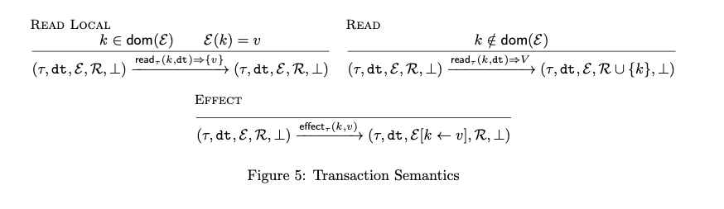
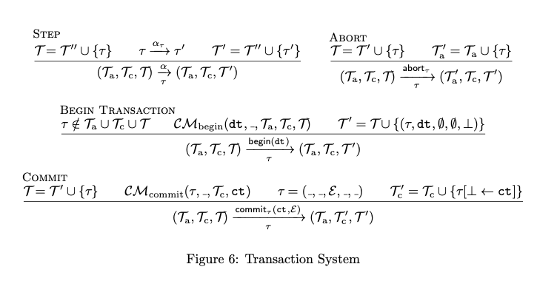
Specification of the model
Operational semantics
Invariant

Slide 8
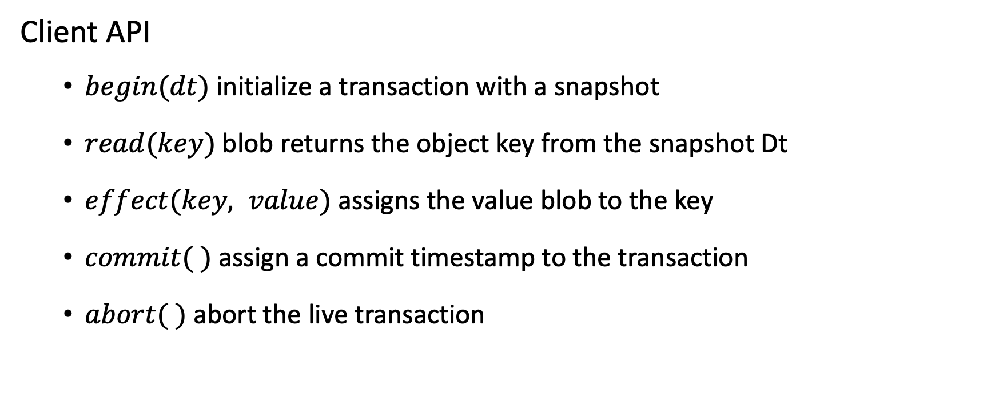
Starting simple
Client API
$begin(dt)$initialize a transaction with a snapshot
$read(key)$blob returns the object key from the snapshot Dt
$effect(key, value)$assigns the value blob to the key
$commit( )$assign a commit timestamp to the transaction
$abort( )$abort the live transaction

Slide 9
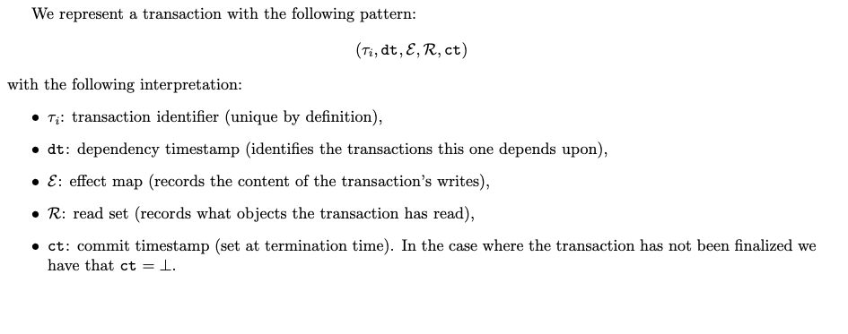
Implementation
We take our specification to be as close as possible to the model

Slide 10
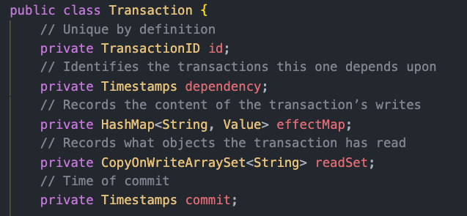
Implementation
We take our specification to be as close as possible to the model

Slide 11
Implementation
Then we add all the necessary invariants
Begin transaction:
Only one active transaction per client
Dependency timestamp must be valid

Slide 12
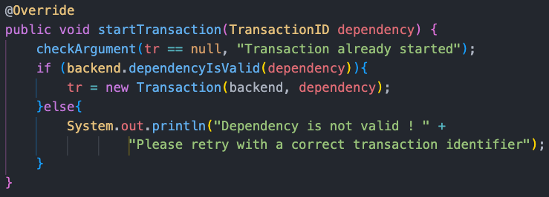
Implementation
Then we add all the necessary invariants.

Slide 13
Implementation
Then we add all the necessary invariants.

Slide 14
Implementation
Then we add all the necessary invariants.

Slide 15
Adding a feature – Bounded Versions
Once everything is working, we add a single feature:
Bounded versions
Write the specification
Implement the new version
Comparison with the previous model
Notes:
Talk about the bounds added the presentation

Slide 16

Bounded Versions – Memory invariants
We define an arbitrary limitation on the size of the memory used by the system.
New system values:
$M_{used}$
$$M_{limit}$$
New invariant:
$$M_{used}≤M_{limit}$$

Slide 17
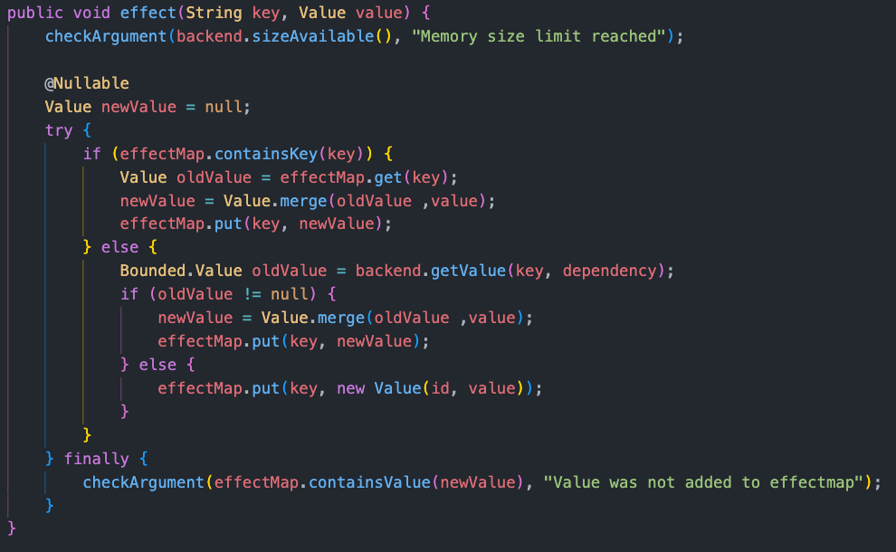
Bounded Versions – Memory invariants

Slide 18
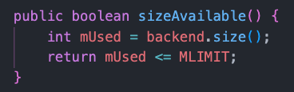
Bounded Versions – Memory invariants

Slide 19
Bounded Versions – Memory invariants

Slide 20
Bounded Versions – Memory invariants

Slide 21
Bounded memory – Garbage collection
How do we know what we can throw away ?
Keep track of the lowest dependency of a running transaction (MinDependency)
Among the versions contained in the snapshot
At the minimum, keep the most recent version of every key

Slide 22
Bounded memory – Garbage collection
Dt
1
Ct
2
3
4
5
6
7
8
time
MinDependency
2

Slide 23
Bounded memory – Garbage collection
©
Dt
1
Ct
2
Snapshot: Dt = 2
3
4
5
6
7
8
time
MinDependency
2

Slide 24
Bounded memory – Garbage collection
Dt
1
Ct
2
3
4
5
6
7
8
time
MinDependency
2

Slide 25
Bounded memory – Garbage collection
Dt
1
Ct
2
Snapshot: Dt = 2
3
4
5
6
7
8
time
MinDependency
2

Slide 26
Bounded memory – Garbage collection
Dt
1
Ct
2
3
4
5
6
7
8
time
MinDependency
6

Slide 27
Bounded memory – Garbage collection
©
Dt
1
Ct
2
3
4
5
6
Snapshot: Dt = 6
7
8
time
MinDependency
6

Slide 28
Bounded memory – Garbage collection
©
Dt
1
Ct
2
3
4
5
6
7
8
time
MinDependency
6

Slide 29
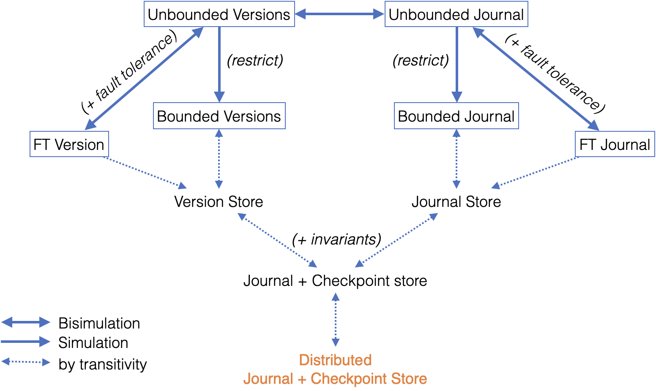
Roadmap
Notes:
This is the conclusion.
Added color coding on the graph
Prouving small thing
The upper bound of the checkpoint store should overlap with the lower bound of the journal

Slide 30
Ongoing and future work
Finishing all implementations
Testing invariants
Performance comparison
Static analysis

Slide 31
Links
https://github.com/Saalik/MultiKVS
https://github.com/Saalik/MultiKVS
https://hal.sorbonne-universite.fr/hal-02902474v2
https://hal.sorbonne-universite.fr/hal-02902474v2

Slide 32
Step-wise approach
We use simulation to show equivalence in the model and the implementation
Performance comparison between the implementation
Specification
Implementation
Implements
Simple model
Simple model
Equivalence
Equivalence
Simple model + bounded memory
Implements
Simple model + bounded memory

Slide 33
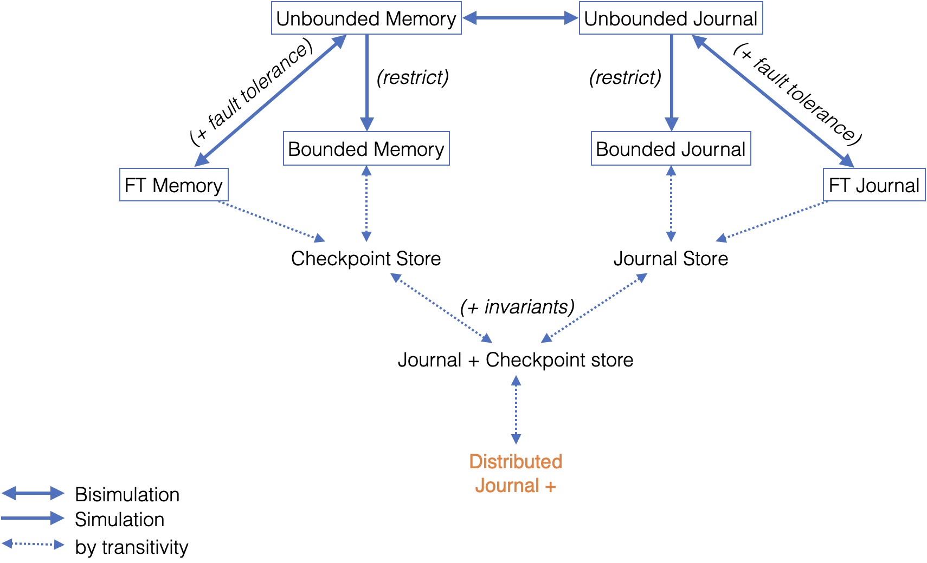
Decomposing features

Slide 34
Starting simple
We start from a simple database
Everything is in memory
Define the APIs
System invariants
Then progressively we add features and restrictions
Fault tolerance
Bounded memory
Geo-replication

Slide 35
Decomposing features

Slide 36
Decomposing features

Slide 37
Simple & intuitive model
API for the Client to interact with the database
A Store: Collection of objects
Transaction information
Timestamps
Transaction
Sequence of operations followed by a commit or abort
Snapshot
Collection of transactions
Object-version
Valid version of an object inside a snapshot

Slide 38
Transaction and snapshots
Dessin de la BD ici
Avec les invariants de transaction
State – Active,inactive
Invariant sur les dépendences

Slide 39
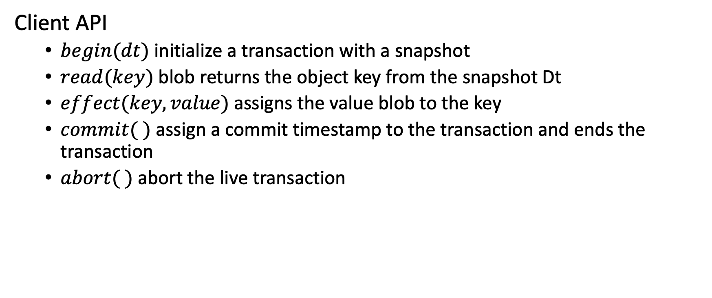
Starting simple
Client API
$begin(dt)$initialize a transaction with a snapshot
$read(key)$blob returns the object key from the snapshot Dt
$effect(key, value)$assigns the value blob to the key
$commit( )$assign a commit timestamp to the transaction and ends the transaction
$abort( )$abort the live transaction

Slide 40
Transaction handling : Specification
begin(dependency Dt)
When a client starts a transaction at the database, begin() creates a transaction object which has a transaction snapshot as an attribute. Transaction object attributes are a unique identifier, a Read Set and a Effect Map dependency snapshot, Commit Timestamp, initialized at null, buffer of pending updates.
Preconditions
There are no active transaction
Returns
The transaction object.
Notes:
Show the formal model one here

Slide 41
Transaction handling : Commit
commit()
Preconditions
The transaction is active.
The caller is in the transaction.
Returns
The value of the key in the buffer if it exist, otherwise returns the value in the snapshot.

Slide 42
Implementation
Java

Slide 43
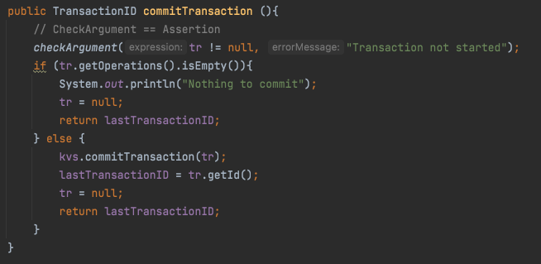
Implementation: commit
Placeholder
Notes:
Showcase the transition between the two model and also all the invariant that are

Slide 44
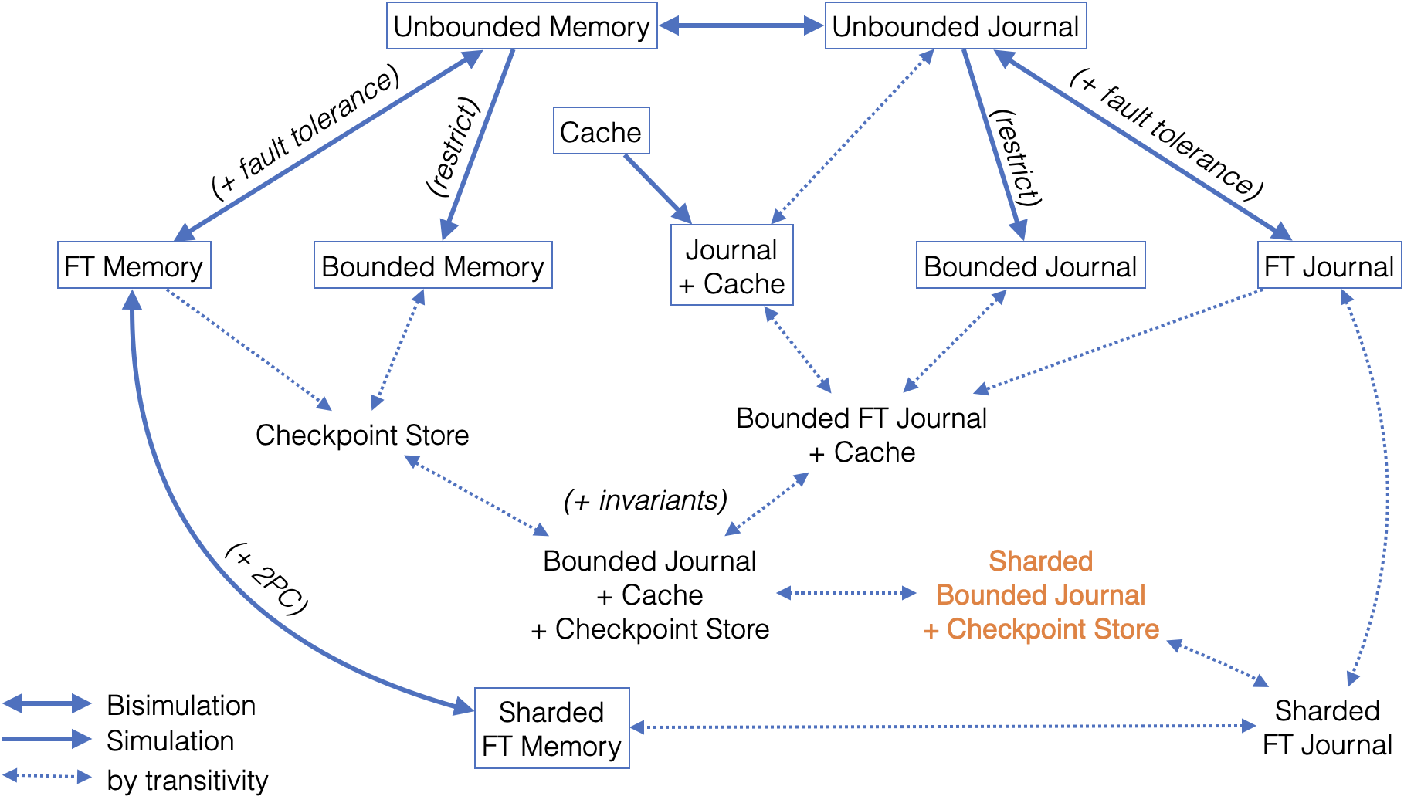
Decomposing features

Slide 45
Notes:
inte

Slide 49
Links
https://github.com/Saalik/MultiKVS
https://github.com/Saalik/MultiKVS
https://hal.sorbonne-universite.fr/hal-02902474v2
https://hal.sorbonne-universite.fr/hal-02902474v2

Slide 50
Transaction handling : Specification
read(Transaction, key)
Preconditions
The transaction is active.
The caller is in the transaction.
Returns
The value of the key in the buffer if it exist, otherwise returns the value in the snapshot.

Slide 51
Architecture
Database
InterDC
Session Manager
Start
Coordinator
Session Coordinator
Session Coordinator
Session Coordinator
InterShard
Cache
Lookup Service
Fill
Service
Backend Actor
Journal
Checkpoint Store
Truncation Service
Recovery
Service
Fill
Service
Checkpoint
Service

Slide 52
Interactions
Database
Transaction Begin | Put | Get | Abort | Commit
InterDC
Begin Session
Session Manager
Start
Coordinator
Session Coordinator
Session Coordinator
Session Coordinator
InterShard
Put | Get
Client
Transaction Begin | Put | Get | Abort | Commit
Get
Cache
Lookup Service
Fill
Service
Begin | Put |
Prepare | Commit
Get
Backend Actor
Journal
Checkpoint Store
Truncation Service
Recovery
Service
Fill
Service
Checkpoint
Service

Slide 53
Architecture
Database
InterDC
Session Manager
Start
Coordinator
Session Coordinator
Session Coordinator
Session Coordinator
InterShard
Cache
Lookup Service
Fill
Service
Backend Actor
Journal

Slide 54
Implementing step by step
Starting with the basic versions
Reference implementation as a baseline
Unbounded Journal
Unbounded Memory
Unify the API
Unify the tests
Add features

Slide 55
Next steps
Use the implementation to complete and adjust the specification
Compare different implementation
Unify the APIs of all the versions
Test
Correct APIs in the specification and code if needed
Test
Benchmark

Slide 56
Support slides
Support slides

Slide 57
Draft slides
Draft slides

Slide 58
Transaction Begin
Database
InterDC
activeTransaction: true
activeTransaction: false
Begin Session
Session Manager
Start
Coordinator
Session Coordinator
InterShard
Client
trID: 23 , [SnapVTS]
begin()
begin(23, SnapVTS)
Cache
Lookup Service
Fill
Service
Backend Actor
Journal
Checkpoint Store
Truncation Service
Recovery
Service
Fill
Service
Checkpoint
Service

Slide 59
Transaction Begin
Database
InterDC
activeTransaction: true
Session Manager
Session Coordinator
InterShard
Client
trID: 23 , [SnapVTS]
put(Hello, “World”)
put(23, Hello, “World”)
Cache
Lookup Service
Fill
Service
Backend Actor
Journal
Checkpoint Store
Truncation Service
Recovery
Service
Fill
Service
Checkpoint
Service

Slide 60

Transactions
Database
InterDC
activeTransaction: false
Session Manager
Session Coordinator
InterShard
Client
get(Hello)
Cache
Lookup Service
Fill
Service
Backend Actor
Journal
Checkpoint Store
Truncation Service
Recovery
Service
Fill
Service
Checkpoint
Service

Slide 61
Transaction handling : Specification
put(Transaction, Key, Operation)
The update create a version of the object Key and is added to the buffer of the transaction object.
An operation record is written in the journal with the following information: CommitTimestamp, TransactionID, Type, Key, Operation, SnapshotTime.
Preconditions
The transaction is active.
The caller is in the transaction.
Returns
Nothing

Slide 62
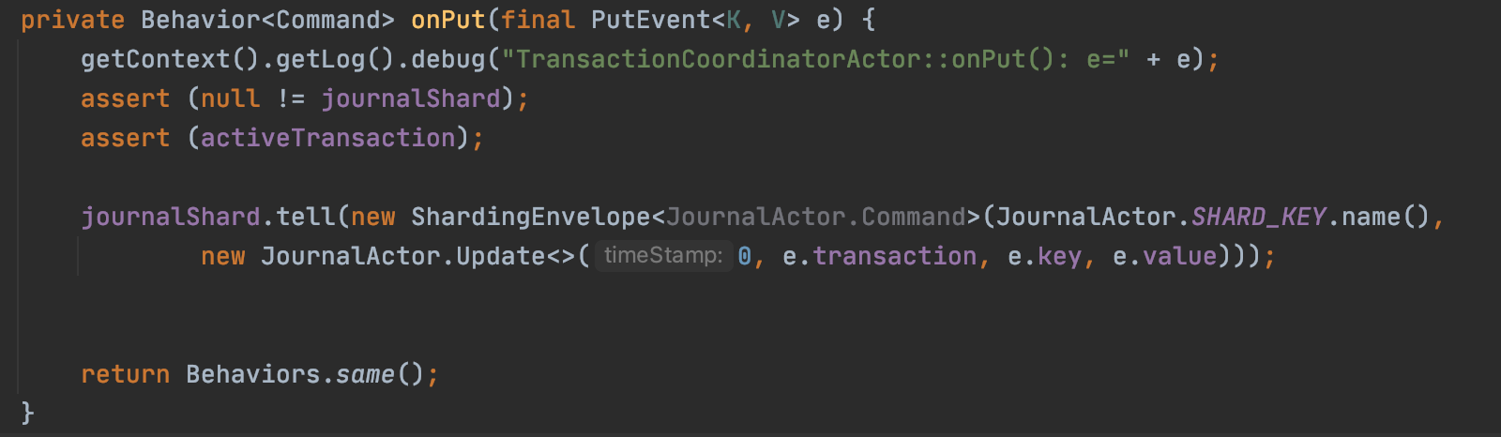
Transaction handling : Specification

Slide 63
State of the Thesis
Work in progress
Prototype based on the specification (Collaboration with Benoit Martin)
Verify our design (Collaboration with Carla Ferreira, Annette Beniusa and Gustavo Petri)
Benchmark
Future Work
Submit Paper to SIGMOD/ASPLOS/PODS (October – December)
Write Thesis ( December – April 2022)
PhD Defense (June 2022)
Notes:
Add information about the demo.
Add information about what happened since the last CSD.
Move work to the beginning of the slide to talk about.

Slide 64
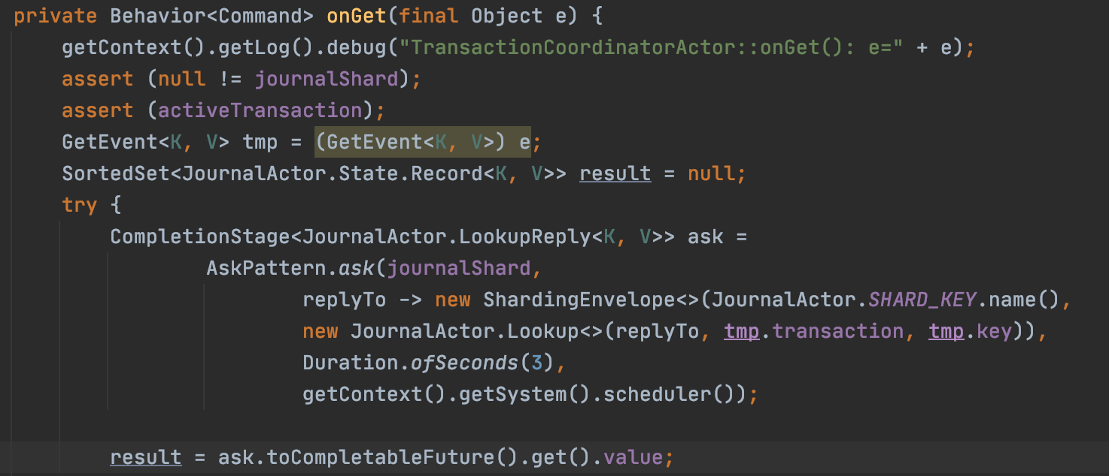
Transaction handling : Specification

Slide 65
Transaction handling
When a client connects, it connects to a Session Manager:
A Session Coordinator is assigned to the client
Session guarantees for a client
One transaction at a time
Causality between transactions in a Session
On session end (abort or commit) all transactions are committed or aborted
Transaction Guarantees
Reads from a snapshot (Dependency Snapshot)
Effects are visible at commit time
Aborting a transaction deletes the effects of the transaction
Notes:
A transaction reads from a snapshot. A snapshot is a set of versions. For any key, it maps the start/dependency timestamp of the transaction to the version of that key that is visible at that timestamp. The visibility relation is specific to an isolation level
Presenting the guarantees, this is how we do it.
Here's is the goal:
take one specific piece from the piece
Read something from write. Here's the implement.
Transactions how we do a transaction:
Change life cycle of the transactions

Slide 66
Transaction handling
Sessions are a sequence of transaction from a client:
One transaction at a time
A transaction in a session reads from a Snapshot with the commit time of the last transaction.
On session end (abort or commit) all transactions are committed or aborted
Notes:
A transaction reads from a snapshot. A snapshot is a set of versions. For any key, it maps the start/dependency timestamp of the transaction to the version of that key that is visible at that timestamp. The visibility relation is specific to an isolation level
Presenting the guarantees, this is how we do it.
Here's is the goal:
take one specific piece from the piece
Read something from write. Here's the implement.
Transactions how we do a transaction:
Change life cycle of the transactions

Slide 67
Architecture
Presentation specification -> implementation
Gestion des transactions

Slide 68
Three main parts
Specification rappel (2) – (Mention de la verification formelle et de la collaboration)
Prototype(6)
Ending(1)

Slide 69


Architecture
Database
Shard
Session Manager
Session Coordinator
Truncate/Fill Actor
Overview
Session Manager
Session Coordinator
Backend Actor
Cache
Truncate/Fill Actor
Client
Cache
Backend Actor

Slide 70
Formal Model: Writing a specification
Specification of the structures of interest, i.e., journal, materialization cache, and checkpoint store.
Specification of transactions and interaction with the database
Specification of the invariants that link the different parts together

Slide 71
These are complex features
Support for transactions and sessions
Journal - Operation based backend
Checkpoint Store - State based backend
Journal truncation
Recovery
Sharding and geo-replication
Notes:
Target requires all these features

Slide 72
These are complex features to do correctly
Support for transactions and sessions
Journal - Operation based backend
Checkpoint Store - State based backend
Journal truncation
Recovery
Sharding and geo-replication
Notes:
Requirement are this nanani and this is the architecture it should look like

Slide 73
What we want from the system
Correct by design
Data safety
Fast reads and fast writes
Geo-replication
Features optimization like caching, fault tolerance

Slide 74
End of thesis plan
Continue working on the implementation of the specification.
Collaborate on the formal verification side to compare to the prototype results.
Submit paper in SIGMOD (Deadline (tbc))
Write Thesis
Estimated date of defense May 2022

Slide 75
Architecture
Database
Shard
Session Manager
Session Coordinator
Truncate/Fill Actor
Session Coordinator
Session Coordinator
Overview
Session Manager
Session Coordinator
Backend Actor
Cache
Truncate/Fill Actor
Cache
Backend Actor

Slide 76
Architecture
Database
InterDC
Session Manager
Start
Coordinator
Session Coordinator
Session Coordinator
Session Coordinator
InterShard
Cache
Lookup Service
Fill
Service
Backend Actor
Journal
Checkpoint Store
Truncation Service
Recovery
Service
Fill
Service
Checkpoint
Service

Slide 77
Formal verification: Semantic approach to database design
Semantic domains
Generic Conditions and Predicates

Slide 78
Current architecture
Database
Shard
Session Manager
Session Coordinator
InterShard
Session Coordinator
Session Coordinator
Overview
Session Manager
Session Coordinator
Cache
Backend Actor
Journal
Checkpoint Store
Client
Cache
Backend Actor
Notes:
Remove this slide and extend the next slide

