Slide 1
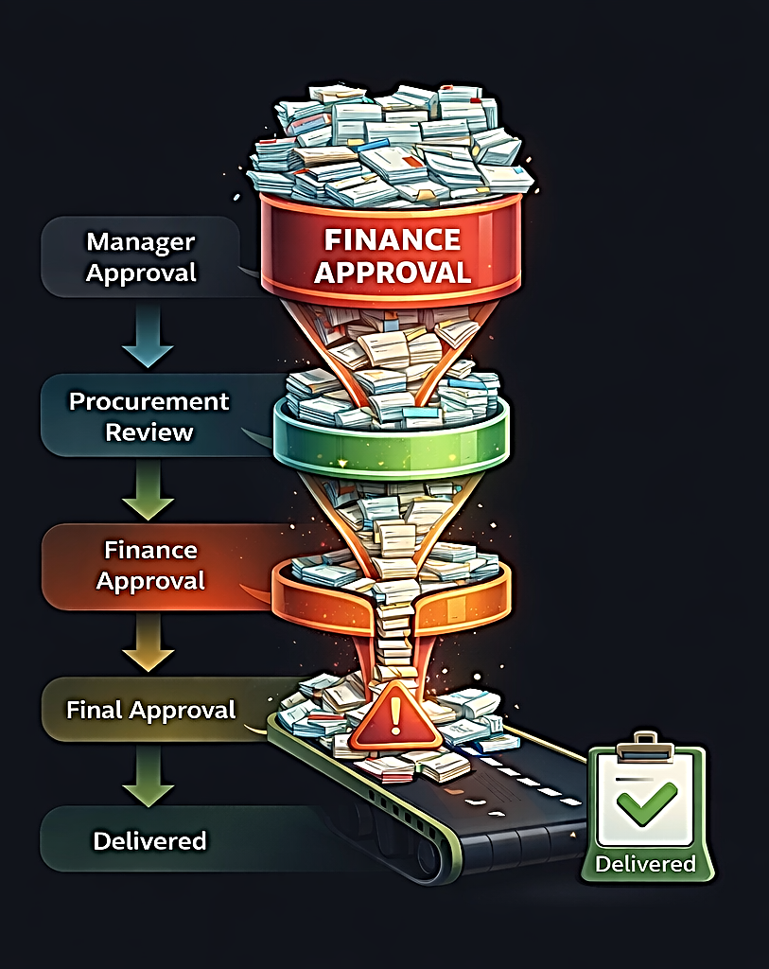
Diagnosing Bottlenecks in Procurement Approval Processes
Data-driven workflow analysis, bottleneck diagnosis, and delay-risk prediction
Saami Anware
Data Analyst | Business Analytics Focus
MSc Data Science
Live dashboard: procurement-bottleneck-dashboard.streamlit.app
A decision-support dashboard built on synthetic workflow data, process diagnostics, and a leakage-controlled prediction model.
1

Slide 2
Problem and objective
Why procurement workflows need diagnosis, not just reporting
Sequential approvals create dependency-driven delays that are hard to localize.
Organizations often see SLA breach outcomes but not the stage causing the delay.
The project objective was to identify bottlenecks, explain delay drivers, predict risk, and support action through a dashboard.
1
Stage-level timing
2
Request-level aggregation
3
Bottleneck diagnosis
4
Delay-risk prediction
2

Slide 3
Approach and pipeline
End-to-end structure used in the project
1
2
3
4
5
6
Synthetic data generation
→
Processing and feature engineering
→
EDA
→
Bottleneck analysis
→
Random Forest modeling
→
Streamlit decision dashboard
Final datasets: data/final/final_stage_level.csv and data/final/final_request_level.csv
3

Slide 4
Data structure
Two linked datasets for process-level and request-level analysis
Stage-level dataset
Request-level dataset
Stage
Processing_Time / Waiting_Time / Total_Stage_Time
Rework_Flag
Start_Time / End_Time
Request_ID
Total_TAT / Total_Processing / Total_Waiting
SLA_Hours / Delayed_Flag
Request_Type / Priority / Department / Vendor
Complexity_Score / Num_Stages / Max_Stage_Delay
Bottleneck_Stage
4

Slide 5
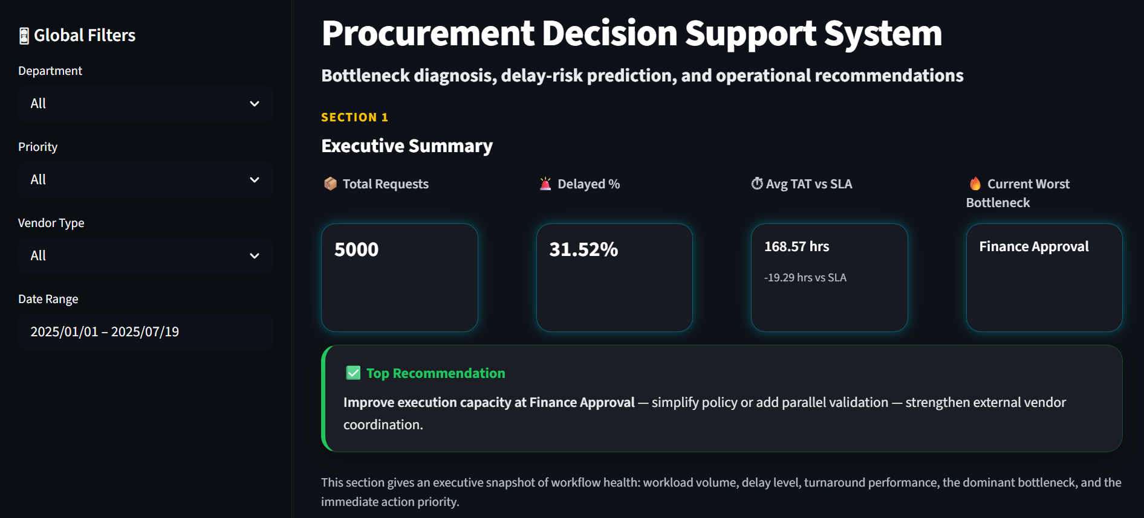
Executive dashboard view
The dashboard surfaces workload, delay level, SLA gap, bottleneck, and action priority
5

Slide 6
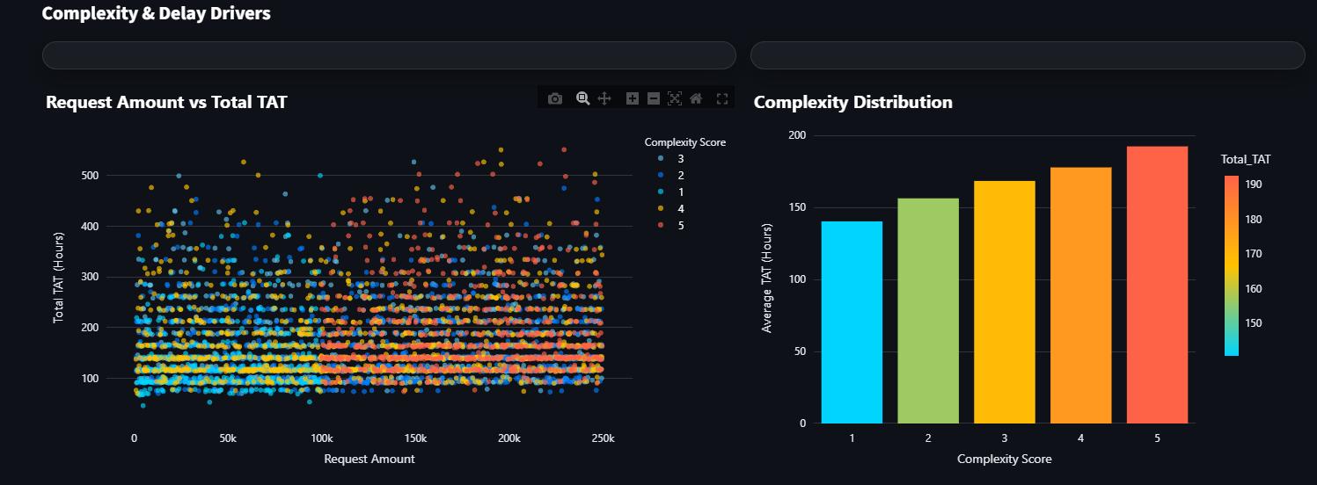
Core EDA findings
High-level patterns before deeper bottleneck diagnosis
Turnaround time varies meaningfully across request types, departments, and vendor categories.
Higher complexity and higher-value requests show stronger delay tendency.
Rework events materially increase stage duration and amplify overall turnaround time.
6

Slide 7
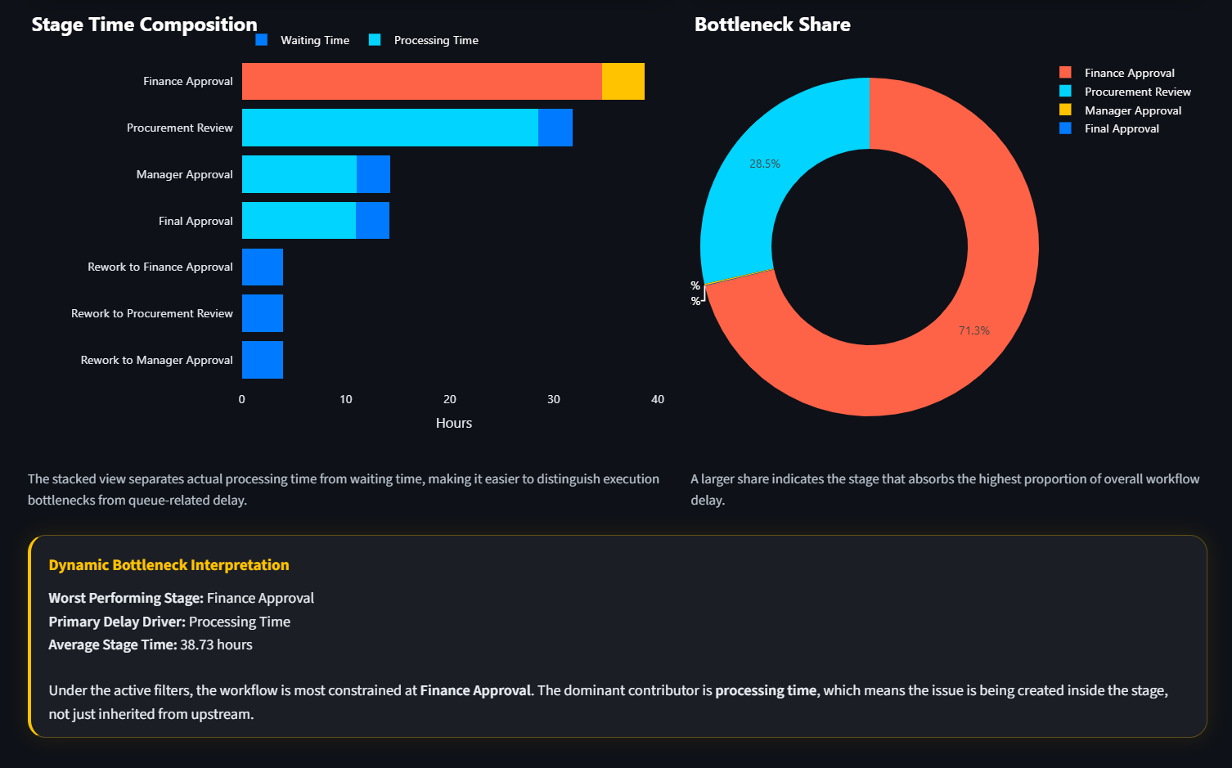
Bottleneck diagnosis
Delays are concentrated in specific stages rather than evenly spread
7

Slide 8
Key bottleneck insight
Finance Approval emerged as the dominant workflow constraint
Worst-performing stage
This indicates the bottleneck is being created inside the stage, not merely inherited from upstream waiting.
The dominant stage becomes the highest-value intervention point for managers.
Finance Approval
Primary delay driver
Processing time
Average stage time ≈ 38.7 hours
8

Slide 9
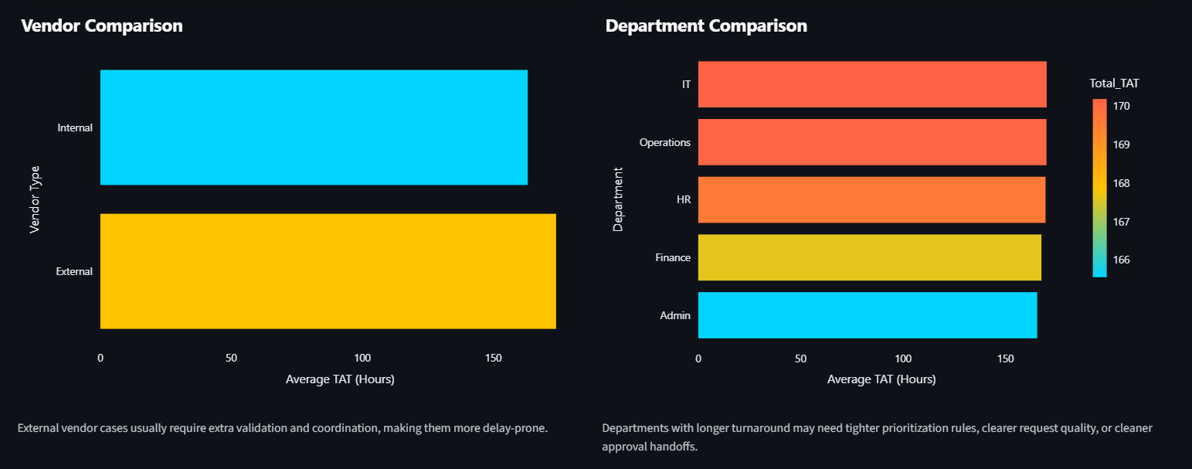
Operational drivers
Vendor type, and department context influence turnaround time
9

Slide 10
Modeling approach
Leakage-controlled Random Forest classifier for delay-risk prediction
Target variable: Delayed_Flag.
Model: Random Forest classifier using request and workflow features.
Leakage removed: Delay_Ratio and SLA_Breach_Hours.
Train/test split used a realistic class balance (≈68.5% non-delayed, 31.5% delayed).
Top predictive signals
• Total_Waiting
• Max_Stage_Delay
• Complexity_Score
• Num_Stages
• Request_Amount
10

Slide 11
Model results
High performance with realistic non-perfect error
Confusion matrix
Accuracy: 95%
Recall for delayed requests: 95%
False negatives stayed low, which matters because missed risky requests are operationally costly.
Pred 0 Pred 1
True 0
True 1
655
30
16
299
11

Slide 12
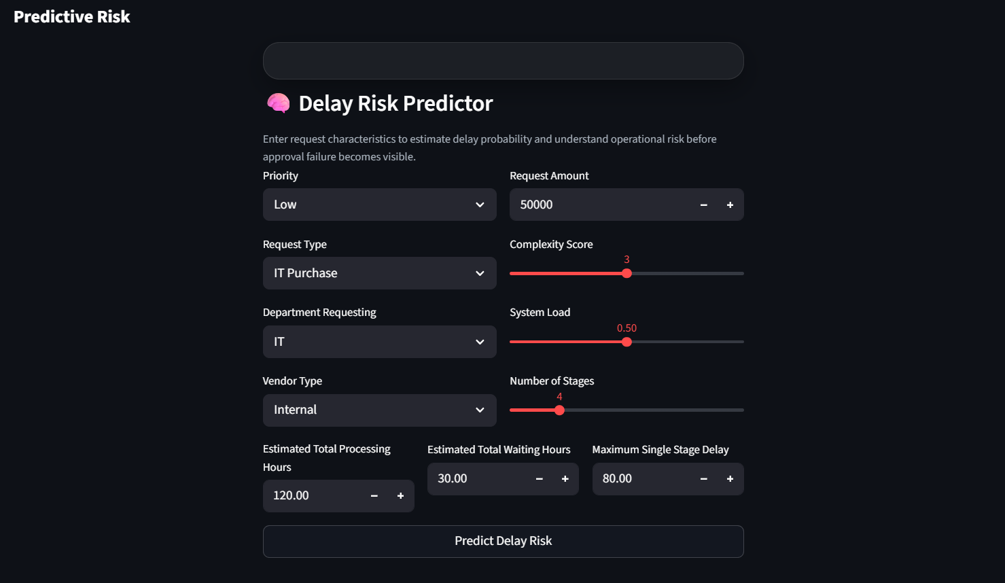
Decision support interface
The model is embedded inside a usable dashboard experience
12

Slide 13
Saami Anware
Data Analyst | Business Analytics Focus
MSc Data Science
Conclusion and recommendations
What the project shows and what managers should do
Procurement delays are concentrated, explainable, and stage-dependent rather than random.
Finance Approval is the highest-priority intervention point in the current workflow design.
Waiting and rework are not enough to explain all delay; execution capacity inside key stages also matters.
The dashboard turns the analysis into an actionable decision-support tool for monitoring and early risk screening.
This project transforms procurement workflows from passive reporting systems into proactive decision intelligence tools.
Recommended actions
• Increase capacity or streamline policy at Finance Approval
• Track rework loops as an explicit process KPI
• Use the risk model to triage high-risk requests earlier
Saami Anware
13

