Slide 1
High performance computing title : Social distancing monitor

Slide 2
Abstract:
During this COVID-19, it is very important to maintain social distance to break the chain of virus. Through this project, we can monitor if persons are following social distancing or not.
The main idea behind this project is to check the distance between the persons.
This distance can be calculated using the coordinates of bounding box of the detected person. If the distance is less than a pre-defined threshold value, then it shows red which means persons are close to each other. If the distance is greater than the threshold value, then it shows green.

Slide 3
Overview of the process:
Video is taken as input
We divided our entire project into basic steps
We are going to do the project using opencv-python coding.
After running the code through normal Python environment,we use openVINO environment to run the code.

Slide 4
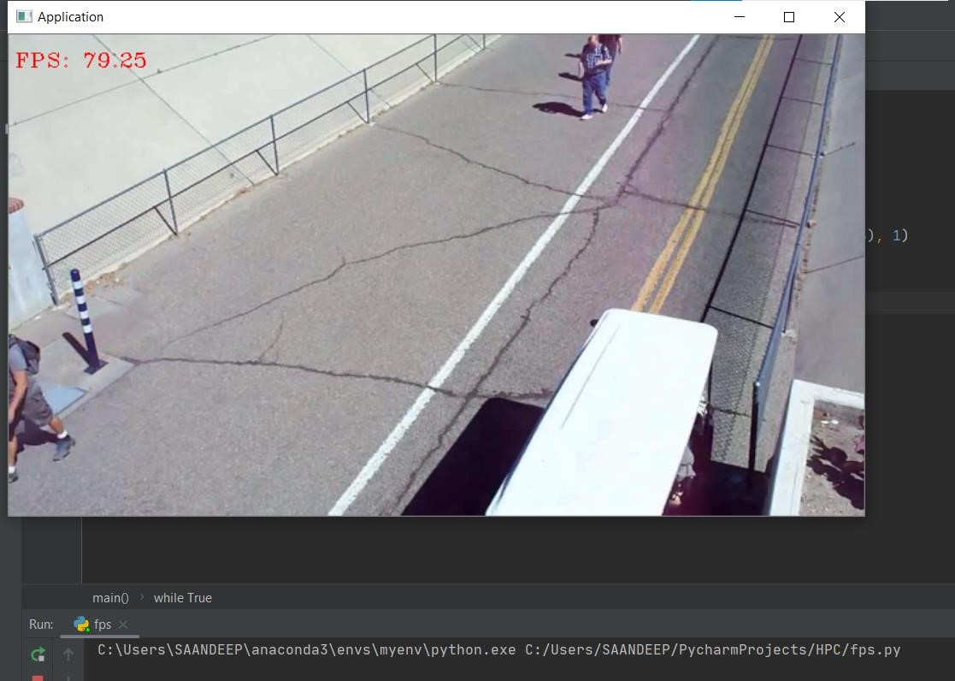
Step 1:Divide the input video file into frames and caluculate the fps.

Slide 5
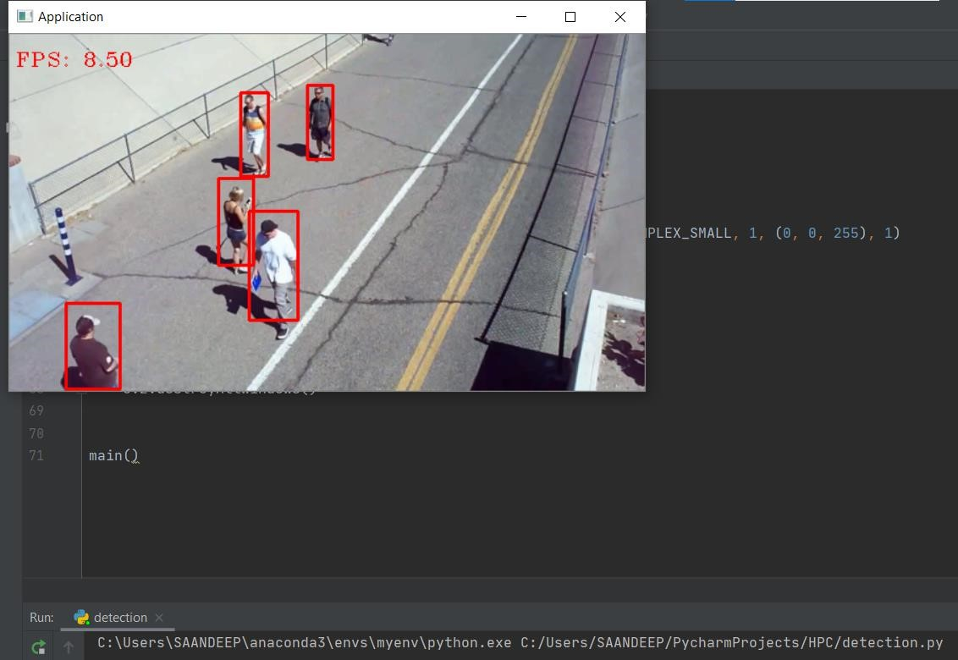
Step 2:Detecting the persons in the video file.

Slide 6
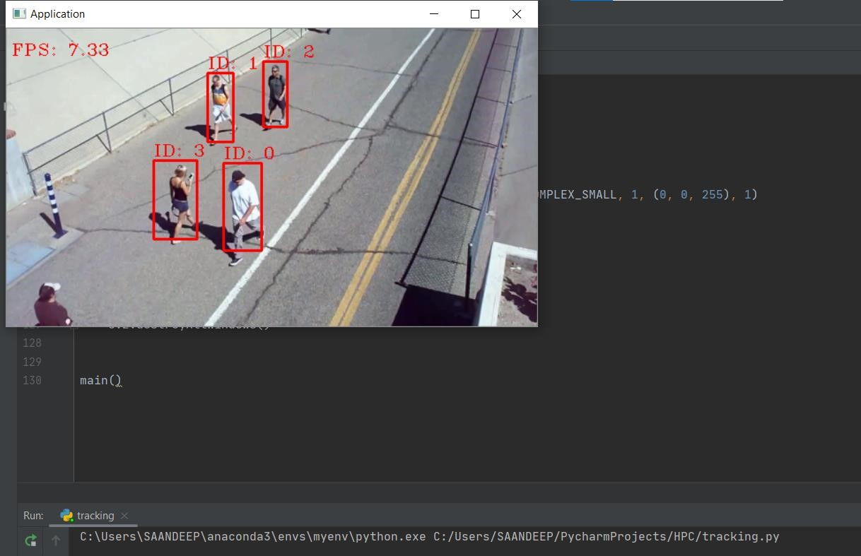

Step 3:Tracking the persons in the videofile by assigning an object id.

Slide 7
Step 4:Writing distance constraints.
Here we are going to monitor the social distancing between the persons, so what social distancing means is that there should be minimum distance between walking or standing nearby .So we will do inferencing over a video file and will monitor the social distance .The basic idea behind this monitoring the social distancing code is that we will detect the persons and based on the boundary box of those person we will calculate the centroid . Once we have the centroid of the particular person we are going to calculate the distance between the centroid 1 and centroid 2 which means centroid of person 1 and centroid of person 2 and if that particular distance is less than a threshold value then we will mark it as red which means the social distancing is false otherwise it will be simply green boundary box

Slide 8
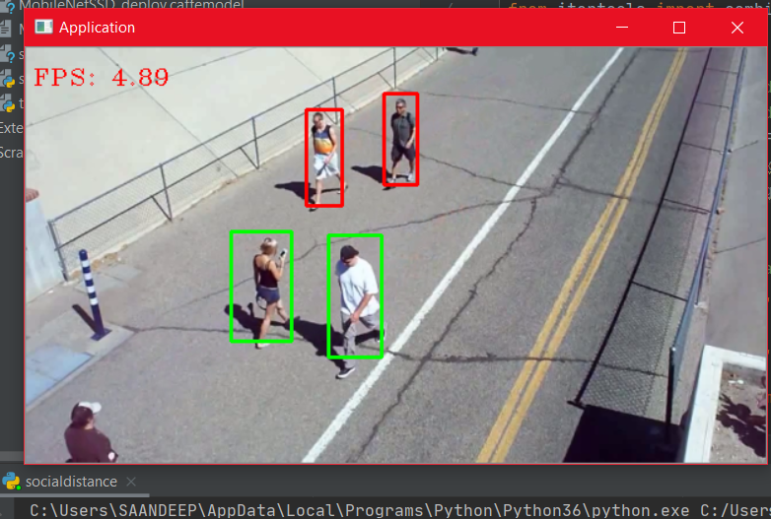

Slide 9
Relating the project to HPC
Suppose we are running this person detection code but we are not sure if it is consuming all the CPU resources effectively or not which leads to low performance.
The FPS that we get for a video if we run person detection the code by cpu is very less which makes the project not feasible.So inorder to improve the FPS the code should be run by GPU.
OpenVINO stands for Open Visual Inference and Neural Network Optimization. It is a toolkit provided by Intel to facilitate faster inference of deep learning models.
We are planning to use Openvino environment which allows us to specify the hardware.

Slide 10
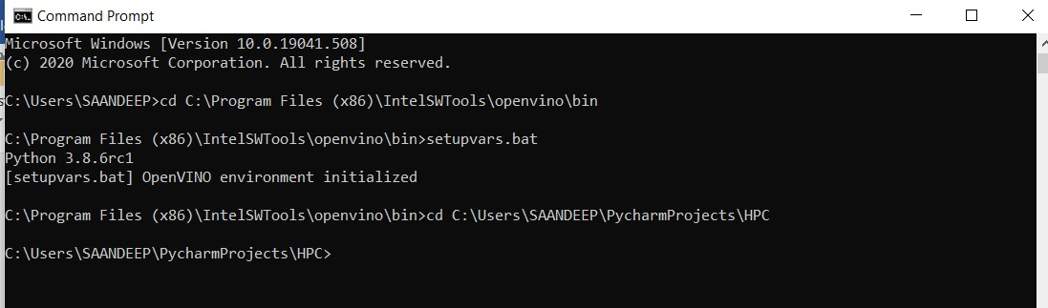
Open vino environment

Slide 11
Result:
Improved performance by using openVINO environment as compared to CPU.
The persons are surrounded by bounding rectangular boxes.
Red bounding box indicates the person is not following social distance.
Green bounding box indicates the person is maintaining social distance.

