Slide 1

PROJECT-BASED LEARNING
PHASE-I EVALUATION
SkillMitra
Team ID: BCA IJP-V-2026-T040
Department of Computer Applications
Graphic Era (Deemed to be University), Dehradun
Academic Session 2026–27

Slide 2

Team & Mentor Details
TEAM
TEAM MEMBERS
1. Simran Chauhan(Team Lead)—ID 24152189, Sec.H
24152189@geu.ac.in
Team ID: BCA IJP-V-2026-T040
Semester: V
Section(s): H
Domain: Java Programming
Astha Adhikari — ID 24152627, Sec. H
24152627@geu.ac.in
Saanidhya Kunwar — ID 240411266, Sec. H
240411266@geu.ac.in
Mentor: Dr. Aditya Joshi

Slide 3
Problem Statement & Motivation
PROBLEM STATEMENT
The local home-services market (plumbing, electrical work, carpentry, repairs) remains largely unorganized. Therefore, creation of a solution that solves the problem where workforce with customers.
MOTIVATION
TARGET USERS
The main reason behind selecting this particular project and considering its development in the future is the necessity to digitize and regulate the local informal market. The traditional word-of-mouth method usually results in a lack of control and creates limitations for b2b service providers like plumbers or carpenters.
The Worker Marketplace will be used by three main types of users. First, searching for specific local services and wanting to receive high-quality verified orders. Second, skilled workers, like plumbers, electricians, and carpenters, wish to post their available hours to gain more users and expand their customer base without additional agents or companies. Finally, the Admins Fixing the gap between workers and client.

Slide 4
Objectives
Project Objectives
Digitize Discovery: Connect the target audience of homeowners with local tradespeople.
Direct Booking: Remove middlemen agencies and standardize the fee charging process.
Ensure Trust: Facilitate skill-specific search, cost transparency, and review-based ratings.
Build Full-Stack Application: Develop a full-stack application based on REST API using Java Spring Boot and MySQL database.
Multi-User Dashboards: Create multi-user dashboards for Homeowners, Workers, and Admins.

Slide 5
Proposed Solution
Proposed Approach
1. Requirement Analysis: Elaborate the end-user requirements, design MySQL database schema, plan system architecture, develop wireframes and mockups.
2. Development: Build a REST API using Java Spring Boot, implement Spring Security features, develop responsive web interfaces using Bootstrap front-end framework.
3. Testing & Deployment: Conduct REST API testing using Postman tool, carry out end-to-end testing, fix discovered bugs, prepare final project documentation.

Slide 6
Integration of PBL Course Concepts
Course Concepts Applied
Data Structures / OOPs (Java)—classes, Multithreading
backend — Spring boot
DBMS — MySql
Software Engineering — modular design, monitoring & telemetry integration

Slide 7
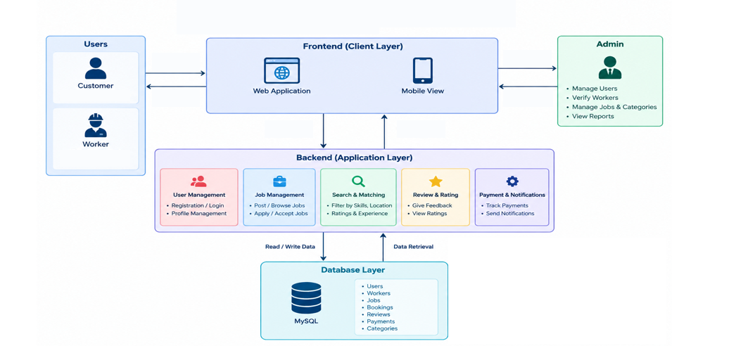
System Architecture

Slide 8
Technology Stack & Methodology
DEVELOPMENT METHODOLOGY
Requirement Analysis
System Design
Implementation.
Testing).
Evaluation .
TECHNOLOGY STACK
Programming: Java
Database: MySql
Tools / Framework: Node.js / Express, React
Monitoring: WebSocket
Backend: Spring Boot
Version Control: Git / GitHub
To be decided further

Slide 9
Initial Progress & Team Contribution
PROGRESS ACHIEVED
INDIVIDUAL CONTRIBUTION
▶
Study of java basic concepts completed
Sql database understanding. System architecture designed (overflow control loop).
Initial monitoring scaffolding started.
Member | Role | Contribution
▶
Simran chauhan | Team Lead | Backend and Database (mysql)
Astha Adhikari | Tester | Frontend
Saanidhya Kunwar | Developer | Backend
▶
▶

Slide 10
Roadmap, Expected Outcomes & References
ROADMAP
Phase-I
Proposal & Design (current)
→
Phase-II
Development — SkillMitra in Java
→
Phase-III
Final Implementation, dashboards & evaluation
EXPECTED OUTCOMES
The project will deliver a fully functional, multi-role web platform that directly connects homeowners with verified local service providers. Powered by a Java Spring Boot backend, a MySQL database, and a responsive Bootstrap frontend, the system automates service discovery, skill-based search filtering, real-time job bookings, and authentic customer reviews. Final deliverables include production-ready source code, secure REST APIs, complete database ER schematics, API test suites, and full technical documentation.

Slide 11
Thank you

