Slide 1


PersistHotStuff: Production-Oriented HotStuff BFT Consensus
Saanvi Shet - 612203164
Tejas Kolhe - 612203097
Dr.Vahida Attar
March 2026
Department of Computer Science & Engineering and Information Technology
School of Computational Sciences
COEP Technological University
05-03-2026
1

Slide 2
Motivation: Why BFT for critical replicated services?
Byzantine faults: A replica performing arbitrary/malicious behavior: lie, send conflicting messages to different peers (equivocation), omit messages, replay old messages, or follow a different/buggy protocol version.
Safety required under adversarial conditions: Safety in distributed systems ensures that "bad things" never happen, maintaining system correctness, data integrity, and consistency even during failures
Consensus is needed for replicated state machines: process where multiple independent nodes (computers) agree on a single data value or state even when some nodes fail or network issues occur
Deployments face crashes and restarts too. It risks forgetting critical protocol state, which can break safety after restart if the node behaves like it’s “fresh.”
Department of Computer Science & Engineering and Information Technology
School of Computational Sciences
COEP Technological University
05-03-2026
2

Slide 3
Problem Statement
HotStuff is a leader-based Byzantine Fault Tolerant (BFT) consensus protocol known for its linear view changes, high responsiveness, and safety in partially synchronous networks.
However there exist four practical limitations
Limitation
Impact
L1 Persistence + crash recovery
Safety breaks after restart
L2 Dynamic membership
Can’t add/remove replicas safely
L3 Pluggable state machine
Hard to integrate real applications
L4 Enhanced pacemaker
Liveness fragile under delays/failures
Department of Computer Science & Engineering and Information Technology
School of Computational Sciences
COEP Technological University
05-03-2026
3

Slide 4

Objectives
O1: Write Ahead Log (WAL) + snapshots + deterministic recovery
O2: Safe membership transitions
O3: Clean, pluggable state-machine API
O4: Robust pacemaker (timeouts, leader rotation)
Lx
Ox
Success criteria
L1
O1
Restart yields same committed chain/state
L2
O2
Reconfig does not violate quorum safety
L3
O3
App logic swappable without consensus rewrite
L4
O4
Progress continues despite of leader/network stalls
Department of Computer Science & Engineering and Information Technology
School of Computational Sciences
COEP Technological University
05-03-2026
4
Notes:
5

Slide 5
Literature Review
Protocol | Paper | Findings
Hotstuff | “HotStuff: BFT Consensus in the Lens of Blockchain” | Reduction of communication complexity to O(n) per decision (vs. O(n²) in PBFT).' Proof that a 3-chain commit rule is suﬀicient and necessary for safety.
DynaNet | “DynaNet: A Dynamic BFT Consensus Framework” | Explores reconfiguration in BFT systems and proposes flexible membership management under Byzantine faults.
RAFT | “The Raft Consensus Algorithm” | Raft uses Write-Ahead Logging (WAL) and periodic snapshots to ensure that nodes can reboot without losing committed entries
Tendermint | “Tendermint ABCI (Application Blockchain Interface)” | Allows arbitrary applications to connect over a message-based interface
Department of Computer Science & Engineering and Information Technology
School of Computational Sciences
COEP Technological University
05-03-2026
5
Notes:
6

Slide 6
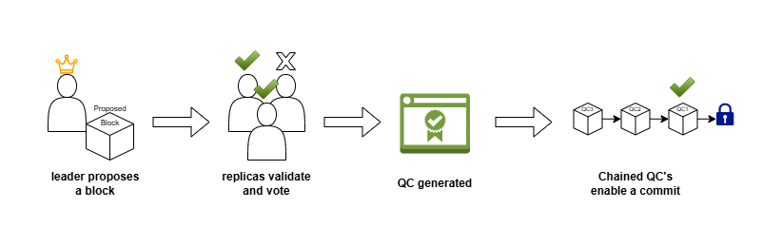
Broad Design - Part 1 (Process Flow)
View
Identifies a leader’s term
Leader
Proposes blocks for the view
Replica
Votes on a proposed block
QC
Collection of signed votes from replicas
Department of Computer Science & Engineering and Information Technology
School of Computational Sciences
COEP Technological University
05-03-2026
6
Notes:
7

Slide 7
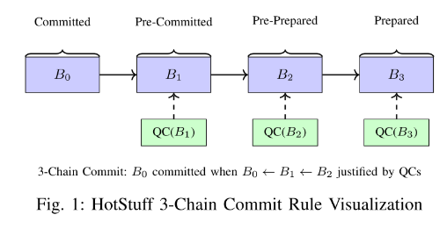
Part 2 - ( Consensus Logic )
Constraints -
f - Number of byzantine replicas
n - Total number of replicas
Quorum size - 2f + 1
Total number of replicas >= 3f + 1
QC1 -> 2*f + 1 (quorum size)
QC2 -> 2*f + 1 (quorum size)
QC3 -> 2*f + 1 (quorum size)
Quorum intersection ( QC1 ∩ QC2 ) -> f + 1 (assuming >=3*f+1 number of replicas)
This guarantees at least 1 honest node once a chain of 3 QC’s is formed
Department of Computer Science & Engineering and Information Technology
School of Computational Sciences
COEP Technological University
05-03-2026
7
Notes:
8

Slide 8
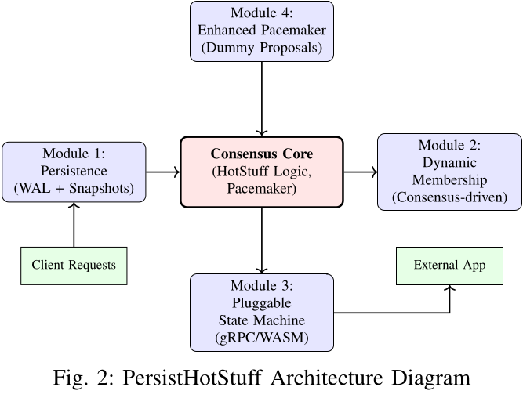
Part 2 - ( System Architecture )
Per replica core logic: HotStuff + QC handling
Networking transport: Pluggable abstraction
Persistence: WAL + snapshots; Recovery module
Membership manager: configuration changes
Pacemaker: Liveness
Crypto: signatures and QC verification
Department of Computer Science & Engineering and Information Technology
School of Computational Sciences
COEP Technological University
05-03-2026
8
Notes:
9

Slide 9
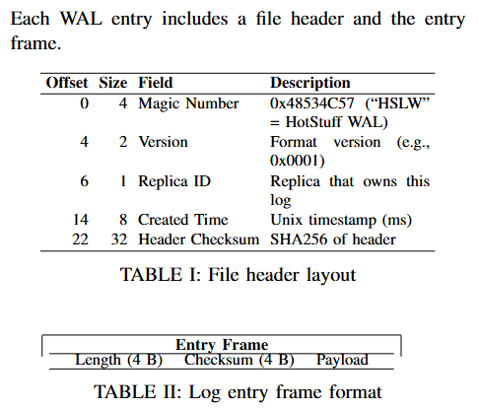
M1 - Persistence/Recovery
WAL records proposals, QCs, commits deterministically
Snapshot compacts state; speeds recovery
Recovery replays WAL; restores safe committed state
Crash
|
Load snapshot
|
Replay WAL sequentially
|
Restore chain & state (same commits)
Department of Computer Science & Engineering and Information Technology
School of Computational Sciences
COEP Technological University
05-03-2026
9
Notes:
10

Slide 10
M2 - Dynamic Membership
Config changes via explicit “reconfig tx”
Safety: quorum intersections across configs
View 5: Leader proposes "AddValidator(R4)" ← just a command in a block
View 6: Block gets QC
View 7: Block gets QC
View 8: 3-chain satisfied → command committed
↓
NOW switch to new config (n=5, f=1)
Department of Computer Science & Engineering and Information Technology
School of Computational Sciences
COEP Technological University
05-03-2026
10
Notes:
10

Slide 11
M3 - Pluggable State Machine
A clean API boundary for enhanced flexibility
Separates consensus engine from application logic
Enables multiple applications without rewriting protocol
Supports snapshot/export for recovery
[Clients] → [State Machine API]
Department of Computer Science & Engineering and Information Technology
School of Computational Sciences
COEP Technological University
05-03-2026
11

Slide 12
M4 - Enhanced Pacemaker
Addressing liveness in dynamic network conditions
Leader failure stalls progress without view changes
Variable network delay causes premature timeouts
Need adaptive timeouts + leader rotation rules
View
Timeout
Trigger
Action
v
t0
leader stalls
enter new view
v+1
t1>t0
network delay
rotate leader
Department of Computer Science & Engineering and Information Technology
School of Computational Sciences
COEP Technological University
05-03-2026
12

Slide 13
Implementation Methodology - Development Strategy
We will be using an incremental model to add the features in phases
Key Aspects of the Methodology:
Rust Modules: Each module is aligned with specific protocol components for modularity and maintainability. Enables independent development and testing of features.
Phase Milestones/Modules :
Core: Basic HotStuff implementation.
Persistence: Write-Ahead Logging (WAL) and snapshots for crash recovery.
Membership: Dynamic join/leave operations using quorum certificates.
Pluggable State Machine: gRPC-based interface for extensible state machines.
Pacemaker: Dummy proposals for improved liveness under low client load/leader stalls.
Department of Computer Science & Engineering and Information Technology
School of Computational Sciences
COEP Technological University
05-03-2026
13

Slide 14
Implementation Methodology - Testing Strategy
Comprehensive verification for reliability and correctness
Unit tests: crypto, data types, WAL logic
Protocol tests: QC formation, commit rule, safety invariants
Network simulation: multi-replica behavior under delays
Crash recovery: restart correctness across cycles
Docker-based multi-node system tests
Test type
What it proves
Unit tests
Correctness of individual components
Protocol tests
Safety (no conflicting commits)
Network simulation
Liveness under network conditions
Crash recovery
Durability and consistency
Department of Computer Science & Engineering and Information Technology
School of Computational Sciences
COEP Technological University
05-03-2026
14

Slide 15
Results: Test & Simulation Summary
Persistence (18) — WAL create/append/read/corrupt/truncate Snapshot save/load/checksum/cleanup Crash recovery from fresh start, WAL-only, snapshot+WAL, and out-of-order replays QC Formation (3) — ≥ 2f+1 signatures enforced Ed25519 votes aggregate into valid QC high_qc updates correctly 3-Chain Commit (4) — Full chain commits​ Partial chains blocked Multi-block chains commit in order No double-commits | Proposal Phase (4) — Only round-robin leader can propose Valid proposals accepted Under-quorum QCs rejected Pacemaker (7) — Timeout increments view Clears vote pool Leader rotation verified across 8 views Timer resets on proposal and commit Network (3) — Send/receive round-trip Broadcast reaches exactly n−1 replicas
Department of Computer Science & Engineering and Information Technology
School of Computational Sciences
COEP Technological University
05-03-2026
15

Slide 16
Roadmap & Success Metrics
Charting the path forward and key success criteria
Remaining Work + 10-Week Timeline
Success Metrics Checklist
Week 1-3: finalize Dynamic Membership integration
Week 4-5: integrating State Machines
Week 6-7: pacemaker tuning + liveness tests
Week 7-8: edge cases + reconfig tests
Week 9-10: final demo + report polishing
Metric
Pass Criteria
Safety
No conflicting commits
Recovery
Restart preserves state
Liveness
Commits continue
Reconfig
Join/leave quorum safety
Department of Computer Science & Engineering and Information Technology
School of Computational Sciences
COEP Technological University
05-03-2026
16

Slide 17
References
[1] M. Yin, D. Malkhi, M. K. Reiter, G. G. Gueta, and I. Abraham, ”HotStuff: BFT Consensus in the Lens of Blockchain,”
[2] M. Castro and B. Liskov, ”Practical Byzantine Fault Tolerance,”
[3] D. Ongaro and J. K. Ousterhout, ”In Search of an Understandable Consensus Algorithm,”
[4] D. Kang et al., ”HotStuff-1: Linear Consensus with One-Phase Speculation,”
[5] I. Abraham, D. Malkhi, K. Nayak, L. Ren, and M. Yin, ”Sync-HotStuff: Simple and Practical Synchronous State Machine
Replication,”
[6] H. Guo et al., ”DynaNet: A Dynamic BFT Consensus Framework”
[7] StanfordCS244B, ”HotStuff Implementation and Advice”
[8] J. Kwon, ”Tendermint: Consensus Without Mining”
[9] ”gRPC: A High Performance, Open Source Universal RPC Framework.”
[10] C. Dwork, N. Lynch, and L. Stockmeyer, ”Consensus in the Presence of Partial Synchrony”
[11] Brendel, Jacqueline and Cremers, Cas and Jackson, Dennis and Zhao, Mang, ”The Provable Security of Ed25519: Theory and Practice”
[12] Chaudhuri Kaustuv, Doligez Damien, Lamport Leslie, Merz Stephan ”A TLA+ proof system”
Department of Computer Science & Engineering and Information Technology
School of Computational Sciences
COEP Technological University
05-03-2026
17

Slide 18
Thank You!
Any Questions?
Department of Computer Science & Engineering and Information Technology
School of Computational Sciences
COEP Technological University
05-03-2026
18

