Slide 1


GoGreen
Chandradeo Prasad
(Team Leader) , Front-end Programmer
Cse2024chandradeo43@iesbpl.ac.in

Slide 2


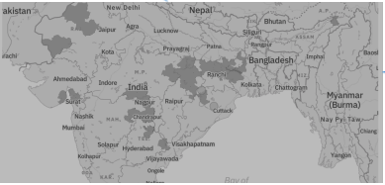
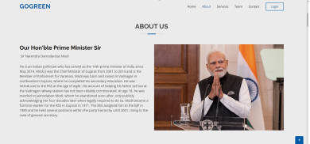
ROADMAP:
data
data
creating
extraction
analysis
dashboard
Prototyping Strategies:
Data Extraction and Cleaning.
Development of Analytical Models.
Socio-economic Analysis Models.
Data Handling and Quality Assurance.
Accuracy models .

Slide 3
Our Dashboard include several features:-
Barren Land Information: Providing data on lands post-coal mining completion, helping stakeholders understand the transformation and potential for future use.
Coal Mine Details: Offering a detailed breakdown of areas where coal mining has been completed, aiding in land-use planning and resource allocation.
Geospatial Imaging: Regular geospatial imagery captured every six months provides a dynamic view of changing land conditions, facilitating informed decision-making.
Soil Cover Percentage Analysis: Utilizing advanced techniques, we assess soil cover percentages, aiding in identifying lands suitable for agriculture beds based on predefined criteria.
Illicit Land Occupation Analysis: Investigation into the nature and extent of unauthorized land use on Coal India's properties.
Dynamic Hazard Assessment Dashboard:-Development of a cutting-edge dashboard to assess the safety risks associated with barren lands, ensuring timely intervention.

Slide 4
Prototype Journey: Bringing Ideas to Life
The above data given by the respected evaluators, is a Govt. Land Information System(GLIS) Data.
The data works on the following parameters:
Name of state, subsidiaries in state, accusation mode, district name, block name, village name and id, government land, tenant area along with the shape-values of the length and area.

Slide 5
Data Cleaning:
Data Inspection
Handling Missing Values
Handling Outliers
Standardizing Data
Handling Inconsistencies
Understand Data Structure:
Familiarize with GLIS geospatial data types and structure.
Data Inspection:
Identify issues like missing values, outliers, and inconsistencies.
Coordinate System Consistency:
Ensure consistent use of coordinate systems across the dataset.
Standardize Data Formats:
Standardize date formats, land use codes, and categorical variables.
Topological Checks:
Perform checks to ensure spatial relationships and integrity.
Documentation and Iterative Cleaning:
Document cleaning steps and decisions, and iterate as needed.
Quality Assurance:
Conduct quality assurance to ensure data accuracy and reliability.

Slide 6
Machine Learning Model:
Data Collection and Exploration:
Gather historical data and explore its characteristics, addressing missing values and outliers.
Feature Selection and Preprocessing:
Select relevant features and preprocess the data, handling scaling, encoding, and other quality issues.
Data Splitting:
Split the data into a training set (e.g., 80%) and a testing set (e.g., 20%).
Model Selection and Training:
Choose a suitable machine learning algorithm and train the model on the training set.
Model Evaluation on Training Set:
Assess the model's performance on the training set using appropriate metrics.
Model Testing and Evaluation:
Test the model on the unseen testing set to evaluate its generalization performance.
Hyperparameter Tuning and Deployment:
Fine-tune model hyperparameters, deploy the final model, and consider ongoing monitoring and maintenance.

Slide 7
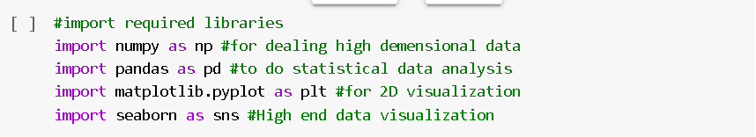
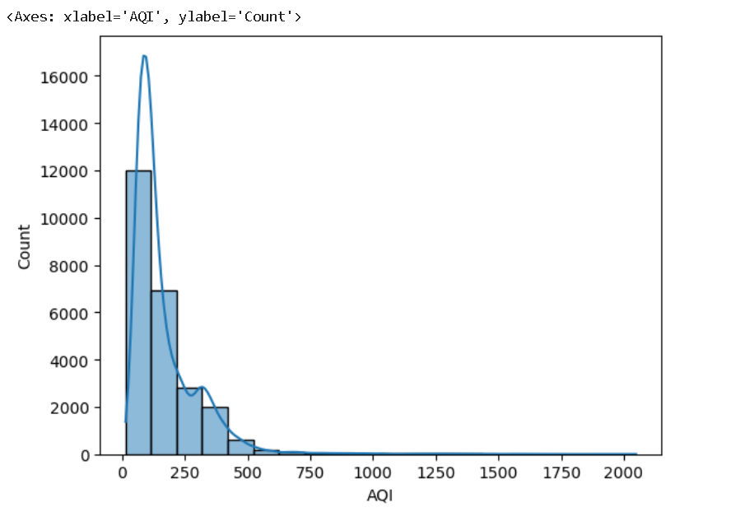


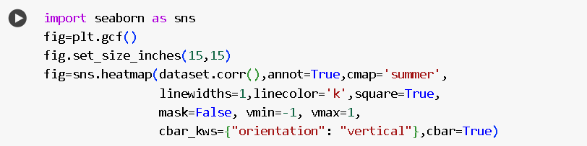
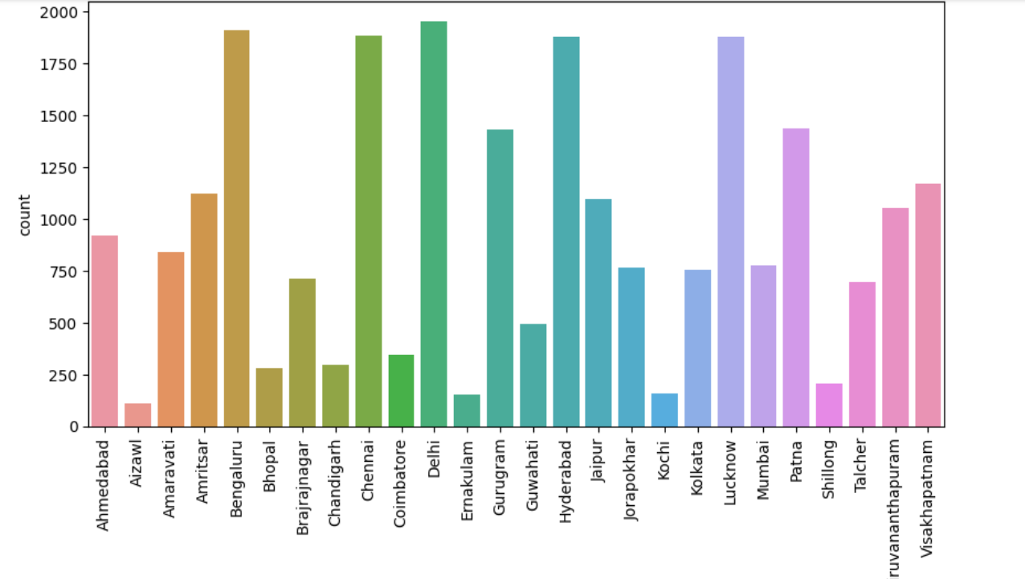
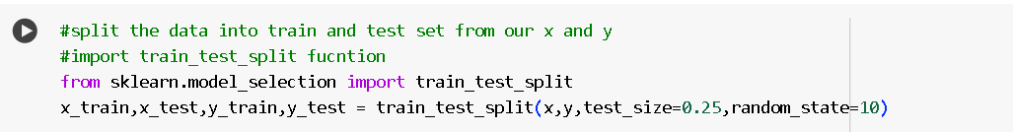
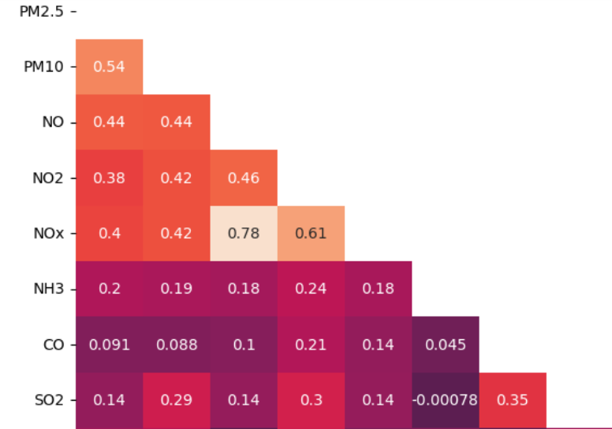
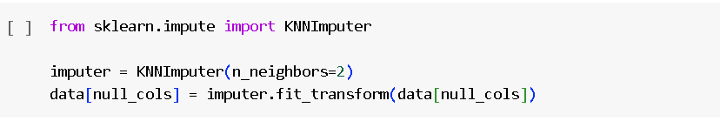

Slide 8
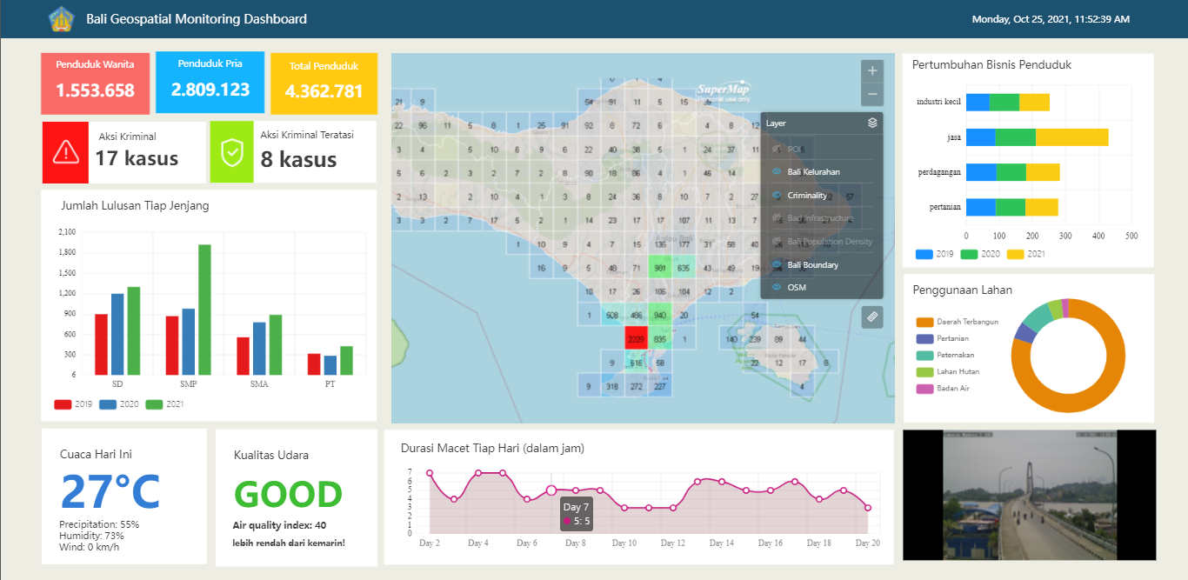
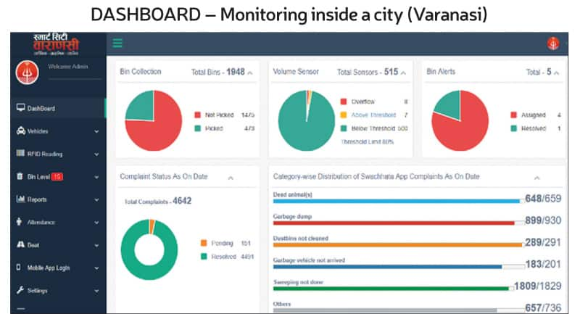
SMART URBAN PLANNIG DASHBOARD
We are Creating a Smart Urban Planning Dashboard using GLIS Data which become a super tool for evidence based decision making.

Slide 9
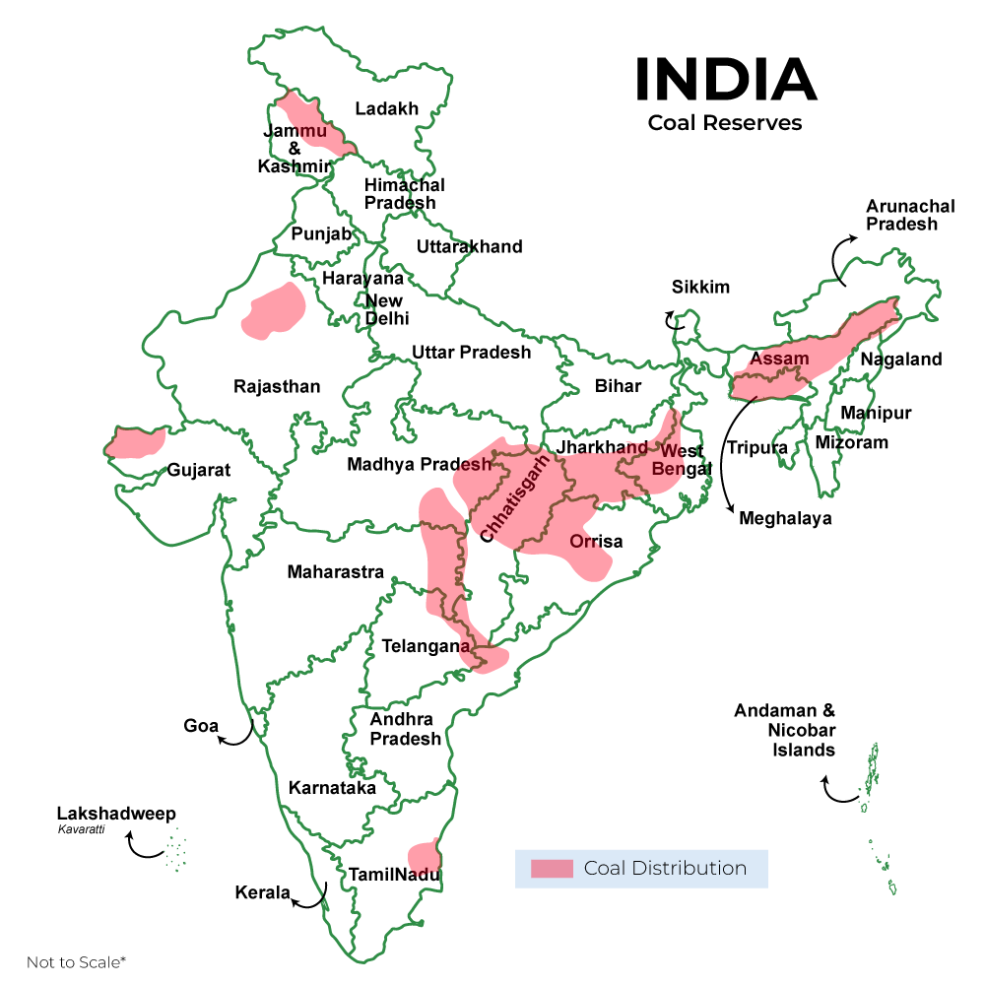
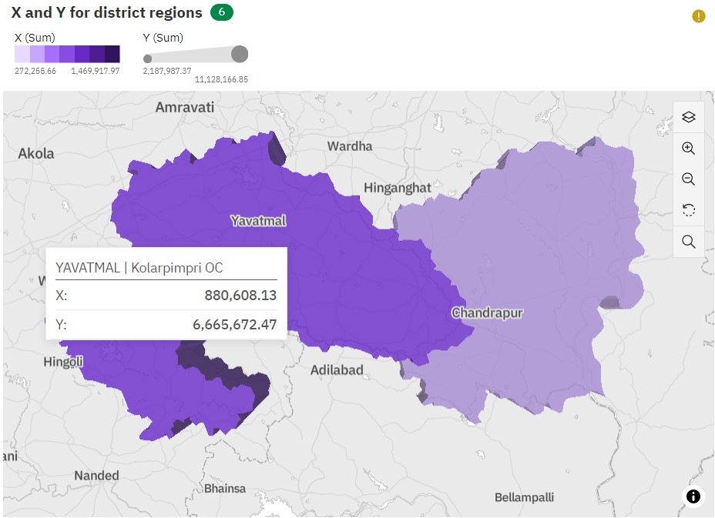
Dashboard Designing

Slide 10
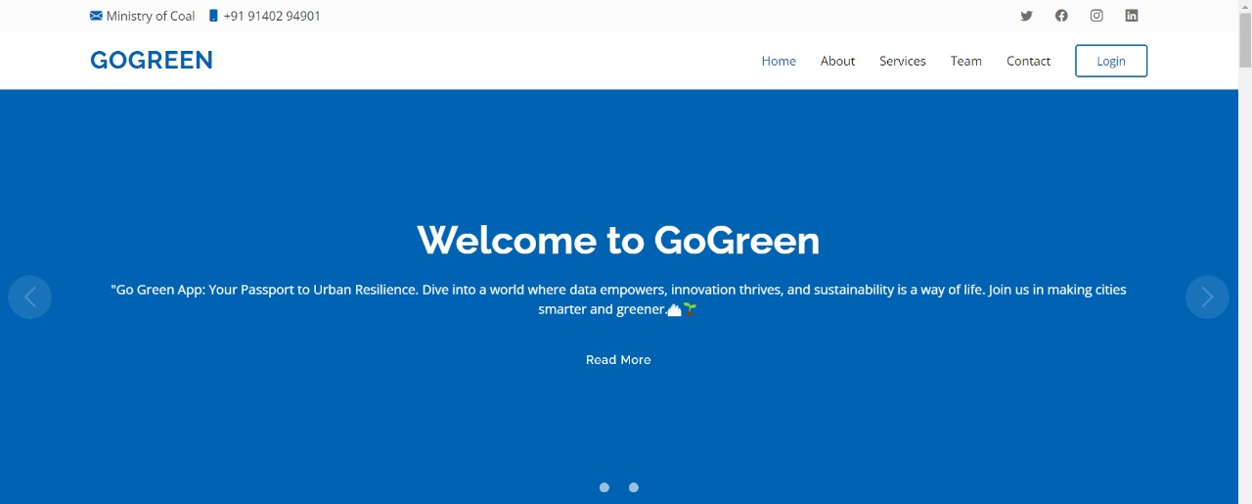
Front-end Side

Slide 11
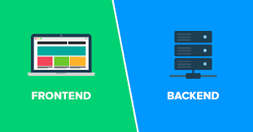
Integration

Slide 12
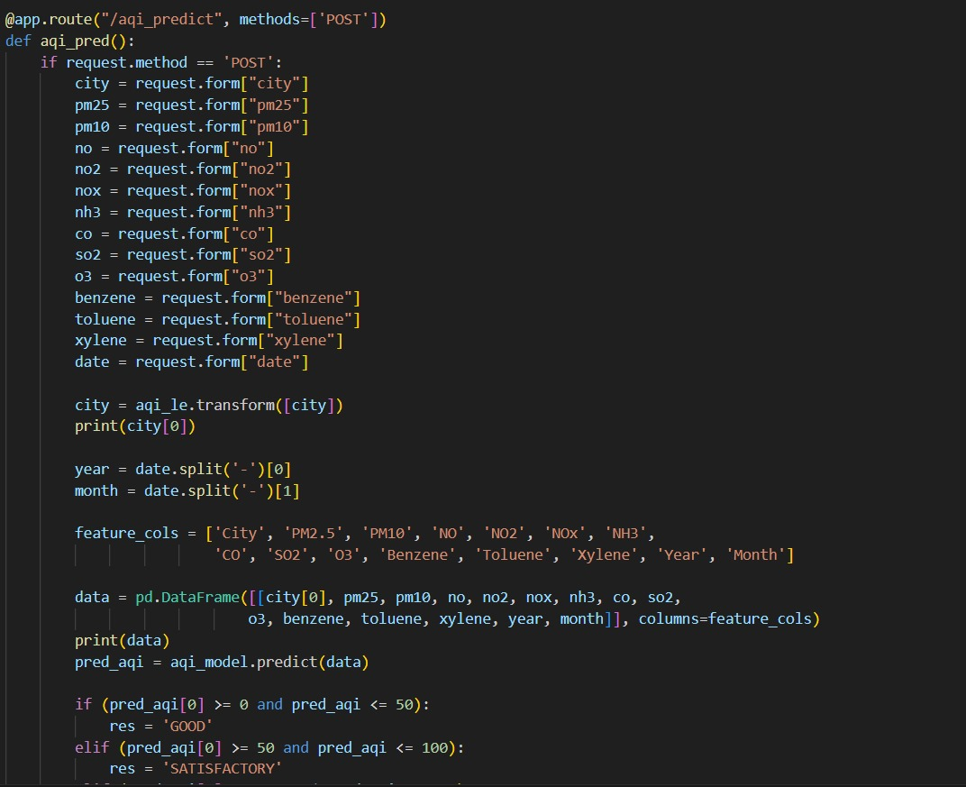
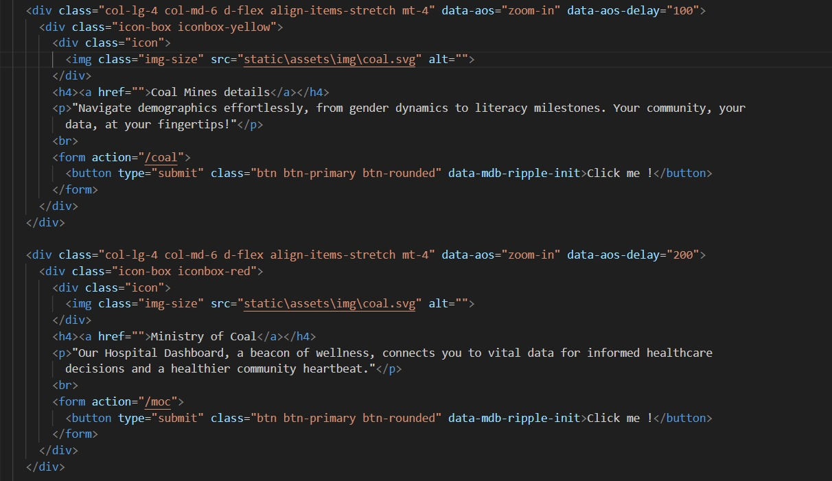
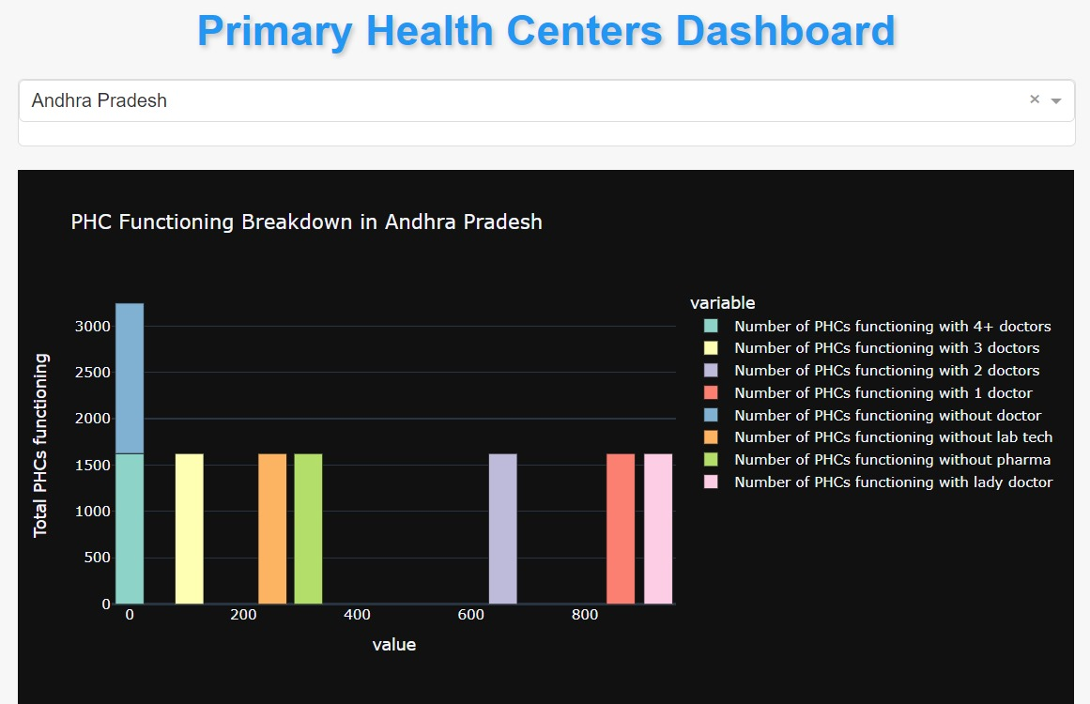
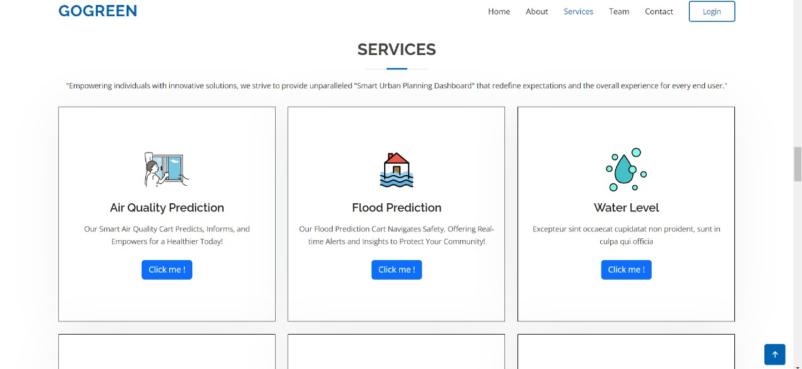

Slide 13
COMPONENT COST
GOOGLE CLOUD COST :Rs. 16,250/year
IBM COGNOS:- Rs. 15,000/year
TOTAL:-Rs. 31,250/year

Slide 14
Implementation cost:-
Domain Cost:-Rs. 1,502/year
Server Infrastructure Development cost:-Rs. 15,000/year
Development Cost : - Rs. 1 Lakh
Total Implementation Cost:- Rs. 1,16,502

Slide 15
Total Application Cost:-
IMPLEMENTATION COST + COMPONENT COST + = Rs. 1,16,502 + Rs. 31,250=Rs.1,47,752-Rs.1,50,000
AMC(Annual Maintenance Charge) :- 20% OF TOTAL COST AFTER 1 YEAR FOR MAINTAINENCE.

Slide 16
Contract Based Application Cost –(yearly):-
40 % Of Implementation cost + server charge = Rs. 60,000 + Rs. 16,250=76,250
NOTE:-IN YEARLY PURCHASE, WE PROVIDE UPGRADE VERSION OF OUR APPLICATION.

Slide 17
Revenue Model:
Advertisements:
Free Basics Access Models: Offers basic features and limit access to GUIs analysis for free, to attract wide user base.
Premium Model: Introduce premium subscription plan with advance analysis of real-time update and additional functionalities as a subscription fee.
Marketing and Outreach:
Develop a comprehensive marketing strategy to promote your platform. Utilize digital marketing, content creation, social media, and other channels to reach your target audience.
Platform Charges

Slide 18
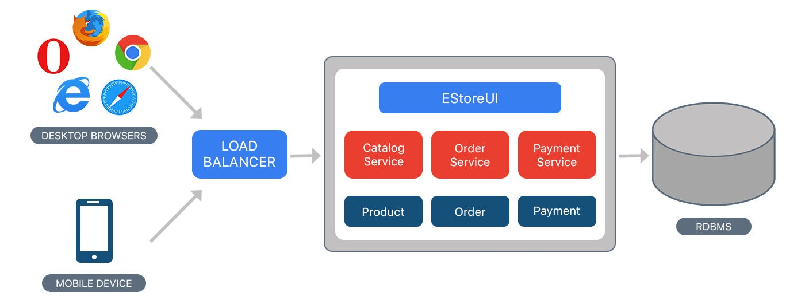
Monolith Vs Microservices
Monolithic Architecture:
A monolithic architecture is a traditional approach where an entire application is built as a single, tightly integrated unit.
In a monolithic application, all components (such as user interface, business logic, and data access) are tightly coupled and run as a single process.
Scaling a monolithic application typically involves replicating the entire application, which can be inefficient and resource-intensive.

Slide 19
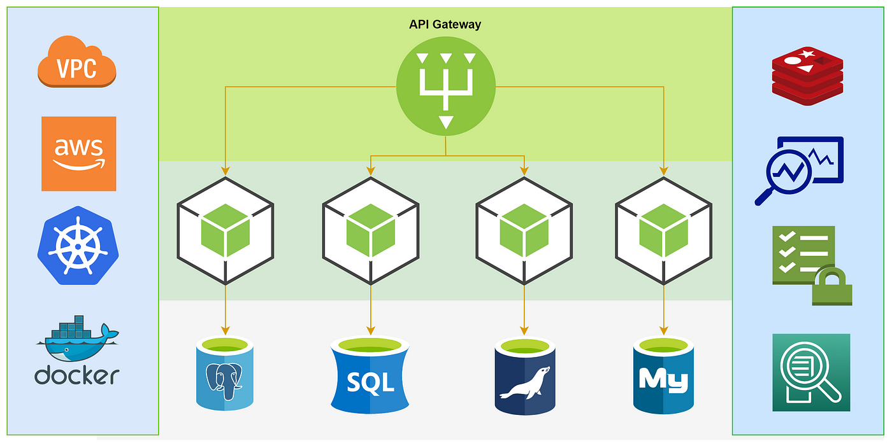
Monolith Vs Microservices
Microservices Architecture:
Microservices is an architectural style where an application is built as a collection of small, independent services that communicate with each other through well-defined APIs.
Each microservice is a self-contained unit with its own specific business functionality and can be developed, deployed, and scaled independently of other services.
Microservices promote flexibility, scalability, and maintainability by allowing different services to be developed and deployed independently.

Slide 20
Comparison
Scalability:
Monolithic applications scale by replicating the entire application, while microservices allow for independent scaling of individual services based on their specific needs.
Flexibility and Maintenance:
Microservices provide flexibility as each service can be developed, deployed, and maintained independently. Changes to one service do not affect others.
Monolithic applications may require more coordination when making changes, as all components are tightly coupled.
Fault Isolation:
In a monolithic architecture, a failure in one module can potentially bring down the entire application.
Microservices are designed for fault isolation. If one service fails, it doesn't necessarily impact the entire application.
Development Speed:
Microservices can allow for faster development cycles as smaller, independent teams can work on different services concurrently.
Monolithic applications might face challenges when multiple teams are working on the same codebase, leading to coordination and integration issues.
Complexity:
Microservices introduce distributed system complexities, such as service discovery, inter-service communication, and data consistency.
Monolithic applications are generally simpler to develop and deploy but may become complex and hard to maintain as they grow.

Slide 21
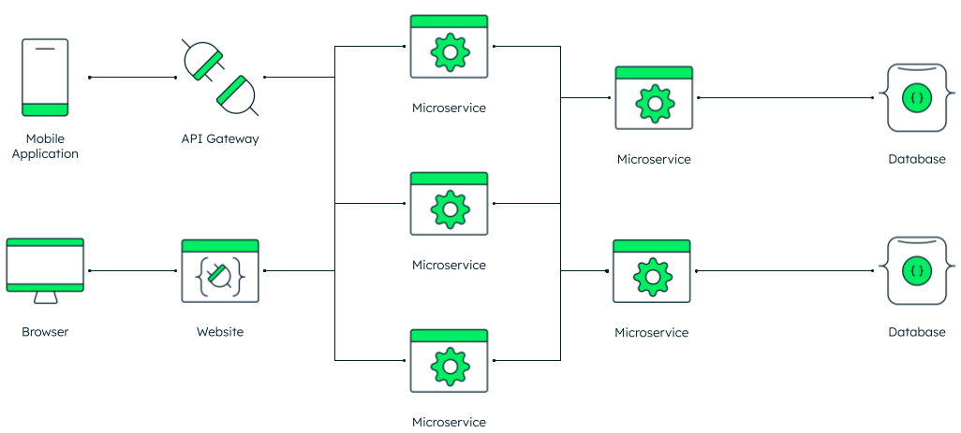
Micro-Services

Slide 22
TEAM DETAILS:
Team Leader Name: CHANDRADEO PRASAD
Branch : B.tech Stream : CSE Year : IV
Team Member 1 Name: DIVYA KUMARI
Branch : B.tech Stream : CSE Year : IV
Team Member 2 Name: ADITYA RAJ
Branch : B.tech Stream : CSE Year : IV
Team Member 3 Name: SANIA CHARPE
Branch : B.tech Stream : CSE Year : III
Team Member 4 Name: SAANVI SHUKLA
Branch : B.tech Stream : CSE Year : III
Team Member 5 Name: SHRUTI SRIVASTAVA
Branch : B.tech Stream : CS Year : Il
Team Mentor 1 Name: Prof. Vijay Dhote Sir
Category (Academic) Expertise (ML) Domain Experience (5 years)
Team Mentor 2 Name: Mr. Kuldeep Kr Mishra
Category (Industry): Expertise (ML) Domain Experience (10 years)

