Slide 1
Supervised ML – Regression Capstone Project On Retail Sales Prediction Team Members- 1. Raja Chowdhury 2. Saaquib Mustafa 3. Sandipan Das 4. Sahil Kolambkar

Slide 2

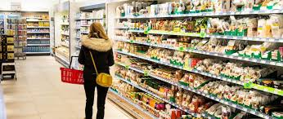
Rossmann
Dirk Rossmann GmbH, commonly referred to as Rossmann, is one of the largest
drug store chains in Europe with around 56,200 employees. The company was
founded in 1972 by Dirk Rossmann with its headquarters in Burgwedel near
Hanover in Germany. The Rossmann family owns 60% of the company. The
Hong Kong based A.S. Watson Group owns 40% which was taken over from the Dutch Kruidvat in 2004.
The product range includes up to 21,700 items and can vary depending on the size of the shop and the location. In addition to drugstore goods with a focus on skin,
hair, body, baby and health, pet food, a photo service and a wide range of natural
foods and wines. Rossmann has 29 private brands with 4600 products (as of 2019).
In 2019 Rossmann had more than €10 billion turnover in Germany, Poland,
Hungary, the Czech Republic, Turkey, Albania, Kosovo and Spain. In 2021,
sales increased by 8.1 percent to 11.1 billion euros. There are a total of 4,361
Rossmann branches, 2,231 of which are in Germany.

Slide 3

Points of Discussion
1. Problem Statements
2. Understanding Dataset
3. Data Pre-Processing
4. Exploratory Data Analysis
6. Feature Engineering
5. ML Model
6. Feature Importance
7. Challenges faced
8. Conclusions

Slide 4
Problem Statements
Rossmann operates over 3,000 drug stores in 7 European countries. Currently, Rossmann
store managers are tasked with predicting their daily sales for up to six weeks in advance.
Store sales are influenced by many factors, including promotions, competition, school and
state holidays, seasonality, and locality. With thousands of individual managers predicting
sales based on their unique circumstances, the accuracy of results can be quite varied.
You are provided with historical sales data for 1,115 Rossmann stores. The task is to forecast the "Sales" column for the test set. Note that some stores in the dataset were temporarily closed for refurbishment.

Slide 5

Understanding The Dataset
Data Description
Rossmann Stores Data.csv - historical data including Sales
store.csv - supplemental information about the stores
{After merging both the datasets we have 1017209 number of records and 18 number of fields and our dataset period is from 1st Jan-2013 to 31st July-2015.}
Data Fields
Most of the fields are self-explanatory. The following are descriptions
for those that aren't.
Id - an Id that represents a (Store, Date) duple within the test set
Store - a unique Id for each store
Sales - the turnover for any given day (this is what we are predicting)

Slide 6
Customers - the number of customers on a given day. Open - an indicator for whether the store was open: 0 = closed, 1 = open. StateHoliday - indicates a state holiday. Normally all stores, with few exceptions, are closed on state holidays. Note that all schools are closed on public holidays and weekends. a = public holiday, b = Easter holiday, c = Christmas, 0 = None SchoolHoliday - indicates if the (Store, Date) was affected by the closure of public schools StoreType - differentiates between 4 different store models: a, b, c, d Assortment - describes an assortment level: a = basic, b = extra, c = extended CompetitionDistance - distance in meters to the nearest competitor store CompetitionOpenSince[Month/Year] - gives the approximate year and month of the time the nearest competitor was opened

Slide 7

Promo - indicates whether a store is running a promo on that day Promo2 - Promo2 is a continuing and consecutive promotion for some stores: 0 = store is not participating, 1 = store is participating Promo2Since[Year/Week] - describes the year and calendar week when the store started participating in Promo2 PromoInterval - describes the consecutive intervals Promo2 is started, naming the months the promotion is started anew. E.g. "Feb,May,Aug,Nov" means each round starts in February, May, August, November of any given year for that store

Slide 8
Data Pre- Processing
Data wrangling and processing requires cleaning of data and preparing it for further analysis. Our cleaning process involved the following parts:
Merge Both Dataset: We have merge both the available dataset
Data Extraction: We have extracted Date, Year, Month, Day, Week, Week Of Year
from Date column for further analysis and then dropped the Date column.
Combining and Creating Columns:
We have created a new column called ‘PromoOpen’ from existing columns to measure more accurate period in months from when the store is participating in Promo2.
We have created a new column called ‘CompetitionOpen’ from existing columns to measure more accurate period in months from when the nearest competition has opened.
Then we replaced the negative values present in ‘PromoOpen’ and ‘CompetitionOpen’ with zero value.

Slide 9
Null Value Treatment:
We have found out that whenever the store was not participating in Promo2, we had null values present in ‘PromoOpen’ and ‘PromoInterval’ columns. So we have imputed those null values with zero because logically when promo2 is zero then PromoOpen and PromoInterval should be zero as well.
We have replaced null values present in ‘CompetitionDistance’ column with median as the CompetitionDistance’s distribution was skewed towards right.
We have replaced null values present in ‘CompetitionOpen’ column with mode as the CompetitionOpen column was made by combing the two categorical columns.
Changing Dtypes:
‘CompetitionOpenSinceMonth’, ‘CompetitionOpenSinceYear’, ‘Promo2SinceWeek’ and ‘Promo2SinceYear’ columns are only using whole numbers and they have a discrete value, So we will change them from floats to integers.

Slide 10
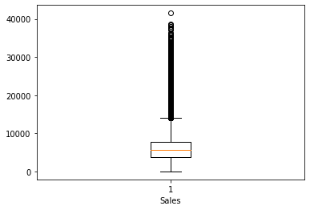
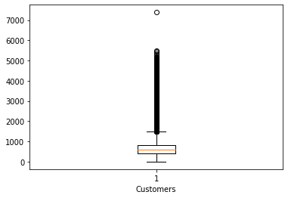
Handling Outliers:
'Sales' and 'Customers’ columns were very important columns so outliers in these columns would have affected our prediction tremendously therefore we have removed them using z score method.
‘CompetitiononDistance’, ’CompetitionOpen’, ’PromoOpen’ columns has huge number of outliers so we have replaced the outliers with different percentiles values using capping method.

Slide 11

Exploratory Data Analysis Basically we have two important categorical columns which need explanation in our dataset so lets start our visualization with those data.
Assortment
a = Basic
b = Extra
c = Extended
State Holidays
a = Public Holiday
b = Easter Holiday
c = Christmas Holiday
d = None

Slide 12
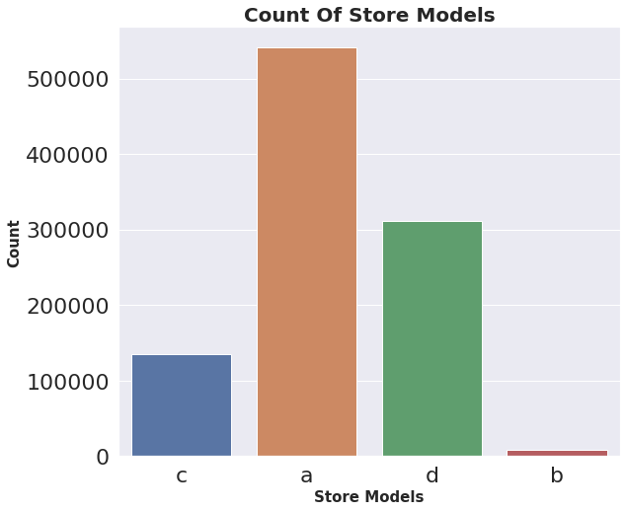
Store Models
Store Model ’a’ have the maximum
number of sales and store counts followed
by ’d’ while Store Model 'b' have the least
number of sales and store counts.

Slide 13
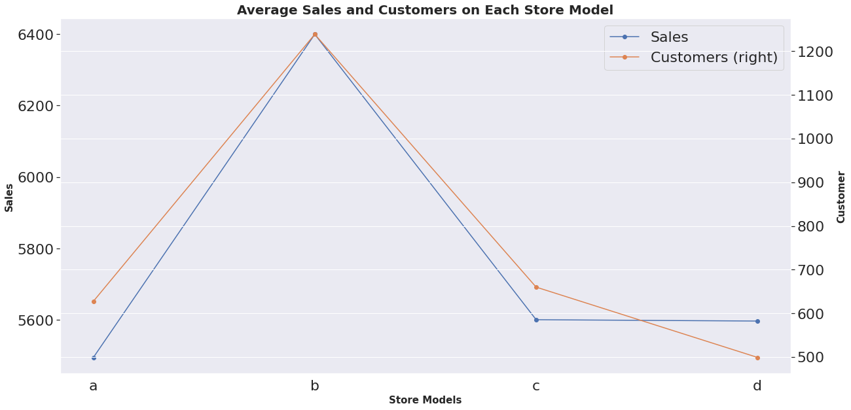
Average sales and Customers of Store Models
Store model ‘b’ which have least number
of store counts performed quite well on
average sales and customers compared to
other store models.

Slide 14
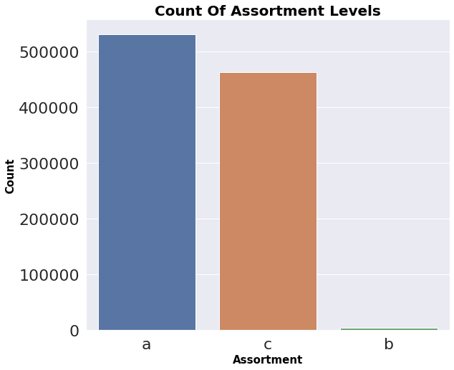
Assortment Levels
a = Basic, b = Extra, c = Extended
Basic Assortment level have maximum
number of sales and store counts followed
by Extended level while Extra Assortment
have the least number of sales and store
counts.

Slide 15
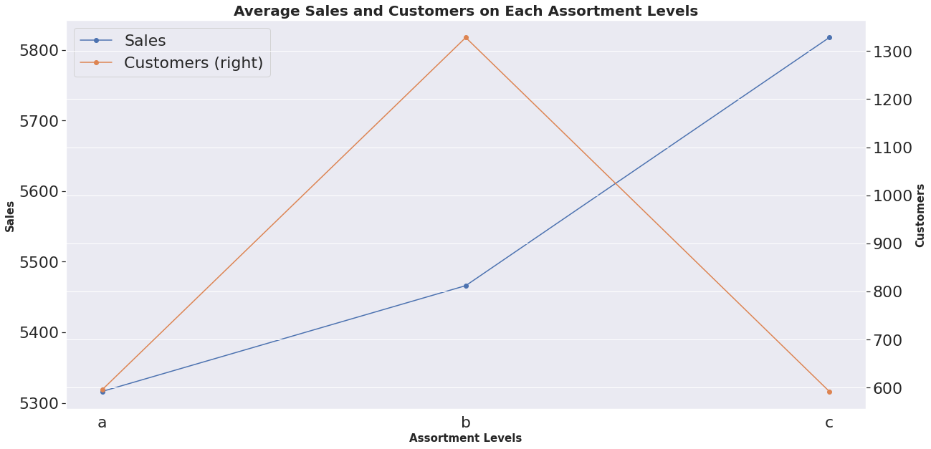
Average Sales and Customers of Assortment Levels
Assortment level 'b’ with least store counts
have perform quite well compared to ’a’
while there is an another surprising fact
that assortment level 'c’ have maximum
number of sales with the least number of
customers.

Slide 16
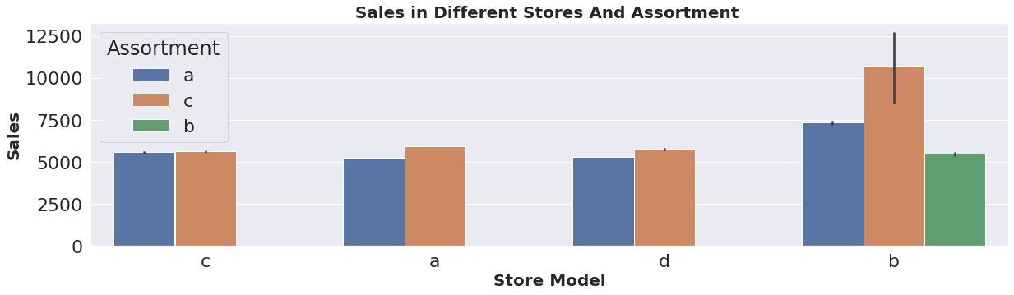
Sales In Different Stores And Assortment
Store Model ‘b’ has the maximum number of sales at all assortment level and assortment level ‘b’ is only available in store level ‘b’.

Slide 17
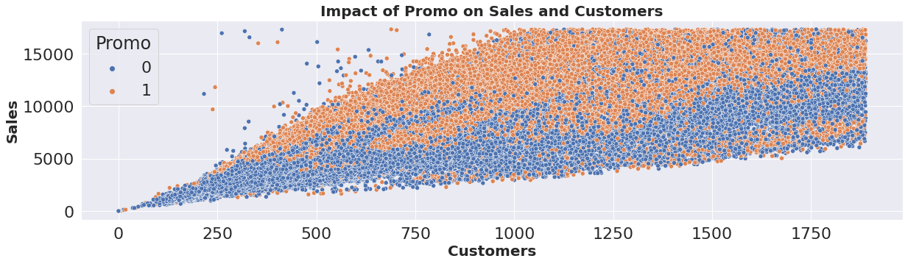
Impact Of Promo On Sales And Customers
There is a linear relationship between customers and sales and it is also noticeable that whenever
the promo was open, stores has higher sales and customers compared to the similar period when
promo was closed, which means promo had good impact on the business.

Slide 18
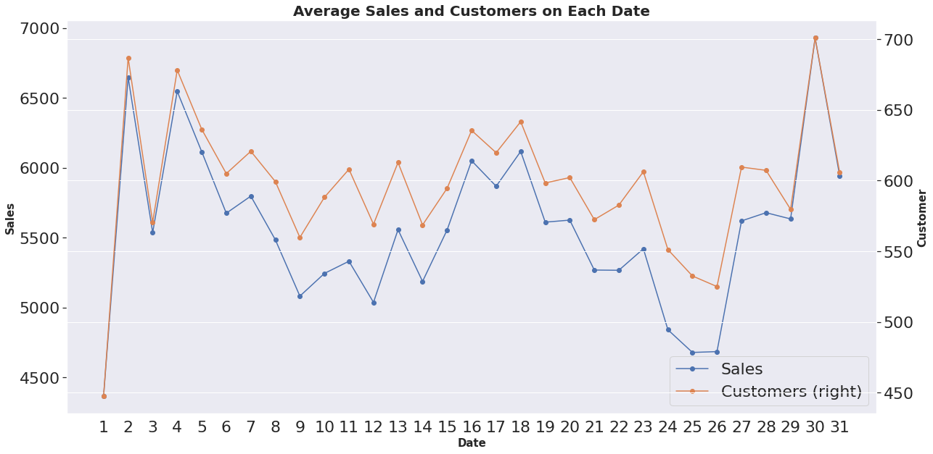
Sales and customers are highest on 30th followed by 2nd and 4th date of every month while sales and customers are lowest on the 1st date of every month followed by 25th and 26th date.
Prices In Neighbourhood Groups

Slide 19
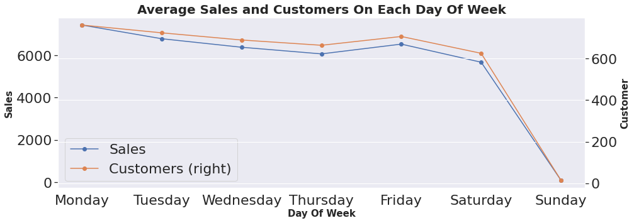
Average Sales And Customers On Each Day Of Week
Sales and customers are at maximum on
Mondays while sales and customers are
nearly zero on Sundays because it seems
like store use to remain closed on Sundays.

Slide 20
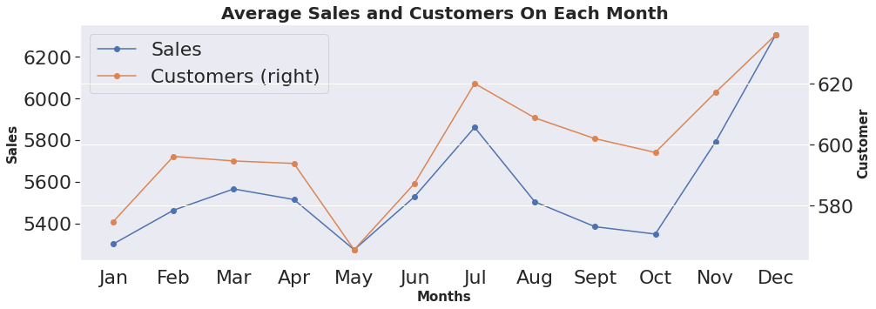
Average Sales And Customers On Each Month
Sales and customers are at peak during November and December due to festive seasons like
Christmas while sales and customers are at lowest during January and May or we may say
these months to be the off-seasons.

Slide 21
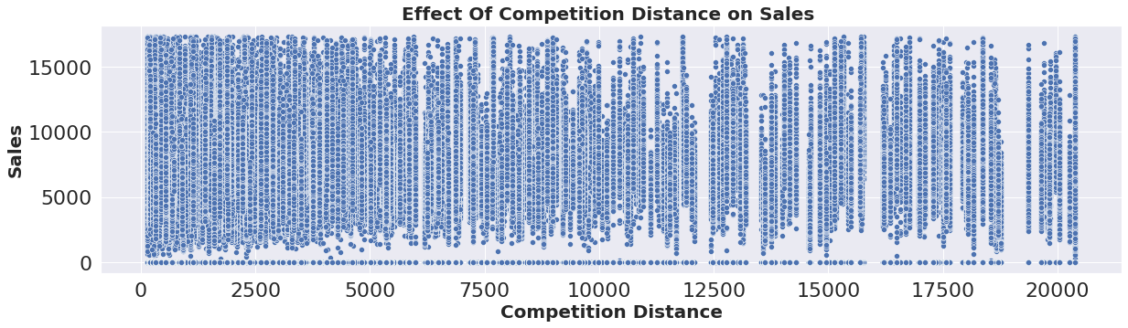
Effect Of Competition Distance on Sales
Mostly stores were not that far from competitors and the stores were densely located near each
other and surprisingly sales were higher when competition was nearer.

Slide 22
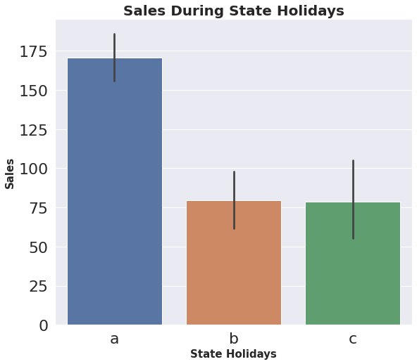
Sales During State Holidays
a = Public holiday, b = Easter holiday, c = Christmas
Stores has made more sales during Public
holidays compared to Easter and Christmas
holidays.

Slide 23
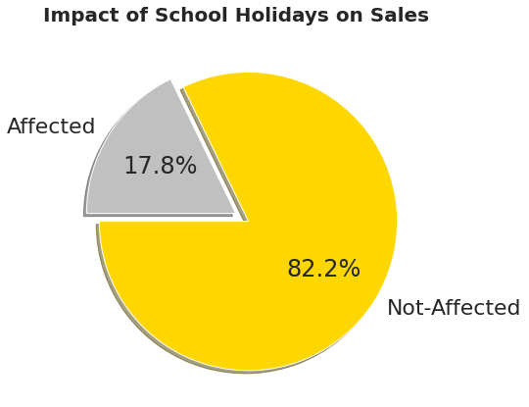
Impact Of School Holidays On Sales
17.8% of the total sales gets affected by
the school holidays which also means
that around 17% of the sales are
oriented from the school students

Slide 24
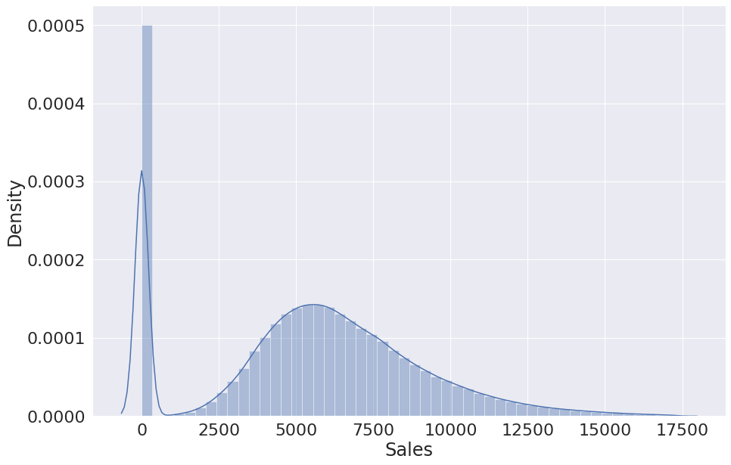
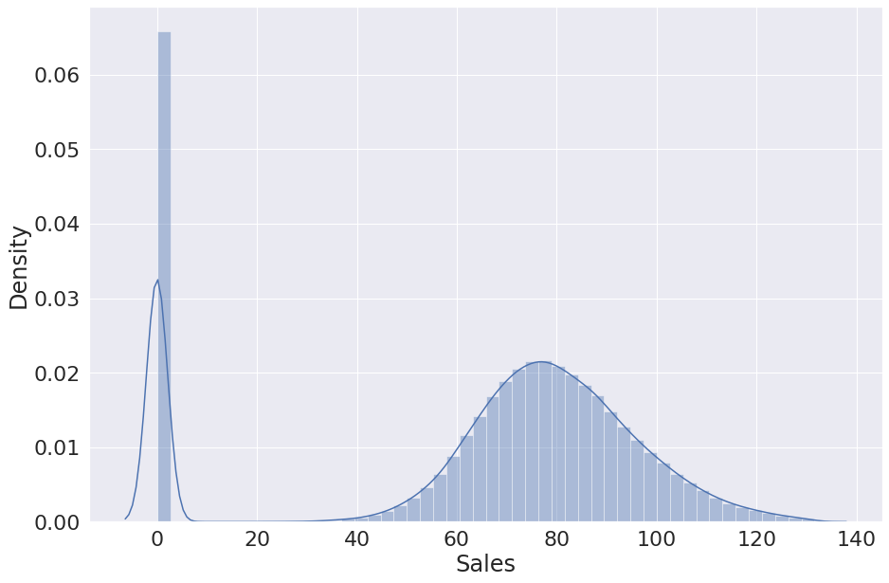
Feature Engineering
Before proceeding to ML Model we did some feature engineering to simplify and speed up data transformation while also enhancing model accuracy.
Dependent Variable Transformation: We did sqrt transformation to remove the right skewness from the dependent variable.
Before Sqrt Transformation After Sqrt Transformation

Slide 25
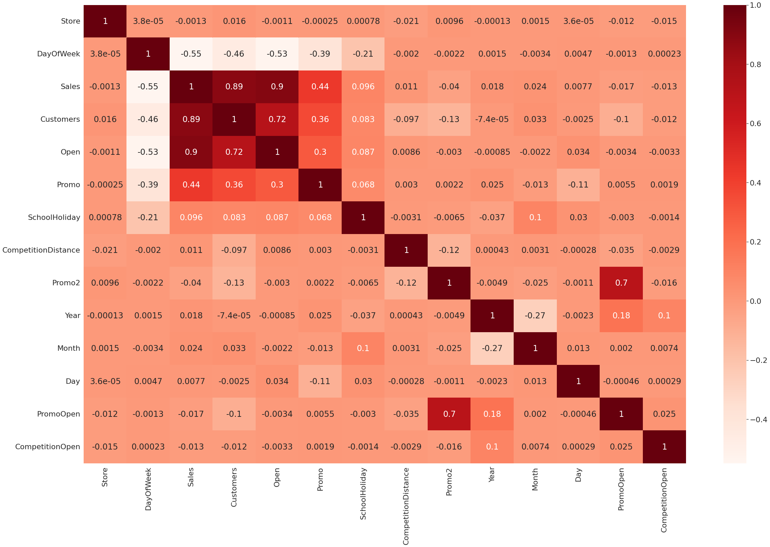
Multicollinearity: We didn't find any correlation between independent variables but we found
some correlation with our dependent feature which is a good sign for our model.

Slide 26
Feature Selection: After analysis each columns we found out that ‘Store’ column have all unique values which won’t help me in any prediction so we dropped that column.
Scaling Numerical Feature: We used MinMaxScaler to scale numerical variables ['Customers’, 'CompetitionDistance’, 'Year’, 'Month’, 'DayOfWeek’, 'Day’, 'CompetitionOpen’, 'PromoOpen’] within a given range of 0 to 1 .
Dummification: We used dummies to convert categorical variables ['StateHoliday’, 'StoreType’, 'Assortment’, ‘PromoInterval’] into dummies variables of 1 and 0.

Slide 27
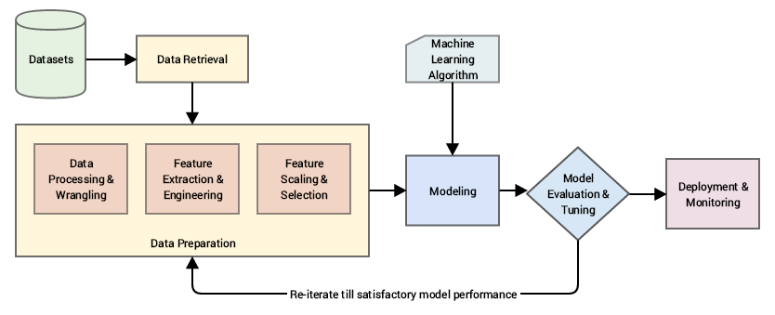
ML Model
After performing all these steps our dataset is ready for ML Modeling. Now we will train a model over a set of data, providing it an algorithm that it can use to reason over and learn from those data and then making predictions on those data which hasn’t been seen.

Slide 28
ML Model Performance
After performing various regression techniques on our predictive model and we found out that XGboost regression and Decision Tree regression has performed better than any other regression model with 98.8% and 98.7% respectively.
Regression Techniques | MAE | MSE | RMSE | RMPSE | R2 | Adjusted R2
Linear | 5.0754 | 42.0343 | 6.4833 | 0.0975 | 0.9628 | 0.9628
Lasso | 7.4080 | 87.1560 | 9.3357 | 0.1404 | 0.9229 | 0.9229
Ridge | 5.0754 | 42.0343 | 6.4833 | 0.0975 | 0.9628 | 0.9628
Decision Tree | 2.3959 | 13.7608 | 3.7095 | 0.0558 | 0.9878 | 0.9878
Random Forest | 4.1294 | 33.8483 | 5.8179 | 0.0875 | 0.9700 | 0.9700
Gradient Boosting | 3.8355 | 27.1009 | 5.2058 | 0.0783 | 0.9760 | 0.9760
XGboost | 2.6834 | 13.1049 | 3.6200 | 0.0544 | 0.9884 | 0.9884

Slide 29
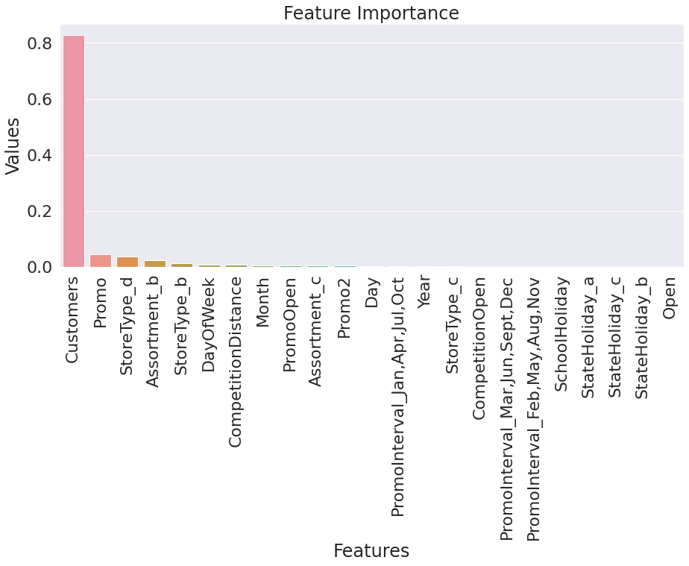
Feature Importance
After selecting our XGBoost regression model we can see the importance of each features in our model prediction.

Slide 30
Challenges Faced
Handling and understanding large amount of data.(1017209 number of records and 18 number of fields )
Columns with improper data type and wrong values.
Combining, creating and removing columns.
Records containing more than 50% of nan values and replacing it with substitutes.
Removing and replacing outliers from dependent and independent variables.
Reducing skewness from the variables.
Feature selections for ML Model.
Converting columns with categorical variables to integer type and scaling numerical variables for regression models.
Performing and choosing right kind of model.

Slide 31
Conclusions
Store model 'b' have least number of stores in Rossmann yet it performed well and made more sales than other store models so it is advisable to increase the number of 'b' store model.
Assortment level 'Basic' have the maximum number of stores in Rossmann yet it performed very badly but at the same time 'Extra' and 'Extended' assortment level with less number of store had preformed extra ordinarily so it would be advisable to increase these assortment level.
Linear relationship have been found among customer, sales and promo. And it has been seen that most of the customers came for shopping during the promo days as the cost was lower on those days. So promo should be initiated to more stores to increase the sales.
Sales has been low on the initial days of the month as compared to the end days, it can be assumed that people used to shop for the next month at the end of the previous month. Those products can be mainly be of basic necessities of a person's daily life.

Slide 32

Conclusions (cont.)
Average sales on weekdays was more as compared to weekends because promo's were provided to the customers during weekdays to increase the sales and not to weekends and reason might be that store use to remain close on Sundays.
Sales during November and December month was higher compared to other months and that can be due to festive season in western European countries.
School holidays also influenced the sales a lot as it can be observed that 17.8% of the sales gets affected by the school holidays which also means that around 17% of the sales are oriented from the school students.

Slide 33

THANK YOU

