Slide 1



One Problem,
Three Independent Solutions
Brownian motion with drift — solved by calculus, a grid solver,
and 100,000 simulated particles. Validated in SQL.
Calculus
Grid solver
Monte Carlo
Saad Ahmed Qureshi · Data Processors · 27 July 2026
Notes:
Good morning. I'm going to show a small project: one physics problem solved three completely independent ways - by calculus, by a grid solver, and by simulation - with results stored and verified in SQL. I chose it because it demonstrates Python, SQL, mathematical reasoning, and how I engineer for correctness.

Slide 2

01 · THE PROBLEM
A particle that drifts and jitters
Steady push (drift): a breeze carries the particle at speed μ. Random knocks (diffusion): unpredictable jostling of strength σ.
So the honest answer is a probability: where is the particle likely to be at time t?
One particle's rule (SDE): dX = μ dt + σ dW
The whole cloud's rule (PDE): ∂p/∂t = −μ ∂p/∂x + (σ²/2) ∂²p/∂x²
Why this problem? It has a known exact answer — a perfect calibration case. Any method that reproduces it here can be trusted on problems where nobody knows the answer.
02
Notes:
Plain English: a particle gets a steady push (drift, mu) and random knocks (diffusion, sigma). You can only say how LIKELY each position is. Two equations: the SDE for one particle, the PDE for the whole probability cloud. I chose this problem deliberately - it has a known exact answer, so it's a calibration case.

Slide 3

02 · THE EXACT ANSWER
A moving, spreading bell curve
Change to a frame moving with the drift (y = x − μt): the drift cancels, leaving the
classic heat equation — whose solution is a Gaussian (bell curve).
p(x, t) = Normal( mean = μt , variance = σ²t )
Centre drifts at μt — the most likely position moves steadily with the breeze.
Width grows like √t — twice the uncertainty takes four times as long.
Cross-checked independently: integrating the SDE directly gives the same Gaussian.
This is the ground truth every other method is measured against. Full derivation → appendix
03
Notes:
Exact solution: move into a frame travelling with the breeze - the drift cancels, leaving the heat equation, whose solution is a bell curve: mean mu-t, variance sigma-squared-t. Width grows like root-t - the fingerprint of diffusion. Verified a second way by integrating the SDE directly. If they want the derivation, the appendix link jumps straight to it.

Slide 4




03 · SYSTEM DESIGN
Compute, persist, verify
fokker_planck.py
experiments.py
results.db (SQLite)
Calculation module
• analytical density
• grid (FD) solver
• Monte Carlo
Pure functions — no I/O, no side effects
Orchestrator
Runs parameter sweeps, logs every run — including the deliberate failures
The logbook
One row per experiment: settings, results, errors, stability flag, runtime
test_fokker_planck.py
SQL analysis + plots
Quality control
5 automated checks that try to prove the maths wrong
Cross-run questions a single run can't answer (convergence, stability edge)
Separation of concerns — the maths knows nothing about storage; change one, not both.
Persist everything, incl. failures — the runs that blow up are the most informative rows.
Automate the checking — claims are asserted by tests, not eyeballed from a graph.
04
Notes:
The architecture. A pure calculation module - three solvers, no side effects, unit-testable. An orchestrator runs sweeps and writes every run to SQLite, including deliberate failures. SQL asks cross-run questions; a test suite tries to prove the maths wrong. Three principles: separation of concerns, persist everything including failures, automate the checking.

Slide 5

04 · THE GRID SOLVER
Neighbours nudging neighbours
Chop space into buckets, time into ticks. Each tick, every bucket looks at its two
neighbours: the drift slides probability along; the diffusion averages it out.
p_new[1:-1] = ( p[1:-1]
- c * (p[2:] - p[:-2]) # slide (drift term)
+ d * (p[2:] - 2*p[1:-1] + p[:-2]) ) # spread (diffusion term)
Slide: right neighbour minus left = local slope (∂p/∂x). Spread: neighbours minus twice me = curvature (∂²p/∂x²) — peaks get shaved, dips get filled.
The catch: Δt and Δx are not independent. Stability requires r = DΔt/Δx² ≤ ½ — beyond it, each step amplifies noise instead of damping it.
05
Notes:
The solver is handed the PDE. One vectorised NumPy line is the engine: new height = old height minus a slide correction plus a spread correction. Right-minus-left is the slope; neighbours-minus-twice-me is the curvature. The catch: r must stay at or below one half, or each step amplifies noise - I'll show that failing on purpose shortly.

Slide 6

05 · MONTE CARLO
Be the particle — 100,000 times
The opposite philosophy: never touch the PDE. Simulate one particle's journey — a fixed
drift move plus a random knock each step — then repeat 100,000 times and count.
increments = mu*dt + sigma*np.sqrt(dt) * rng.standard_normal((n_paths, n_steps))
terminal = increments.sum(axis=1) # each particle's final position
Fully vectorised — 10 million random movements in two lines, no Python loops.
Seeded RNG — every result in this talk is exactly reproducible.
The histogram of final positions IS the answer — no calculus anywhere.
Solver = told the cloud's equation. Monte Carlo = only told one particle's rule.
No shared code, no shared assumptions — exactly what makes agreement meaningful.
06
Notes:
Monte Carlo never touches the PDE. Simulate one particle - fixed drift plus a random knock - 100,000 times, and count where they land. Two vectorised lines, ten million movements, seeded and reproducible. Key point: the solver knew the cloud's equation; Monte Carlo only knew one particle's rule. No shared code or assumptions - so agreement means something.

Slide 7

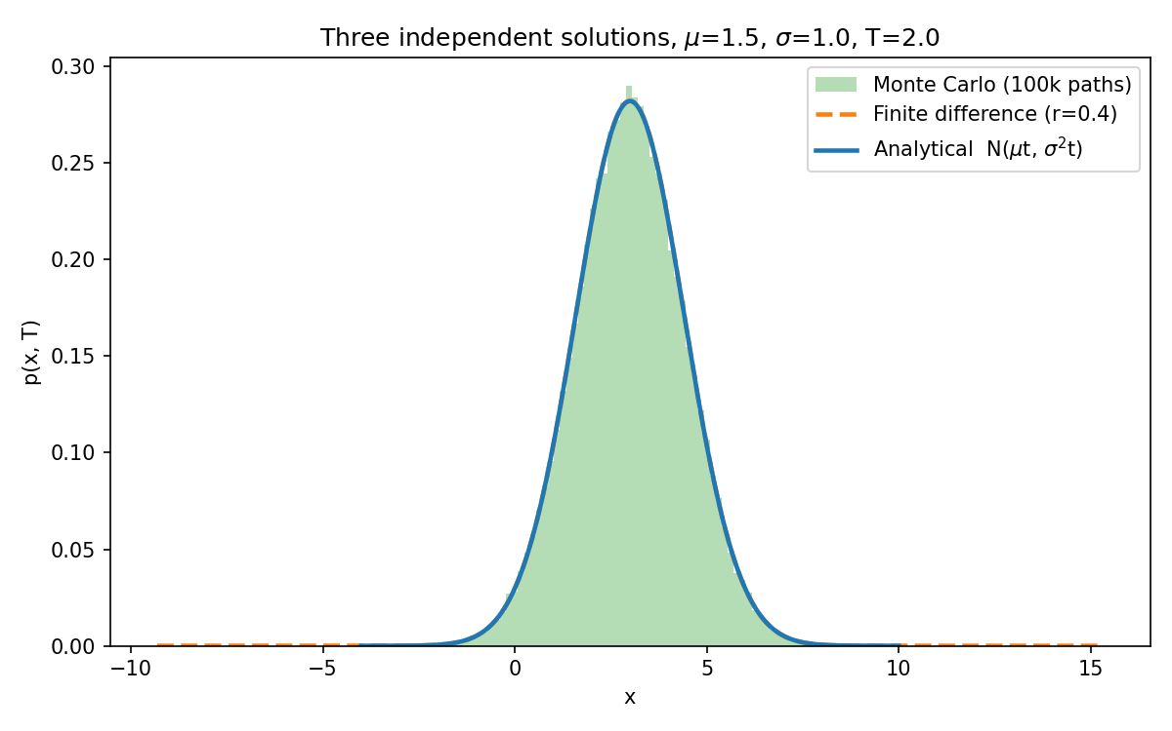
06 · RESULT
Three methods, one curve
Calculus, grid arithmetic, and dice-rolling land on the same bell curve.
07
Notes:
The payoff. Blue: exact analytical curve. Orange dashed: grid solver. Green: histogram of 100,000 simulated particles. Three independent routes, one curve. If any one had a bug or wrong assumption, they'd disagree.

Slide 8

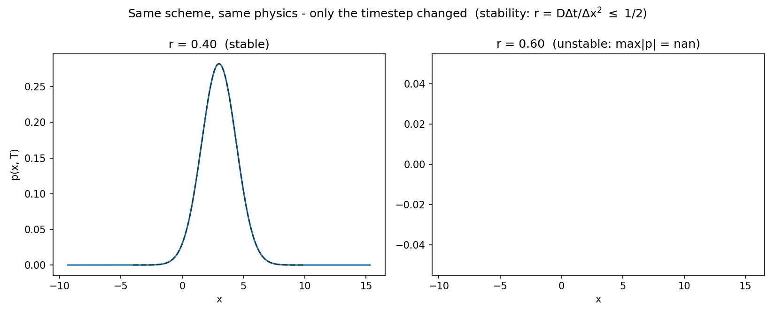
07 · CORRECTNESS
Engineered, not assumed
Same code, same physics — only Δt changed. The failure mode is known, provoked deliberately, and asserted by one of 5 automated tests — alongside mass conservation, exact moments, solver accuracy, and MC convergence.
08
Notes:
Correctness is engineered. Left: r = 0.4, stable, sits on the exact answer. Right: r = 0.6 - same code, only the timestep changed - and it explodes. I provoke this deliberately and one of five automated tests asserts it happens. The others check mass conservation, exact moments, solver accuracy, and Monte Carlo convergence. Nothing here is eyeballed - it's asserted.

Slide 9

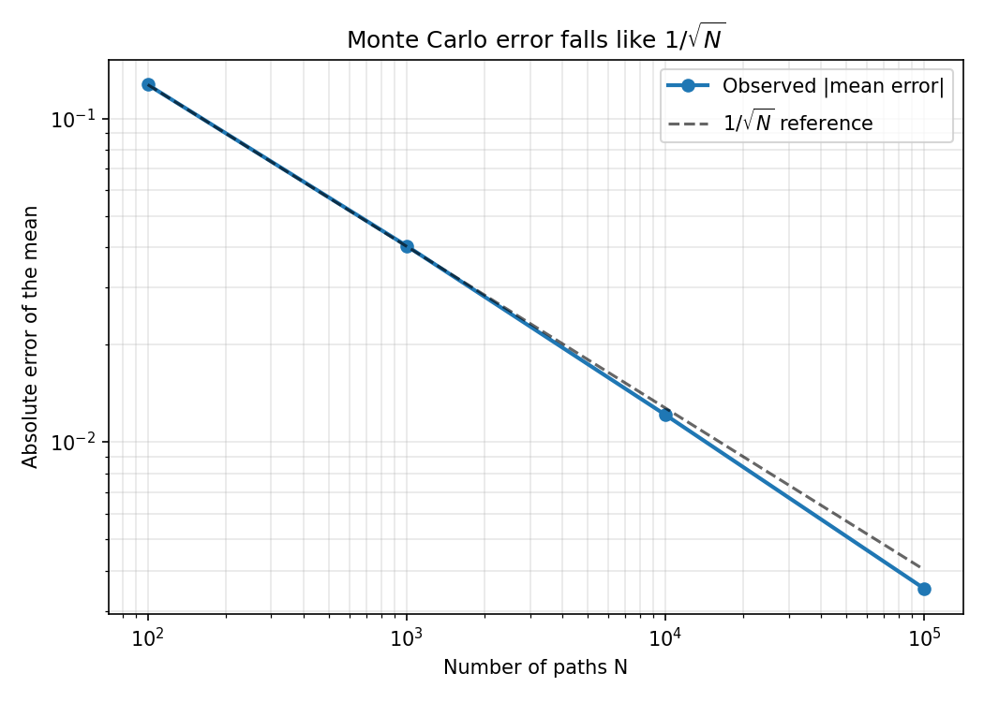
08 · THE DATA LAYER
SQL proves the convergence
AVG(err) / LAG(AVG(err))
OVER (ORDER BY n_paths)
A window function compares each batch of runs to the previous batch:
Paths Avg error Ratio
100 0.127 —
1,000 0.040 0.317
10,000 0.012 0.30
100,000 0.0035 0.29
Theory predicts 1/√10 ≈ 0.316 per tenfold — the database confirms it.
09
Notes:
Every run is persisted, so SQL can answer what one run can't. A window function - LAG over n_paths - compares each batch's error to the previous batch. Theory: each tenfold in paths multiplies error by about 0.316. Measured: 0.317, 0.30, 0.29. The database proves the convergence rate. A second query exposes the stability cliff between r = 0.5 and 0.55.

Slide 10





09 · CLOSING
What this demonstrates
Independent methods agreeing — the strongest evidence an implementation is right.
Failure modes known, provoked deliberately, and covered by automated tests.
Every result persisted and queryable — conclusions come from data, not memory.
Python computes, SQL analyses, tests build trust — structured like production work.
“Accuracy can’t be taken on faith — it has to be demonstrated.
That’s how I’d approach reliability in your systems too.”
Code, tests, figures and README: github.com/Saaqure94
10
Notes:
To close: independent methods agreeing is the strongest evidence an implementation is right. Failure modes are known, provoked, tested. Everything persisted and queryable. Python computes, SQL analyses, tests build trust. Accuracy can't be taken on faith - it has to be demonstrated. That's how I'd approach reliability in your systems too. Happy to take questions - including the full derivation.

Slide 11

APPENDIX
The derivation in five steps
1. Moving frame: y = x − μt. Chain rule: ∂p/∂t = ∂q/∂τ − μ ∂q/∂y ; space derivatives unchanged.
2. Substitute — the drift terms cancel, leaving the pure heat equation: ∂q/∂τ = (σ²/2) ∂²q/∂y².
3. Fourier transform: derivatives become multiplication → ODE per mode: q̂(k,τ) = e^(−σ²k²τ/2).
4. Invert (Gaussian ↔ Gaussian): q(y,τ) = (2πσ²τ)^(−½) · e^(−y²/2σ²τ).
5. Transform back (y = x − μt): p(x,t) = (2πσ²t)^(−½) · exp( −(x−μt)² / 2σ²t ) — N(μt, σ²t).
Independent check: integrate the SDE directly — X(t) = μt + σW(t), and W(t) ~ N(0, t) gives the same result. ← back to talk
11
Notes:
Only if asked: five steps. Moving frame kills the drift; what's left is the heat equation; Fourier turns it into one ODE per wave number; invert - a Gaussian; transform back. Cross-check by integrating the SDE directly. Offer to go slower on any step.

