Slide 1

CookShare
RECIPES SHARING APPLICATION – FAST, EASY TO USE AND AD-FREE!
[24a10357] Saar gamzo 205385792

Slide 2







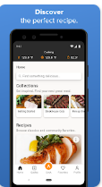

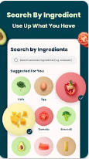
Market research
There are more than 20 similar applictaions
Search keywords:
Recipe
Food
Recipe sharing
Recipe keeper
Food guide
Best: +10M downloads

Slide 3
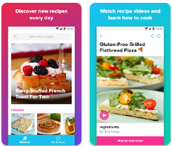
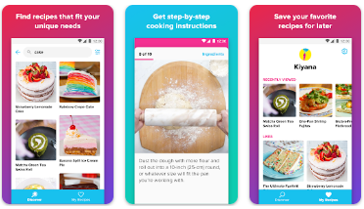
Tasty
Link
Released on: 14/8/2015
Last updated: 15/2/2024
Downloads: +10M
Rating: 4.8 147K reviewers
Main features:
Search
Categories
Sync online
Get reviews
Video player

Slide 4


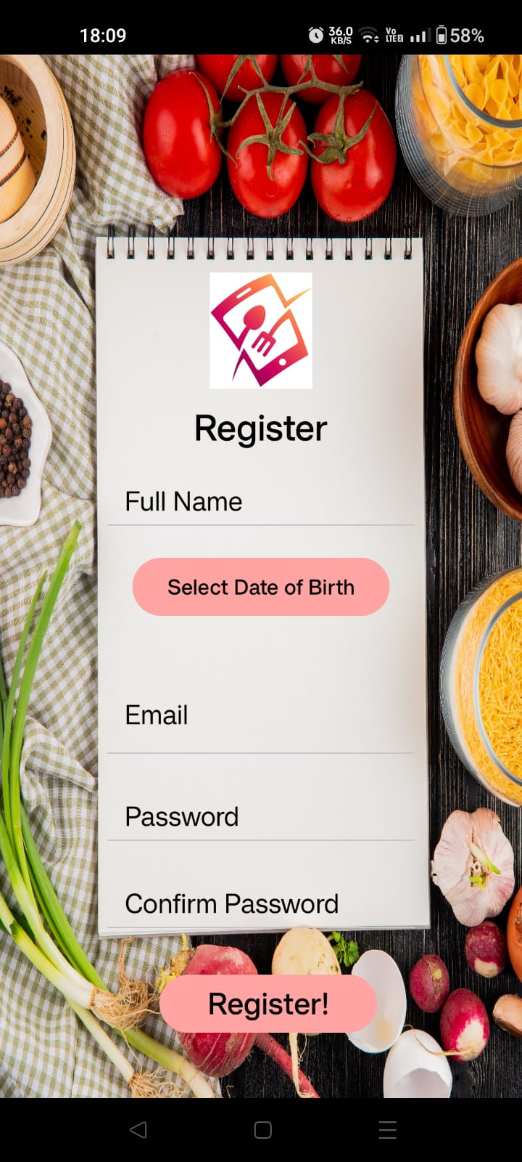
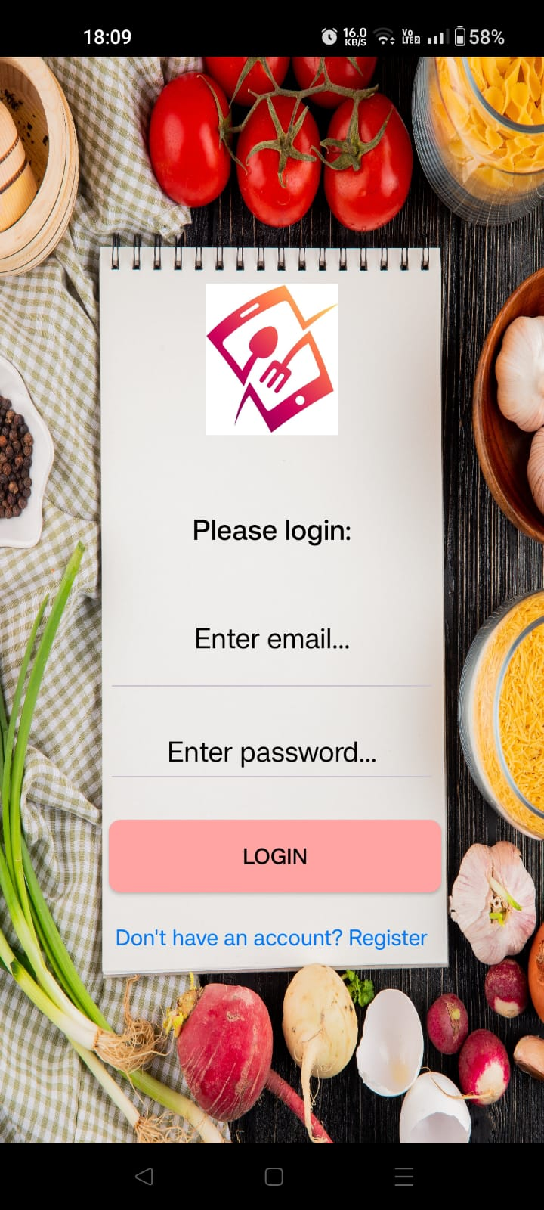
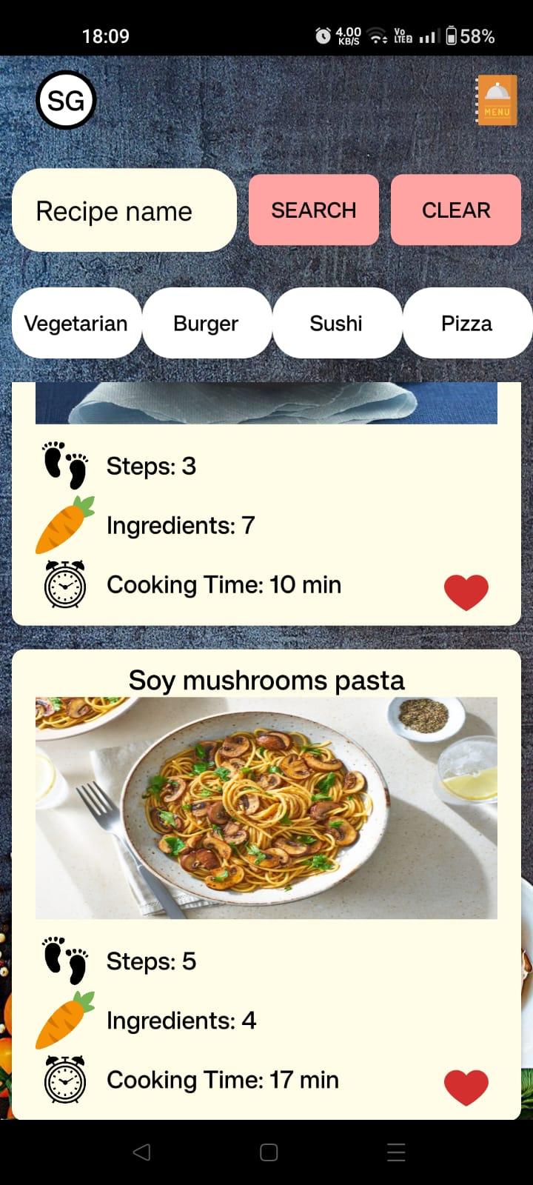
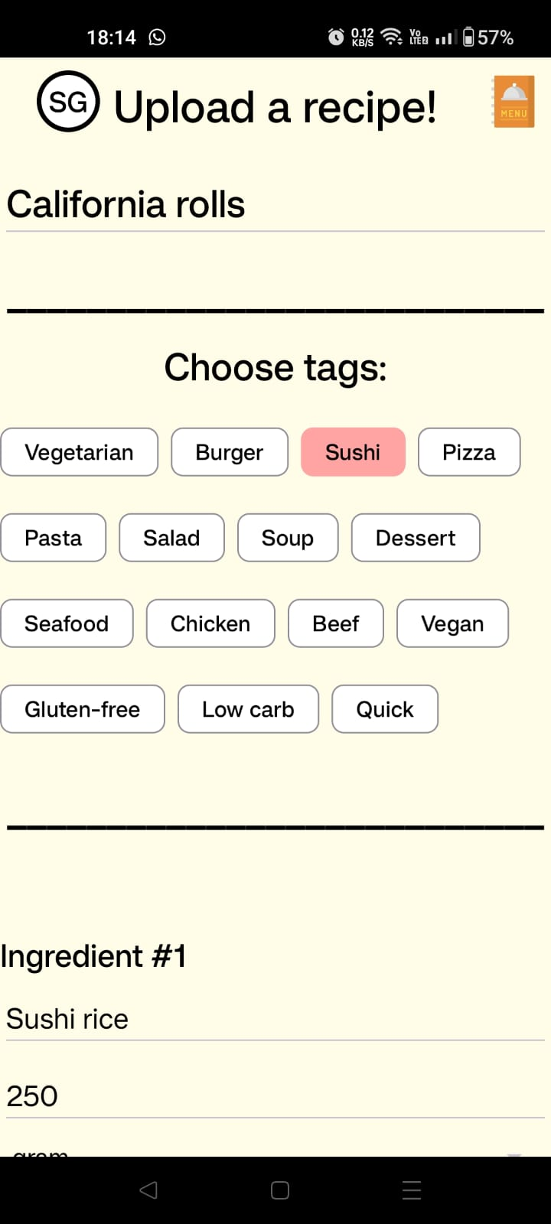
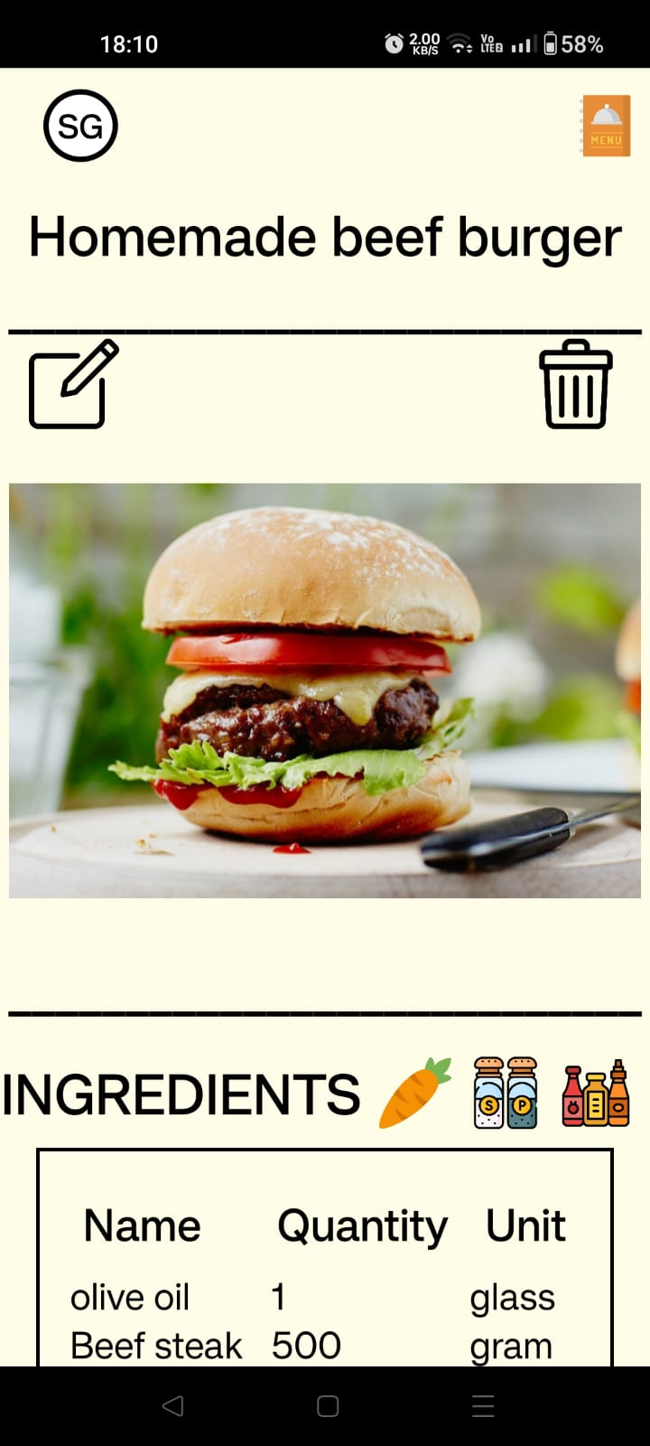
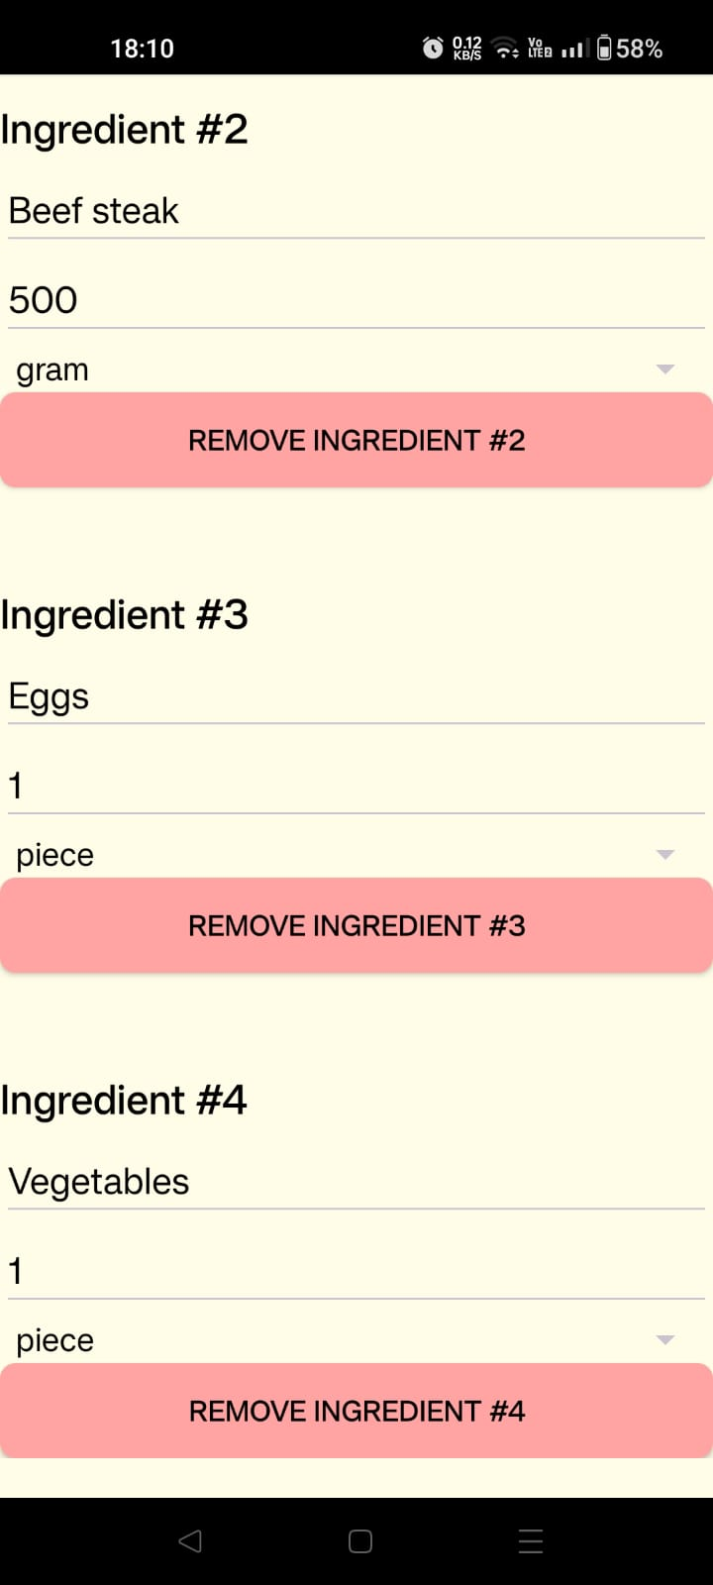
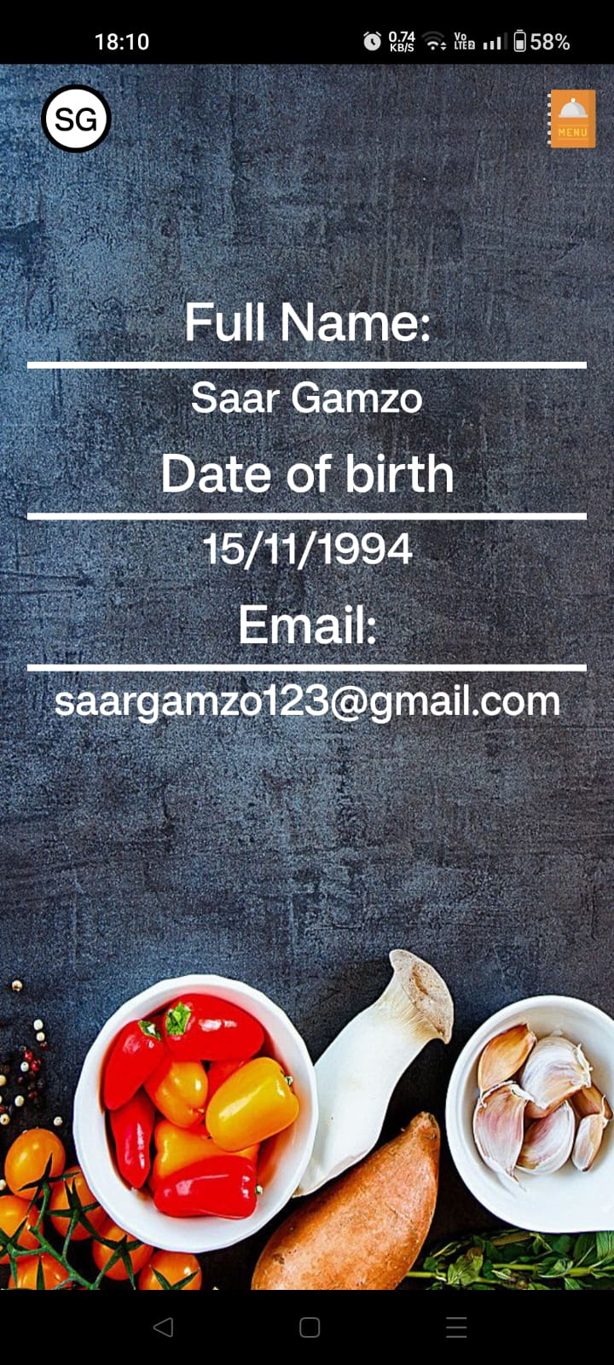
Cookshare – Flow chart
Upload Recipe
Register screen
Login screen
Main feed
Recipe
Update recipe
Personal details
Search
Filter

Slide 5
My app - features
Login with email & password – firebase authentication
Maintain Firebase database – save users & recipes
Maintain Firebase storage – an image to each recipe
Upload a recipe image from camera/gallery
Search recipes by category – filter with chips (tags)
Search recipes by keywords in it
Each user have ‘liked Recipes’ list
Navigation to Youtube & Google with specific by a single click

Slide 6
The server’s uses
Backup and transfer data between users with firebase Real-time database
Firebase Auth to manage user's authentication
Save images with Firebase storage

