Slide 1
MENTORNESS NLP TASK 3
WORLD CUP TWEETS SENTIMENT ANALYSIS

Slide 2
Abstract:
This project focuses on leveraging Natural Language Processing (NLP) techniques to analyze and predict sentiments and trends in T20 World Cup 2021 tweets. Analyzing and predicting the sentiments and trends in tweets related to a major sporting event is a complex task that requires understanding the nuances of social media text and the dynamics of fan engagement. By harnessing NLP tools and machine learning algorithms, this project aims to develop a predictive model that can anticipate the sentiments, popular hashtags, and key insights from T20 World Cup 2021 tweets. The project is designed to assist cricket enthusiasts, sports analysts, and marketers in understanding the social media landscape surrounding this event.

Slide 3
How can NLP techniques be employed to extract valuable information from T20 World Cup 2021 tweets, such as sentiment, trending topics, and user engagement?
Natural Language Processing (NLP) techniques can be employed to extract valuable information from T20 World Cup 2021 tweets, such as sentiment, trending topics, and user engagement. Here's a high-level overview of how you can approach this task:
Data Collection:
Gather a dataset of T20 World Cup 2021 tweets. You can use Twitter API or web scraping tools to collect tweets related to the event.
Data Preprocessing:
Preprocess the collected tweets by removing noise, such as URLs, special characters, and stopwords. Tokenize the text and perform lowercasing.
Sentiment Analysis:
Use sentiment analysis techniques to determine the sentiment of each tweet. This can be done using pre-trained sentiment analysis models or custom classifiers.
You can categorize tweets as positive, negative, or neutral to gauge the overall sentiment around the event.
Trending Topics:
Employ techniques like text clustering and topic modeling (e.g., Latent Dirichlet Allocation or Non-Negative Matrix Factorization) to identify the trending topics in the tweets.
Visualize the most frequent terms or hashtags to identify popular themes.

Slide 4
Contd:
5.Named Entity Recognition (NER):
Utilize NER models to extract named entities such as player names, team names, or stadium names from the tweets. This can help in understanding which players or teams are receiving the most attention.
6.Emotion Analysis:
Go beyond simple sentiment analysis by performing emotion analysis to capture more nuanced emotions expressed in the tweets. Emotions like excitement, frustration, and disappointment can provide additional insights.
7.Network Analysis:
Construct a social network of users and analyze the connections between them. Identify key influencers, retweet patterns, and communities within the Twitter ecosystem.
8.Visualization:
Create visualizations like word clouds, bar charts, and line graphs to present the extracted information in a clear and understandable manner.
9.Data Interpretation:
Analyze the results to draw meaningful insights about the T20 World Cup 2021. Identify key moments, controversies, and sentiments associated with the event.
10.Continuous Monitoring:
Implement real-time or periodic data collection to monitor how sentiment, trending topics, and user engagement change throughout the event.

Slide 5
Can we build predictive models that analyze tweet contents, user profiles, and tweet metadata to anticipate sentiments and trends during the T20 World Cup 2021?
Yes, you can build predictive models that analyze tweet contents, user profiles, and tweet metadata to anticipate sentiments and trends during the T20 World Cup 2021. Here's how you can approach the development of such predictive models:
Data Collection:
Collect a comprehensive dataset of T20 World Cup 2021 tweets, including tweet contents, user profiles, and tweet metadata (e.g., timestamps, retweets, likes, etc.).
Data Preprocessing:
Preprocess the data by cleaning and standardizing the text, handling missing values, and encoding categorical features. You may also need to perform text normalization and tokenization.
Feature Engineering:
Create relevant features from the tweet contents, user profiles, and tweet metadata. Some features to consider include:
Text-based features: TF-IDF, word embeddings, sentiment scores, and topic modeling.
User-based features: User follower count, user influence score, user activity level, etc.
Temporal features: Time of day, day of the week, and time since the tweet was posted.

Slide 6
Sentiment Analysis:
Sentiment Analysis:
Train or use pre-trained sentiment analysis models to label tweets as positive, negative, or neutral based on their contents.
Trend Prediction:
Utilize machine learning or deep learning models to predict trending topics and themes in the tweets. This can be done using techniques like topic modeling, time series analysis, or recurrent neural networks (RNNs).
Sentiment Prediction:
Build predictive models that anticipate changes in sentiment over time during the T20 World Cup. Time series analysis or recurrent neural networks (RNNs) can be useful for this purpose.

Slide 7
What features and factors are most influential in determining the sentiments and trends in T20 World Cup 2021 tweets?
The factors and features that are most influential in determining sentiments and trends in T20 World Cup 2021 tweets can vary, and their importance may change over time as the event progresses. However, some key factors and features that are likely to have a significant impact on sentiment and trends in these tweets include:
Content Features:
Keywords and Hashtags: The presence of specific keywords and hashtags related to the T20 World Cup, teams, players, or specific matches can influence the sentiment and trending topics.
Emotion and Tone: The emotional content of tweets, such as expressions of excitement, frustration, or celebration, can affect sentiment analysis.
Sentiment Words: The use of sentiment-bearing words (positive or negative) in tweets can be a strong indicator of sentiment.
User-Related Features:
User Influence: The influence of the user posting the tweet, as measured by factors like follower count, retweet count, and historical engagement, can affect trends and sentiments.
User Engagement: The level of engagement the user's tweets receive (retweets, likes, and replies) can impact trends, as highly engaged tweets tend to attract more attention.
Temporal Features:
Time of Day: The time of day when tweets are posted can influence trends, as different topics and sentiments may prevail at different times.
Event Milestones: Key events during the T20 World Cup, such as match outcomes, significant plays, and awards, can trigger changes in sentiment and trends.
Text Features:
Text Length: The length of the tweet may influence sentiment. Longer tweets may provide more context and emotional expression.
Text Complexity: The complexity of the language used in tweets can affect how sentiments are expressed.

Slide 8
How accurate and reliable can an NLP-based prediction model be in the context of analyzing sentiments and trends in tweets related to a sporting event?
The accuracy and reliability of an NLP-based prediction model for analyzing sentiments and trends in tweets related to a sporting event can vary based on several factors. Here are some considerations that can impact the performance and dependability of such models:
Data Quality: The quality of the data is paramount. Noisy or biased data can lead to inaccurate predictions. If the dataset contains a lot of spam, irrelevant, or low-quality tweets, it can negatively impact the model's accuracy and reliability.
Model Complexity: The choice of NLP models and their complexity can significantly impact accuracy. More advanced models, such as deep learning models, can capture intricate patterns but may require larger datasets and more computational resources.
Training Data: The size and representativeness of the training dataset are critical. A smaller dataset may lead to overfitting, while an unrepresentative dataset may not capture the diversity of sentiments and trends.
Data Preprocessing: Proper data preprocessing, including text cleaning, tokenization, and feature engineering, is essential for improving model accuracy and reliability.
Sentiment and Trend Volatility: Sentiments and trends during a sporting event can change rapidly, and models may struggle to keep up with such changes. Continuous data collection and model updates are essential.

Slide 9
Scope:
This project's scope encompasses several critical aspects:
1. Data Preprocessing: Cleaning and preparing the textual data from T20 World Cup 2021 tweets for NLP
analysis.
2. Feature Engineering: Extracting relevant features from user profiles, tweet text, and tweet metadata.
3. Sentiment Analysis: Developing and training NLP models to determine the sentiments expressed in the
tweets.
4. Trend Analysis: Identifying popular hashtags and trends in T20 World Cup 2021 tweets.
5. Model Evaluation: Assessing the accuracy, precision, recall, and F1-score of the predictive models.
6. Interpretability: Analyzing the factors and linguistic patterns contributing to sentiment and trend
predictions.
7. Social Media Insights: Providing cricket enthusiasts, sports analysts, and
marketers with insights into the social media landscape during the T20 World Cup 2021.

Slide 10
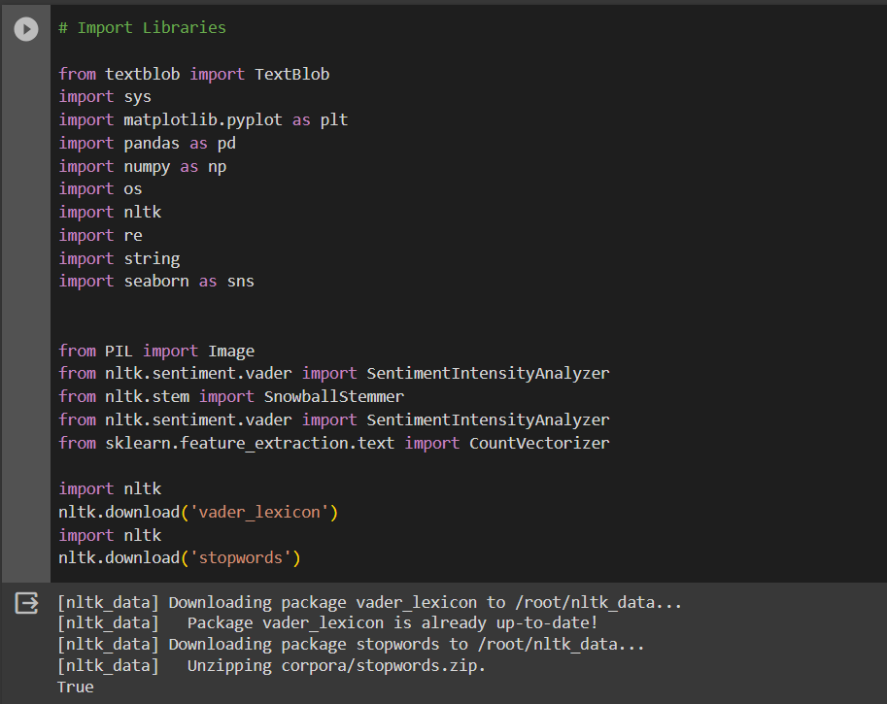
Importing Libraries:

Slide 11
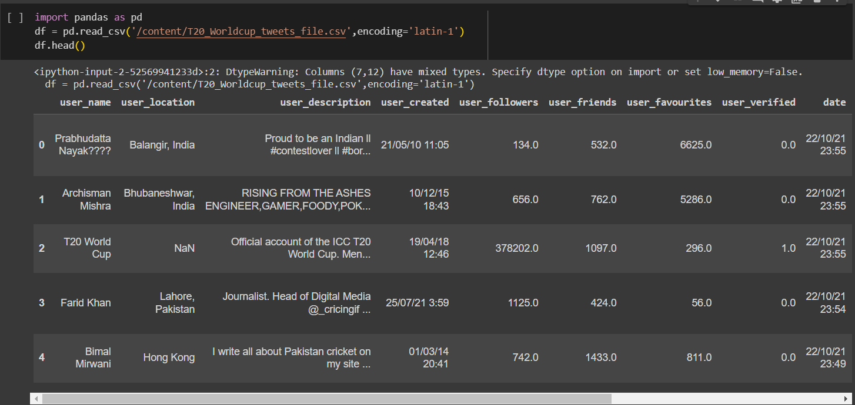

Slide 12
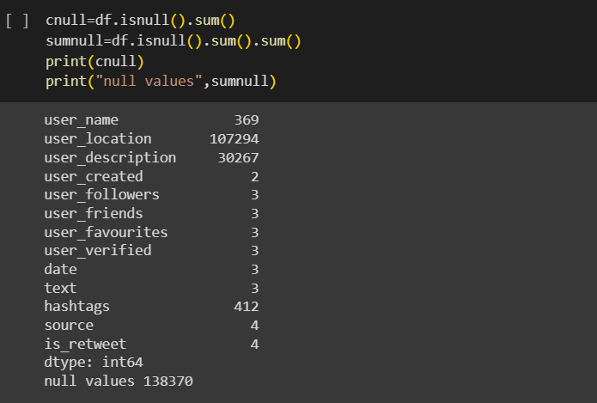
Number of total fields:

Slide 13
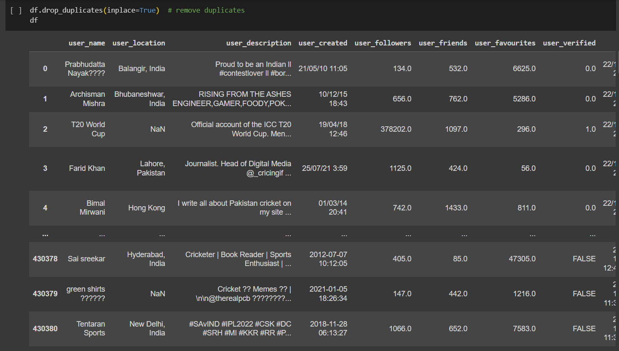
Drop Duplicate Values

Slide 14
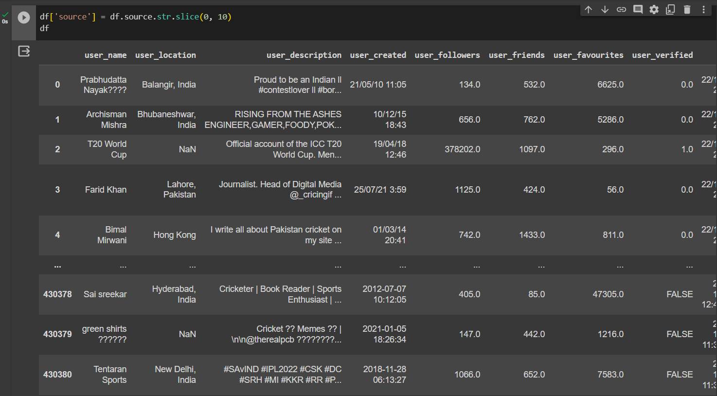

Slide 15
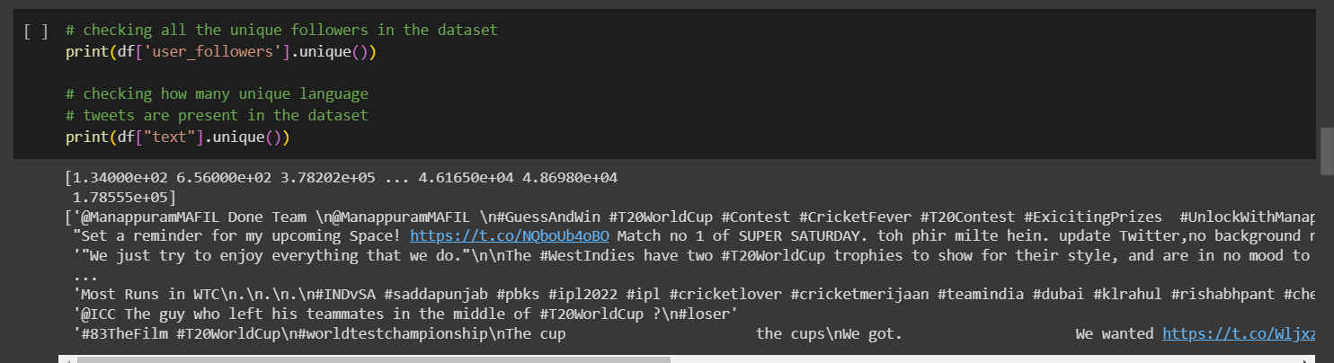
Checking for unique fields in the dataset:

Slide 16
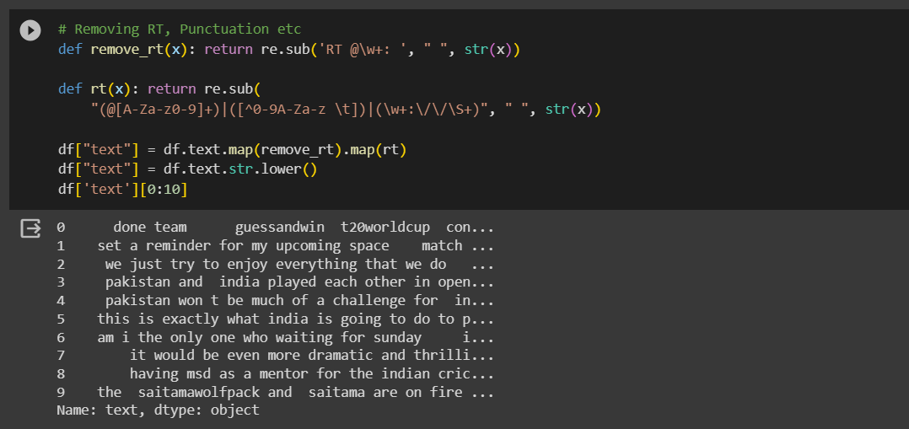
Removal of Punctuations:

Slide 17
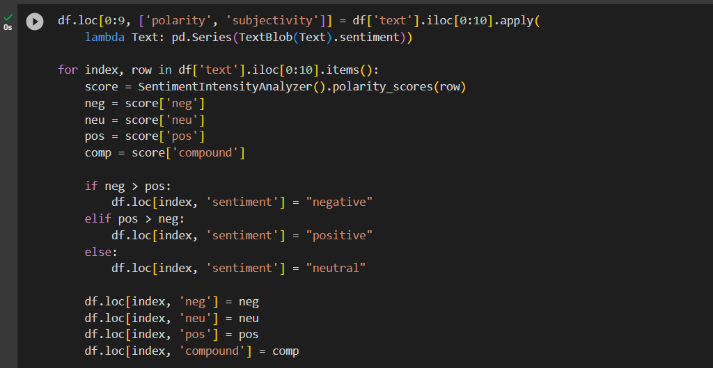
Polarity and Subjectivity Check:

Slide 18
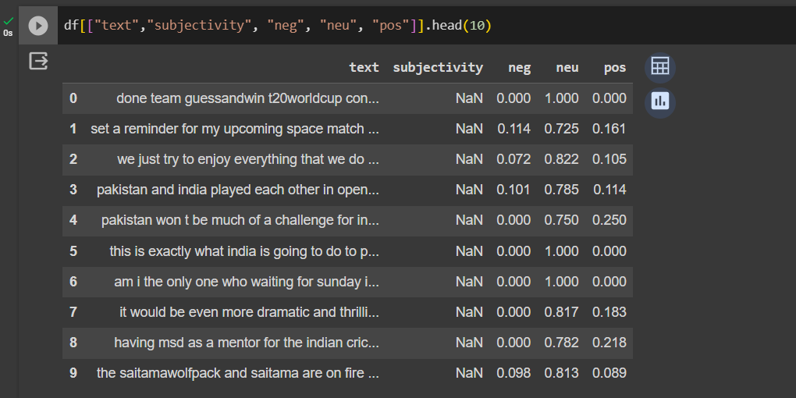
Classify into positive, negative and neutral:

Slide 19
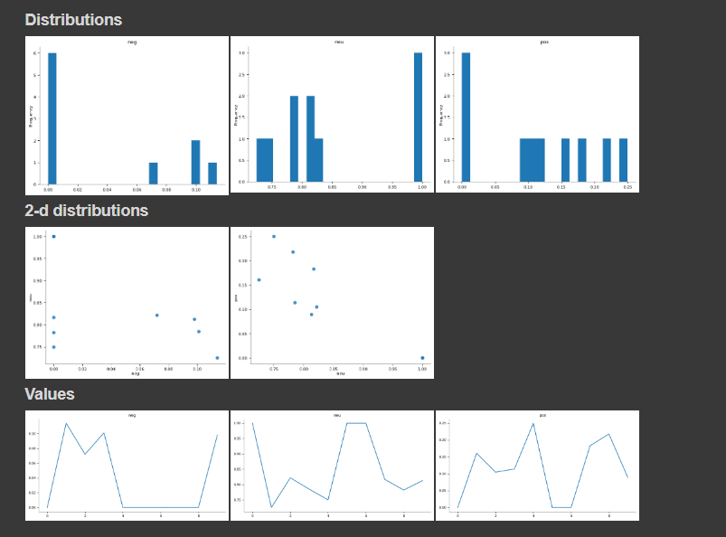

Slide 20
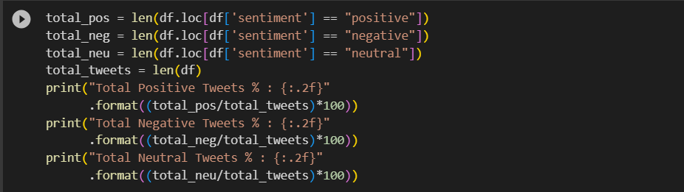
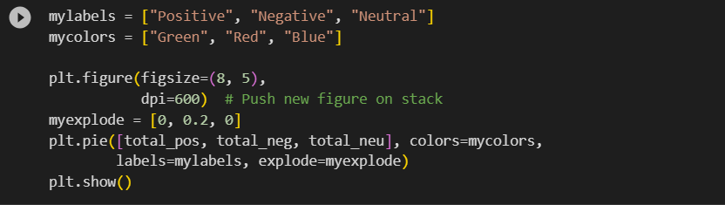
Total positive, negative and neutral tweets:

Slide 21
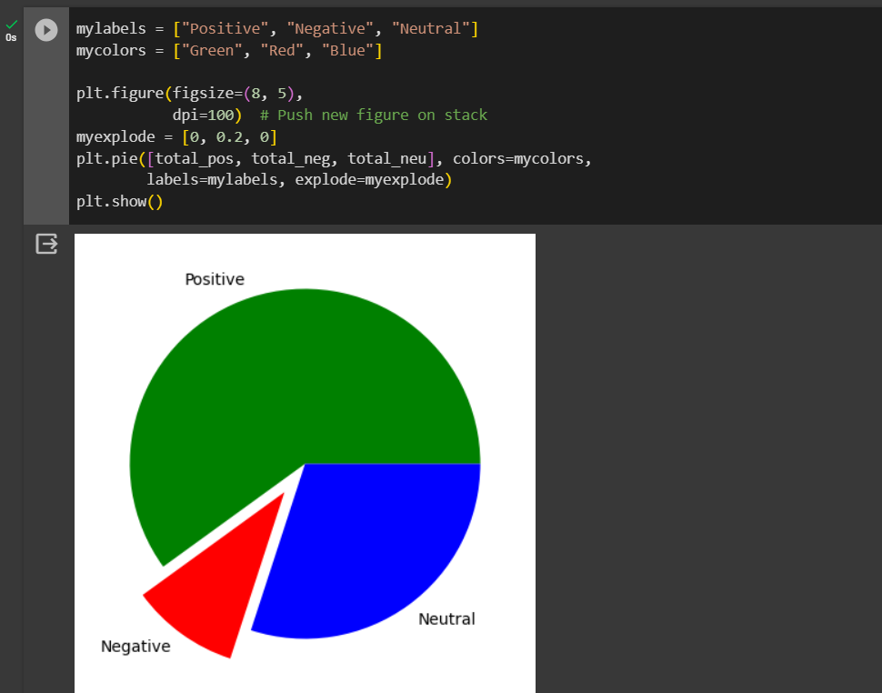
Graph plotted:

Slide 22
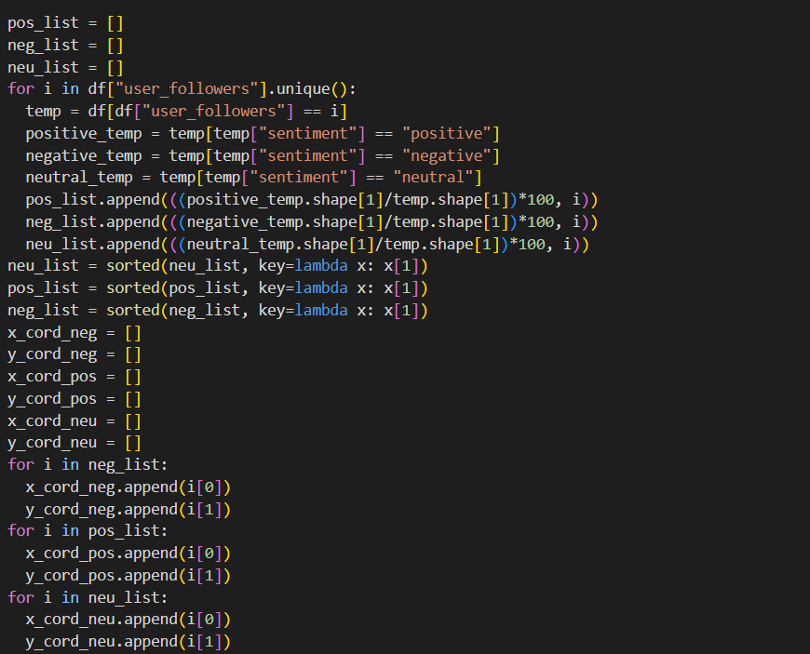

Slide 23
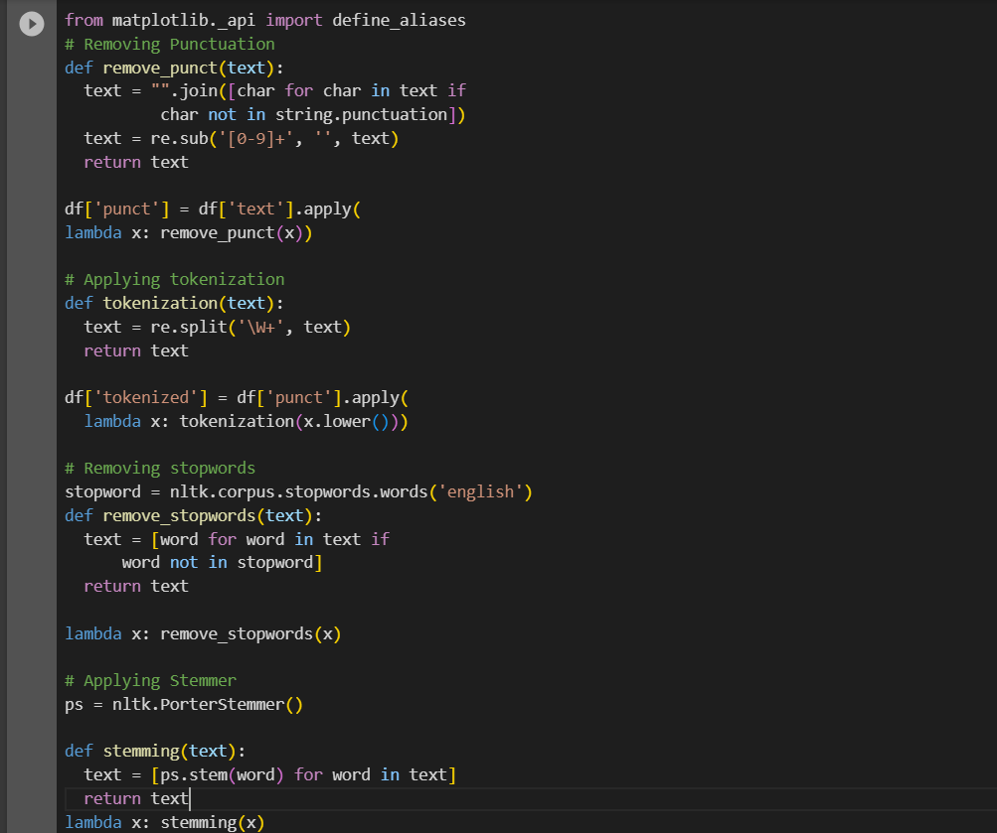
Removing Stopwords, Applying Tokenization and Stemming:

Slide 24
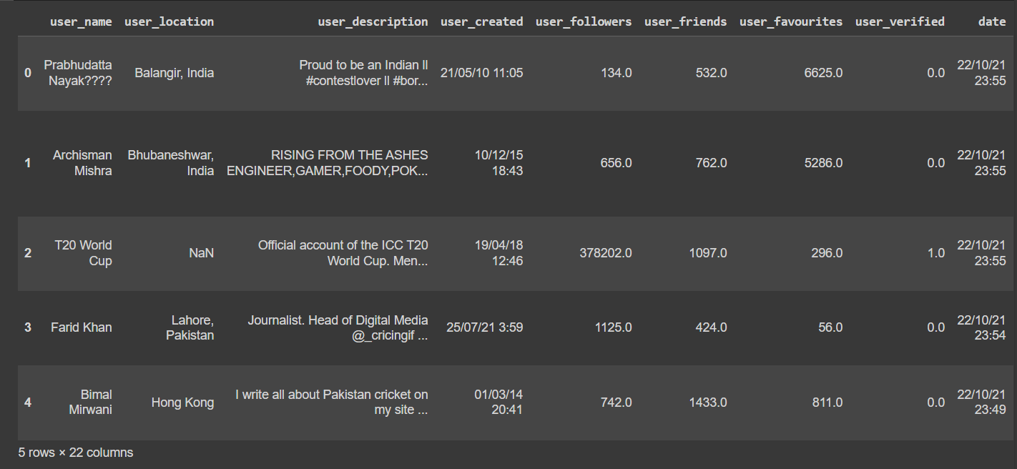

Slide 25
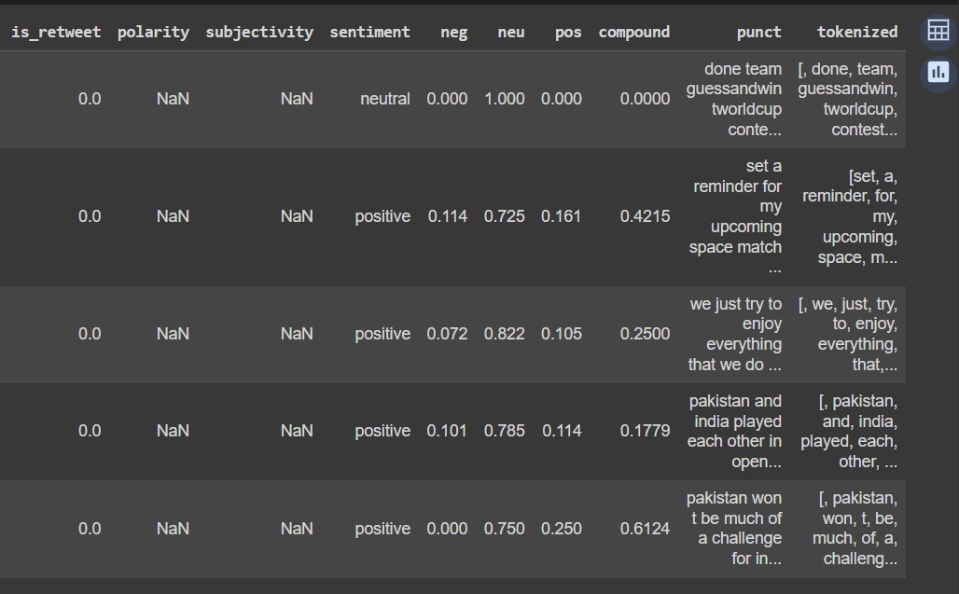

Slide 26
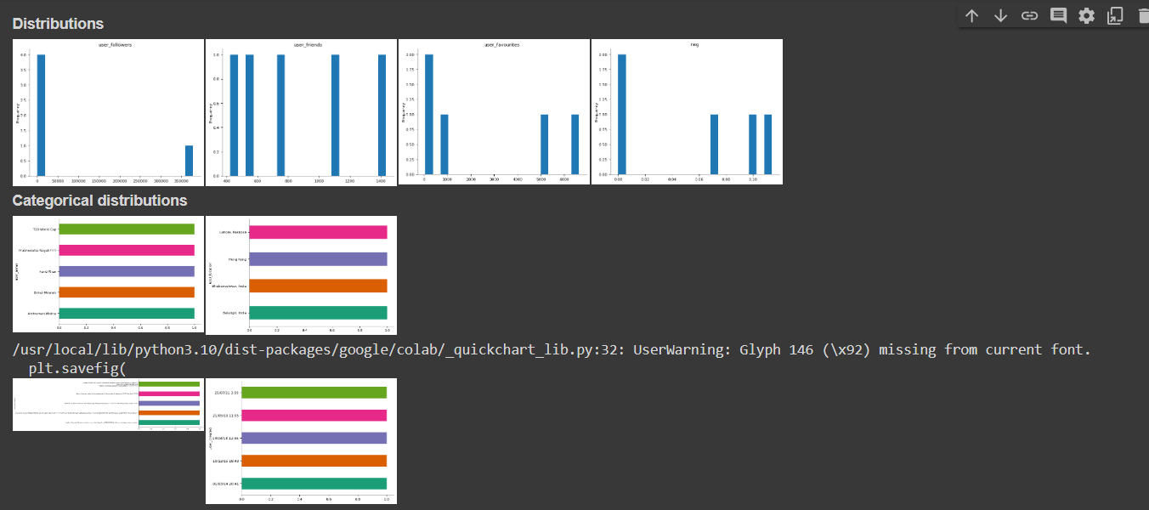

Slide 27
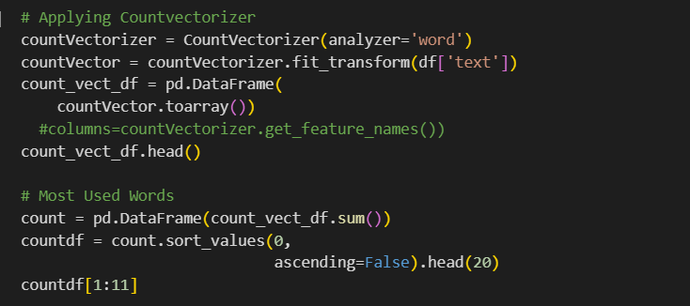
Applying Countvectorizer:

Slide 28
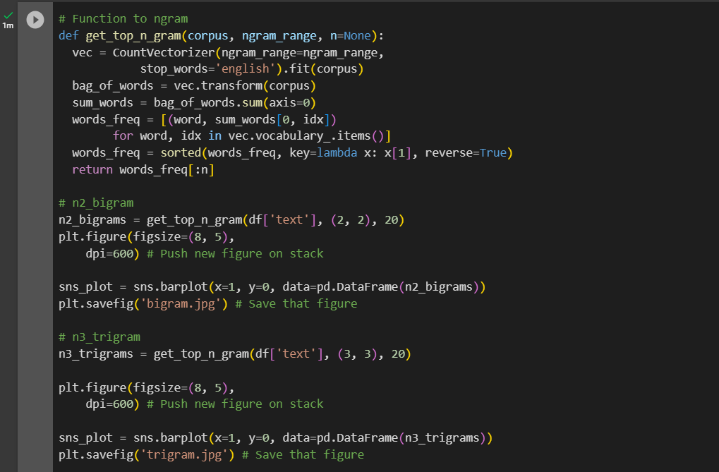
Function to n-gram:

Slide 29
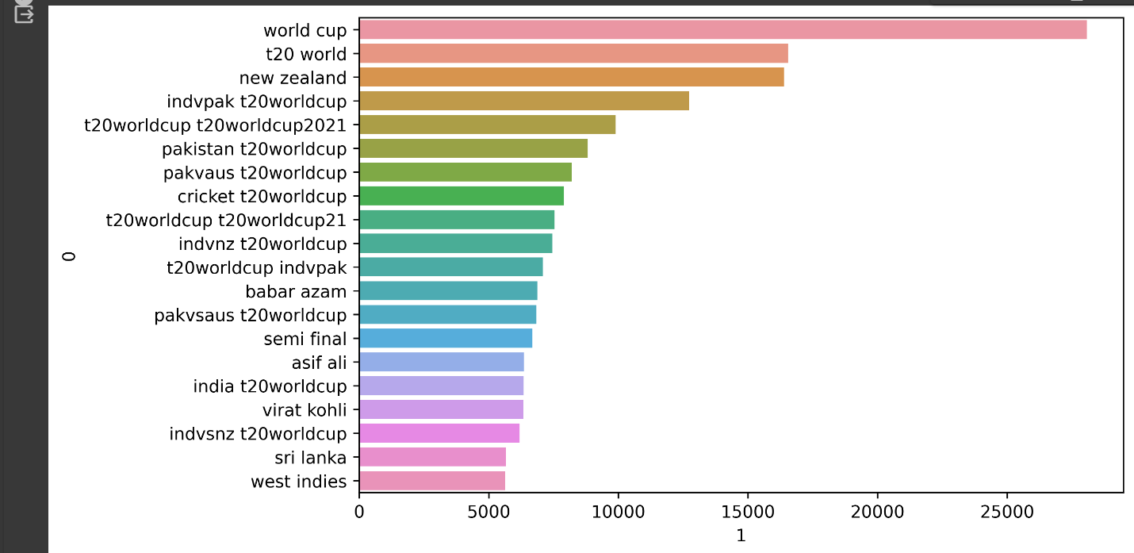

Slide 30
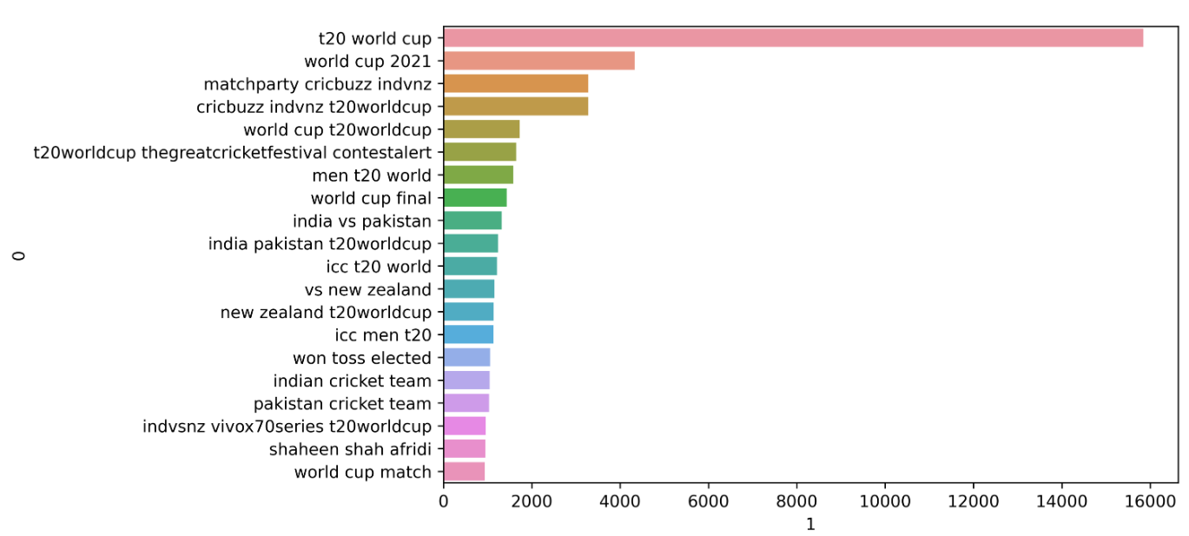

Slide 31


