Slide 1
MENTORNESS NLP INTERNSHIP TASK
ISRAEL PALESTINE WAR SENTIMENT ANALYSIS

Slide 2
ABSTRACT:
This project focuses on applying Natural Language Processing (NLP) techniques to analyze and understand the sentiment and impact of textual data related to the current Israel-Palestine conflict. The project leverages advanced NLP methods to process comments from the online platform Rediff, specifically analyzing the sentiment and context of these comments in the context of the ongoing conflict. By categorizing comments as positive, negative, or neutral and exploring the relationship between sentiment and the conflict's developments, this project aims to gain insights into public sentiment and opinions regarding the Israel-Palestine conflict.

Slide 3
How can NLP techniques be applied to analyze comments from Rediff related to the Israel-Palestine conflict?
Analyzing comments from a platform like Rediff related to the Israel-Palestine conflict using Natural Language Processing (NLP) techniques can provide valuable insights into public sentiment, opinions, and discussions. Here's a high-level overview of how you can apply NLP to this task:
Data Collection:
Scrape comments: Use web scraping techniques to gather comments from Rediff articles related to the Israel-Palestine conflict. Make sure to respect the website's terms of use and policies.
Data Preprocessing:
Text cleaning: Remove irrelevant characters, HTML tags, and special symbols.
Tokenization: Split comments into individual words or tokens.
Lowercasing: Convert all text to lowercase to ensure consistency.
Stopword removal: Eliminate common and irrelevant words like "the," "and," "in."
Sentiment Analysis:
Analyze sentiment: Apply sentiment analysis to determine the emotional tone of each comment. You can use pre-trained sentiment analysis models or create your own using labeled data.
Categorize comments: Categorize comments as positive, negative, or neutral based on their sentiment scores. This will help you understand the overall sentiment of the discussions.

Slide 4
Contd:
4. Topic Modeling:
Extract topics: Utilize topic modeling techniques (e.g., Latent Dirichlet Allocation or Non-Negative Matrix Factorization) to identify key themes or topics in the comments. This can help in understanding the main issues people are discussing.
5.Named Entity Recognition (NER):
Identify entities: Use NER to detect and categorize named entities in comments, such as the names of politicians, organizations, or specific locations relevant to the conflict.
6.Network Analysis:
Identify influencers: Analyze user interactions and comments to identify influential users and track how information spreads through the network.
Visualize interactions: Create network graphs to visualize how different users are connected and how discussions evolve.

Slide 5
Can we accurately classify the sentiment of comments as positive, negative, or neutral to gauge public sentiment?
Classifying the sentiment of comments as positive, negative, or neutral to gauge public sentiment is a common and valuable use of sentiment analysis. While sentiment analysis can provide valuable insights, it's essential to understand its limitations:
Accuracy: Sentiment analysis models are not perfect. The accuracy of sentiment classification can vary depending on the quality of the model and the complexity of the text. Many models perform better on formal and well-structured text than on informal comments.
Subjectivity: Sentiment is inherently subjective. What one person considers a positive comment, another might see as negative. Models may struggle to accurately gauge sentiment when comments contain sarcasm, irony, or complex emotions.
Context: Sentiment analysis often lacks the ability to understand context fully. Comments might express nuanced opinions that are not easily categorized as purely positive, negative, or neutral. Understanding the context of the Israel-Palestine conflict, with its historical and geopolitical complexities, can be challenging for sentiment analysis models.
Bias: Sentiment analysis models can be biased. They may produce biased results due to the data they were trained on, and this bias can influence public sentiment analysis. This is especially important to consider when analyzing comments on sensitive topics.

Slide 6
Contd:
Despite these limitations, sentiment analysis can still offer valuable insights into public sentiment. To improve the accuracy of sentiment analysis for comments on the Israel-Palestine conflict on Rediff or similar platforms, consider these best practices:
Custom Model Training: Train or fine-tune sentiment analysis models with domain-specific data to better capture the nuances of this particular topic and the way people express their sentiment.
Human Annotation: Consider using human annotators to validate and improve sentiment annotations, especially for complex or ambiguous comments.
Ensemble Models: Combine the predictions of multiple sentiment analysis models to improve accuracy.
Regular Model Updates: Continuously update and retrain sentiment analysis models to adapt to evolving language and sentiment expressions.

Slide 7
What are the prevailing sentiments in the comments, and how do they correlate with significant events in the conflict?
To determine the prevailing sentiments in comments related to the Israel-Palestine conflict on a platform like Rediff and how they correlate with significant events, you'll need to perform a comprehensive analysis. Here's a general approach to carry out this analysis:
Data Collection:
Gather comments from Rediff articles or discussions related to the Israel-Palestine conflict. Ensure that the data includes timestamps for each comment.
Sentiment Analysis:
Use sentiment analysis techniques to classify comments as positive, negative, or neutral. You can employ pre-trained sentiment analysis models or train custom models for better accuracy.
Categorize comments based on their sentiment scores.
Event Timeline:
Create a timeline of significant events related to the Israel-Palestine conflict, such as escalations, peace talks, political developments, and major incidents. This information can be gathered from news sources, historical data, or official records.

Slide 8
Contd:
4. Correlation Analysis:
Overlay the sentiment data onto the event timeline to visualize the sentiment trends before, during, and after significant events.
Analyze the correlation between sentiment changes and specific events. Look for patterns in sentiment fluctuations and try to understand the reasons behind these changes.
5. Topic Modeling:
Use topic modeling techniques to identify the main themes and topics within the comments. This can help you link specific sentiments to particular issues or aspects of the conflict.
6. User Behavior Analysis:
Investigate how user sentiment varies based on factors like user demographics, posting patterns, or the duration of their engagement with the topic.

Slide 9
Is it possible to identify trends or patterns in public sentiment over time, and can these insights inform our understanding of the conflict?
Yes, it is possible to identify trends and patterns in public sentiment over time in discussions related to the Israel-Palestine conflict. Analyzing sentiment trends can offer valuable insights into how public sentiment evolves, and these insights can inform our understanding of the conflict. Here's how you can go about it:
Sentiment Data Collection: Collect a significant amount of historical comments or social media posts related to the conflict, ideally spanning a wide timeframe. Ensure the data includes timestamps.
Sentiment Analysis: Use sentiment analysis techniques to classify comments as positive, negative, or neutral. Pre-trained models or custom models can be used for this purpose.
Time Series Analysis:
Organize the sentiment data into a time series format, with sentiments recorded at regular intervals (e.g., daily, weekly, or monthly).
Calculate summary statistics for each time interval, such as the average sentiment score or the percentage of positive, negative, and neutral comments.

Slide 10
SCOPE:
This project's scope encompasses several critical components:
• Data Preprocessing: Cleaning and preparing the textual data from Rediff comments for sentiment
analysis.
• Sentiment Analysis Models: Developing NLP models for classifying comment sentiment as positive,
negative, or neutral.
• Contextual Analysis: Understanding the context and content of comments to explore themes and
insights related to the Israel-Palestine conflict.
• Sentiment Trends: Analyzing sentiment trends over time to identify patterns and correlations with
significant events.

Slide 11
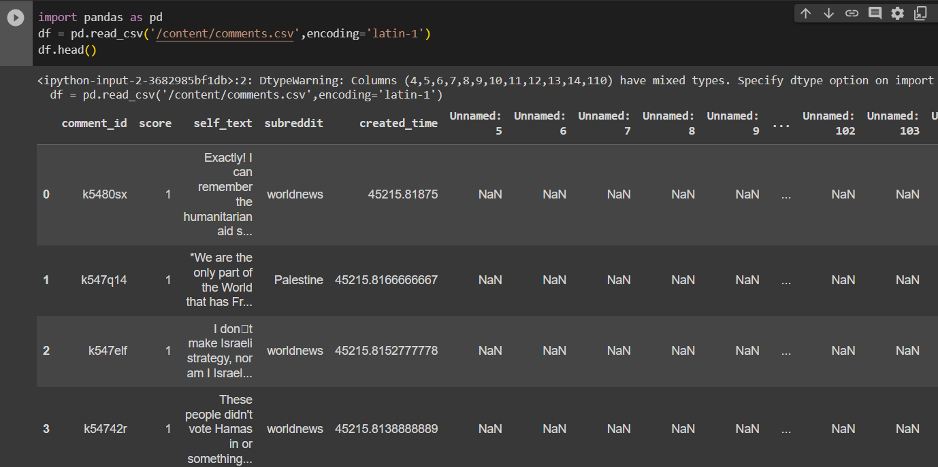

Slide 12
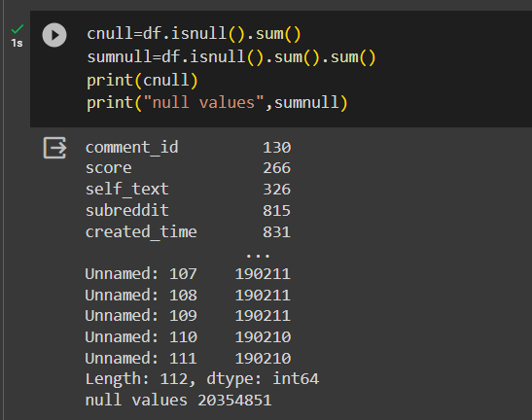

Slide 13
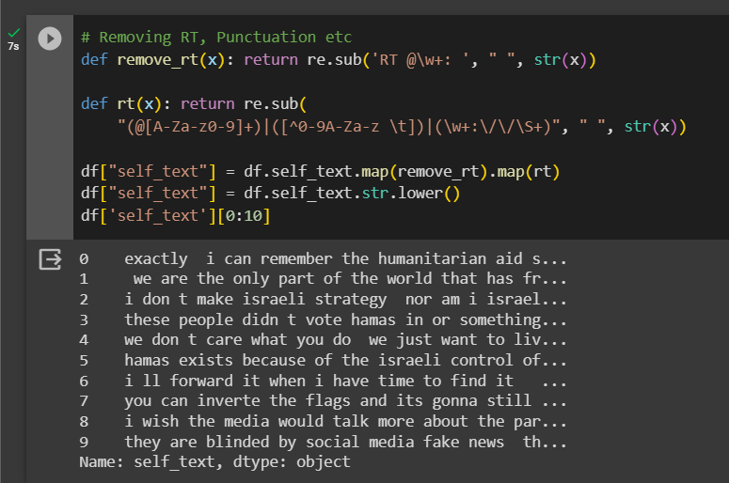
Removing Punctuations:

Slide 14
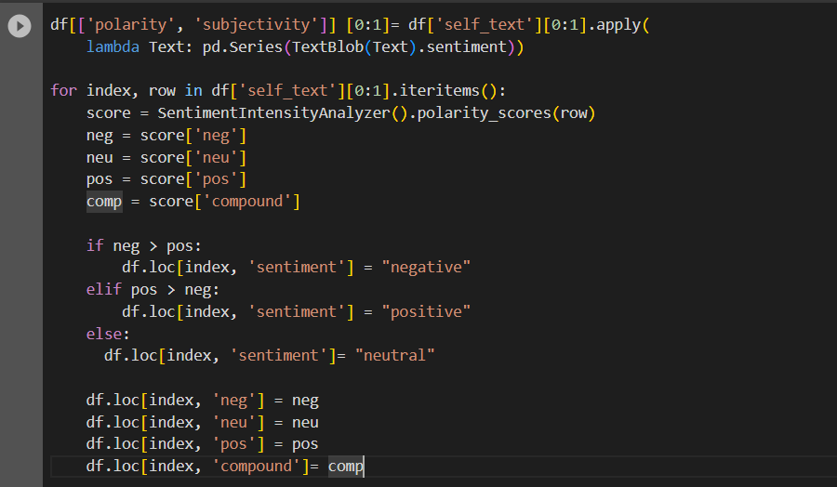

Slide 15
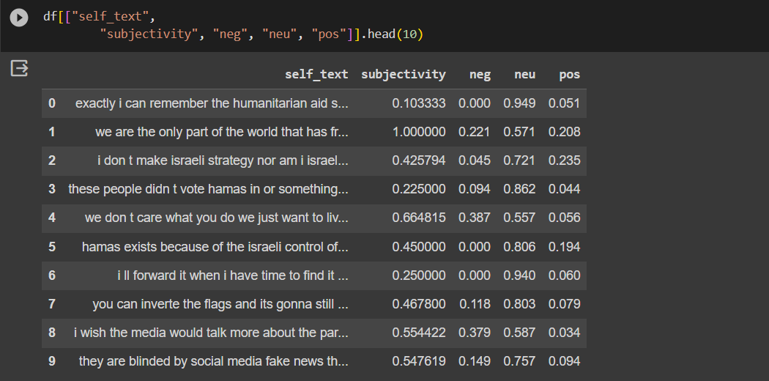
Assigning Scores:

Slide 16
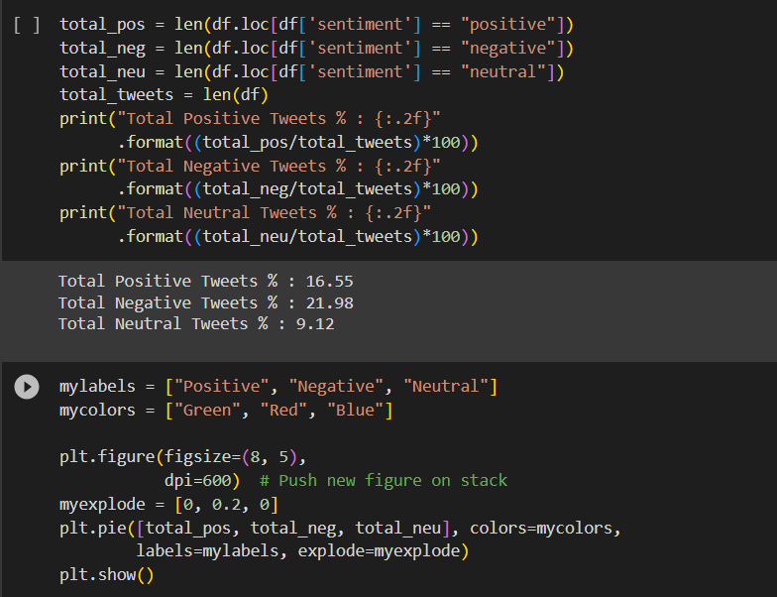

Slide 17
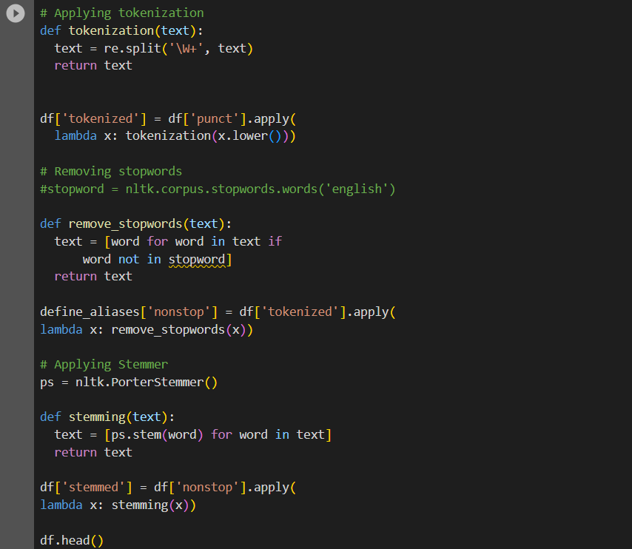
Applying Tokenization and removing stop words:

Slide 18
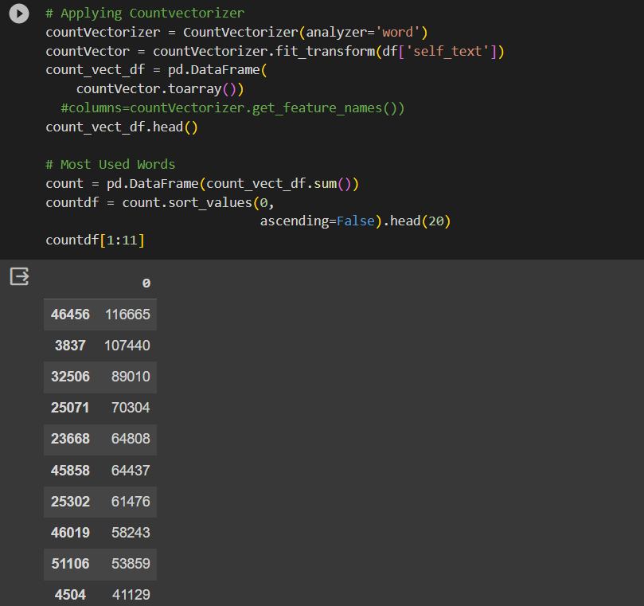

Slide 19
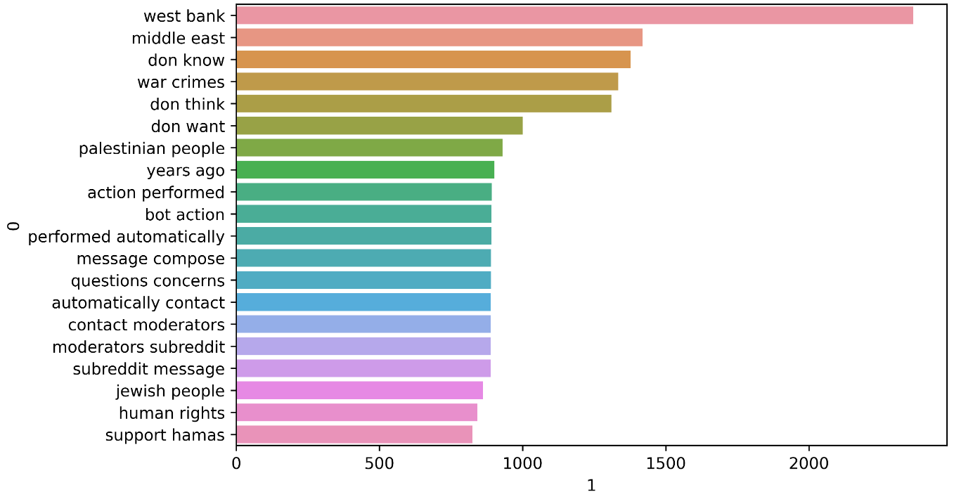
Function to n-gram display:

Slide 20
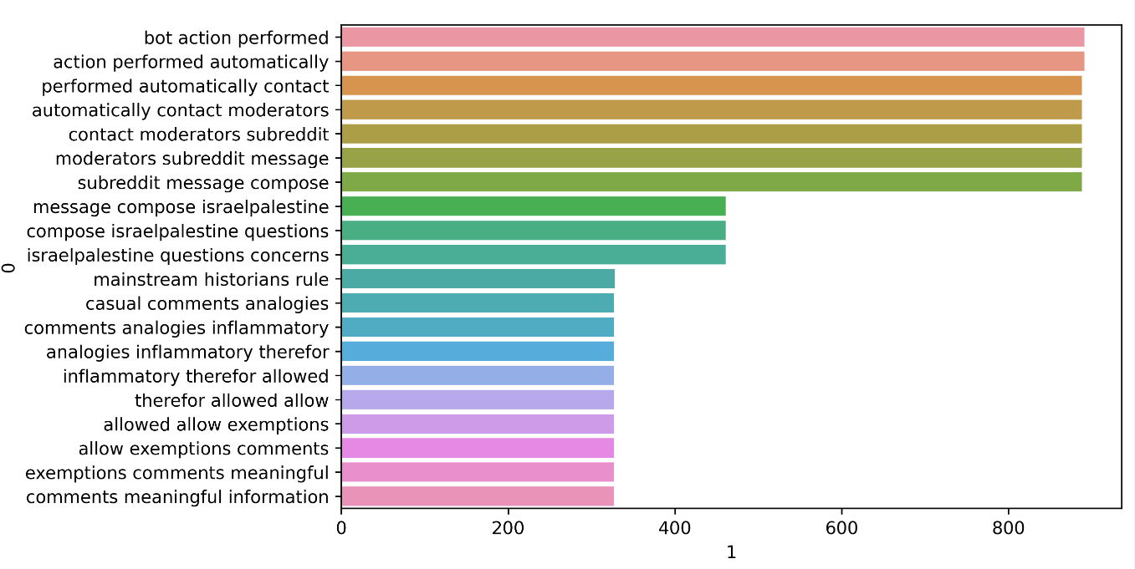

Slide 21


