Slide 1
Maritime Distress Intelligence
From a noisy multilingual VHF call to a verified incident and a search plan
Data Science course project
Notes:
Open with the one-line promise: a distress call comes in on channel 16, possibly in Hindi, Tamil or Malayalam, over a noisy radio. The system turns it into a structured, explained incident and a search plan in seconds, and the operator verifies everything.

Slide 2
THE PROBLEM
4
0
24 h
languages on the radio along the Indian coast: English, Hindi, Tamil, Malayalam
public labelled VHF distress-call datasets for Indian waters
a drifting casualty can move 10+ nm; every hour widens the search
Operators must extract who, where, what and how many, under stress, from a few seconds of radio.
Notes:
There is no public labelled corpus for this, which is why the project generates its own labelled data and validates on external datasets.

Slide 3
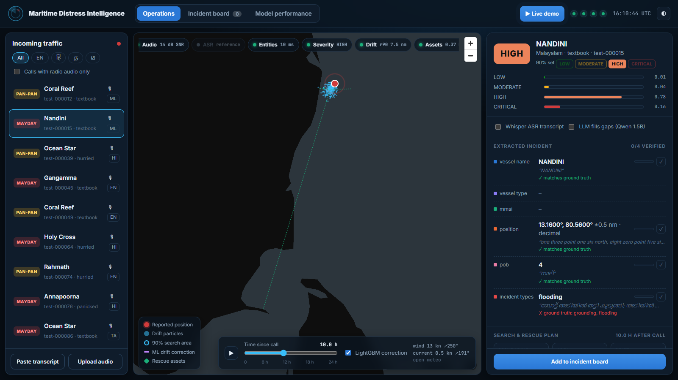
THE PRODUCT
1
Listens
Whisper ASR with fine-tuned Indic checkpoints
2
Extracts
Vessel, MMSI, position, persons on board, incident type, with evidence
3
Judges
Severity with calibrated probabilities and a 90% set
4
Plans
Drift forecast, search area and fastest assets
The operator verifies every field. The system never dispatches on its own.

Slide 4
HOW IT WORKS
Audio
Speech
Entities
Incident
Severity
Drift
Assets
VHF channel
simulation
Whisper +
Indic fine-tunes
CRF sequence
labelling
TF-IDF +
logistic regression
Calibrated,
conformal sets
Physics +
LightGBM
Hungarian
assignment
Optional LLM layer Qwen2.5-1.5B fills fields the CRF misses. Every LLM answer must quote the transcript, and our own parsers convert numbers, never the LLM.

Slide 5
DATA SCIENCE DEPTH
Learning models · 6
Uncertainty · 5
Simulation · 4
Evaluation design · 5
Linear-chain CRF (NER)
Temperature scaling + ECE
Synthetic data generator
Leakage-controlled splits
TF-IDF + logistic regression
Split conformal prediction
VHF signal processing
Buoy-grouped cross-validation
Ordinal vs multinomial regression
Conformal search radius
Monte Carlo drift
Dev / test protocol
LightGBM residual model
Bootstrap confidence intervals
Hungarian assignment
Robustness vs ASR noise
Whisper transfer learning
Exact linear SHAP
Learned CRF/LLM routing
Grammar-constrained LLM
Every technique is evaluated against a baseline on held-out or external data.
Notes:
20 distinct methods. Stress that each has a baseline and a held-out evaluation, not just an implementation.

Slide 6
Labels we generate, realism we borrow
DATA
20,000
MARTTS
test
SeaAlert
test
240 real radio dialogues
1,872 VHF messages + ASR
synthetic distress dialogues
Kathbath
test
MUSAN
train
real Indian speech
real background noise
Labels sampled before text, so spans are exact
4 languages × 3 caller styles
Held-out vessels, landmarks and phrasings
NOAA drifters
train/test
ERA5 + Copernicus
input
real buoy tracks
wind and currents
MarineCadastre AIS
input
GEBCO
input
real vessel speeds
bathymetry / land mask

Slide 7
Entities and incidents, on phrasings never seen in training
LANGUAGE UNDERSTANDING
0.89
entity micro-F1 (95% CI 0.885–0.898)
0.89
incident macro-F1, vs 0.80 for keyword rules
Unseen vessel names: a shape feature stops the CRF memorising names (66% → 99.6% exact).

Slide 8
Probabilities you can trust, sets that admit doubt
SEVERITY AND TRUST
81%
Explained
fire
severity accuracy vs 46% majority baseline
man overboard
89%
capsizing
n incident types
conformal 90% sets hit the true severity (mean size 1.40)
flooding
Linear SHAP: weights that raise HIGH/CRITICAL

Slide 9
Where the severity model goes wrong
SEVERITY DIAGNOSTICS
Predicted
LOW
MODERATE
HIGH
CRITICAL
LOW
182
96%
2
1%
6
3%
0
0%
MODERATE
3
1%
288
90%
29
9%
0
0%
True
HIGH
15
2%
45
5%
843
92%
14
2%
CRITICAL
11
2%
12
2%
248
43%
303
53%
43% of CRITICAL calls are rated HIGH: the costly error
Conformal sets cover 99% of HIGH but only 68% of CRITICAL calls. Next: class-conditional conformal.

Slide 10
Fine-tuned Whisper cuts noisy-speech errors in half
SPEECH RECOGNITION
73% → 28%
Hindi word errors over radio noise
94% → 78%
caller WER on our 24 synthetic TTS calls; CER 76% → 77%, so synthetic audio is the bottleneck
AI4Bharat Kathbath, 8 speakers per language (Malayalam 2). No training run: published checkpoints, measured on our channel.

Slide 11
A small open LLM, kept honest by a grounding guard
LLM EXTRACTION
123
LLM answers blocked: quote not in the transcript or not a valid value
1.5B
parameters, 4-bit, laptop CPU, output constrained to a JSON schema
Learned on dev data: vessel: LLM · mmsi: LLM · position: CRF · POB: LLM

Slide 12
Physics plus machine learning, tested on real ocean buoys
DRIFT FORECASTING
17%
better than 'object stays put' at 24 h
+2.1%
LightGBM over physics at 24 h
95% CI 0.6% to 3.6%
1600 start points from 11 NOAA buoys · cross-validated by buoy · conformal 90% search radius

Slide 13
Trained on synthetic data, tested on real radio dialogues
EXTERNAL VALIDATION
62% → 2%
routine calls wrongly rated HIGH or CRITICAL
0.56
SeaAlert category F1 at heavy ASR noise, vs 0.42 published logistic regression
Fixes were made on a dev split only; test dialogues were scored, never inspected.

Slide 14
What a real deployment would still need
HONEST LIMITS AND NEXT STEPS
Limits
Next steps
Labels are synthetic; Indic phrasing needs native-speaker review
Record real calls with consenting operators
Only 11 buoys with current data limit the drift model
LoRA fine-tune Whisper on radio-channel audio
Small external samples (24–177 items) give wide intervals
LoRA fine-tune the LLM on our labelled dialogues
Kathbath may overlap the checkpoints' training data
Stream live calls through Kafka; real AIS feed

Slide 15
Live demo
One distress call, end to end: audio, transcript, extraction, severity, drift and dispatch
Thank you · questions welcome

