Slide 1
KRISHI SINCHAI SEVAK
SCORPION
Saaransh Panjrath 20211502819
Harshvardhan Joshi 20511502819
Prabhakar Kumar 20911502819
Shrey Goel 21011502819

Slide 2
Theme
The KRISHI SINCHAI SEVAK is an IoT based device which is capable of automating the irrigation process by analyzing the moisture of soil and the climate condition (like raining).
Also the data of sensors will be displayed on mobile device

Slide 3
Problem
Irrigation of farmlands are not just time consuming but also require excessive efforts
In water scarce areas, water needs to be used judiciously and cannot be left running
Solution
Krishi Sinchai Sevak automates the problem completely with help of IoT device starting drips when moisture content of soil reaches below set threshold.
Water will be used judiciously leaving no scope for nutrient leaching or soil erosion thereby supporting MORE CROP PER DROP

Slide 4
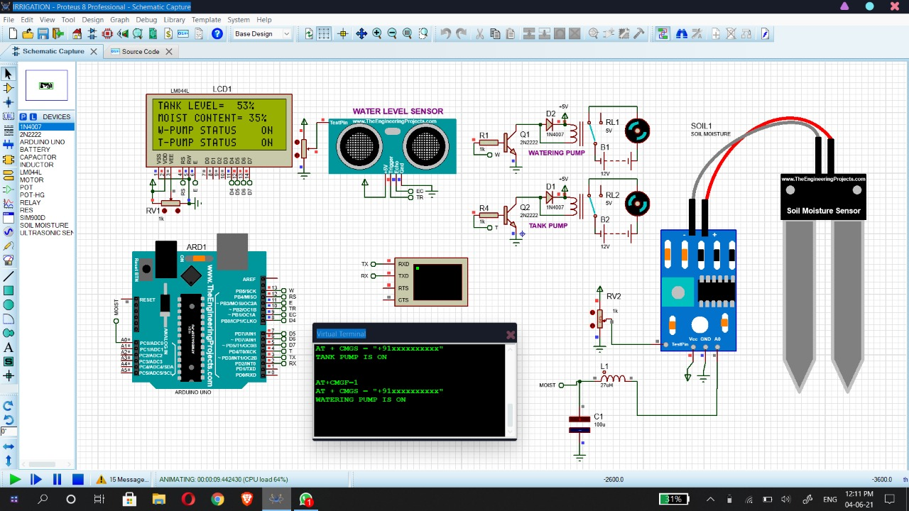



Working

Slide 5
Advantages
Water Conservation
Gives Real -Time Data
Lowered Operation Costs
Efficient and Saves Time
Increase in Production
Reduce soil erosion and nutrient leaching

Slide 6
Tech stack
First install Proteus 8 Professionals
2. Assemble the items
Arduino uno
Bread board
Lcd Display
Water level sensor (Ultrasonic Sensor)
GSM
Soil Moisture Sensor
2 Pump
Active and Passive Elements
Voltage source
3. And then simulate

Slide 7
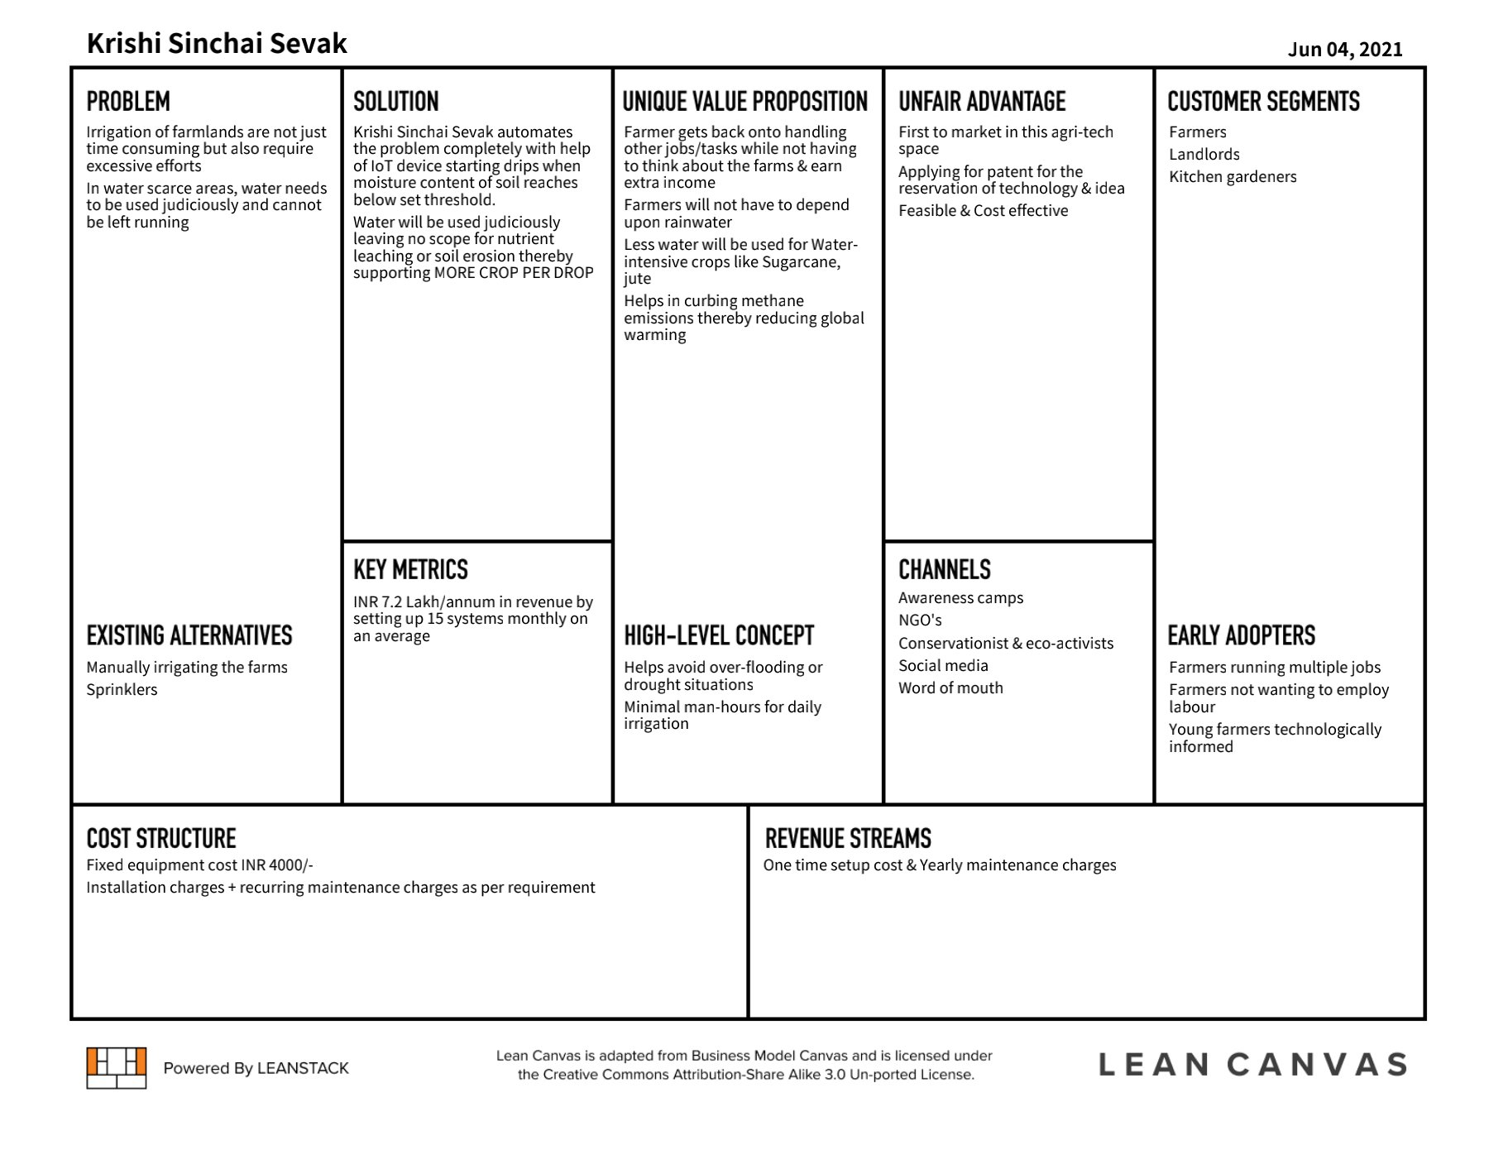

Slide 8
Future scope
Agri-tech is the next booming industry which has a lot of scope and a lot more is yet to be achieved in this space
We are designing the hardware system for which will be cost efficient to farmer
We can also collaborate with various government policies which help in reach of the product.
By maintaining the various scenario information on cloud , users can access or control over his farming activity

Slide 9
References
1. Arduino.cc
2. automatic_irrigation_code
3. Proteus 8 professional

