Slide 1
Gender based Abuse Detection in Indic Languages
Group - 30
Prashant Shrotriya (MT24065)
Saarim Khan (MT24077)
Vatsaly Rai (MT24144)

Slide 2

INTRODUCTION
Online gender-based abuse has emerged as a growing challenge that reflects underlying social and economic vulnerabilities. This project focuses on creating a multilingual abuse detection system for Hindi , Tamil ,Indian English, utilizing a dataset of 23,000 annotated posts.
This project aims to classify whether a given post from multilingual datasets of languages like English, Hindi, Tamil is abuse or non abusive .
The problem statement can be broken down into three subtasks based on the project, which are as follows:
Create a classifier using only the provided dataset to identify gendered abuse (label 1).( Is this post gendered abuse when not directed at a person of marginalized gender and sexuality?)
Employ transfer learning from other open datasets focused on hate speech and toxic language detection in Indic languages to develop a classifier for gendered abuse (label 1).
Construct a multi-task classifier that simultaneously predicts both gendered abuse (label 1) and explicit language (label 3)(explicit/aggressive).

Slide 3
MOTIVATION
Growing Need for Regional Language Moderation With over 600M+ Indic language internet users, online abuse in Hindi, Tamil, and other regional languages is rampant. Current tools focus mainly on English, leaving regional speakers vulnerable to unchecked harassment.
Unique Linguistic Challenges Indic abuse involves complex code-mixing (Hinglish), transliteration and cultural nuances that English models miss. For example, Tamil combines caste and gender slurs, requiring specialized detection.
3. Real-World Impact on Safety Weak moderation fuels cyberviolence against women and marginalized groups, forcing self-censorship. Better detection tools can enforce India’s IT Rules (2021) and create safer digital spaces.

Slide 4
BASELINE - 1: Bert multilingual with simple preprocessing
Multilingual BERT Model
Uses bert-base-multilingual-cased for text classification
Fine-tuned separately for English (en), Hindi (hi), and Tamil (ta)
Trained with 3 epochs per language
Data Processing
Aggregates annotations via majority_vote (6 annotators for en/ta, 5 for hi)
Converts raw text to BERT tokens) using BertTokenizer
Performance Insights
Best F1: English (0.67)
Hindi (0.36)
Tamil (0.57)
Hindi's lower score highlights challenges with code-mixing/transliteration

Slide 5
BASELINE-2: BiLSTM with advance preprocessing
Multi-Language Data Processing
Handles English (en), Hindi (hi), and Tamil (ta) datasets with language-specific processing
For Hindi: Includes Hinglish-to-Devanagari transliteration using indic-transliteration
Model Architecture
BiLSTM-based models with pretrained or random initialization Bidirectional LSTM layers (256 hidden units, 2 layers)
Task-specific classification heads Two variants: Single-task model (BiLSTMModel) Multi-task model (MultiTaskBiLSTM) with shared encoder and separate heads for labels l1/l3
Training Strategy
BiLSTM-based models with pretrained or random initialization Bidirectional LSTM layers (256 hidden units, 2 layers)
Task-specific classification heads Two variants: Single-task model (BiLSTMModel) Multi-task model (MultiTaskBiLSTM) with shared encoder and separate heads for labels l1/l3
Three-phase approach:
Task 1: Vanilla BiLSTM trained on gendered abuse detection (label l1)
Task 2: Transfer learning pretrained on external hate speech data (Twitter + Hindi/Tamil)
Task 3: Multi-task learning jointly predicting l1 (gendered abuse) and l3 (explicit content) Uses Adam optimizer (lr=1e-3) with CrossEntropyLoss
Key Innovations
Robust data pipeline handles mixed-script Hindi (Devanagari + Roman) Transfer learning from general hate speech to gendered abuse detection Multi-task architecture improves efficiency by sharing linguistic features across related tasks

Slide 6
Pipeline for Task1, Task2,Task3 -1
TASK-1 : Single Classifier for Label-1
Data Preparation:
Filtered the dataset specifically for question_1 (Label 1).
Combined annotations through majority voting (threshold = 0.5).
Transliterated Hinglish (Romanized Hindi) into Devanagari script.
Model & Training:
Chosen Base Model: bert-base-multilingual-cased.
Hyperparameters:
Batch size: 16 for training, 32 for evaluation,Learning rate: 2e-5, with 3 epochs.
Rationale:
Why BERT?
BERT is a leading language model in NLP, understanding word context by considering surrounding words. This
makes it effective for tasks like sentiment analysis and question answering.
Multilingual Capability
BERT excels in handling multiple languages such as Hindi, Tamil, and English in one model, offering:
Cross-Language Understanding: Versatility in multilingual settings.

Slide 7
Pipeline for Task1, Task2,Task3 -2
TASK-2 : Using Transfer learning for prediction of Label-1
Approach:
1. Domain-Adaptive Pretraining (DAPT):
Pretrained BERT on external hate speech datasets (Hindi/Tamil/English) using MLM.
2. Two-Phase Fine-Tuning:
Phase 1: Frozen BERT + trained classifier head (5 epochs).
Phase 2: Unfreeze last 4 layers + differential LRs (BERT: 1e-5, Classifier: 2e-5).
3 .Focal Loss:
Addressed class imbalance by focusing on hard samples.
Rationale:
Cross-Language Transfer:
English hate speech data (Davidson dataset) improved Hindi performance (F1: 0.72 → 0.78) because:
Shared abusive lexicons.
Multilingual BERT transfers knowledge across languages.
Focal Loss vs. Cross-Entropy:
Abusive samples were rare (class imbalance).
Focal loss down-weighted easy negatives (e.g., "Hello!") and focused on hard abusive samples

Slide 8
Task3 –Multi Task classifier for label-1,3
Approach
Model Architecture:
Shared BERT encoder (bert-base-multilingual-cased) + Task-specific heads for:
Loss: Total Loss = CrossEntropy(Label 1) + CrossEntropy(Label 3)
•Training Strategy:
Phase 1: Frozen BERT layers + train classifiers (4 epochs, LR=2e-5).
Phase 2: Unfreeze last 4 BERT layers + differential LRs:
Data Preparation:
Combined Label 1 and Label 3 datasets (Hindi, Tamil, English) followed by Augmentation: Random word deletion (deletion_prob=0.1).
Rationale:
Phased Training Strategy
Phase 1: Frozen BERT + warmup classifier heads (prevents early overfitting)
Phase 2: Gradual unfreezing (last 4 layers) with differential learning rates:
Lower LR for BERT layers (preserve language knowledge)
Higher LR for task heads (faster adaptation)
Enables stable fine-tuning of pretrained model
Data Augmentation & Validation : Random word deletion (10% probability) increases robustness

Slide 9
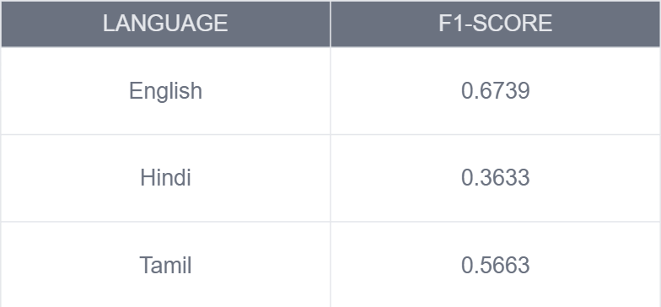
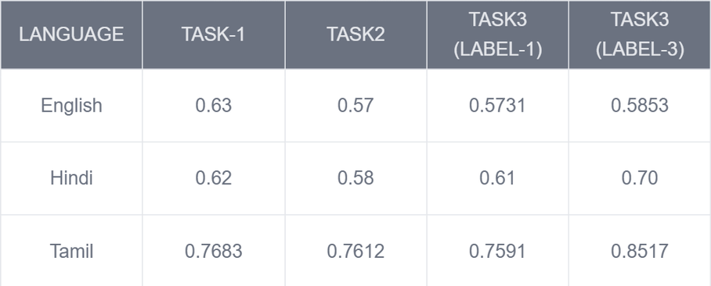
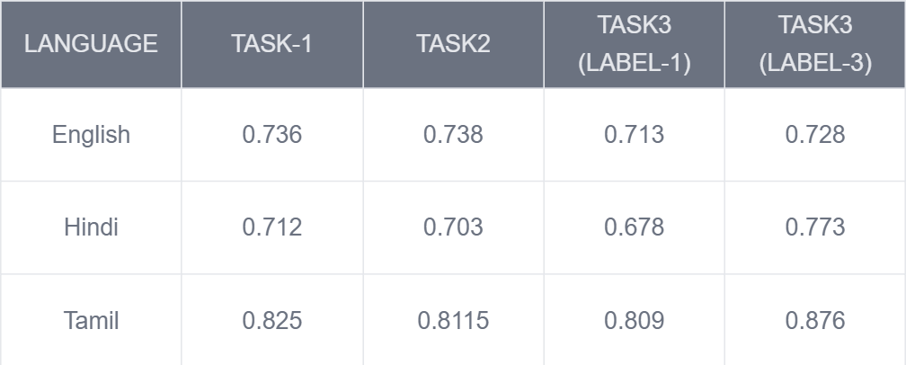
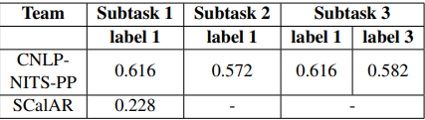
DATASET & RESULTS ANALYSIS
Dataset : Gender Abuse Dataset (uli-dataset) of Hindi, Tamil, and Indian English, utilizing a dataset of 23,000 annotated posts
Below are the results of .
Evaluation Metrics: Performance is measured using Macro F1 and accuracy
Final Results
Baseline-1Results
Baseline-2 Results
Baseline-2 Results
ICON TASK Results

Slide 10
THANK YOU

