Slide 1
Data Science
Project

Slide 2
PREDICTION OF CAR INSURANCE CLAIM

Slide 3
Introduction
The objective of this project was to develop an ML-based model that can accurately predict whether a policyholder is likely to file a car insurance claim in the next 6 months or not. The dataset used for this project contained information about the policyholder, their car, and the other information about the trigger the policyholder to file a claim such as the population density, the area cluster etc.

Slide 4
Methodology
The project involved several steps, starting with data cleaning and preprocessing to ensure that the data was in the right format for the ML model. The next step was to analyze the data and identify patterns and correlations that could be used to train the ML model. Different ML algorithms were tested, such as logistic regression, decision trees, and random forests, to identify the best algorithm for the data.

Slide 5
Data Mining
The procedure employed to derive meaningful information from a larger pool of raw data involves the extraction and identification of patterns within extensive datasets, employing a combination of machine learning, statistical methods, and database systems.

Slide 6
Data Cleaning
It is a process of transform the informal data to formal… the process of fixing or removing incorrect, corrupted, incorrectly formatted, duplicate, or incomplete data within a dataset.

Slide 7
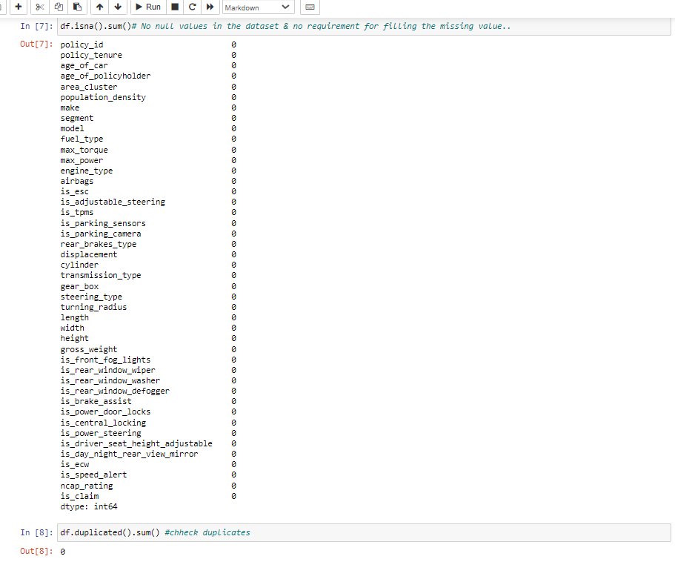
No null values in datatset & require for filling the missing value
DATA CLEANING
No duplicate present in dataset

Slide 8
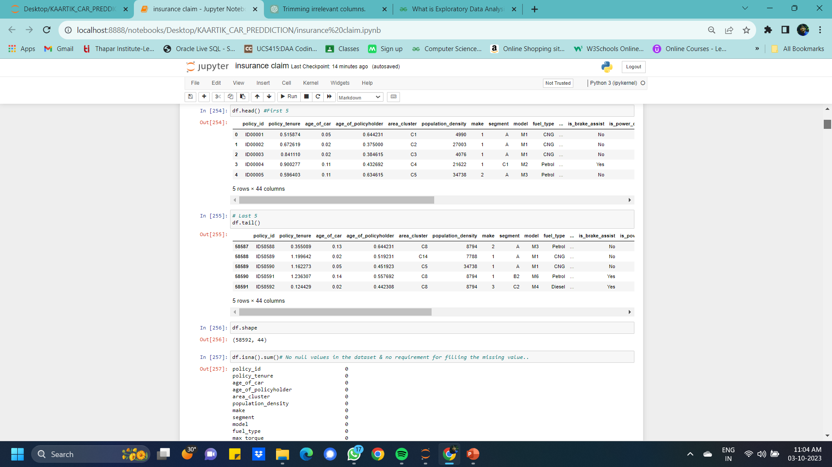
EDA – Exploratory Data Analysis
data scientists to analyze and investigate data sets and summarize their main characteristics, often employing data visualization methods.
The four types of EDA are univariate non-graphical, multivariate non- graphical, univariate graphical, and multivariate graphical.

Slide 9
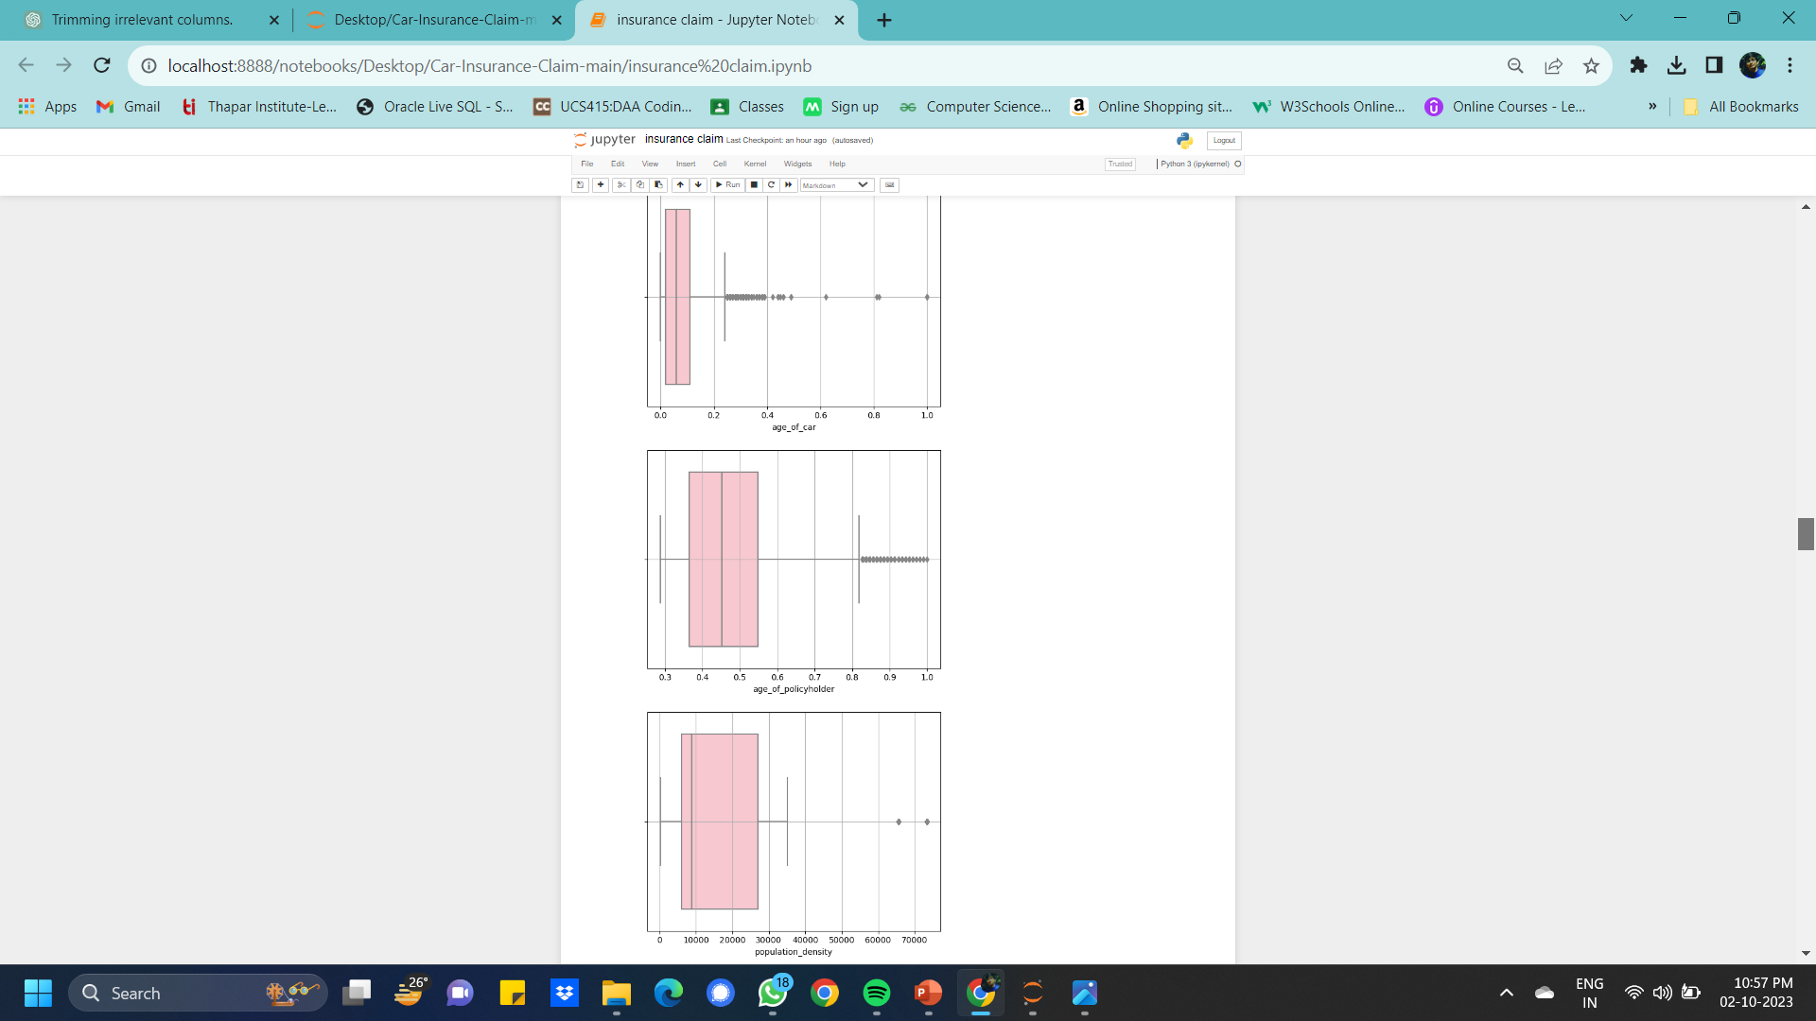
Data Exploration BOX plot
Its analyse the distribute data . To find how the data is distribute in data set.
Value of age_car the dataset lies in b/w 0.2-1 policy_holder lies b/w 0.8-1 population data lies b/w 65k-75k

Slide 10
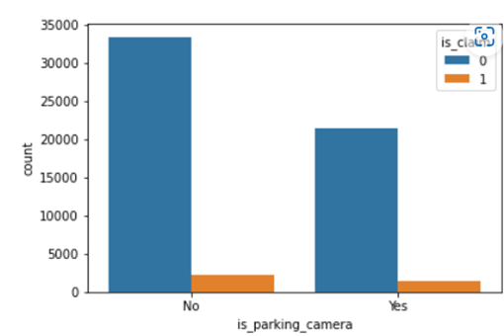
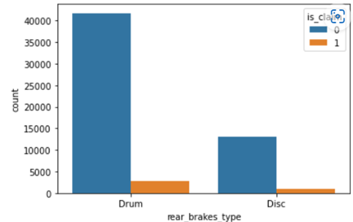
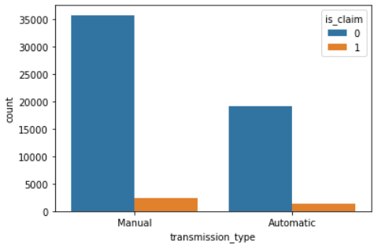
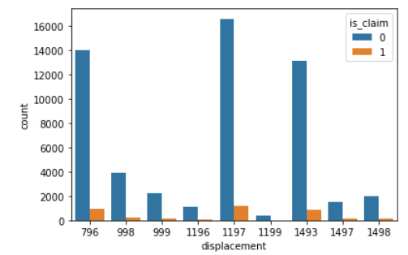
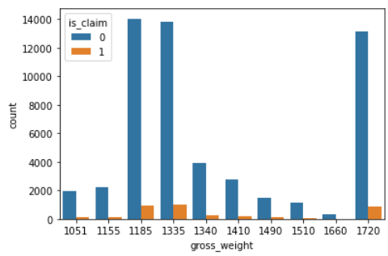
Count Plot
Countplot display the count of categorical observations in each bin in the dataset.

Slide 11
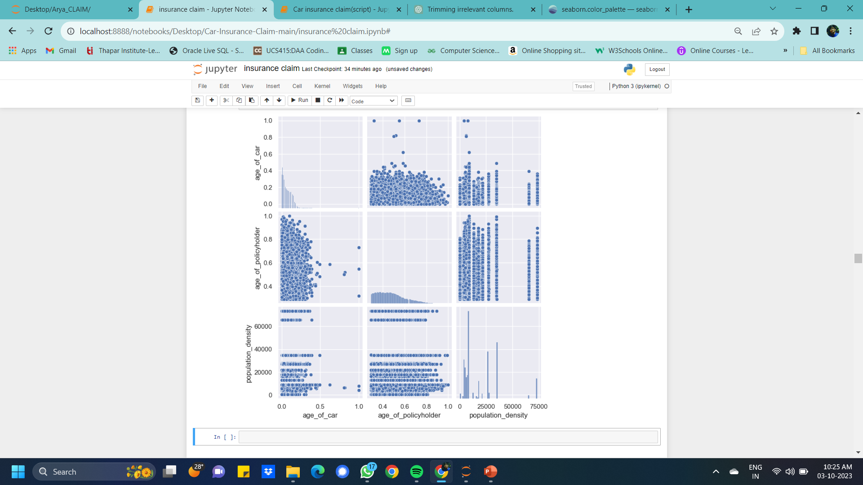
Pair Plot
plot a pairwise relationships in a dataset.
the seaborn library, offers a user-friendly and visually appealing interface for creating informative statistical graphics.

Slide 12
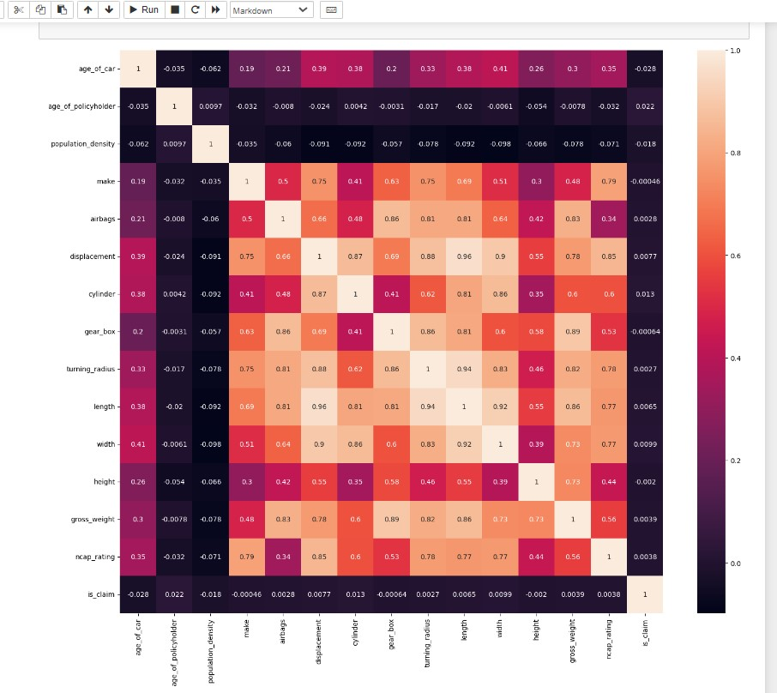
HeatMap
In the notebook rephrase the sentence machine learning algorithms to systematically analyze and graphically represent predictions related to various aspects of car insurance.
HeatMap correlation-
Plots are used to understand which variables ate related to each other and the strength of this relationship.
Correlation heatmap means a type of plot that visualize the strength of relationship[ between numerical variable.

Slide 13
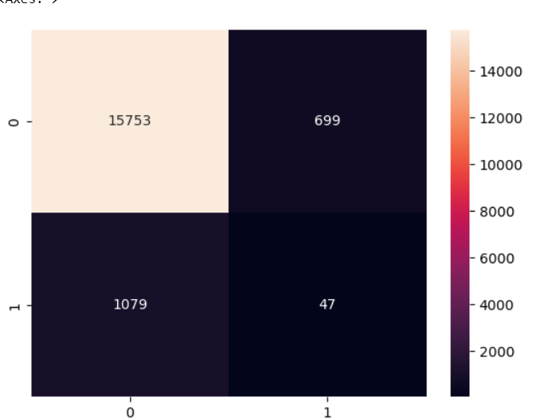
Decission Tree - non-parametric supervised learning method used for classification and regression
Library- sklearn.tree
Confusion Matrix: [[15753 699] [ 1079 47]]
Accuracy : [0.89885084]
Sensitivity : [0.93589591] Specificity : [0.06300268]
Precision: [0.95751276]
Recall: [0.93589591]
F-score: [0.94658094]

Slide 14
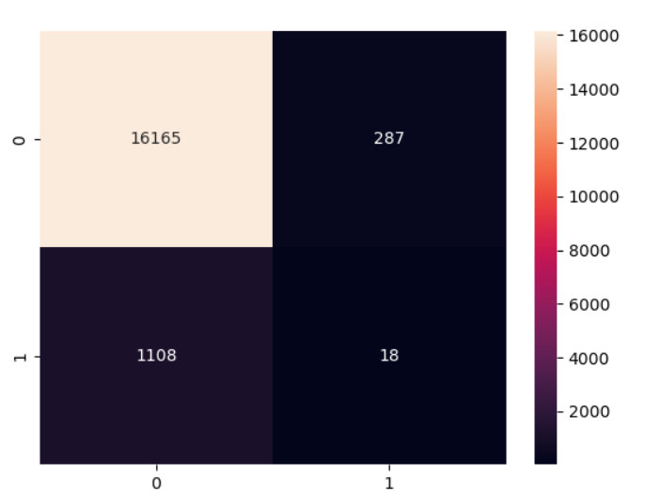
Random Forrest- both regression and classification to perform. It used to get good predction analyze easyily. higher level of accuracy in predicting outcomes compared to decision tree algorithm.
Confusion Matrix: [[16165 287] [ 1108 18]
Accuracy : [0.92063944]
Sensitivity : [0.93585364]
Specificity : [0.05901639]
Precision: [0.98255531]
Recall: [0.93585364]
F-score: [0.95863603]

Slide 15
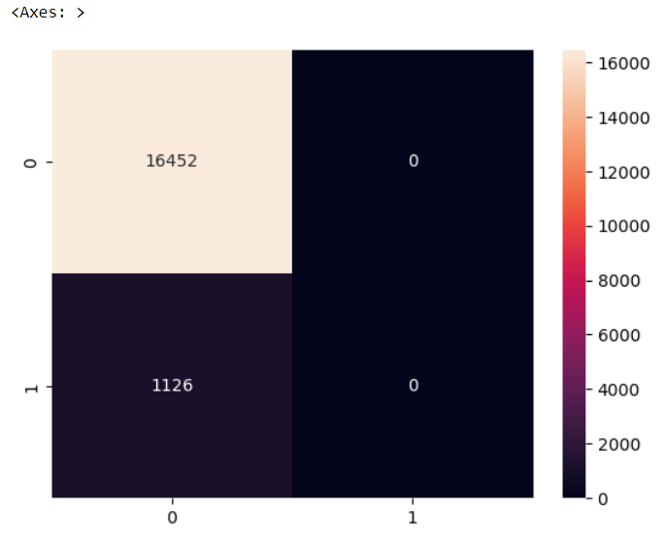
Logistic Regression- used for classification and predictive analytics. Logistic regression estimates the probability of an event occuring, such as voted or didn't vote, based on a given dataset of independent variables
Confusion Matrix: [[16452 0] [ 1126 0]]
Accuracy : [0.93594266]
Sensitivity : [0.93594266]
Specificity : [nan]
Precision: [1.]
Recall: [0.93594266]
F-score: [0.96691155]

Slide 16
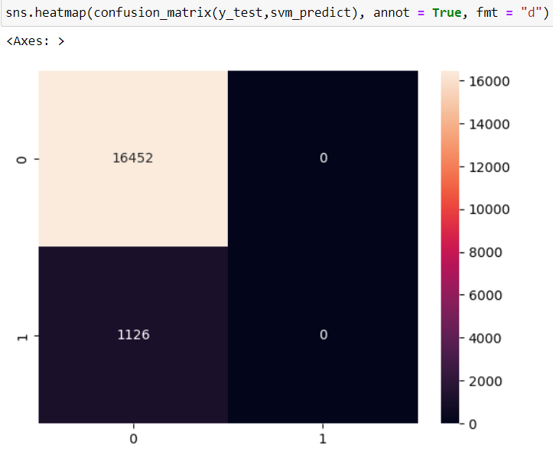
SUPPORT VECTOR MACHINE (SVM)
Confusion Matrix: [[16452 0] [ 1126 0]]
Accuracy : [0.93594266] Sensitivity : [0.93594266] Specificity : [nan] Precision: [1.]
Recall: [0.93594266]
F-score: [0.96691155]

Slide 17
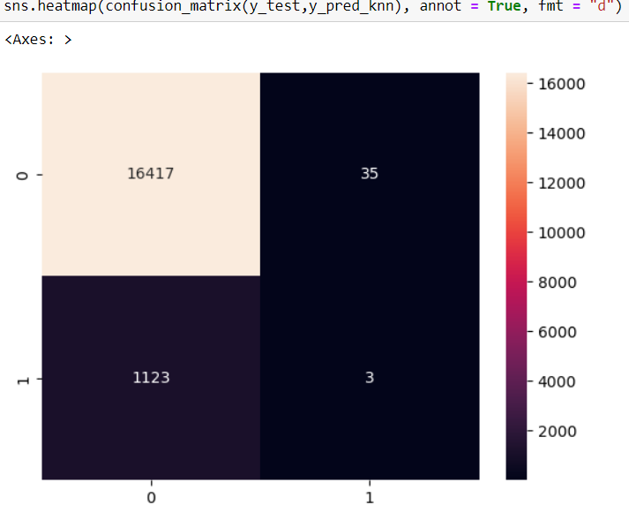
KNN-very simple algorithm used to solve classification problems. KNN stands for K-Nearest Neighbors. K is the number of neighbors in KNN. The k-nearest neighbor algorithm stores all the available data and classifies a new data point based on the similarity in training dataset.
Confusion Matrix: [[16417 35] [ 1123 3]]
Accuracy : [0.9341222] Sensitivity : [0.93597491] Specificity : [0.07894737] Precision: [0.9978726]
Recall: [0.93597491]
F-score: [0.96593316]

Slide 18
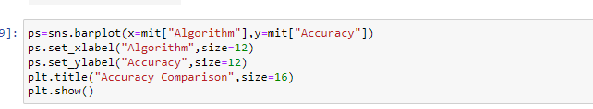
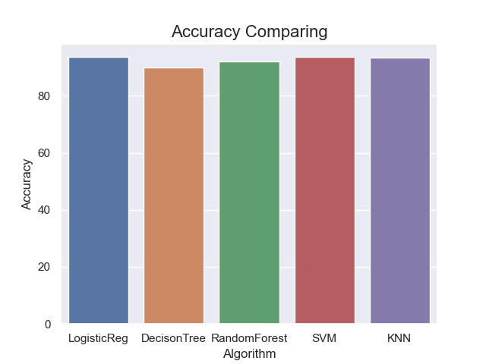
Accuracy Comparision
Accuracy is nothing but percentage of correct predictions.
It is calculated on the basis of number of correct prediction to the total Number of prediction.
In this graph we see logistic and SVM has highest accuracy in prediction..
 | Algorithm | Accuracy
0 | LogisticReg | 93.59
1 | DecisonTree | 89.80
2 | RandomForest | 92.00
3 | SVM | 93.59
4 | KNN | 93.40

Slide 19
Results
The machine learning model demonstrated an impressive accuracy score of 93%, signifying a high level of performance in classifying policyholders for potential claims in the upcoming 6 months. The model's efficacy in accurately identifying individuals likely to file claims provides valuable insights for insurance companies, enabling them to implement proactive measures and mitigate potential losses. Subsequent analysis highlighted that factors such as historical claim records and car characteristics played pivotal roles in influencing the likelihood of claims.

