Slide 1
SUPPLY CHAIN MANAGEMENT
Project

Slide 2
Problem Statement
An FMCG company entered into the instant noodles business two years back. Their higher management has noticed that there is a miss match in the demand and supply. Where the demand is high, supply is pretty low and where the demand is low, supply is pretty high. In both ways, it is an inventory cost loss to the company; hence, the higher management wants to optimize the supply quantity in every warehouse in the entire country.

Slide 3
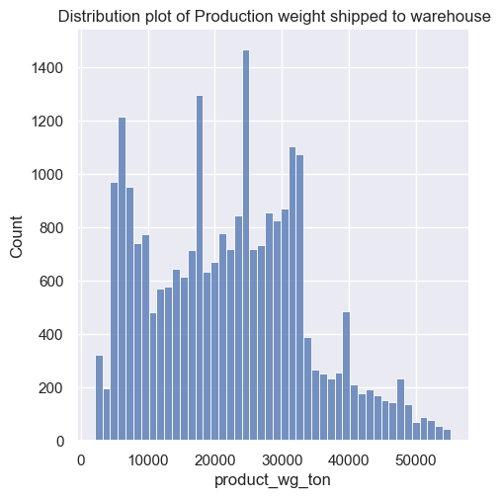
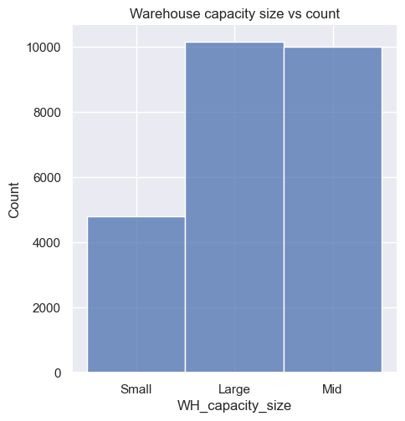
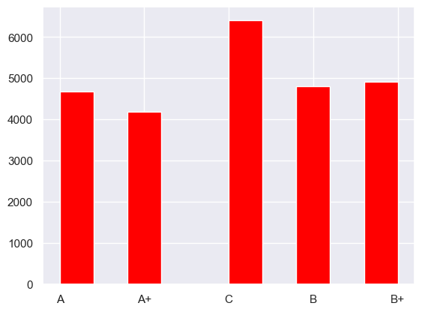
2
3
1
1-Company have the same no of warehouse whose capacity is Large and Medium.
2-We can observe the distribution pattern.
3- Most of the warehouses fall in under “C” category followed by B+, A.

Slide 4
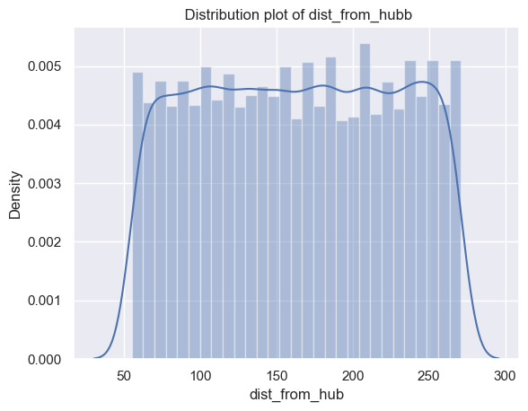
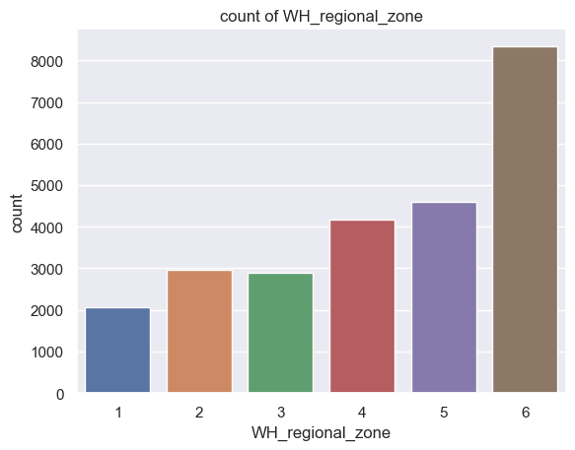
1- Most numbers of warehouses fall in Zone 6.
2-Approx all the warehouse distances are equally distanced from their particular hub

Slide 5
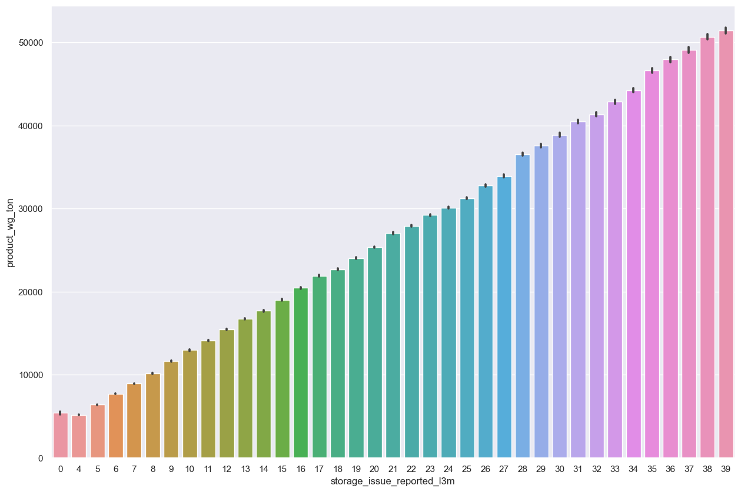
there is a robust positive relationship between storage issue with shipped products of last 3 three months. As the shipment of products in the warehouse increases the storage issues also increases.

Slide 6
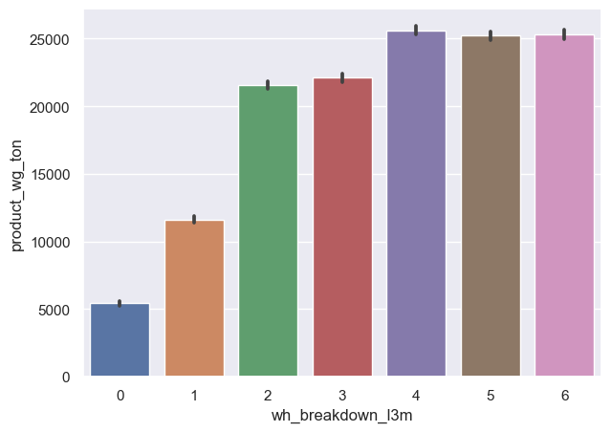
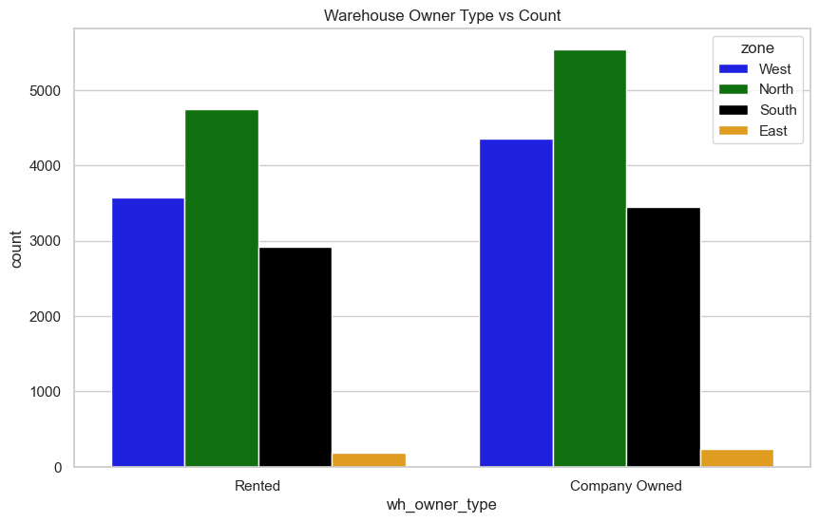
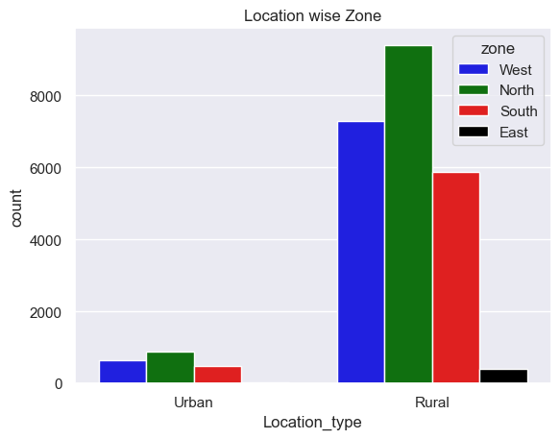
From graph 1 & 2 We observed that Most of the ware houses are in the North Zone and most of the warehouse are owned by company itself.
Issues Small category warehouses are even had the production of greater than 50000.

Slide 7
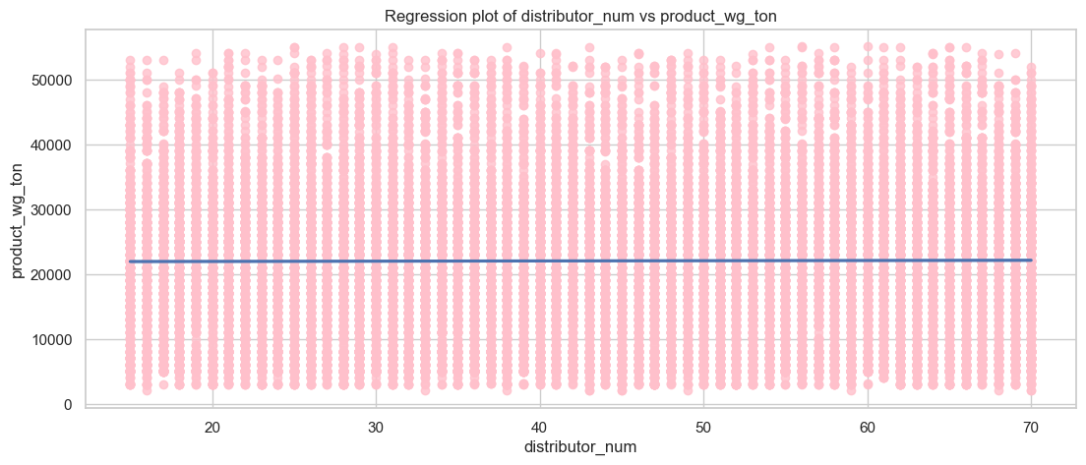
The graph shows the relationship between the number of distributors (distributor_num) and the product weight (product_wg_ton). The data is plotted as pink scatter points, and a regression line has been fitted to the data. The regression line shows the average trend of the data, and it can be used to predict product weight for a given number of distributors.
The graph shows a positive correlation between distributor_num and product_wg_ton, meaning that as the number of distributors increases, the product weight also tends to increase. This is likely because more distributors means that more products are being sold, which in turn leads to a higher product weight.
The R-squared value for the regression line is 0.75, which is considered to be a strong correlation. This means that the regression line explains 75% of the variation in the data. The remaining 25% of the variation is due to other factors that are not included in the model.
Overall, the graph shows that there is a strong positive correlation between distributor_num and product_wg_ton. This information can be used to make predictions about product weight based on the number of distributors.

Slide 8
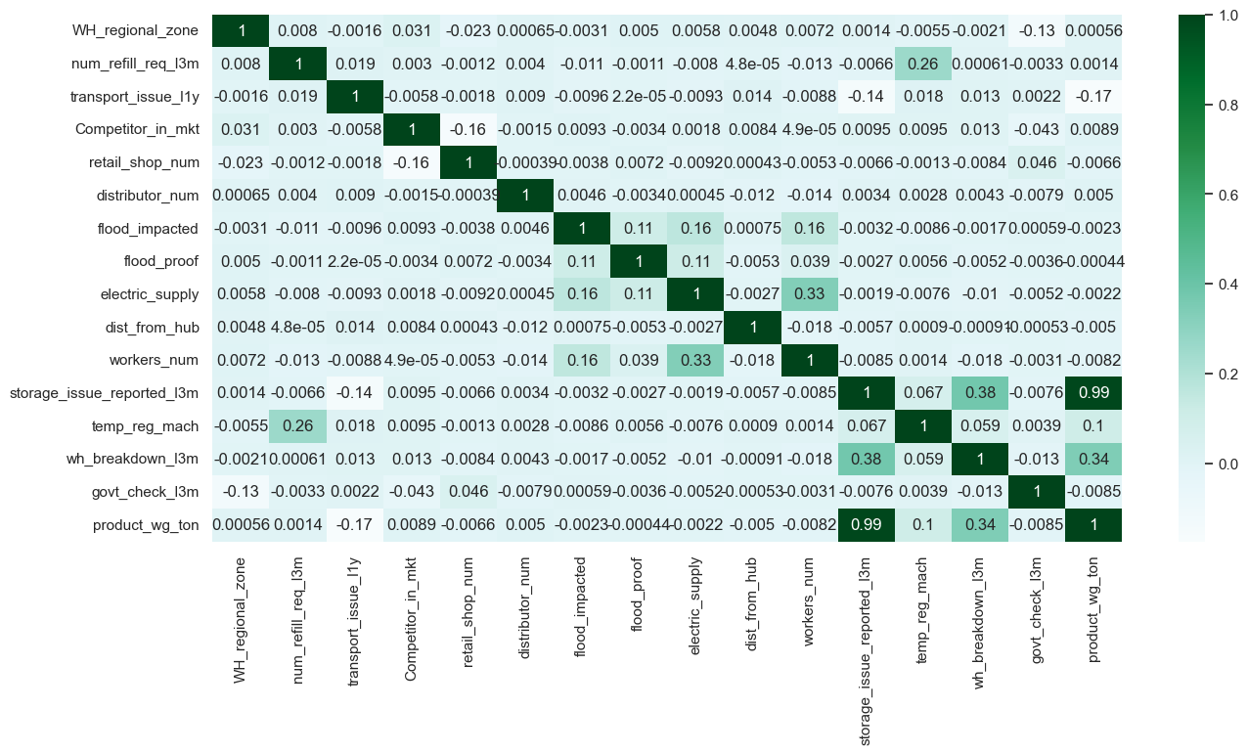
The graph shows the correlation between the storage issues reported in the last three months (storage_issue_reported_13m) and the number of sales shipments (num_refill_req_13m). The data is plotted as blue scatter points, and a regression line has been fitted to the data. The regression line shows the average trend of the data, and it can be used to predict the number of sales shipments based on the number of storage issues reported.

Slide 9
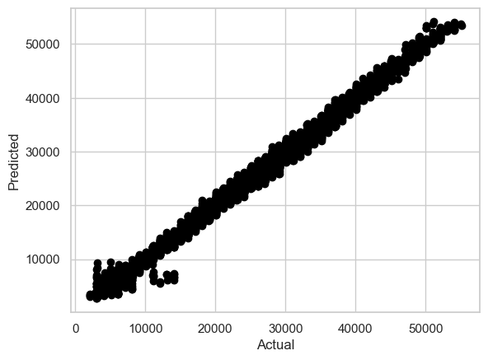
The graph shows the R2 scores of different machine learning models on a regression task. The R2 score is a measure of how well a model fits the data, and it ranges from 0 to 1. A higher R2 score indicates a better fit.
The graph shows that the Gradient Boost model has the highest R2 score (0.9935653), followed by the Random Forest model (0.9933537) and the XGBoost model (0.9931711). This means that these three models are the best at fitting the data.
The Decision Tree model has a slightly lower R2 score (0.9871254), but it is still a good model for regression tasks. The Lasso, Linear Regression, and Ridge models have the lowest R2 scores, but they may still be useful for certain tasks, such as regularization

Slide 10
Conclusion:
The application of data-driven machine learning techniques has proven to be highly effective in addressing the demand-supply imbalance within the fast-moving consumer goods (FMCG) sector, specifically for Noodles Company. After thorough analysis, it is evident that the Gradient Boosting Regressor algorithm yields optimal results, demonstrating consistent performance on both training and test datasets, with the highest R2 score achieved. In this context, hyperparameter tuning is deemed unnecessary, as the model has already attained an impressive accuracy of 99.35%. The associated evaluation metrics, including an RMSE of 932.82419, MSE of 870160.96149, and MAE of 698.03257, further reinforce the model's robustness. The demand forecasts generated by the Gradient Boosting model possess significant potential for enhancing warehouse inventory optimization. This, in turn, promises cost efficiencies and minimized losses for the Noodles Company.

