Slide 1
Data Science
Project

Slide 2
"Comprehensive Water Quality Assessment and Potability Prediction using Multi-parameter Analysis"

Slide 3
Introduction
In this project, I will analyse and manipulate a dataset. Access to safe drinking-water is essential to health, a basic human right and a component of effective policy for health protection. This is important as a health and development issue at a national, regional and local level. In some regions, it has been shown that investments in water supply and sanitation can yield a net economic benefit, since the reductions in adverse health effects and health care costs outweigh the costs of undertaking the interventions. The aim of the project is to classify water quality.

Slide 4
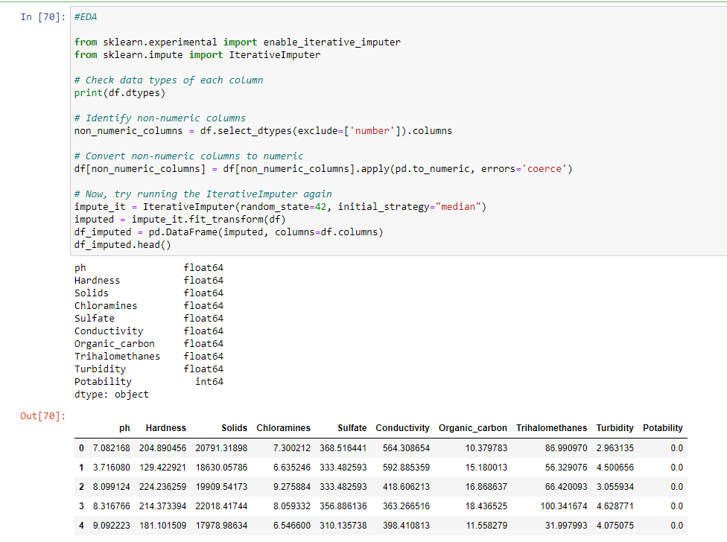
Data scientists to analyse and investigate data sets and summarize their main characteristics, often employing data visualization methods.
The four types of EDA are univariate non-graphical, multivariate non- graphical, univariate graphical, and multivariate graphical.
EDA – Exploratory Data Analysis
a. Handling missing values
In order to handle missing values I decide to use a multivariate approach in which more than one feature is taken into consideration. There are two ways to impute missing values considering the multivariate approach. Using KNN Imputer or Iterative Imputer classes. I follow the second method. This model actually builds a regression model with features and one target and then makes predictions on any places where there are missing values. And those predictions are the imputed values.

Slide 5
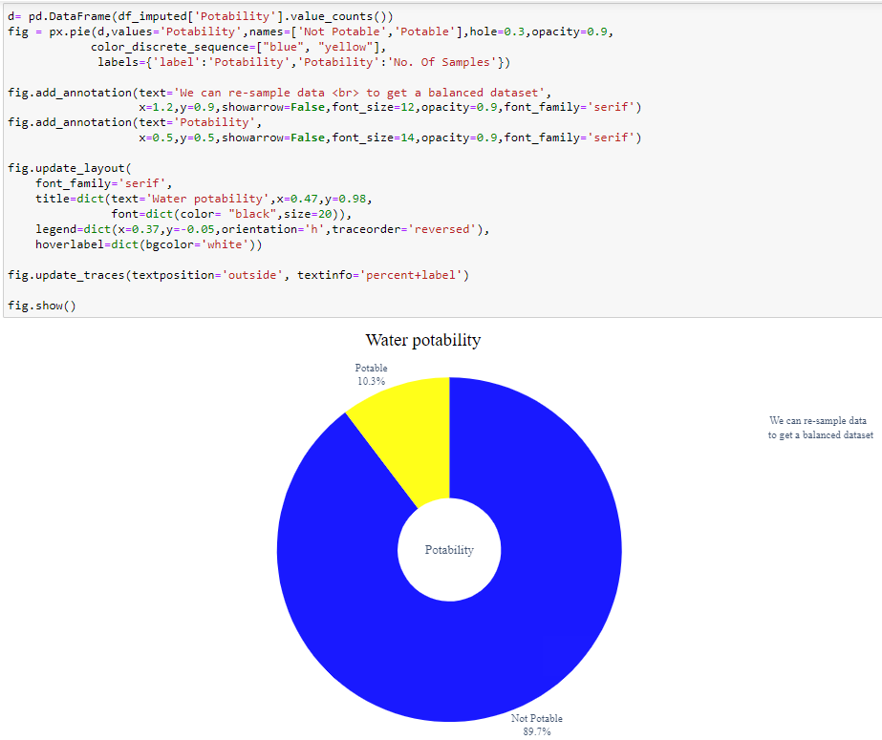
B. Analysis of target distribution (potability): dataset rebalancing?
This is a classification problem with 2 classes. The dataset, however, is not balanced. So, I try to rebalance it while doing train test split by oversampling the minority class only on the training set.
The pie chart shows that the dataset is highly imbalanced, with the majority of the samples being not potable. This can be problematic for machine learning models, as they may be biased towards the majority class. One way to address this imbalance is to use oversampling or undersampling techniques to create a more balanced dataset.

Slide 6
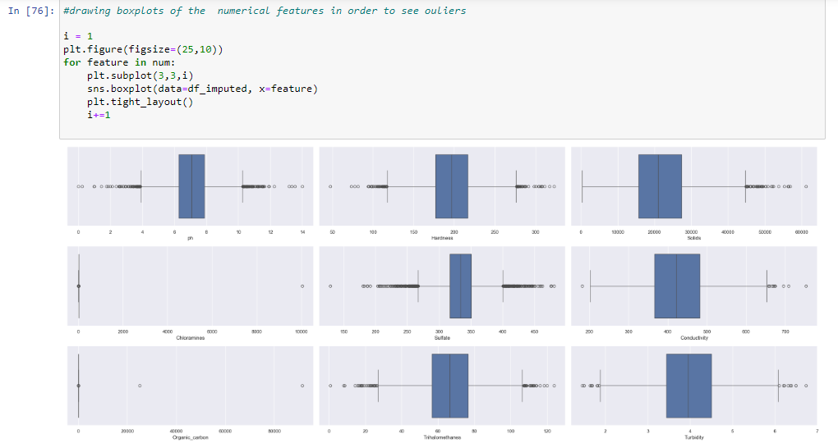
c. Outliers detection
'The x-axis of the graph shows the four variables (ph, Hardness, Solids, and Conductivity).\nThe y-axis of the graph shows the values of the variables.\nEach box represents the distribution of a variable at a particular location.\nThe horizontal line inside the box represents the median value of the variable.\nThe boxes extend from the first quartile (Q1) to the third quartile (Q3) of the data.\nThe whiskers extend from the boxes to the most extreme values that are still within 1.5 IQRs of the median.\nAny values that fall outside of the whiskers are considered outliers and are plotted as individual points.'

Slide 7
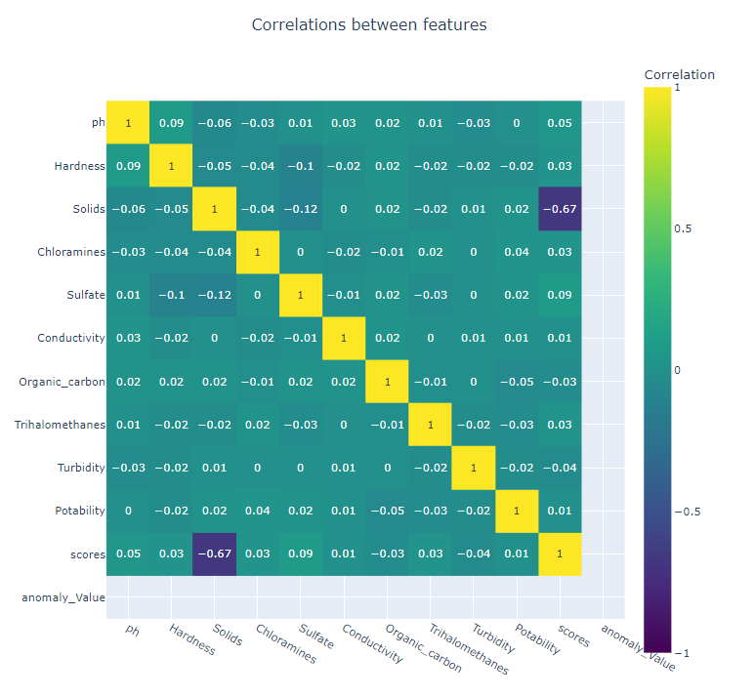
"The correlation matrix is being calculated using the Pearson correlation coefficient, which measures the strength and direction of the linear relationship between two variables. Values closer to 1 indicate a strong positive correlation, meaning that as one variable increases, the other variable also increases. Values closer to -1 indicate a strong negative correlation, meaning that as one variable increases, the other variable decreases. Values close to 0 indicate no correlation."
"We don't have high linear correlation between features. I take a look at the distributions" = in the dataset do not exhibit a strong linear relationship with each other. This means that changes in one feature do not necessarily lead to predictable changes in another feature.

Slide 8
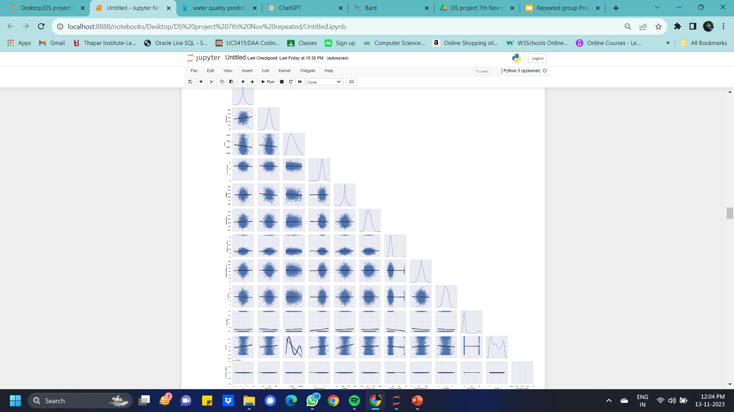
Every features follow a bell distribution but we have confirmation that there aren't strong linear correlations.
Graph Interpretation:
The graph shows the pairwise relationships between the variables in the DataFrame df_imputed. The scatter plots in the off-diagonal plots show the relationship between two variables, while the KDE plots on the diagonal show the distribution of each variable.
Based on the graph, it appears that all of the features follow a bell distribution, which suggests that the data is approximately normally distributed. However, the scatter plots do not show any strong linear correlations between the variables. This indicates that the features are not highly correlated with each other.
Overall, the pairplot provides a comprehensive overview of the relationships between the variables in the DataFrame df_imputed. It is a useful tool for exploring the data and identifying potential relationships between variables.

Slide 9
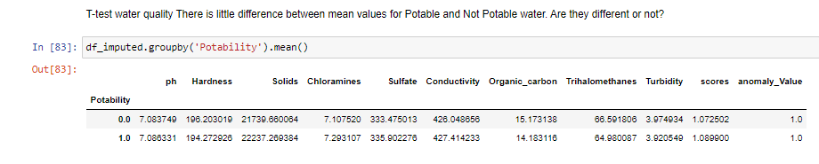
I use t-test to check if the mean values of Potable and Not Potable water are significantly different. Null Hypothesis: There is no significant difference between the two means. Alternative Hypothesis: There is difference between the two means.

Slide 10
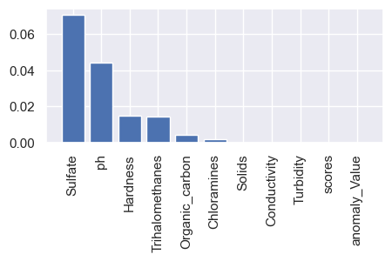
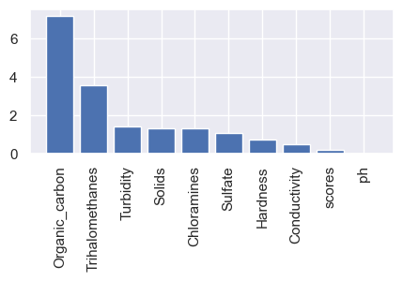
The results are very important in terms of the importance of the terms, especially between two models for a very specific task. This indicates a high level of interdependence between the terms, while the model does not provide any type of information. Considering the results, the correlation matrix may be missing important information. This indicates that the term-term relationships are likely to be the matter for this type of problem.

Slide 11
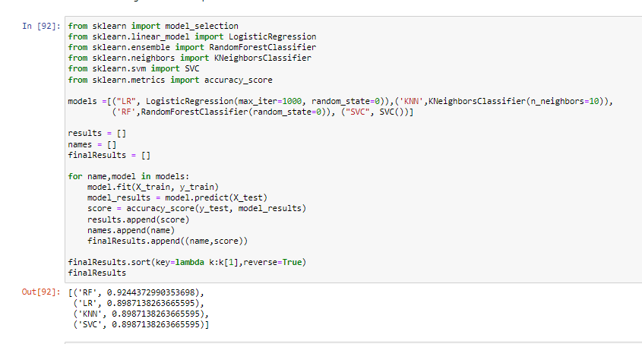
Is a great method to find out the baseline models for our data. It's quite easy and takes really less time. I perform a spot check with Stratified KFold . The models to be spotted will be: Logistic Regression, Random Forest Classifier, KNN and SVC. I decide to use only one evaluation metric at this stage; for simplicity, I choose accuracy. I will then use the other metrics chosen before for evaluating the performance of the models.

Slide 12
Conclusions
Accuracy =92%. The current feature set appears to be insufficient for the model to effectively discriminate between the two classes, hindering its performance. Therefore, collecting additional data is a viable option. However, based on the conducted analysis, utilizing the SVC model with a reduced set of the most relevant features could be a more effective approach.

