Slide 1
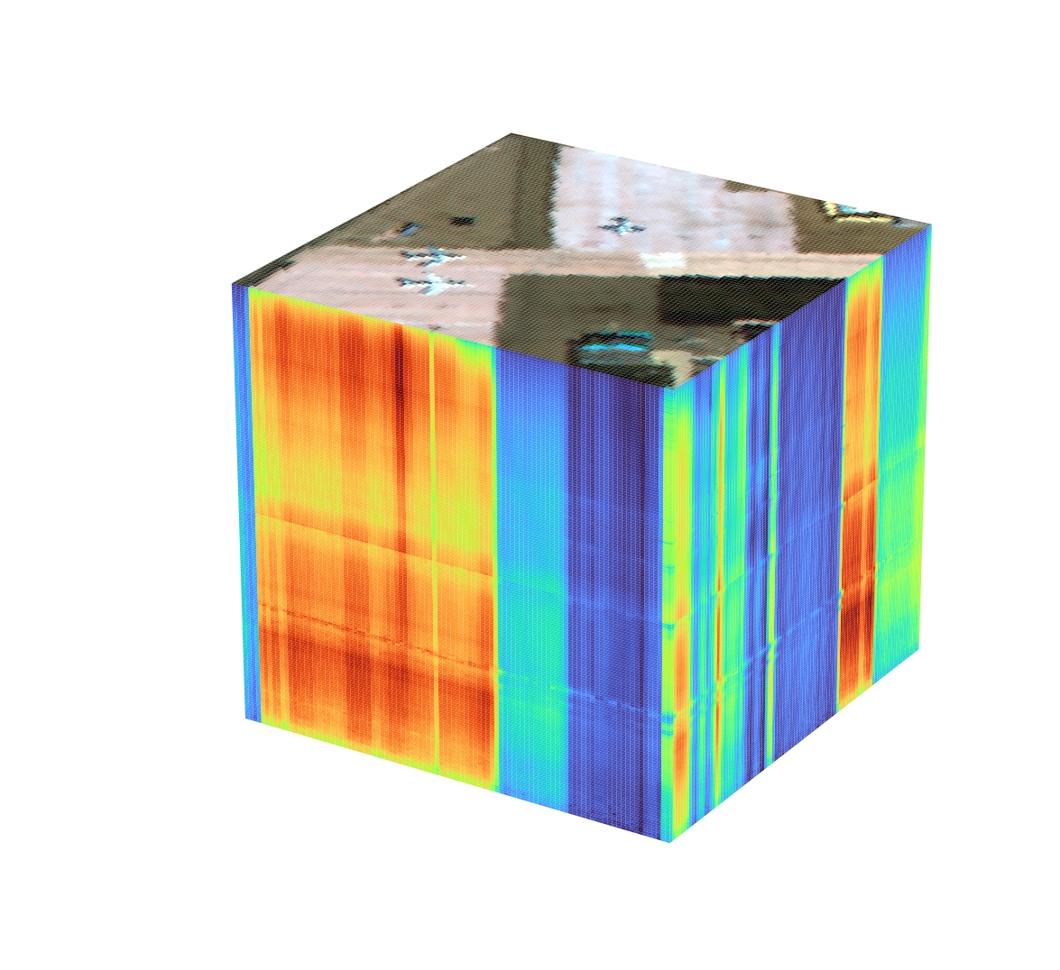
WACV 2026 · paper implementation project
DMS2F-HAD
A Dual-branch Mamba-based Spatial–Spectral Fusion Network for Hyperspectral Anomaly Detection
Paper: A. Pant, L. Tamang, T.-K. Lee, S. Aryal — Deakin University
This project: compact PyTorch re-implementation, trained and evaluated on four benchmark scenes
San Diego scene: 100 × 100 pixels × 189 spectral bands
Notes:
This project re-implements DMS2F-HAD, a WACV 2026 paper on hyperspectral anomaly detection. I explain what hyperspectral images and anomaly detection are, how the method works, the datasets, and the results of my own runs compared with the paper.

Slide 2
Roadmap
1
2
3
4
5
Hyperspectral images
Anomaly detection
DMS2F-HAD method
Data & setup
Results
What the data looks like: a cube of spectra
The HAD problem, how it is evaluated, families of methods
Mamba, dual spatial/spectral branches, gated fusion
Benchmark scenes, training setup, our code
AUC, anomaly maps, ROC, ablation, takeaways
Notes:
The talk follows five steps: data, problem, method, experimental setup, results.

Slide 3
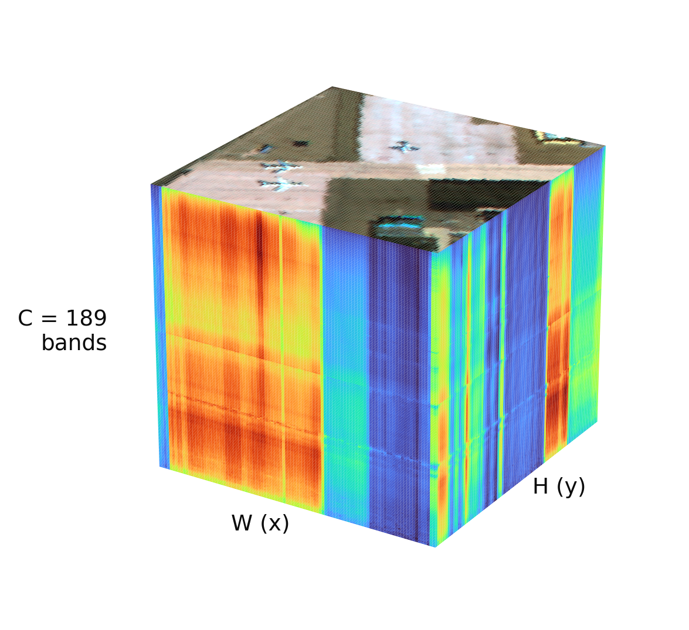
A hyperspectral image is a cube: every pixel is a spectrum
RGB camera: 3 broad bands. Hyperspectral sensor: 100–200+ narrow, contiguous bands (AVIRIS: 224 bands, 400–2500 nm, ~10 nm each).
The data is an H × W × C cube; each pixel is a C-dimensional spectral signature.
Materials (metal, paint, vegetation, soil, rock) reflect light differently at each wavelength, so the spectrum works like a material fingerprint.
Hard parts: hundreds of correlated bands, sensor noise, mixed pixels, and almost no labels.
189
10 000
~1.3 %
bands per pixel
pixels (100 × 100)
pixels are anomalies
Numbers for the San Diego scene used in this project.
Notes:
A normal camera records 3 broad colour bands. A hyperspectral sensor such as AVIRIS records hundreds of narrow contiguous bands from visible to short-wave infrared. So each pixel is a full spectrum, and the image is a 3-D cube H x W x C. Different materials have different spectral fingerprints.

Slide 4
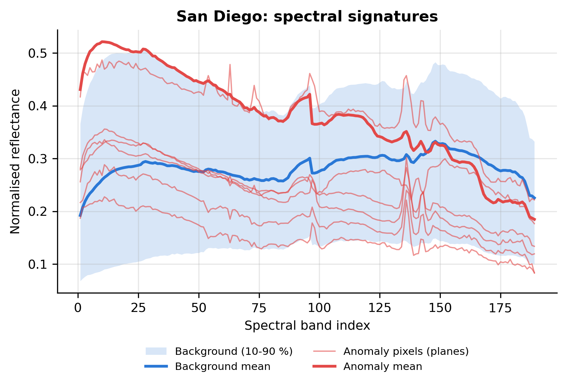
Anomaly detection (HAD): find pixels that don't fit
Goal: give every pixel an anomaly score → an anomaly map.
Unsupervised: no target spectra and no labels; the background model is learned from the image itself.
Anomalies are small, rare (often < 1 % of pixels) and spectrally different from their surroundings: planes, vehicles, rocks, boats.
Output is thresholded into detections and compared with a ground-truth mask.
Where HAD is used
Defence & surveillance
Search and rescue
Mineral exploration
Environmental monitoring
Precision agriculture
Notes:
Hyperspectral anomaly detection gives every pixel a score for how different it is from the background. It is unsupervised: we have no target spectra and no labels. In San Diego the planes are rare and their spectra differ from the apron and roads, which is exactly what HAD exploits.

Slide 5
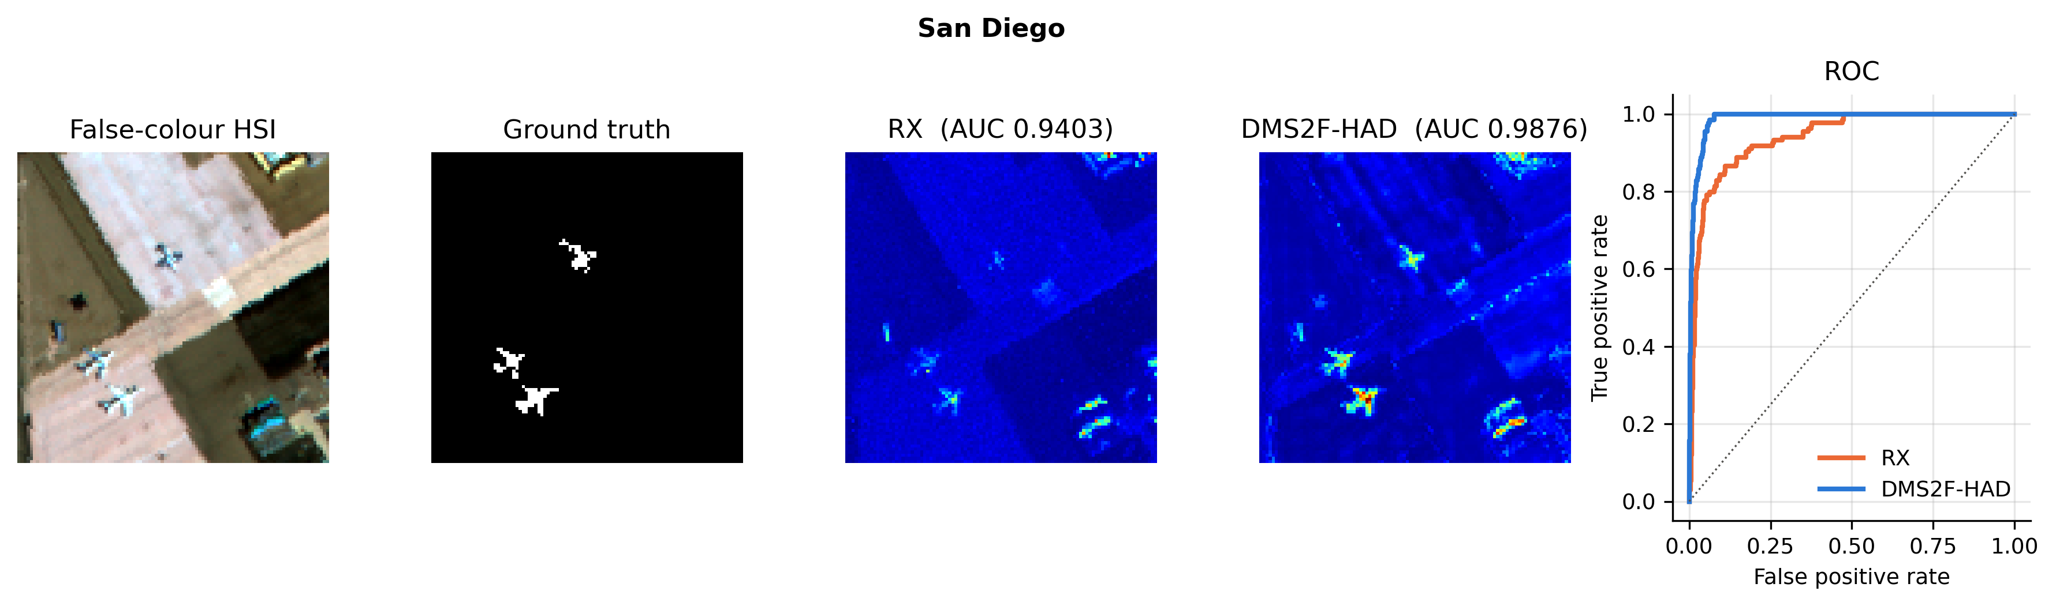
How a HAD method is evaluated
1
Anomaly map
2
ROC curve & AUC
3
Box plots
Scores shown with a jet colour map: blue = background, red = anomaly. Qualitative check against the ground truth.
Sweep the threshold: probability of detection vs. false-alarm rate. AUC = 1 is perfect, 0.5 is random guessing.
Score distributions of anomaly vs. background pixels. A large gap with little overlap means fewer false alarms.
Example from our run on San Diego: false-colour image, ground truth, RX and DMS2F-HAD anomaly maps, ROC.
Notes:
Three standard ways to judge a detector. The colour anomaly map is the qualitative view. The ROC curve plots detection rate against false-alarm rate as the threshold moves; AUC summarises it in one number. Box plots show how well anomaly scores are separated from background scores.

Slide 6
Four families of HAD methods
1
2
3
4
Statistical
Representation
Deep learning
Mamba (SSM)
RX (Reed–Xiaoli): Mahalanobis distance to a Gaussian background.
Background dictionary, low-rank + sparse decomposition.
Autoencoders, GANs, CNNs, Transformers (AUTO-AD, LREN, RGAE, TDD, GT-HAD).
MMR-HAD, DMS2F-HAD: selective state-space sequence models.
+ Fast, no training
+ Better separation of outliers
+ Learn non-linear backgrounds
+ Long-range context in linear time; small models
− Gaussian assumption fails in cluttered scenes → false alarms
− Sensitive to noise and parameters; slow
− CNN: local view. Transformer: O(L²) cost, many parameters
− Young research area
Notes:
HAD research moved from statistics to deep learning. RX is the classic baseline. Representation methods learn a background dictionary. Deep models learn non-linear backgrounds but CNNs see only local context and Transformers are expensive. Mamba-based state-space models are the newest family, and DMS2F-HAD belongs to it.

Slide 7
Why Mamba? Long-range modelling in linear time
hₜ = Āₜ · hₜ₋₁ + B̄ₜ · xₜ
yₜ = Cₜ · hₜ + D · xₜ
State-space model: a hidden state h carries information along the sequence.
Selective (S6): Δ, B and C are computed from the input, so the model decides what to keep and what to forget.
Cost: O(L) in sequence length L, versus O(L²) for self-attention.
In DMS2F-HAD: a 16 × 16 patch = 256 pixel tokens (spatial) and 7 band groups (spectral).
Notes:
A state-space model keeps a hidden state h and updates it at every position of the sequence. Mamba makes the step size and the B and C matrices depend on the input, so it can choose what to remember. The cost grows linearly with sequence length, while self-attention grows quadratically. A 16x16 patch is a sequence of 256 pixel tokens.

Slide 8
DMS2F-HAD at a glance
Train an autoencoder on patches of the image itself (no labels).
Background dominates the data, so it is reconstructed well; rare anomalies are not.
Spatial branch
3×3 + 5×5 conv →
256 pixel tokens → Mamba
HSI patch
16×16×C
Random mask
(training only)
In-head
1×1 conv → 64
Gated fusion
G·Fspa + (1−G)·Fspe
SS decoder ×2
+ out-head
Spectral branch
1-D band convs → 7 band
groups (16 bands) → Mamba
0.65 M parameters in our build (paper: 0.64 M).
Linear-time Mamba blocks instead of attention.
Anomaly score R(i, j) = ‖ original − reconstruction ‖₂
Notes:
The image is cut into overlapping 16x16 patches; random rectangles are masked during training. A 1x1 convolution reduces the bands to 64 features. The spatial branch looks at texture across the 256 pixels; the spectral branch looks at correlations between bands. A learned gate mixes them pixel by pixel, a decoder rebuilds the patch, and the reconstruction error is the anomaly score.

Slide 9
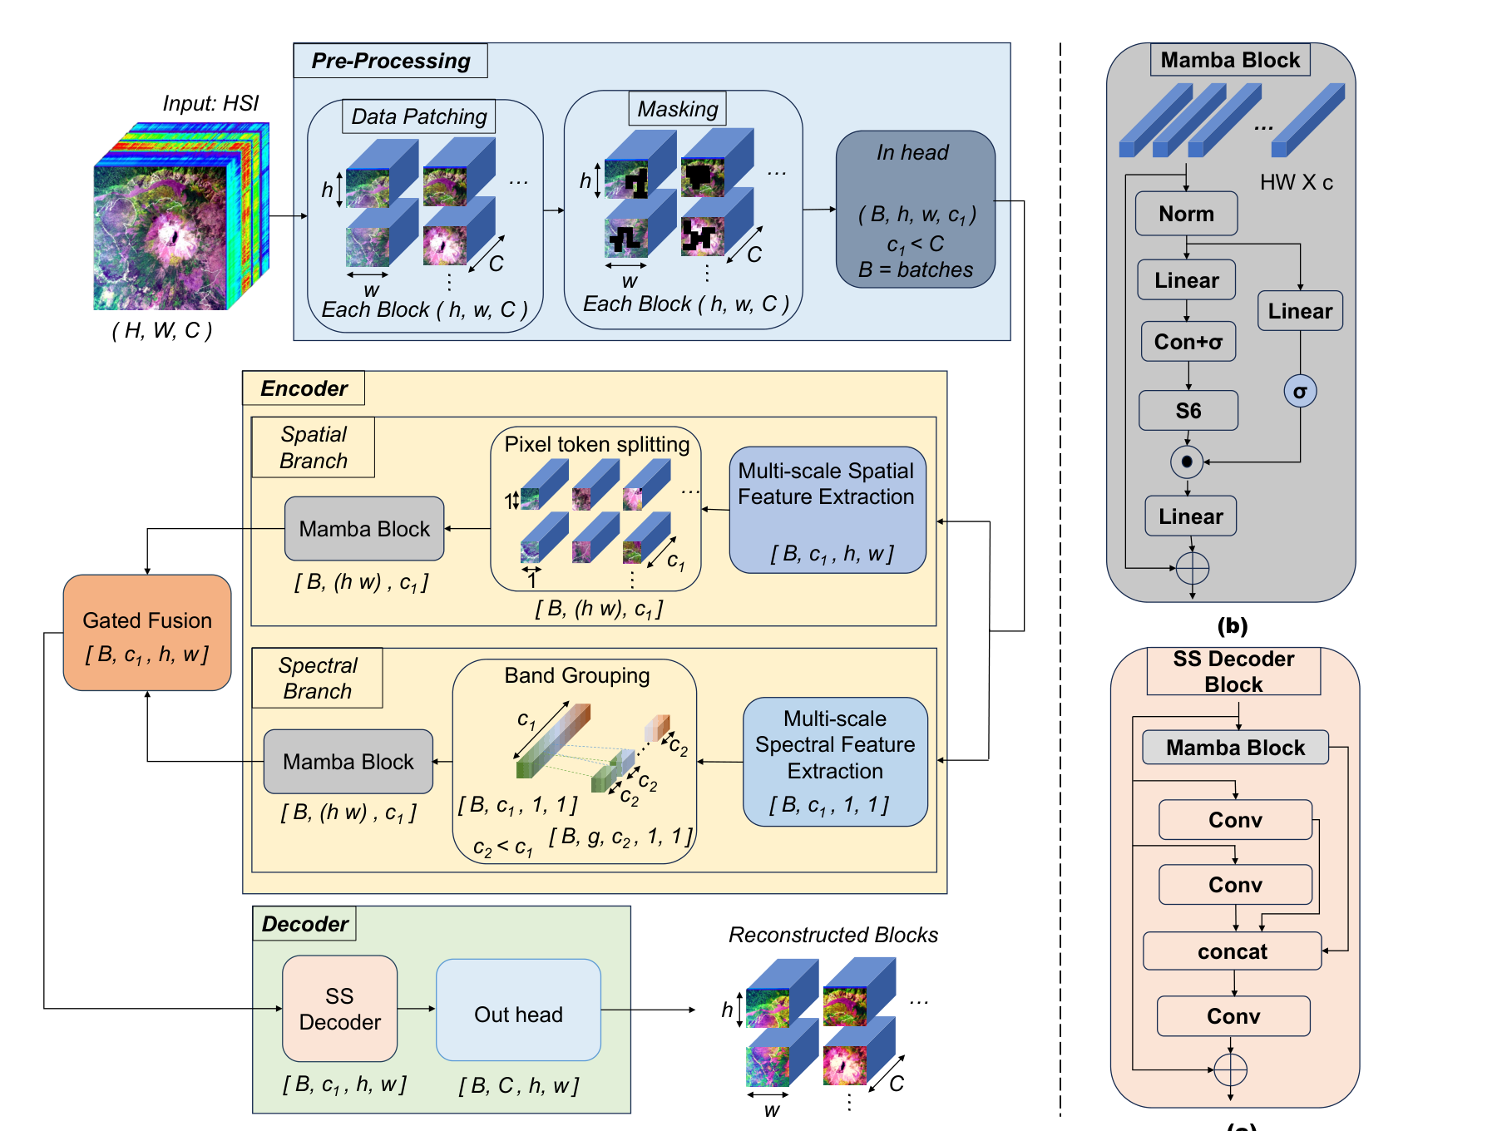
Architecture as drawn in the paper
Figure 2 of Pant et al., “DMS2F-HAD”, WACV 2026: (a) overall framework, (b) Mamba block, (c) SS decoder block.
Notes:
The original architecture figure from the paper, for reference: (a) the full network, (b) the Mamba block, (c) the spatial-spectral decoder block.

Slide 10
The four building blocks
1
Spatial branch
2
Spectral branch
Parallel 3×3 and 5×5 convolutions capture multi-scale texture. The 16×16 map is flattened row-major into 256 tokens and a Mamba block gives every pixel a global receptive field.
Two 1-D convolutions along the spectrum (kernel 7 and 3). The 64-d spectrum is split into g = 7 overlapping groups of c₂ = 16 bands (stride k = 8); Mamba runs over the groups.
3
Adaptive gated fusion
4
SS decoder + detection
G = σ(Conv₁ₓ₁([F_spa, F_spe])) gives one weight per pixel. F_fusion = Proj(G ⊙ F_spa + (1 − G) ⊙ F_spe): texture where it helps, spectra where the scene is smooth.
Two blocks of Mamba ‖ 3×3 conv ‖ 5×5 conv → concat → 1×1 conv, then a 1×1 out-head back to C bands. Overlapping patches are averaged; the L2 residual is the score.
Notes:
Four pieces. The spatial branch sees each patch as 256 pixel tokens. The spectral branch splits the 64 features into 7 overlapping groups of 16 so Mamba can model band correlations cheaply. The gate is a 1x1 convolution with a sigmoid giving one weight per pixel. The decoder mixes a global Mamba path with local 3x3 and 5x5 convolutions.

Slide 11
Benchmark datasets in the paper (14 scenes)
Dataset | Size (H×W×C) | Res. (m) | Anomaly
CRI | 400×400×46 | – | Rocks
Salinas | 512×217×224 | 3.7 | Rooftops
San Diego | 100×100×189 | 3.5 | Planes
Bay Champagne | 100×100×188 | 4.4 | Watercraft
Abu-urban-2 | 100×100×207 | 17.2 | Buildings
Abu-urban-3 | 100×100×191 | 3.5 | Buildings
Abu-urban-4 | 100×100×205 | 7.1 | Houses
Dataset | Size (H×W×C) | Res. (m) | Anomaly
Abu-urban-5 | 100×100×205 | 7.1 | Houses
AVIRIS-1 | 100×100×186* | 3.5 | Planes
AVIRIS-2 | 128×128×189 | 3.5 | Plane
Cat Island | 150×150×188 | 17.2 | Plane
Gulfport | 100×100×191 | 3.4 | Planes
Pavia University | 224×423×102 | 1.3 | Vehicles
Texas Coast | 100×100×204 | 17.2 | Buildings
Highlighted = provided with the official code and used in this project.
All scenes captured by AVIRIS except CRI (Nuance CRI sensor). *The released AVIRIS-1 file has 189 bands; the paper lists 186.
Notes:
The paper evaluates on 14 public scenes, all AVIRIS except CRI. The official code release ships four of them: CRI, AVIRIS-1, AVIRIS-2 and San Diego, which are the ones I used (highlighted).

Slide 12
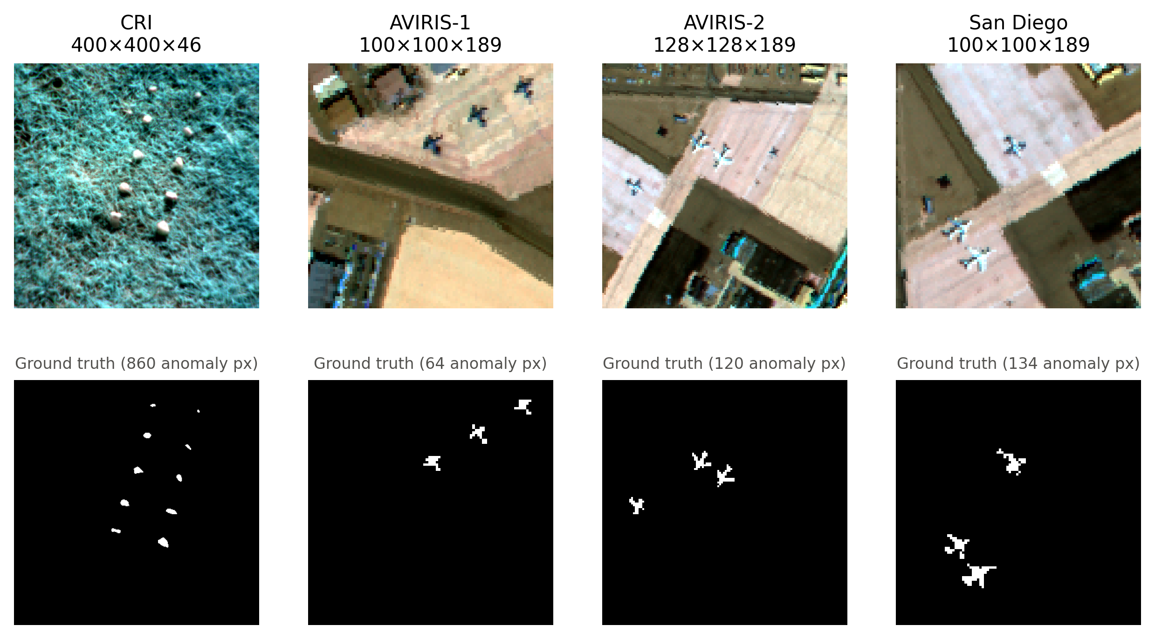
The four scenes used in this project
Top: false-colour composites (three bands). Bottom: ground-truth anomaly masks (white = anomaly).
Notes:
The four scenes: CRI is a large grassland scene with ten rocks; the three AVIRIS scenes are airport images with planes. White pixels in the ground truth are anomalies.

Slide 13
Implementation and training setup
Setting | Value
Patch size / stride | 16 × 16 / 8
Embedding c₁ | 64
Band group c₂ / stride k | 16 / 8 (7 groups)
Mamba state size | 16
Optimiser | Adam, lr 5e-4, weight decay 1e-4
Epochs / batch | 100 / 32
Loss | MSE + 0.1 · L1 (official code)
Masking | p = 0.5, random 2–5 px rectangle
Code: method in ≈ 440 lines of Python
model.py
Mamba in pure PyTorch + DMS2F-HAD network
utils.py
data loading, patching, RX baseline, metrics
train.py
unsupervised training + anomaly map per image
make_figures.py
paper-style PNG figures and tables
presentation/make_ppt.py
this slide deck
No mamba_ssm needed: the selective scan runs as an exact two-level chunked scan (16 + 16 steps instead of 256), so it runs on Windows/CPU/any GPU.
Parameters: 0.647 M (AVIRIS-1, AVIRIS-2, San Diego)
Notes:
The official code depends on the mamba_ssm CUDA kernels, which do not build on Windows. I wrote the Mamba selective scan in plain PyTorch with an exact two-level chunked scan, and kept the paper's training settings. Each image is trained on its own, without labels; the ground truth is only used to compute AUC.

Slide 14
Results: detection accuracy (AUC)
0.9795
0.9821
0.9150
0.21 s
mean AUC, ours (best epoch)
mean AUC, paper
mean AUC, RX baseline
mean inference per image
Dataset | RX | DMS2F-HAD ours (best epoch) | DMS2F-HAD ours (epoch 100) | DMS2F-HAD paper | Inference (s)
CRI | 0.9990 | running | running | 0.9999 | –
AVIRIS-1 | 0.8866 | 0.9871 (ep 35) | 0.9597 | 0.9891 | 0.140
AVIRIS-2 | 0.9181 | 0.9639 (ep 60) | 0.9250 | 0.9851 | 0.309
San Diego | 0.9403 | 0.9876 (ep 25) | 0.9707 | 0.9722 | 0.182
Average | 0.9150 | 0.9795 | 0.9518 | 0.9821 | 0.210
Best epoch = checkpoint with the highest AUC (evaluated every 5 epochs), the protocol of the paper and official code. Epoch 100 = final model, selected without ground truth.
Notes:
The main numbers. 'Best epoch' follows the paper and the official code, which keep the checkpoint with the highest AUC; 'epoch 100' is the model at the end of training, which needs no ground truth to select. RX is the classic statistical baseline computed on the same data.

Slide 15
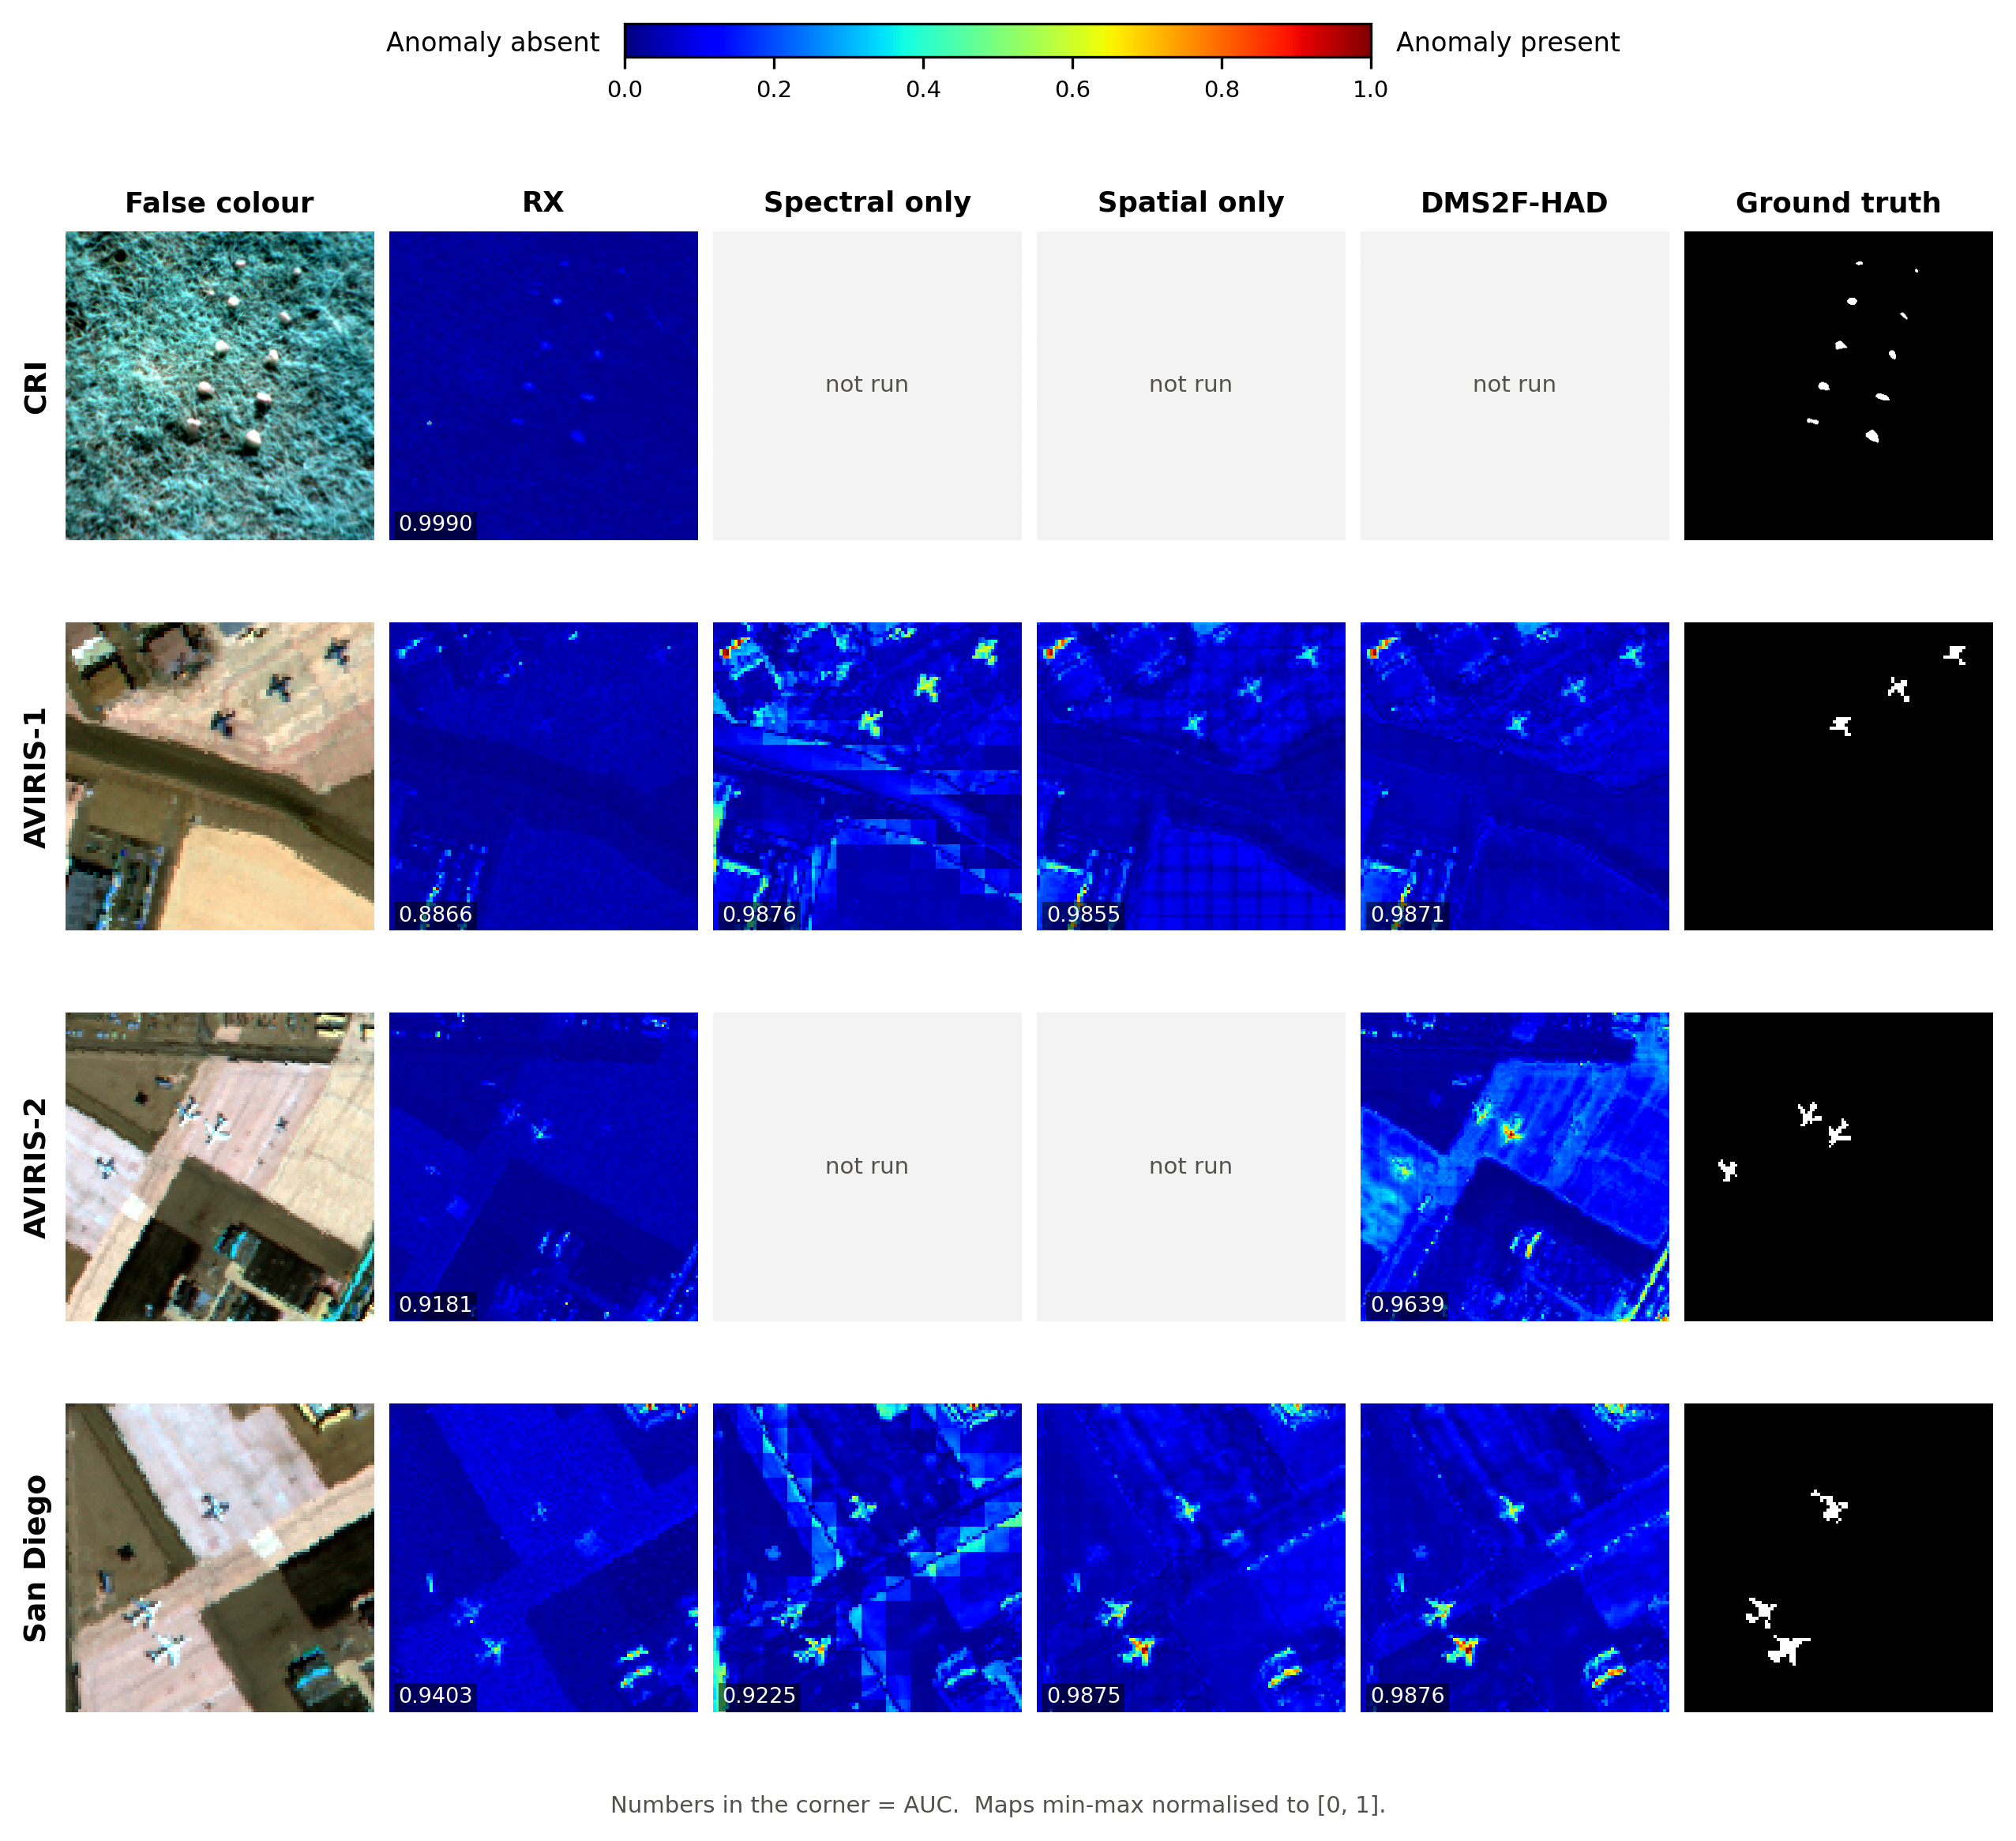
Colour anomaly maps
Same layout as Fig. 3 of the paper. AUC in each panel's corner.
Notes:
Colour anomaly maps in the style of the paper's Figure 3. Red means high anomaly score. RX highlights many background structures; DMS2F-HAD suppresses the background and keeps the planes and rocks.

Slide 16
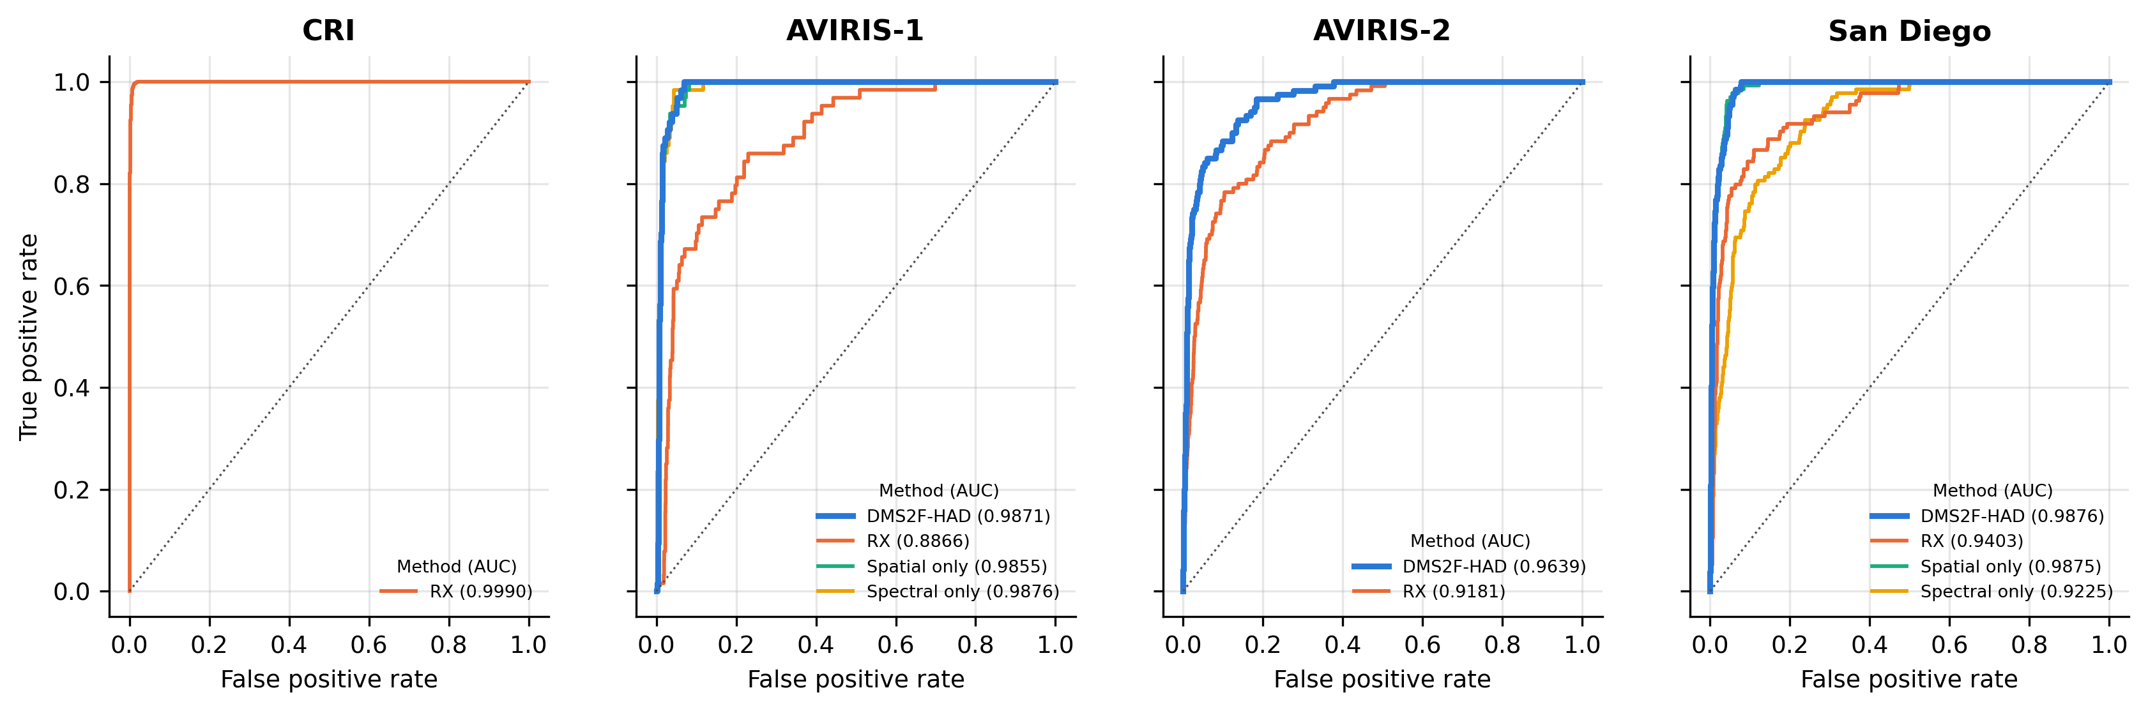
ROC curves
A curve closer to the top-left corner = more anomalies found at fewer false alarms. Legend values are AUC.
Notes:
ROC curves in the style of the paper's Figure 5. Curves that hug the top-left corner detect most anomaly pixels at a very low false-alarm rate.

Slide 17
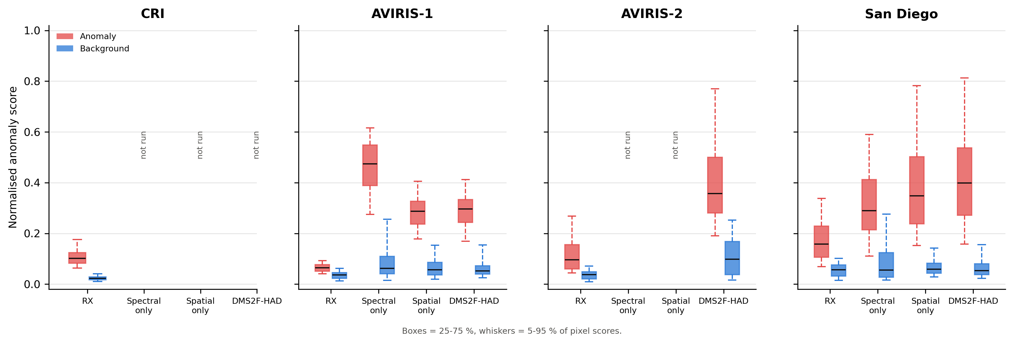
Separating anomalies from background
Red = anomaly pixels, blue = background pixels. A large gap with little overlap means a threshold exists that separates the two.
Notes:
Box plots in the style of the paper's Figure 4. For each method, red is the score distribution of anomaly pixels and blue of background pixels. A good detector keeps the blue box low and narrow and the red box high.

Slide 18
Ablation: do we need both branches and the gate?
Ablation runs not finished yet.
Notes:
Ablation in the style of the paper's Table 5: each branch on its own, simple addition of the two, and the full gated fusion. Each cell shows our AUC with the paper's value in brackets.

Slide 19
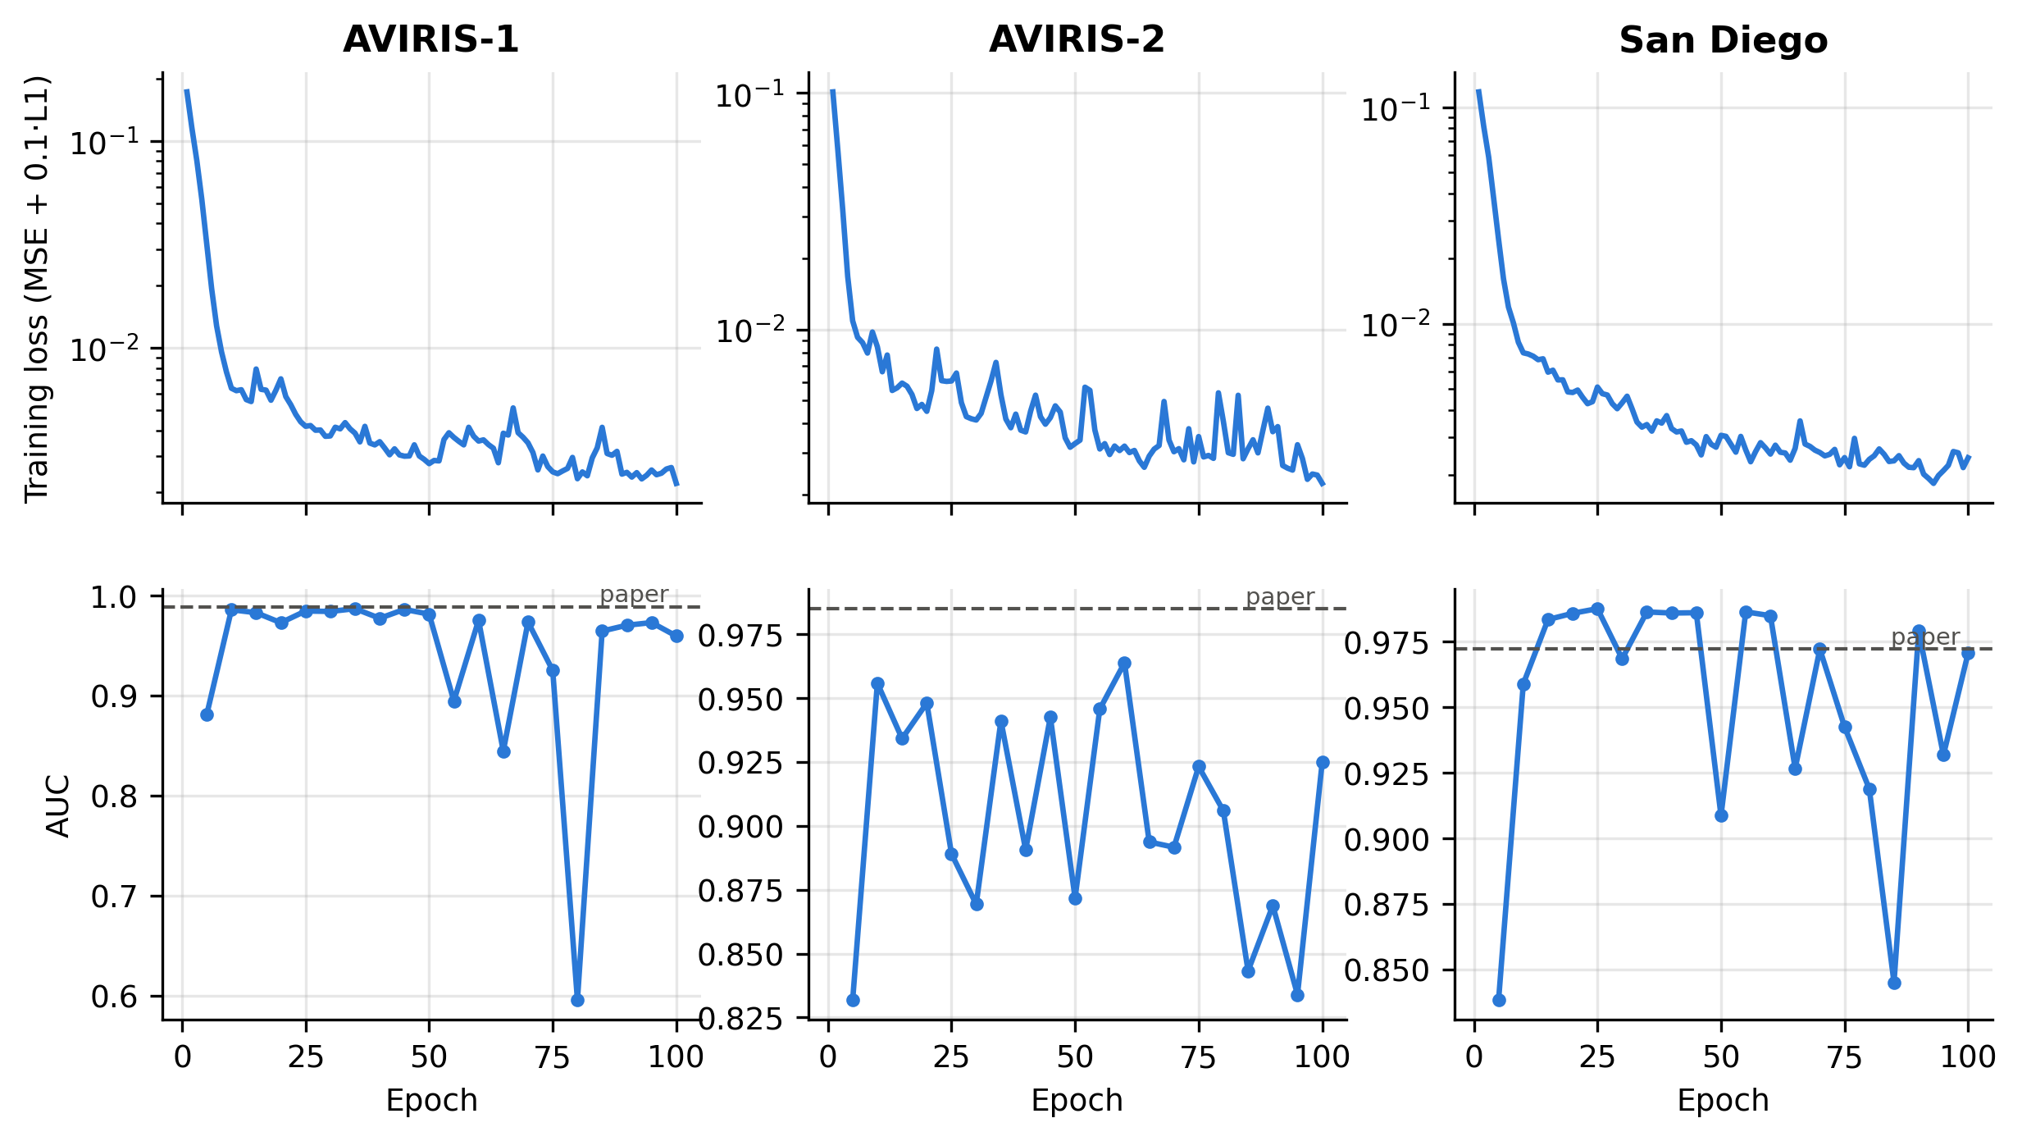
Training behaviour: lower loss is not always better detection
Loss falls steadily on every scene.
AUC can peak early, then drop: once the background is learned, the decoder starts to reconstruct anomalies too.
Model selection matters. The paper reports the best checkpoint; with no labels, early stopping or fewer epochs would be needed.
Notes:
Training curves. The loss keeps going down, but AUC does not always keep going up: after the background is learned, the network also starts to reconstruct the anomalies, and the anomaly scores shrink. That is why the choice of checkpoint matters, and why we report both the best epoch and the final epoch.

Slide 20
Takeaways
1
What DMS2F-HAD does
2
What we reproduced
3
Limits of this study
Learns the background of one image without labels, as a patch autoencoder.
Splits modelling into a spatial and a spectral Mamba branch, mixed per pixel by a learned gate.
Stays tiny (≈0.65 M parameters) and fast thanks to linear-time Mamba.
Mean AUC 0.9795 (best epoch) vs 0.9821 in the paper on the same 3 scenes.
RX baseline matches the paper exactly (mean 0.9150).
Full-image inference in 0.21 s on a shared GPU.
4 of the paper's 14 scenes (the ones released with the code); one random seed.
Best-epoch numbers use the ground truth to pick the checkpoint, as the paper does.
Pure-PyTorch scan is slower to train than the fused CUDA kernels.
Bottom line: a small dual-branch Mamba autoencoder reproduces the paper's accuracy level on the released scenes; the open problem is choosing the checkpoint without labels.
Notes:
Summary of what the method does, what we reproduced, and the limits of this study.

