Slide 1
Intellimark AI Task
By Saarthak Jain
LinkedIn ID: www.linkedin.com/in/saarthakjain01/
Git Hub ID: https://github.com/SaarthakJain01

Slide 2
Libraries used
Pandas
Numpy
Matplotlib
Seaborn
Xgboost
Sklearn
Statsmodels
Prophet
Joblib
Pickle

Slide 3
Categorical Variables and their unique values
The Channel had three unique channels
Channel1
Channel3
Channel2
The Brand had two unique brands
B1
B2

Slide 4
Categorical Variables and their unique values
The Category column had three different categories:
Cat2
Cat3
Cat1
There were four different sub-categories
Sub-Cat2
Sub-Cat4
Sub-Cat1
Sub-Cat3
And finally there were 5 different serial numbers from 1 to 5.

Slide 5
Categorical Variables and their joint unique values
Although there we several levels in each of the categorical variable not all of them interacted with each other. The following were the unique combinations we had and their respective counts.
Channel | Brand | Category | Sub-Category | Serial-Number | Count
Channel1 | B1 | Cat2 | Sub-Cat2 | 1 | 118
Channel2 | B2 | Cat3 | Sub-Cat3 | 2 | 110
Channel2 | B1 | Cat1 | Sub-Cat1 | 5 | 109
Channel3 | B1 | Cat3 | Sub-Cat4 | 3 | 106
Channel2 | B1 | Cat3 | Sub-Cat4 | 4 | 85
Channel2 | B1 | Cat3 | Sub-Cat3 | 4 | 72

Slide 6
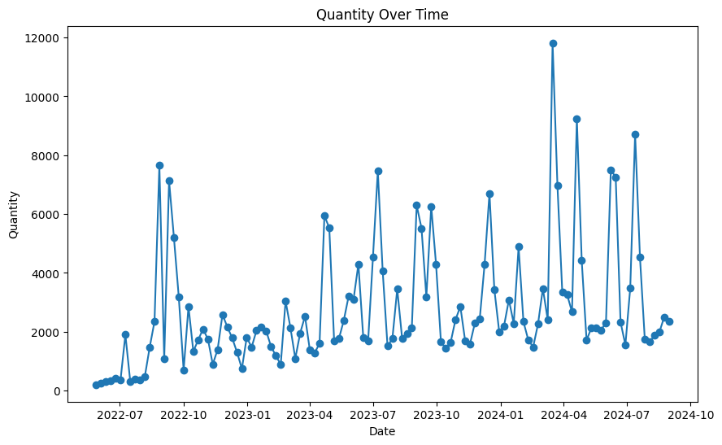
Time Series Plot of Quantity

Slide 7
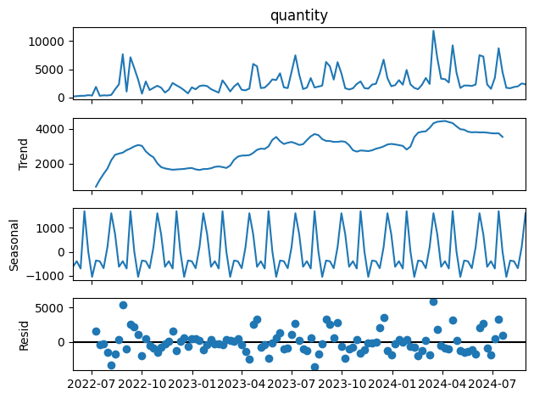
Seasonal Decomposition

Slide 8
Trends and Seasonal Pattern
Both the seasonal decomposition plot and the time series plot indicate a slight upward trend in the data over time.
A clear seasonal pattern is also present. This seasonality was further confirmed through the ACF (Autocorrelation Function) plot, which revealed a periodicity of 12 time periods — equivalent to approximately 84 days.

Slide 9
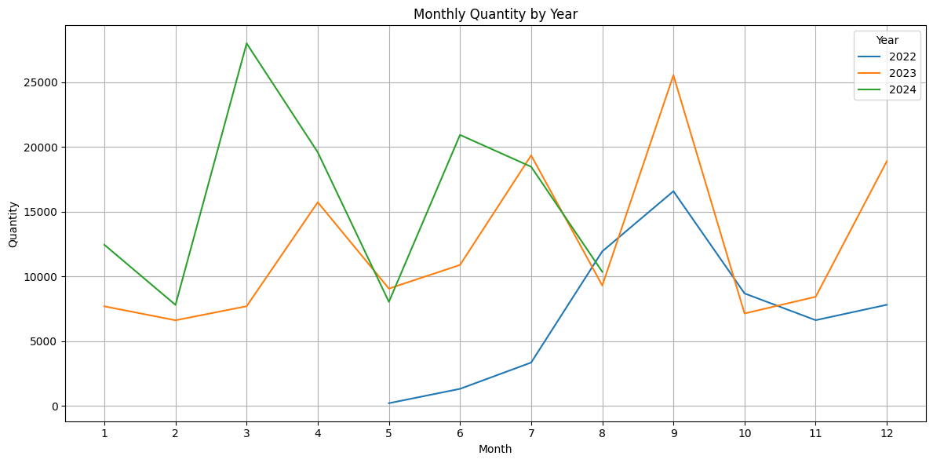
Year-wise monthly total of quantities sold

Slide 10
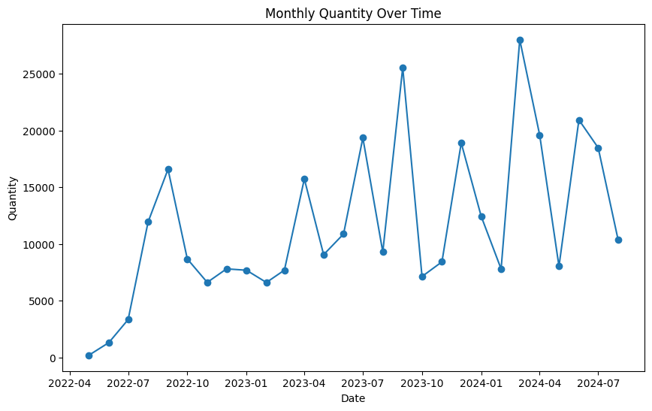
Quantity sold month wise across time
The data exhibits a period of stagnation between November 2022 and February 2023, characterized by a flat trend. Identifying the root cause of this anomaly is essential, as it may affect the reliability and performance of the forecasting models.

Slide 11
Feature Engineering
lag_1
lag_2
lag_3
lag_4
lag_5
lag_6
lag_7
rolling_mean_4
rolling_mean_8
rolling_median_4
rolling_median_8
year
month

Slide 12
Predictions for the month of June, July and August 2024
date | quantity | Random Forest | Gradient Boosting | XGBoost | Sarima | Sarima+GB | Prophet | Sarima+Prophet | Combined_S+P
2024-06-01 | 2306 | 2290.935 | 2031.383156 | 2003.218872 | 3584.667932 | 3584.667932 | 1236.785522 | 3584.667932 | 2410.726727
2024-06-08 | 7492 | 3831.110 | 2996.227014 | 4861.388184 | 7428.545249 | 7428.545249 | 2095.953665 | 7428.545249 | 4762.249457
2024-06-15 | 7257 | 4802.200 | 5726.842808 | 4934.036133 | 4531.459662 | 4531.459662 | 3389.775755 | 4531.459662 | 3960.617709
2024-06-22 | 2325 | 3933.000 | 3472.028602 | 3676.198242 | 2657.843596 | 2657.843596 | 2166.114766 | 2657.843596 | 2411.979181
2024-06-29 | 1551 | 3153.070 | 3174.646815 | 2650.477051 | 2753.761719 | 2753.761719 | 1585.679110 | 2753.761719 | 2169.720415
2024-07-06 | 3492 | 2644.225 | 2834.188519 | 3829.164307 | 2474.536978 | 2474.536978 | 1642.153111 | 2474.536978 | 2058.345044
2024-07-13 | 8716 | 2807.695 | 2898.898984 | 1757.482910 | 6131.789852 | 6131.789852 | 1383.820425 | 6131.789852 | 3757.805139
2024-07-20 | 4530 | 4094.340 | 5261.084422 | 3401.122314 | 3209.014508 | 3209.014508 | 3109.166136 | 3209.014508 | 3159.090322
2024-07-27 | 1731 | 3396.455 | 1854.305174 | 1960.682861 | 1769.139420 | 1769.139420 | 2079.889037 | 1769.139420 | 1924.514229
2024-08-03 | 1656 | 2455.900 | 1613.177146 | 2151.520020 | 2370.563509 | 1613.177146 | 917.567472 | 917.567472 | 1644.065490
2024-08-10 | 1871 | 2741.545 | 2996.239288 | 3163.711914 | 2446.634599 | 2996.239288 | 1730.602119 | 1730.602119 | 2088.618359
2024-08-17 | 1986 | 3174.690 | 2390.343430 | 4273.682129 | 2686.451930 | 2390.343430 | 1606.447203 | 1606.447203 | 2146.449566
2024-08-24 | 2501 | 2564.100 | 2793.677944 | 2225.263428 | 3839.913828 | 2793.677944 | 1498.486290 | 1498.486290 | 2669.200059
2024-08-31 | 2342 | 4000.945 | 3074.301284 | 1897.689941 | 7269.594040 | 3074.301284 | 2357.654433 | 2357.654433 | 4813.624237

Slide 13
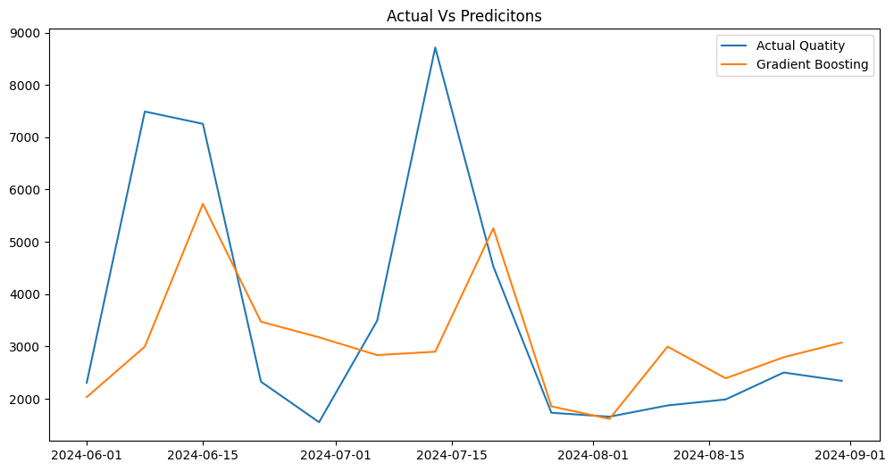
Actual Values Vs Gradient Boosting

Slide 14
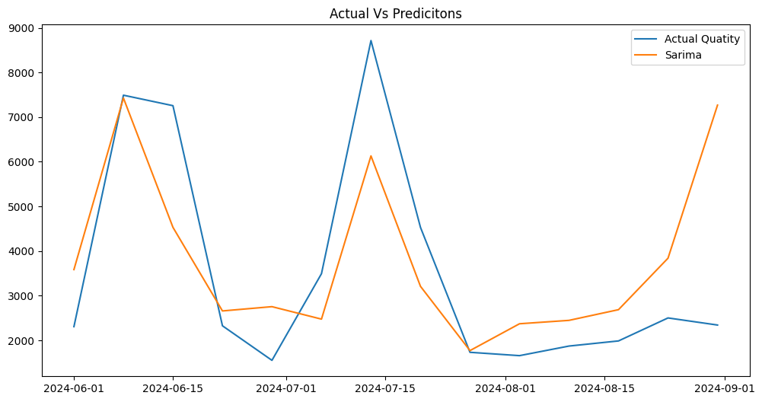
Actual Values Vs SARIMA

Slide 15
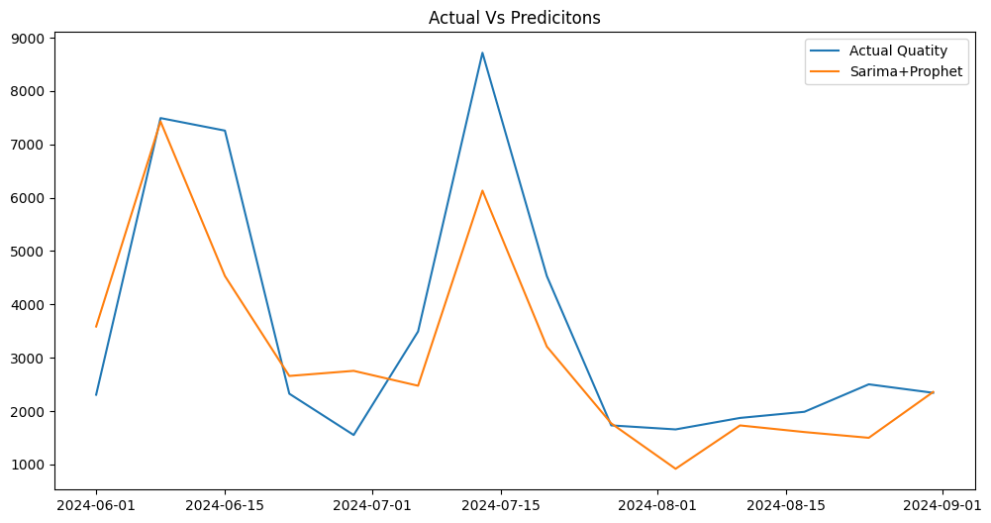
Actual Values Vs SARIMA+Prophet
Sarima for the first two months and then Prophet

Slide 16
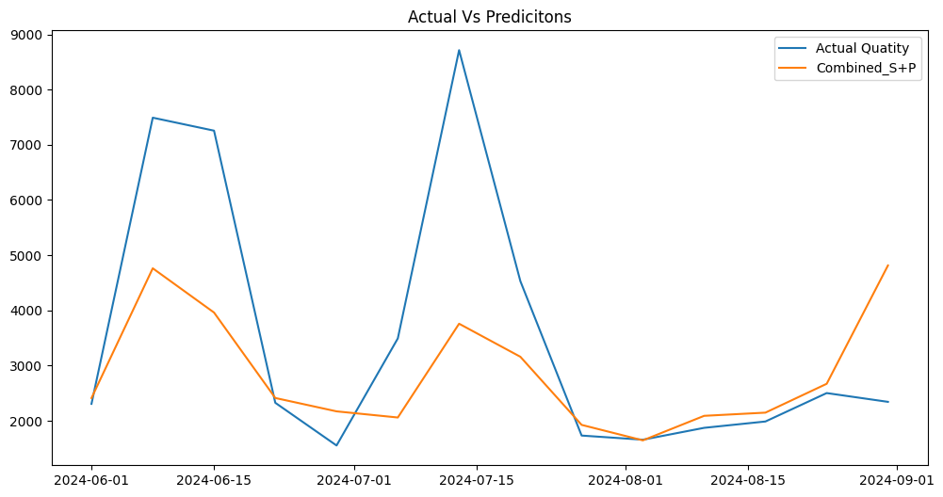
Actual Values Vs SARIMA and Prophet
0.5*Sarima + 0.5*Prophet

Slide 17
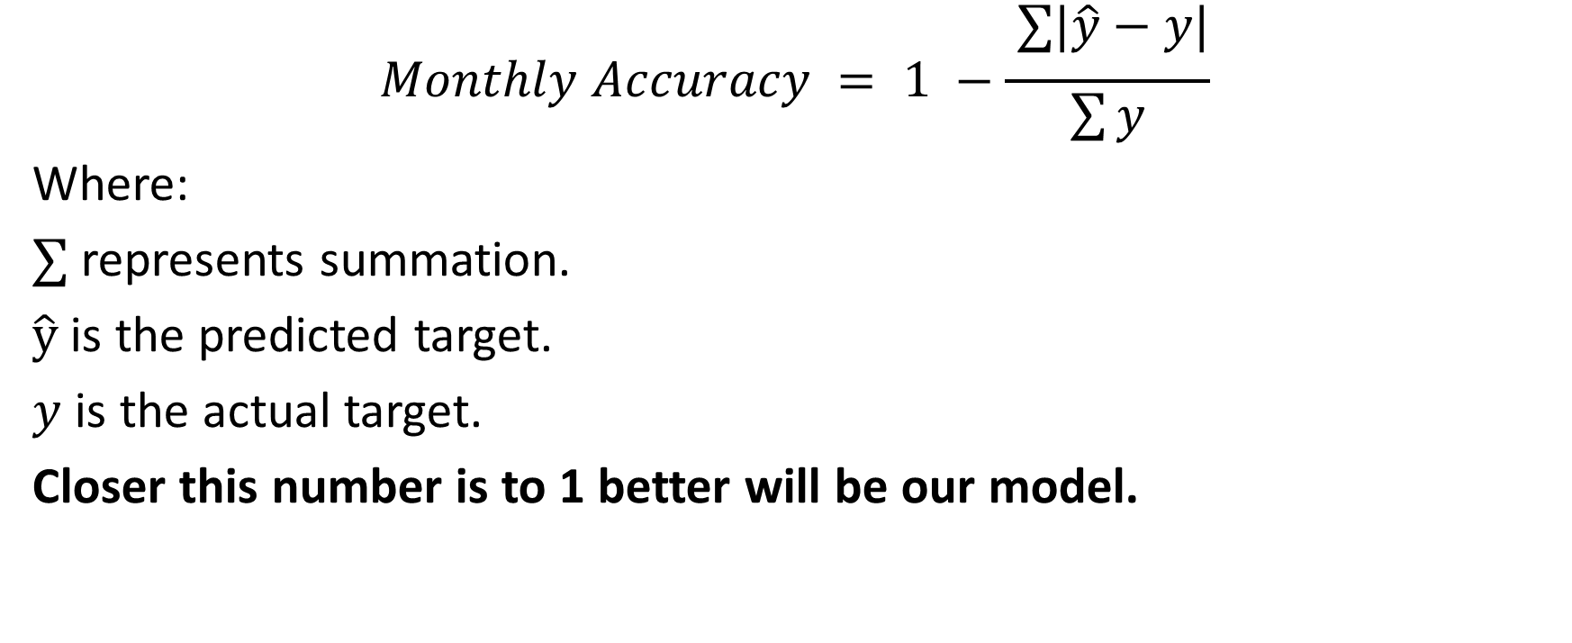
Accuracy Formula
$$Monthly Accuracy = 1 −\frac{ ∑|\hat{y}−y|}{\sum{y}}$$
Where:
$∑$represents summation.
$\hat{y}$ is the predicted target.
$y$ is the actual target.
Closer this number is to 1 better will be our model.

Slide 18
Accuracy Table for various models
Random Forest | Gradient Boosting | XGBoost | Sarima | Sarima+GB | Prophet | Sarima+Prophet | Combined_S+P
0.553733 | 0.566613 | 0.631789 | 0.732298 | 0.732298 | 0.497107 | 0.732298 | 0.673376
0.520429 | 0.603157 | 0.531418 | 0.731399 | 0.731399 | 0.407020 | 0.731399 | 0.569209
0.557630 | 0.749190 | 0.536891 | 0.202669 | 0.749190 | 0.780171 | 0.780171 | 0.707433
Model | Average Monthly Accuracy
Sarima+Prophet | 0.747956
Sarima+GB | 0.737629
Combined_S+P | 0.650006
Gradient Boosting | 0.639653
XGBoost | 0.566699
Prophet | 0.561433
Sarima | 0.555455
Random Forest | 0.543931
SARIMA performed the best for the first two months while prophet gave very average results for the same.
When we combined both the models. Their Average monthly accuracy came out to be 65%.

Slide 19
Predictions for the month of September October and November 2024
date | Sarima | Prophet | Combined
2024-09-07 | 3584.667932 | 6952.773280 | 5268.720606
2024-09-14 | 7428.545249 | 6705.997125 | 7067.271187
2024-09-21 | 4531.459662 | 6400.844319 | 5466.151991
2024-09-28 | 2657.843596 | 5045.913440 | 3851.878518
2024-10-05 | 2753.761719 | 5192.834630 | 3973.298175
2024-10-12 | 2474.536978 | 3008.296095 | 2741.416536
2024-10-19 | 6131.789852 | 1829.440089 | 3980.614971
2024-10-26 | 3209.014508 | 3121.394264 | 3165.204386
2024-11-02 | 1769.139420 | 2905.553171 | 2337.346296
2024-11-09 | 2370.563509 | 2584.740707 | 2477.652108
2024-11-16 | 2446.634599 | 3051.943437 | 2749.289018
2024-11-23 | 2686.451930 | 5159.967112 | 3923.209521
2024-11-30 | 3839.913828 | 5475.312933 | 4657.613381

Slide 20
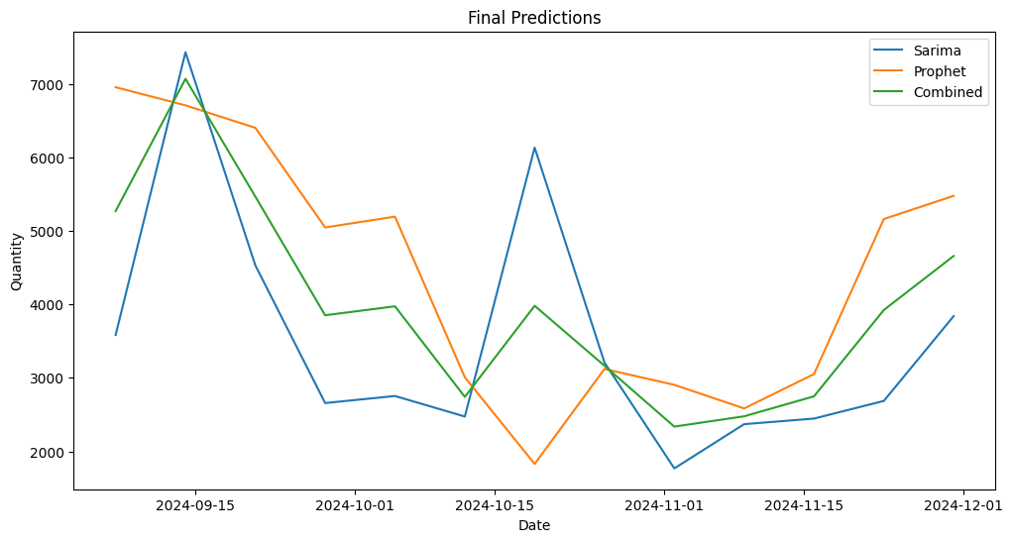
Predictions for the month of September October and November 2024
Both SARIMA and Prophet models produce forecasts that individually deviate significantly from the actual values. However, by combining their predictions, we obtain an averaged result that tends to be closer to the true values, potentially enhancing overall forecast accuracy.

Slide 21
Save the fitted model
SARIMA Model: sarima_model.pkl
Propeht Model: prophet_model.pkl
Their individual values are combined to give a third prediction, which is called Combined_S+P.

Slide 22
Steps for improving the model
Having access to a longer historical time series allows the model to better learn and capture the underlying trends and seasonal patterns in the data.
We have deliberately avoided using machine learning models, as they typically require extensive feature engineering. This process can introduce dependencies on past predictions, which may degrade model performance over time and reduce robustness.
Instead, where possible, we recommend generating short-term forecasts first, followed by rolling predictions using the SARIMA model alone. This approach leverages SARIMA’s inherent strength in handling seasonality and trends without relying on externally engineered features.

