Slide 1

ME 609: Programming Project Phase 3
Group 19
Saarthak Sarkar 200103094
Shreerup Ikare 200103128

Slide 2
Optimization Methods
Multi-variable Method : Conjugate Gradient Method.
Unidirectional Search :
Bracketing Method : Bounding Phase
Accurate Method : Bisection Method
Penalty Function: Bracket-Operator Penalty method

Slide 3
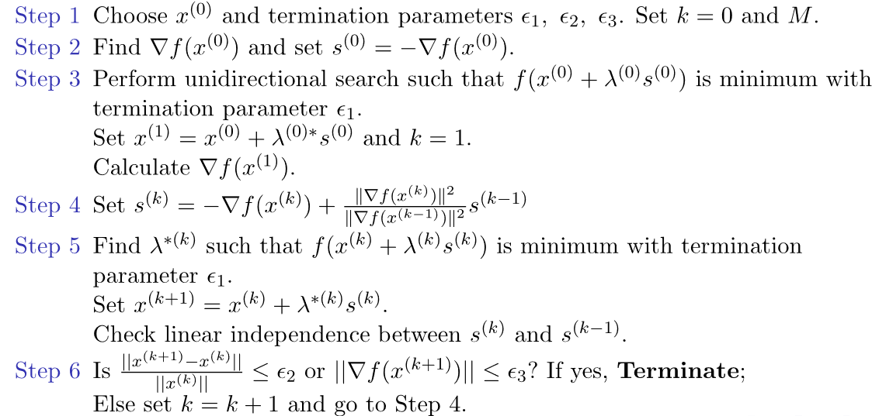
Algorithm: Conjugate Gradient Method

Slide 4
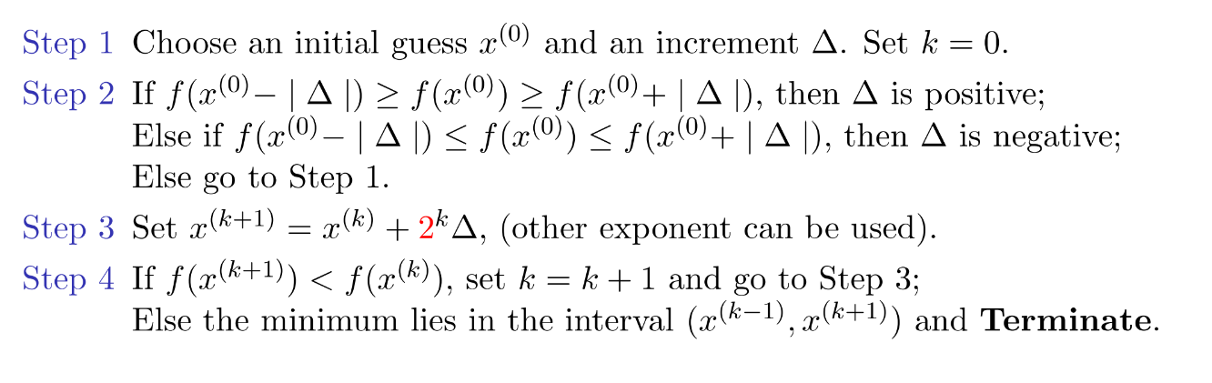
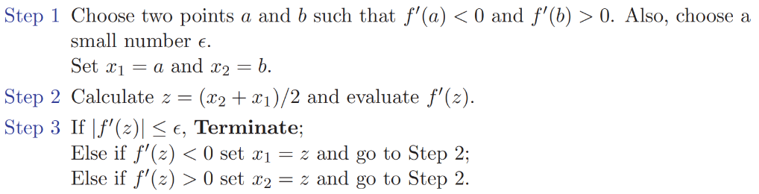
Algorithm: Bounding Phase Method
Algorithm: Bisection Method

Slide 5
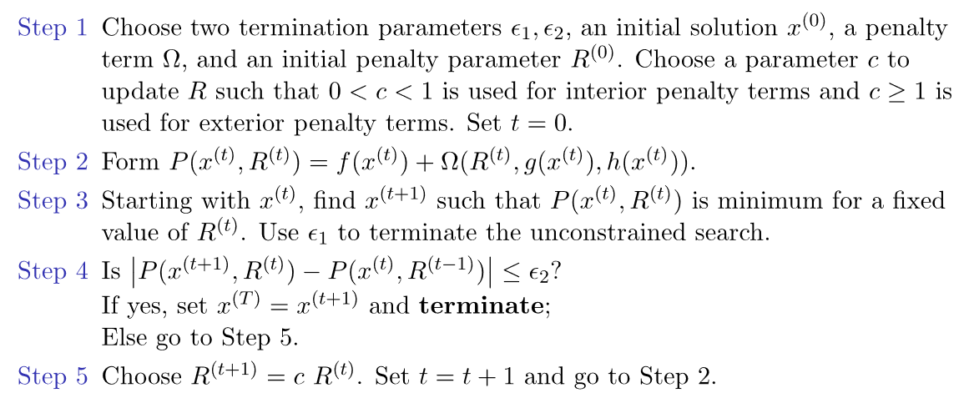
Algorithm: Penalty Function Method

Slide 6
Flowchart: Bounding Phase and Bisection Method
Choose initial guess x0 and delta
Find optimum range that is now input for Bisection Method
Find z = (x1+x2)/2
Is dot product (dz, s0) < epsilon
Calculate Gradient d(z) = gradient(z)
Calculate (f_0), f(x_0 + delta),f(x_0-delta) by choosing appropriate sign for delta
False
Is dot product (dz, s0) > 0
True
f(x(k+1)<f(x(k))
x2 = z
x(k+1) = x(k) + (2^k)*delta
False
Terminate
x1 = z
True

Slide 7
Flowchart: Conjugate Gradient Method
Choose initial guess x0
Calculate negative Gradient
True
Find x(k+1) using Bisection Method
Is norm of gradient > epsilon and K<M
Update direction using Formula
False
Terminate

Slide 8
Flowchart: Penalty Function Method
Choose e_1, e_2, x0, R, Penalty Function
Calculate P(x,R) = f(x) + omega(R, g(x). h(x))
Minimize P(x(t+1), R(t))
|P(x(t+1), R(t)) P(x(t), R(t-1))|<e
R(t+1) + e*R(t)
else
True
Terminate

Slide 9
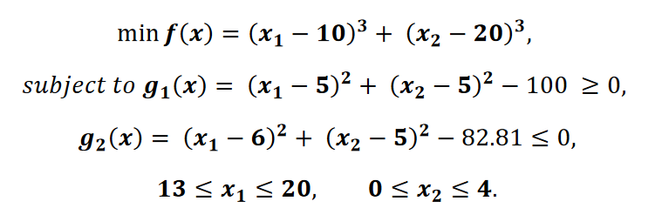
Problem 1:

Slide 10
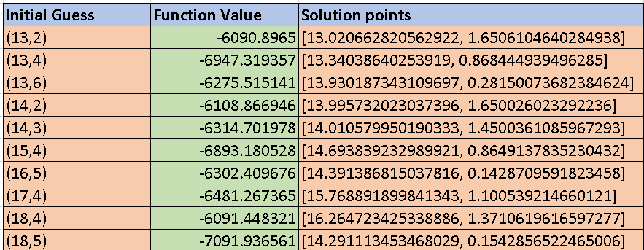
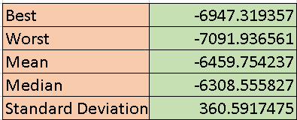
Results for 10 different Initial Guess

Slide 11
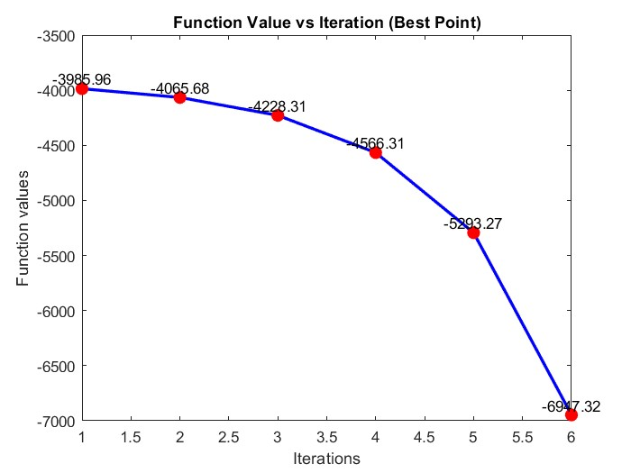
Question 1 : For Best point(13,4)

Slide 12
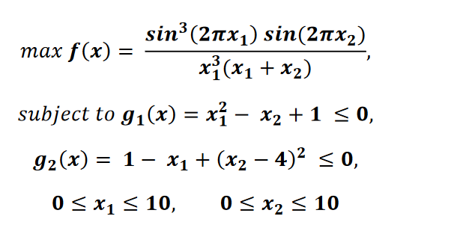
Problem 2:

Slide 13
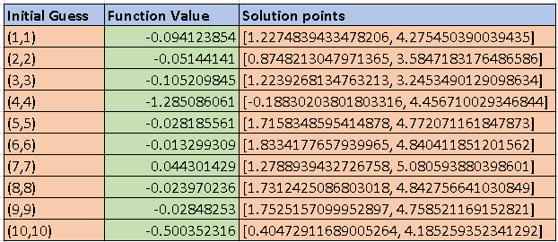
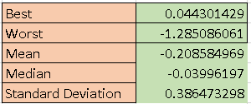
Results for 10 different Initial Guess

Slide 14
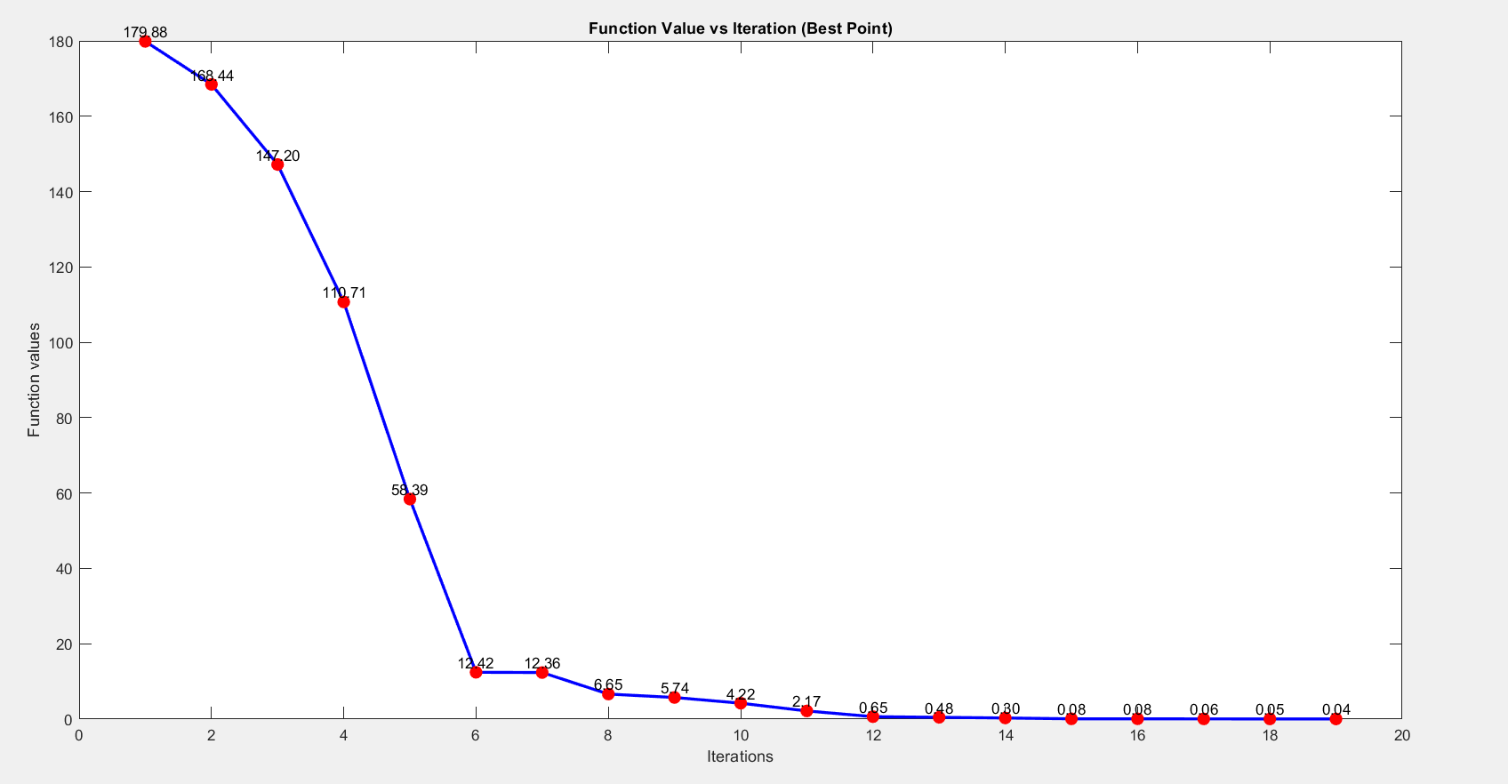
Question 2 : For Best point(7,7)

Slide 15
Results and Conclusions
We have used bracket-operator penalty method for the constrained optimization problems provided to us. The bracket-operator penalty method penalizes the violation of constraints and guides the search towards the feasible solutions.
This code takes input of no. of variables and the initial points after which it computers the direction for unidirectional search by calculating the negative gradient of the function at input points.
The result of bounding phase is passed to the bisection method for accurate computation of lambda so that we obtain the most optimum point in the unidirectional search direction. Here, we ensure that the point that we want follows all the constraints and the necessary bounds.
Upon finding the optimum value of lambda, the conjugate gradient function finds the next point in the search space, updates the search direction and again the whole process is repeated.
When the distance of the new generated point and previous point is less than the preset epsilon, the algorithm terminates.
The direction of maximum reduction in objective function value is the negative gradient of the point in n-dimensional space.

