Slide 1
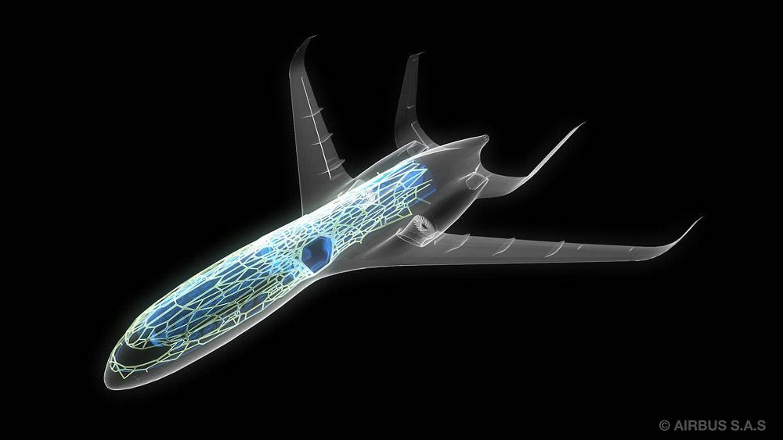
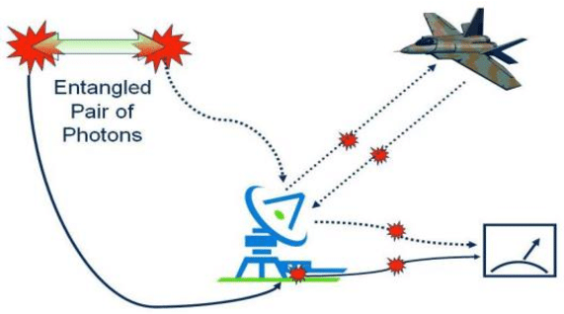
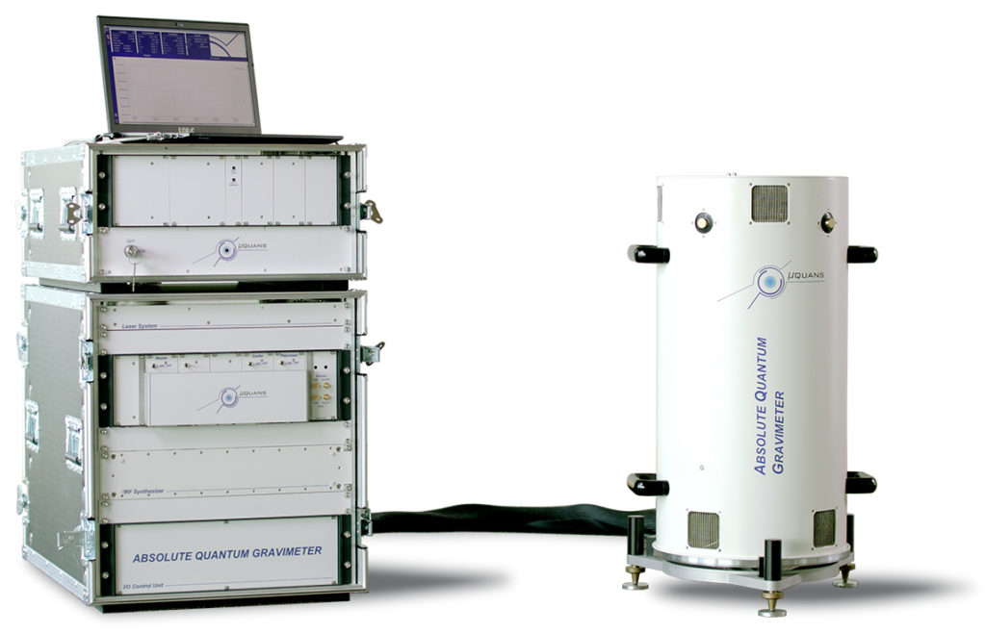
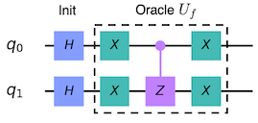
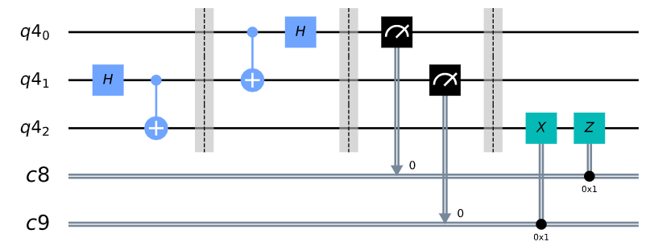
Defense applications of Quantum Computing
Saasha Joshi¹
¹Panjab University, Chandigarh, India
QUANTUM RADAR
Working in the microwave range, quantum radars can significantly outperform its classical counterpart. Based on the concept of input quantum correlations, the entangled photons reveal the shape and location of clocked aircrafts and missiles, without giving away their position, in a process called QUANTUM ILLUMINATION.
The basic concept is to create and split the stream of entangled visible-frequency photons. Both the separate streams of photons are compared after reflection from an intruder such as a missile or an aircraft [1].
QUANTUM SATELLITE AND NANO-SATELLITE
Such satellites in space can provide digital wireless communication and may also help in establishment of quantum internet.
The mobile ground station performs quantum key distribution in which particles of light, called PHOTONS, are transmitted between different cities exploiting the process of quantum entanglement for an effective teleportation of information.
QUANTUM AIRCRAFT DESIGN
Challenges such as aircraft climb optimization, computational fluid dynamics, wing-box design optimization, quantum neural network for solving partial differential equations, and aircraft loading optimization are famously being solved by companies such as Airbus[4] with the help of latest quantum technology.
QUANTUM SUBMARINE COMMUNICATION
Quantum theory can be used to store data in fragile or superimposed quantum states. Such states can collapse in an attempt to gain unauthorized access to the stored data. Nuclear armed submarines can be communicated with the help of such protected quantum technology.
Technology such as the very sensitive GRAVIMETERS when deployed on an aircraft or satellite can detect underground bunker, missile silos or any cavity. It can detect any change in gravitational field and things which do not emit any electromagnetic signal
QUANTUM CRYPTOGRAPHY
Secure communication, specially in regard with military communication can be achieved with strong encryption keys and algorithm development [3]. A secure key distribution scheme can be developed with the possible application of quantum technology.
GROVER’S ALGORITHM
QUANTUM TELEPORTATION
Process in which quantum information can be transmitted from one location to another with the help of classical communication and quantum entanglement between sender and receiver locations.
QUANTUM TELEPORTATION
QUANTUM CLOCK
Based on aluminum spectroscopy ion, a quantum clock is 37 times more precise than the existing standard [2]. Insensitive to background electric and magnetic fields, such clock is viewed as a viable alternative to GPS.
CHALLENGES TODAY
1. Development issues and number of qubits on the processor chip.
2. Errors due to noise.
3. Integration of Artificial Intelligence and Quantum Computing.
1. Malik M, Magaña-Loaiza OS, Boyd RW. Quantum-secured imaging. Applied Physics Letters. 2012 Dec 10;101(24):241103.
2. Ghose, Tia (5 February 2010). "Ultra-Precise Quantum-Logic Clock Puts Old Atomic Clock to Shame". Wired. Retrieved 2010-02-07.
3. Naguleswaran S. A new paradigm for secure military communications: Quantum information processing. InMilitary Communications and Information Systems Conference (MilCIS 2010), Canberra, Australia 2010 Nov 9 (pp. 1-5).
4. Airbus Quantum Challenge (2019) 5. Figures from Qiskit Textbook: https://qiskit.org/textbook/preface.html

