Slide 1

Cyclistic Bike share case study
GOOGLE DATA ANALYTICS PROFESSIONAL CERTIFICATE CAPSTONE PROJECT
Presented by: Saatwik Dutta
Date: 11-09-2024

Slide 2
Background
Cyclistic is a bike sharing company based in Chicago, US.
They have a fleet of 5,824 bicycles and a network of 692 docking stations.
Pricing Plans:
a. Single Ride Pass
b. Full Day Pass
c. Annual Membership
Casual Riders
Member Riders
Also the most profitable

Slide 3
Objective
Key to future growth
How?
Business Task
Maximizing the number of annual members.
Convert the casual riders into annual members.
Find out how do annual members and casual riders use Cyclistic bikes differently?

Slide 4
Data Sources
Divvy Trip Data- July 2023 to August 2024

Slide 5
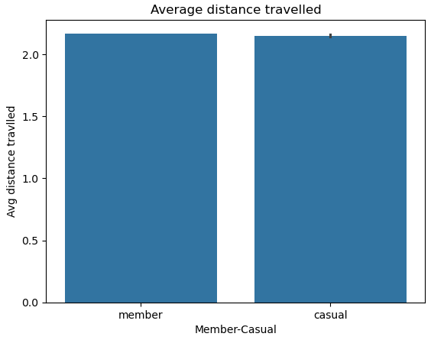
What did the data tell us? 1. Average distance travelled by both members and casual riders.

Slide 6
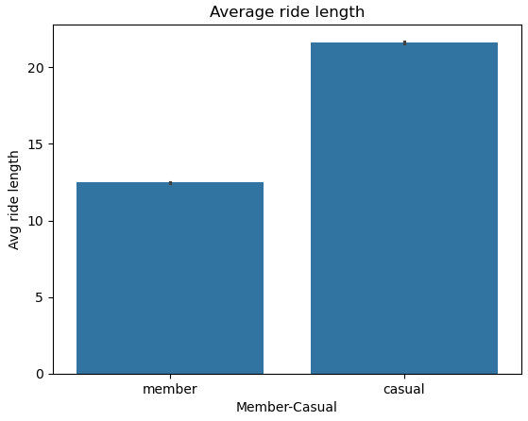
2. Average ride length by both members and casual riders.

Slide 7
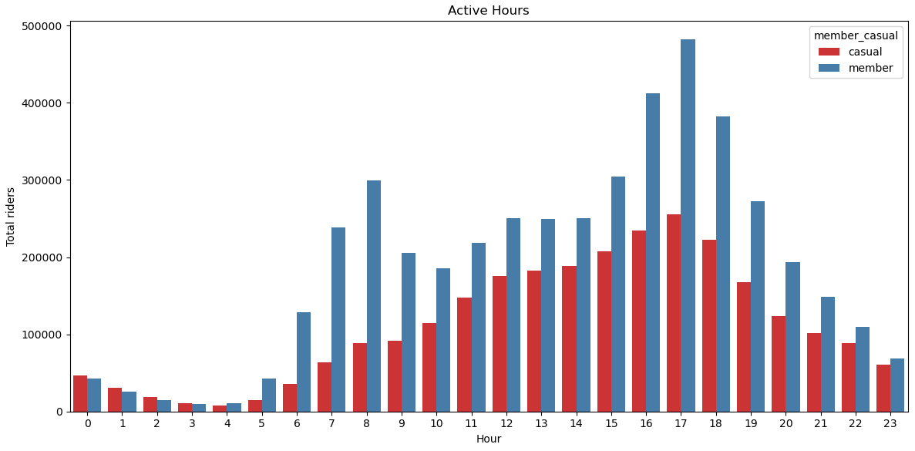
3. Average ride length by both members and casual riders

Slide 8
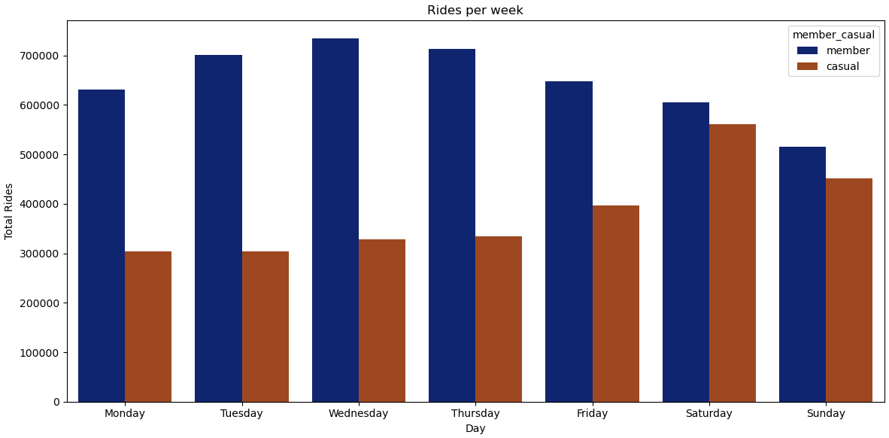
4. Total Rides per week

Slide 9

5. Total Rides each day of the week

Slide 10
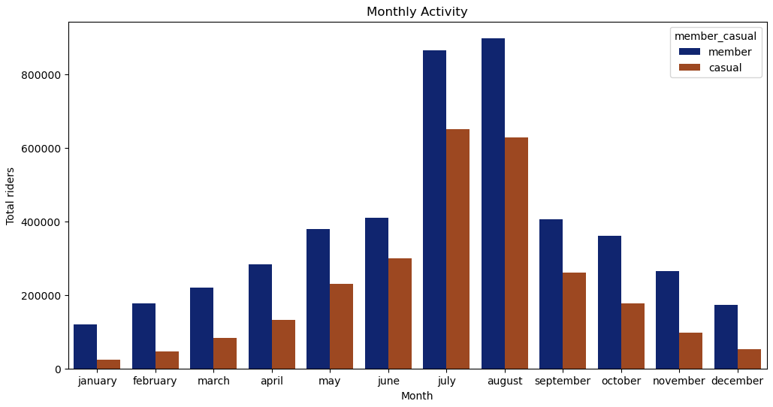
6. Total rides in each month of the year

Slide 11
Key findings: summary
Member Riders' Commuting Behavior Member riders predominantly use the bike service as a reliable means of transportation for their daily commute to work. This consistent pattern suggests that the bike service is an integral part of their weekday routine.
Casual Riders' Recreational Usage Casual riders typically use the bike service for recreational purposes, such as leisure rides, exploring the city, or engaging in outdoor activities. Their usage reflects a more flexible and leisure-oriented approach, highlighting a different kind of motivation compared to member riders.

Slide 12
Seasonal Popularity The bike service experiences a notable increase in usage during the summer months, particularly in July and August. This seasonal spike indicates that warmer weather and longer days contribute to higher demand.
Weekend Usage Pattern Both member and casual riders show increased usage of the bike service during weekends. This trend indicates a higher demand for the service on Saturdays and Sundays, likely due to more free time and the opportunity for leisure activities.

Slide 13
Recommendations
Summer Membership Introduce a "Summer Membership" aimed at casual riders who might be hesitant to commit long-term. This special seasonal offer can showcase the benefits of membership during the busy summer months and make it easier for them to consider a full annual plan.
Weekday and Short Trip Discounts Implement coupons and discount schemes to encourage casual riders to use the bikes more on weekdays or for shorter journeys. These offers can help integrate biking into their daily routines and shift their view from just a recreational activity to a practical transportation option.
Promote Regular Bike Use Develop marketing strategies that emphasize the everyday benefits of biking, such as convenience, health benefits, and environmental impact. This approach can help casual riders see the value in using bikes regularly, not just for leisure.

Slide 14
Thank you for your time!
You can contact me at:
saatwikdutta21@gmail.com
linkedin.com/in/saatwik-dutta-6271b31b4/
github.com/SaatwikDutta

