Slide 1

Can Energy Generation Show Progression Through GDP?
Humaid · Suhail · Nikita · Sabyasachi
1

Slide 2
Contents
01
02
Problem Statement
EDA
03
04
8-Variable Model
Adjustments
05
06
Classified by Country
Classified by Year
07
08
Decision Tree
Conclusion
2

Slide 3


Problem Statement
55 years ago, 7 emirates were united by Sheikh Zayed Bin Sultan Al Nahyan — transforming a desert into a nation ranked 15th worldwide in HDI and 30th in GDP. UAE energy production grew from 12.18 TWh in 1985 to 133 TWh in 2019 (Statbase).
Core Question: Can energy generation show progression through GDP?
3

Slide 4

EDA: Data Cleaning Process
Filter UN Countries
Combine Dependents
Find Consistent Years
Drop Incomplete
Data became consistent from 1995 onwards. After filtering for UN-recognized sovereign countries and combining dependent economies, we retained 77 countries with complete data across 31 years.
4

Slide 5
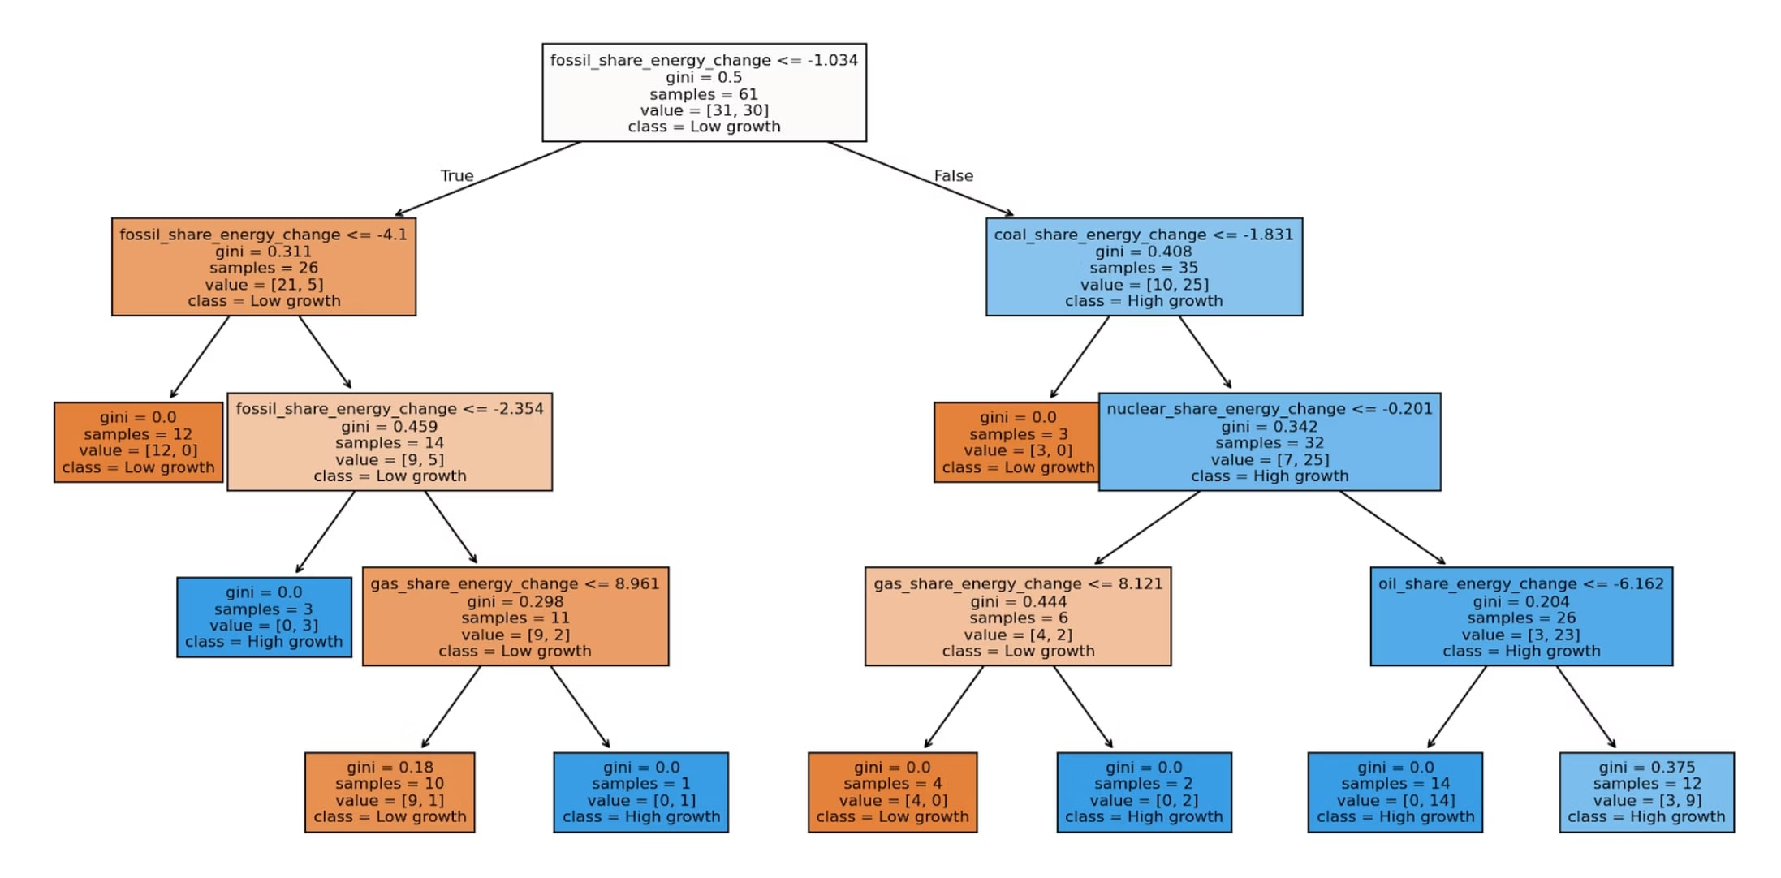
Initial Model: 8 Variables
Predictor Features
Renewables share (energy & electricity change)
Fossil, coal, oil & gas share (energy change)
Nuclear share (energy & electricity change)
All 8 variables were used to predict GDP. The model overfit, indicating further adjustments were needed.
5

Slide 6
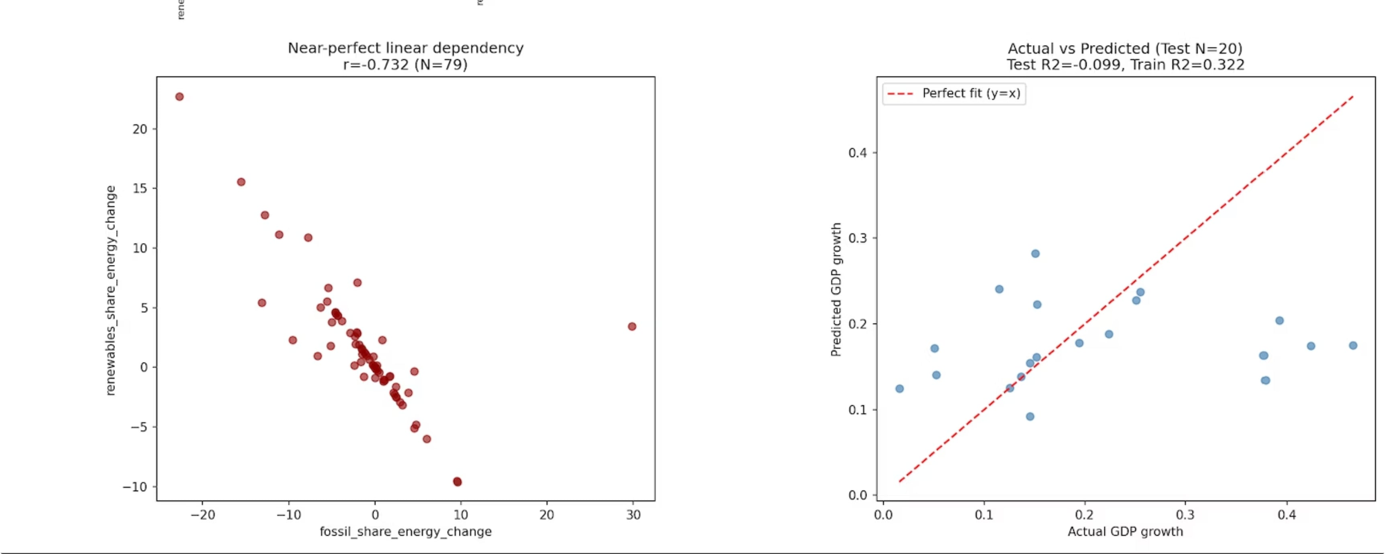
6

Slide 7
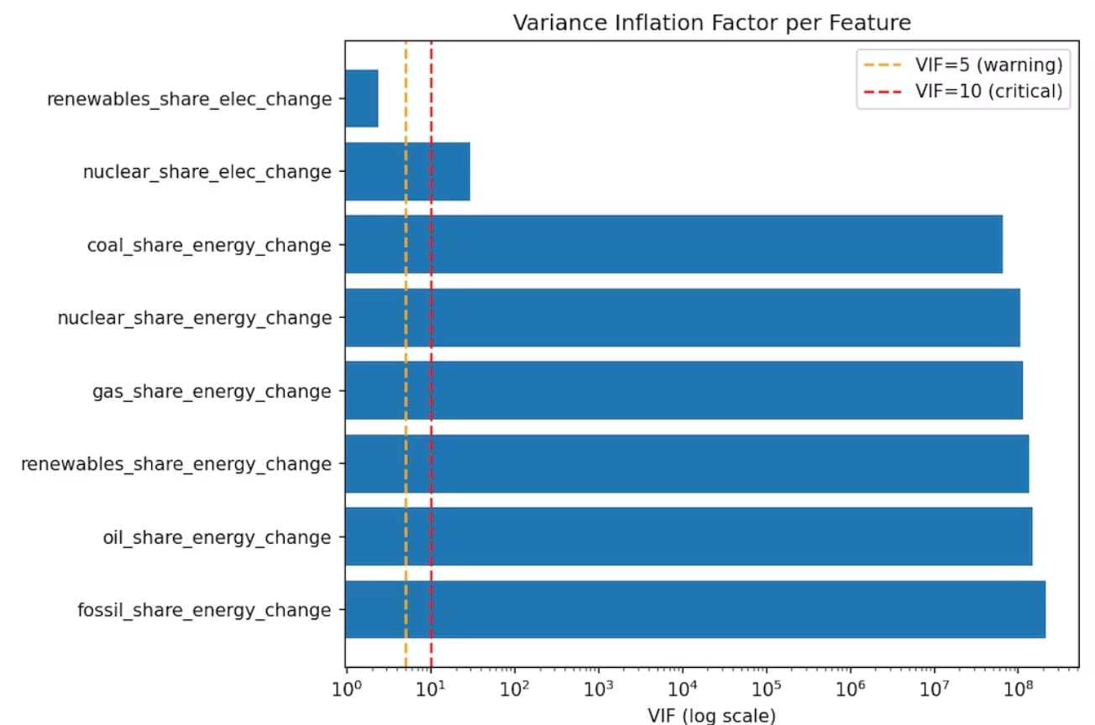
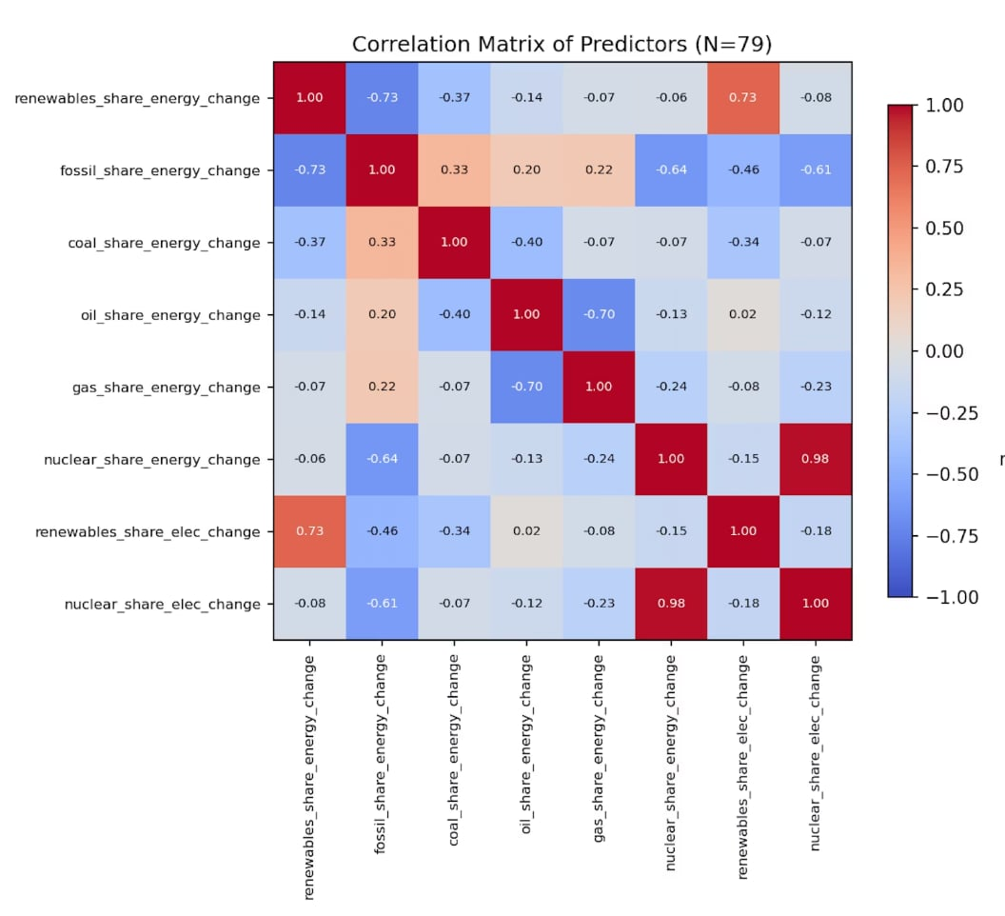

Adjustments: Solving Multicollinearity
The Problem
The Solution
Initial models produced negative R² and overfit decision trees. The root cause was VIF (Variance Inflation Factor) — severe multicollinearity among predictors.
Iteratively removed features with VIF > 5, keeping only those with low correlation to GDP and strong economic interpretability.
Final model: Electricity generation + Energy per capita — R² approaching 1.
7

Slide 8

Classified by Country
Per-country regression and classification models. The development of each country is compared against the median development of each country in the dataset.
Version 1
Version 2
Version 1b
2 features + Linear Regression
4 features + Linear Regression
2 features + Logistic Regression (binary growth label)
Finding: ~25 training rows per country is insufficient for reliable generalization — a sample-size ceiling, not a tuning problem.
8

Slide 9
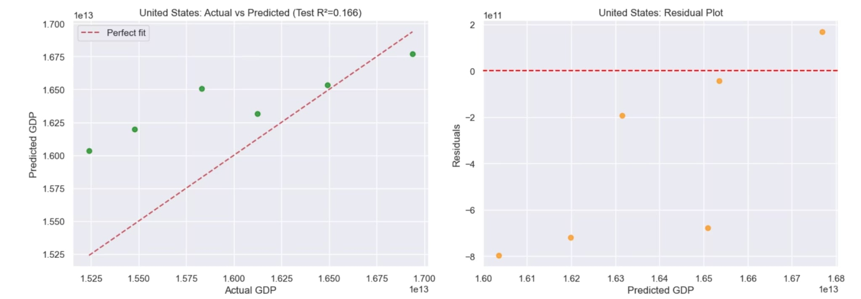
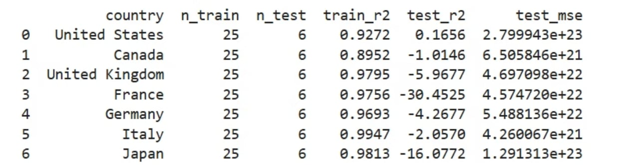
Version 1 (2 features + Linear Regression)
9

Slide 10
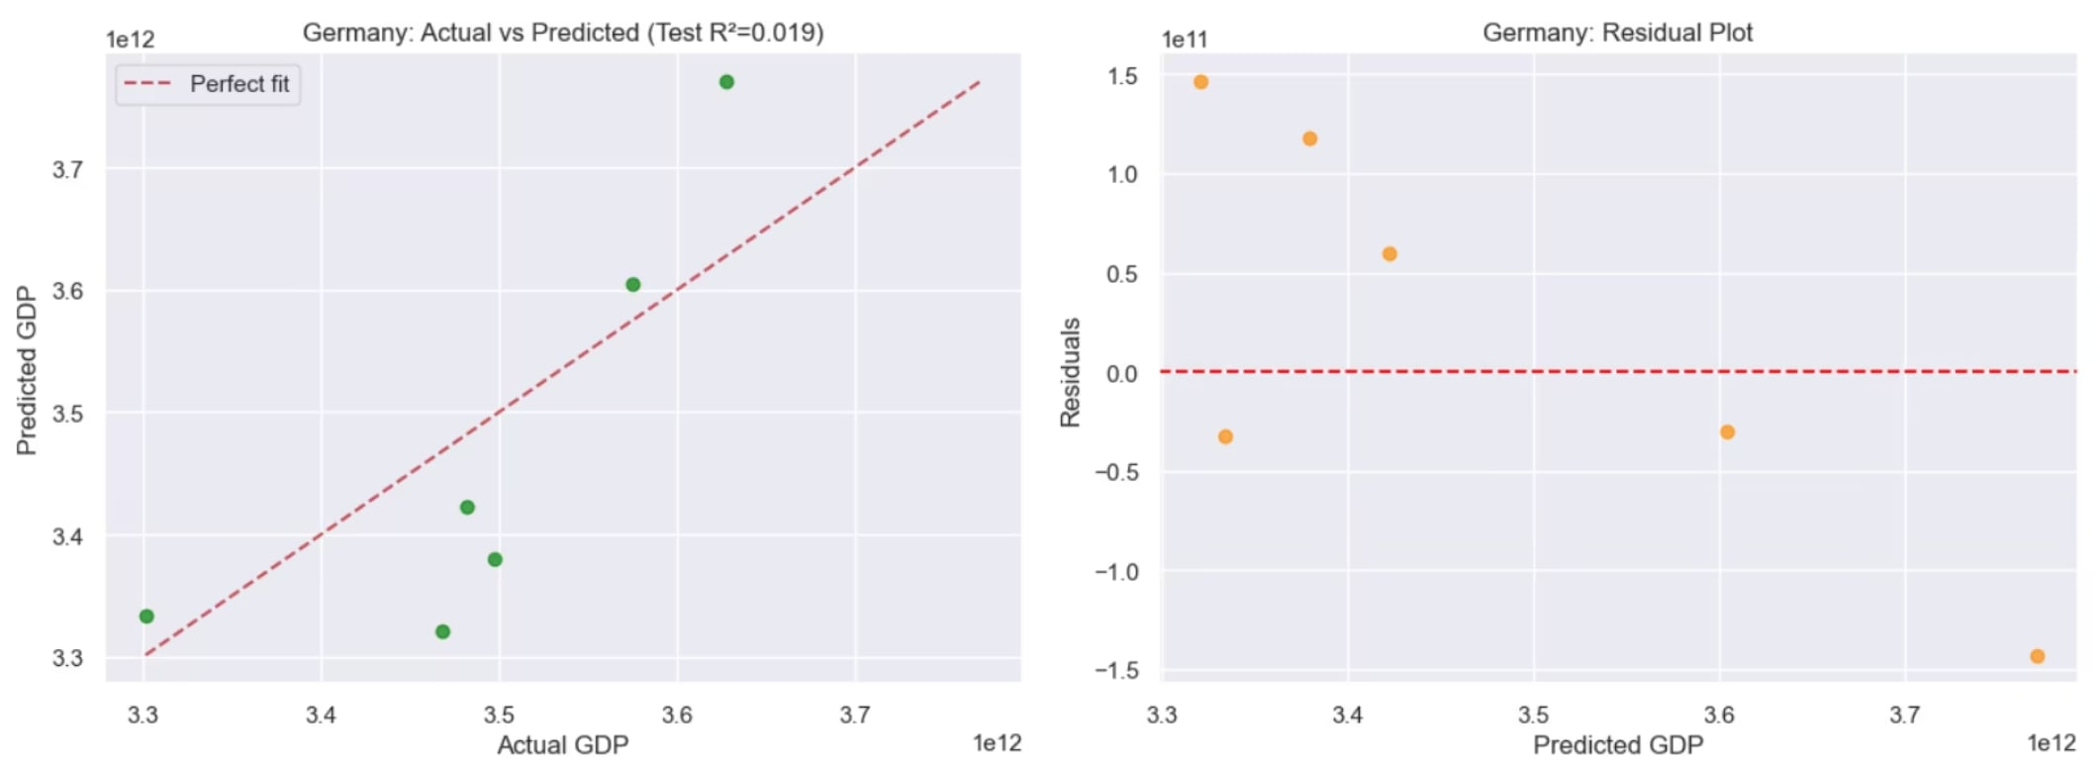
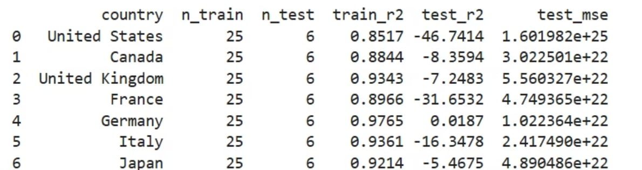
Version 2 (4 features + Linear Regression)
10

Slide 11
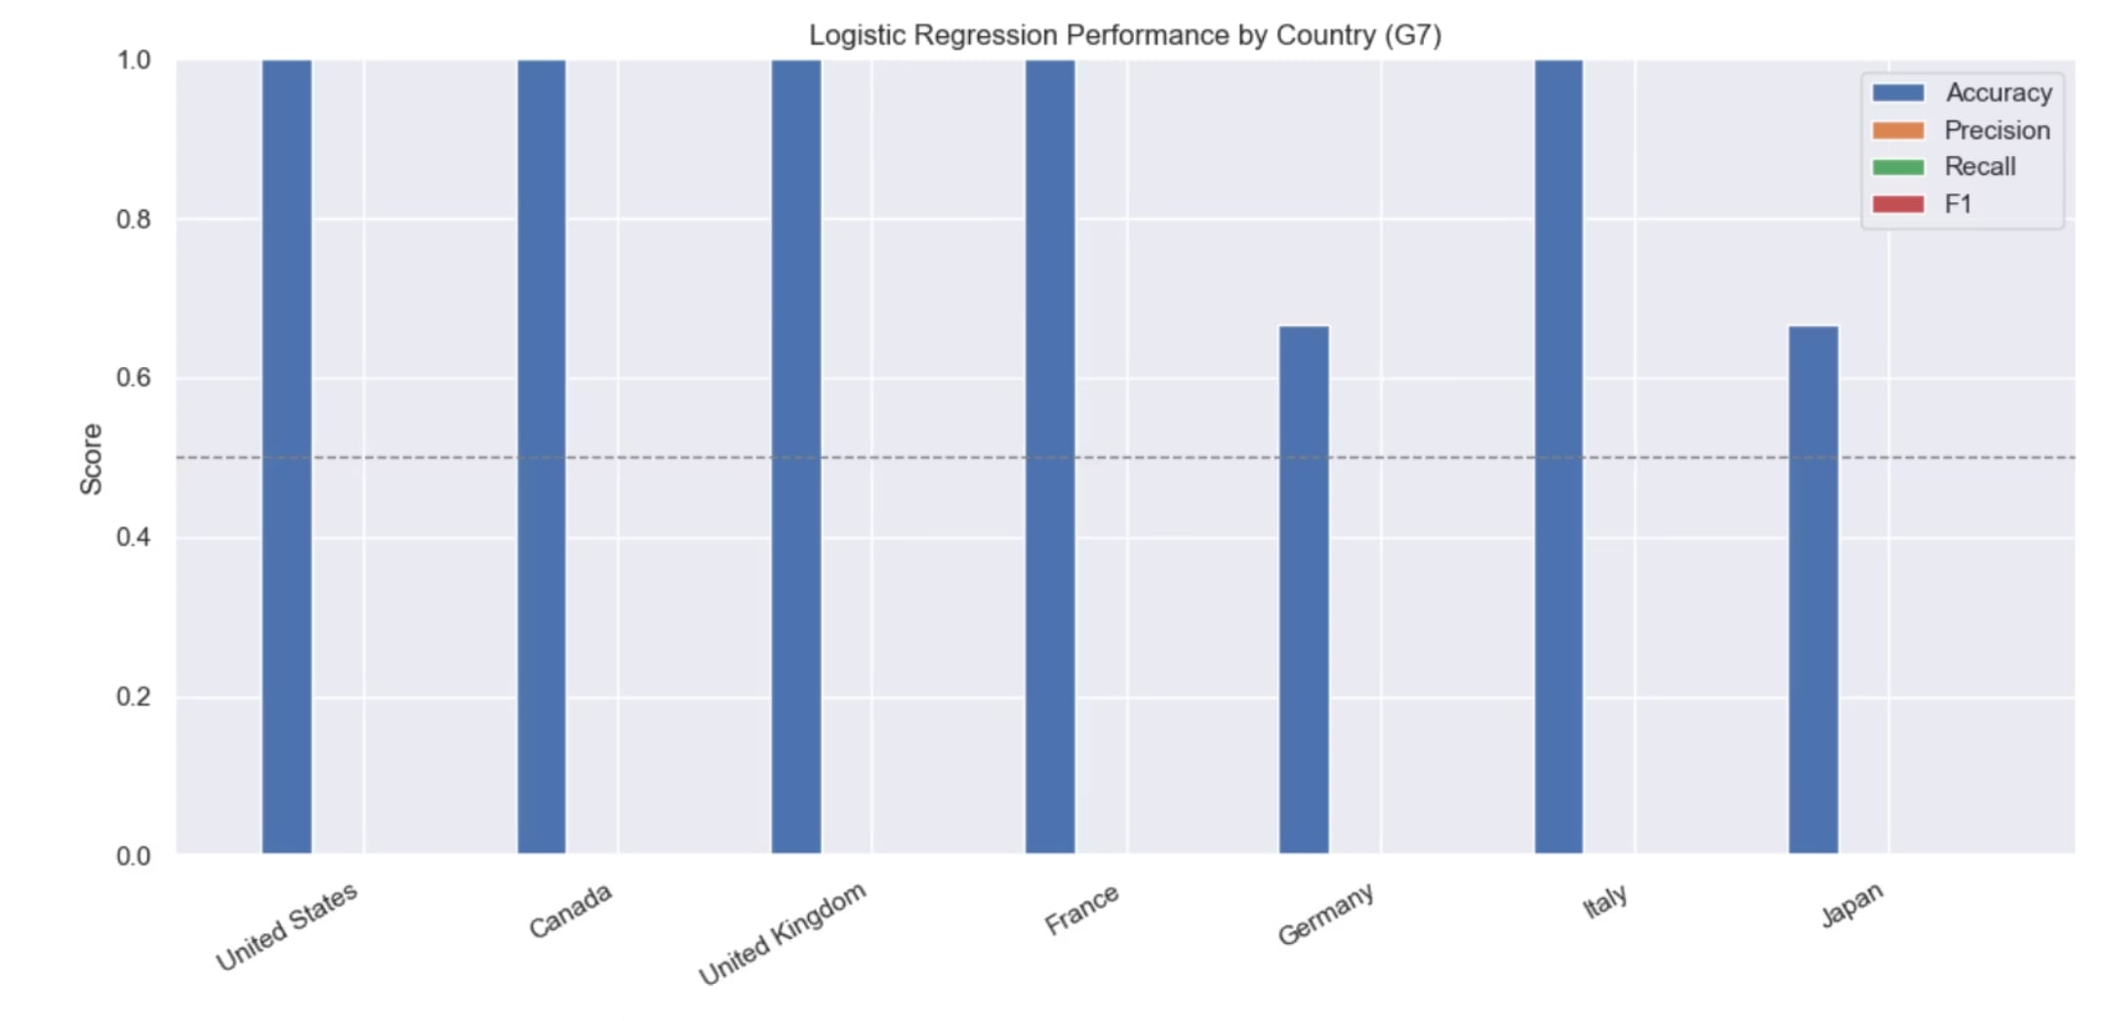
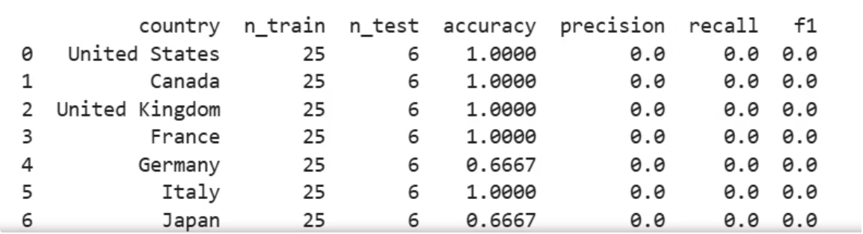
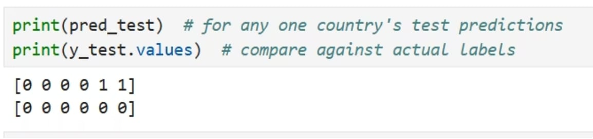
Version 1b (2 features + Logistic Regression)
11

Slide 12
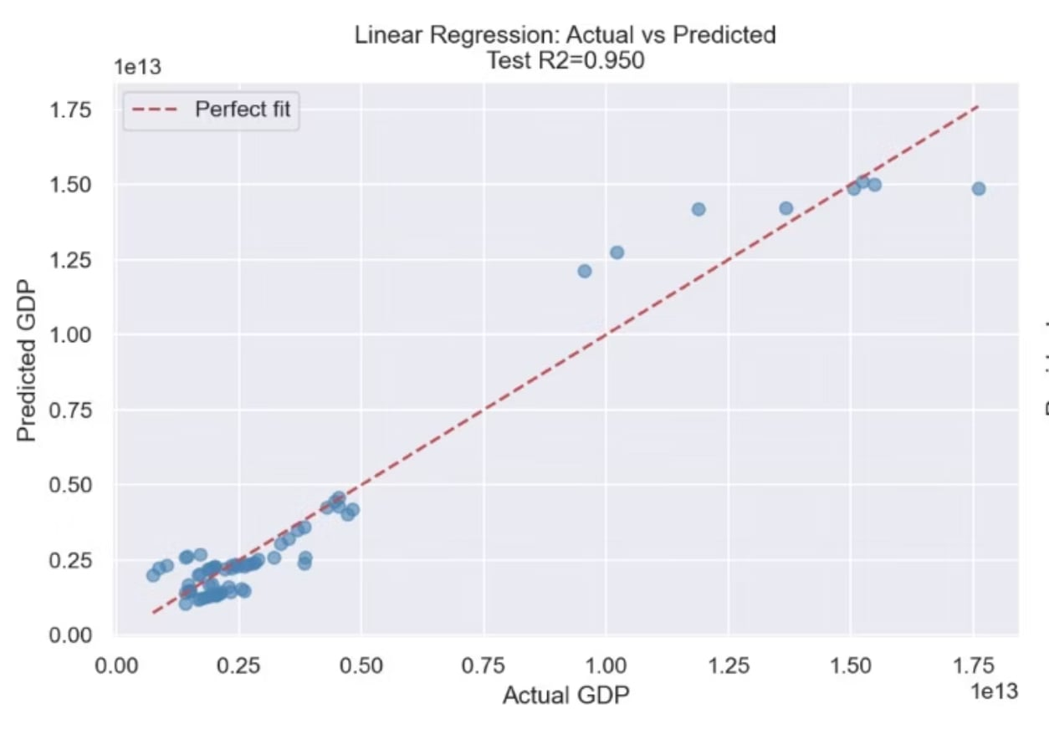
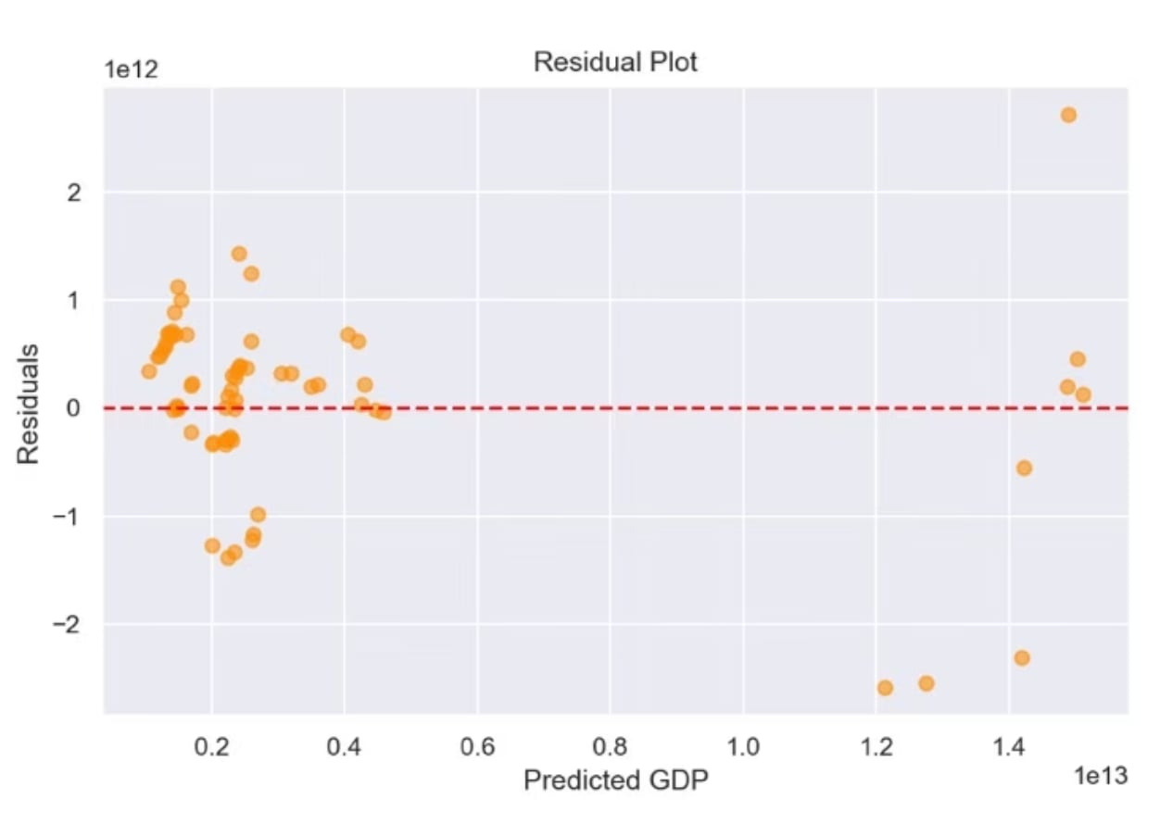
Classified by Year: G7 Subset
Version 1: Linear Regression
Predicting GDP directly from electricity generation and energy per capita across G7 countries, year by year.
Test R² = 0.950
Low residual spread
Best performance at mid-range GDP
vs. R² ≈ -0.001 on full 77-country panel
Errors cluster tightly around zero for most year-country pairs
Most accurate where G7 countries behave most consistently over time
12

Slide 13
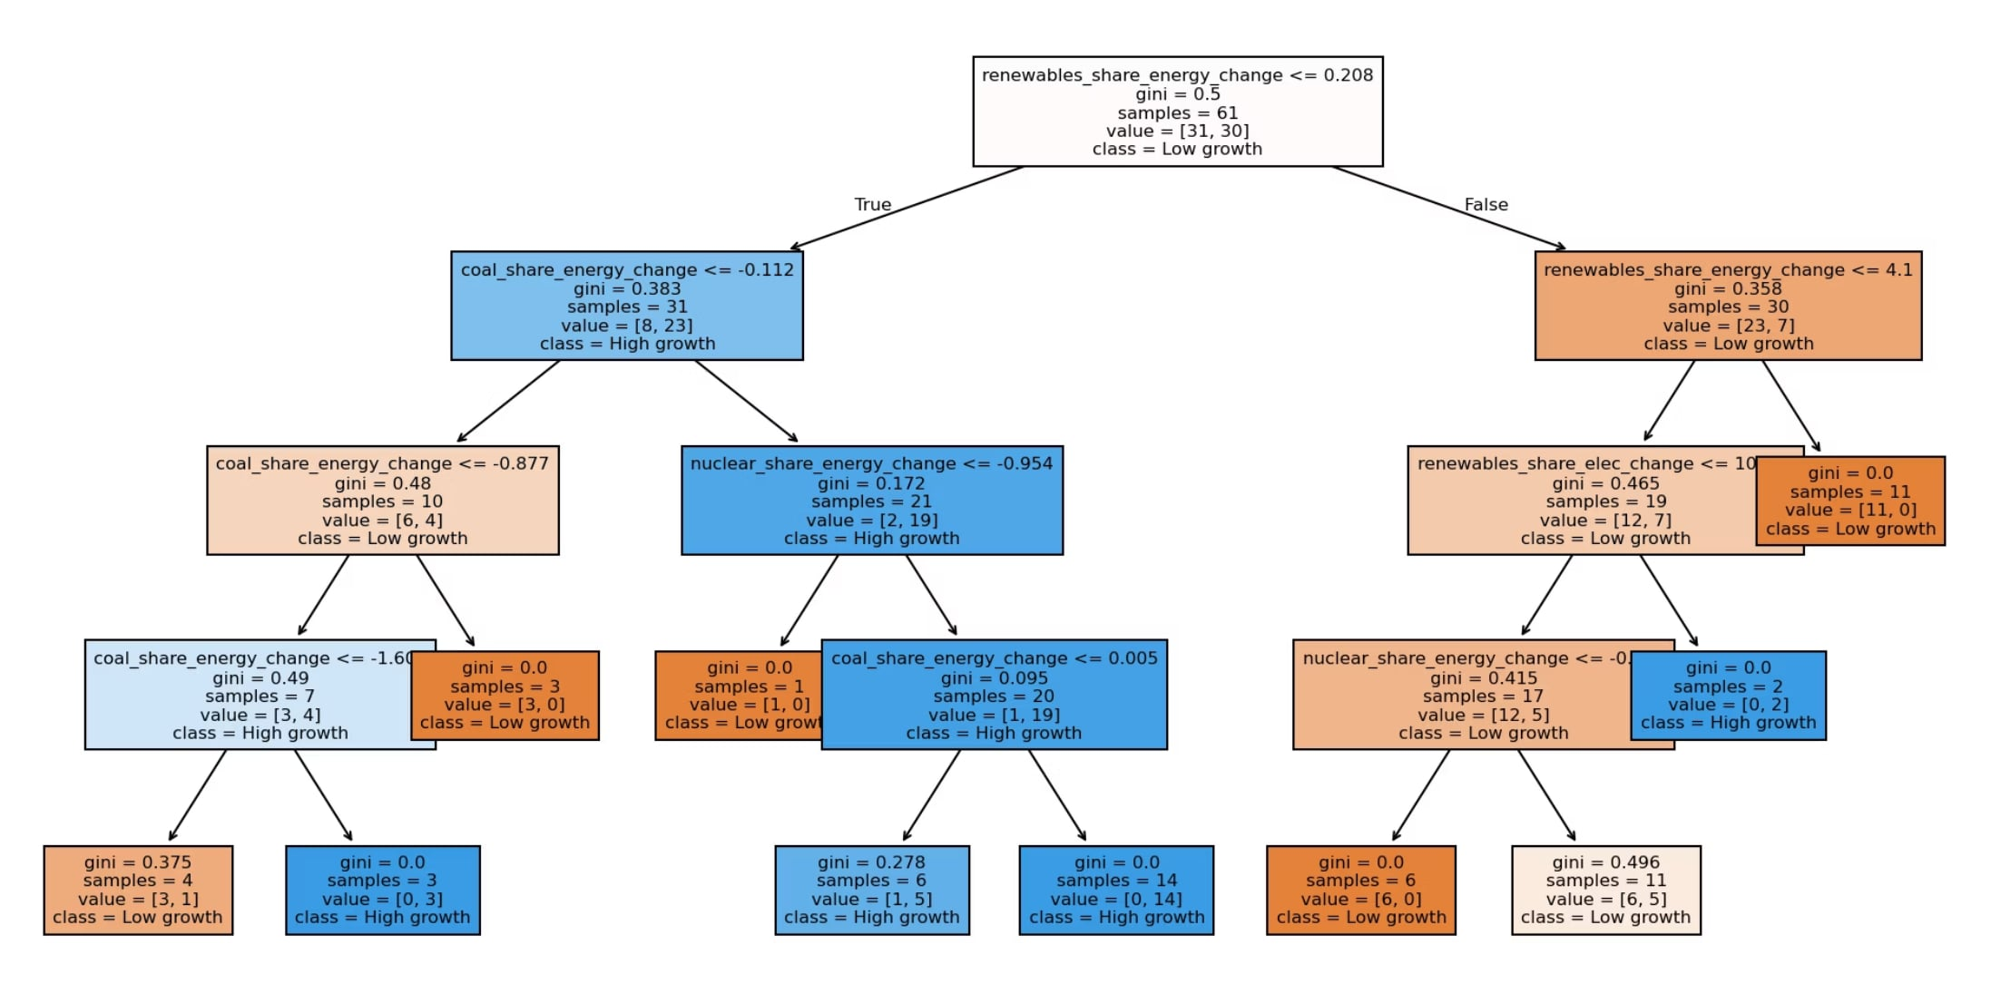
Decision Tree: Classification
Version 2: High/Low growth
Logistic Regression and Decision Tree classifiers on the G7 subset achieved 82–90% accuracy — a sharp improvement over ~57–59% from the full-country attempt.
Key Insight: Restricting to G7 economies — with comparable data quality and infrastructure — removed the heterogeneity noise causing negative R² and unstable classification.
13

Slide 14
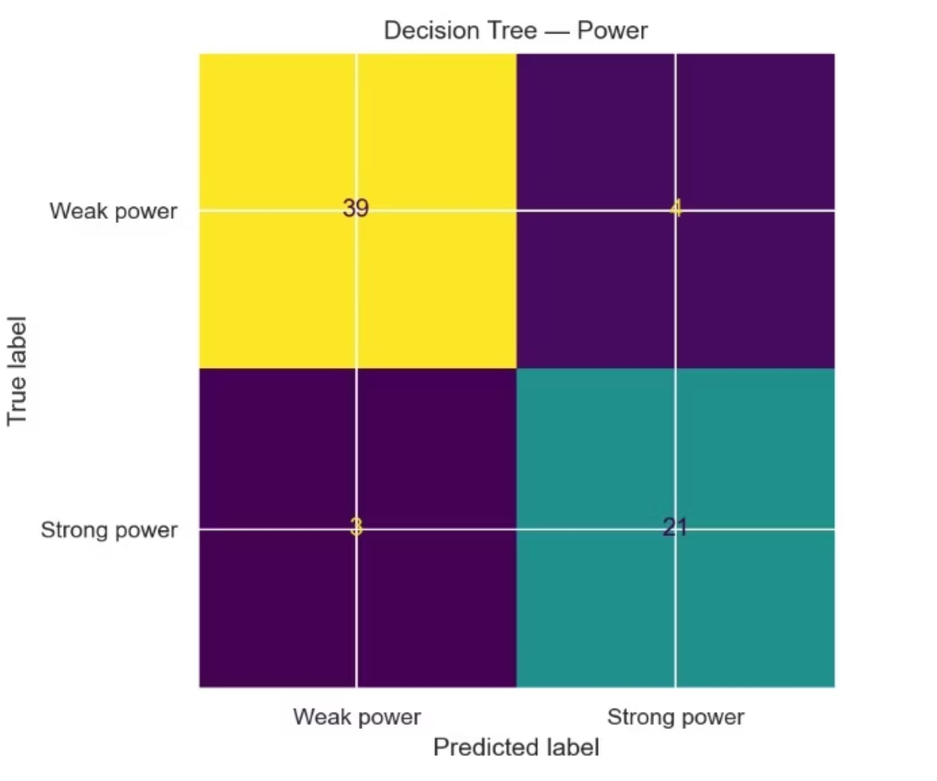
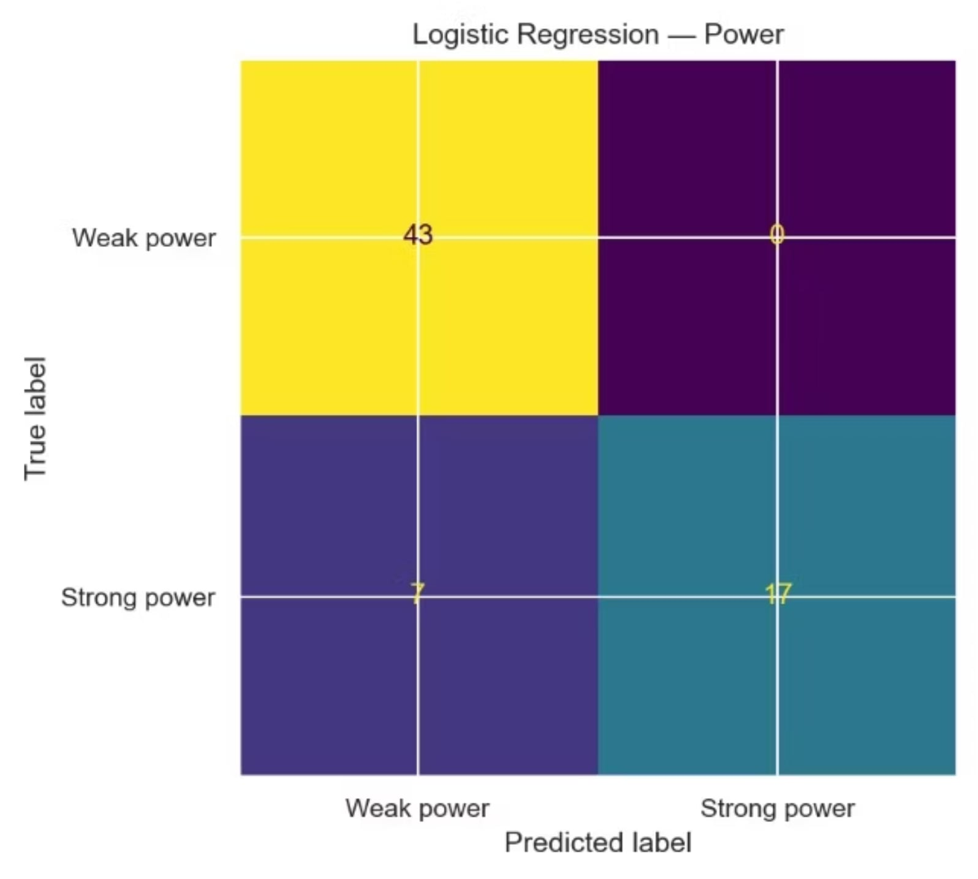
14

Slide 15
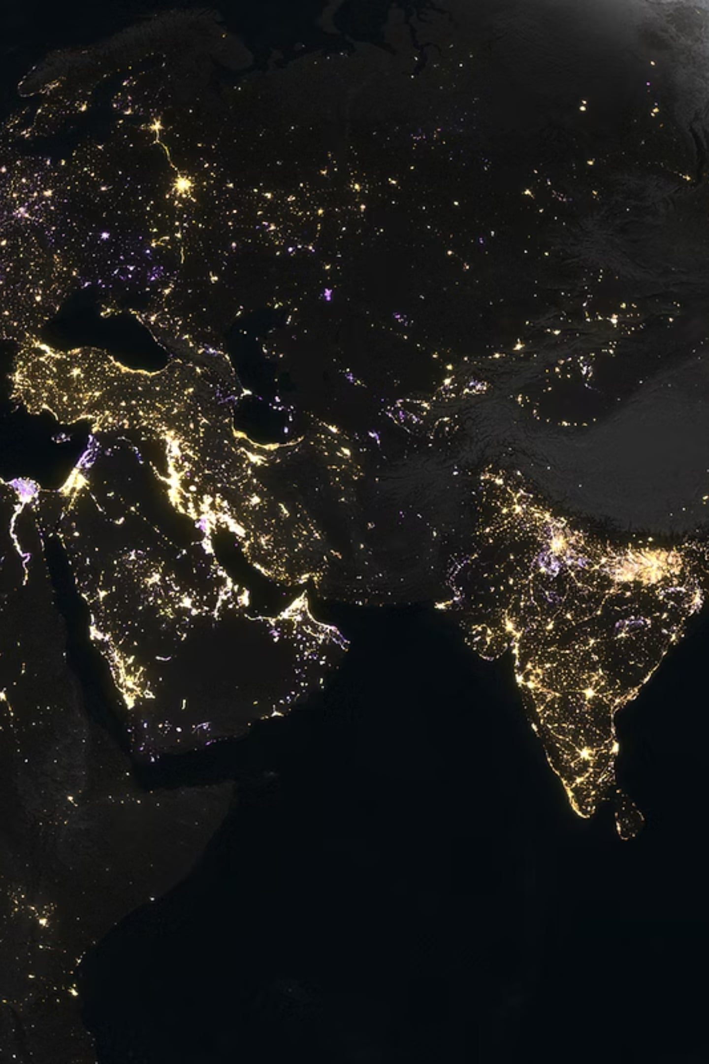
Conclusion
Not universally applicable
Heterogeneity is the key obstacle
Energy metrics do not reliably predict GDP progression across all countries — model performance varied significantly by classification and variable set.
G7-focused models succeeded (R² = 0.950, 82–90% accuracy), confirming that economic diversity — not modeling technique — drove earlier failures.
Final verdict
These energy metrics alone may not be the best way to measure a country's GDP and thus its progression.
15

