Slide 1

COVID-19 Vaccination Analysis
Project Title: COVID-19 Vaccinations - Global Insights & Trends
Submitted by: Saba Azhar Shaikh
Submitted to: Elevate labs
Date: May 19, 2025

Slide 2

Executive Summary
This report provides a detailed analysis of global COVID-19 vaccination trends using Power BI dashboards. It highlights the progress and distribution disparities of vaccination efforts worldwide.

Slide 3

Key Statistics
• Total Vaccinations Administered: 13.27 Billion
• People Vaccinated (1st Dose): 6.52 Billion
• People Fully Vaccinated: 2.96 Billion
• Latest Daily Vaccinations: 35.28 Million

Slide 4

Global Vaccination Trends
• Steady rise from Jan to May, peaking in
May (~0.75B)
• Decline from June; December lowest
• Countries with high daily vaccinations per million: Falkland Islands, Seychelles, UAE

Slide 5
Vaccination by Country
Top 5 Countries by Total Vaccinations:
1. China
2. United States
3. India
4. United Kingdom
5. Brazil

Slide 6

Vaccine Type Distribution
Most Widely Used Vaccines:
• Oxford/AstraZeneca: 16.73%
• Multi-combos (e.g., J&J, Moderna, Pfizer): 13.29%
• Regional variants like Sinovac, Covaxin also notable

Slide 7

Geographic Coverage
• High coverage in North America & Europe (0.7+ per hundred)
• Moderate in Asia & South America (0.5–0.69)
• Low in parts of Africa (<0.5)

Slide 8
Conclusion & Recommendations
Progress notable, but disparities remain
Recommendations:
Boost aid to low-income nations
Plan for boosters
Strengthen vaccine supply chains

Slide 9
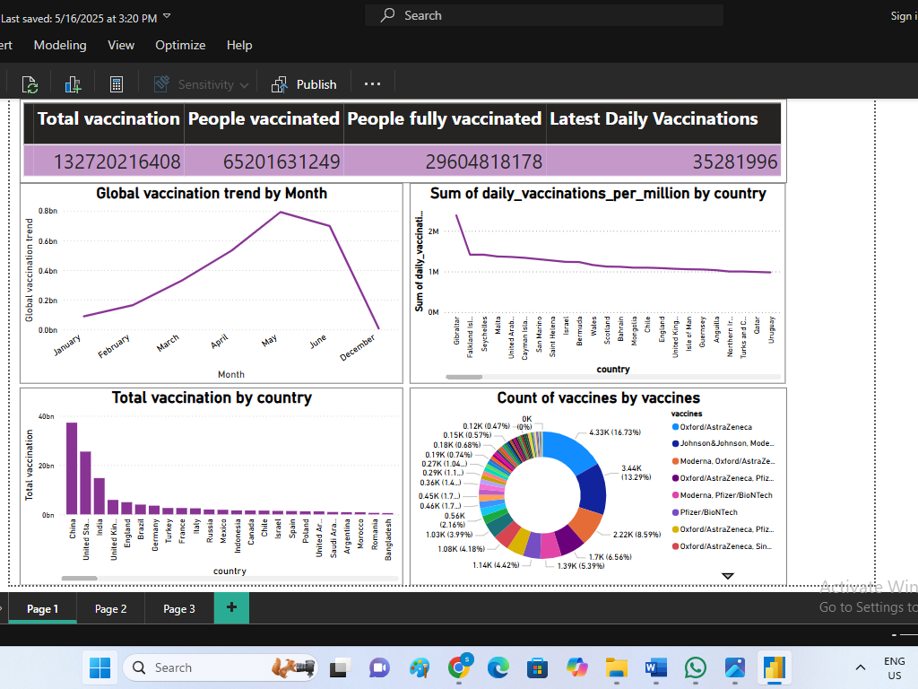

Slide 10
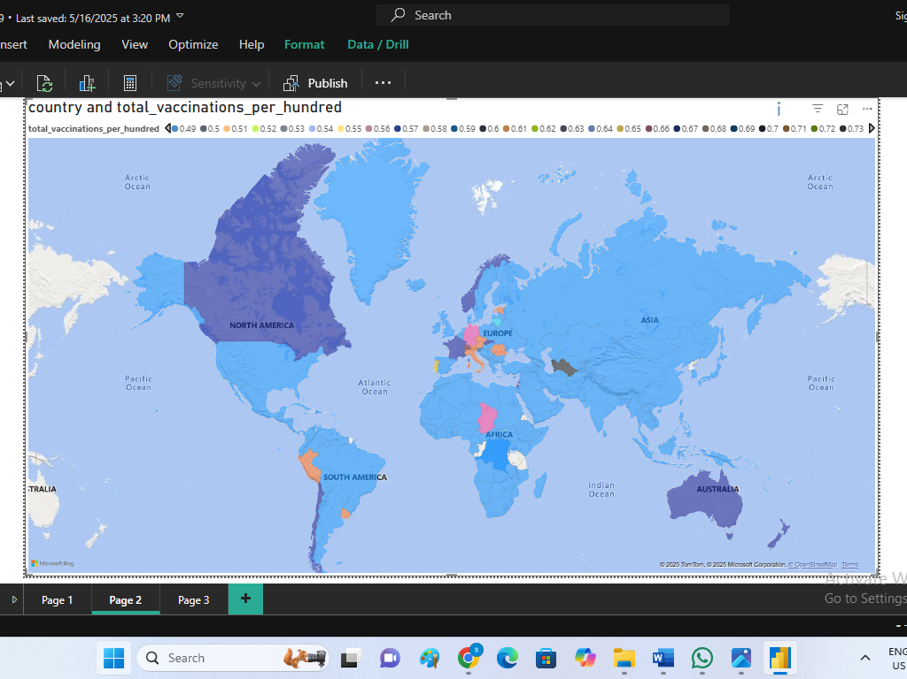

Slide 11
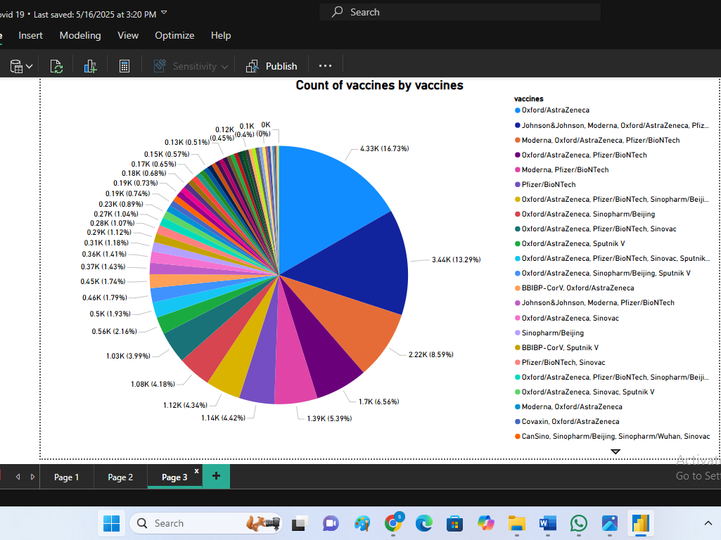

Slide 12

SQL Analysis Overview
In addition to Power BI visualizations, key analytical insights were derived using SQL queries in pgAdmin 4. These queries enhanced understanding of vaccination patterns and outliers across countries.

Slide 13
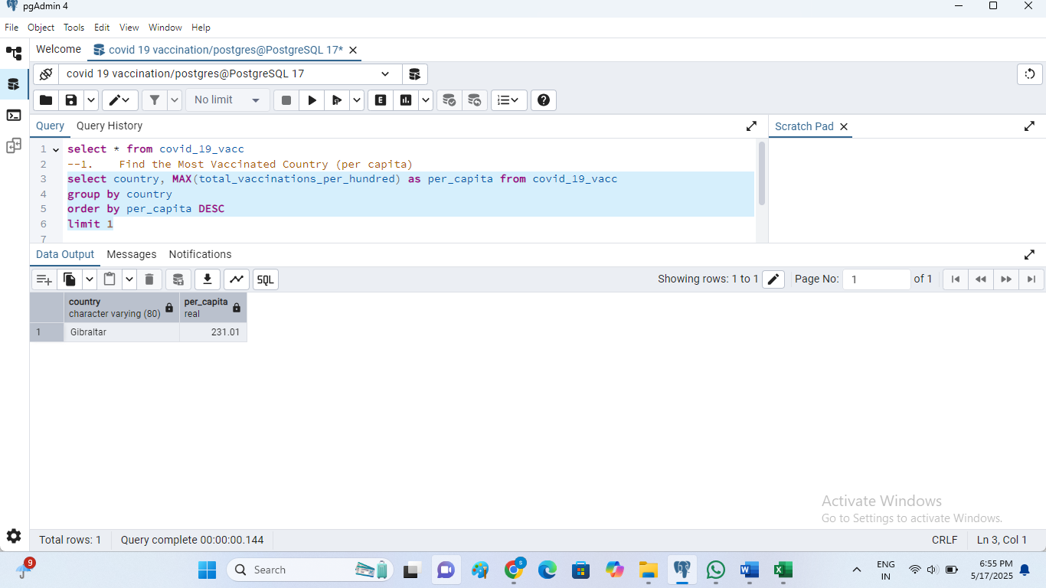
1. Most Vaccinated Country (Per Capita)
• Output: Country with the highest per capita vaccination rate.
• Insight: Enables identification of the most efficient vaccination program.

Slide 14
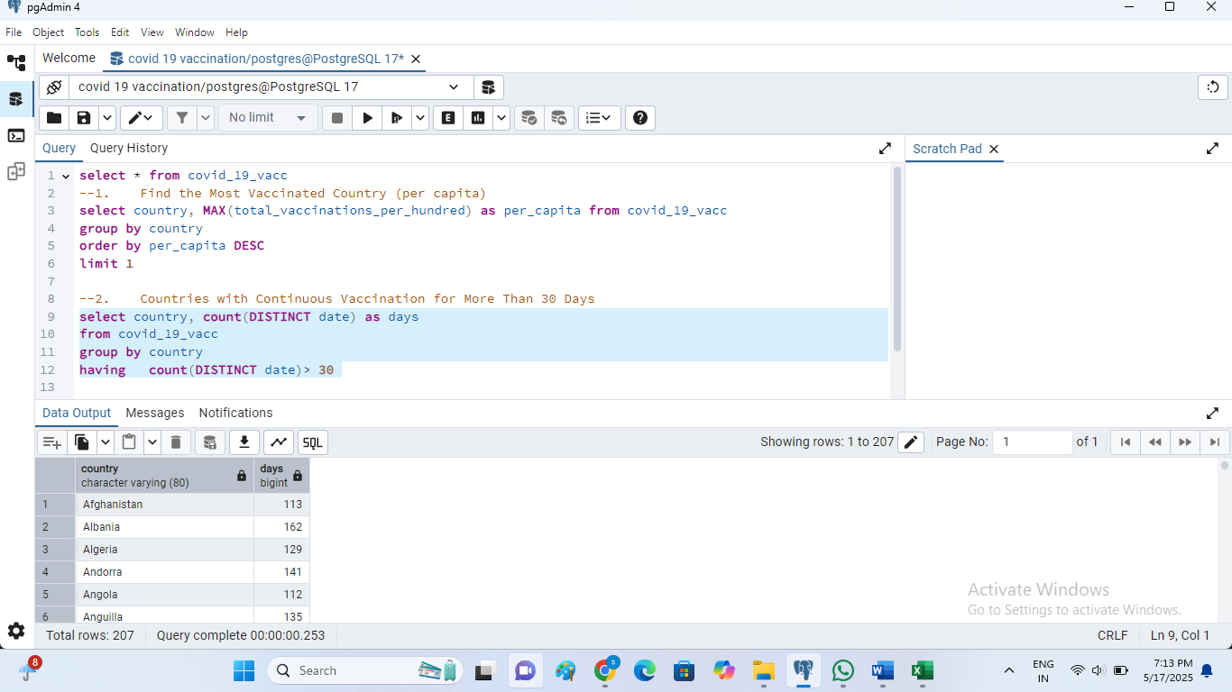
2. Continuous Vaccination for >30 Days
• Output: Countries with non-stop vaccination drives over 30 days.
• Insight: Reflects sustained government efforts.

Slide 15
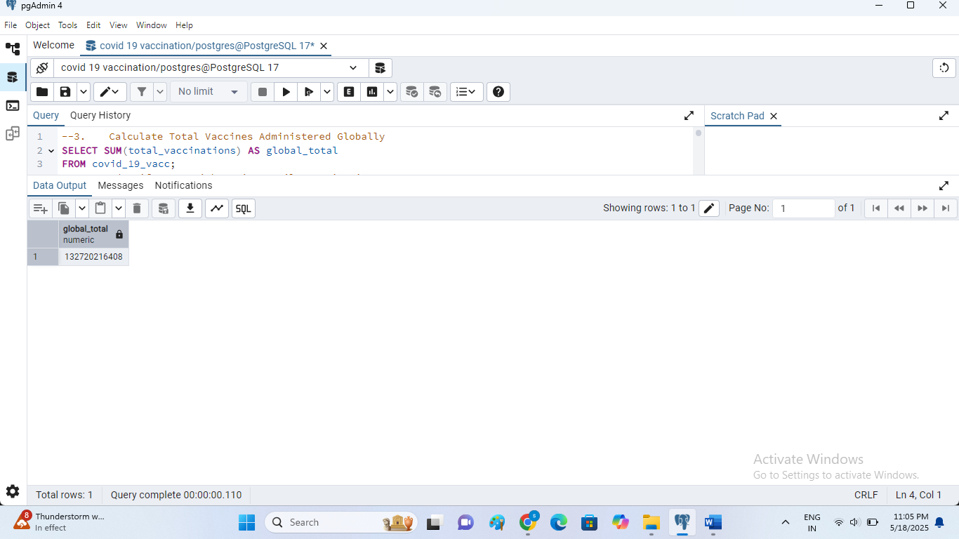
3. Total Vaccines Administered Globally
• Output: Global vaccination count (matches Power BI data).
• Insight: Cross-verification of data reliability.

Slide 16
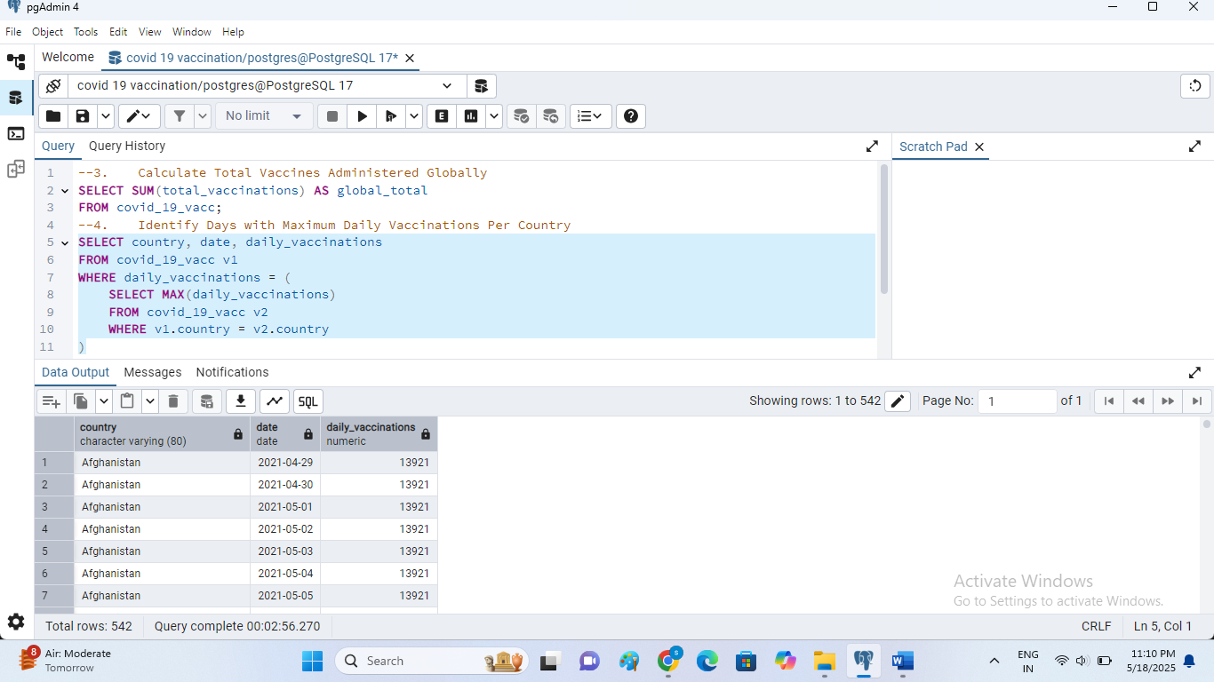
4. Maximum Daily Vaccinations by Country
• Insight: Identifies peak operational capacity by country.

Slide 17
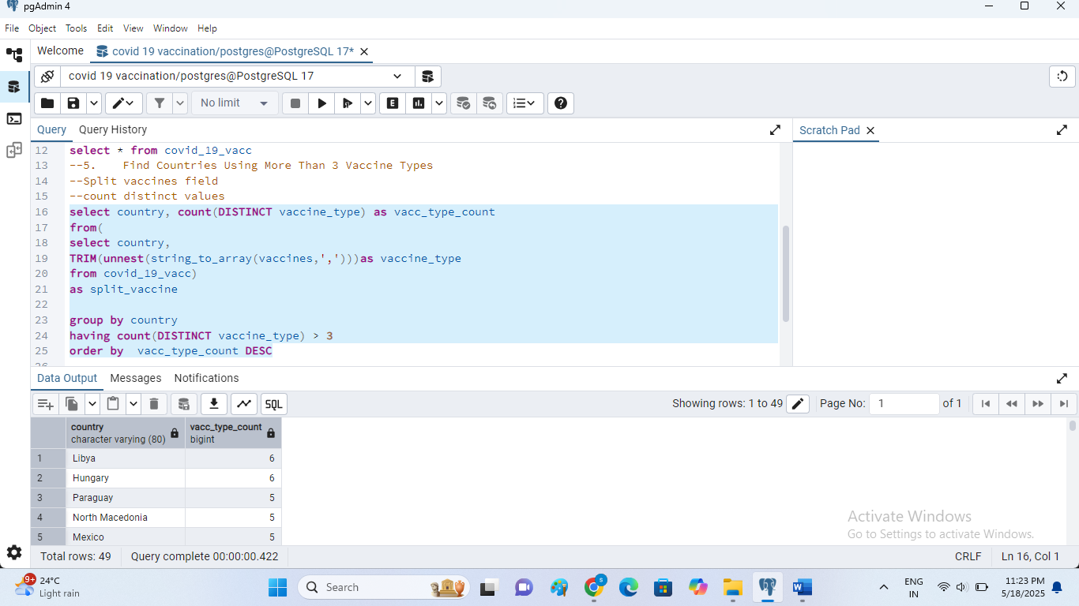
5. Find Countries Using More Than 3 Vaccine Types
• Output: Diversity in vaccine deployment.
• Insight: Flexibility in vaccine strategy and availability.

Slide 18
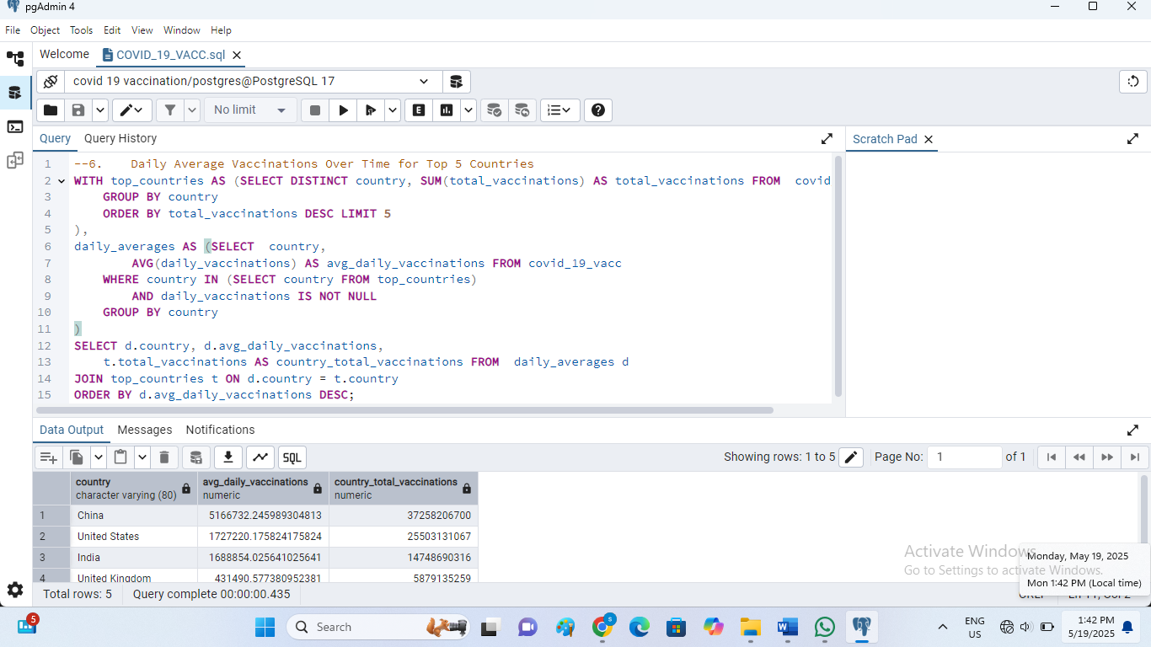
6. Daily Average Vaccinations - Top 5 Countries
Computes average daily doses for the top 5 vaccinating nations.
Insight: Highlights consistently strong performers in the vaccination campaign.

Slide 19
Conclusion - Integrated Insights
• Power BI: Visual trends and summary statistics.
• SQL (pgAdmin 4): In-depth, query-based data analysis.
• Combined approach strengthens reporting, validation, and storytelling through data.

