Slide 1
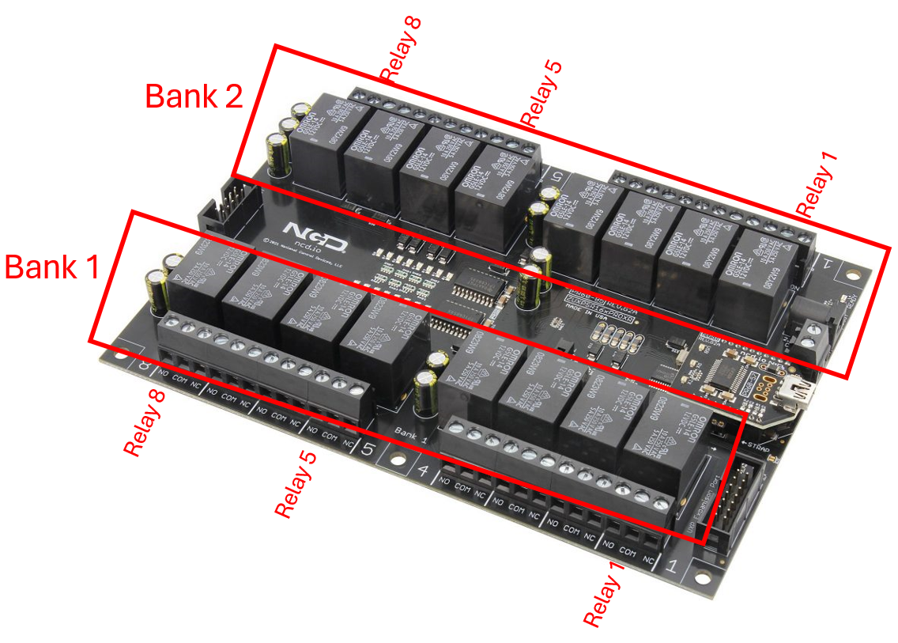
Custom RS485 : No Modbus
RS485 : Modbus
Baud : 9600
Parity : None
Data Bits : 8
Stop Bits : 1
Baud : 19200
Parity : None
Data Bits : 8
Stop Bits : 1
Left
RevPi RS485
Right
Left
USB RS485
Right
Bank 1 - Relay 1
L-SV01- sprayer
Bank 1 - Relay 5
R-SV01- sprayer
L-VFD
Modbus Address : 101
R-VFD
Modbus Address : 201
Bank 1 - Relay 2
L-SV02- to ambient
Bank 1 - Relay 6
R-SV02- to ambient
L-Energy Meter
Modbus Address : 102
R-Energy Meter
Modbus Address : 202
Bank 1 - Relay 3
L-SV03- to discharge
Bank 1 - Relay 7
R-SV03- to discharge
L-PID Controller
Modbus Address : 103
R-PID Controller
Modbus Address : 203
L-A01 – Inlet EE872
Modbus Address : 111
R-A01 – Inlet EE872
Modbus Address : 211
L-A02 – Outlet EE872
Modbus Address : 112
R-A02 – Outlet EE872
Modbus Address : 212
L-A05 – Diff Pressure EE600
Modbus Address : 113
R-A05 – Diff Pressure EE600
Modbus Address : 213
EE650
Temperature (C) – 0x3EA Air Velocity (m/s) – 0x410
L-A08 – Flow EE650
Modbus Address : 114
R-A08 – Flow EE650
Modbus Address : 214
EE600
Diff Pressure (Pa) – 0x4BE
EE872
CO2-avg (ppm) – 0x424
CO2-raw (ppm) – 0x426
Pressure (mbar) – 0x4B0
Temperature (C) – 0x3EA
RH (%) – 0x3FC
VFD
Frequency (0.01Hz) – 0x809 Power (% Rated 0.01) – 0x80A
Current (% Rated 0.01) – 0x80B Voltage (V 0.1) – 0x80C
Motor On/OFF (Boolean) – 0x80E

