Slide 1
TESTING WITH EYE.APPLITTOOL
Saba Zuhra (19L-2224)
Rabia Mehmood (19L-1167)
Iman Jawad (19L-2737)

Slide 2
Introduction
Creating and running demo tests is easy!
Support all web tech
Real time analytics
Root cause analysis

Slide 3
Eye Applittool
It’s a 3 step process
Create Eye Applittol account
for Eye API Key
Configure Key for the Testing
Write and execute the test cases

Slide 4
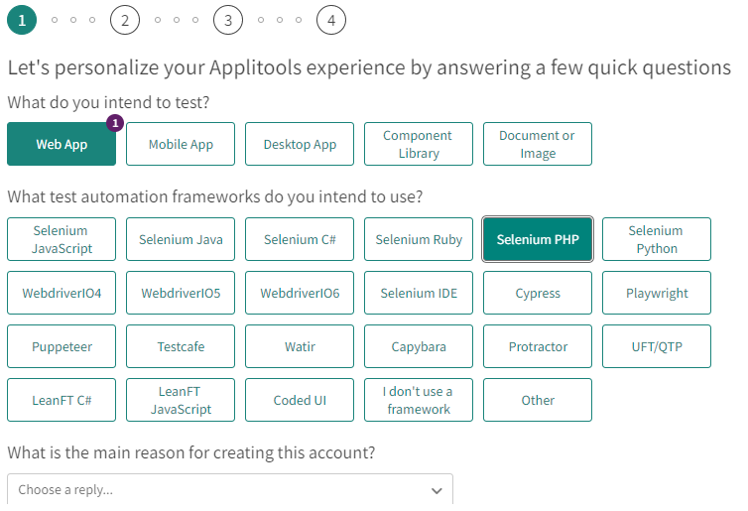
Pictorial Description of process

Slide 5
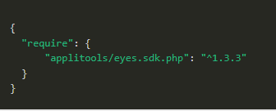
Installation of Composer
Step-1: Installation of Composer with ‘composer install’
Step-2: Include Applittool with ‘composer require applitools/eyes.sdk.php’
Step-3: create a composer.json file With following content:

Slide 6
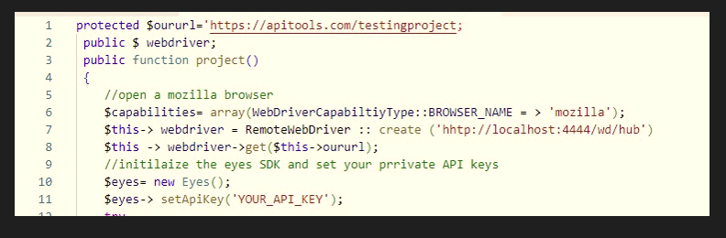
Writing Test Case

Slide 7
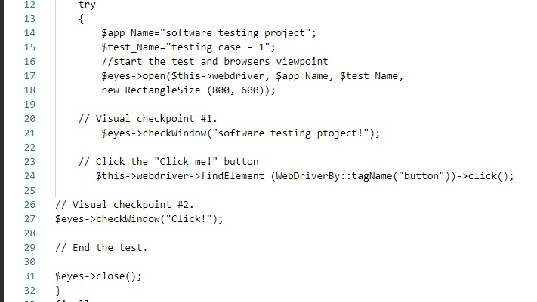

Slide 8
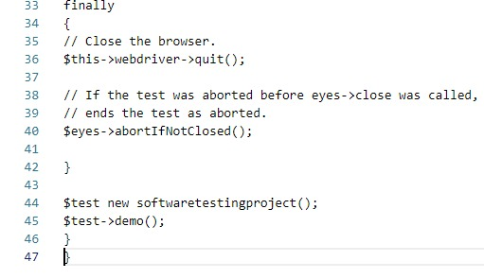

Slide 9
Thank You

