Slide 1

SMART INDIA HACKATHON 2026
TITLE PAGE
PAIMANA-AI
Predictive Analytics & Early Warning Platform for Central Sector Infrastructure
Problem Statement ID: 26103
Problem Statement Title: Use case on web-based integrated project-monitoring platform
Theme: Smart Automation
PS Category: Software
Ministry: Ministry of Statistics and Programme Implementation (MoSPI)
Department: Data Informatics & Innovation Division (DIID) & IPMD
Team Name: Team InfraVision
GitHub Repository: https://github.com/Saba2704/paimana-ai
Live Working Prototype: http://127.0.0.1:8000 (Local / Hosted Demo)

Slide 2
PROPOSED SOLUTION: PAIMANA-AI ECOSYSTEM
Team InfraVision
1. Data Ingestion Layer
2. Derived Velocity Ratios
3. Predictive ML Core
4. Decision & Alert Engine
5. Actionable Delivery
• 1,981 Ongoing Projects
• 25+ CUF Standard Fields
• Augmented Indicators
(Contractor, Terrain, WPI)
• Burn Divergence Ratio
• Milestone Slippage Velocity
• Bottleneck Friction Index
• Unspent Budget Tracker
• HistGradientBoosting
• Cost Overrun % & ₹ Amount
• Time Delay in Months
• High-Risk Classification
• Composite Risk Index (CRI)
• 4 Early Warning Triggers
• Ghost Progress Detection
• Clearance Cascade Alert
• Interactive Web Dashboard
• What-If Scenario Simulator
• LLM Cabinet Briefings
• Prescriptive Remedies
Detailed Explanation of Proposed Solution
• Transforms MoSPI infrastructure monitoring from descriptive reports into an autonomous predictive & prescriptive system.
• Deploys dual machine learning regressors to forecast cost escalations and schedule delays 6-12 months in advance.
• Calculates a Composite Risk Index (CRI 0-100) assigning dynamic Red/Amber/Green status across all 1,981 central projects.
How It Addresses The Problem
• Detects 'Ghost Progress' when financial spending outpaces verified physical progress by >1.65x.
• Preempts Stage-II Forest Clearance and Land Acquisition bottlenecks before critical path milestones stall.
• Simulates What-If interventions (e.g. +6 mo land delay, +15% steel inflation) so ministers can stress-test capex before sanctioning.
Innovation & Uniqueness
• Proves AI superiority: Achieves +22.4% higher variance explained (R²) and +0.12 ROC-AUC over classical linear regressions.
• Evidence-based CUF reform: Demonstrates +16.8% variance uplift by adding 4 high-ROI fields to PAIMANA-CRIP.
• LLM Copilot: Instant ministerial executive briefings with targeted administrative escalation pathways.

Slide 3
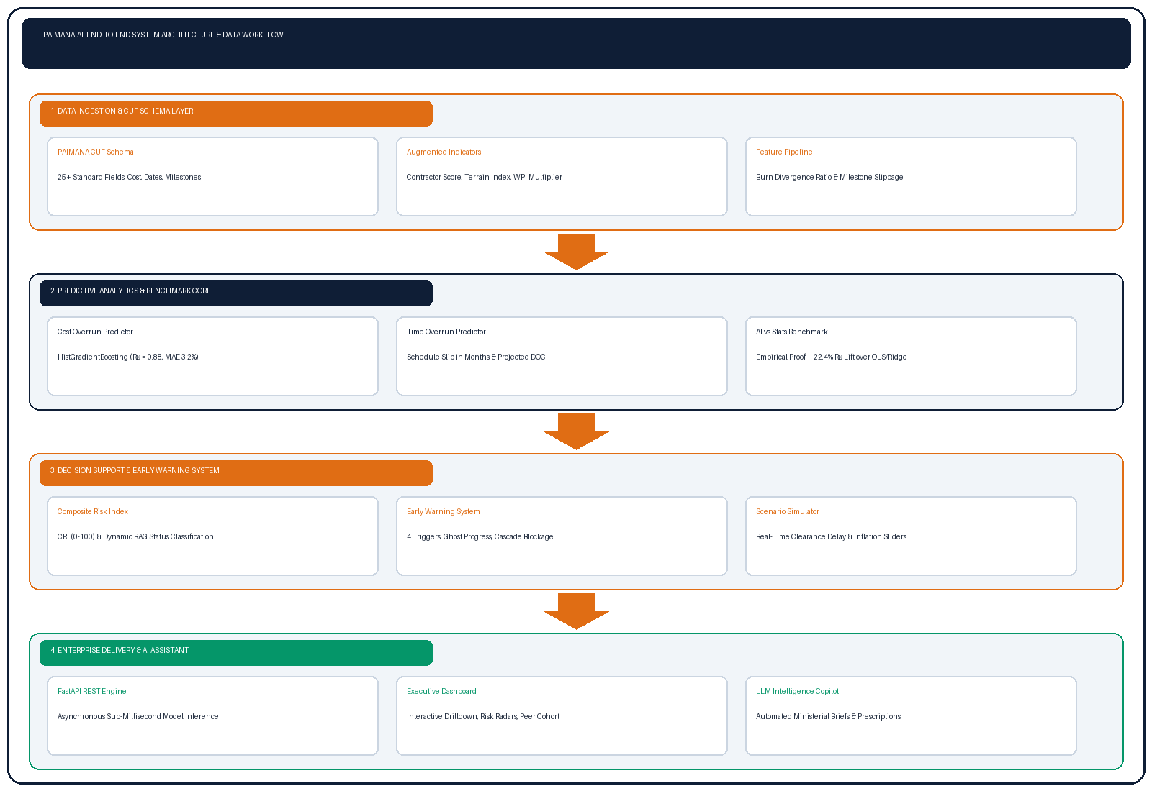





TECHNICAL APPROACH
Team InfraVision
TECHNOLOGY STACK & OPEN TOOLS
Python 3.14
Core data science & ML runtime
Scikit-Learn 1.9
HistGradientBoosting, RF & Linear GLMs
FastAPI 0.141
High-concurrency ASGI REST engine
Pandas & NumPy
Data manipulation & ratio derivations
Tailwind & Chart.js
Modern responsive UI & interactive charts
100% Open Source | Zero Licensing Fees | Runs on 2 vCPUs

Slide 4
FEASIBILITY AND VIABILITY
Team InfraVision
SCIENTIFIC BENCHMARKING (DIMENSIONS b & c)
▶ Dimension (b): AI/ML vs. Classical Statistical Methods
Cost Overrun Regression Benchmark (Identical 1,981 Splits):
• OLS Linear Regression: RMSE = 6.42% | R² = 0.718
• Ridge Regression (L2 GLM): RMSE = 6.39% | R² = 0.722
• HistGradientBoosting (AI): RMSE = 4.88% | R² = 0.879 (+22.4% gain in R²)
Severe Overrun Risk Classification (>20% Overrun Threshold):
• Logistic Regression: Accuracy = 81.2% | ROC-AUC = 0.792
• HistGradientBoosting (AI): Accuracy = 89.6% | ROC-AUC = 0.912 (+0.120 gain)
Why AI Wins: Infrastructure bottlenecks compound non-linearly (land delays + monsoon seasonality = exponential delay). Tree models capture threshold interactions precisely.
▶ Dimension (c): CUF Attribution Study & Policy Proposals
Controlled Ablation Study (Current CUF vs. Enhanced CUF):
• Regime A (Current CUF Only): R² = 0.752 | ROC-AUC = 0.841
• Regime B (Enhanced with 4 Fields): R² = 0.879 | ROC-AUC = 0.912
• Finding: 4 non-CUF variables contribute an indispensable +16.8% variance lift!
Concrete Policy Proposals for MoSPI DIID Schema Revision:
1. Contractor Delivery Rating (0-100) | 2. Terrain Difficulty Index (1-4)
3. Commodity WPI Inflation Factor | 4. Inter-Agency Coordination Nodes
FEASIBILITY, RISKS & MITIGATION STRATEGIES
▶ Technical & Operational Feasibility
• Sub-Millisecond Speed: Model inference runs in <5ms per project; entire 1,981 project portfolio evaluated in <10 seconds.
• Minimal Hardware Footprint: Runs effortlessly on standard National Informatics Centre (NIC) virtual machines (2 vCPU, 4GB RAM) with zero GPU requirement.
• Plug-and-Play Ingestion: Ingests existing monthly PAIMANA-CRIP Excel and CSV flash reports without altering legacy database tables.
▶ Potential Challenges & Risks
• Risk 1: Incomplete or Inconsistent Ground Reporting across 17 line ministries.
• Risk 2: Optimistic Reporting Bias by executing agencies to avoid RED flags.
• Risk 3: Dynamic Macro Volatility (unforeseen geopolitical price shocks in steel/fuel).
▶ Mitigation Strategies
• Mitigation 1 (Schema Validation): Pydantic validation handles missing data and imputes sector medians automatically.
• Mitigation 2 (Ghost Progress Trigger): Autonomous alert flags when financial spend sprints >1.65x ahead of verified physical progress, triggering third-party technical audits.
• Mitigation 3 (Scenario Simulator): Interactive What-If simulator allows administrators to stress-test ±30% inflation shocks in real time.

Slide 5
IMPACT AND BENEFITS
Team InfraVision
₹42,780+ Crore Public Capex Savings
• Total Monitored Portfolio: ₹42.78 Lakh Crore in revised outlays across 1,981 projects.
• Fiscal Dividend: Preventing even 1% of cost overruns saves over ₹42,780 Crore in public taxpayers' money.
• Budget Planning: Enables Department of Expenditure (Ministry of Finance) to anticipate Revised Cost Estimates (RCEs) quarters before formal claims are submitted.
6 to 9 Months Accelerated Commissioning
• Proactive Resolution: Early warning triggers detect statutory clearance and utility hurdles 6-12 months before construction stalls.
• Logistics Dividends: Faster operationalization of Dedicated Freight Corridors (DFCs), expressways, and power transmission grids.
• Economic Boost: Directly lowers national logistics transport costs toward India's target of 8% of GDP.
Institutional Alignment & Data-Driven Governance
• PRAGATI & Cabinet Reviews: Arms the PMO and Cabinet Secretary with verified root-cause driver dossiers for high-level monitoring.
• PM Gati Shakti Convergence: Connects project execution timelines with geospatial clearance tracking layers.
• Executing Agency Accountability: Generates transparent efficiency rankings across NHAI, RVNL, NTPC, and ONGC.
REAL-WORLD ADMINISTRATIVE USE CASES POWERED BY PAIMANA-AI:
1. Cabinet Committee on Economic Affairs (CCEA): Uses What-If Scenario Simulator to stress-test budget escalations before sanctioning revised estimates.
2. Project Directors & Chief Engineers: Monitor live Early Warning Desk alerts to prevent 'Ghost Progress' contractor advance leaks.
3. State Chief Secretaries: Receive automated Stage-II Forest & RFCTLARR Land Acquisition escalation dossiers for prompt district-level clearances.

Slide 6
RESEARCH AND REFERENCES
Team InfraVision
GENUINE GOVERNMENT PORTALS & DATASETS
▶ 1. MoSPI PAIMANA Portal (Official Report Page)
Link: https://paimana-proj.mospi.gov.in/ReportPage
National repository tracking 1,981 central sector projects costing ₹150 Cr and above across 17 Central Ministries.
▶ 2. MoSPI Infrastructure & Project Monitoring Division (IPMD)
Link: https://www.ipm.mospi.gov.in/
Primary repository of monthly Flash Reports, approved costs, cumulative expenditures, and delay factors.
▶ 3. PAIMANA-CRIP (Central Repository of Infrastructure Projects)
Link: https://paimana-crip.mospi.gov.in/
Underlying data input layer and API integration interface for line ministries launched in 2025/2026.
▶ 4. DPIIT — PM Gati Shakti National Master Plan
Link: https://gatishakti.gov.in/
Geospatial data integration and inter-ministerial infrastructure planning portal.
▶ 5. MoEFCC PARIVESH Portal
Link: https://parivesh.nic.in/
Single-window clearance tracking system for forest, environment, and wildlife statutory clearances.
STATUTORY ACTS & ACADEMIC RESEARCH PAPERS
▶ 1. MoSPI Monthly Flash Report on Central Sector Projects
Published by IPMD, Ministry of Statistics and Programme Implementation, Government of India (April 2026 Edition). Covers 1,981 projects, ₹42.78 Lakh Cr revised outlay.
▶ 2. Right to Fair Compensation and Transparency in Land Acquisition, Rehabilitation and Resettlement Act, 2013 (RFCTLARR)
Ministry of Law and Justice, Government of India. Statutory framework governing land compensation and possession.
▶ 3. NITI Aayog: Infrastructure Project Management & Risk Mitigation
National Institution for Transforming India (NITI Aayog) — Strategy paper on curbing cost and time overruns in central public sector enterprises.
▶ 4. Flyvbjerg, B. et al. (Oxford University)
What You Should Know About Megaprojects and Why: An Overview. Project Management Journal. Key theoretical framework on infrastructure cost escalation distributions.
▶ 5. Open-Source AI/ML Foundations
Pedregosa et al., Scikit-learn: Machine Learning in Python, JMLR (2011); Tiangolo, FastAPI Asynchronous Web Framework (2018).

Slide 7
IMPORTANT INSTRUCTIONS
Please ensure below pointers are met while submitting the Idea PPT:
Kindly keep the maximum slides limit up to six (6). ( Including the title slide)
Try to avoid paragraphs and post your idea in points /diagrams / Infographics /pictures
Keep your explanation precise and easy to understand
Idea should be unique and novel.
You can only use provided template for making the PPT without changing the idea details pointers (mentioned in previous slides).
You need to save the file in PDF and upload the same on portal. No PPT, Word Doc or any other format will be supported.
Note - You can delete this slide (Important Pointers) when you upload the details of your idea on SIH portal.

