Slide 1
Name: Sabapathy Vaisshnavi
College: Madras Institute of Technology
Reg No: 2021506078
NM ID: 0986969ECE8C2FDB6E84229D30D5207E
Final Project
3/21/2024 Annual Review

Slide 2
PROJECT TITLE
Location Classification
using CNN
3/21/2024 Annual Review

Slide 3


AGENDA
Problem Statement
Project Overview
End Users
Solution
Model Architecture
Result
3/21/2024 Annual Review

Slide 4

PROBLEM STATEMENT
To develop a machine learning model capable of accurately classifying images into distinct location categories based on visual features. The dataset comprises images captured from different geographical locations, each belonging to one of the following categories: street, sea, mountain, forest, glacier, or building. The challenge lies in building a robust classification model that can effectively differentiate between visually diverse landscapes and accurately classify images into the correct location categories.
3/21/2024 Annual Review

Slide 5

PROJECT OVERVIEW
The location classification project aims to develop an automated system for classifying images into distinct geographical location categories using image analysis techniques. Leveraging machine learning and deep learning methodologies, the project focuses on designing and implementing a Convolutional Neural Network (CNN) model capable of accurately identifying locations such as streets, seas, mountains, forests, glaciers, and buildings from input images. By collecting and preprocessing a diverse dataset of images representing various geographical landscapes, the project endeavours to train and validate the CNN model to achieve high accuracy and robustness in location classification. The project addresses challenges such as variability in image appearance, class imbalance, and model generalization through rigorous experimentation and optimization. Upon successful completion, the developed model is expected to have practical applications in environmental monitoring, urban planning, tourism analysis, and other fields, providing valuable insights and facilitating data-driven decision-making processes.
3/21/2024 Annual Review

Slide 6

WHO ARE THE END USERS?
Environmental Agencies: Utilize location classification for monitoring and analyzing changes in natural habitats, vegetation cover, and land use patterns.
Urban Planners: Incorporate location classification insights for assessing urban development, green space distribution, and infrastructure planning.
Tourism Industry: Employ location classification to enhance travel recommendations, identify popular destinations, and personalize tourist experiences.
Remote Sensing Researchers: Leverage location classification for analyzing satellite imagery, studying environmental phenomena, and conducting geographic research.
Emergency Services: Utilize location classification to identify areas prone to natural disasters, assess emergency response needs, and enhance disaster preparedness.
Geospatial Analysts: Integrate location classification into geographic information systems (GIS) for spatial analysis, mapping, and visualization purposes.
3/21/2024 Annual Review

Slide 7
YOUR SOLUTION AND ITS VALUE PROPOSITION
Solution:
Automated Location Classification: Develop a machine learning model capable of automatically classifying images into distinct geographical location categories using image analysis techniques.
Convolutional Neural Network (CNN) Model: Implement a robust CNN architecture tailored for location classification tasks, leveraging deep learning methodologies.
Data-driven Insights: Provide accurate and reliable location classification results to enable informed decision-making in various domains.
Value Proposition:
Efficiency: Streamline location classification processes, saving time and resources compared to manual image analysis methods.
Accuracy: Achieve high accuracy and reliability in location classification, enabling precise identification of geographical features and landscapes.
Versatility: Adapt the solution to diverse applications including environmental monitoring, urban planning, tourism analysis, and disaster management.
Insights: Generate valuable insights from location classification results to facilitate data-driven decision-making and strategic planning initiatives.
3/21/2024 Annual Review

Slide 8
THE WOW IN YOUR SOLUTION
Cutting-Edge Technology: Leveraging state-of-the-art machine learning and deep learning techniques to automate location classification with unprecedented accuracy and efficiency.
Real-Time Analysis:Providing instantaneous location classification results, enabling rapid decision-making and response to dynamic environmental changes.
Adaptability: Tailoring the solution to diverse applications and industries, from environmental monitoring to urban planning, showcasing its versatility and wide-ranging impact.
Precision Mapping:Delivering highly detailed and precise maps of geographical locations, empowering users with granular insights into terrain features and landscape characteristics.
Scalability: Designing a scalable solution capable of handling large-scale datasets and accommodating future growth and expansion in data volume and application domains.
Actionable Insights: Going beyond mere classification to offer actionable insights and recommendations, empowering users to make informed decisions and drive positive outcomes.
3/21/2024 Annual Review

Slide 9
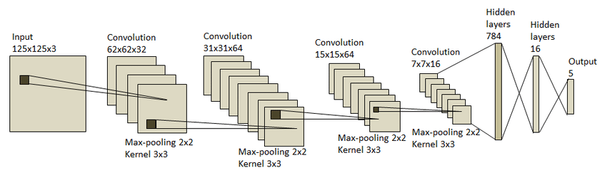
MODELLING - Architecture
3/21/2024 Annual Review

Slide 10
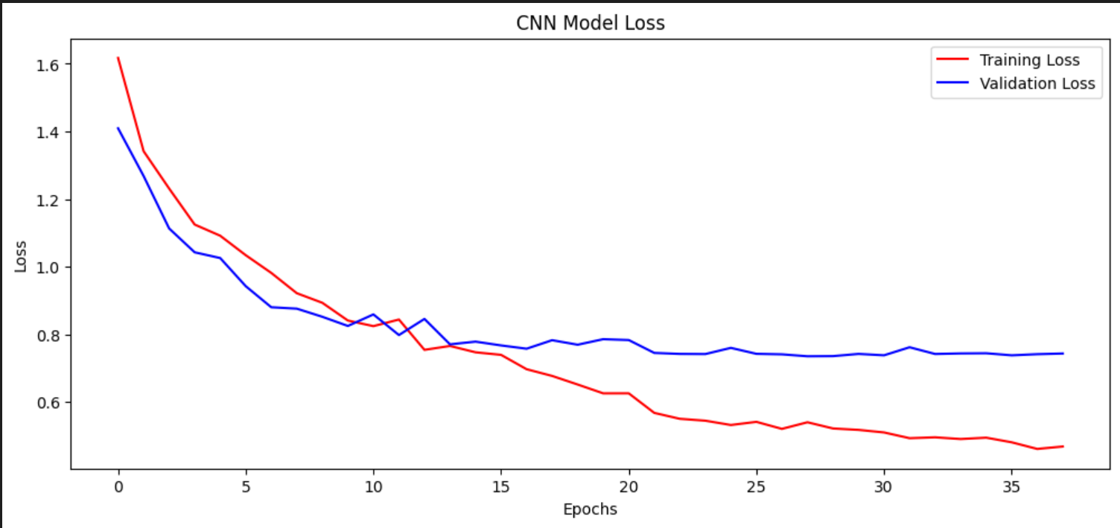
RESULTS - model
3/21/2024 Annual Review

Slide 11
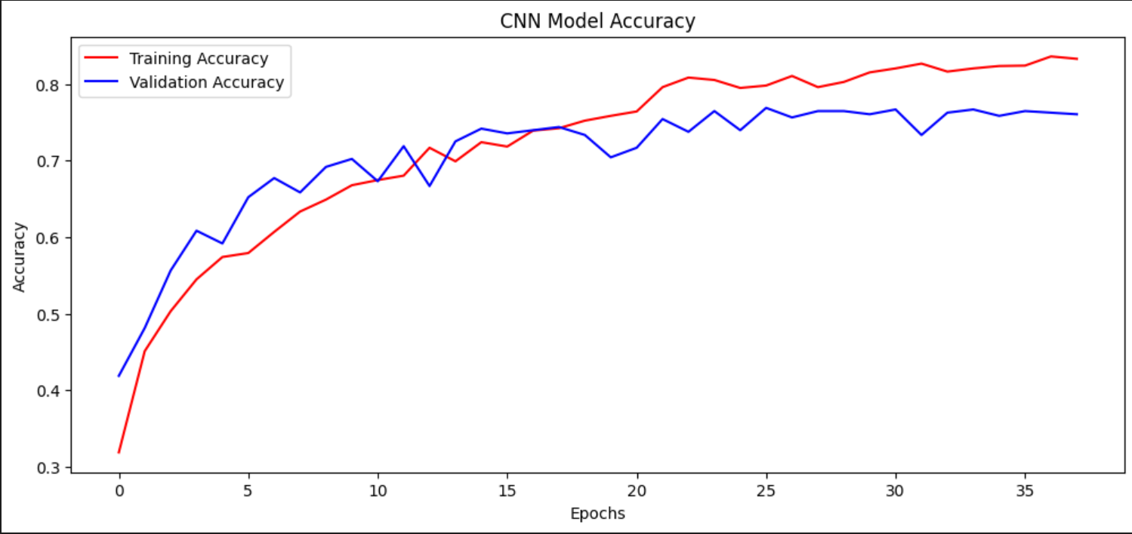
RESULTS - model
Demo Link
3/21/2024 Annual Review

Slide 12
RESULTS
Successfully Developed and Deployed a Location Classification tool.
Achieved High Accuracy in Predicting User Preferences and Behavior
Enhanced User Engagement and Satisfaction Across Multiple Platforms
Positive Feedback from Users and Stakeholders on Improved Shopping Experience
Demo Link
3/21/2024 Annual Review

