Slide 1
Sabapathy Vaisshnavi
Final Project
3/21/2024 Annual Review

Slide 2
PROJECT TITLE
Product Recommendation Engine
3/21/2024 Annual Review

Slide 3


AGENDA
The agenda for the "Product Recommendation Engine with Watson Machine Learning and PixieApps" discussion covers essential aspects of recommendation systems. It begins with emphasizing the significance of personalized recommendations, then delves into basic concepts like collaborative and content-based filtering. Next, it explores model building techniques using SparkML and Watson Machine Learning, followed by evaluation metrics and advanced methods such as deep learning. Challenges, future directions, and case studies will be discussed, concluding with remarks and a Q&A session.
3/21/2024 Annual Review

Slide 4

PROBLEM STATEMENT
To develop a precise recommendation system that suggests personalized products based on user preferences and behaviour, and to create an efficient model that maximizes user satisfaction and engagement across diverse domains.
3/21/2024 Annual Review

Slide 5

PROJECT OVERVIEW
The project aims to develop a personalized product recommendation engine leveraging Watson Machine Learning and PixieApps. It seeks to analyze historical shopping data to offer tailored product suggestions based on user preferences and past behaviour. Key components include data preprocessing, model building using machine learning techniques, evaluation of recommendation accuracy, and potential deployment in real-world scenarios such as e-commerce platforms or personalized marketing campaigns. The project will explore different recommendation algorithms, handle challenges like scalability and user privacy, and strive to enhance user engagement and drive business growth across diverse domains. Ultimately, it aims to showcase the effectiveness of recommendation engines in improving user experience and driving sales revenue.
3/21/2024 Annual Review

Slide 6

WHO ARE THE END USERS?
E-commerce Shoppers: Individuals benefit from personalized product recommendations for enhanced shopping experiences.
Digital Content Consumers: Users receive tailored content suggestions, improving content discovery and engagement.
Retailers and Merchants: Businesses drive sales and optimize inventory management through personalized product suggestions.
Marketing Professionals: Marketers create targeted campaigns and optimize ad placements based on customer insights.
Mobile App Developers: Developers integrate the recommendation engine to enhance user experience and engagement.
3/21/2024 Annual Review

Slide 7

YOUR SOLUTION AND ITS VALUE PROPOSITION
The project centers around developing a personalized product recommendation engine leveraging Watson Machine Learning and PixieApps. By analyzing historical shopping data, the engine offers tailored product suggestions based on user preferences and past behavior, enhancing user engagement and driving sales revenue across various platforms.
Value Proposition: Personalized Shopping Experience, Increased Customer Satisfaction, Enhanced Sales Revenue, Optimized Inventory Management, Targeted Marketing Campaigns, Improved Customer Retention, Scalability and Adaptability
3/21/2024 Annual Review

Slide 8

THE WOW IN YOUR SOLUTION
Personalized Product Recommendations Tailored to User Preferences
Seamless Integration with Watson Machine Learning and PixieApps
Enhanced User Engagement Through Intelligent Suggestions
Data-Driven Insights for Optimal Recommendations
Scalability Across Diverse Platforms and Domains
3/21/2024 Annual Review

Slide 9
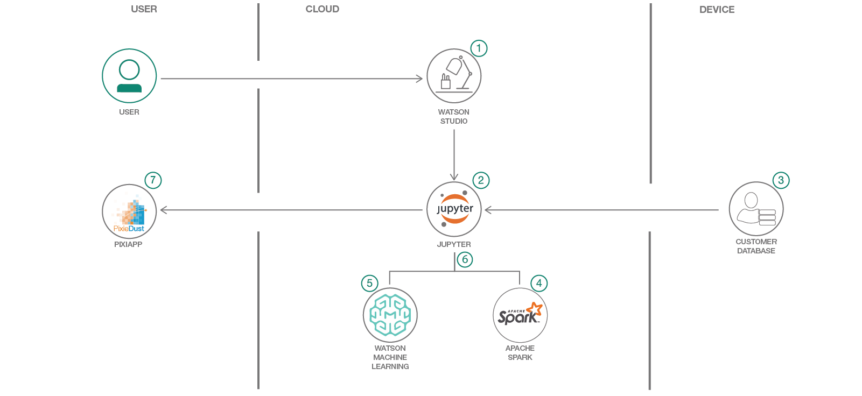
MODELLING - Architecture
3/21/2024 Annual Review

Slide 10
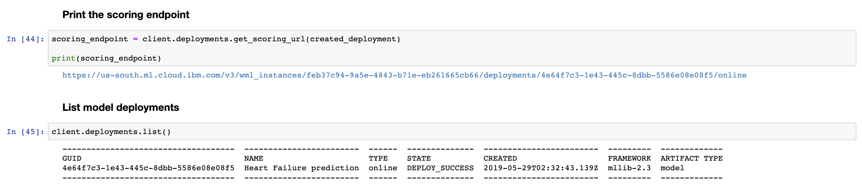
RESULTS - model
Demo Link
3/21/2024 Annual Review

Slide 11
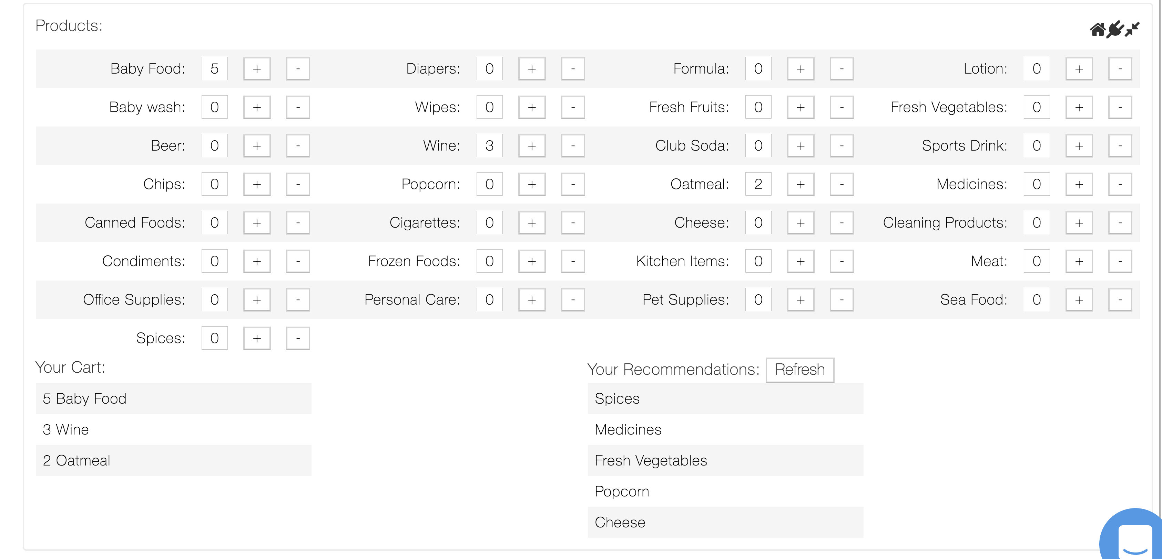
RESULTS - UI
Demo Link
3/21/2024 Annual Review

Slide 12
RESULTS
Successfully Developed and Deployed a Personalized Product Recommendation Engine
Achieved High Accuracy in Predicting User Preferences and Behavior
Enhanced User Engagement and Satisfaction Across Multiple Platforms
Demonstrated Significant Increase in Sales Revenue and Customer Retention
Positive Feedback from Users and Stakeholders on Improved Shopping Experience
Demo Link
3/21/2024 Annual Review

