Slide 1

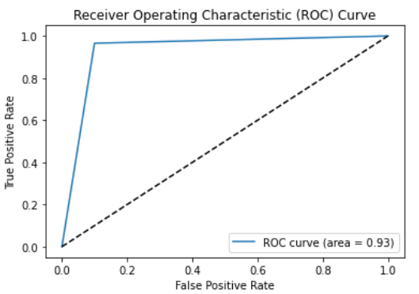
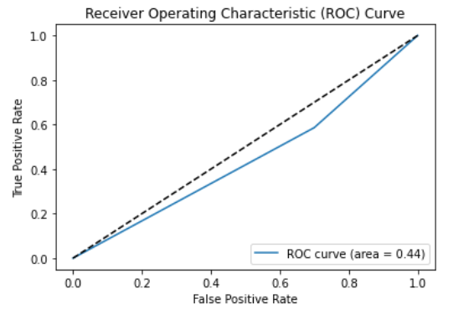
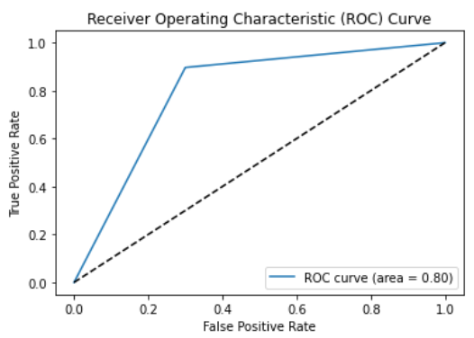
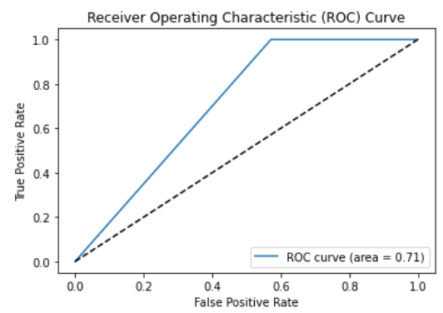
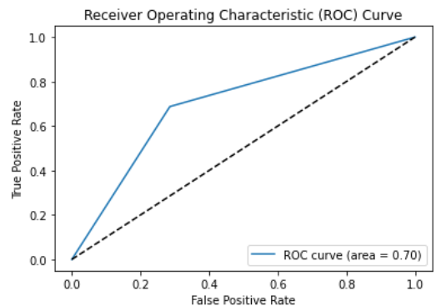
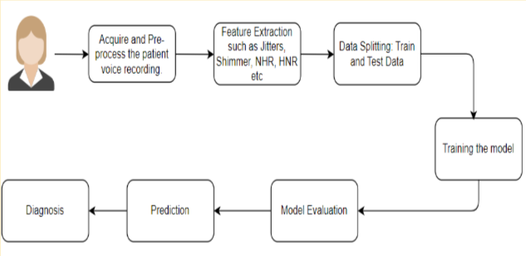
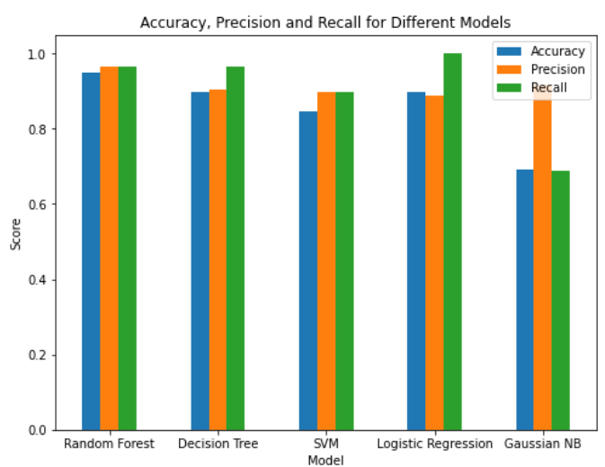
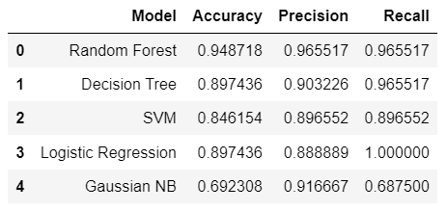
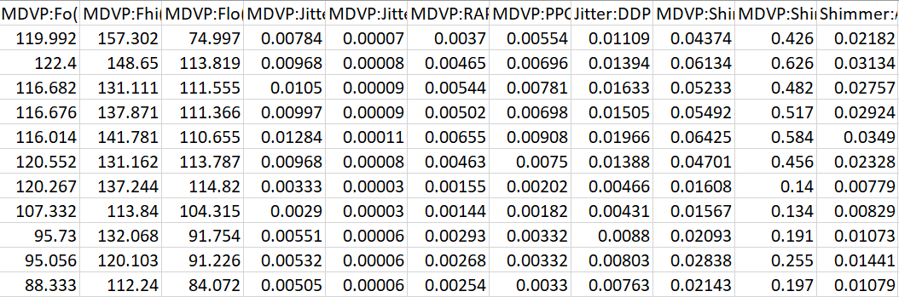
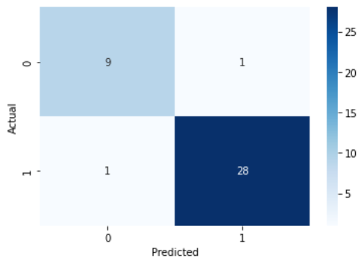
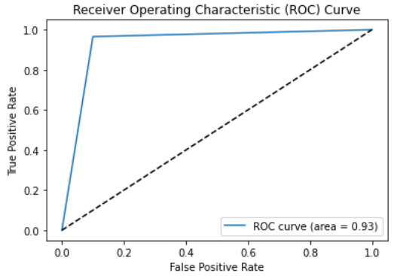
Detection of Parkinson’s Disease Using Random Forest Classifiers Sabahat Shaik, 20WU0101019, Computer Science Engineering
Overview:
Parkinson's disease is a progressive neurological disease that results in tremors, stiffness, and trouble with coordination, making early detection essential for proper care and treatment. Traditional methods of diagnosis are based on clinical evaluation and imaging, which can be biased and time-consuming. Machine learning algorithms provide a more objective and efficient approach to Parkinson's disease diagnosis.
Objective:
To build a machine learning model based on a random forest classifier that can estimate whether a patient has Parkinson's disease based on voice recordings.
Dataset:
The dataset for this project is sourced from Kaggle. People with Parkinson's disease frequently notice changes in their speech, therefore this approach provides a non-invasive, cost-effective, and scalable means of diagnosing Parkinson's disease. Each row of the dataset contains a voice recording of a different person.
Implementation:
In this project, we pre-process the voice recordings to extract important features such as jitter, shimmer, NHR, and HNR.
After extracting the features, we compare the performance of several machine learning models, such as SVM, Gaussian Naive Bayes, Linear Regressor, Decision Tree, and Random Forest, to determine the most efficient technique for detecting Parkinson's disease based on voice recordings.
Results:
The suggested method obtained an accuracy of 94.8% in detecting Parkinson's disease based on voice recordings. The model's precision and recall were 96.5% and 96.5%, respectively.
The Qualitative Results are:
The Quantitative results include:
Conclusion:
The results of this study indicate that random forest classifier-based machine learning algorithms can provide an accurate and reliable means of diagnosing Parkinson's disease based on voice recordings.
In the end, this project demonstrates the potential of machine learning algorithms and speech recordings in the diagnosis of Parkinson's disease, as well as the significance of pre-processing and feature extraction for obtaining accurate and effective outcomes.

