Slide 1

BeCode.org/BXL-Bouman-2.22
Real Estate Data
(Cleaning, Analysis,
Visualization and Interpretation)
Saba, Joachim, Francesco, Orhan

Slide 2
Introduction:
Data Cleaning
Data Analysis
Data Visualization
Data Interpretation

Slide 3
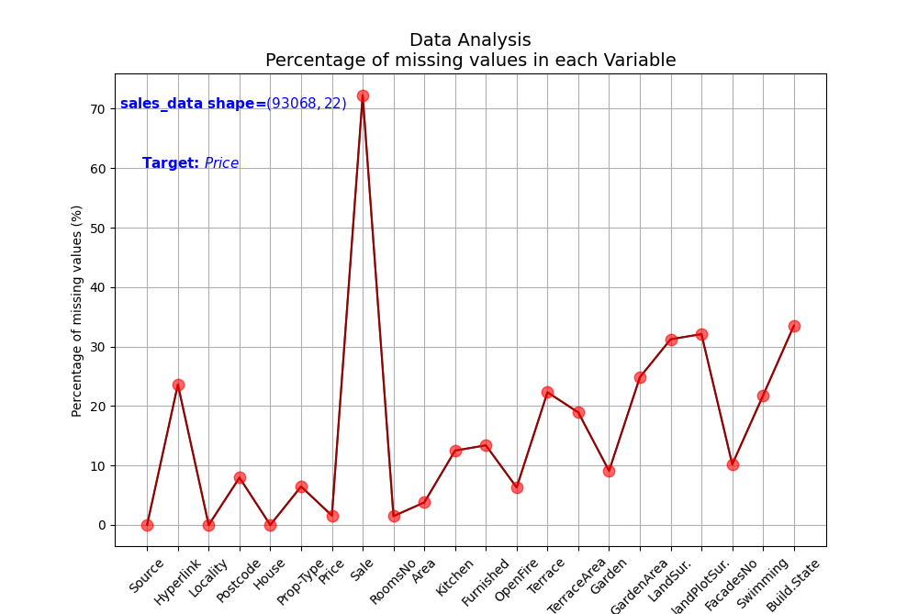
Data Cleaning and Analysis:
Percentage of missing values
Sale, hyperlink are deleted, merged locality and postcode

Slide 4
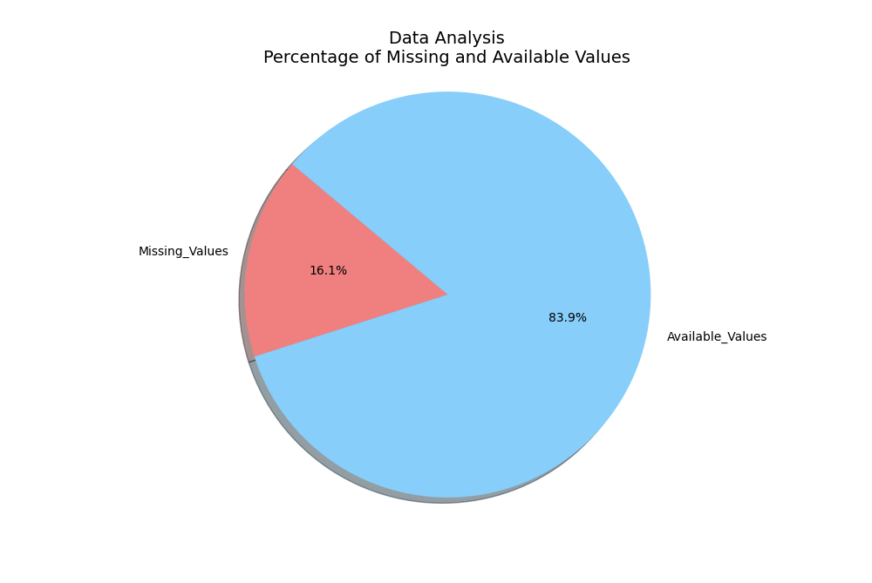
Data Cleaning and Analysis:
Percentage of missing values

Slide 5
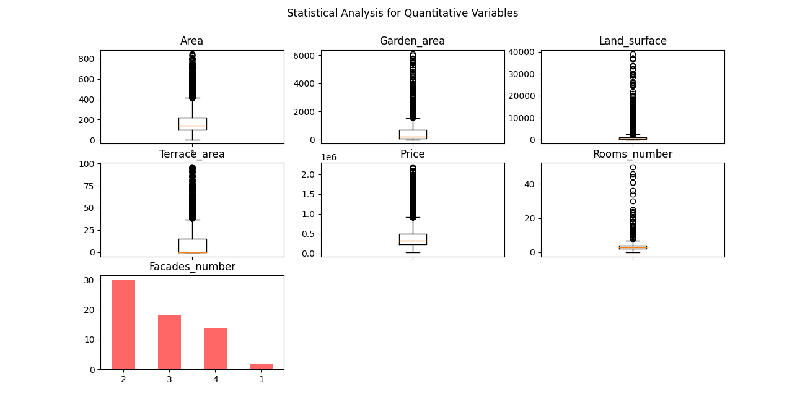
Data Cleaning and Analysis:
Outliers and quantitative variables
The number of observation of the original CVS file is 93068, after removing duplicated, empty rows and outlier, the number of observation is 10730

Slide 6
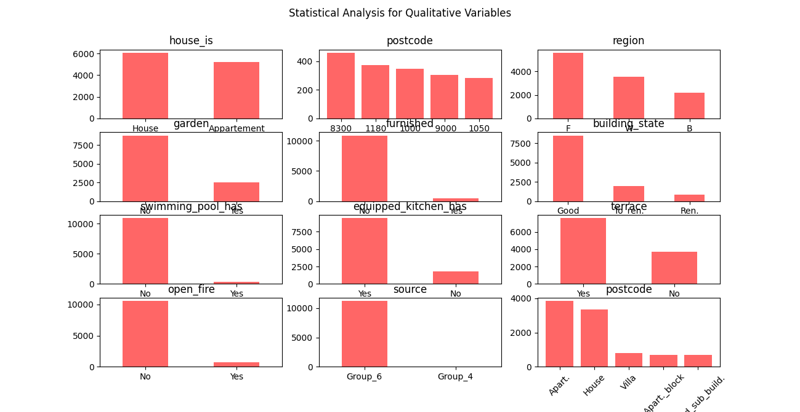
Data Cleaning and Analysis:
Qualitative variable

Slide 7
Data Cleaning and Analysis:
Correlation among variable

Slide 8
Data Cleaning and Analysis:
Correlation among variable

Slide 9
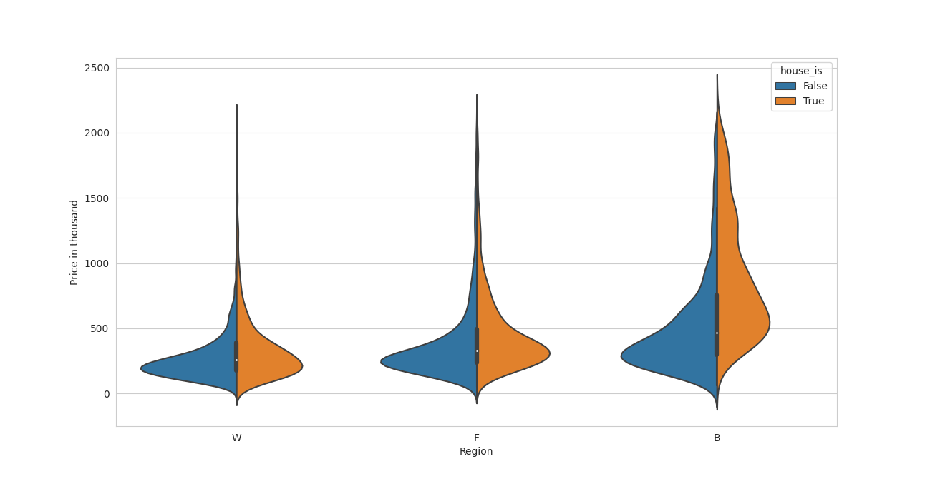
Data Visualization and Interpretation:
Price per region

Slide 10
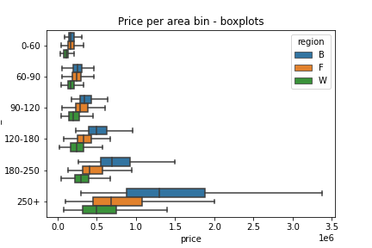
Data Visualization and Interpretation:
Price per area

Slide 11
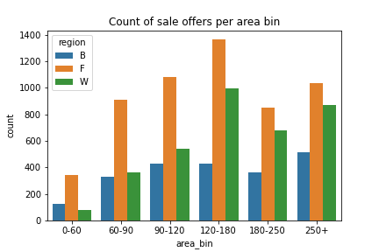
Data Visualization and Interpretation:
Count of sale by area

Slide 12
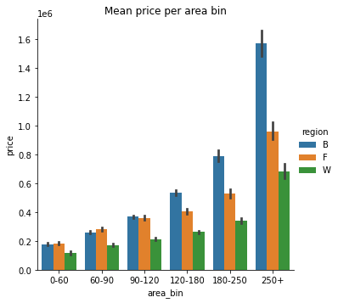
Data Visualization and Interpretation:
Mean price by area

Slide 13
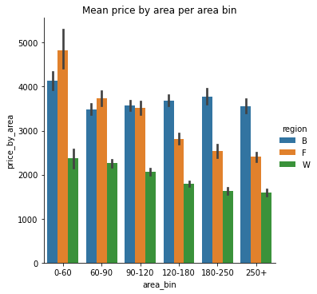
Data Visualization and Interpretation:
Mean area-price per region

Slide 14
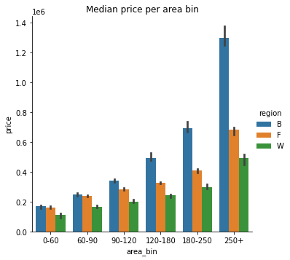
Data Visualization and Interpretation:
Median price by area

Slide 15
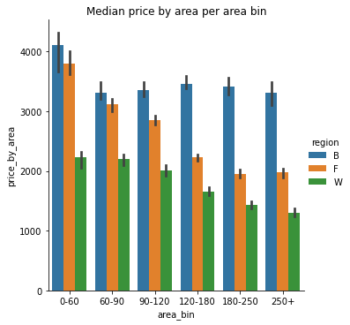
Data Visualization and Interpretation:
Median price-by- per area region

Slide 16
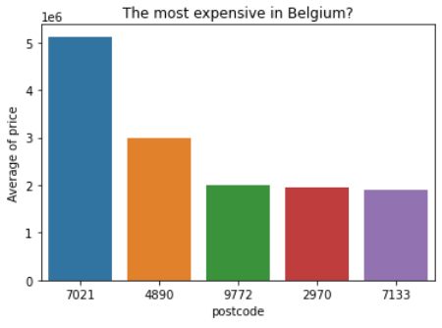
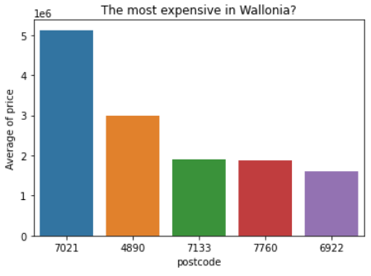
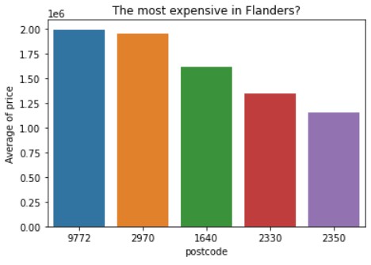
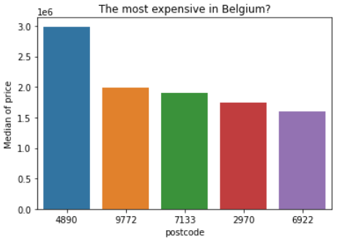
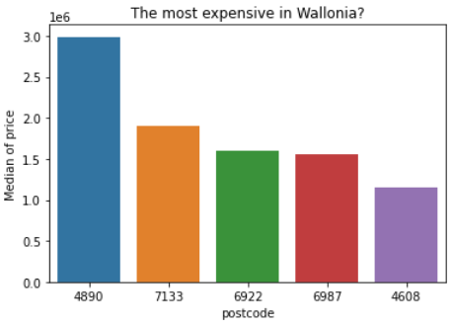
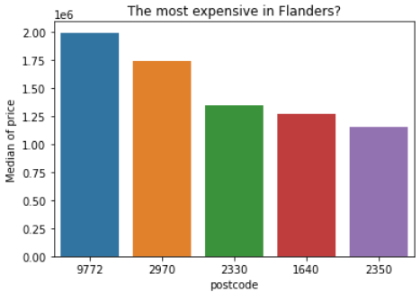
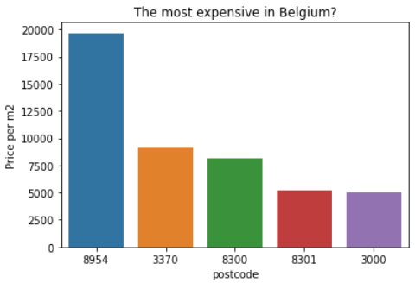
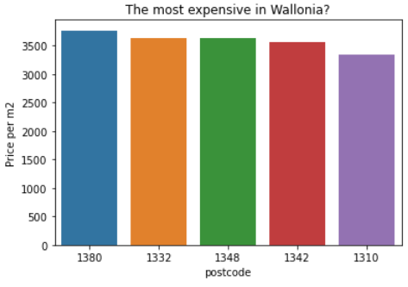
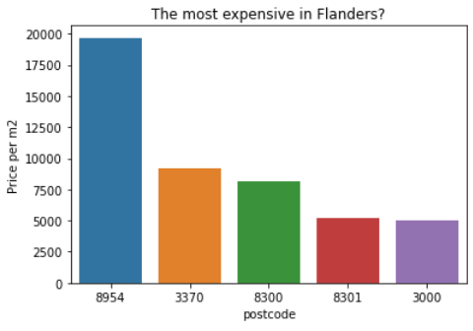

Slide 17
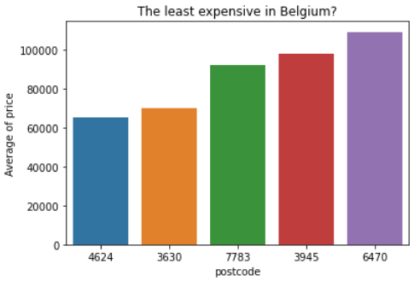
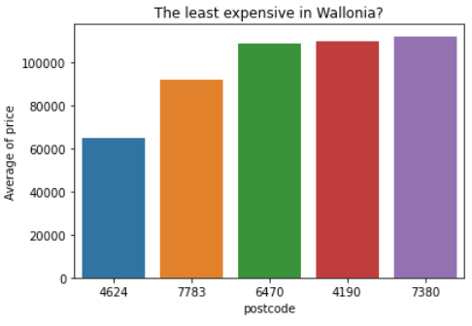
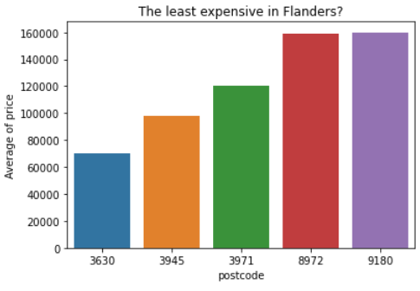
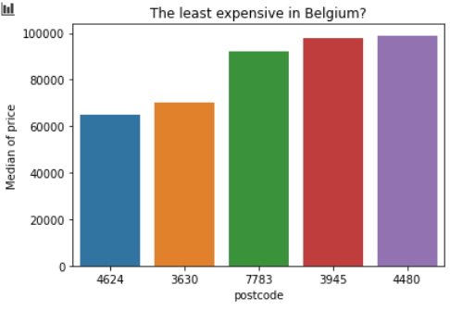
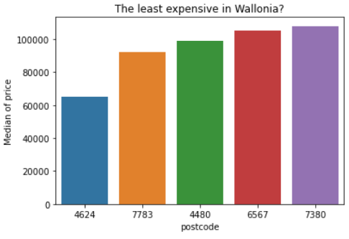

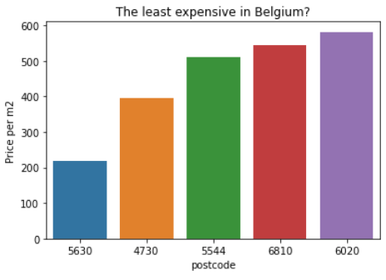
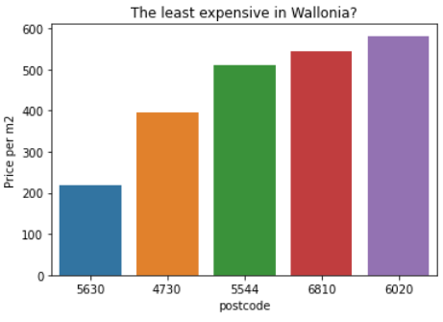
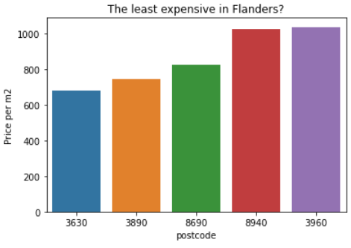

Slide 18
Conclusion:
Brussels is the most expensive region in Belgium for houses and apartment.

Slide 19
Machine Learning Model:
We use Random Forest to predict the Price since we have qualitative and quantitative features.

Slide 20
Questions

Slide 21
Thanks

