Slide 1

Automated Home Service Solutions: Improving Efficiency and Satisfaction through Real-Time Management
Sabah H. Alsehli
Shahad A. Alharbi
Khulud H. Allugmani

Slide 2
Problem statement
Current systems for managing home service care are fragmented or manual, leading to inefficiencies such as scheduling conflicts, poor service tracking, and limited data insights. Clients face challenges finding reliable technicians, and technicians encounter issues managing their availability and assignments.

Slide 3
Objectives
1. Develop a unified platform for managing client reservations and technician schedules.
2. Implement real-time scheduling and technician tracking to reduce conflicts.
3. Enhance client satisfaction by improving service transparency and reliability

Slide 4
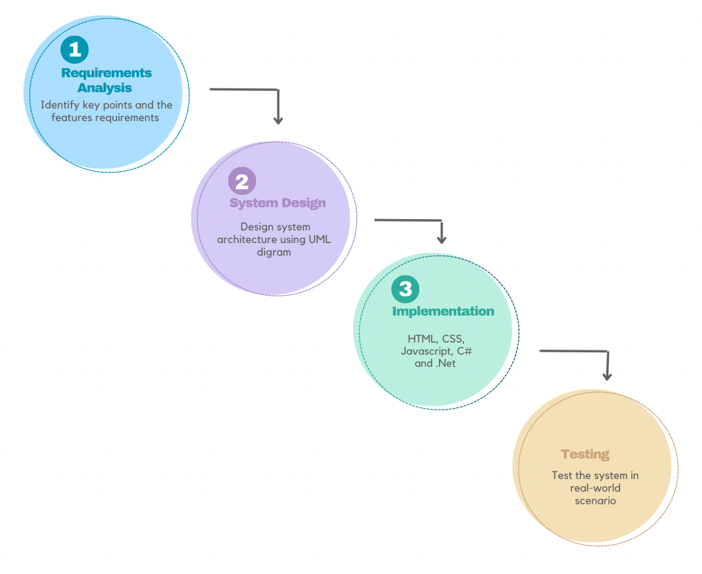
Methodology

Slide 5
Current State of Home Service Management Systems
Home service management systems have evolved from manual methods to modern platforms offering features like secure payments, real-time tracking, and geo-location scheduling. However, many lack predictive analytics, AI-driven recommendations, and robust data privacy, with scalability remaining a key challenge. These gaps highlight the need for a comprehensive, technology-driven solution to optimize service delivery and enhance user experience.

Slide 6
Taxonomy Table
Feature | Study 1 | Study 2 | Study 3 | Study 4 | Study 5 | Proposed system
Platform Support (Web) | ✓ | ✓ |  | ✓ |  | ✓
Platform Support (Mobile) | ✓ | ✓ | ✓ |  | ✓ | ✓
Platform Support (IoT) |  |  |  |  |  | ✓
Real-Time Tracking |  | ✓ |  |  | ✓ | ✓
Secure Payment | ✓ | ✓ |  |  | ✓ | ✓
Feedback System |  | ✓ |  |  | ✓ | ✓
AI-Driven Recommendations |  |  |  |  |  | ✓
Geo-Intelligent Scheduling |  | ✓ |  |  |  | ✓
Predictive Analytics |  |  |  |  |  | ✓
Advanced Privacy Protocols |  |  |  |  | ✓ | ✓
Comprehensive Service Coverage | ✓ | ✓ | ✓ | ✓ | ✓ | ✓
Cross-Platform Scalability |  |  |  |  | ✓ | ✓

Slide 7
Proposed system: Key Features
Real-Time Scheduling Algorithms
Intuitive User Interfaces
Advanced Analytics
Optimize task allocation and reduce conflicts.
Enhance user experience for clients and technicians
Streamline operations and improve satisfaction.

Slide 8
Proposed system: System Modules
Technician Management
Client Reservation
Visit Scheduling
Tracks availability, assigns tasks dynamically, and updates schedules in real-time to optimize resource use and minimize idle time
Provides an easy booking system with service browsing, real-time updates, and notifications for seamless client experience
Automates task allocation considering availability, proximity, and preferences to ensure timely service delivery.

Slide 9
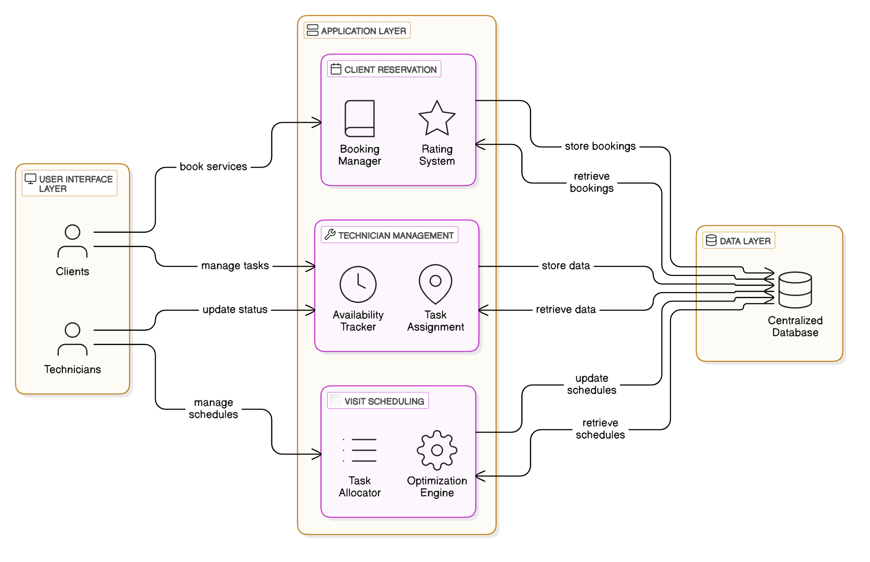
Proposed system: System architectures

Slide 10
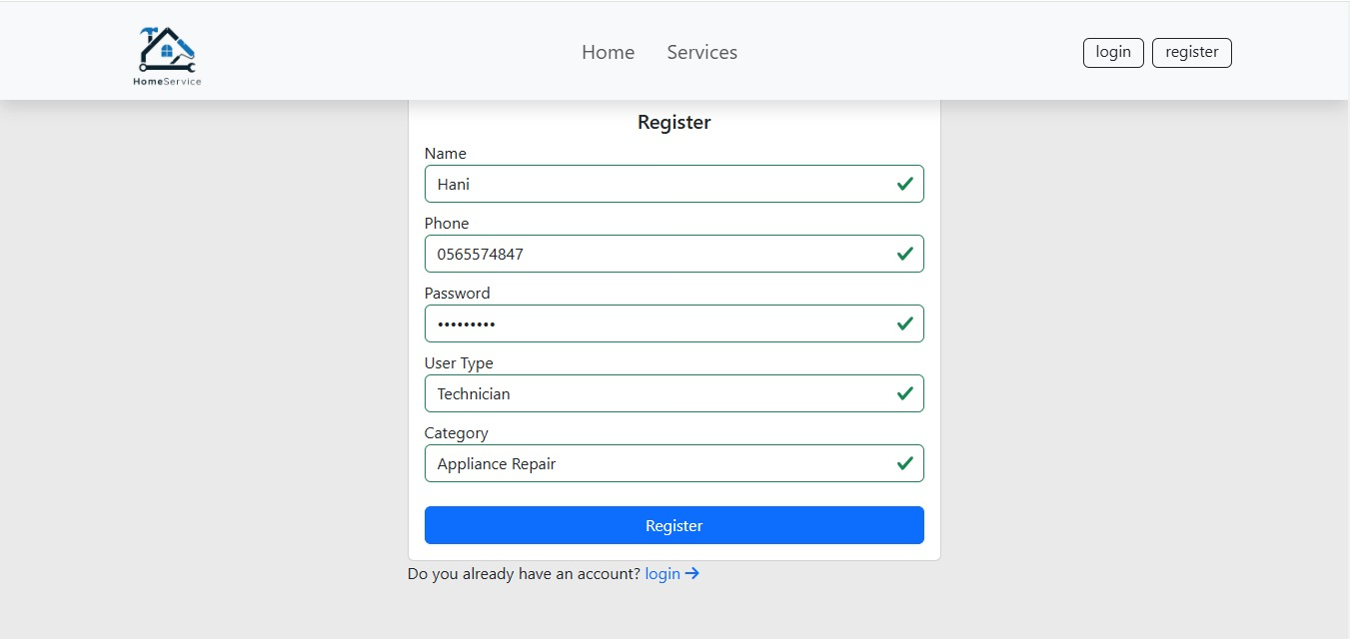
Implementation

Slide 11
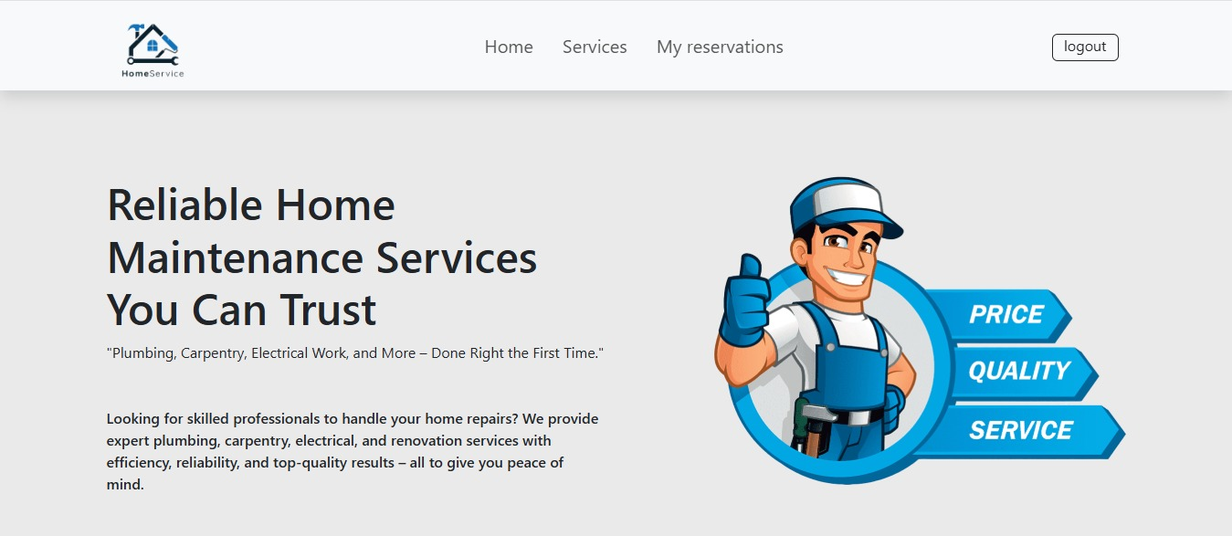
Implementation

Slide 12
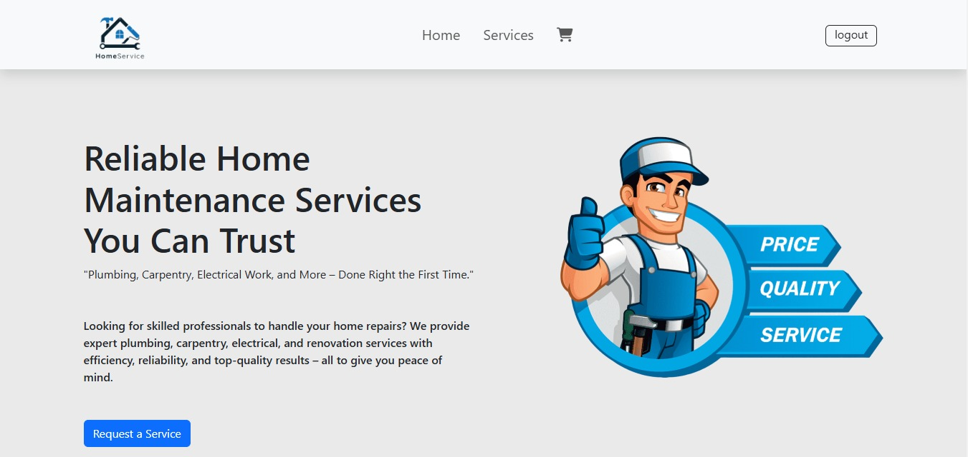
Implementation

Slide 13
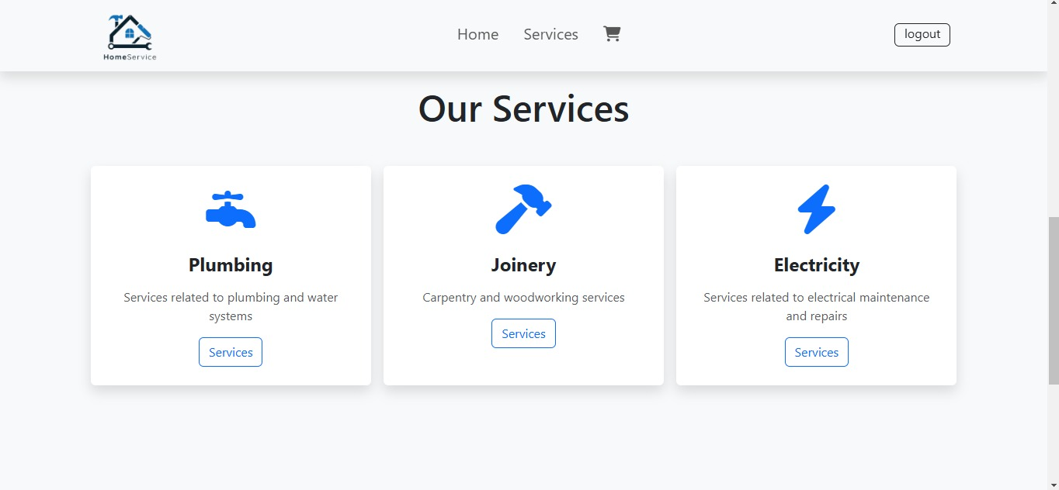
Implementation

Slide 14
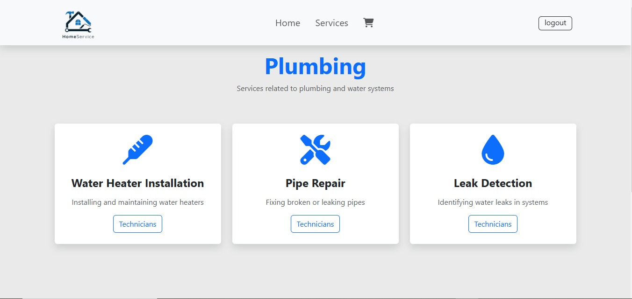
Implementation

Slide 15
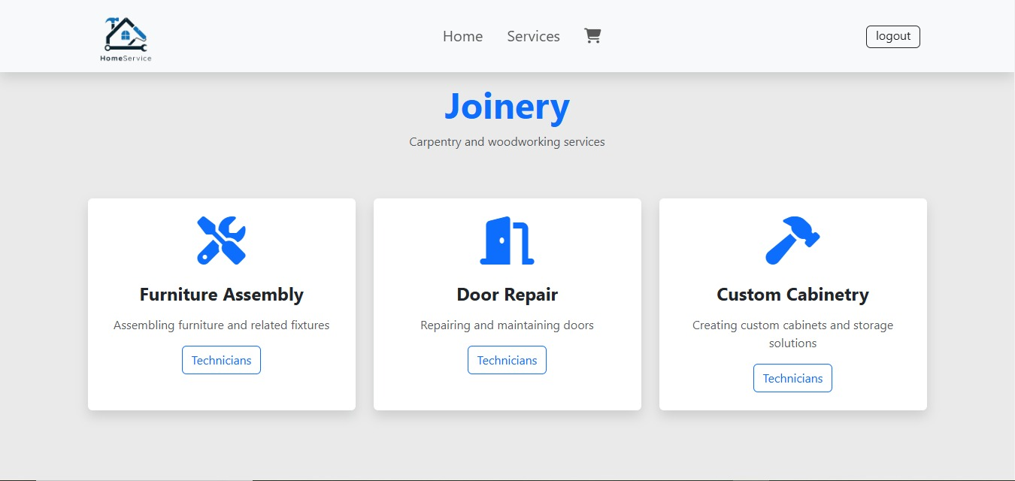
Implementation

Slide 16
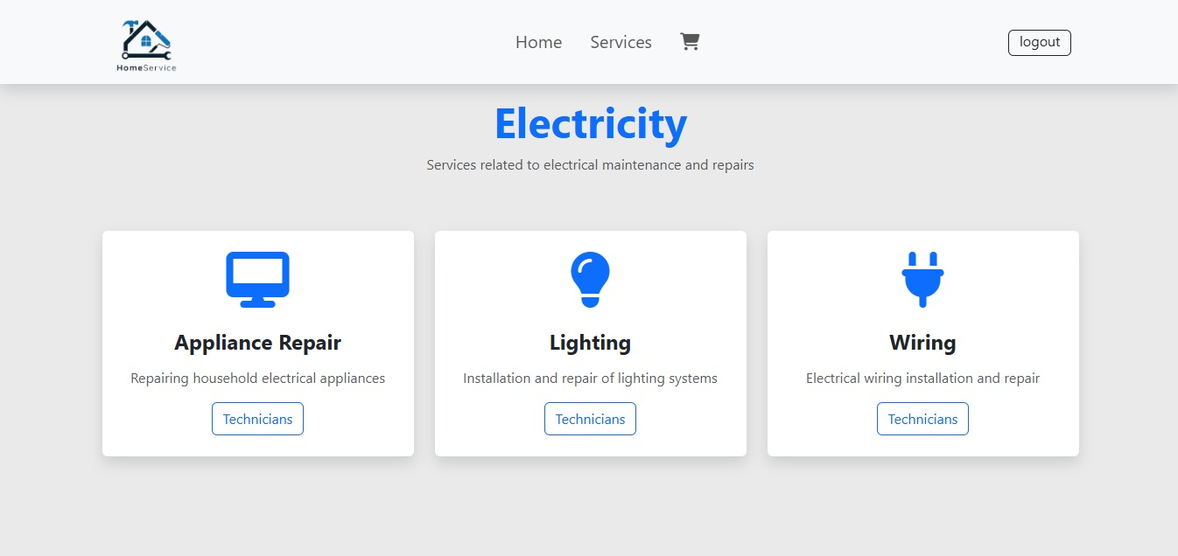
Implementation

Slide 17
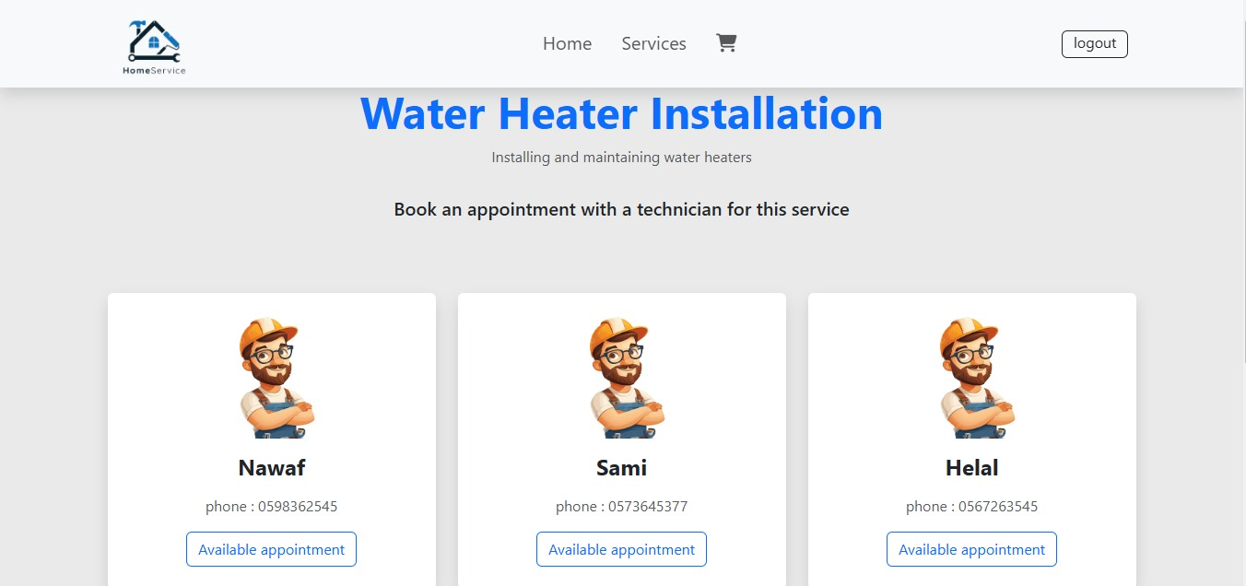
Implementation

Slide 18
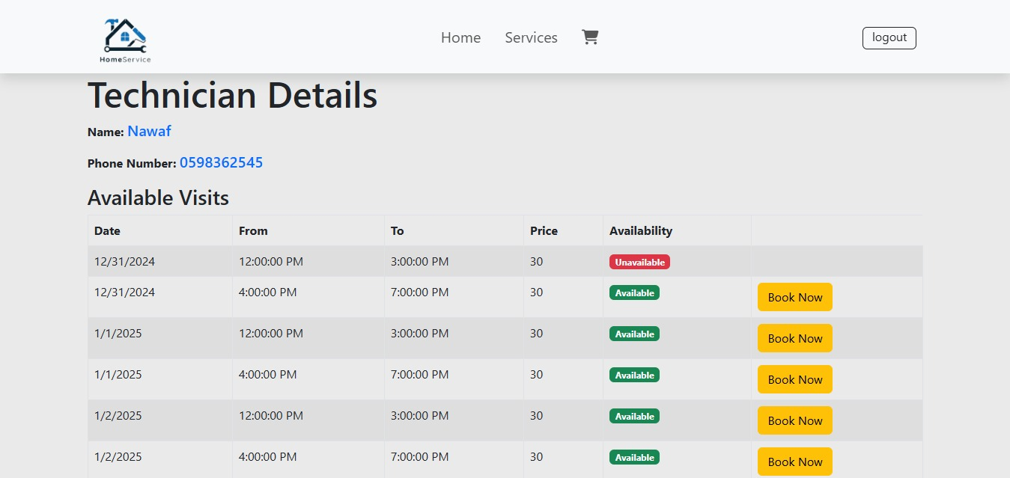
Implementation

Slide 19
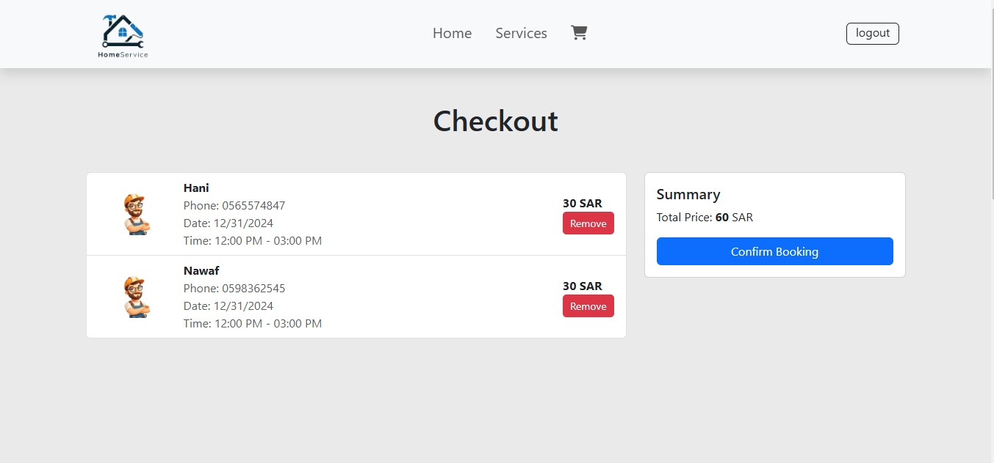
Implementation

Slide 20
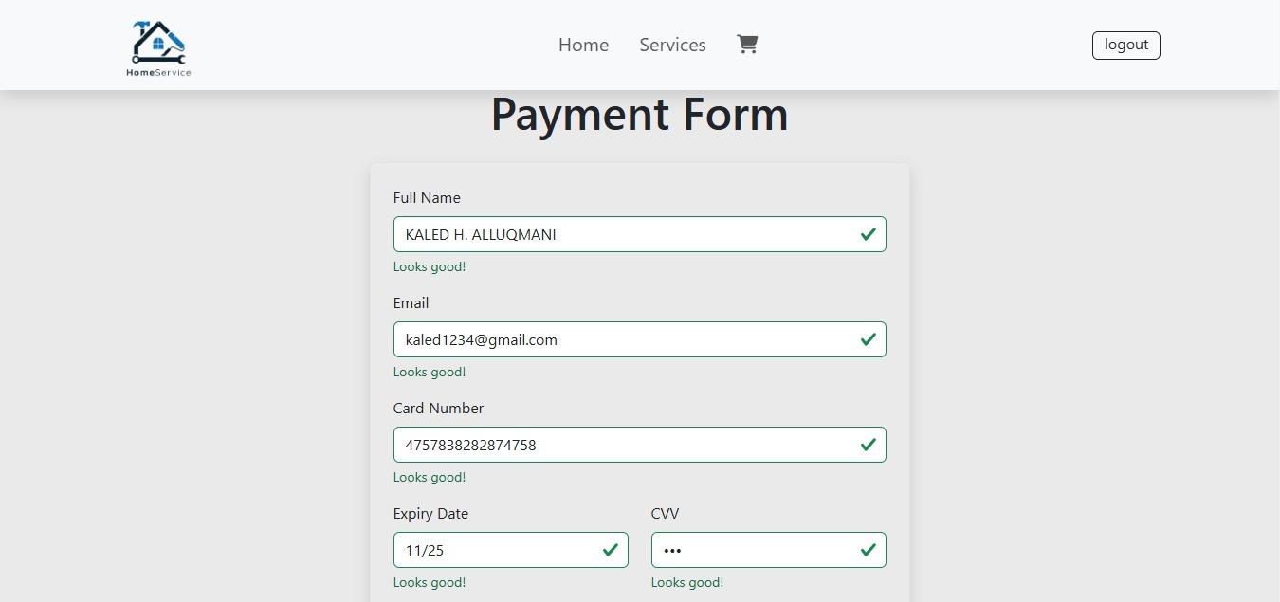
Implementation

Slide 21
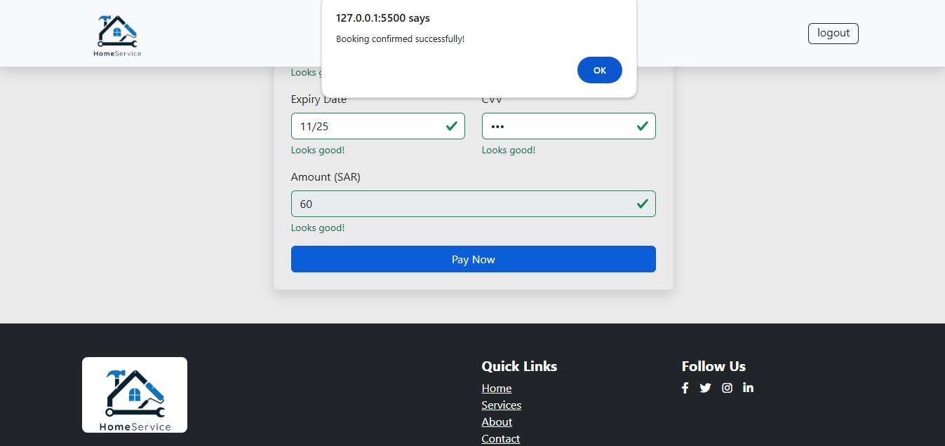
Implementation

Slide 22
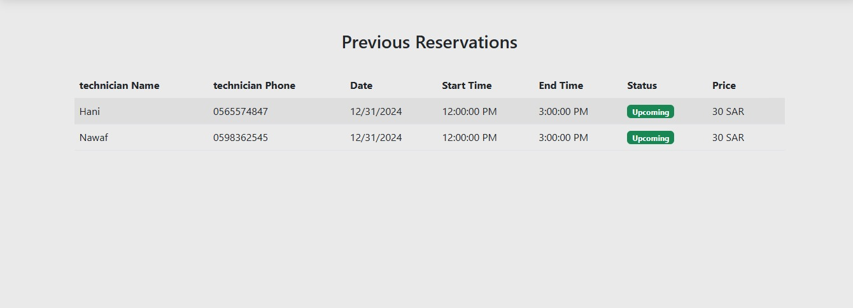
Implementation

Slide 23
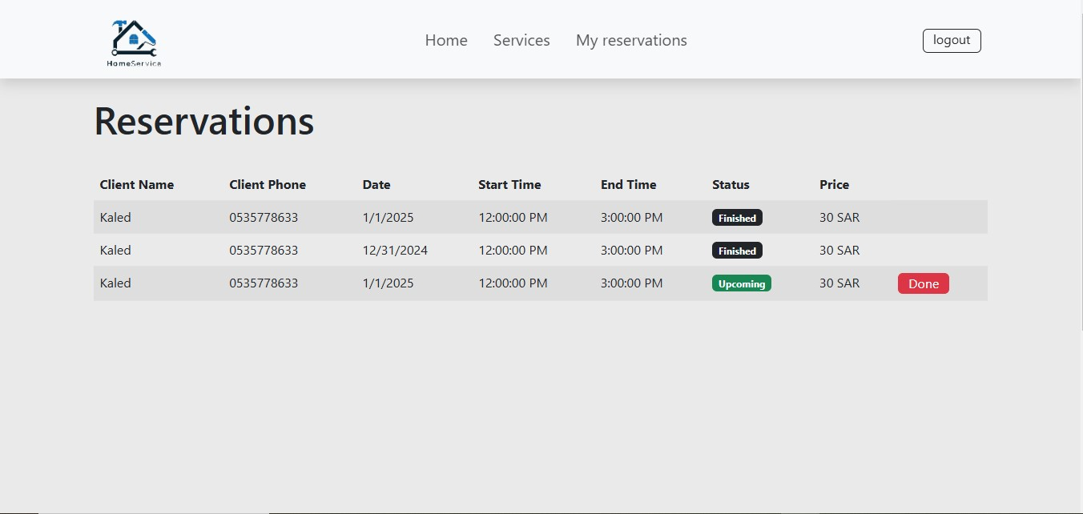
Implementation

Slide 24
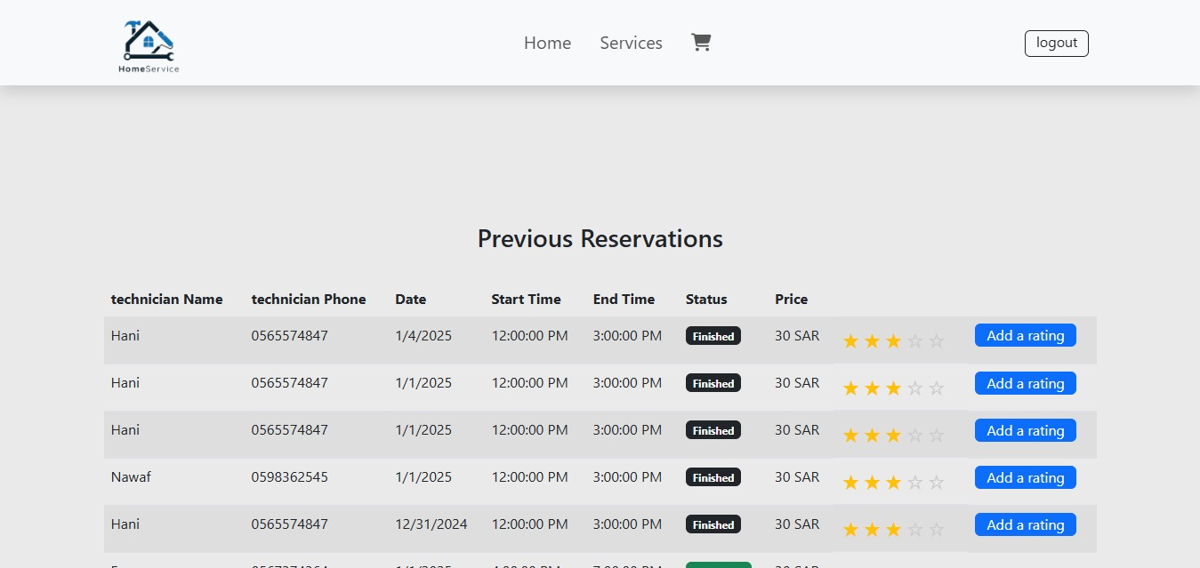
Implementation

Slide 25
conclusion
The Automated Home Service Management System addresses key inefficiencies in traditional home service platforms by integrating real-time scheduling, technician tracking, and predictive analytics. This unified platform improves operational efficiency, enhances user satisfaction, and ensures scalability for future advancements. It sets a strong foundation for modernizing service delivery and meeting the evolving demands of users and providers.

Slide 26
THANK YOU

