Slide 1


Slide 2
Group Members:
Members | Institution
Ashiqur Rahman | Bangladesh University of Engineering and Technology
Rafia Tasnim Ahona Takwa Jahin Feeza Sabah Zerin | Ahsanullah University of Engineering and Technology Ahsanullah University of Engineering and Technology Ahsanullah University of Engineering and Technology

Slide 3
Storyline
Ruby, is an adventurous and passionate protagonist of our game. On her thrilling treasure hunt, she found a map of a hidden treasure hutch, but it won't be easy. We have to help her overcome challenges and reach the prize. Experience Ruby's determination and join her exciting journey on Nexusfury !

Slide 4
Game Concept
Nexusfury is a 2D computer game where we are going to use C++ and Microsoft Visual Studio 2010 and I graphics functions.
This is a game where the player can gain points by collecting coins. The player has to fight and defeat the opponent characters to survive and play further.
The goal is to find a purse string and reach the last level to find a treasure hutch and open it. The purse string will be needed to open the treasure hutch finally.
There are three levels in total.
Battlefield
Coral Kingdom
Steller Voyage

Slide 5
Characters
The main character of the game is Ruby.
There are three different conveyance for the main character in three different levels. There will also be other different carriages in the levels for the rival characters.
In the level ‘Battlefield’, the main character will be in
- A Tank
In the level ‘Coral Kingdom', the main character will be in
- A Submarine
In the level ‘Steller Voyage’, the main character will be in
- A Spaceship

Slide 6
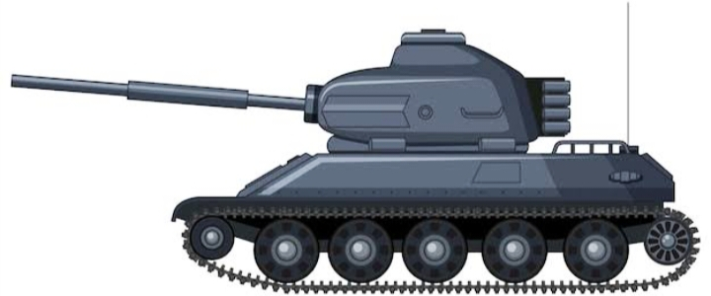
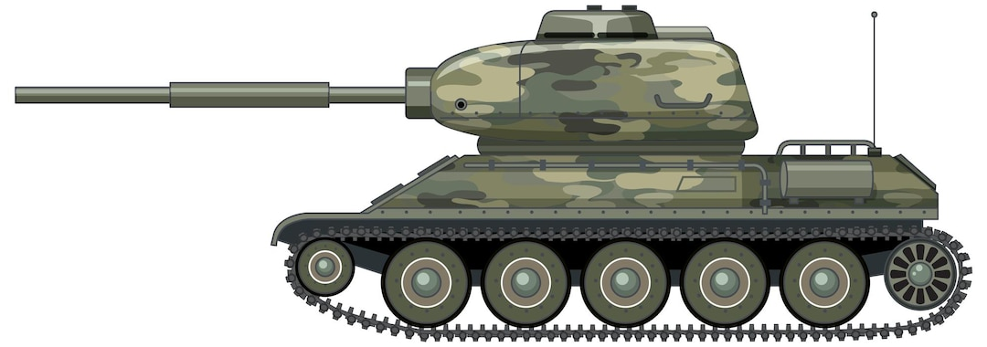
Characters of ‘Battlefield’
Main character’s tank
Rival character’s tank

Slide 7
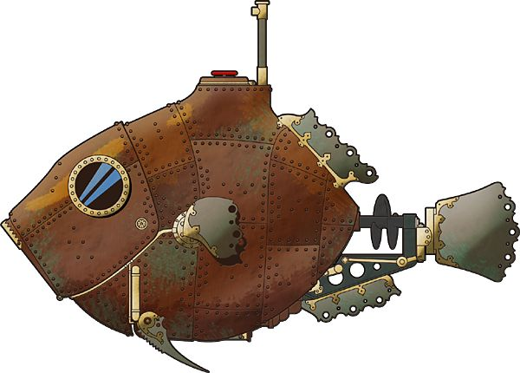
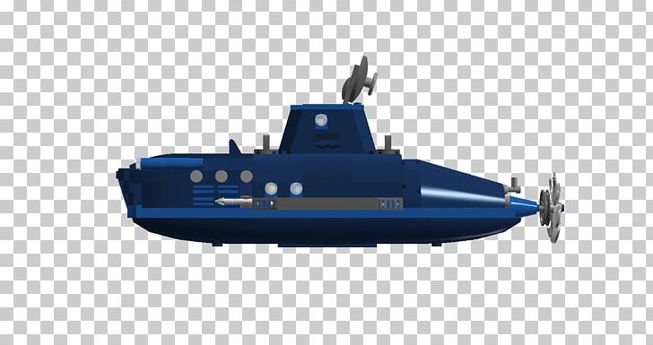
Characters of ‘Coral Kingdom’
Main character submarine
Rival character submarine

Slide 8
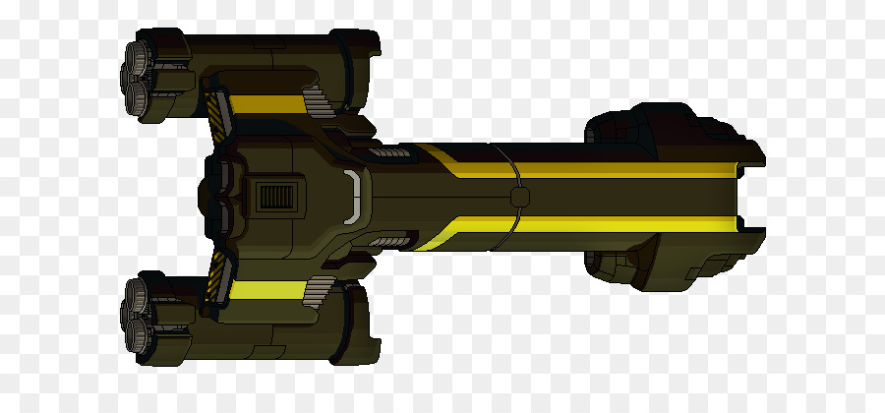
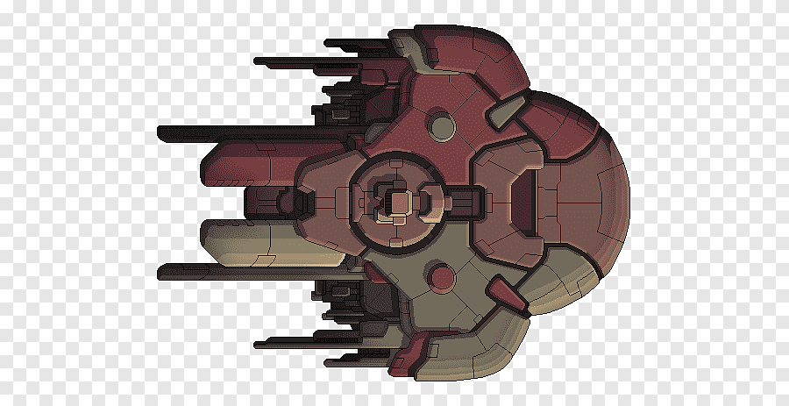
Characters of ‘Steller Voyage’
Main character’s spaceship
Villain character’s spaceship

Slide 9
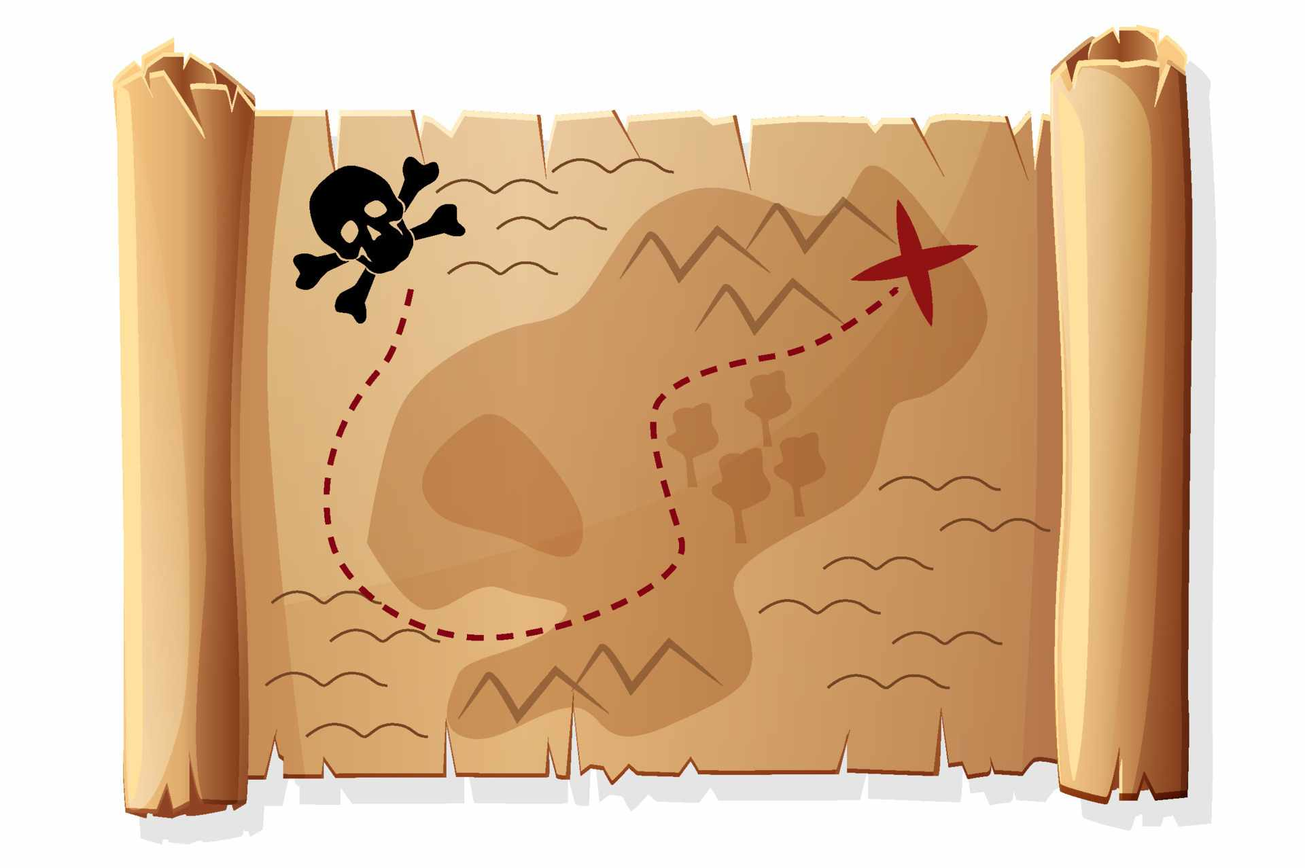
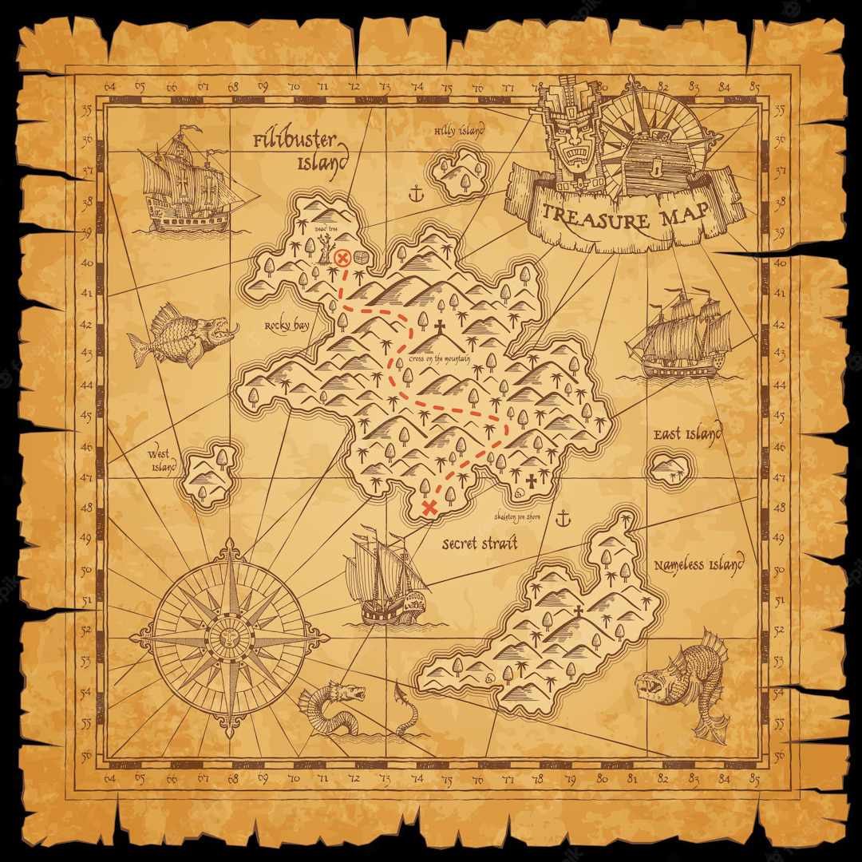
Maps for Level-1 and Level-2
Level-1
Level-2

Slide 10

Level 1 : Battlefield (Poster)

Slide 11
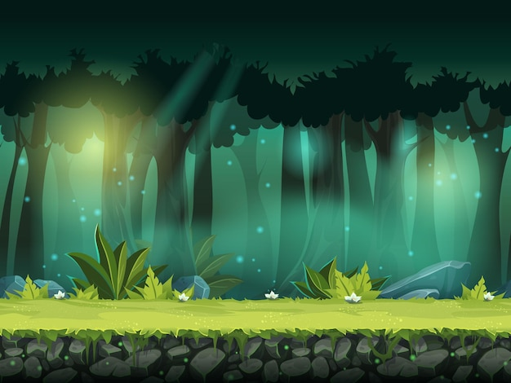
Level 1 : Battlefield (Background)

Slide 12
Gameplay Mechanics of ‘Battlefield’
Objective :
Survive by evading enemy bullets and collecting coins
5 lives or chances to continue
Target – 80 points
Gain 2 points for each successful dodge or coin collection
Beware of the bullets coming from the rival carriage. If the player get hit by any of the bullets, 1 life will be lost.
The score will be shown on the top right side of the screen.
High score will be saved and shown after game over,before starting and after finishing the game.

Slide 13

Level 2 : Coral Kingdom (Poster)

Slide 14
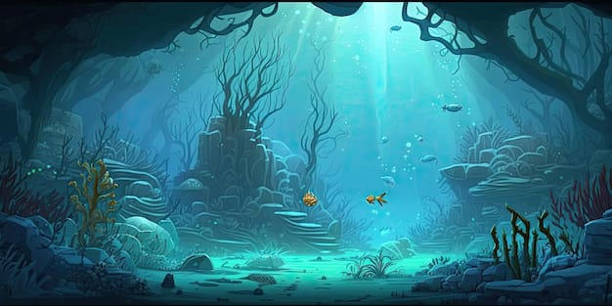
Level 2 : Coral Kingdom (Background)

Slide 15
Gameplay Mechanics for ‘Coral Kingdom’
Objective:
Find the Purse string by collecting required points
3 lives or chances available
Target- 150 points
Collect green coins and yellow coins. Each green coin adds 3 points and each yellow coins adds 2 points to boost the score.
Avoid the red coins. Each red coin deducts 1 point from the total score
The opponent bullet speeds will be faster than that of ‘Battlefield’ level.

Slide 16
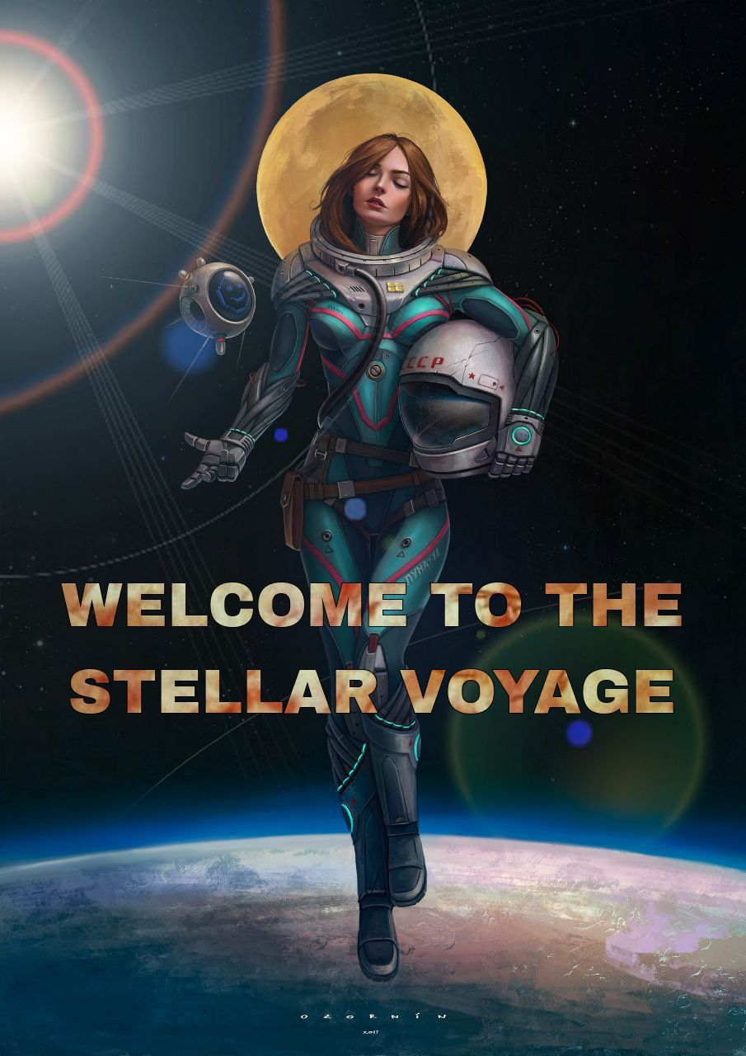
Final Level : Steller Voyage (Poster)

Slide 17

Final Level : Steller Voyage (Background)

Slide 18
Gameplay Mechanics for ‘Steller Voyage’
Objective:
Obtain the treasure hutch and open it with the purse string
2 lives or chances available
Target – 220 points within seven minutes
Collect green coins and yellow coins. Each green coin adds 5 points and each yellow coin adds 3 points to boost score
Beware of red coins. Each red coin deducts 2 points from total score
Fastest opponent bullet speeds.

Slide 19
Control Keys
Direction Keys : To control main character’s Carriage :
Key ‘up’ : Move upward
Key ‘down’: Move downward
Key ‘right’: Move right side
Key ‘left’: Move left side
Key ‘S’ : To shoot
‘Esc’ key : To go back to main menu
Extra control :
Pause the game by clicking ‘P’
Resume the game by clicking ‘R’
Sounds can be controlled by clicking ‘S’

Slide 20
We hope a thrilling gaming experience with escalating challenges can be gained by playing Nexusfury…
Thank you everyone !

