Slide 1
Etihad Cargo green coding challenge
Amadeus global hackathon - #1AHACK4SUSTAINABILITY

Slide 2

objective
benefits
The Green Coding Challenge is to develop a SMART Parser Application
To process Cargo EDI Messages in a specified format.
To identify and log any errors encountered during the processing of the message.
Ability to auto correct common errors contained in the message.
Ability to skip any complex errors or incorrect data elements in the message.
A dashboard to view the parsed data as well as monitor the messages with errors.
Improve the % of messages processed by the application.
Reduce or eliminate the need for manual corrections in processing the message.
Retrieve/Process as much data as possible from the messages.
Increased data quality results in qualitative improvements in the Positional Load Factor reporting.
Accurate Positional Load Factor reporting supports aircraft/ULD loading optimization which in turn results in a sustainable cargo operation.

Slide 3



Etihad mentors & jury
3
Domain & Technology Experts for Support
Etihad Cargo is the cargo and logistics arm of Etihad Aviation Group, the national airline of the UAE. Established in 2004, we’ve come a long way in a short amount of time, and with our specialist teams we’ve developed a range of dedicated air cargo and freighter services that you can trust. We're proud to be your air cargo partner of choice.
4
mentors
6 JURY MEMBERS
Manoj Chandran
Snr Product Manager – Cargo DTI
Leonard Rodrigues
Head of Cargo Revenue Management
Devendra Chavan
Product Owner – Cargo DTI
Upkar Rehan
Solution Architect – Cargo DTI
Martin Drew
SVP Sales & Cargo
Slobodan Stamenkovic
Senior Manager Projects
Dr Reem Alaya Lebhar
Director Strategy - DTI
Francisco Javier Malpica
Innovation Lead – DTI
Arun Subramanian
Value Stream Lead – Cargo DTI
Mariam Musallam Al Qubaisi
Head of Sustainability

Slide 4
OVERVIEW OF THE PROCESS
4
BUILD a parser to process IATA CPM & LDM Messages
Current Process
Future Process
Out station Ground Handling
Out station Ground Handling
Eliminate the error queue and the manual correction.
Process, Auto Correct, Skip errors.
Record the skip reasons and add it to the data hub.
Manual Correction
Hub Message Processing System
Error Queue
Process
SMART PARSER
Error
Correct
Processed
Skip
Data Hub
Data Hub
Messages are pushed to the queue on the first instance of a format error or a data error.
Manual correction is required to reprocess the message and retrieve the data.
Reporting
Reporting

Slide 5
Message specifications
5
CPM MESSAGE SPECIFICATIONS
CPM MESSAGE SPECIFICATIONS
Reference : IATA Airport Handling Manual

Slide 6
COMMON Message ERRORS
6
CPM MESSAGE ERRORS
Syntax Errors.
Invalid Footer (e.g. :- Email Disclaimer)
Invalid new line character
Invalid flight date format
Invalid ULD Number format
Invalid Position format
Data Errors.
Invalid Flight Date (GMT vs Local)
Invalid ULD Destination (Not a valid station)
ULD Information is missing

Slide 7
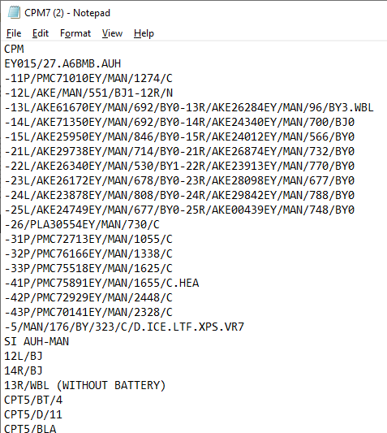
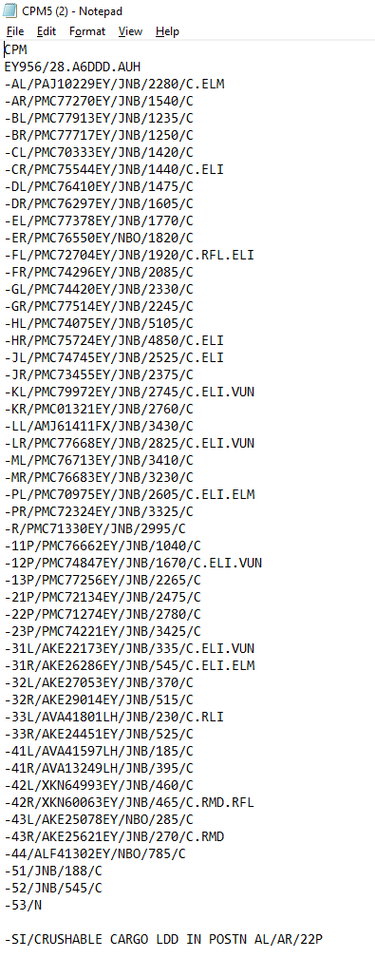
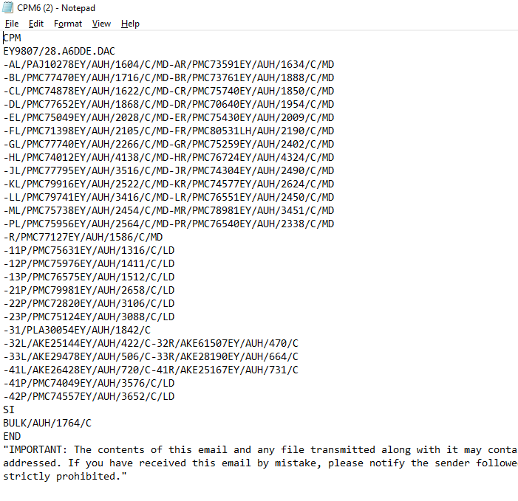
Message samples
7
Invalid ULD
CPM MESSAGE SAMPLES
Mail Disclaimer
Invalid Syntax
Invalid Space

Slide 8
Message samples
8
CPM MESSAGE SAMPLES
Message Samples in Correct Format
Message Samples in In-correct Format
* More Samples can be provided on request

Slide 9
SAMPLE DASHBOARD
9
MESSAGE OUTPUT SAMPLE
The parsed data should be tokenized and stored in a table and a UI should be provided to retrieve data as indicated below..

Slide 10
THANK YOU

