Slide 1


Basic Details of the Team and Problem Statement
HackToFuture-2024
In Association with
The Institution of Engineers (India)
Local Centre, Belagavi
Domain :AIML
PS Code: AM-01
Problem Statement Title: AI - Powered Indian Startup Success
Prediction
Team Name: Dominators
Team Leader Name: Narayan S Sabale
Institute Name: Jain College Of Engineering , Hunchanatti Cross, Tippusultan Nagar, Machhe, Belagavi, Karnataka 590014

Slide 2
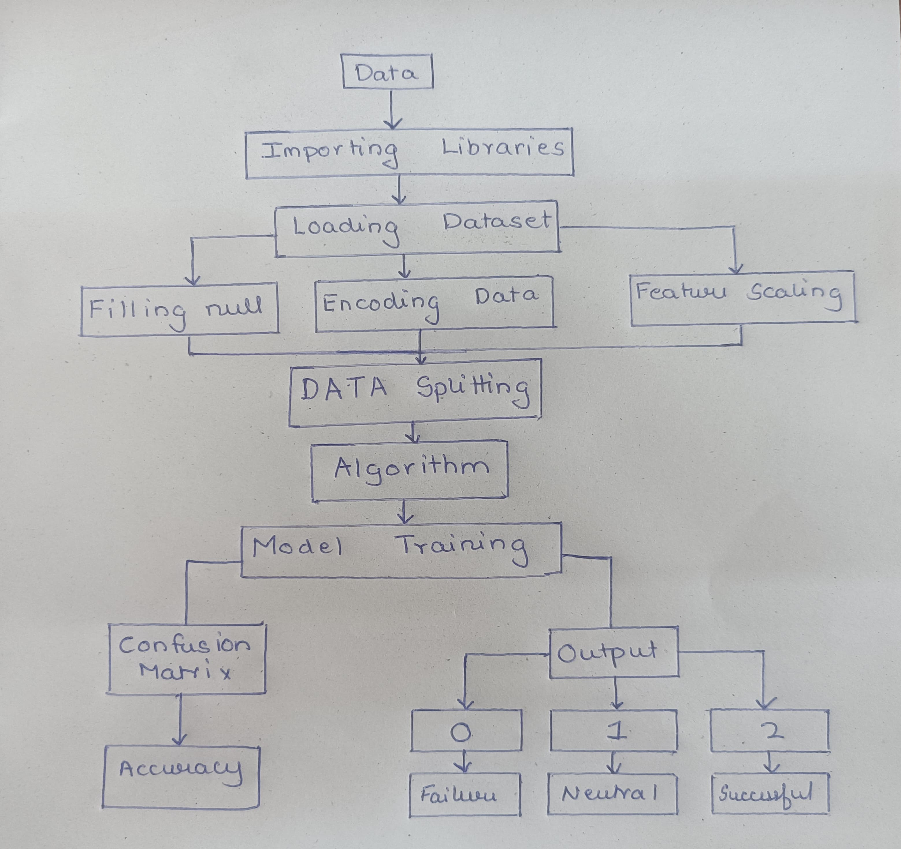
Idea/Approach Details
Success Prediction Rate: Accurate predictions to enhance user success.
Investor Attraction: Strategies to attract new investors.
Churn Prediction: Predict if employees will leave the company or stay
AI Assistant: advanced algorithms to predict trends and provide strategic guidance.
Product Comparison: Guidance through comparing different products
Sentiment Analysis: Analyze user feedback to understand public opinion
Technology stack :
Frontend: HTML , CSS , JAVASCRIPT
Backend: Django
Database: SQLite
⮚ AI Analysis: Python( Scikit-Learn/Pandas/NumPy )
⮚ External Api Integration: Gemini API

Slide 3
Idea/Approach Details
Dependencies / Show stopper
Use Cases
Dependencies:
Tech Stack: Choose relevant programming languages, frameworks, and tools.
Data Sources: Integrate data from users, APIs, or databases.
Infrastructure: Set up hosting and configure servers.
Third-Party APIs: Ensure seamless integration.
Security Measures: Implement encryption and authentication.
User Authentication: Decide on login methods.
Analytics and Monitoring: Track user behavior and performance.
Showstoppers:
Scalability: Design for increased traffic.
Performance Optimization: Optimize load times.
Legal Compliance: Understand privacy laws.
User Experience: Prioritize usability.
Testing and Maintenance: Regularly update and monitor.
Success Prediction Rate: Predict the likelihood of project success to guide investment and development decisions
Investor Attraction: Identify and implement strategies to attract new investors to fund projects.
Product Comparison: Assist users in comparing different products to make informed purchasing decisions.
Sentiment Analysis: Analyze customer feedback to gain insights into public opinion and improve products/services.
AI Assistant: Use advanced algorithms to predict market trends and provide strategic guidance to users.
Churn Prediction: Predict employee turnover to implement retention strategies and reduce attrition rates.

Slide 4
Team Member Details
Team Leader Name: Narayan S Sabale
Branch: BE, Stream: EC, Year: III
Team Member 1 Name: Aditya S Mehetri
Branch: BE, Stream: EC, Year: III
Team Member 2 Name: Aditya A Dhamanekar
Branch: BE, Stream: EC, Year: III
Team Member 3 Name: Chandan P Kangralkar
Branch: BE, Stream: EC, Year: III

