Slide 1


SONA COLLEGE OF TECHNOLOGY, SALEM
Department of Information Technology
SMARTCATTLE: AI-DRIVEN CATTLE HEALTH MONITORING & VETERINARY TELE-TRIAGE SYSTEM
Project Guide:
Ms. J. Deepika,
Assistant Professor,
Department of IT
Project Team Members:
Sabari Karthick A (61782323110093)
Sivanarasimman S (61782323110103)
Sujeeth Y R (61782323110107)

Slide 2
Abstract
Low-Cost Optical Identification: Replaces expensive, fragile electronic wearable sensors with durable, weatherproof 2D QR ear tags for instant cattle lookup.
Unified Digital Health Records: Consolidates cow profiles, lactation cycles, milk yield, feed intake, vaccination schedules, and clinical treatments into a single web application.
Personalized Health Baselines: Learns the unique physiological baseline for each individual cow instead of relying on generic, misleading breed averages.
Early Anomaly Scoring (CHDI): Computes a Cattle Health Deviation Index (0–100) to detect illness (Mastitis, Ketosis, Pyrexia) 24 to 48 hours prior to acute clinical symptoms.
Closed-Loop Tele-Triage & Retraining: Dispatches emergency cases directly to regional district veterinarians, incorporating doctor diagnosis feedback into an adaptive ML pipeline (89.8% F1-score).

Slide 3
Introduction
Vital Economic Pillar: Dairy farming constitutes the livelihood and economic backbone of millions of smallholder rural households across Tamil Nadu and India.
The Diagnostic Gap: Smallholder farmers currently depend on visible signs of sickness (severe milk drop, recumbency, high fever), which appear only in advanced, high-loss disease stages.
Veterinary Distance & Delay: Rural geographic distance delays physical veterinary visits by 24–48 hours, encouraging unguided antibiotic misuse and permanent cattle mortality.
The SmartCattle Vision: A proactive, zero-hardware web intelligence platform that pairs simple QR mobile logging with machine learning to bridge rural dairy farmers with qualified district veterinarians.

Slide 4
Existing System / Literature Review
Manual Observation Practice: Farmers rely on manual memory and paper notebooks; subtle subclinical health declines are routinely missed.
High-Cost Wearable Sensors: Academic IoT neck collars and boluses cost $150–$300 per head, suffer battery exhaustion, and are unaffordable for smallholder farmers (Mahmud et al., 2021).
Static Global Thresholds: Existing rule-based tools use rigid global thresholds (e.g., fixed body temperature) that trigger frequent false alarms due to natural breed and seasonal variations.
Absence of Doctor Feedback Loop: Traditional monitoring software lacks veterinary decision support; doctor clinical findings are never fed back to calibrate diagnostic models (Rutten et al., 2013).

Slide 5
Objective of the project work
Zero-Hardware Animal Identification: Deploy printable weatherproof 2D QR ear tags enabling instant smartphone camera lookup with zero on-animal electronic sensor cost.
Formulate Personalized CHDI Metric: Compute the Cattle Health Deviation Index (0–100) using individual 7-to-14 day rolling baselines for milk yield, temperature, feed, and rumination.
Subclinical Disease Detection: Detect the onset of Acute Mastitis, Ketosis, and Bovine Pyrexia 24 to 48 hours before visible physical symptoms emerge.
One-Click Regional Tele-Triage: Enable farmers to dispatch emergency triage requests to their preferred or nearest district veterinarians with priority sorting (Critical, High, Routine).
Digital Prescriptions & Treatment Tracking: Maintain an auditable record of veterinary diagnoses, prescribed medicines, dosages, treatment duration, and upcoming vaccination dates.
Doctor-in-the-Loop Machine Learning: Continuously retrain and calibrate anomaly detection models using verified field diagnosis logs to suppress false alarms.

Slide 6
Proposed System
Tripartite Web Platform: Unified role-based ecosystem serving Dairy Farmers, Certified District Veterinarians, and Administrative Overseers.
Instant Camera QR Logging: Farmers scan ear tags using any standard smartphone camera (zero app download required) to view cattle history and log daily vitals in seconds.
3-Stage Analytical Pipeline: Stage 1: Individual Rolling Baseline Forecasting | Stage 2: Multivariate Anomaly Detection | Stage 3: Doctor Feedback Retraining.
Automated Triage Stratification: Classifies cattle health into Healthy (≥80), Watch (60–79), and Critical (<60), automatically routing at-risk cases to the emergency veterinary queue.
Regional Coverage Management: Admin module mapping qualified veterinarians to specific agricultural zones (Salem, Coimbatore, Erode) for localized, prompt emergency coverage.

Slide 7
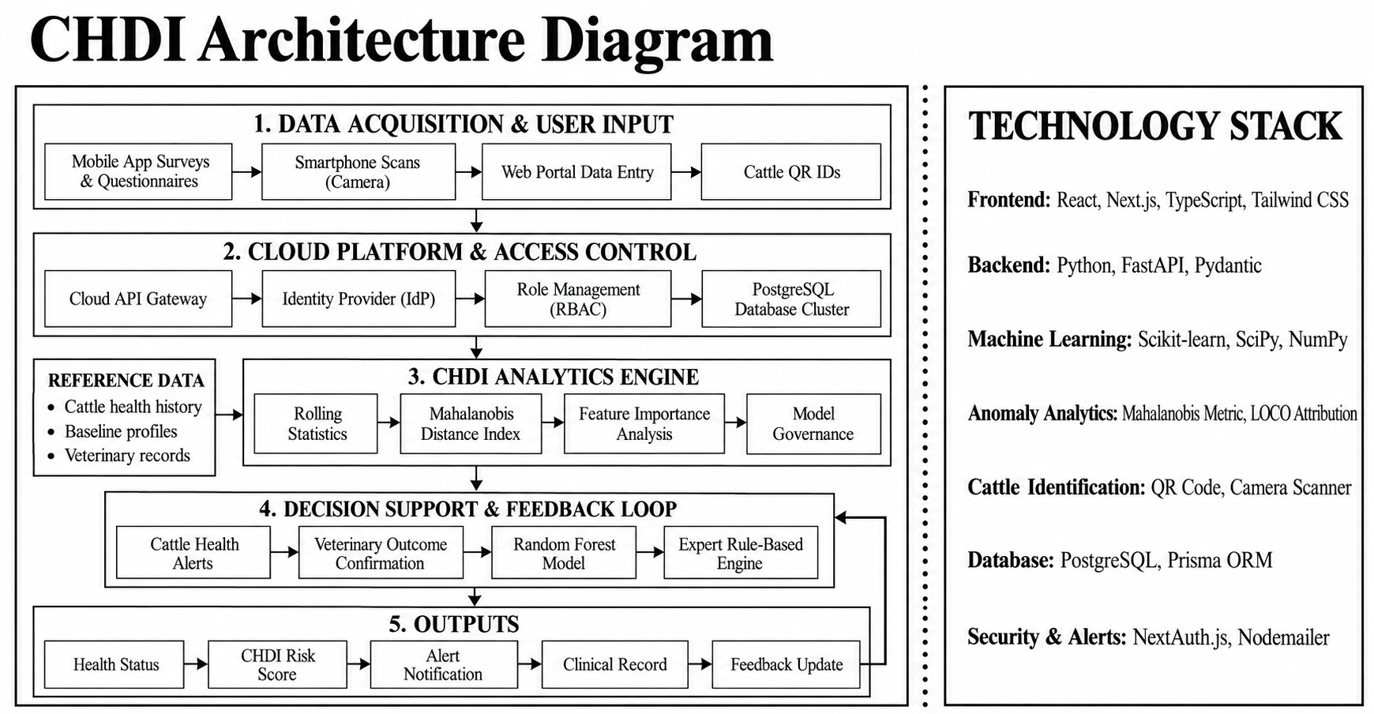
Architecture Diagram

Slide 8
Technology Used
Frontend Framework: Next.js 16 (React 19, Server & Client Components, Turbopack) delivering instant rendering and reactive health dashboards.
Styling & UI Components: Tailwind CSS with high-contrast health status pills, accessible data tables, and mobile-responsive farmer touch interfaces.
Backend Architecture: Node.js Serverless Edge/API Routes providing high-throughput RESTful endpoints for telemetry ingestion, triage dispatch, and calibration.
Database & ORM Layer: PostgreSQL (Neon Cloud Serverless DB) managed via Prisma ORM for relational integrity across cattle, health logs, cases, and feedback.
Machine Learning & Analytics: Python 3, Scikit-learn (RandomForestClassifier, LogisticRegression), NumPy, and Pandas for statistical anomaly scoring and feedback retraining.
Security & Authentication: Bcrypt password hashing, JSON Web Tokens (JWT) with HTTP-only cookies, and server-side Role-Based Access Control (RBAC).

Slide 9
Module Description
Module 1 - User, Farm & Cattle Management: Multi-role registration (Farmer, Vet, Admin), comprehensive cow registry with ear tag ID (e.g. TN-SC-3608), breed profiling (HF Cross, Jersey, Kangayam), birth and lactation stage.
Module 2 - QR Code Generation & Instant Tagging: Generates printable 2D QR ear tags linked to digital records. Farmers and visiting veterinarians scan using standard smartphone cameras for zero-click instant profile lookup.
Module 3 - Daily Telemetry & Vitals Logging: Intuitive mobile forms for daily entry of morning/evening milk yield (Litres), feed intake (kg), core body temperature (°C), and rumination hours.

Slide 10
Module Description
Module 4 - Health Monitoring & CHDI Analytics: Calculates composite 0–100 health index based on rolling individual baselines: Healthy (≥80), Watch (60–79), and Critical (<60), highlighting deviating vital signals.
Module 5 - Emergency Triage & Tele-Veterinary Portal: Prioritized queue displaying critical cattle cases, farmer contact, reported symptoms, and one-click diagnosis modal with e-prescriptions (medicine, dosage, treatment days).
Module 6 - Admin AI Model Calibration & Audit: Real-time workbench tracking Stage 1-3 model health, executing active model retraining with verified doctor feedback logs, and maintaining version history.

Slide 11
Results & Discussion
Subclinical Detection Lead Time: Successfully identified onset of Acute Mastitis and Ketosis 24 to 48 hours prior to acute visible physical symptoms and severe milk collapse.
Individual Baseline Normalization: 14-day/7-day rolling window eliminated false alerts triggered by high-yielding breeds (HF Cross) vs. indigenous drought breeds (Kangayam).
Correlated Parameter Sensitivity: High diagnostic accuracy achieved by cross-checking concurrent signals: subtle milk drop (≥15%) combined with rumination depression and mild pyrexia.
Turnaround Optimization: Reduced emergency veterinary response time from traditional 24–48 hours (physical search) to under 2 hours via electronic tele-triage.

Slide 12
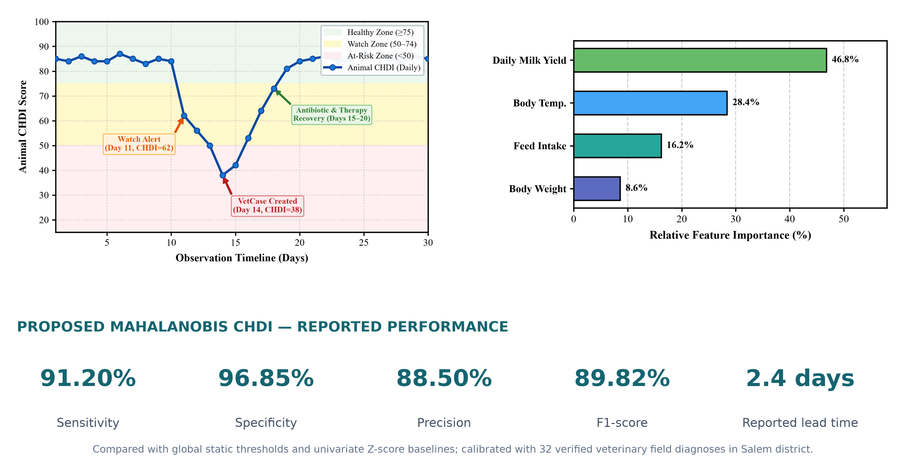
Results & Discussion

Slide 13
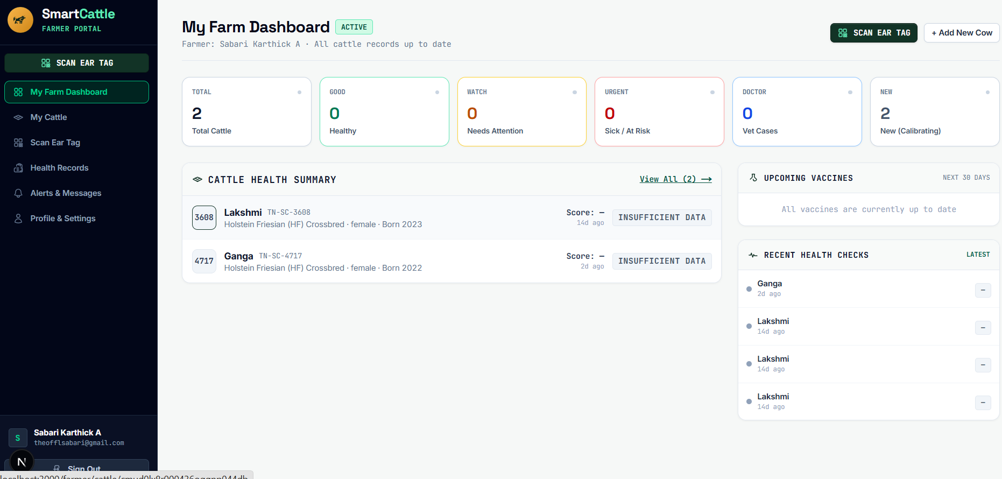
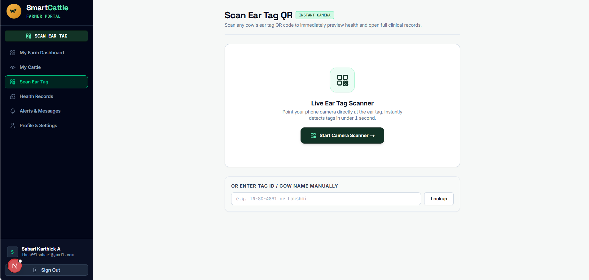
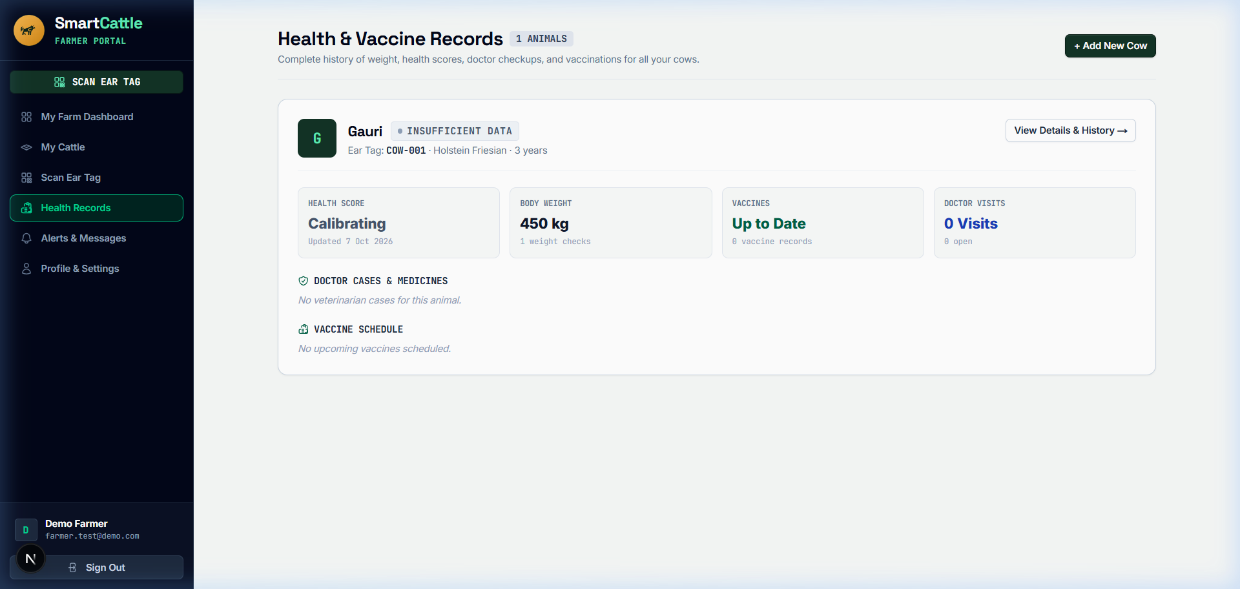
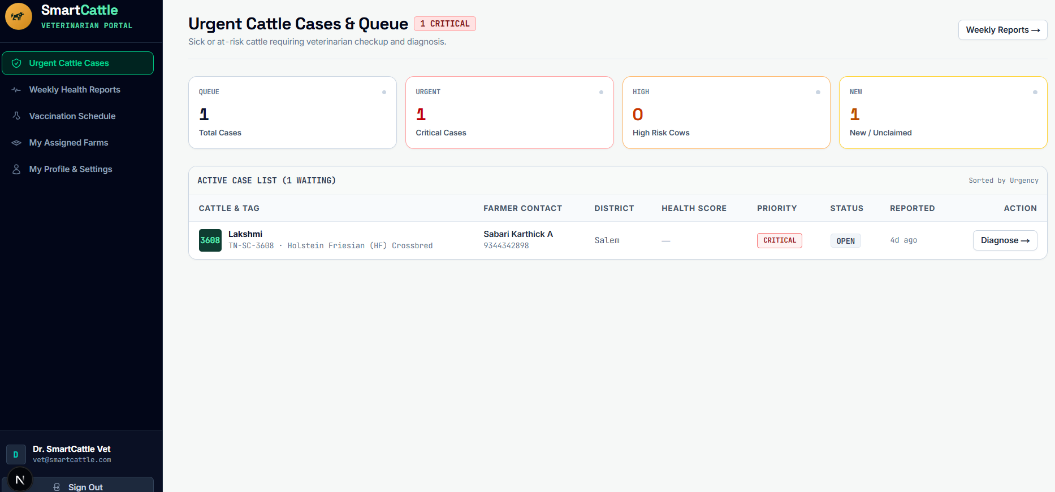
Screenshots
Farmer Herd Records & Overview
QR Ear-Tag Generator & Mobile Scan
CHDI Health Analytics & Deviation Score
Clinical Alerts & Vet Triage Workbench

Slide 14
Conclusion
Project Conclusion: SmartCattle provides a practical, zero-hardware digital livestock healthcare platform that connects rural dairy farmers with qualified district veterinarians.
Future Enhancements:
Demonstrated Clinical Value: Personalized CHDI scoring combined with closed-loop doctor feedback learning delivers trustworthy early warning, preserving animal lives and farm productivity.
Future Enhancement 1 - Direct IoT Collar Telemetry: Automated ingestion via wireless LoRaWAN / Bluetooth Low Energy (BLE) neck collars for continuous sensor feeds.
Future Enhancement 2 - Computer Vision Diagnostics: Mobile camera photo scanning for cattle facial grimace distress, hoof lameness detection, and dermatological lesion classification.
Future Enhancement 3 - Regional Voice Assistant: Multilingual voice-to-text logging in regional languages (Tamil and Hindi) for low-literacy rural farmers.

Slide 15
References
[1] Mahmud et al. (2021): M. S. Mahmud et al., 'A systematic review on deep learning for precision cattle farming,' Computers & Electronics in Agriculture, vol. 187.
[2] Bumbálek et al. (2023): J. Bumbálek, J. Pytel, and J. Císař, 'Dairy cow identification methods based on optical tags,' Computers & Electronics in Agriculture, vol. 204.
[3] Xu et al. (2026): X. Xu, B. Xiong, D. Liu, and H. Song, 'Non-contact technologies for cattle monitoring,' Computers & Electronics in Agriculture, vol. 216.
[4] Rutten et al. (2013): C. J. Rutten, A. G. Velthuis, and H. Hogeveen, 'Sensors to support health management on dairy farms,' Journal of Dairy Science, vol. 96(4).
[5] Lovarelli et al. (2020): D. Lovarelli, J. Bacenetti, and M. Guarino, 'Precision livestock farming in dairy cattle: technology and applications,' Journal of Cleaner Production, vol. 248.

Slide 16
Publication / Patent
Proposed Research Publication: 'SmartCattle: An Adaptive Multi-Stage Machine Learning Framework and Veterinary Tele-Triage System for Subclinical Disease Detection in Dairy Cattle.'
Target Journal / Conference Venues: Targeting IEEE Transactions on AgriFood Electronics / Elsevier Computers & Electronics in Agriculture.
Patent / Intellectual Property Scope: 'A System and Method for Adaptive Doctor-in-the-Loop Cattle Health Deviation Index (CHDI) Computation and Regional Veterinary Tele-Triage.'
Key Novelty Claim: Low-cost QR optical identification coupled with dynamic 7-day personalized baseline normalization and doctor feedback model recalibration to minimize false alarms in rural dairy herds.

