Slide 1


SONA COLLEGE OF TECHNOLOGY, SALEM
Department of Information Technology
QR-BASED CATTLE MANAGEMENT SYSTEM
Smart Health Monitoring & Automated Veterinary Alerts
Project Guide:
Mrs. J. Deepika,
Assistant Professor,
Department of IT
Project Team Members:
Sabari Karthick A (61782323110093)
Sivanarasimman S (61782323110103)
Sujeeth Y R (61782323110107)

Slide 2
Abstract
• Low-Cost QR Identification: Uses simple weatherproof QR ear tags instead of expensive wearable electronic sensors.
• Digital Cattle Records: Stores cattle profiles, milk yield, feed intake, vaccinations, and treatment history in one web app.
• Personalized Health Tracking: Learns the normal health baseline for each individual cow instead of using generic breed averages.
• Early Disease Alerts: Detects health drops (CHDI score) and alerts farmers and veterinarians 24 to 48 hours before severe illness.
• Seamless Vet Coordination: Automatically assigns sick cattle cases to nearby veterinarians for prompt treatment.

Slide 3
Objectives of the Project
• Replace Paper Records: Create an easy digital platform for farm and cattle management.
• Fast QR Code Identification: Enable instant cattle lookup by scanning ear tags using any smartphone camera.
• Complete Medical History: Track daily milk yield, feeding, vaccinations, and veterinary treatments in one secure place.
• Personalized Health Baseline: Monitor each cow's individual normal state to prevent false alarms.
• Early Anomaly Detection: Calculate a Composite Health Deviation Index (CHDI) to spot sickness early.
• Automated Vet Alerts: Automatically notify veterinarians when a cow shows signs of illness.
• Affordable for Small Farms: Deliver a simple, mobile-friendly system with zero on-animal hardware cost.

Slide 4
Proposed System / Methodology
• 1. Registration & Tagging: Farmer registers cattle and attaches a unique printed QR ear tag.
• 2. Daily Data Logging: Farmer scans the QR tag with a smartphone and enters daily milk yield and feed intake.
• 3. Baseline Learning: The system learns the cow's normal health patterns over a 14-day period.
• 4. Health Scoring (CHDI): Compares new entries with the baseline to calculate a Health Score (0 to 100).
• 5. Automated Triage: Normal (≥80), Watch (60–79), and At-Risk (<60). Alerts are triggered automatically if health drops.
• 6. Vet Check & Treatment: Veterinarian inspects the cow, adds treatment details, and confirms the diagnosis.

Slide 5
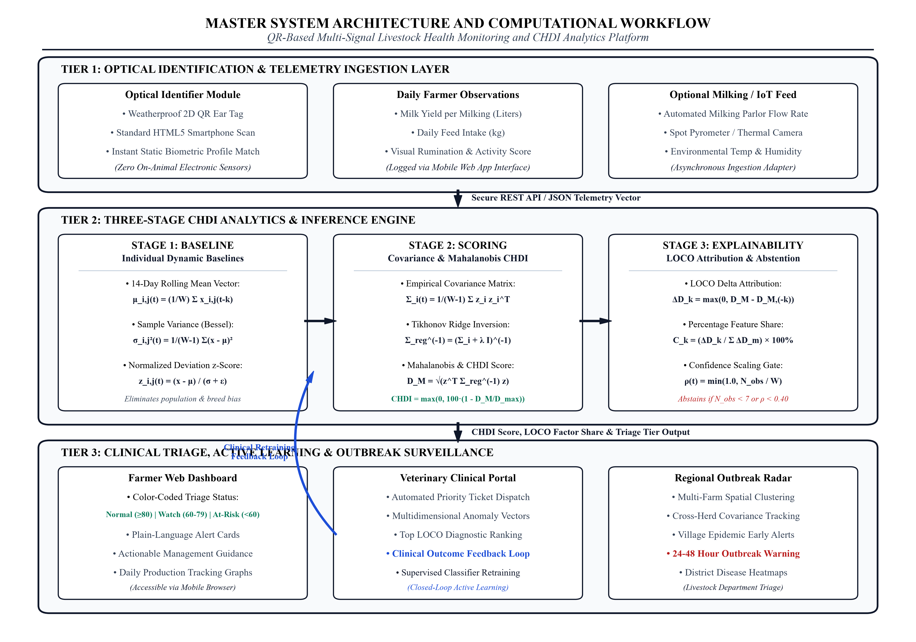
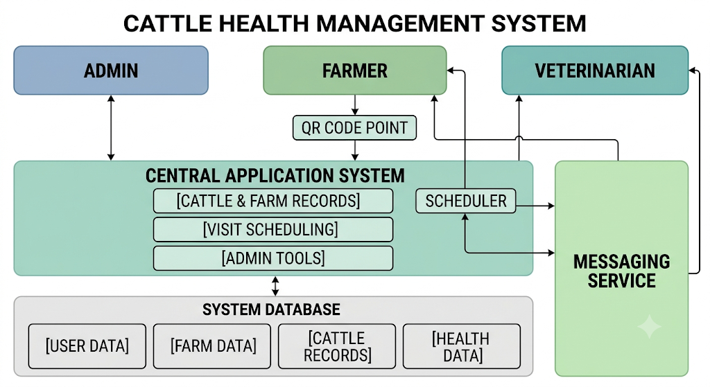
System Architecture & Workflow

Slide 6
Core Modules of the System
• 1. User Management: Separate logins and permissions for Admin, Farmer, and Veterinarian.
• 2. Farm & Cattle Records: Manage farm profiles, cow details, breed, age, and lactation stages.
• 3. QR Code Tagging: Generate and scan unique QR codes for instant animal lookup.
• 4. Daily Health Logging: Simple mobile form to log milk yield, feed intake, and activity.
• 5. Health Analysis Engine (CHDI): Compares daily records against the cow's own baseline.
• 6. Smart Alert System: Sends instant notifications when health drops or check-ups are due.
• 7. Veterinary Case Management: Assigns sick cattle tickets directly to regional veterinarians.
• 8. Medical & Vaccination Records: Tracks prescribed medicines, treatment logs, and vaccination dates.

Slide 7
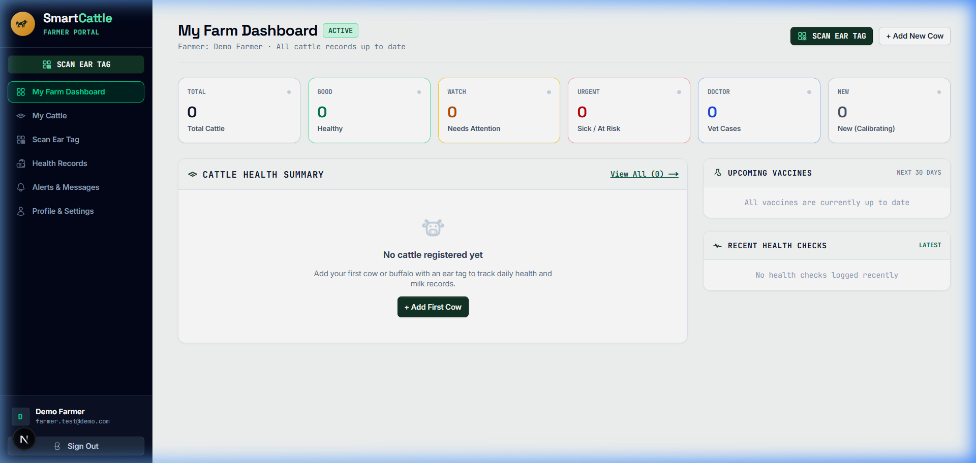
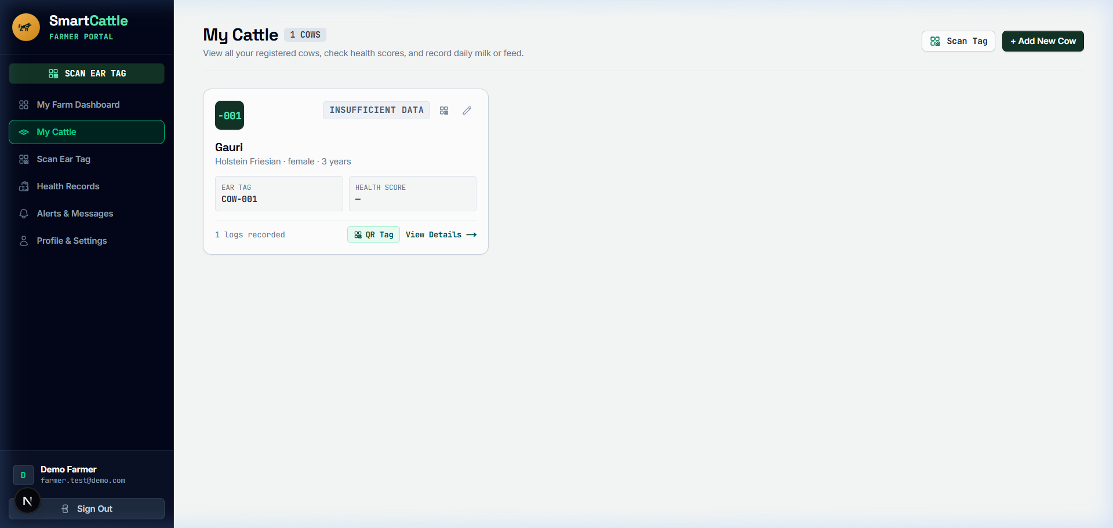

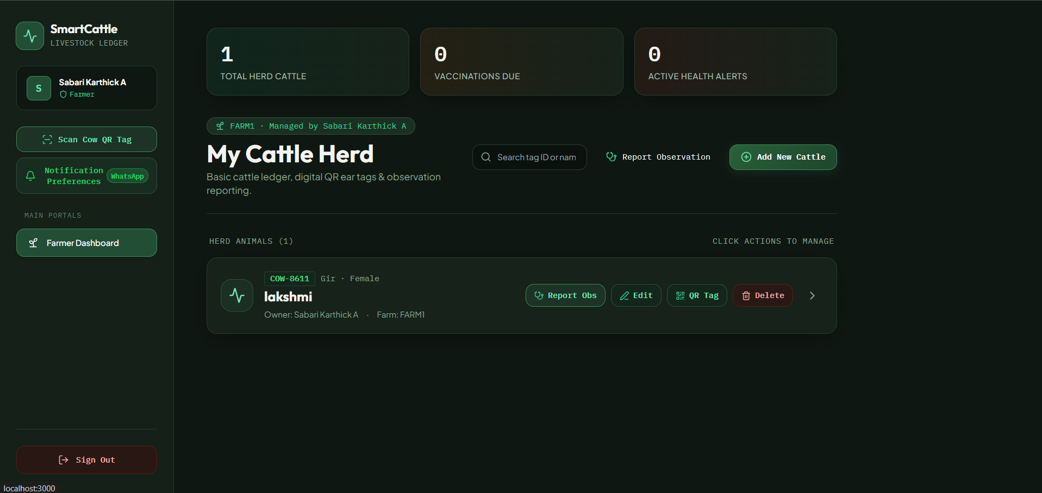
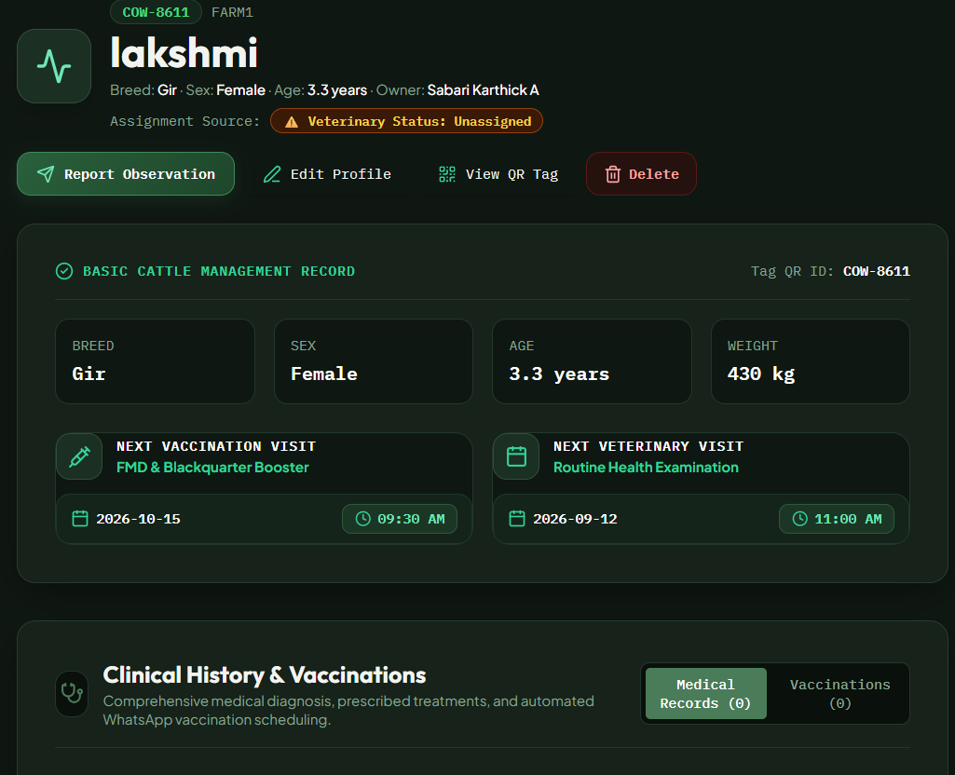
Module 1: User, Farm & Cattle Management
User Roles & Access Control
• Admin: Platform logs & settings • Farmer: Farm herd & health logs
• Vet: Multi-farm health oversight
Farm Management
• Register farm location & capacity
• Assign responsible veterinarians
• View all cattle under each farm
Cattle Digital Profile
• Cattle ID (e.g. COW-001), breed, age
• Weight & lactation stage (lactating/dry)
• Live status: Healthy, Watch, At-Risk

Slide 8
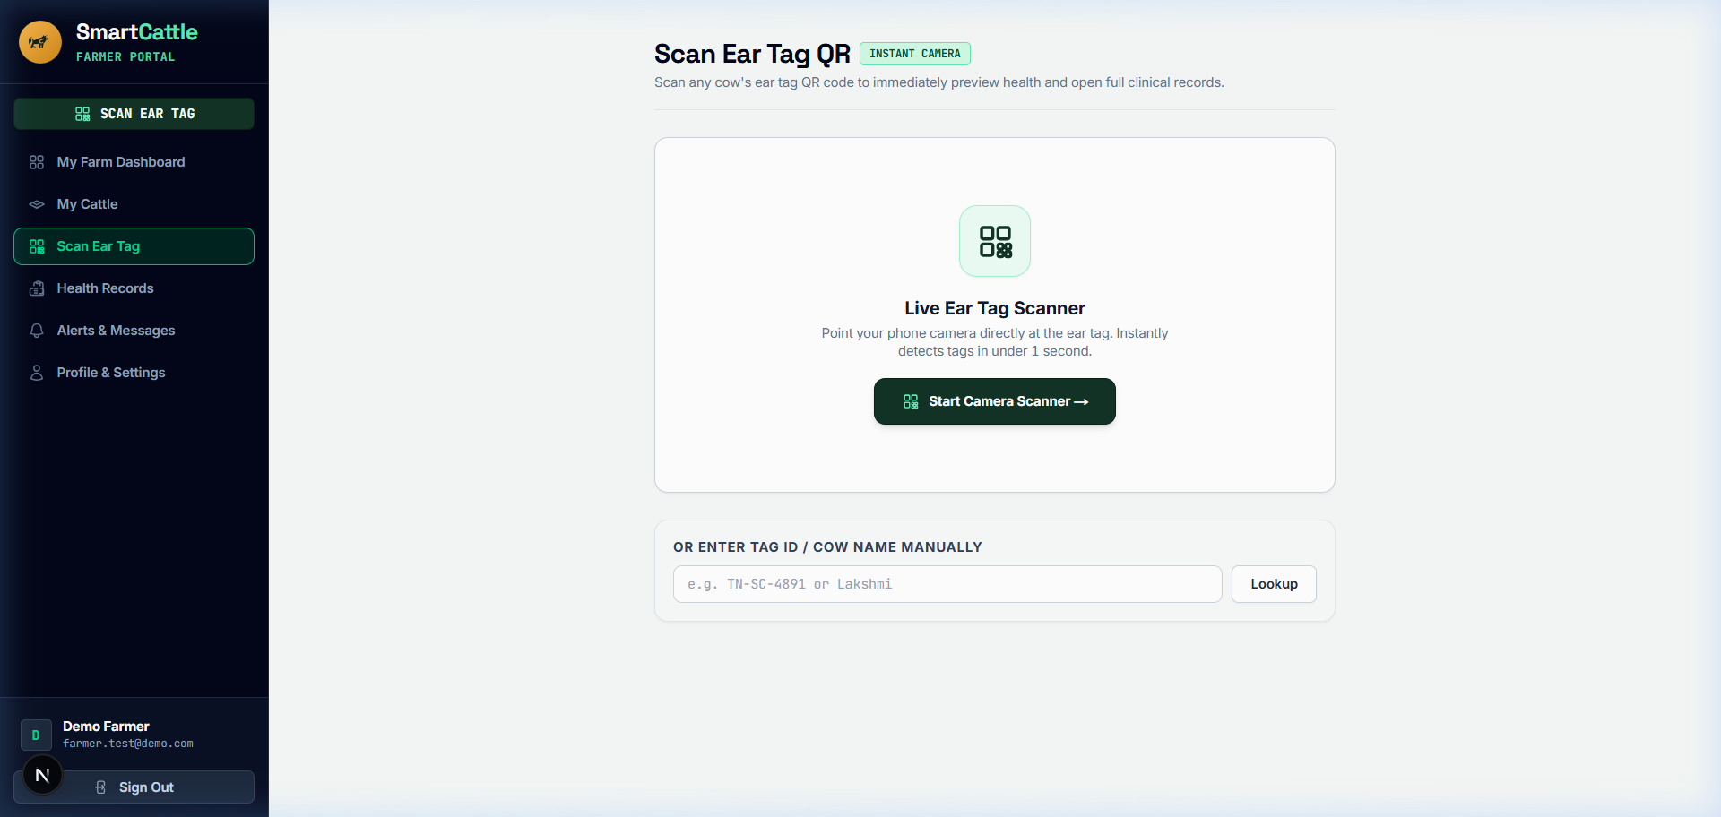
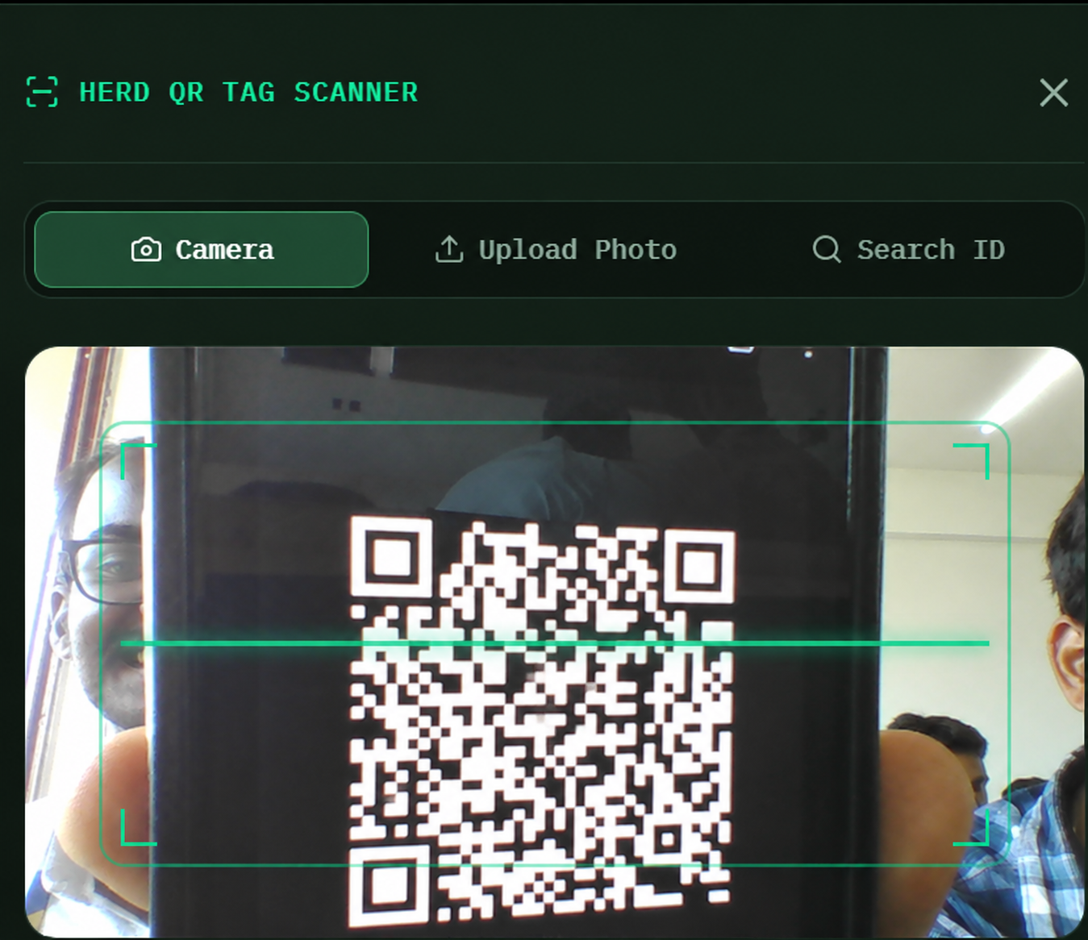
Module 2: QR Code Generation & Tagging
• Weatherproof 2D QR Ear-Tags: Every cow receives a unique printable QR tag linked to its digital cloud record. Eliminates expensive RFID tags with zero on-animal electronic sensors.
• Instant Phone Camera Scan (/scan): Farmers scan the ear tag using standard smartphone cameras (no app install needed) to immediately view milk records, vaccination status, and log daily observations.

Slide 9
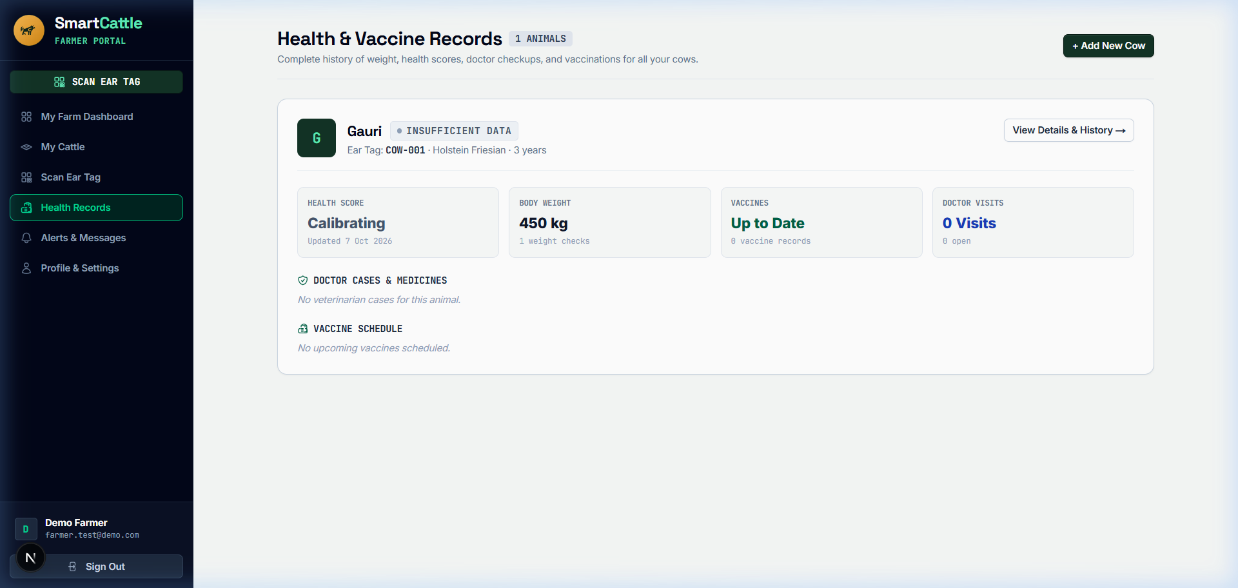
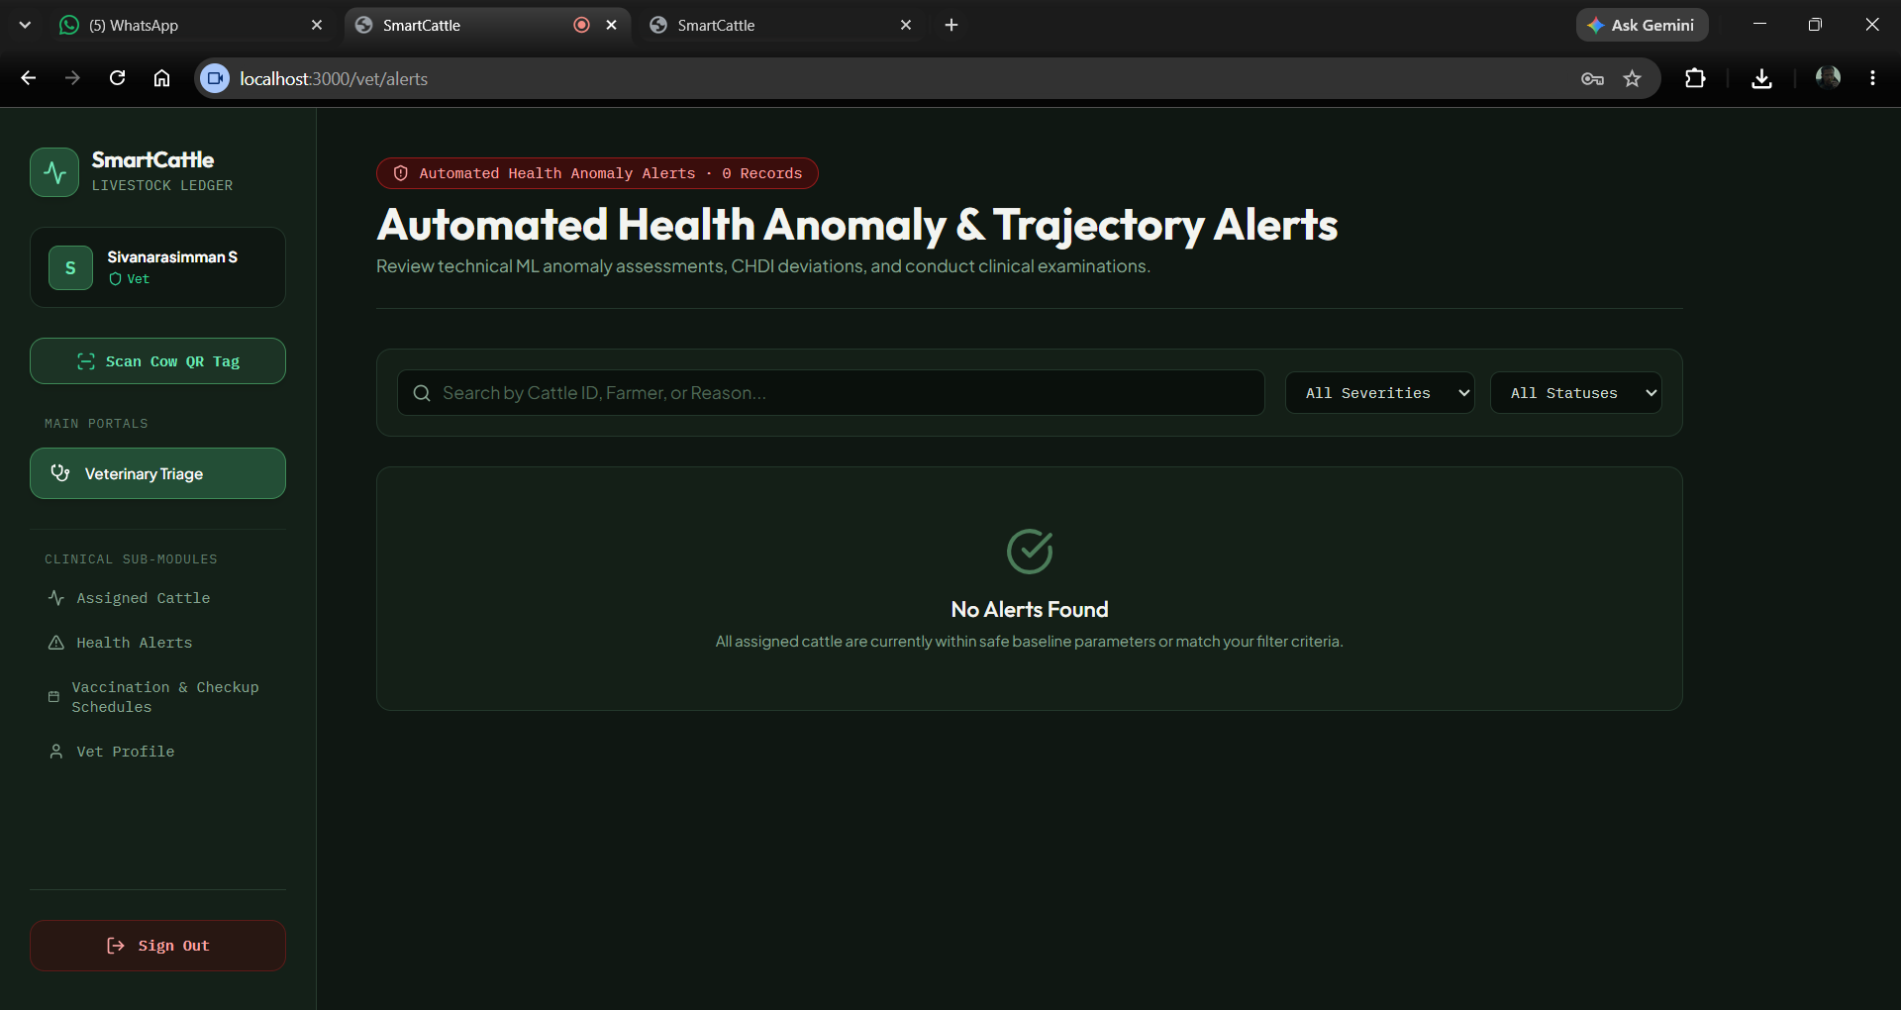
Module 3: Health Monitoring & CHDI Analytics
Daily Parameters Logged:
• Daily Milk Yield (Litres per milking)
• Daily Feed Intake (kg) & Feed Type
• Rumination Time & Activity Score
• Core Body Temperature (°C) & Weight
3-Stage CHDI Health Scoring:
• 14-Day Baseline: Learns normal levels per cow
• Deviation Score (0–100): Combines all vitals
• Normal (≥80): Routine healthy logging
• Watch (60–79): Advisory alert to farmer
• At-Risk (<60): Urgent alert to veterinarian

Slide 10
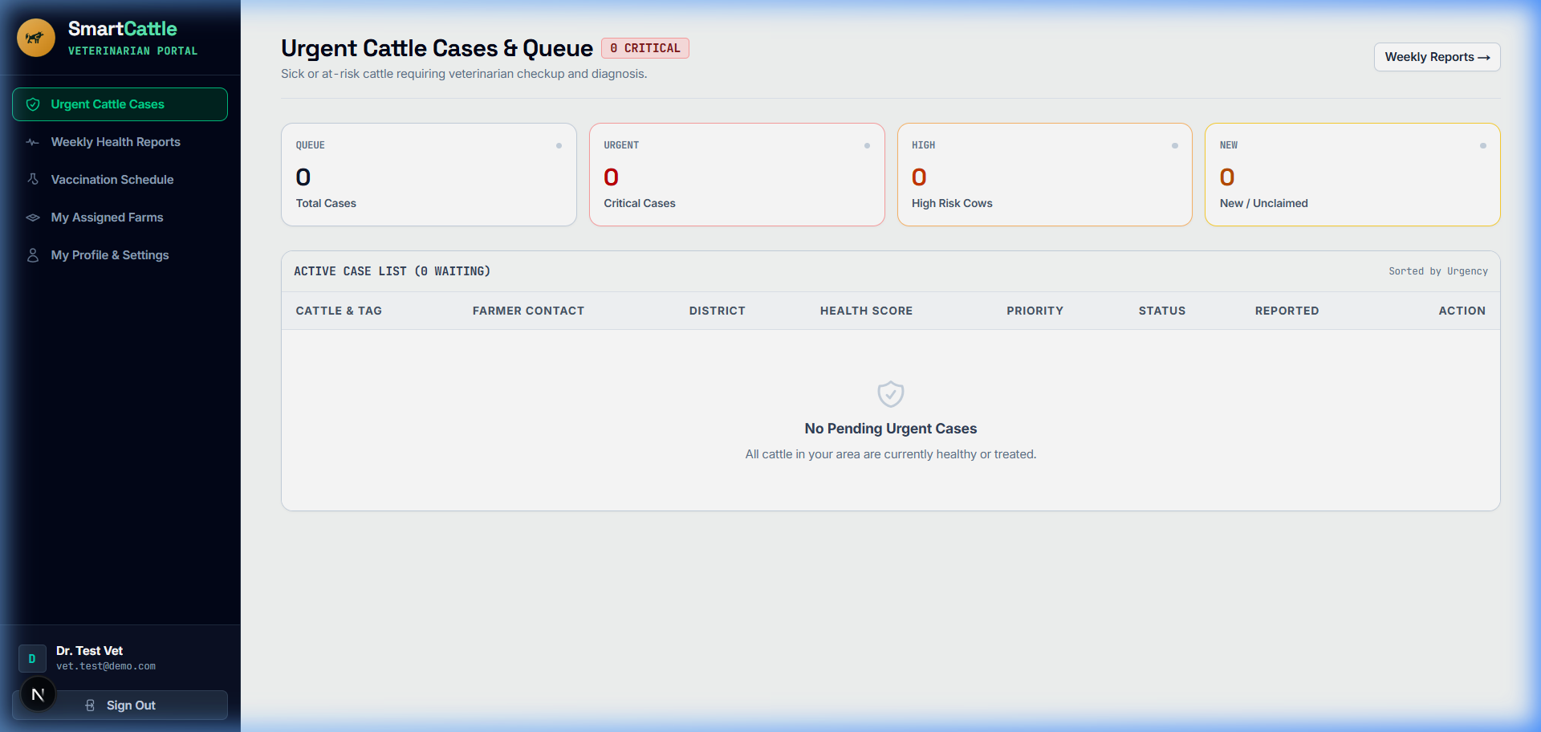
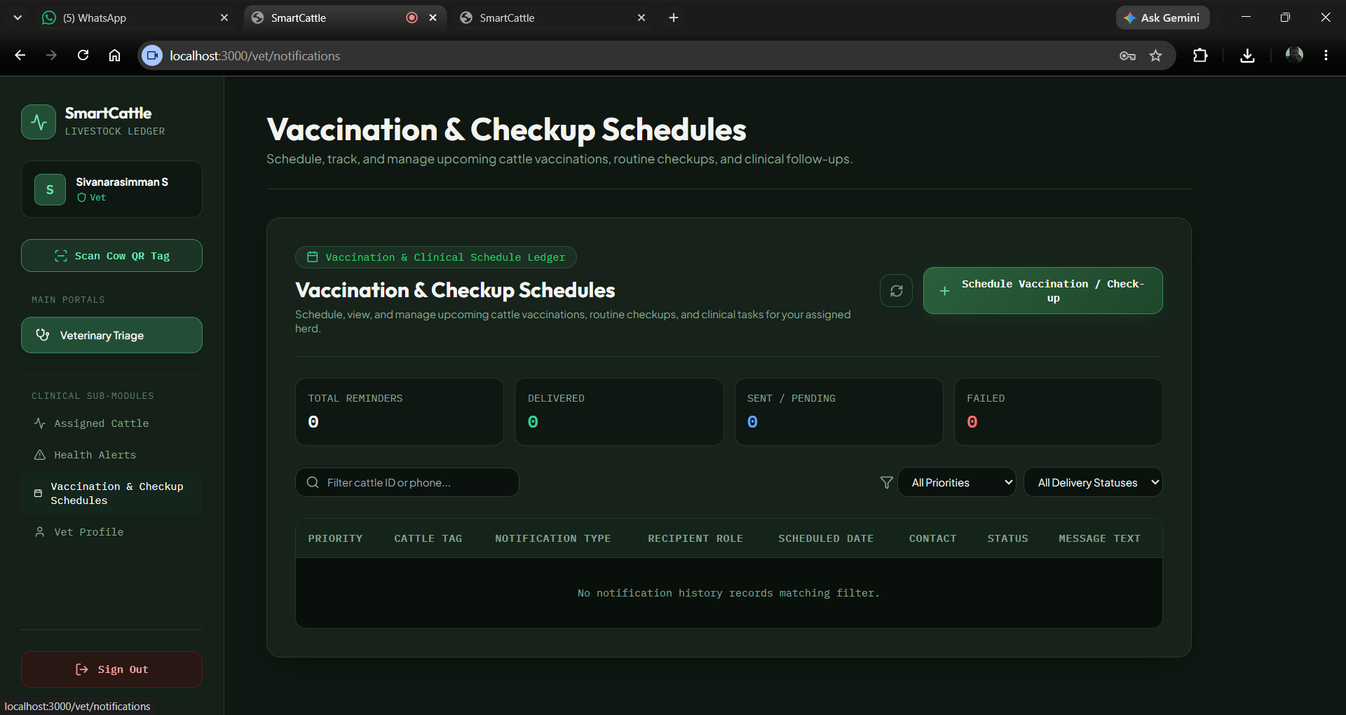
Module 4: Clinical Alerts & Veterinary Triage
Automated Clinical Triage:
• Instant ticket dispatch for At-Risk cows
• Highlights top root causes (e.g. Milk Drop 54%)
• Tracks emergency cases by urgency level
• Regional disease outbreak radar for multi-farms
Veterinary Records & Feedback:
• Doctor records diagnosis (Mastitis, Ketosis)
• Prescribes medicines, dosages & visit notes
• CONFIRM / OVERRIDE feedback retrains model
• Vaccination tracking (FMD, Anthrax, Brucellosis)

Slide 11
References
[1] M. S. Mahmud et al., “A systematic review on deep learning for precision cattle farming,” Computers & Electronics in Agriculture, 2021.
[2] J. Bumbálek, J. Pytel, and J. Císař, “Dairy cow identification methods based on optical tags,” Computers & Electronics in Agriculture, 2023.
[3] X. Xu, B. Xiong, D. Liu, and H. Song, “Non-contact technologies for cattle monitoring,” Computers & Electronics in Agriculture, 2026.
[4] C. J. Rutten, A. G. Velthuis, and H. Hogeveen, “Sensors to support health management on dairy farms,” Journal of Dairy Science, 2013.
[5] D. Lovarelli, J. Bacenetti, and M. Guarino, “Precision livestock farming in dairy cattle,” Journal of Cleaner Production, 2020.

Slide 12
Conclusion & Future Work
• Affordable Cattle Tracking: Provides smart health monitoring using low-cost QR ear tags without expensive wearable sensors.
• Early Sickness Detection: Identifies health drops (CHDI) 1 to 2 days earlier, allowing timely treatment before milk yield suffers.
• Better Vet Coordination: Connects farmers directly with veterinarians for rapid case response and clear treatment history.
• Future Scope: Adding offline mode for rural areas with low network connectivity, and voice assistance in Tamil and Hindi.

