Slide 1
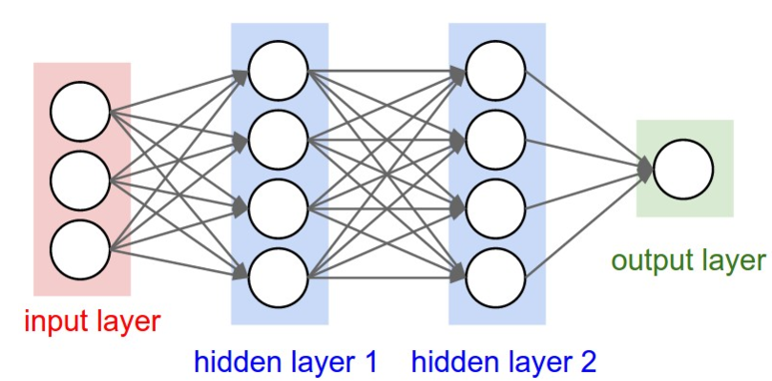
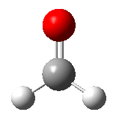
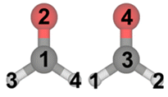
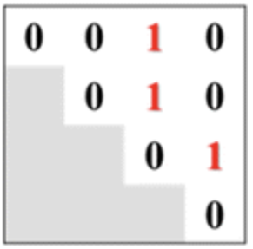
SMILES → 3D (Week 5)
Molecular descriptors (Week 6, 8)
QM-derived descriptors (Week 7, 9)
Fingerprint and similarity
(Week 10)
Input features
w/ or w/o 3D coord.
Descriptors such as graphs, fingerprints, …
Rotation/permutation ‘invariant’
Regression
Multivariate model
(Week 11)
Machine learning
(Week 13)
Deep learning
(Week 14), etc.
Various physical/chemical properties (experimental, calculated)
Handling big data
(Week 12)

Slide 2
Regression
Multivariate model
(Week 11)
Machine learning
(Week 13)
Deep learning
(Week 14), etc.
Data points > 10⁴, 10⁵
→ Minimal information is given in the input layer (SMILES, atom, bond feature, connectivity, etc.)
→ Minimal human intervention
→ Deep learning, so that the computer automatically recognizes and learns some ‘patterns’ that are consistent (sometimes not consistent) with our chemical intuition
Data points < 10³
→ Molecular descriptors can be generated (from QM calculations, Python packages, etc.) and chosen based on our intuition
→ Target property = f(chosen molecular descriptors/features)
** Just in my opinion, the perspective in this slide is not always right.

Slide 3

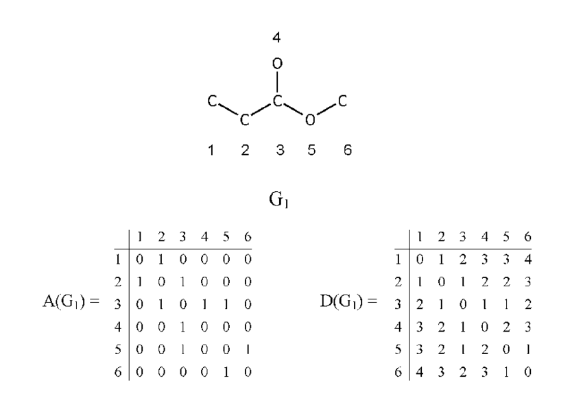
Topological Descriptors
Balaban’s J index
(γ = m – n + 1, m: # of bonds, n: # of atoms)
Topological polar surface area
Bertz complexity index
An index defined to quantify complexity,
extent of branching of a molecule
https://www.rdkit.org/docs/source/rdkit.Chem.GraphDescriptors.html
https://www.rdkit.org/docs/source/rdkit.Chem.rdMolDescriptors.html
And refs therein

Slide 4
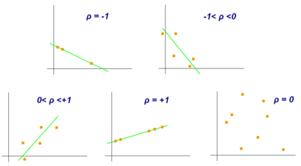
Pearson Correlation Coefficient

Slide 5
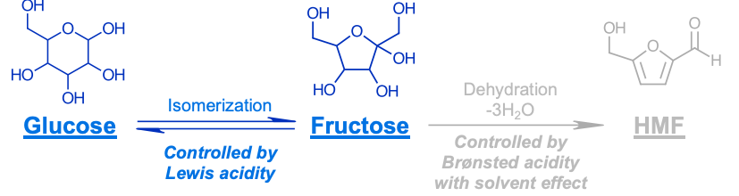
Exercise 2

