Slide 1

Summer Coding Camp 2022
Class - 1
Python and scripting basics: Setting up jupyter, python basics

Slide 2

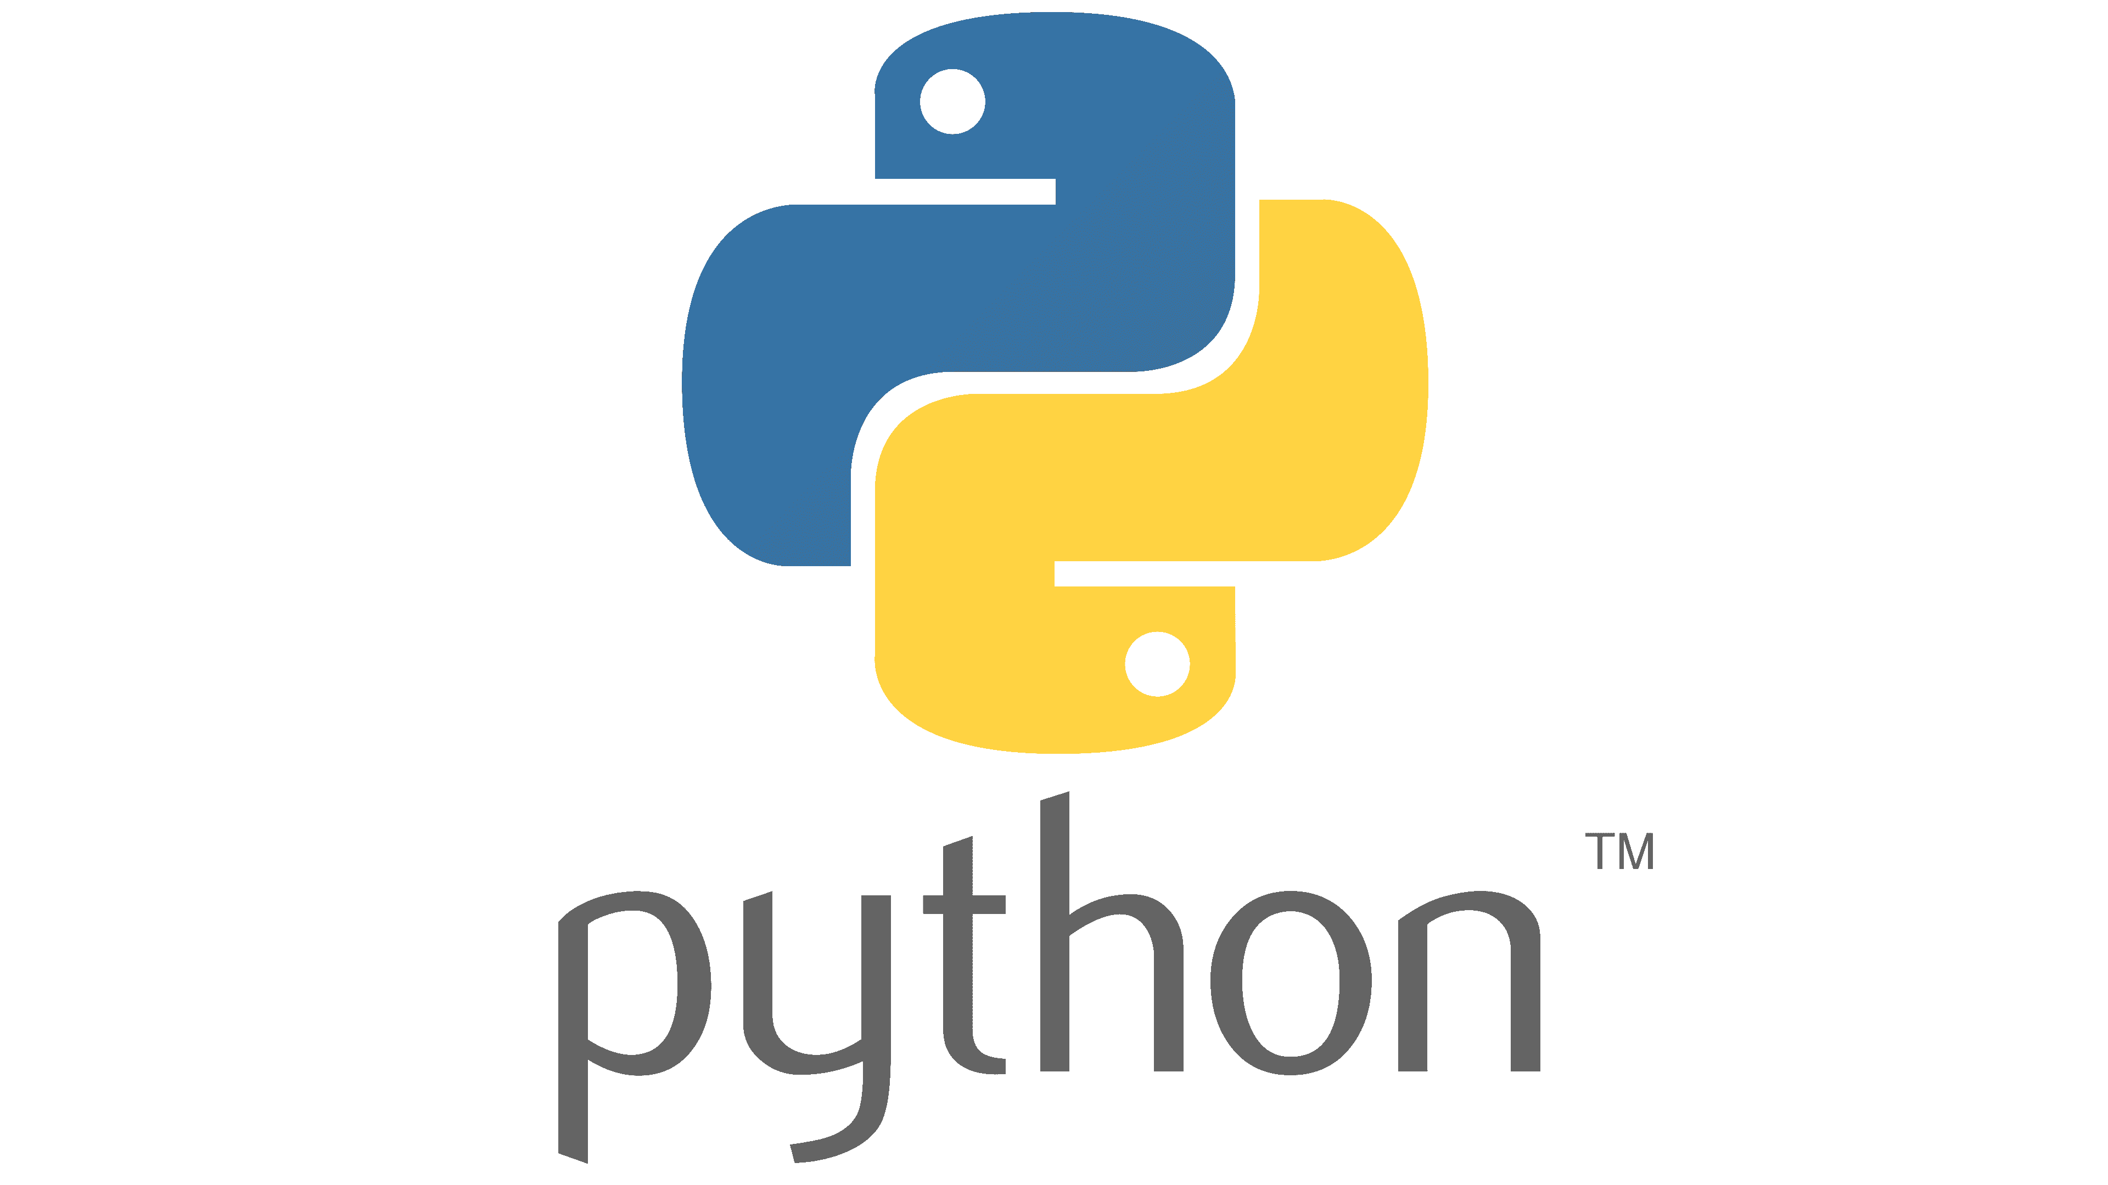

Contents
Today’s Basic outline
Scripting vs. Writing a complete program
Conda Environments
Setting up Jupyter lab, connecting to a remote Jupyter server
Python basics: variable assignment + scope, conditionals, looping + logic flow, functions

Slide 3
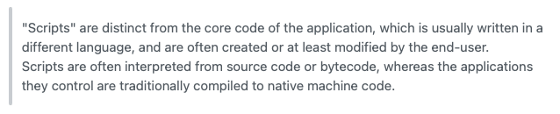
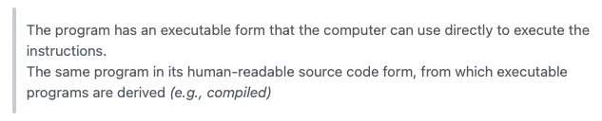
Why Coding?
Scripting vs Complete Program
Day to day repeated tasks
Make something automatic
Write scripts
Run programs
What’s the difference?
Scripting
Complete program
A set of tasks – Classify?
Creation of inputs
Analyze outputs
Run calculations like G16, ORCA
What will we cover in this coding camp -> Scripting
https://stackoverflow.com/questions/2286552/difference-between-a-script-and-a-program,
Notes:
Scripting simple terms – Typically, a script is a lightweight, quickly constructed, possibly single-use tool. It's usually interpreted, not compiled. Python and bash are examples of languages used to build scripts.
view a script in a text editor to see what it does.
Program - A program is constructed in a compiled language, like C or C++
Run quicker
the latter's instructions have been compiled into bytecode or machine language that makes it very difficult for humans to understand, without specialized tools.

Slide 4
Google Collab
Open source
Open-source coding platform developed by google
We can set up code and do calculations
Check out the github link

Slide 5
When to write new code?
Modules
Mostly a lot of people already have though of problems which we have
We can reuse most of it
How do you find existing code?
Pip
Conda
These methods can be used to install existing code
Pip install module-name
Conda install module-name –c channel-name
Example:
Finding distance between two points.

Slide 6
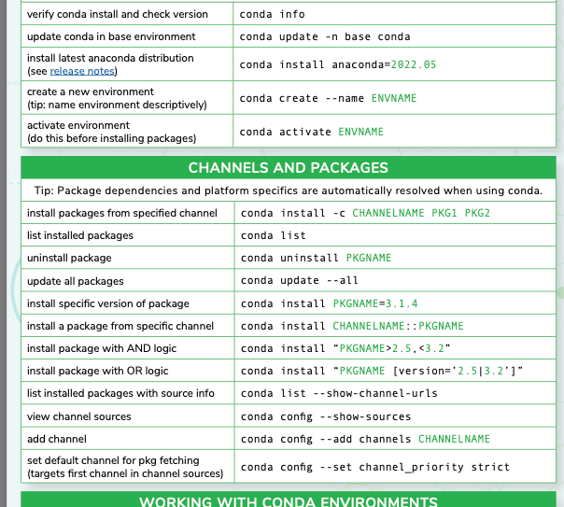
Conda
Open source
Environment (envs)
A workspace where a script/code can be executed
This has necessary modules for running code.
How can we create envs?
Conda helps set up envs.
Create our first environment
Can be used for this summer coding camp
Conda create –n cc python=3.8 numpy pandas
Conda activate cc
Lets check what is there in the env
Conda list
Modules to install (we can talk about them as we get there)
pip install scikit-learn
conda install rdkit –c conda-forge
conda install -c conda-forge jupyterlab

Slide 7
Important links
Open source
Saving – conda env export cc >cc.yml
Reinstall – conda create –n cc –file cc.yml
Ipykernel https://ipython.readthedocs.io/en/stable/install/kernel_install.html
Jupyter lab https://jupyterlab.readthedocs.io/en/stable/
Conda https://docs.readthedocs.io/en/stable/guides/conda.html

Slide 8
Jupyterlab vs google collab
Why Jupyter
Can track on your computer
Have your own workspace
Mostly work done is not open for public
Setup Jupyter
Open the docx and we will set it up!
How can the environment we accessed by the Jupyter notebook?
Conda activate cc
python -m ipykernel install --user --name cc--display-name ”cc”

Slide 9
Python Basics
Variable assignment + scope
Conditionals
Looping + Logic flow
Functions

