Slide 1
Personality Analysis Through CV
M. SABARI
2021506080
MIT CAMPUS, AU

Slide 2
PERSONALITY ANALYSIS THROUGH CV
The "Personality Analysis through CV" project aims to create a cutting-edge platform that predicts personality traits by harnessing the power of the Big Five model and data extracted from CVs.
This initiative is geared towards refining candidate assessments and streamlining recruitment processes.
By employing Natural Language Processing (NLP) techniques for CV analysis and logistic regression for model development, the system provides a comprehensive approach to evaluating candidates based on their personality characteristics.
Its key features include robust CV analysis, precise model training, and an intuitive user interface designed to simplify candidate selection

Slide 3


AGENDA
PROBLEM STATEMENT
PROJECT OVERVIEW
END USERS
SOLUTION AND ITS VALUE PROPOSITION
THE WOW IN A SOLUTION
MODELLING
RESULTS
3/21/2024 Annual Review

Slide 4

PROBLEM STATEMENT
Traditional CV analysis, while offering a glimpse into a candidate's skills and experience, remains a one-dimensional snapshot in the recruitment process. Personality, however, is a critical but often overlooked factor that significantly impacts job fit, team dynamics, and overall company culture. To bridge this gap, we propose developing a system that leverages machine learning to analyze CV data and predict personality traits. This system would identify patterns in resumes, such as specific action verbs used or the types of roles pursued, that correlate with established personality models (e.g., the Big Five personality traits). By incorporating personality prediction alongside traditional methods, we aim to achieve a more holistic evaluation of candidates, leading to several potential benefits

Slide 5

PROJECT OVERVIEW
The project endeavors to create a sophisticated system capable of predicting an individual's personality traits based on the renowned Big Five Personality Traits model (Openness, Conscientiousness, Extraversion, Agreeableness, Neuroticism), utilizing their resume and supplementary data.
This system is tailored to cater to diverse business sectors in need of skilled professionals, with the primary goal of alleviating the burdensome tasks associated with hiring, training, and personnel management.
Through the application of Natural Language Processing (NLP) techniques, the system will adeptly parse resumes, extract pertinent details, and employ logistic regression for model refinement.
Developed in Python and incorporating libraries like pandas, numpy, tkinter, and pyresparser, key functionalities encompass resume parsing, model training, and the provision of an intuitive user interface. Furthermore, administrators will have the capability to effortlessly shortlist candidates based on their personality scores, facilitating the selection of ideal candidates for specific job roles.

Slide 6
WHO ARE THE END USERS?
The primary users of this system are professionals engaged in the hiring process within organizations, including
HR departments
Hiring managers
Recruitment teams
They stand to gain significant advantages from the system's capability to forecast personality traits using resumes and supplementary data. This tool assists them in identifying candidates who align best with specific job profiles, streamlining the selection process. These individuals will actively interact with the system, leveraging its features and functionalities to assess and select candidates based on predicted personality traits.

Slide 7

MY SOLUTION AND ITS VALUE PROPOSITION
Solution:
Our solution offers a robust system designed to predict an individual's personality traits (Openness, Conscientiousness, Extraversion, Agreeableness, Neuroticism) based on their resume and additional data. Powered by NLP, it effectively parses resumes, extracts relevant information, and trains a model using logistic regression. By prioritizing personality traits, our system presents a holistic approach to candidate assessment, facilitating the identification of ideal candidates for specific roles.
Value Proposition:
Efficiency: Streamlines the hiring process by automating personality assessment, reducing workload.
Accuracy: Relies on the Big Five Personality Traits model for precise and dependable predictions.
Comprehensive Evaluation: Considers both qualifications and personality traits for a thorough candidate assessment.
User-Friendly: Intuitive interface enables administrators to easily shortlist candidates.
Cost-Effective: Saves time and resources, optimizing the candidate selection process.

Slide 8

THE WOW IN MY SOLUTION
Our solution apart is its cutting-edge integration of Natural Language Processing (NLP) techniques, which enables the system to meticulously parse resumes and extract pertinent details. By seamlessly merging NLP with the Big Five Personality Traits model and logistic regression, our system offers a holistic and automated approach to evaluating candidates' personalities.
This not only lightens the burden on hiring teams but also enriches the selection process by factoring in crucial personality traits alongside qualifications. Complemented by a user-friendly interface and robust data storage capabilities, our solution presents an unparalleled value proposition, empowering businesses to streamline and optimize their recruitment processes effectively.
3/21/2024 Annual Review

Slide 9
MODELLING
The modeling involves using logistic regression to predict personality traits based on the OCEAN values and additional data extracted from resumes.
The system utilizes the Big Five Personality Traits model, which measures key dimensions of personalities.
Using the extracted data, the system trains a model to predict the personality traits of individuals.
The logistic regression model is trained on a dataset containing gender, age, and scores for openness, conscientiousness, extraversion, agreeableness, neuroticism, and experience.
This modeling approach allows for the prediction of personality traits, which can be valuable in various business areas for selecting the right candidate for a job profile.

Slide 10
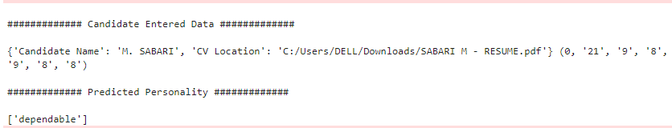
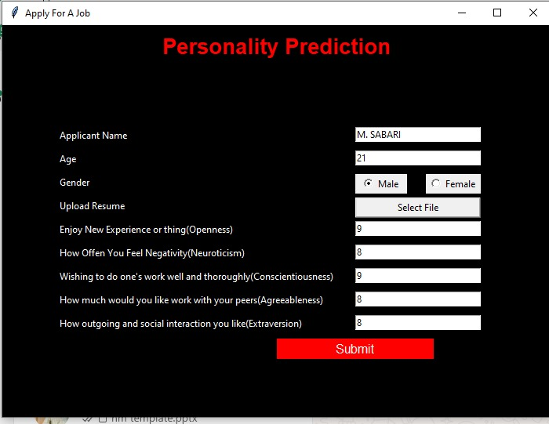
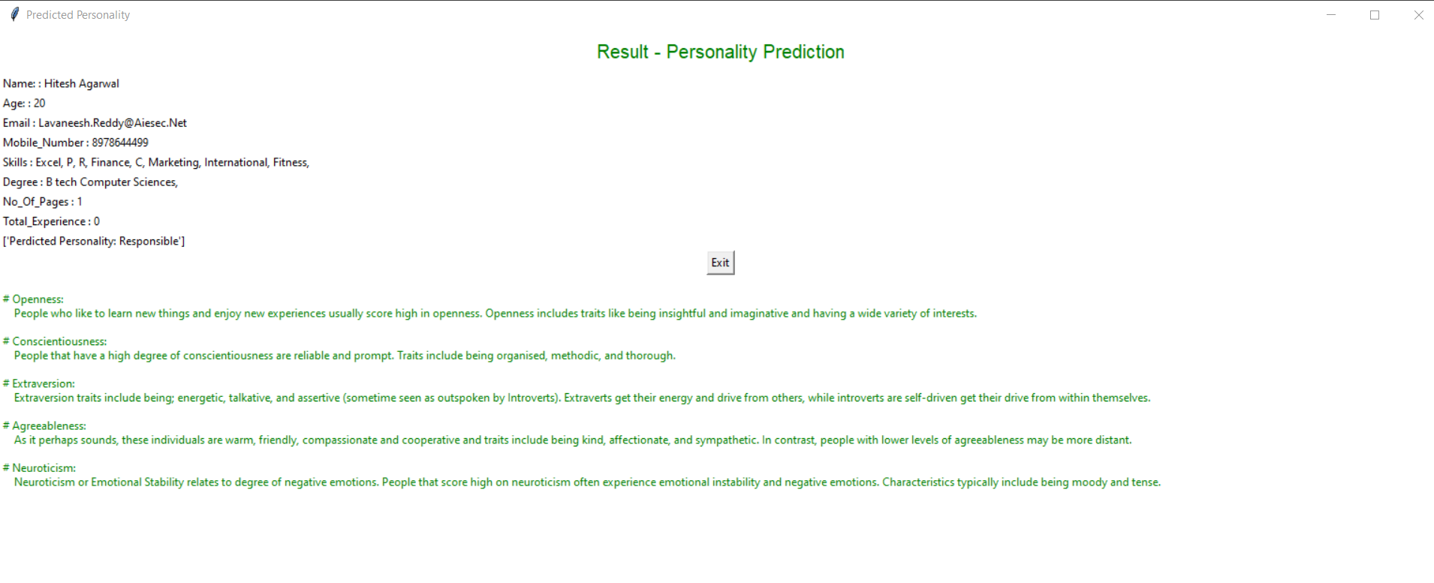
RESULTS
https://drive.google.com/file/d/1j4WXvGK59k6bV9LNJBO28X3sJjZb8xDM/view?usp=sharing

Slide 11
CONCLUSION
In conclusion, the integration of personality analysis through CVs presents a promising avenue for revolutionizing the hiring process. By leveraging advanced techniques such as Natural Language Processing (NLP) and the Big Five Personality Traits model, organizations can gain invaluable insights into candidates' suitability for specific roles.
This approach not only streamlines candidate evaluation but also enhances the objectivity and efficiency of the recruitment process. With the ability to predict personality traits based on CV data, businesses can make more informed hiring decisions, leading to better job-person fit and ultimately contributing to the overall success of the organization. As technology continues to evolve, the utilization of personality analysis through CVs is poised to become an indispensable tool in modern talent acquisition strategies.

