Slide 1
HR Chat Agent
HR
An HR assistant you can trust with real numbers
Answers from policy · reads your own records · never submits anything without your confirmation
AI Master evaluation · Sabarinath V · Emp Id: I21229
Sample data and sample policies, written for this demonstration
Notes:
Open with the one-line promise: an HR assistant you can trust with real numbers. Everything in this deck serves that. The assistant answers from policy, reads the employee's own records, and cannot submit anything without the employee confirming. Mention that the data and policies are samples written for the demonstration. About 15 minutes: a live demo first, then how it works, how we know it works, and where it falls short.

Slide 2
The problem we set out to solve
What employees face
What the brief asked for
Policy answers are scattered across documents
Leave balances and eligibility need rules plus personal data, not guesses
One wrong number in an HR answer costs trust, and can cost money
Employees sign in, and every answer is for the right person
Answers come from the HR policy documents, with their source
Tools and a database answer the dynamic questions: leave balance, eligibility, calculations
Architecture that is documented and can be evaluated
Our answer: the model talks, and code decides facts and permissions.
HR Chat Agent · sample data and sample policies are illustrative
2
Notes:
HR questions repeat constantly, and the answers sit in policy documents and HR systems. Leave questions are the hard kind: they depend on a rule and on the person's own data. A chatbot that guesses a number loses trust immediately. The brief asked for authenticated employees, answers from the policy documents, tools and a database for the dynamic questions, and documented architecture. Our answer is one idea: let the model talk, and let code decide facts and permissions.

Slide 3
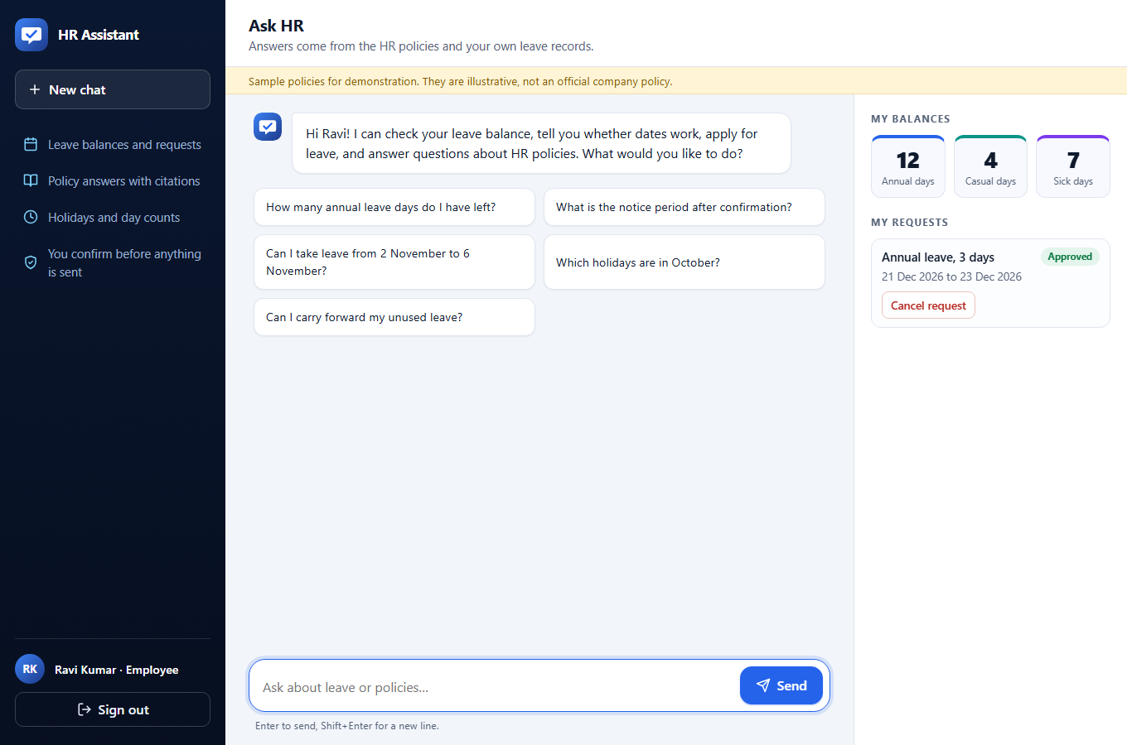
What it does
Policy answers with clause citations that open the policy text
Your leave data balances, requests and holidays from your own records
Day counts and eligibility from tested rule code, not from the model
Apply for leave the assistant prepares a draft, you confirm it
Manager tools pending approvals and team availability, for direct reports only
Planning compare leave options across holidays
HR Chat Agent · sample data and sample policies are illustrative
3
Notes:
Walk down the list. Policy answers carry clause citations, and each citation opens the policy text. Personal data comes from the employee's own records. Day counts and eligibility are computed by tested rule code, not by the model. Applying for leave produces a draft the employee confirms. Managers get approvals and team availability for their own direct reports. Planning compares leave options across holidays. The screenshot is the real application after sign-in as Ravi, an employee.

Slide 4
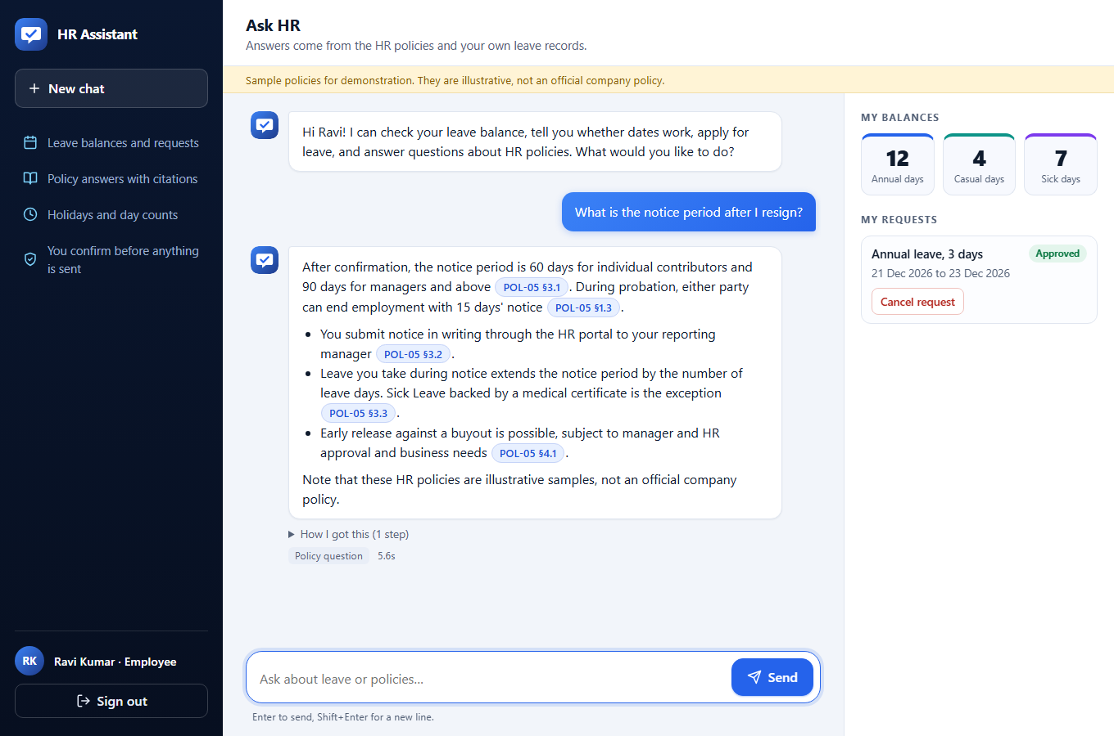
Demo 1: a policy question, answered with its source
1
Real source
Each rule carries a clause chip, like POL-05 §3.1. Clicking it opens the policy text.
2
Visible steps
“How I got this” lists the tool calls behind the answer.
3
Verified first
The text is sent only after numbers and citations have been checked.
4
Honest
The assistant says the sample policies are illustrative.
Asked: “What is the notice period after I resign?” Answered in 5.6 s.
HR Chat Agent · sample data and sample policies are illustrative
4
Notes:
Live demo: sign in as Ravi and ask what the notice period is after resigning. Point at the answer: each rule has a clause chip like POL-05 section 3.1, and clicking it opens the policy text. 'How I got this' shows the tool call behind the answer, and the tag shows the detected intent and the time. Explain that the text appears only after the verifier has checked it, which is why the answer arrives as a whole and not word by word. Note that the assistant says the policies are illustrative samples.

Slide 5
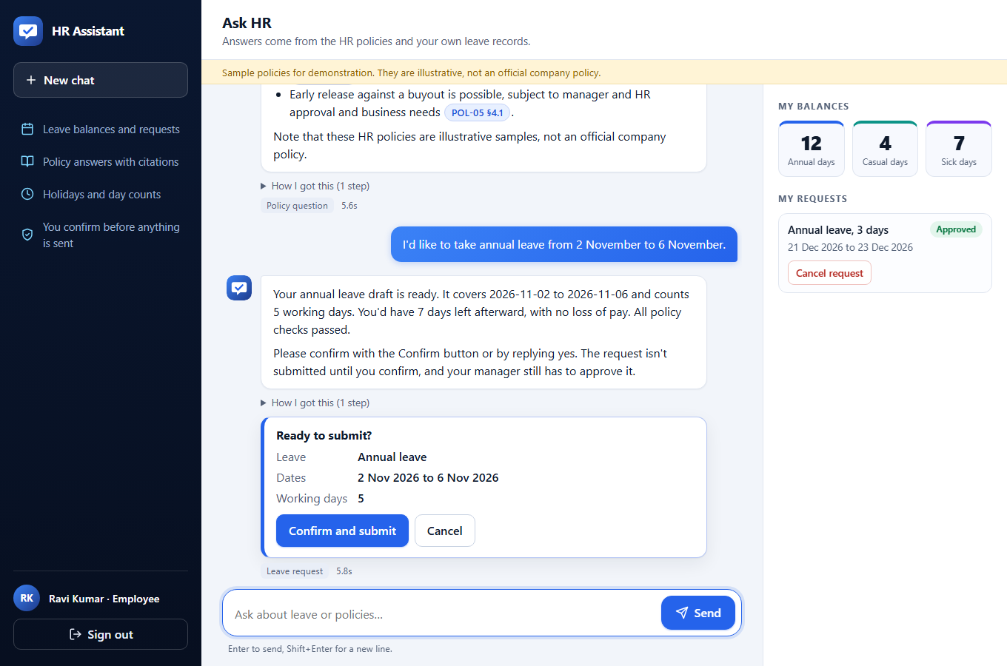
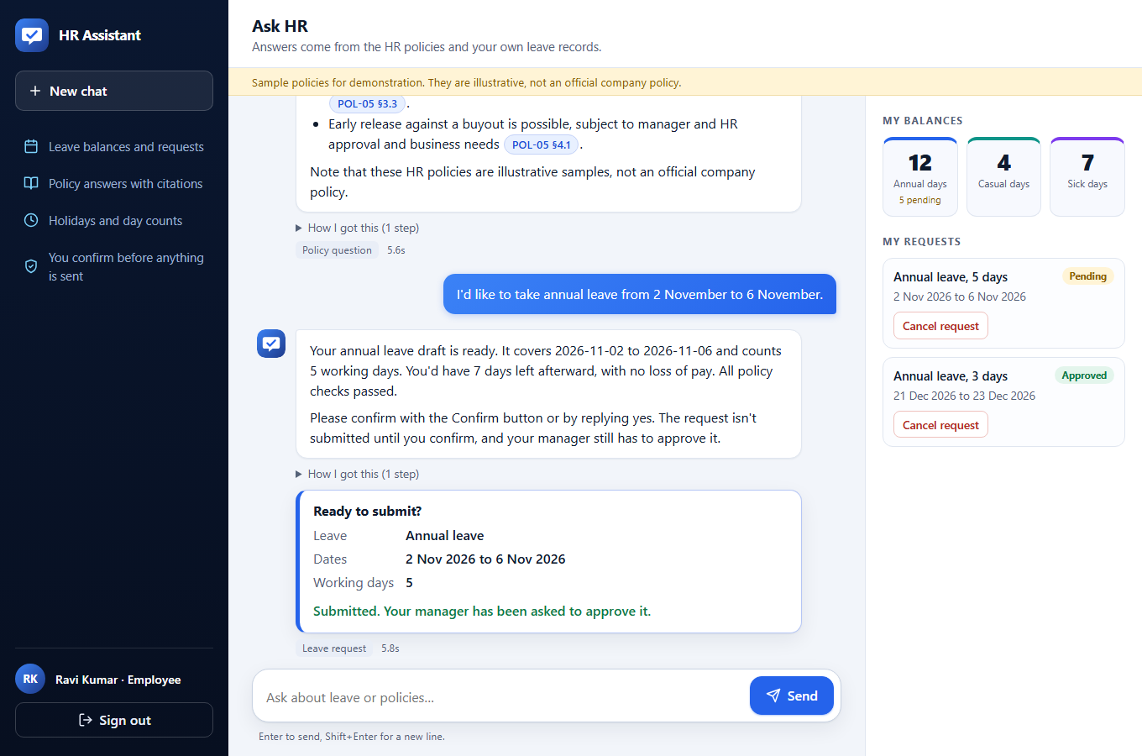
Demo 2: applying for leave. The model proposes, you confirm.
1 Draft prepared. Nothing is submitted yet.
2 After Confirm: the request is pending and the manager is asked.
The model can prepare a draft but never sees its id. Only the Confirm click (or a bare “yes”, handled by code) creates the request, and the rules are checked again at that moment.
HR Chat Agent · sample data and sample policies are illustrative
5
Notes:
Live demo: ask to take annual leave from 2 to 6 November. The assistant checks every rule and stores a draft; it shows a confirmation card with the leave type, dates and working days, and says nothing has been submitted. Click Confirm. The request appears as pending in the side panel and the manager is asked to approve. The key design point: the model never sees the draft id and has no tool that submits. Only the Confirm click, or a bare 'yes' handled by code, creates the request, and confirmation re-checks eligibility.

Slide 6
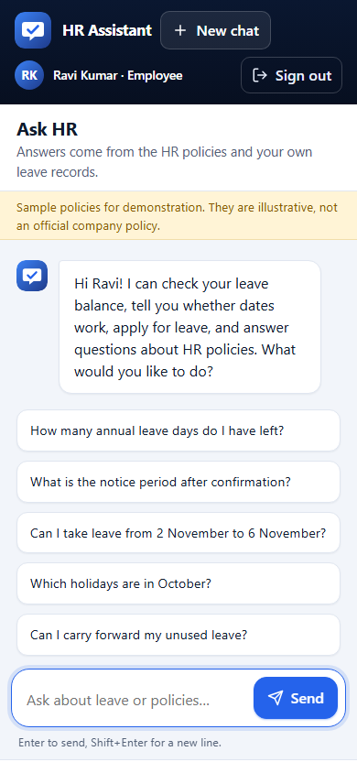
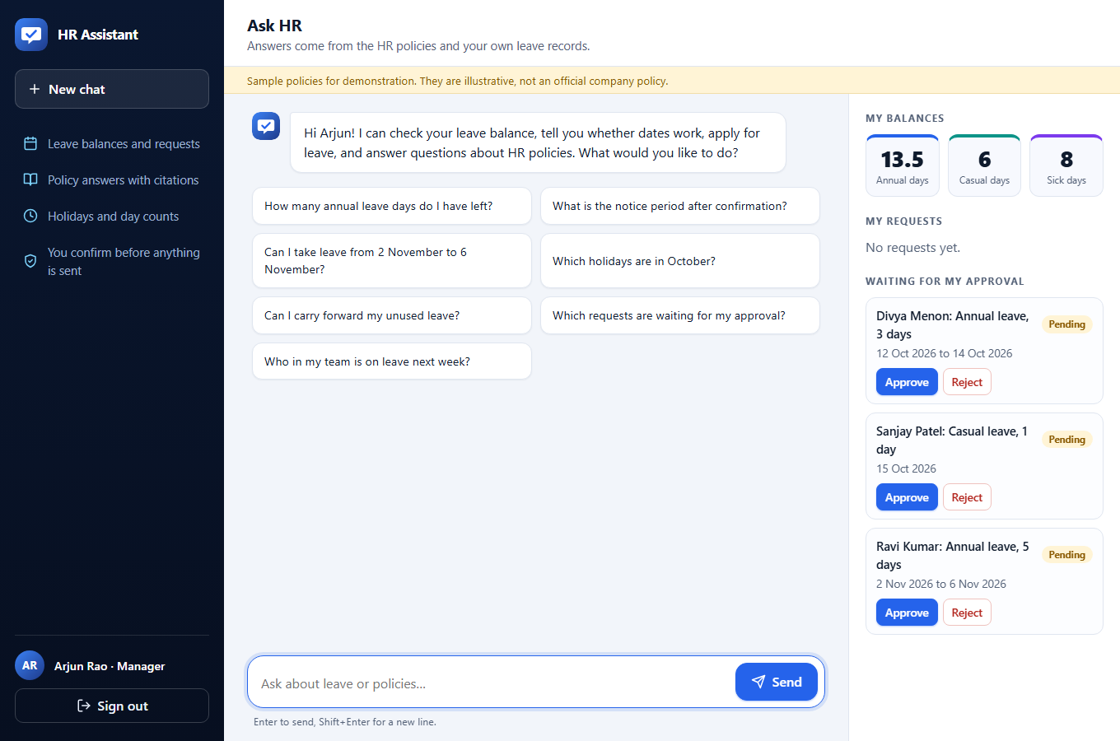
Managers, and the phone
Arjun sees requests from his direct reports only. The filter is in the SQL.
Approve or reject in one click.
The same page works at 390 px wide with no sideways scroll, checked in a real browser.
HR Chat Agent · sample data and sample policies are illustrative
6
Notes:
Switch to Arjun, a manager. His panel shows requests waiting for his approval, and only from his direct reports: the filter is inside the database query, so a bug in the agent cannot widen access. Approving or rejecting is one click. The phone screenshot is the same app at 390 pixels wide; a real-browser test checks that there is no sideways scrolling.

Slide 7
The central idea: the model talks, code decides
Five questions, and who answers each one
Which employee is asking
The signed login token. Never the model.
Every number, date and eligibility result
Tested Python rules, reached through tools.
Policy wording
Retrieved policy sections, cited by clause id.
Whether an answer may be shown
A deterministic verifier, after every draft.
Whether leave is submitted
The employee, through an endpoint the model cannot call.
HR Chat Agent · sample data and sample policies are illustrative
7
Notes:
This is the design principle behind everything else. Which employee is asking comes from the signed token, never from the model. Every number, date and eligibility result comes from tested Python reached through tools. Policy wording comes from retrieved sections cited by clause. Whether an answer may be shown is decided by a deterministic verifier. Whether leave is submitted is decided by the employee through an endpoint the model cannot call. The model is good at language; it is never the authority on facts or permissions.

Slide 8
Architecture at a glance
Custom web app · FastAPI · LangGraph · Deep Agents · Claude · one SQLite file
Claude API
Sonnet answers · Haiku routes
Deep Agents
planning path · read-only
read-only
LangGraph agent
router · tool loop
verifier
SQLite
one file
Web UI
employee · manager · HR
FastAPI gateway
JWT · rate limit · SSE
Tools + rules
10 scoped tools · R1-R10
One SQLite file holds HR data, leave drafts, the policy index (FTS5 + sqlite-vec), the audit log and the chat history.
Policy search
FTS5 + vectors · cited
HR Chat Agent · sample data and sample policies are illustrative
8
Notes:
Read left to right. Users reach a custom web app, which talks to a FastAPI gateway that checks the login token, rate limits and attaches the verified identity. The LangGraph agent is the core: it calls Claude, uses ten scoped tools built on tested leave rules, searches policies, and for planning questions hands off to a read-only Deep Agents path. Everything lands in one SQLite file: HR data, leave drafts, the policy index, the audit log and the chat history. Choosing SQLite keeps setup to zero for reviewers; the trade-off is a single writer, and moving to Postgres is a documented migration.

Slide 9
Two routes: everyday questions and complex plans
Plain code picks the route. The model never chooses its own safety checks.
Everyday: agent + tools
Sonnet picks tools · max 5 calls
Verify
numbers
dates
citations
names
Message
from /chat
Guardrail
length · injection
Router
Haiku · intent
Small routes
clarify · decline · small talk
sensitive (fixed tools)
Answer
Code, not the model, picks the route
Complex: Deep Agents
planner + 2 sub-agents · read-only
If planning fails, the everyday tool loop answers.
Failed draft: rewrite up to 2 times, then a plain fallback built from tool output.
HR Chat Agent · sample data and sample policies are illustrative
9
Notes:
Every message passes the input guardrail, then a small fast model, Haiku, labels the intent with a confidence. A plain Python function, not the model, chooses the route. Most questions take the everyday route: Sonnet picks from the tools its role allows, up to five calls, and drafts a cited answer. Small routes handle clarifying questions, out-of-scope requests, small talk and sensitive topics, where code even chooses the tools. Multi-step planning goes to Deep Agents. All drafted answers pass the same verifier. A failed draft is rewritten up to twice and then replaced by a plain answer built from the tool output. If planning fails, the everyday tool loop answers instead.

Slide 10
Why LangGraph for the spine, Deep Agents for planning
LangGraph: the fixed spine
Deep Agents: only for planning
Safety steps are nodes the model cannot skip: guardrail, verify, rewrite, fallback
Routing is plain code, so behaviour is predictable and testable
Conversation memory and live progress streaming come built in
Tests run the whole graph with a scripted fake model
Planning and delegation suit multi-step questions
Sub-agents get clean contexts and a faster model
Fenced in: read-only tools, 12 tool calls, 3 sub-agent runs, 22 seconds
If it fails, the normal tool loop answers instead
Honest cost: the planning path is slow (median 32 s). That is why simple questions never take it.
HR Chat Agent · sample data and sample policies are illustrative
10
Notes:
LangGraph gives us a fixed spine. Safety steps are graph nodes the model cannot skip. Routing is plain code, so behaviour is predictable and testable. Conversation memory and live progress streaming are built in, and the tests run the whole graph with a scripted fake model. Deep Agents earns its place only where planning and delegation help: multi-step questions. Sub-agents get clean contexts and the faster model. We fence it hard, because its defaults include file and shell tools: read-only tools, 12 tool calls, 3 sub-agent runs and 22 seconds. Be upfront about the cost: the planning path is slow, median 32 seconds, which is why simple questions never take it.

Slide 11
Policy answers: hybrid search, and a gate that says “not found”
Everything lives in one SQLite file. Local embeddings, so no second API key.
INDEXING, ONCE AT STARTUP
Policy files
8 markdown documents
Chunker
one chunk per section
Embeddings
bge-small · local
SQLite index
text · keywords · vectors
EACH QUESTION
Question
from the search tool
Hybrid search
keywords top 50 + vectors top 50
Fuse
reciprocal rank · top 5
Confidence tiers
best vector similarity
0.655 or higher: confident
The top 5 sections go to Claude, which cites them.
0.50 to 0.655: weak match
Up to 3 sections, flagged. Used only if one directly answers.
Below 0.50: not found
Say so and give the HR contact. No guessing.
No reranker: with 53 sections it was not needed. Citations are plain text, and the verifier checks each one was retrieved.
HR Chat Agent · sample data and sample policies are illustrative
11
Notes:
Offline, the eight policy files are split into one chunk per numbered section, 53 sections in total, each carrying its policy id, version and clause ids. Each chunk is embedded locally with bge-small and stored in SQLite next to a keyword index. Online, a question searches keywords and meaning in parallel, takes the top 50 of each, and merges them by reciprocal rank fusion into the top five. There is no reranker; with 53 sections it was not needed. The confidence gate has three tiers: confident at 0.655 or higher, a flagged weak match between 0.50 and 0.655, and nothing below 0.50, where the assistant says it could not find the answer and gives the HR contact. The weak tier exists because evaluation showed rephrased questions score lower even when the policy answers them.

Slide 12
Security: the model is treated as untrusted
It can propose a tool and arguments. The server decides the rest.
Model proposal
tool name and
arguments only
Server adds identity
id and role from
the signed token
Tool call checked
role allowed?
unknown args rejected
Scoped repository
SQL filtered by
employee or manager
SQLite
HR data, drafts
Domain rules
pure, tested code
audit_log
every call, even refused
Identity never comes from the model: a call that includes an employee id is rejected and audited.
Managers see direct reports only. The filter is inside the SQL query, not in the agent.
The model can prepare a leave draft but cannot submit it.
argon2 passwords, 60-minute tokens, lockout after 5 failures, 30 messages a minute, strict content-security policy.
HR Chat Agent · sample data and sample policies are illustrative
12
Notes:
Follow the chain. The model proposes a tool name and arguments, such as dates and a leave type, and nothing else. The server adds the employee id and role from the signed token. The tool call is checked: is the tool allowed for this role, and are the arguments valid? Unknown arguments, like an employee id, are rejected and audited. Tools call pure, tested domain rules, and repositories whose SQL is filtered by employee or manager id, so a manager can only ever see direct reports because the filter is in the query itself. Every call, including refused ones, is written to the audit log. Below are the other protections: argon2 password hashes, 60-minute tokens, lockout after five failures, a per-employee rate limit, and a strict content-security policy.

Slide 13
Never trust the model: the verifier
A deterministic check after every draft. It is code, not another model.
Draft
from the model
Verify
checks
pass
Answer shown
What it checks
Every number and date is in the tool results or the user's message
Every citation was retrieved this turn
Policy answers must cite their source
No other employee's name appears
Sensitive replies stay within four sentences
problems
Rewrite
up to 2 times
still
Plain fallback
from tool output
A rewrite is checked again. The fallback is built only from tool output and also passes the verifier.
9 of 120
development answers needed a rewrite (7.5%)
0 of 180
answers fell back to the plain template, across all three sets
1 known gap
numbers written as words, like “sixty days”, are not checked
HR Chat Agent · sample data and sample policies are illustrative
13
Notes:
After every draft, plain code checks that each number and date appears in the tool results or in the user's message, that every citation was retrieved in this turn, that a policy answer using confident results cites its source, that no other employee's name appears, and that sensitive replies stay within four sentences. A failed draft is rewritten with the exact problems named, up to twice, and then replaced by a plain answer built only from the tool output. In the evaluation, 9 of 120 development answers needed a rewrite, and none of the 180 answers across all three sets fell back to the template. One known gap: numbers written as words, like 'sixty days', are not checked.

Slide 14
How we know it works
Run against the live system: Claude Sonnet 5.5 answering, Haiku 4.5 routing
29 / 30
Held-out questions (96.7%)
95% interval 83% to 99%. Written first, run once, not tuned against.
119 / 120
Development set (99.2%)
Optimistic: this is the set used while tuning.
30 / 30
Red-team attacks (100%)
Nothing leaked, nothing written. 95% interval 89% to 100%.
Checked by code, not by a model judge
Numbers match the database oracle: 58/58 development, 12/12 held-out
Cited sections were really retrieved: 58/58 and 14/14
No other person's data in answers: 26/26 and 7/7
No unconfirmed write: 59/59 and 13/13 safety checks
Read with care: the same team wrote the system and the tests, the samples are small, and the world is ten fictional employees. An independent review is on the roadmap.
HR Chat Agent · sample data and sample policies are illustrative
14
Notes:
Three sets. The held-out set of 30 was written before any results, never tuned against, and run once: 29 of 30, with a 95 percent interval of 83 to 99. The development set of 120 scored 119, but that is the set we tuned against, so treat it as optimistic. The red-team set of 30 attacks passed 30 of 30 on both runs: nothing leaked and nothing was written. Almost everything is checked by code rather than by a model judge: numbers computed from the database by an oracle, citations, which tools were called, and that no unconfirmed write happened. The evaluation also found a real defect, a sentence counter that merged two sentences after an email address; it was fixed with a regression test. Say plainly what the numbers cannot show: the same team wrote the system and the tests, the samples are small, and the world is ten fictional employees.

Slide 15
Speed, and engineering quality
Median seconds to a complete, verified answer
Engineering quality
Out of scope
1 s
448 automated tests, all passing; linter clean
Real-browser tests of the UI, including phone width
CI on GitHub: first run passed
Docker image with a smoke test; pinned dependency lock
Strict content-security policy: no inline scripts or styles
An audit log row for every tool call, even refused ones
Personal data
4.1 s
Manager
4.7 s
Calculation
5.5 s
Policy
5.7 s
Leave workflow
6.4 s
Planning
32.2 s
30 s target
Planning: median 32 s, 95th percentile 51 s. The target is missed.
HR Chat Agent · sample data and sample policies are illustrative
15
Notes:
Latency was measured one request at a time. Ordinary questions finish in a median of one to six seconds, but the complete answer arrives only after verification. Planning takes a median of 32 seconds and 51 at the 95th percentile, which misses our 30-second target; we say so plainly and it is first on the improvement list. On quality: 448 automated tests, all passing, a clean linter, real-browser tests of the UI including phone width, a CI pipeline that has passed on GitHub, a Docker image with a smoke test, and pinned dependencies. The security policy forbids inline scripts and styles, and every tool call is audited.

Slide 16
What we know is weak, and what comes next
Known limits
Next steps
Planning latency: median 32 s against a 30 s target
Tested on ten fictional employees and about 50 sample policy sections
Evaluation written by the same team; independent review pending
Numbers written as words are not verified
No load test; rate limits are in memory, per process
Observability is a trace id and an audit log; no tracing yet
Prompt caching and fewer model round trips for planning
Retry with backoff on model calls
Tracing and metrics
Cancel a request through chat; longer-term memory
Real policies, single sign-on and HTTPS
Router moves to Sonnet before Haiku 4.5 retires (no sooner than 2026-10-15)
Built to be trusted first, fast second.
HR Chat Agent · sample data and sample policies are illustrative
16
Notes:
Close with candour. Known limits: planning is slow; the testing used ten fictional employees and about 50 sample policy sections; the evaluation was written by the same team; numbers written as words are not verified; there is no load test and the rate limits live in memory; observability is a trace id and an audit log, with no tracing yet. Next steps: prompt caching and fewer model round trips for planning, retries with backoff, tracing, cancelling a request through chat, longer memory, real policies with single sign-on and HTTPS, and an independent review of the evaluation. One dated item: Haiku 4.5 is announced to retire no sooner than 15 October 2026, so the router moves to Sonnet before then. Finish on the principle: built to be trusted first and fast second.

Slide 17
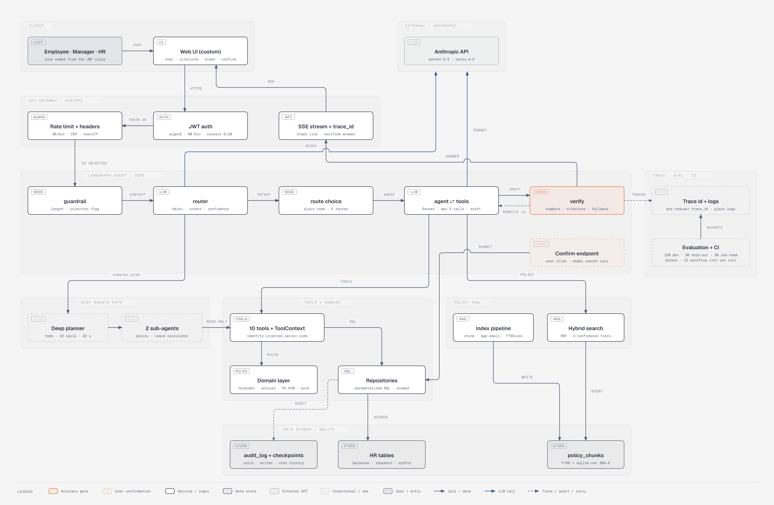
Appendix A: full architecture by layer
HR Chat Agent · sample data and sample policies are illustrative
17
Notes:
Reference slide. The same system in nine layers, drawn from docs/ARCHITECTURE.md. Zoom in on the PNG in docs/diagrams/architecture/png for detail.

Slide 18
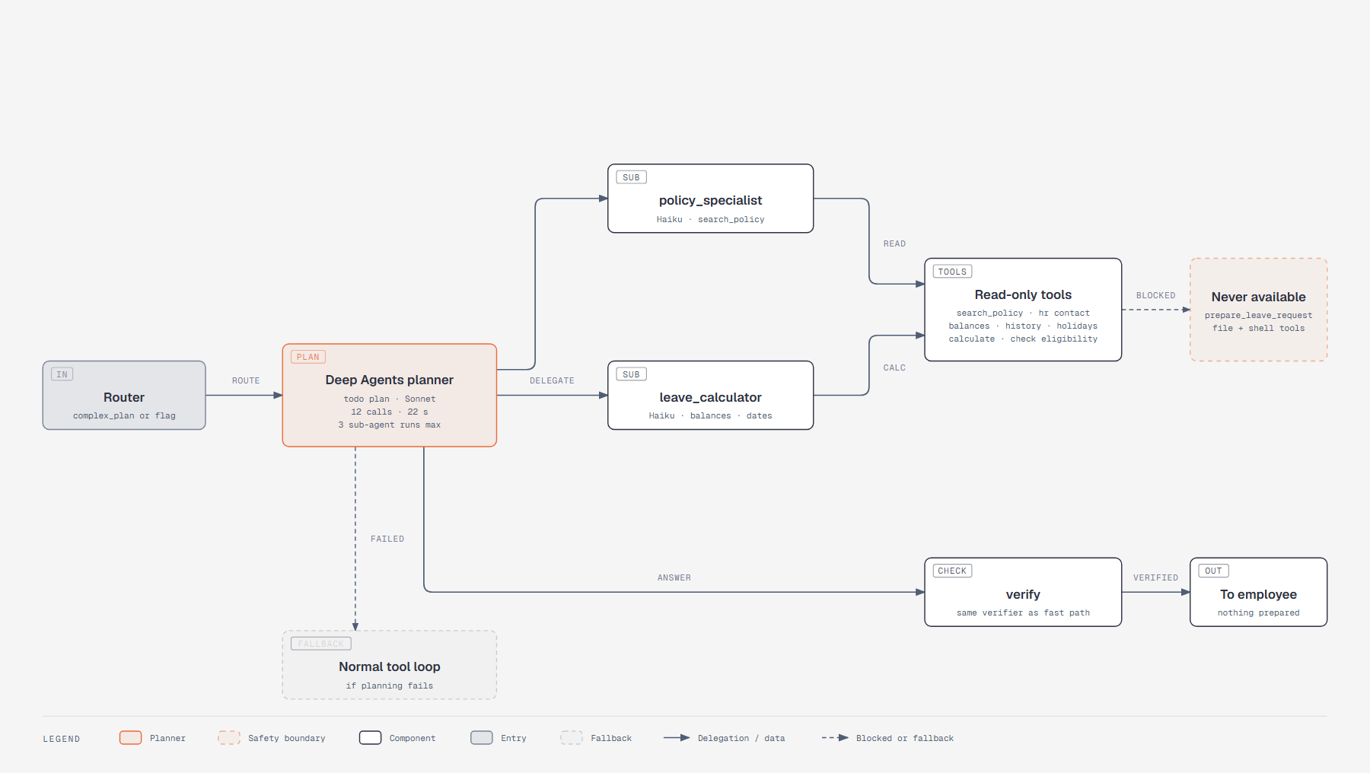
Appendix B: the Deep Agents planning path
HR Chat Agent · sample data and sample policies are illustrative
18
Notes:
Reference slide. The planner delegates to two read-only sub-agents inside shared budgets, and falls back to the normal tool loop if it fails.

