Slide 1
AUTOMATION OF CONVOCATION REGISTRATION and seat allotment

Slide 2
Agenda
Abstract
Motivation behind Project
Literature Survey
Inference from Literature Survey
Proposed Project “Automation of Convocation Registration and Seat Allotment”.
High level architecture diagram
Input screen shot
Process
Output screen shot
Modular Decomposed of ACR-SA with cohesion and coupling
Registration Module
Data Management Module
Seat Arrangement and Ticket Generation Module
Test case Generation with Project Output/Result
Conclusion with Future Enhancement
References

Slide 3
Abstract
In current scenario, University convocation online registration and management processes has major issues such as inefficiency leading to delays, chaotic seating arrangement with logistical challenges for students and parents.
The registration module facilitates user registration for convocation events by capturing personal details, managing payment processing securely, and collecting food preferences to accommodate dietary needs.
Automated data management tasks including document collection, candidate verification, and certificate distribution, the system promises enhanced efficiency and accuracy.
Additionally, automated seat arrangement based on department, batch, and alphabetical order, along with ticket generation for food preferences, seat allocation, and ceremonial attire, will optimize logistical coordination.

Slide 4
Motivation behind Project
We, the teammates of the project involved in the convocation ceremony of 2023 at our University. During this significant event, we encountered substantial challenges related to on-the-spot registration and the allocation of seats for attendees. These issues motivated us with the need for a more efficient, time-constraint, and user-friendly dynamic seating arrangement system to manage real-time Convocation event.
Key Challenges Observed
On-the-Spot Registration
Long queues and extended waiting times due to manual registration processes.
Inconsistent data handling, leading to potential errors and delays.
Seat Allocation
Difficulty in ensuring that all attendees were appropriately seated.
Lack of a dynamic system to manage last-minute changes and special requests.
These challenges underscored the need for an automated solution that could streamline registration and seat allocation, improve attendee experience, and reduce the burden on event organizers. By addressing these issues, our project aims to create a seamless and efficient system that can handle high volumes of registrations and dynamically allocate seats in real-time, ensuring a smoother and more organized convocation event in the future.

Slide 5
Literature Survey
S.No. | Title | Journal Details | Technical Description | Research Gap
1 | Enhancing User Experience in Online Seat Booking Systems: A Comparative Study | International Journal of Human-Computer Interaction Author: M. Gupta and S. Verma Volume: 28 Issue: 5 Year: 2023 | Convocations primarily handle pre-registration, seat allocation, and digital ticket generation but often lack efficient mechanisms for on-spot registration and real-time seat management. | Current seat booking systems for convocations need improved seat booking including on spot registration.
2 | Optimizing Seat Allocation Through Grouping and Sorting: A Convocation Event Case Study | Proceedings of Event Management Research Author: Dr. Samantha Lee Volume: 12 Year: 2024 Pages: 45-56 | This research explores an innovative approach to seat allocation for convocation events using grouping and sorting techniques. By categorizing attendees based on preferences and optimizing seat assignments, the study aims to enhance participant satisfaction and logistical efficiency. The methodology involves a systematic analysis of attendee data to determine optimal group configurations and seating arrangements, thereby improving overall event experience and resource utilization. | Existing literature often focuses on traditional seat allocation methods without exploring the potential benefits of grouping and sorting techniques tailored to specific attendee preferences and needs.
3 | Effective Communication Strategies in Event Management: Enhancing User Engagement and Satisfaction | Journal of Event Management Volume: 18 Year: 2023 Pages: 245-260 | This article explores the pivotal role of communication strategies in event management, focusing on their impact on user engagement and satisfaction. It discusses various communication channels such as email, social media, and mobile apps, highlighting best practices for delivering timely updates, reminders, and personalized messages to attendees. The study emphasizes the importance of clear and consistent communication throughout the event lifecycle to foster positive participant experiences and enhance overall event success. | Existing Event management lacks a comprehensive exploration in integrating diverse communication technologies within event management systems.

Slide 6
Inference From Literature Survey
Improving Seat Booking Systems Current convocation seat booking systems require enhancements, particularly in facilitating on-the-spot registrations and ensuring seamless seat allocation. Integrating real-time updates, flexible booking options, and efficient resource management can significantly improve user experience and operational effectiveness during convocation events.
Optimizing Seat Allocation Lack of exploration into advanced grouping and sorting techniques tailored to specific attendee preferences and needs in existing literature, which primarily focuses on traditional seat allocation methods. Addressing this gap could enhance the efficiency and satisfaction of seat booking systems for convocations..
Integration of Communication Technologies The need for comprehensive exploration of integrating diverse communication technologies within event management systems, which is currently lacking in existing event management practices. Addressing this could improve coordination, real-time updates, and overall event experience.
Recognizing these drawbacks, the "Automation of Convocation Registration and Seat Allotment" project emerges as a pioneering initiative to revolutionize this process.

Slide 7
Admin Hierarchy
1. Convocation Convenor
Role Description: The highest level of administration responsible for overall system management, decision-making, and ensuring compliance with institutional policies.
Functions:
Approves the admin requests.
Close convocation registration.
Payment verification.
Certificate collection.
2. Payment Officer
Role Description: Responsible for managing financial operations, including approval and rejection of fee payments.
Functions:
Approve or rejects the payment
3. Controller of Examination Officer
Role Description: Responsible for collecting the certificates of the candidates who are all registered for convocation.
Functions:
Can view whose certificates are to be collected and their certificate number.

Slide 8
Proposed Project Objectives
Streamline Registration Process
Develop an intuitive online registration platform.
Manage absentia registrations efficiently.
2. Enhance Data Management and Verification.
Automate document submission and data collection.
Implement automated candidate verification.
3. Optimize Seat Allotment
Develop an algorithm for seat allocation.
Automatically generate and distribute seat assignments and tickets.
4. Manage Communication and Notifications
Implement automated email notifications.
Provide real-time updates to candidates.
5. Enhance Logistical Coordination
Automate ticket generation for food preferences and ceremonial attire.
Enable real-time adjustments to seat allocations.
6. Ensure a Memorable Convocation Experience
Provide a seamless and error-free convocation experience.

Slide 9
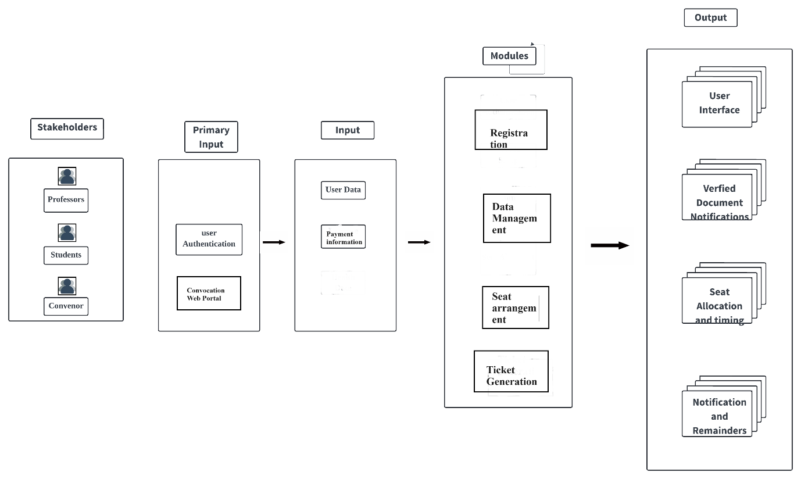
ACRS - SA High level Architecture
Fig. 1.1 : ACR – SA High level Architecture Diagram

Slide 10
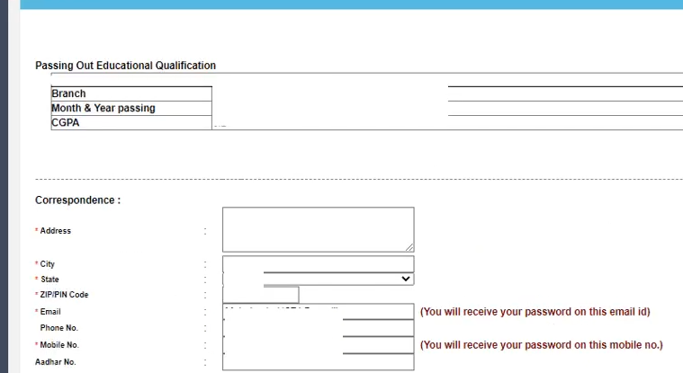
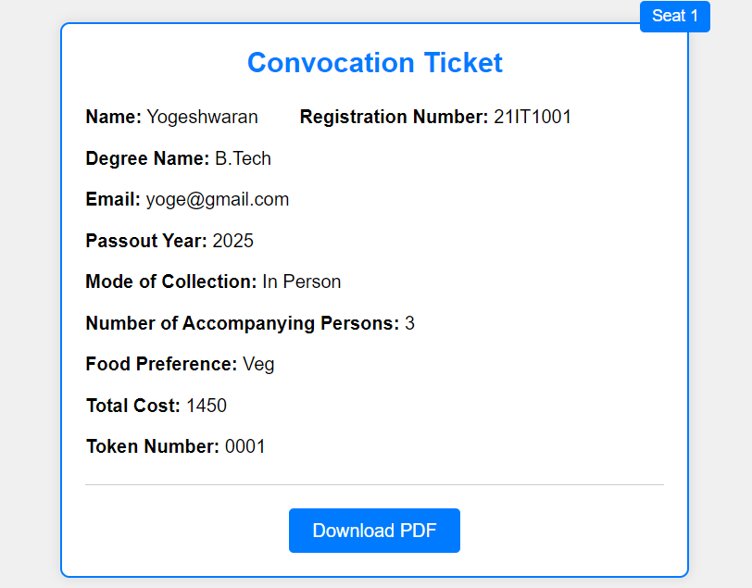
Expected Input and Output Screenshots
Fig. 1.2 : Registration Form
Fig. 1.3 : Convocation Ticket

Slide 11
Modular Decomposed of ACR-SA
Registration Module
Data Management Module
Seat Arrangement and Ticket Generation Module

Slide 12
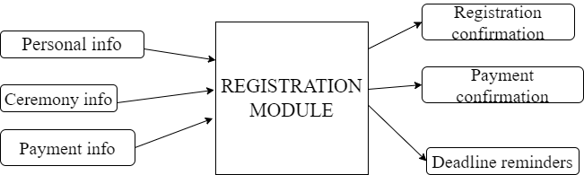
Registration Module
User Registration: Users input their personal information including name, contact details, and other relevant data.
Payment Processing: Secure processing of payments for convocation registration fees.
Food Preferences Management: Collection and management of food preferences to accommodate dietary requirements.
Communication: Sending confirmation emails to users upon successful registration.
Diagram
Fig. 1.4 : Registration Module

Slide 13
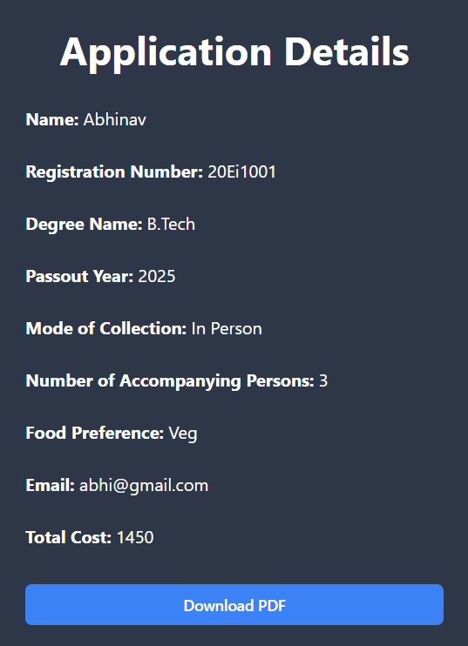

Fig. 1.5 : Application Details
Fig. 1.6 : Downloaded pdf of Application

Slide 14
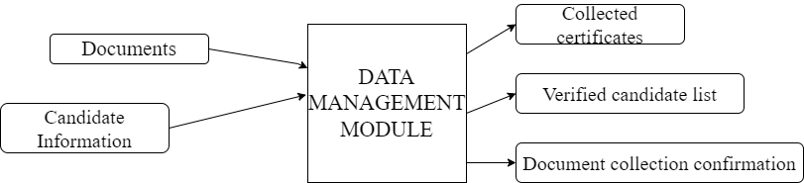
Data Management Module
Document Collection: Gathering required documents such as academic transcripts and identification from registrants.
Candidate Information Verification: Verifying candidate eligibility using provided information, such as student IDs.
Certificate Collection: Managing the collection of certificates post-ceremony.
Data Integrity Checks: Ensuring the accuracy and integrity of collected data through validation and verification processes.
Reporting: Generating reports on data integrity, verification status, and other relevant metrics.
Diagram
Fig. 1.7 : Data Management Module

Slide 15

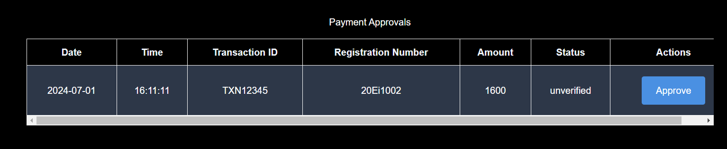
Fig. 1.8 : Certificates to be Collected from COE
Fig. 1.9 : Payment Approval

Slide 16
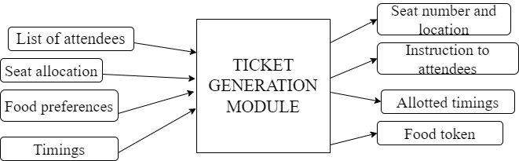
Seat Arrangement and Ticket Generation Module
Attendee Categorization: Categorizing attendees based on department and batch information.
Seat Allocation: Allocating seats to attendees based on predefined criteria, such as departmental groups, batch cohorts, and alphabetical order.
Sorting: Sorting attendees alphabetically to ensure orderly seating arrangements.
Logistical Planning: Optimizing seat utilization and ensuring efficient use of venue space.
Ticket Creation: Automatically generating tickets for registered attendees.
Personalization: Including personalized details on tickets such as seat numbers, food preferences, and ceremony details.
Distribution: Distributing tickets to attendees via email or other designated channels.
Confirmation: Confirming ticket receipt and attendance details with attendees.
Diagram
Fig. 1.10 : Seat Arrangement and Ticket Generation Module

Slide 17
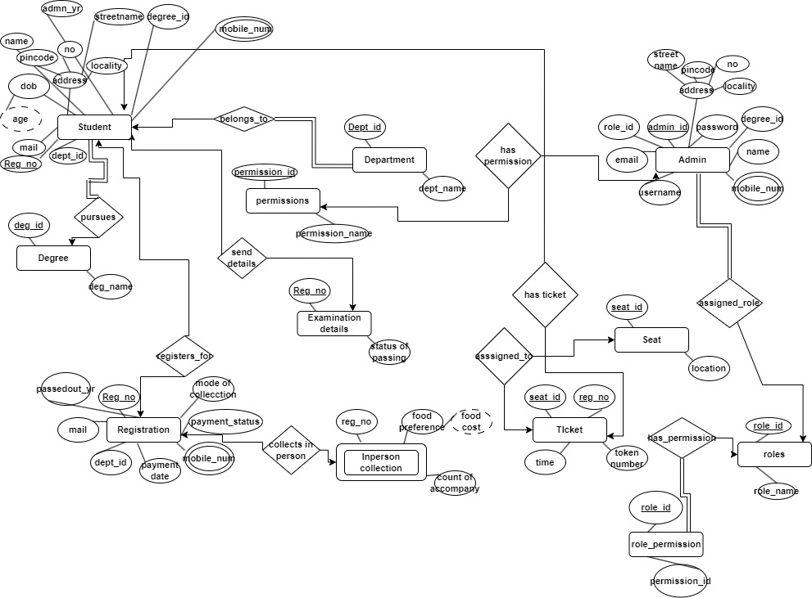
ER Diagram of ACR - SA
Fig. 1.11 : ER Diagram of ACR - SA

Slide 18
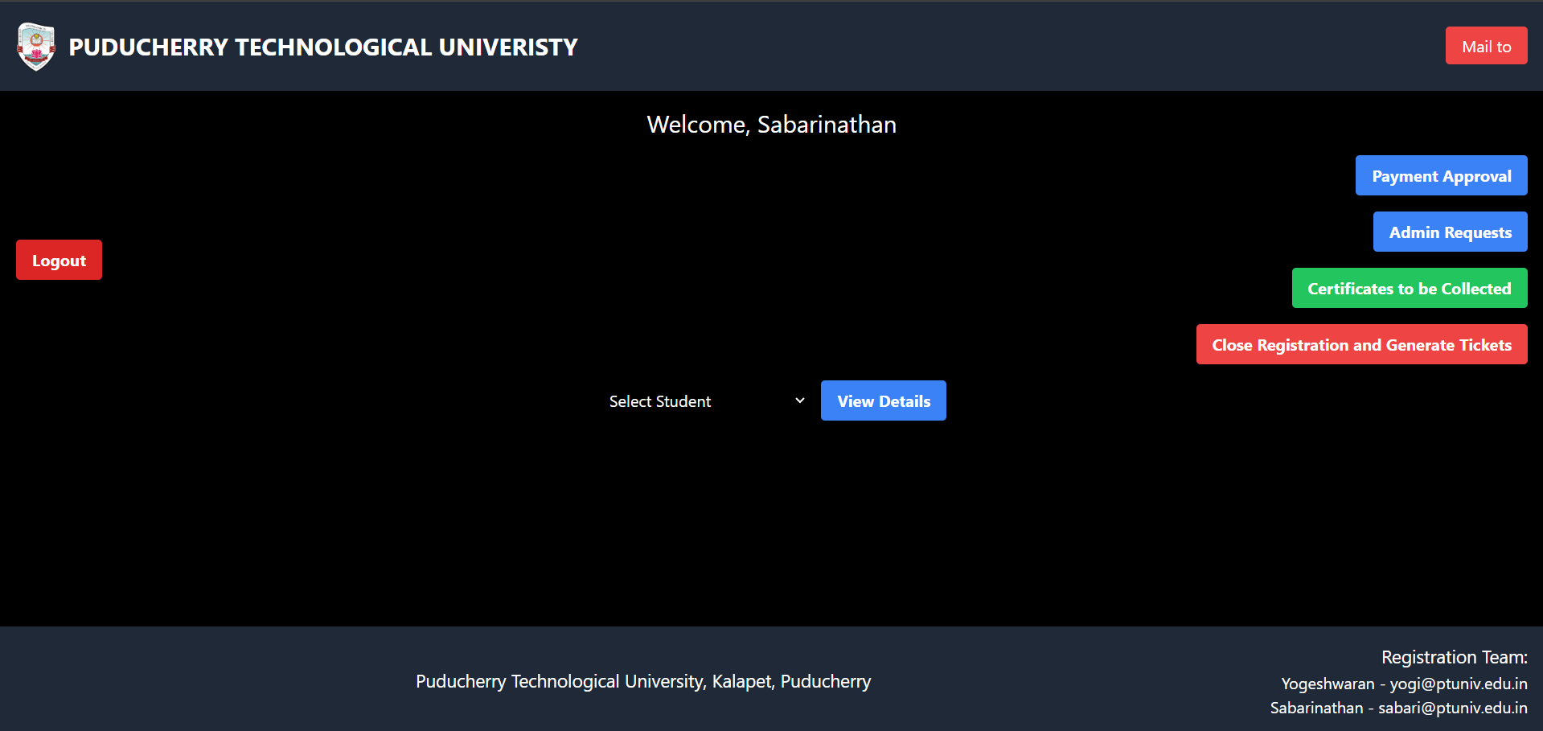
Admin Hierarchy
Fig. 1.12 : Super Admin Dashboard

Slide 19
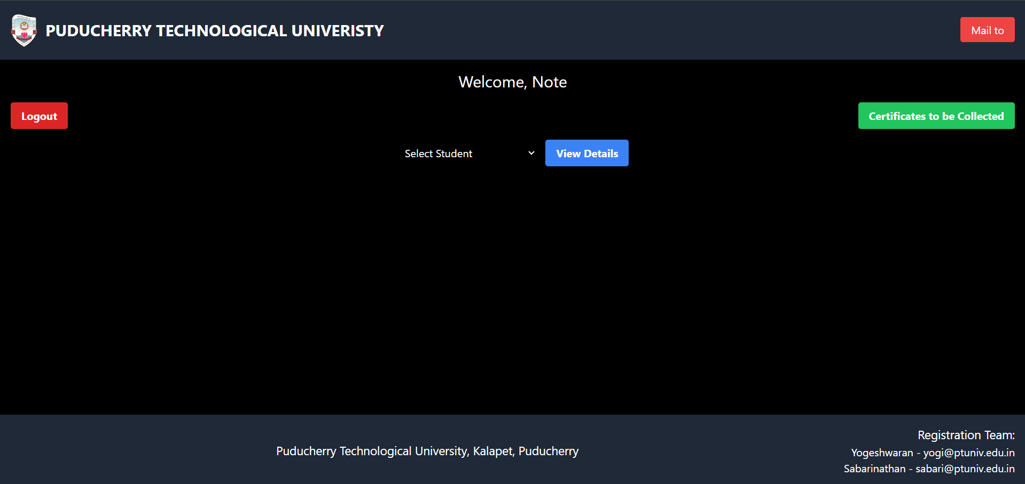
Fig. 1.13: COE Dashboard

Slide 20
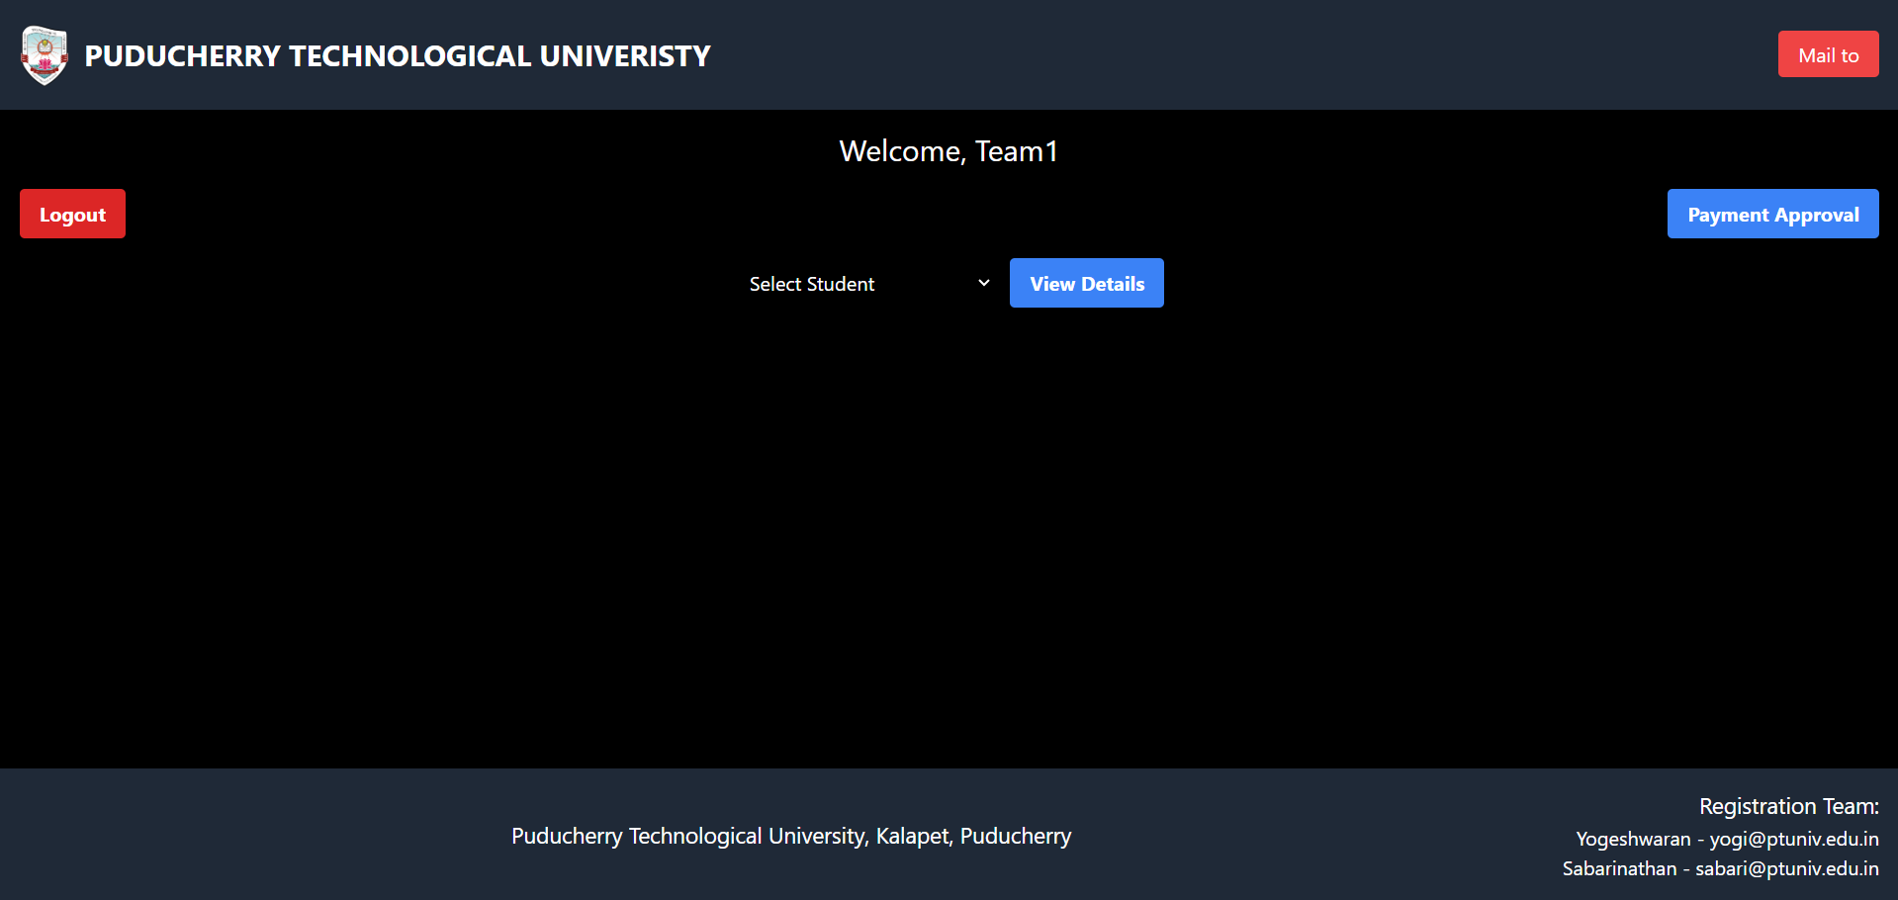
Fig. 1.14 : Banking Officer Dashboard

Slide 21
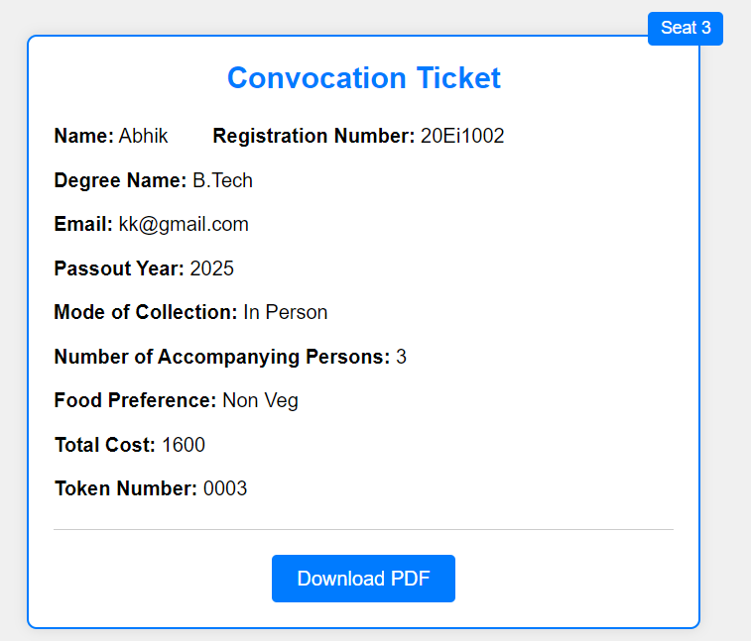
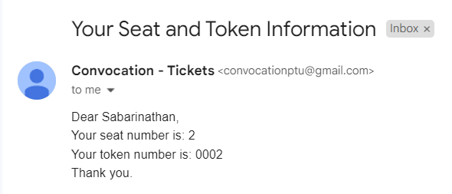
Result
Fig. 1.15 : Convocation Ticket
Fig. 1.16 : Mail of the ticket

Slide 22
Conclusion
Application of Project in Real Time
The "Automation of Convocation Registration and Seat Allotment" project has significant real-time applications, enhancing efficiency and user experience for universities and colleges by streamlining the entire convocation process, reducing administrative burdens, and ensuring smooth event execution.
The system's real-time communication features keep attendees informed with timely updates and accurate information, improving the overall event experience.
Additionally, the project simplifies payment processing, enhances document verification for admissions and certifications, and optimizes logistical coordination for event management companies, ensuring seamless and organized events.

Slide 23
Conclusion – cont.
Future Enhancements
Virtual Reality (VR) Technology
Offer immersive virtual tours of the event venue.
Allow attendees to familiarize themselves with the setup beforehand.
AI-Powered Chatbots
Provide real-time assistance.
Streamline the registration process.
Live Streaming and Interactive Platforms
Ensure remote participants can actively engage in the ceremony.
Enable Q&A sessions and polls.
Digital Certificates and Badges
Secure through blockchain technology.
Easily shareable and verifiable, adding value to attendees' achievements.

Slide 24
References
Brown, J., et al. "Web Application Security: Best Practices and Guidelines." International Journal of Web Security, vol. 18, no. 2, 2022, pp. 65-78.
Brown, E. (2020). The role of communication in event management: Strategies for success. Journal of Event Communication, 15(4), 200-215.
Indira Gandhi National Open University – Convocation Registration Website
https://onlineservices.ignou.ac.in/convocation
International Journal of Human-Computer Interaction, Gupta. M and S. Verma
Design and Implementation of Seat Reservation System for Cinema Halls" by Kumar. R and Sharma.G.
Proceedings of Event Management Research, Dr. Samantha Lee
Walker, S., & Dickson, L. M. (2021). A study on event management and its impact on the hospitality sector. International Journal of Hospitality Management, 31(2), 90-99.

Slide 25
Thank You
Queries ?

