Slide 1


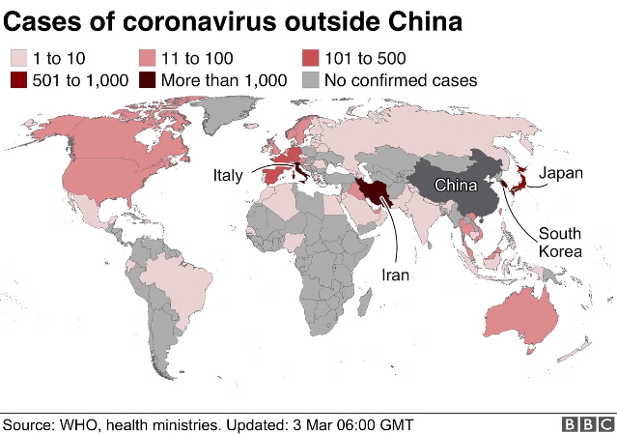
COVID-19 Data Analysis
The analysis of COVID-19 data from a global perspective. We'll dive into the key aspects of data collection, exploration, visualization, and insights to better understand the pandemic's impact across different countries.

Slide 2

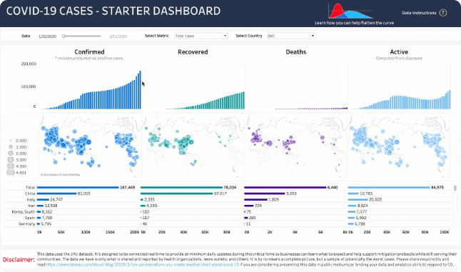
Data Collection and Preprocessing
1
Gathering Data Sources
Collect data from government and health organization reports, as well as aggregated data platforms.
2
Data Cleaning and Transformation
Ensure data quality by normalizing formats, and grouping columns in the datasets.

Slide 3
Exploratory Data Analysis
Understand Data Trends
Identify Geographical Variations
Correlate with Factors
Analyze the temporal patterns of COVID-19 cases, deaths, and recoveries to identify critical points and fluctuations.
Investigate potential relationships between COVID-19 data and other variables, such as population, demographics
Explore the geographic distribution of the pandemic to uncover regional differences and hotspots.

Slide 4

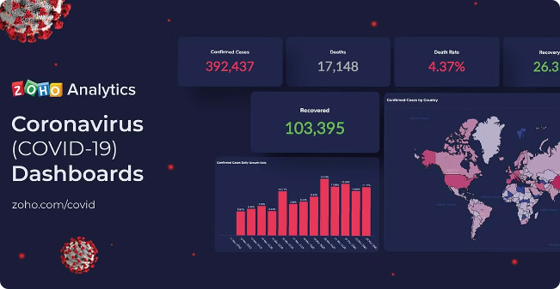
Visualizing COVID-19 Trends
1
Cases Over Time
Track the growth and progression of COVID-19 cases globally or within specific countries.
2
Deaths and Recoveries
Monitor the trends in COVID-19 deaths and recoveries to better understand the pandemic's impact.
3
Policy Interventions
Correlate the implementation of public health measures with changes in COVID-19 data.

Slide 5


Comparing Country-Wise Data
Caseload and Mortality
Compare the total cases, active cases, and death rates across different countries to understand the pandemic's impact.

Slide 6

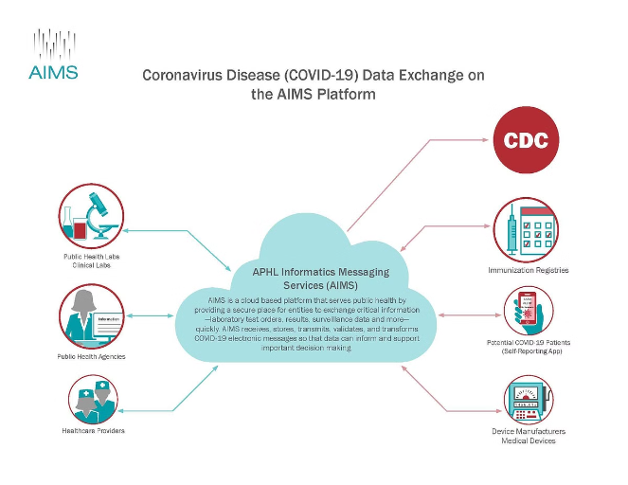
Conclusion and Key Takeaways
Active cases correlate moderately with Recovered cases, suggesting that regions with more active cases also tend to have more recoveries.

