Slide 1
Employee Data Analysis using Excel
STUDENT NAME: SABARISH R.C
REGISTER NO:312204517, 5942E3B5045877EA9DE4A163450BAA6B
DEPARTMENT:COMMERCE
COLLEGE: K.C.S. KASI NADAR COLLAGE OF ARTS & SCEINCE

Slide 2
PROJECT TITLE
Employee Project management analysis

Slide 3


AGENDA
Problem Statement
Project Overview
End Users
Our Solution and Proposition
Dataset Description
Modelling Approach
Results and Discussion
Conclusion
3/21/2024 Annual Review

Slide 4

PROBLEM STATEMENT
The problem is to identify the employee project performance using excel tools.

Slide 5

PROJECT OVERVIEW
In this analysis I am going to ease the process of identify the employees project progress using excel, with the help of below mentioned tools in excel.
Tables.
Slicers.
Pivot chart(line chart,pie chart & bar chart).

Slide 6

WHO ARE THE END USERS?
Human Resources (HR) Department
Finance Department
Compensation and Benefits Specialists
Operational Managers
IT and Data Management Teams

Slide 7

OUR SOLUTION AND ITS VALUE PROPOSITION
User-Friendly Interface:
Accessibility
Ease of Use
Comprehensive Data Management:
Data Organization
Data Integration
Advanced Analytical Tools:
Formulas and Functions
PivotTables
Visual Representation:
Charts and Graphs
Scenario Analysis:
Used to analyse different situation

Slide 8
Dataset Description
Data Overview:
The dataset contains information about employees within an organization, (project performance). This data is used to calculate and analyze the project progress metrics.
Data Fields:
Project Name
Task Name
Assigned to
Progress

Slide 9

THE "WOW" IN OUR SOLUTION
Dynamic Dashboards
Advanced Data Visualization
Segmentation Analysis
Comparative Analysis
Interactive Reports
Slicers
3/21/2024 Annual Review
9

Slide 10
MODELLING
Data cleaning.
Creating table.
Creating pivot chart.
Creating dashboard.
Inserting pivot chart in dashboard..
Creating interactive dashboard by putting all together elements.
10

Slide 11

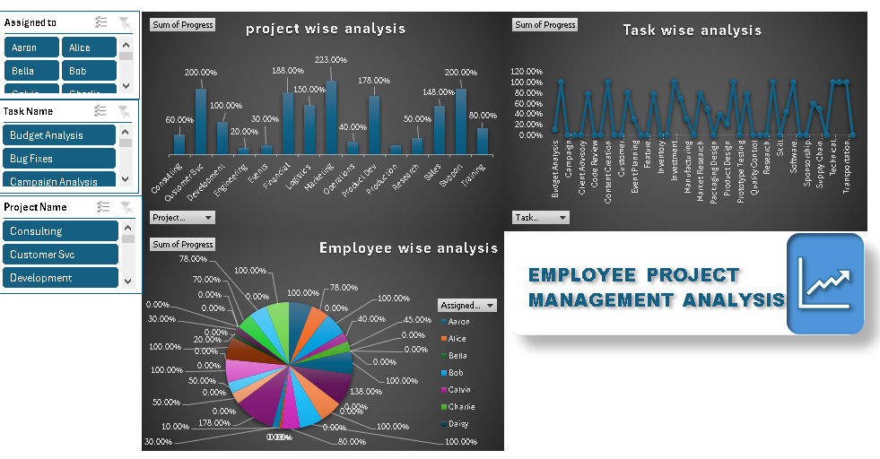
RESULTS
(click to open file)
11

Slide 12
conclusion
The data analysis provides a comprehensive understanding of the factors influencing employee project management. By addressing the identified areas for improvement, the organization can enhance its project management practices, leading to more successful project outcomes and a more engaged and productive workforce.

