Slide 1

Blind Enhanced and Assistive Cap with Optical Navigation
Presented by: Group No:02
Guided by,
Sl no: | Name of the member | Reg. No:
1 | Sabarish A V | AWH22CS048
2 | Madhav M P | AWH22CS029
3 | Nived T | AWH22CS044
4 | Bashaar Abdullah | AWH22CS016
Ms. Rahana Sulthana
Assistant Professor Dept. of CSE
DEPT. OF COMPUTER SCIENCE AND ENGINEERING
AWH ENGINEERING COLLEGE

Slide 2
CONTENTS
INTRODUCTION
ABSTRACT
OBJECTIVES
LITERATURE REVIEW
EXISTING SYSTEM
PROBLEM STATEMENT
PROPOSED SYSTEM
FEASIBILITY STUDY
REQUIREMENT SPECIFICATIONS
USECASE DIAGRAM
DATA FLOW DIAGRAM
ENTITY RELATIONSHIP DIAGRAM
RESULT AND DISCUSSION
CONCLUSION
REFERENCES

Slide 3
INTRODUCTION
Assistive system designed for visually impaired users using AI and sensors
Detects obstacles and provides real-time navigation support
Enhances safety and independence through smart wearable technology

Slide 4
ABSTRACT
User accesses system via mobile app
App provides multiple safety alerts
Backend + AI process data and generate alerts
Camera enables real-time AI detection

Slide 5
OBJECTIVES
Detect obstacles and classify objects in real time
Provide navigation assistance through audio/haptic alerts
Integrate fall detection and emergency alert system
Ensure accuracy, portability, and ease of use

Slide 6
LITERATURE SURVEY

Slide 7
Papers | Authos(s) | Technical Findings | Gaps Identified
Safety Helmet Detection Based on Improved YOLOv8 (2024) | Xudong Song, Tiankai Zhang, Weiguo Yi | YOLOv8-based helmet detection | Single-task; no assistive features
Smart Helmet 5.0 for Industrial IoT Using AI (2020) | I. Campero-Jurado et al. | IoT sensors + CNN monitoring | No vision-based detection
Computer Vision Based Road Obstacle Detection (2025) | Hamza Assemlali et al. | Vision-based obstacle detection | Not wearable; no user alerts

Slide 8
Papers | Authos(s) | Technical Findings | Gaps Identified
Obstacle Detection for Visually Impaired Using IoT Sensors (2025) | Sunnia Ikram et al. | Ultrasonic/IR obstacle sensing | No object classification
Personal Voice Assistant Security and Privacy (2022) | Peng Cheng, Utz Roedig | Voice assistant security analysis | No navigation/awareness
Smart Helmet Compliance Detection Using YOLO-M (2023) | Lili Wang et al. | YOLO-M helmet detection | Limited to single function
Visual Fall Detection for Assistive Living (2023) | Samyan Qayyum Wahla et al. | Video-based fall detection | No obstacle/navigation support

Slide 9
Papers | Authos(s) | Technical Findings | Gaps Identified
Deep Learning Framework for Brazilian Coins (2023) | Debabrata Swain et al. | CNN-based classification of coin images | Static task only
Human-Centered AI in Smart Farming (2024) | Andreas Holzinger et al. | AI + IoT system for adaptive decision-making | Domain-specific
Omni-Directional Obstacle Detection (2020) | Xiangmo Zhao et al. | Depth camera-based 360° obstacle detection system | High cost; not wearable

Slide 10
EXISTING SYSTEM
Existing assistive systems include smart glasses and sensor-based devices
Provide features like obstacle detection, text recognition, and navigation
Use camera-based AI or IoT sensors for assistance

Slide 11
EXISTING SYSTEM(Cont..)
Most systems offer limited or single functionalities
Features like detection, navigation, and alerts work independently
High cost and complex design reduce accessibility
Dependence on cloud processing causes latency
Limited integration of AI vision and sensor data

Slide 12
PROBLEM STATEMENT
Existing assistive devices are expensive and not easily accessible
Limited integration of multiple functionalities in a single system
Dependency on cloud-based AI leads to delays in alert generation during navigation.

Slide 13
PROBLEM STATEMENT(Cont..)
Need for a system that supports continuous and multi-object detection
visually impaired users require a system that can adapt to diverse environments, including indoor, outdoor, crowded, or low-light areas.
Demand for a low-cost, portable, and user-friendly wearable solution
Requirement useful AI models

Slide 14
PROPOSED SYSTEM
Smart assistive cap integrating camera, sensors, and mobile application
Uses AI models for multi-object detection (obstacles, text, currency)
edge AI allows on-device processing, reducing latency and dependency on cloud or smartphone processing.

Slide 15
PROPOSED SYSTEM(Cont..)
Combines multiple features: fall detection, alerts, and location tracking
Uses smartphone + edge processing for faster response (reduced latency)
All functionalities work together in a single system
Low-cost, portable, and easy-to-use design

Slide 16
FEASIBILITY STUDY

Slide 17
TECHNICAL FEASIBILITY
hardware: sensors (accelerometer), camera, microcontroller (esp32/arduino), edge ai modules are readily available.
software: ai models (yolo, cnn) and mobile app platforms (react native) are mature and compatible with low-power devices.

Slide 18
OPERATIONAL FEASIBILITY
usability: wearable cap design is portable and comfortable for visually impaired users.
real-time functionality:AI ensures immediate obstacle detection and navigation alerts.
maintenance: minimal; periodic calibration and software updates are sufficient.
adaptability: can be used in indoor, outdoor, crowded, or low-light environments.

Slide 19
ECONOMICAL FEASIBILITY
hardware cost: moderate; sensors, microcontrollers, and camera modules are affordable.
software cost: minimal; open-source ai frameworks (tensorflow lite, yolo) reduce licensing expenses.
scalability: potential for mass production; mobile app integration reduces additional costs.
long-term benefits: improves safety and independence of visually impaired users, reducing reliance on expensive assistive technologies or caregivers.

Slide 20
REQUIREMENT SPECIFICATIONS

Slide 21
FUNCTIONAL REQUIREMENTS
detect obstacles (stationary & moving)
provide navigation guidance via audio/haptic alerts
recognize obstacles and currency
detect falls or collisions and trigger alerts
process data on-device using edge ai
communicate with mobile app via bluetooth/wifi

Slide 22
NON FUNCTIONAL REQUIREMENTS
lightweight, comfortable, and easy to use
reliable in various environments (indoor/outdoor, low-light)
scalable for future enhancements
portable and mostly independent of smartphone
secure and privacy-protected data

Slide 23
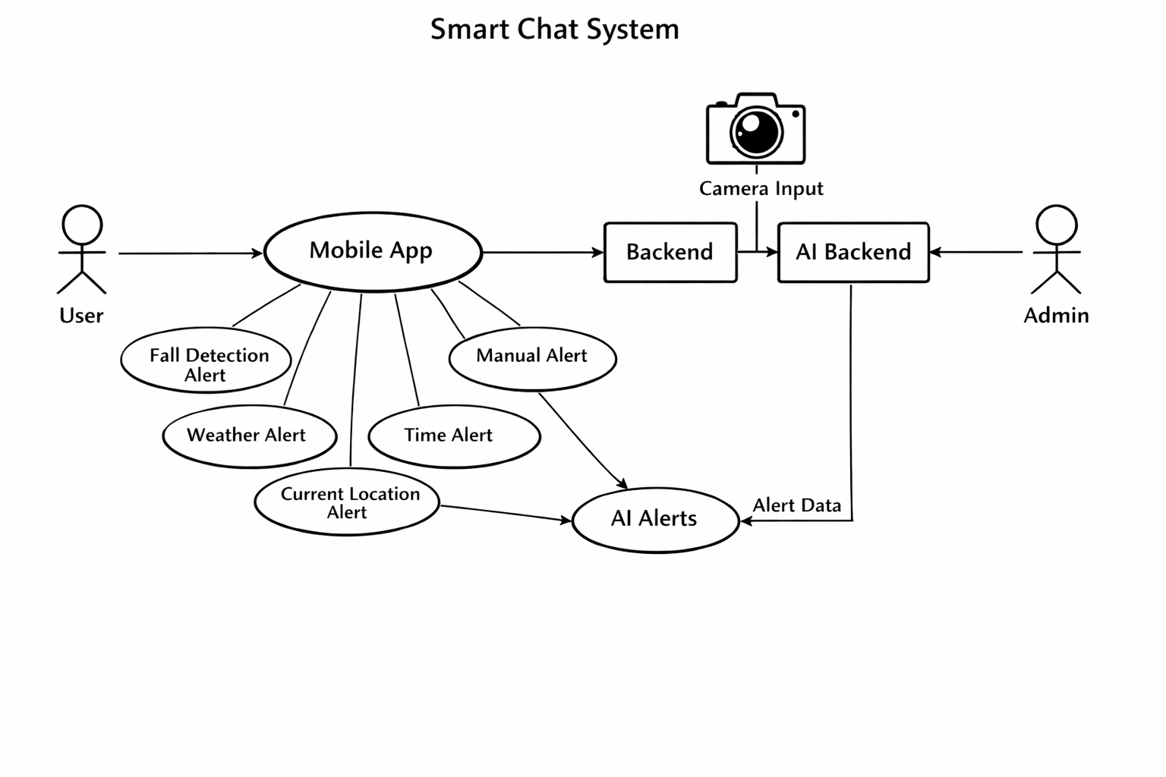
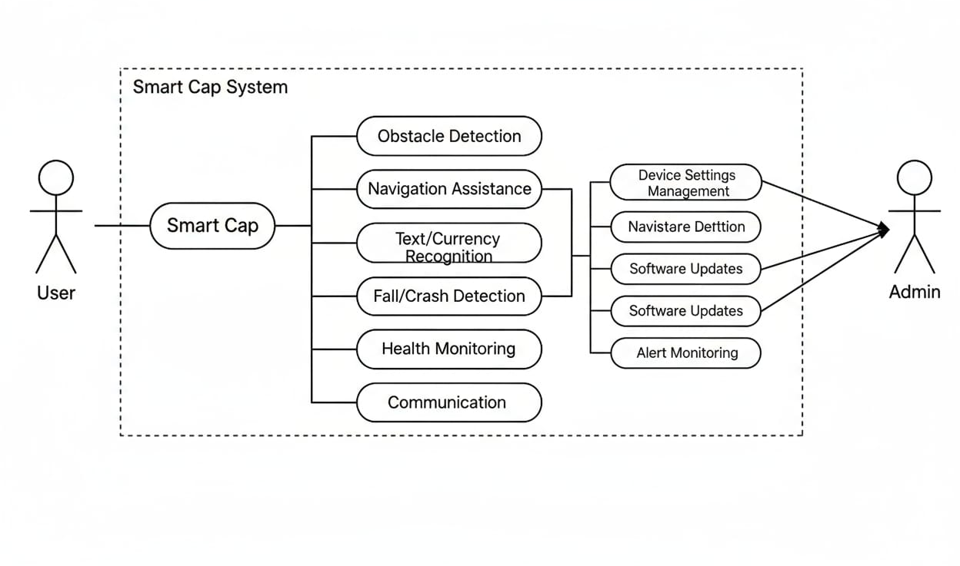
USE CASE DIAGRAM

Slide 24
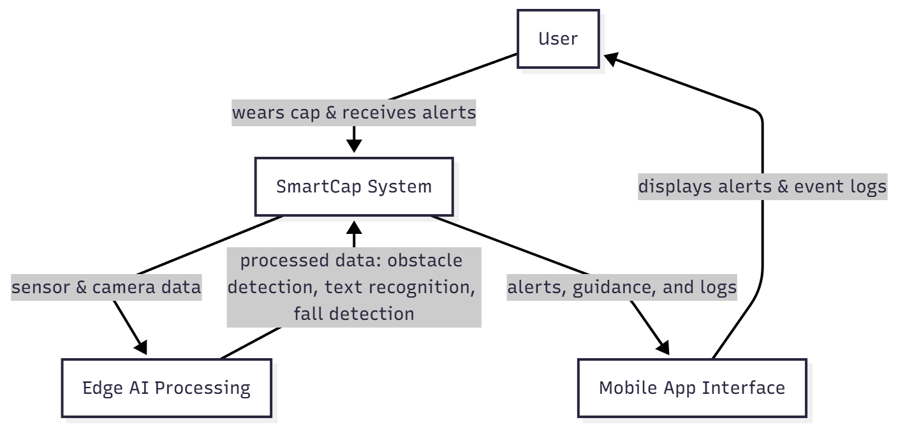
DATA FLOW DIAGRAM
LEVEL 0

Slide 25
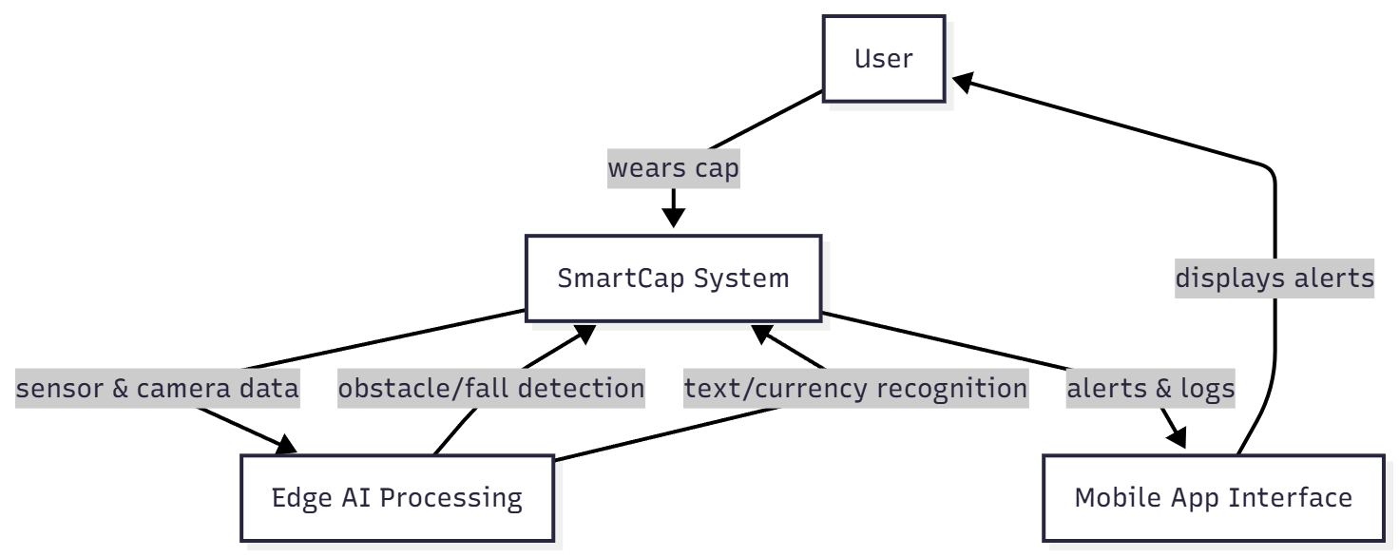
DATA FLOW DIAGRAM(Cont..)
LEVEL 1

Slide 26
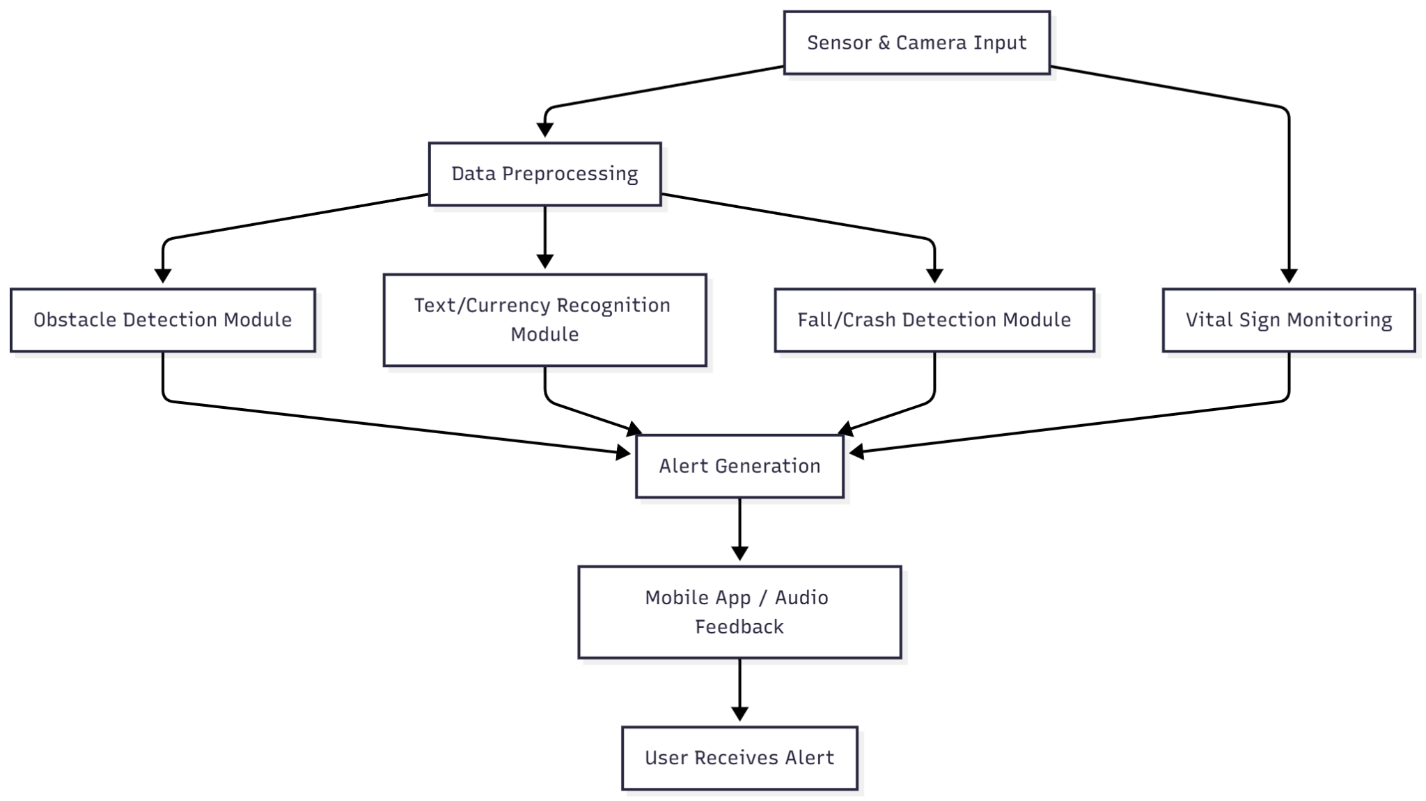
DATA FLOW DIAGRAM(Cont..)
LEVEL 2

Slide 27
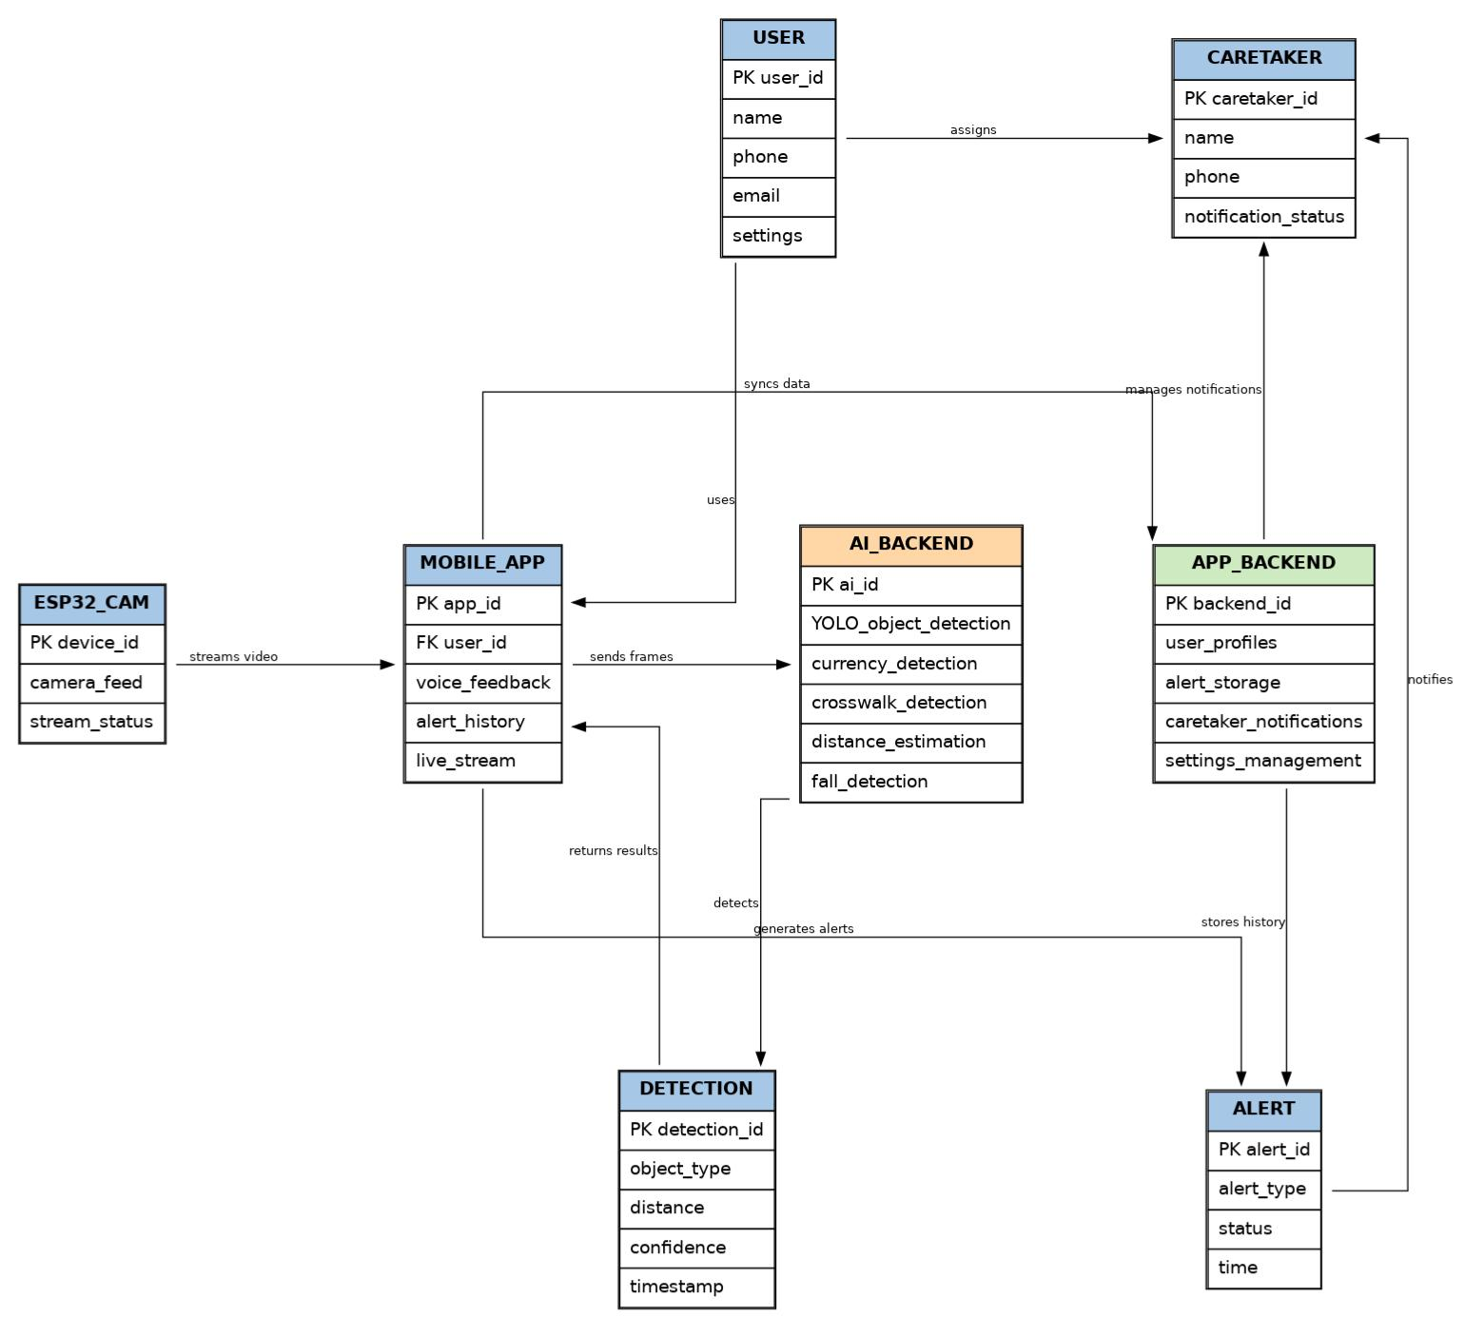
ENTITY RELATIONSHIP DIAGRAM

Slide 28
RESULT AND DISCUSSION
System successfully performs real-time obstacle detection and navigation assistance
Accurate detection of multiple objects (obstacles, text, currency) using AI models
Sensor + camera integration improves reliability of detection
Fall detection and alert system works effectively with minimal delay
Real-time alerts are generated through the mobile application

Slide 29
RESULT AND DISCUSSION
Edge processing using smartphone ensures low latency and faster response
System provides continuous monitoring and multi-functional assistance
Portable and low-cost design makes it practical for real-world use
Performance remains stable in different environments (indoor/outdoor)
Overall system improves safety, independence, and user experience

Slide 30
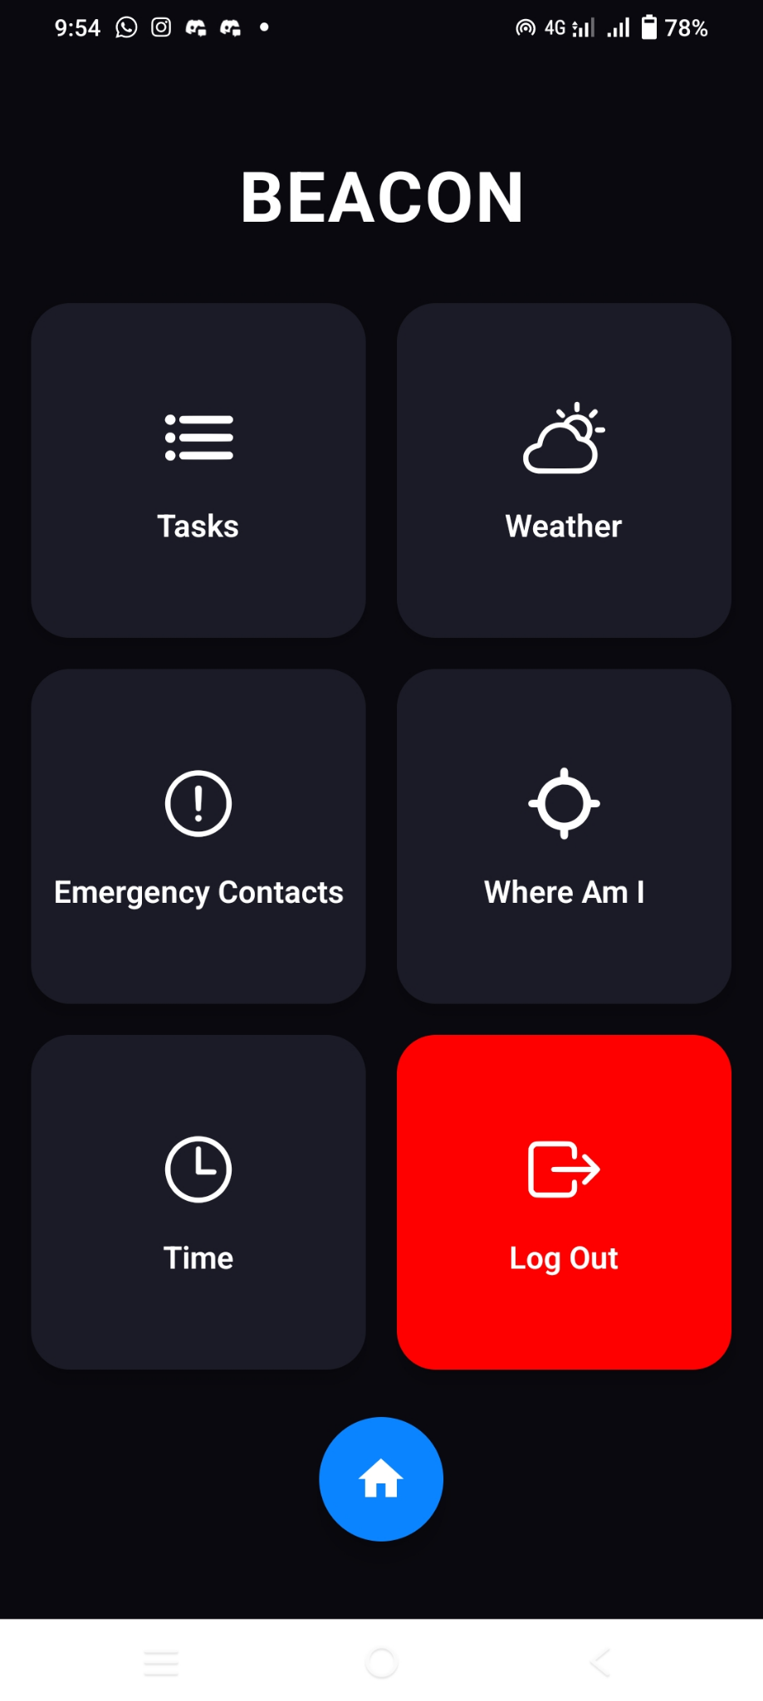
RESULT AND DISCUSSION

Slide 31
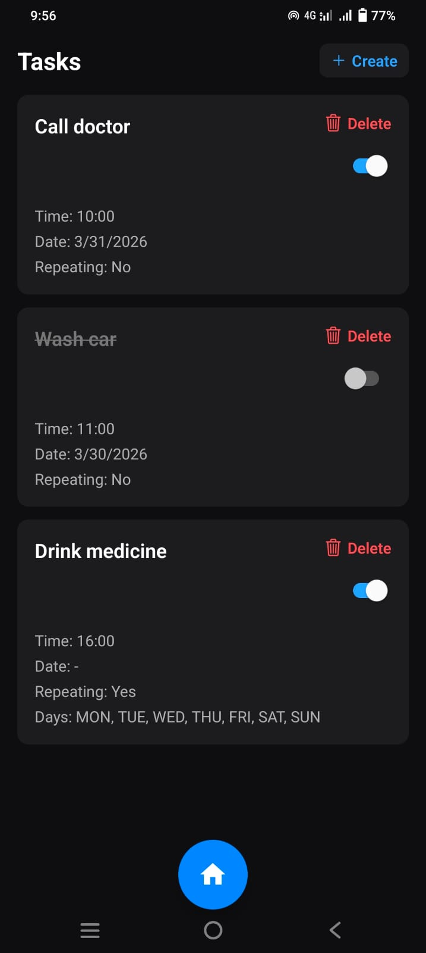
RESULT AND DISCUSSION

Slide 32
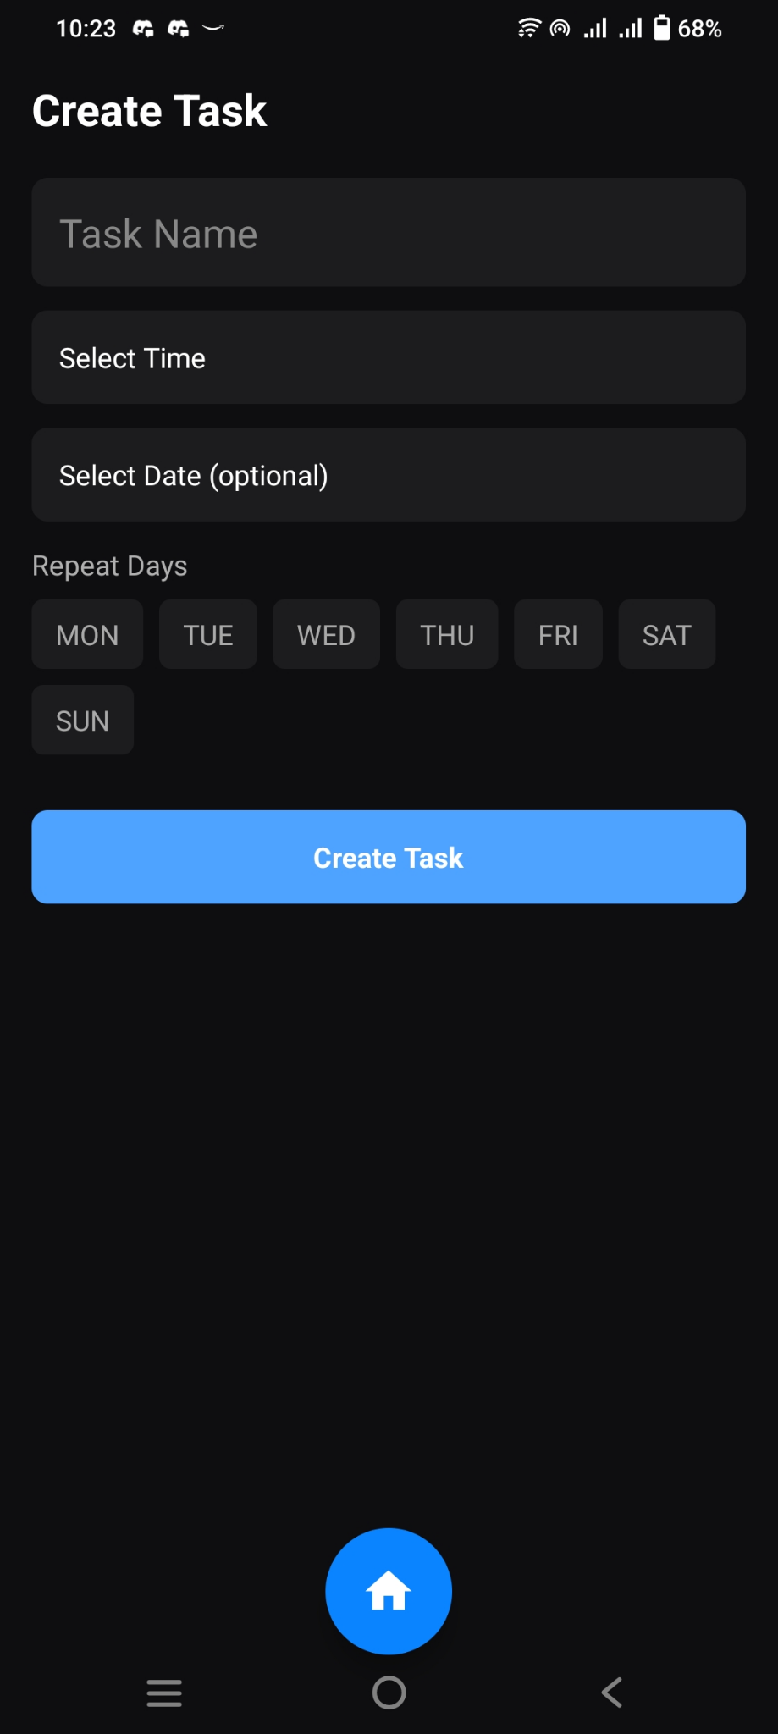
RESULT AND DISCUSSION

Slide 33
RESULT AND DISCUSSION

Slide 34
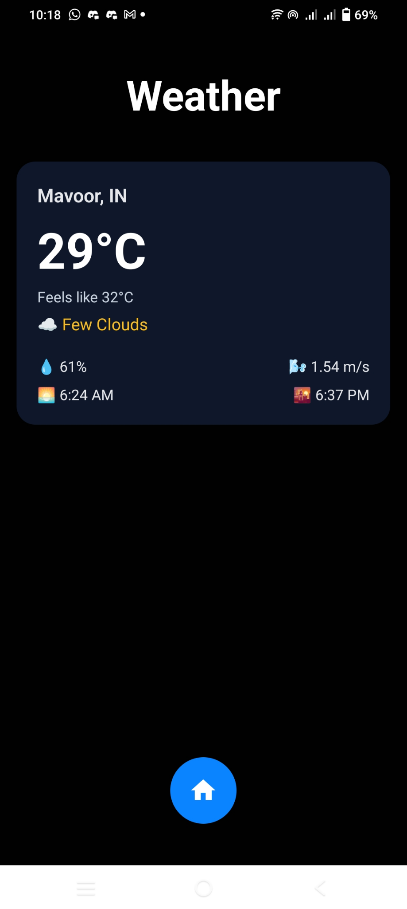
RESULT AND DISCUSSION

Slide 35
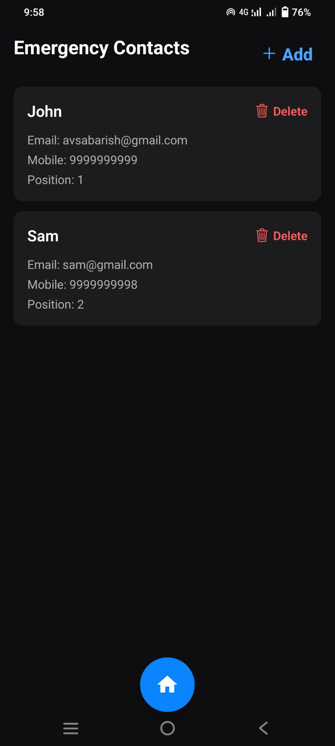
RESULT AND DISCUSSION

Slide 36
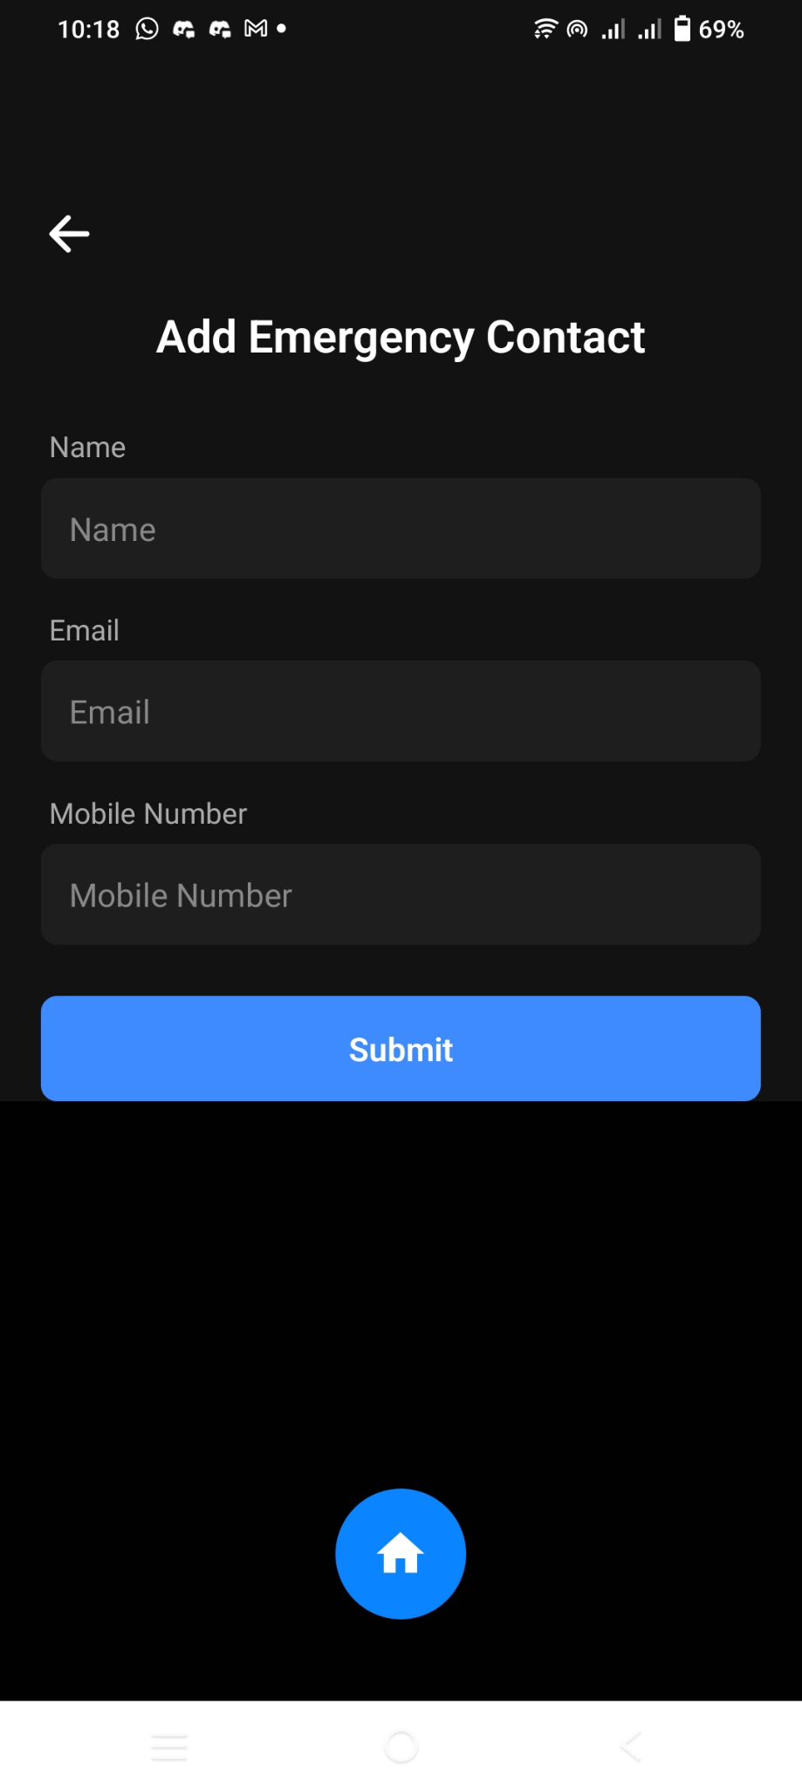
RESULT AND DISCUSSION

Slide 37
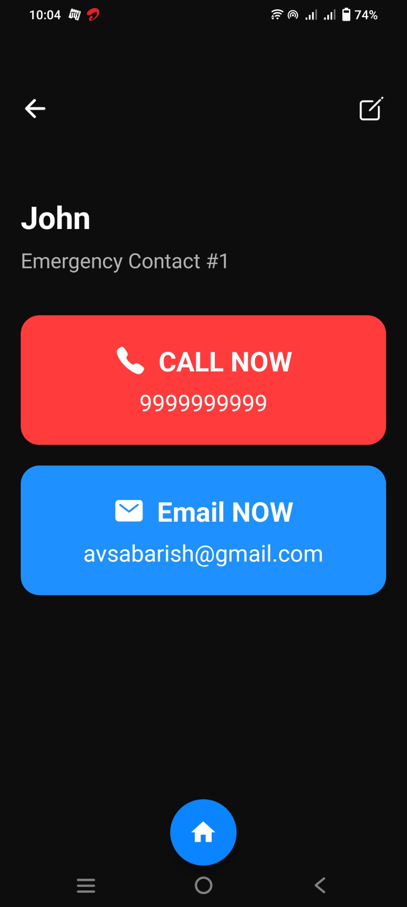
RESULT AND DISCUSSION

Slide 38
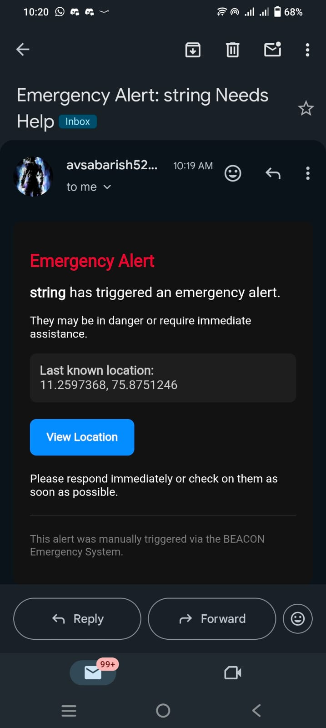
RESULT AND DISCUSSION

Slide 39

RESULT AND DISCUSSION

Slide 40
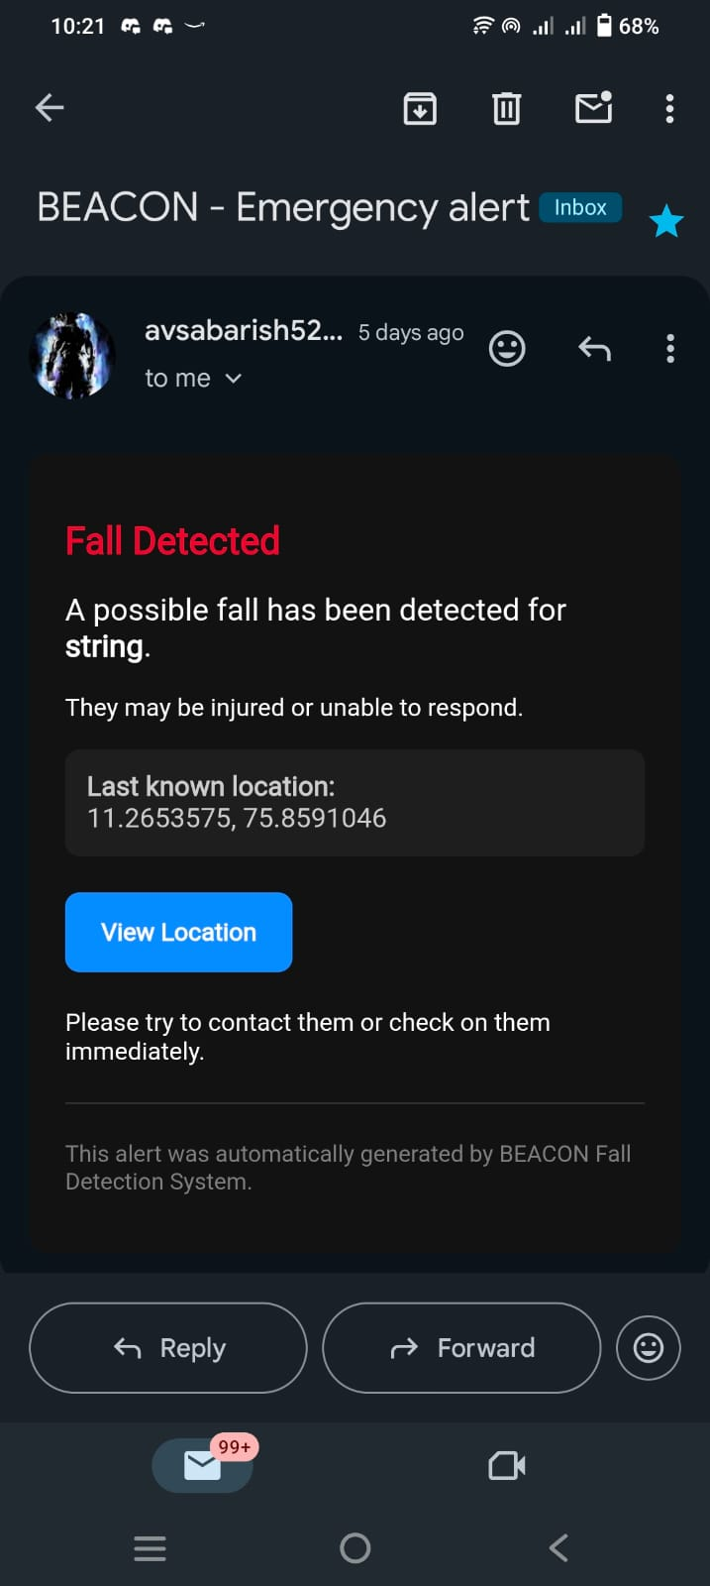
RESULT AND DISCUSSION

Slide 41
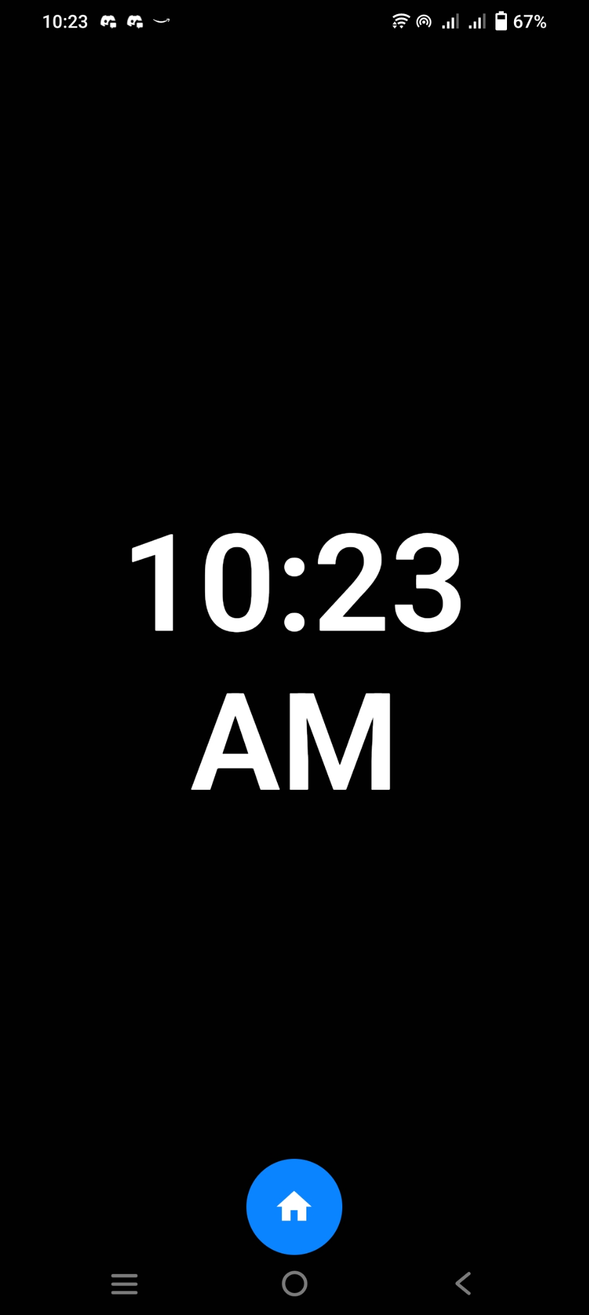
RESULT AND DISCUSSION

Slide 42
CONCLUSION
AI-powered assistive cap enhances safety and navigation for visually impaired users.
Integrates sensors, camera, and edge AI for real-time obstacle and fall detection.
Improves user independence, awareness, and overall safety.
Demonstrates effective IoT and mobile app integration.
Promotes inclusive and accessible smart technology.
Future scope: GPS navigation, voice commands, cloud analytics,priority obstacles warning,facial recognition.

Slide 43
REFERENCES
[1] Bischof E, Botezatu A, Jakimov S, Suharenko I, Ostrovski A, Verbitsky A, Yanovich Y, Zhavoronkov A, & Zmudze G, “LONGEVITY FOUNDATION: PERSPECTIVE ON DECENTRALIZED AUTONOMOUS ORGANIZATION FOR SPECIAL-PURPOSE FINANCING”, IEEE Access, volume 10, 2022
[2] Zhang Y, Wang Z, Deng J, Gong Z, Flood I, & Wang Y,”FRAMEWORK FOR A BLOCKCHAIN-BASED INFRASTRUCTURE PROJECT FINANCING SYSTEM”, IEEE Access, volume 9, 2021
[3]Muhammad Muneeb, Zeeshan Raza, Irfan Ul Haq, Omair Shafiq, ”SMARTCON: A BLOCKCHAIN-BASED FRAMEWORK FOR SMART CONTRACTS AND TRANSACTION MANAGEMENT”, IEEE Access, volume 10, 2022
[4] Giuseppe Antonio Pierro, Henrique Roch,” The Influence Factors on Ethereum Transaction Fees ”, 2019 IEEE/ACM 2nd International Workshop on Emerging Trends in Software Engineering for Blockchain (WETSEB)

Slide 44
REFERENCES(Cont..)
[5] Bin Wang, Xiaohan Yuan, Li Duan, Chunhua Su, Wei Wang, Hongliang Ma,”DEFISCANNER: SPOTTING DEFI ATTACKS EXPLOITING LOGIC VULNERABILITIES ON BLOCKCHAIN”, IEEE TRANSACTIONS ON COMPUTATIONAL SOCIAL SYSTEMS, 2022
[6] B.Sriman, S.Ganesh Kumar,”DECENTRALIZED FINANCE (DEFI): THE FUTURE OF FINANCE AND DEFI APPLICATION FOR ETHEREUM BLOCKCHAIN BASED FINANCE MARKET”, International Conference on Advances in Computing, Communication and Applied Informatics (ACCAI), 2022
[7] Michael Darlin, Georgios Palaiokrassas, Leandros Tassiulas,”DEBT-FINANCED COLLATERAL AND STABILITY RISKS IN THE DEFI ECOSYSTEM”, 4th Conference on Blockchain Research & Applications for Innovative Networks and Services (BRAINS), 2022

Slide 45
THANK YOU

