Slide 1
IT Service desk – Analytics
Problem Description – In the given problem we need to analyze and predict the service desk Average handle time (AHT) to solve the respective ticket. We also need to preform text mining on feedback comments to improve the required areas

Slide 2

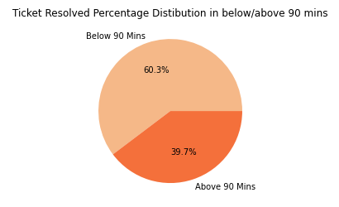
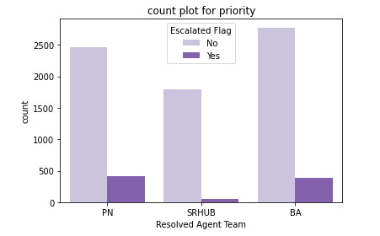
IT Service desk – Analytics
* Initially the data patterns understood and handled null values,conversion of required datatypes
* In the given data around 60 % of the data been resolved before 90 mins
* The most of the tickets been resolved periodically and the escalation ration is below 10 %

Slide 3
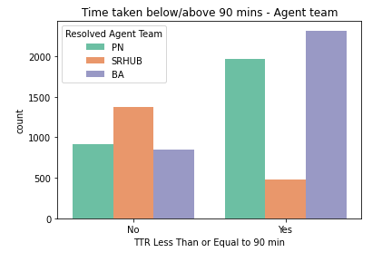
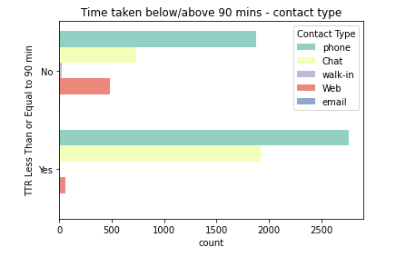
IT Service desk – Analytics
* The Agent Team SRHUB usually takes more time to resolve the tickets. If we resolve this we might drastically improve our AHT to resolve tickets
* Also the contact medium web taking more time and resolving this also helps AHT

Slide 4
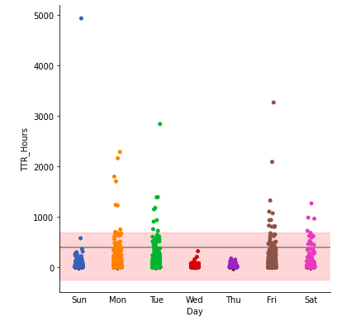
IT Service desk – Analytics
* The chart describes the avearge distribution of hours taken to resolve tickets in daywise
* We don't see any late in time to resolve tickets on Wed,Thu also the average time taken is below the average in overall mean
* So we strongly belives that our resource works efficient on mid of the week and we are less likely to improve our shift plans on Sat and Sun, more likely to improve our shift plans on Mon,Tue,Fri

Slide 5
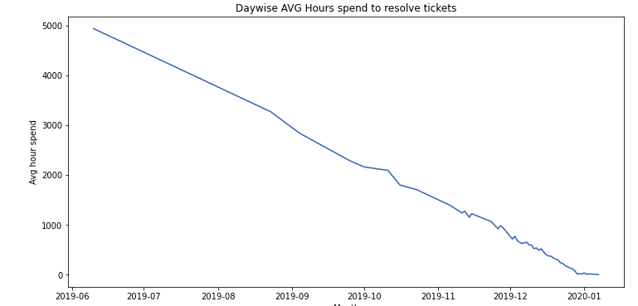
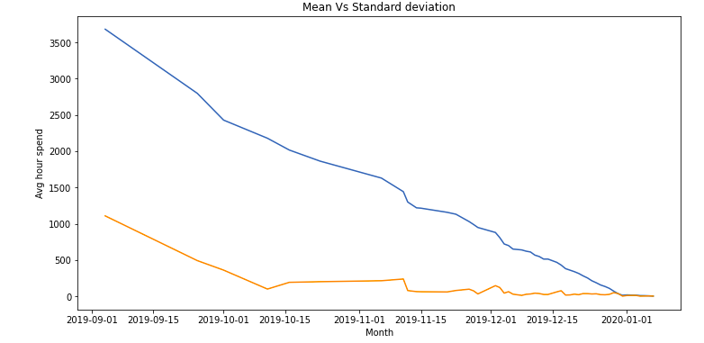
IT Service desk – Analytics
* The chart discribes about how the average time spend to resolve the tickets
* In the given dataset initially it tooks more time to resolve and later it reduces constantly
* We are evident that it follows down trend, means over the period the AHT
To resolve tickets reduces significantly
* Mean and SD are same in the month of Jan, it means that the data values are evenly distributed around the mean

Slide 6
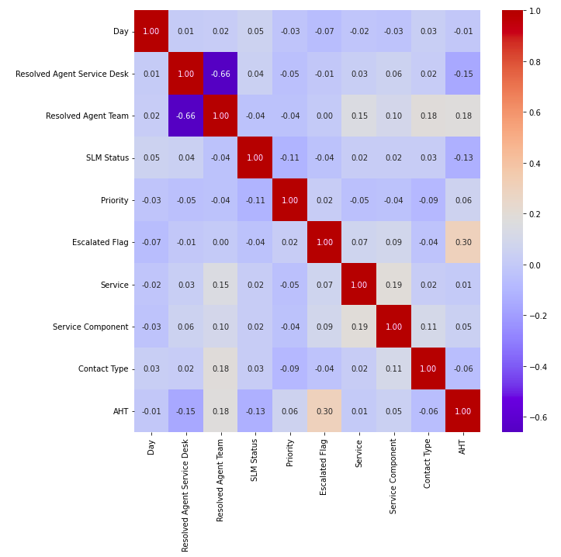

IT Service desk – Predictive Analysis
* The data further clenced and converted in to required model format
* Later did the correlation analysis to identify the highly correlated variables. agent service desk and the agent team are intermediately correlated. all the variables considered since no variables are highly correlated
* Randomforest reggressor used to fit and predict the data, because of continuous and non linearity of predictor variable
* The model achieved about 78 percent of explained variance and error values are bit high due to average between to data points are high

Slide 7
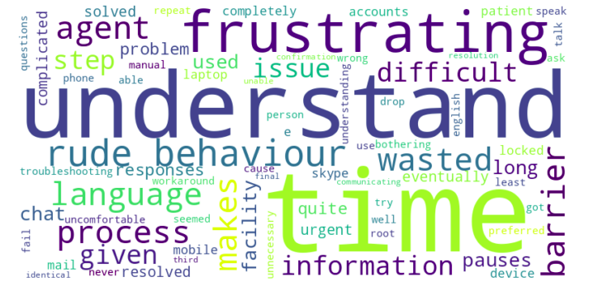
IT Service desk – Sentiment Analysis
* In the given dataset the major of the comments having null values. Initially this been identified and removed
* Converted data to lowercase and removed special charecter, stop words. Performed Stemming, Lammatization
* after that using both NLTK and Text blob respective sentiments been identified. Using the most negative sentiments the major improvement areas are identified

Slide 8
IT Service desk - Analytics
Thank You !

