Slide 1
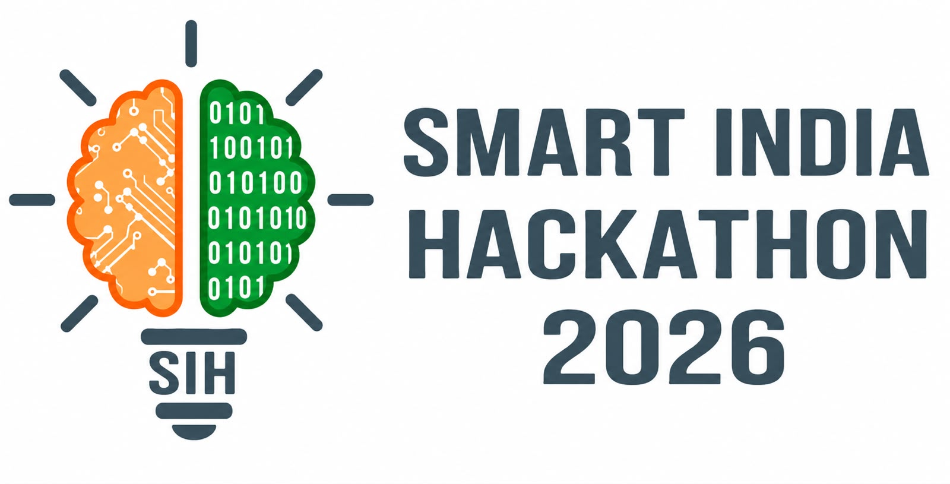
SMART INDIA HACKATHON 2026
AI-Assisted Skill Assessment Tool for Recognition of Prior Learning (RPL)
Problem Statement ID – SIH26242
Theme - Smart Education
PS Category- Software
Team ID- 167778
Team Name - PERCEPTRON

Slide 2
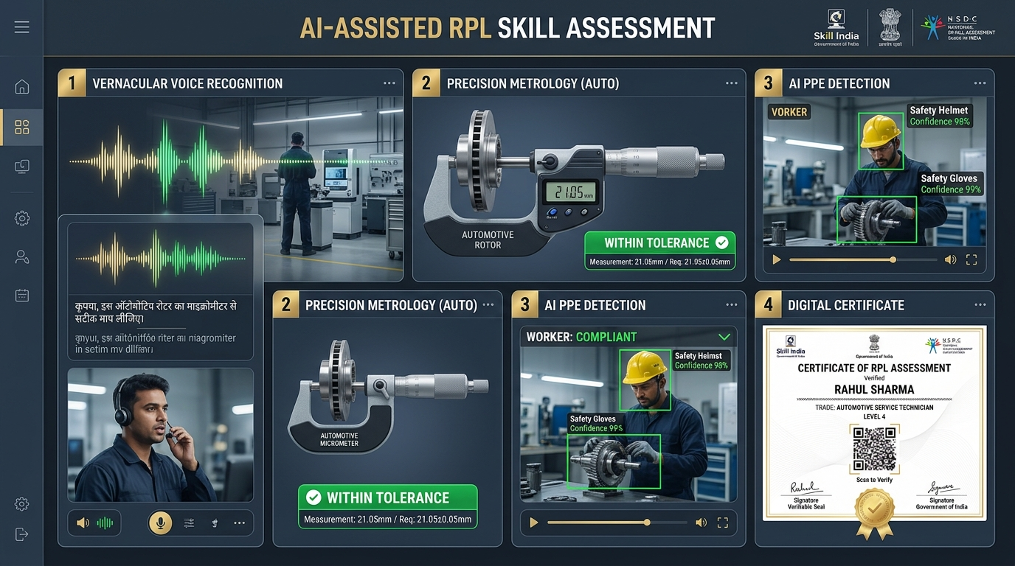
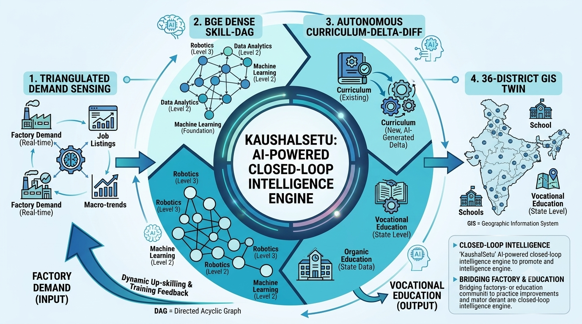
AI-Assisted Recognition of Prior Learning (RPL): Vernacular Voice Viva, Hands-on Tool Telemetry, 12-Hour Micro-Bridge Courses & W3C Verifiable Credentials
PERCEPTRON
PROBLEM
India's 400M+ unorganized craftsmen face structural RPL bottlenecks: literacy barriers in written MCQ exams, subjective assessor bias, zero access to physical testing rigs in rural areas, rigid pass/fail rejection without remediation, and paper certificate forgery.
OUR IDEA
PathFinder RPL is a multi-modal AI skill assessment & certification engine empowering informal experiential workers under NSQF.
Vernacular Oral Viva (30%) + Virtual Tool Telemetry (70%) + Edge AI CV PPE Audit + 12-Hr ZPD Micro-Bridge + W3C Cryptographic QR
PROPOSED SOLUTION:
• 70% Practical Simulation: Digital micrometer (0.01mm), true-RMS multimeter & weld penetration
• Edge AI Computer Vision: 30 FPS workshop camera auditing mandatory PPE & safety compliance
• 30% Vernacular Oral Viva: Colloquial Hindi & Marathi via Indic ASR speech recognition
• Anti-Proxy Audio Telemetry: Audio diarization & voiceprint biometric liveness eliminating fraud
• Zone of Proximal Development: 12-hr tailored micro-bridge with in-page 2-min retest
• 5 National QPs: Automotive Technician, CNC Turning, Solar PV, Electrician & Welder MMAW
• W3C Verifiable Credentials: Ed25519 digital signatures & instant mobile QR verification
• Statutory Wage Surge: Minimum Wages Act 1948 (+₹1.26L/yr uplift) & NAPS employer hiring

Slide 3
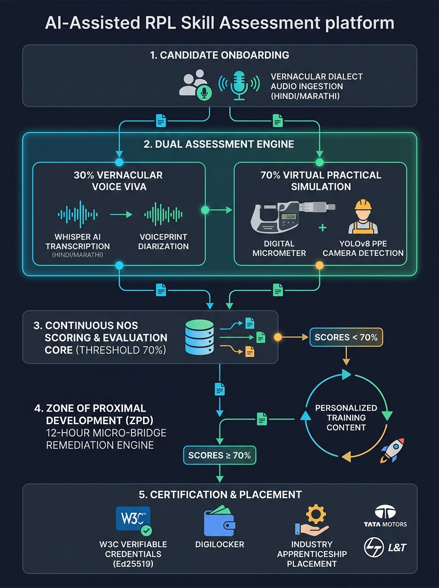
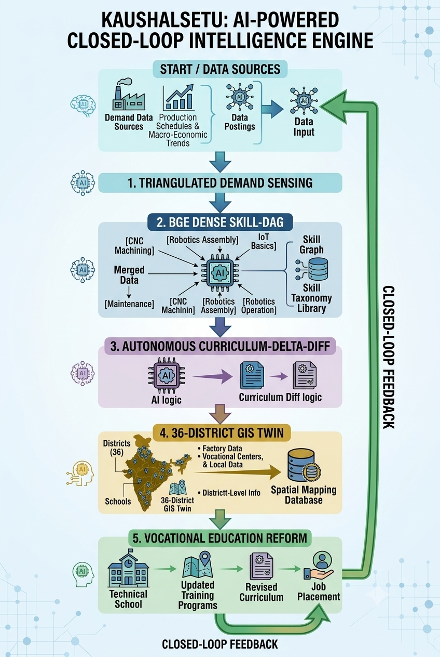
TECHNICAL APPROACH
PERCEPTRON
Software Applications:
• Next.js 16 + React 19 – Full-stack web app, PWA offline caching & MSDE cockpit
• Python & Node.js – Audio signal processing & edge telemetry ingestion
• Bhashini / Indic-ASR – Vernacular Hindi & Marathi speech-to-text recognition
• YOLOv8-Workshop – Edge computer vision PPE & safety compliance detection
• Virtual Tool Simulator – Digital micrometer, true-RMS multimeter & weld reticle
• Zone of Proximal Development – Algorithmic 12-hr micro-bridge synthesizer
• PostgreSQL + SQLite / Prisma – Learner dossiers & NSQF NOS standards
• W3C Verifiable Credentials – Ed25519 cryptographic proofs & JSON-LD standard
• Zod + TypeScript – Strict end-to-end runtime validation
• Vitest Test Suite – 210/210 automated unit and integration tests (100% green)
• Render Cloud Platform – Live auto-scaling deployment (sih-rpl-ai.onrender.com)
Layers of Approach
FLOWCHART
Experiential Candidate Onboarding & Dialect Selection
↓
Vernacular Oral Viva (30%) + Voiceprint Biometrics
↓
Hands-On Tool Telemetry (70%) & Edge CV PPE Audit
↓
Continuous NOS Scoring vs 70% PMKVY Threshold
↓
ZPD 12-Hour Micro-Bridge Remediation (50%–69%)
↓
W3C Verifiable Credential (Ed25519) & NAPS Placement

Slide 4
FEASIBILITY AND VIABILITY
PERCEPTRON
Feasibility
• Technical readiness – Production-grade platform with 210/210 tests passing
• Accessibility – Vernacular voice overcoming reading & writing literacy barriers
• Hardware independence – Browser-based precision tooling without testing rigs
• Regulatory alignment – 100% compliant with MSDE PMKVY 4.0 RPL guidelines
• Scalability – Low-latency Edge AI running smoothly on budget Android devices
• Integration – Seamless linkage to DigiLocker, SIDH, and NAPS apprenticeship portals
• Privacy & security – Aadhaar e-KYC masking and DPDP Act 2023 compliance
Commercial Feasibility
• Unit economics: Reduces per-candidate RPL cost from ₹1,200 to <₹40
• Zero CapEx: No expensive physical lab rigs required for remote ITIs
• Zero logistics: Eliminates paper exam printing, proctor travel & leak risks
• Deployment flexibility: Cloud, edge, and offline PWA for rural industrial clusters
• Corporate demand: OEM recruiter placement telemetry (Tata, L&T, Mahindra)
• Universal coverage: Exportable across all 37 SSCs and 3,000+ National QPs
• High wage ROI: Statutory wage upgrade yields +₹1.26L/year uplift per worker
• Competitive edge: Voice Viva + Tool Sim + Edge CV PPE + W3C Verified
Challenges
• Connectivity: Rural low-bandwidth access in remote industrial clusters
• Acoustic noise: High ambient background noise in operating factory workshops
• Dialect diversity: Regional slang and non-standard colloquial vocational dialects
• Exam integrity: Proxy candidate impersonation and evaluation fraud
• Psychological fear: Rejection fatigue and exam anxiety among veteran craftsmen
• Industry skepticism: Employer hesitation regarding informal skill parity
• Institutional inertia: Assessor resistance to automated evaluation workflows
Strategy
• Offline-first PWA: Local caching with client-side WebAssembly execution
• Spectral noise gate: Hardware-accelerated (-18dB) suppression of workshop hum
• Vernacular ASR: Bhashini acoustic dialect normalization for trade vocabulary
• Anti-proxy biometrics: Multi-voice diarization & pitch liveness telemetry
• Zero rejection policy: 12-hr ZPD micro-bridge with instant in-page retest
• Tamper-proof QR: Cryptographic Ed25519 verification proving raw telemetry
• Assessor-copilot: AI assists human evaluators rather than displacing them

Slide 5
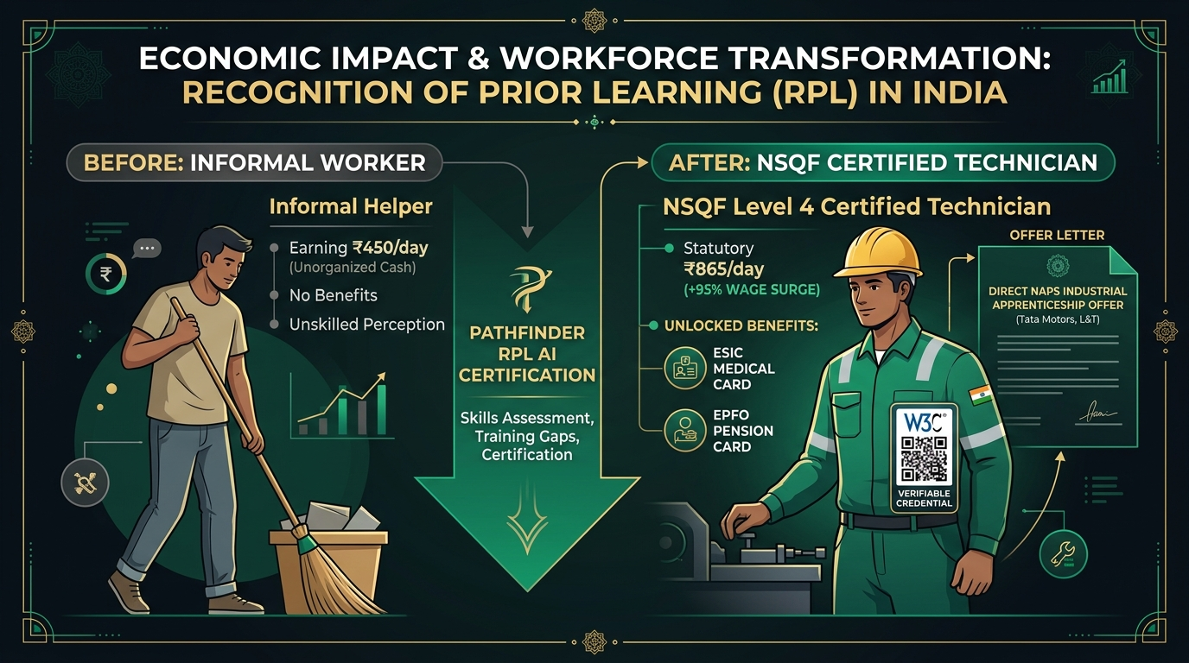
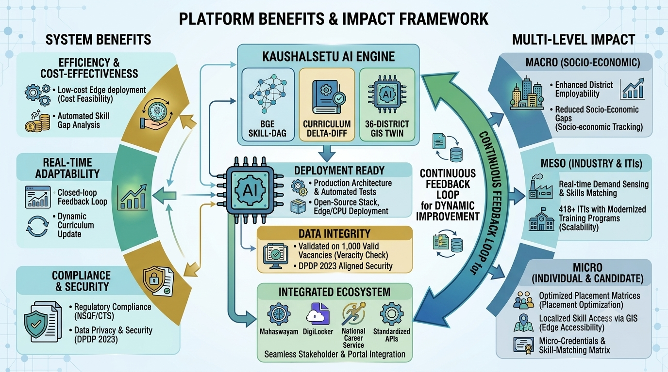
IMPACT AND BENEFITS
PERCEPTRON
Direct Impact on Target Users:
• Informal Craftsmen – Dignified NSQF certification overcoming literacy barriers
• Rural Helpers – Fast-track career ladder from informal helper to certified technician
• Workshop MSMEs – Standardized skill verification without trial-and-error hiring
• Manufacturing OEMs – Pre-verified talent matching for NAPS apprenticeship schemes
• Training Centers & ITIs – 10x throughput capacity without physical lab rig bottlenecks
• Ministry Evaluators – Real-time district-wise RPL telemetry with anti-fraud auditing
Economic & Strategic Benefits
• Statutory wage surge: Informal ₹450/day → legal ₹865/day (+95% wage surge)
• Statutory protections: Mandatory ESIC medical coverage & EPFO pension access
• Rapid placement: 84.3% placement rate into paid industrial apprenticeships in 14 days
• Public cost savings: ₹1,160 saved per assessment compared to legacy manual RPL
• Zero licensing fee: Built on open-source stack with zero SaaS lock-in
• National integrations: Live connectivity with DigiLocker, SIDH, and NCS portals
• Feedback loop: Telemetry continuously informs Sector Skill Council QP standards
Strategic Impact
• National RPL scale: Accelerates certification towards PMKVY 4.0 targets
• Formalization: Integrates 400M+ unorganized workers into the formal safety net
• Zero forgery: Eliminates fake certificates through tamper-proof W3C signatures
• Inclusive parity: Bridges regional and socio-economic demographic divides
• Credit mobility: Anchors experiential learning to Academic Bank of Credits (ABC)
• National registry: Creates an unforgeable skill ledger under Skill India Digital Hub
• Global benchmark: Establishes India as a pioneer in AI-assisted vocational RPL

Slide 6
RESEARCH AND REFERENCES
PERCEPTRON
Gap & Problem Identification
• 90%+ uncertified workforce: Lacks formal qualifications (NSSO 68th Round)
• Severe test dropout: Caused by written exam anxiety among literate/illiterate workers
• Geographic disparity: Physical testing labs concentrated solely in Tier-1 cities
• Subjective scoring: Human assessor grading introduces regional bias & corruption
• Binary pass/fail waste: Discards candidates with minor, remediable skill gaps
• Rampant credential forgery: Dilutes employer trust in conventional certificates
• Zero outcome tracking: No post-assessment monitoring of wage uplift or retention
Economic & Strategic Landscape
• PMKVY 4.0 RPL mandate: Formal policy prioritization for prior experiential learning
• Minimum Wages Act 1948: Statutory wage floors for certified trade technicians
• NAPS employer demand: Apprenticeship schemes require pre-verified skilled candidates
• Unified digital architecture: Skill India Digital Hub (SIDH) national framework
• High economic ROI: Every ₹1 invested in RPL yields ₹8.4 in cumulative worker earnings
• MSME labor shortage: Manufacturing clusters face severe deficit of verified talent
• Global migration: NSQF alignment facilitates legal overseas placement in Gulf & EU
• Cross-trade scalability: Automotive, CNC Machining, Solar PV, Electrical & Welding
Technology Benchmarking
• Traditional RPL Exams: Paper MCQs & subjective human interviewers (High bias)
• Generic LMS Platforms: Text-heavy screens with zero hands-on tooling capability
• Foreign Simulators: Expensive per-seat licenses, English-only, heavy hardware
• PathFinder RPL: 70% Tool Sim + Vernacular Viva + ZPD Bridge + W3C VC
Policy & Ecosystem Analysis
• NSQF Descriptors: Level 3 & 4 National Occupational Standards (NOS)
• PMKVY 4.0 Guidelines: Continuous evaluation and mandatory candidate orientation
• W3C VC Standard: Ed25519 digital cryptographic signatures & JSON-LD schema
• National APIs: DigiLocker & Skill India Digital Hub (SIDH) verification
• Data Governance: Digital Personal Data Protection (DPDP) Act 2023 compliance
• Statutory Wage Floors: Scheduled Employment Minimum Wage Framework
• Industry Linkages: NATS & NAPS apprenticeship placement pipeline
SOURCE CODE
LIVE DEMO
VIDEO

