Slide 1
PS40 - AI-Powered Network Intrusion Detection System
IBM AICTE Internship ProjectSabarish RB.Tech CSBS

Slide 2

Add mobile number and college name
Student Profile | Sabarish R | sabarish.edu2024@gmail.com | B.Tech CSBS 2nd Year, 4th Semester

Slide 3
Problem Statement - PS40Detect intrusion patterns in network connection records
Classify traffic as normal or anomalySupport security monitoring with actionable output

Slide 4
Proposed SolutionModular ML pipeline
Validation-driven model selectionInference on unlabeled test dataExportable predictions and metrics

Slide 5
Tech Stack
Pythonpandas and numpyscikit-learnmatplotlibStreamlitJoblib

Slide 6
LangFlow WorkflowUpload or query inputDetection model node
Granite explanation nodeResponse formatting node

Slide 7
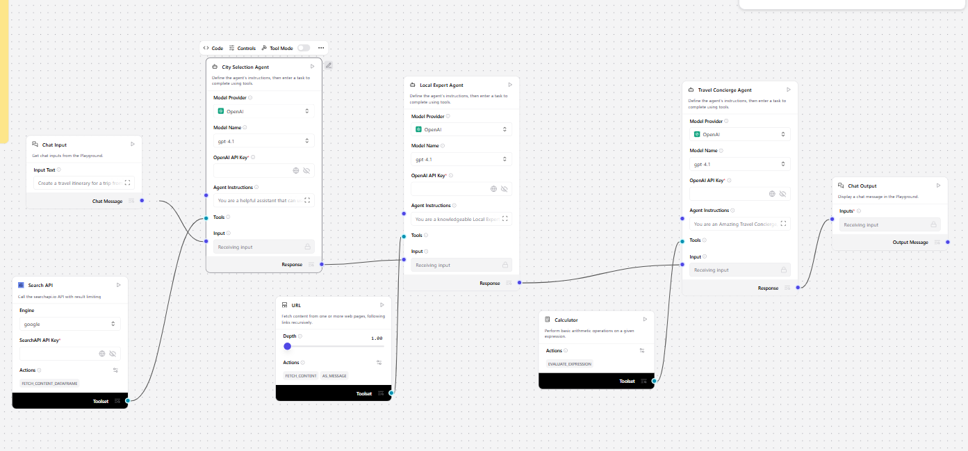
ArchitectureDataset ingestionPreprocessing and feature engineering

Slide 8
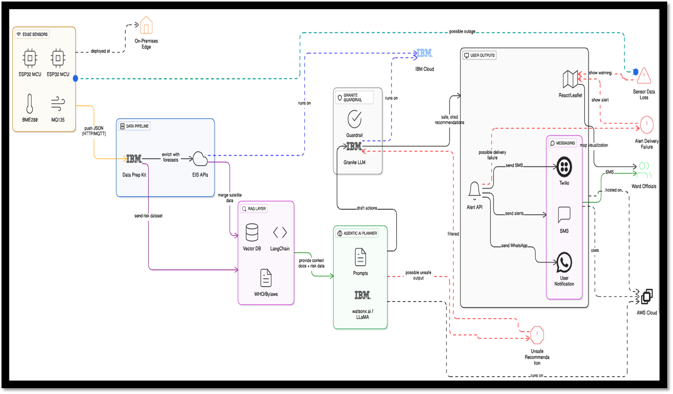
Agentic AI Role

Slide 9

Technology Used
sklearn pipelines
Random ForestGradient BoostingLogistic RegressionVisualization toolkit

Slide 10
Novelty and Uniqueness
Cybersecurity-first positioningClean modular codebaseHandles unlabeled test set safely
IBM-ready narrative alignment

Slide 11
Results
Validation accuracyPrecision, recall, F1ROC-AUC
Confusion matrix

Slide 12
GitHub Repository
Public repository linkREADMEPPTX
Source codeReports

Slide 13
Future Scope
Real-time packet streaming
SOC integration
Explainability viewsMulticlass attack detection

Slide 14


