Slide 1

SRM IST
School of Computing
Department of Networking and Communications
21CSC315J - FOG COMPUTING
Dr. N. Prasath
Associate Professor / NWC

Slide 2
Course Content
Unit 1 - Introduction
Fog Computing Basics, Fog and Edge Computing Completing the Cloud, Hierarchy of Fog and Edge Computing, Business models, Opportunities and Challenges, Fog Computing Communication Technologies.
CO1: Contrast Fog Computing and Edge Computing

Slide 3
Fog Computing Basics
Fog computing, also known as fogging, is a decentralized computing paradigm that extends cloud computing by bringing data storage, processing, and applications closer to the devices and users in the network. It plays a critical role in managing the massive amount of data generated by the Internet of Things (IoT), edge devices, and real-time applications.

Slide 4
Fog Computing Basics
Key Concepts of Fog Computing
Proximity to End Users
Fog computing operates closer to the source of data, such as IoT devices, sensors, or edge devices.
It reduces latency by processing data locally rather than sending it to a distant central cloud.

Slide 5
Fog Computing Basics
Decentralized Architecture
Unlike traditional cloud computing, fog computing uses a distributed approach where data processing happens across multiple nodes, including gateways, routers, and devices.
Security and Privacy
By keeping sensitive data closer to the source, fog computing can enhance data security and privacy compared to transferring everything to the cloud.

Slide 6
Fog Computing Basics
Real-Time Data Processing
Fog computing is ideal for time-sensitive applications like autonomous vehicles, smart grids, industrial automation, and healthcare systems, as it can process data in real-time or near real-time.
Interoperability
It supports diverse devices and protocols, enabling seamless integration between IoT devices and cloud services.

Slide 7
Fog Computing Basics
Key Components of Fog Computing
Fog Nodes
Devices such as routers, switches, gateways, or dedicated servers that perform data processing, storage, and networking tasks
IoT Devices
Sensors, actuators, and other devices generate data that fog nodes process.

Slide 8
Fog Computing Basics
Cloud Layer
The central cloud serves as a backup and performs complex analytics, storage, and processing tasks when necessary.
Network Connectivity
Communication between fog nodes, IoT devices, and the cloud happens through wired or wireless networks.

Slide 9
Fog Computing Basics
Advantages of Fog Computing
Reduced Latency
By processing data locally, it minimizes delays in decision-making
Bandwidth Efficiency
Only filtered or necessary data is sent to the cloud, reducing network congestion

Slide 10
Fog Computing Basics
Enhanced Security
Sensitive data can remain local, reducing exposure to potential breaches during transit.
Scalability
The distributed nature of fog computing allows it to scale efficiently with the growing number of IoT devices.

Slide 11
Fog Computing Basics
Energy Efficiency
By processing data locally, energy consumption associated with data transmission to the cloud is reduced.

Slide 12
Fog Computing Basics
Challenges of Fog Computing
Complexity
Managing a decentralized system requires robust coordination and infrastructure.
Security Concerns
While it enhances privacy, securing distributed fog nodes against cyberattacks is challenging.

Slide 13
Fog Computing Basics
Resource Limitations
Fog nodes may have limited processing power and storage compared to cloud data centers.
Standardization
The lack of universal standards can hinder interoperability across different systems and devices.

Slide 14
Fog Computing Basics
Applications of Fog Computing
Smart Cities
Traffic management, smart lighting, and waste management.
Healthcare
Real-time patient monitoring and diagnostics.
Industrial IoT
Predictive maintenance, process optimization, and safety systems.

Slide 15
Fog Computing Basics
Autonomous Vehicles
Vehicle-to-infrastructure (V2I) and vehicle-to-vehicle (V2V) communication for navigation and safety.
Agriculture
Precision farming and environmental monitoring.

Slide 16
Fog Computing Basics
Fog Computing vs. Edge Computing
Edge Computing is a subset of fog computing, focusing on processing data directly on IoT devices or close to the source.
Fog Computing includes edge computing but also involves intermediate nodes like gateways and routers, offering more flexibility in data processing and storage.
Fog computing complements cloud computing and edge computing, enabling efficient, secure, and scalable systems for modern connected technologies.

Slide 17
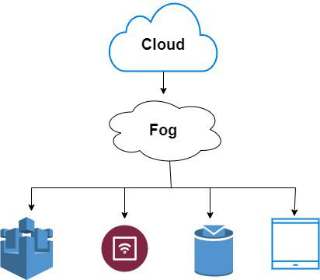
Fog Computing Basics

Slide 18
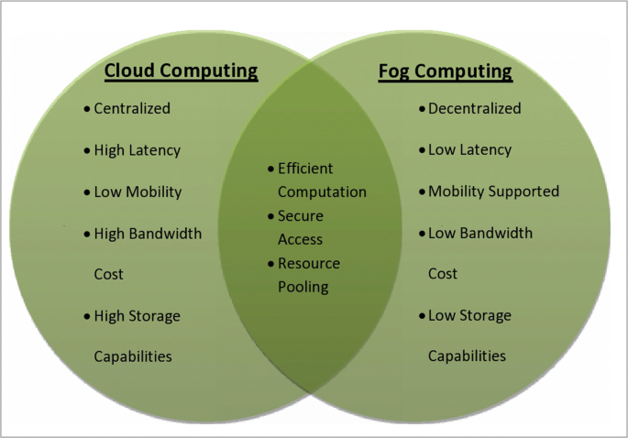
Fog Computing Basics

Slide 19
Fog and Edge Computing Completing the Cloud
Fog and Edge Computing: Completing the Cloud
Fog and edge computing work together to complement cloud computing, creating a robust ecosystem that addresses the limitations of a purely cloud-based architecture. This combination ensures efficient data processing, enhanced scalability, reduced latency, and better support for IoT and real-time applications.

Slide 20
Fog and Edge Computing Completing the Cloud
Cloud Computing: Strengths and Challenges
Cloud computing provides centralized storage and powerful computational resources, making it an essential component of modern IT infrastructures. However, it has limitations:
Latency: Transmitting data to a distant cloud data center and back can introduce delays, unsuitable for time-sensitive applications.
Cost: Constant data transmission to the cloud can lead to higher costs.

Slide 21
Fog and Edge Computing Completing the Cloud
Bandwidth Bottlenecks: The increasing number of IoT devices generates massive data, overloading network bandwidth.
Data Privacy: Sensitive information is at risk during transmission and storage in centralized locations.
To overcome these challenges, fog and edge computing serve as complementary layers.

Slide 22
Fog and Edge Computing Completing the Cloud
Edge Computing: Bringing Computation to the Source
Definition: Edge computing processes data directly on the device or near the data source, minimizing the need for transmission to distant cloud servers.
Key Characteristics
Low latency due to on-device or nearby processing.
Ideal for devices with limited connectivity.
Supports localized decision-making.

Slide 23
Fog and Edge Computing Completing the Cloud
Examples
Smart cameras processing video feeds locally for object detection.
Industrial IoT devices detecting anomalies in machinery in real time.

Slide 24
Fog and Edge Computing Completing the Cloud
Fog Computing: Bridging the Edge and Cloud
Definition: Fog computing serves as an intermediary layer between the edge and the cloud, extending processing and storage capabilities to network nodes like gateways, routers, and servers closer to the data source.

Slide 25
Fog and Edge Computing Completing the Cloud
Key Characteristics
Distributed architecture, ensuring data processing at intermediate nodes.
Reduces the data volume sent to the cloud by filtering or pre-processing information.
Supports complex analytics and resource-intensive tasks that edge devices can't handle.

Slide 26
Fog and Edge Computing Completing the Cloud
Examples
A gateway in a smart city aggregating data from multiple IoT sensors and transmitting only essential insights to the cloud.
Fog nodes optimizing traffic signals based on real-time traffic patterns.

Slide 27
Fog and Edge Computing Completing the Cloud
How Fog and Edge Computing Complete the Cloud?
Distributed Processing
Edge Computing handles immediate, localized tasks (e.g., real-time decision-making).
Fog Computing performs more complex pre-processing and aggregation tasks at intermediate nodes.
Cloud Computing handles long-term storage, large-scale analytics, and historical data analysis.

Slide 28
Fog and Edge Computing Completing the Cloud
Improved Latency
Edge devices and fog nodes reduce latency by processing data closer to the source, ensuring faster responses.
This is critical for applications like autonomous vehicles, remote surgeries, and financial trading systems.

Slide 29
Fog and Edge Computing Completing the Cloud
Optimized Bandwidth Usage
Fog computing reduces data volume by pre-processing it before sending relevant insights to the cloud.
Edge computing eliminates the need for constant cloud communication for localized tasks.

Slide 30
Fog and Edge Computing Completing the Cloud
Enhanced Scalability
The layered approach accommodates the exponential growth of IoT devices and data generation.
Cloud resources can focus on high-level analytics, while fog and edge handle local needs.

Slide 31
Fog and Edge Computing Completing the Cloud
Increased Security and Privacy
Sensitive data can be processed locally on edge devices or fog nodes, reducing exposure during transmission.
  Compliance with data residency and privacy regulations is easier with localized processing.

Slide 32
Fog and Edge Computing Completing the Cloud
Unified Ecosystem: Practical Applications
Smart Cities
Edge: Streetlights automatically adjust brightness based on real-time pedestrian movement.
Fog: A local gateway aggregates data from multiple sensors to optimize city-wide traffic flow.
Cloud: Historical traffic data is analyzed to plan infrastructure improvements.

Slide 33
Fog and Edge Computing Completing the Cloud
Healthcare
Edge: Wearable devices monitor heart rates and issue immediate alerts.
Fog: Hospital servers aggregate patient data from various devices for localized analytics.
Cloud: Centralized systems store and analyze long-term health records for predictive insights.

Slide 34
Fog and Edge Computing Completing the Cloud
Industrial IoT (IIoT)
Edge: Sensors detect machine anomalies and halt operations in real-time.
Fog: Gateways aggregate data for analysis and send actionable insights to the cloud.
Cloud: Historical analysis helps predict maintenance schedules.

Slide 35
Fog and Edge Computing Completing the Cloud
Conclusion
Fog and edge computing, working alongside the cloud, create a distributed, efficient, and secure ecosystem for modern technology. By leveraging the strengths of each layer edge for immediate actions, fog for intermediate processing, and cloud for high-level tasks this combination ensures seamless support for the demands of IoT, real-time applications, and big data analytics. Together, they enable smarter, faster, and more reliable systems, paving the way for the next generation of digital innovation.

Slide 36
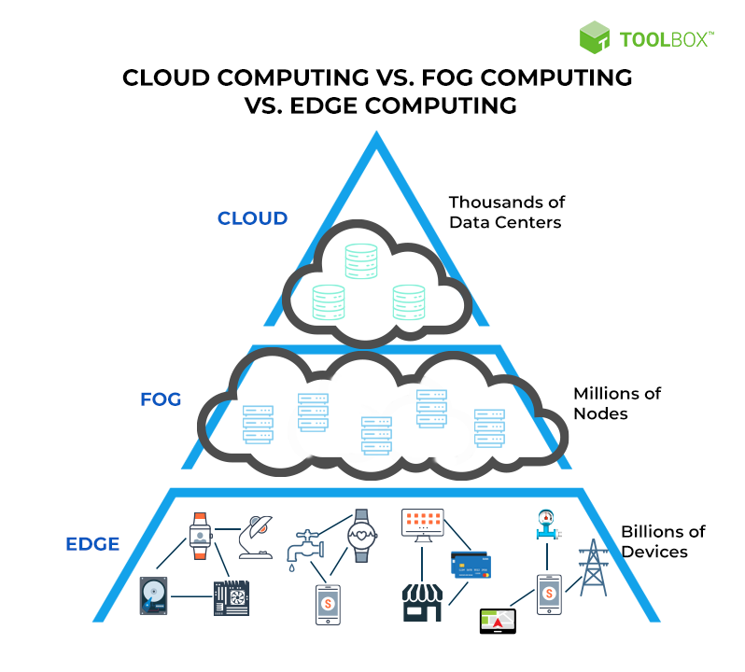
Fog and Edge Computing Completing the Cloud

Slide 37
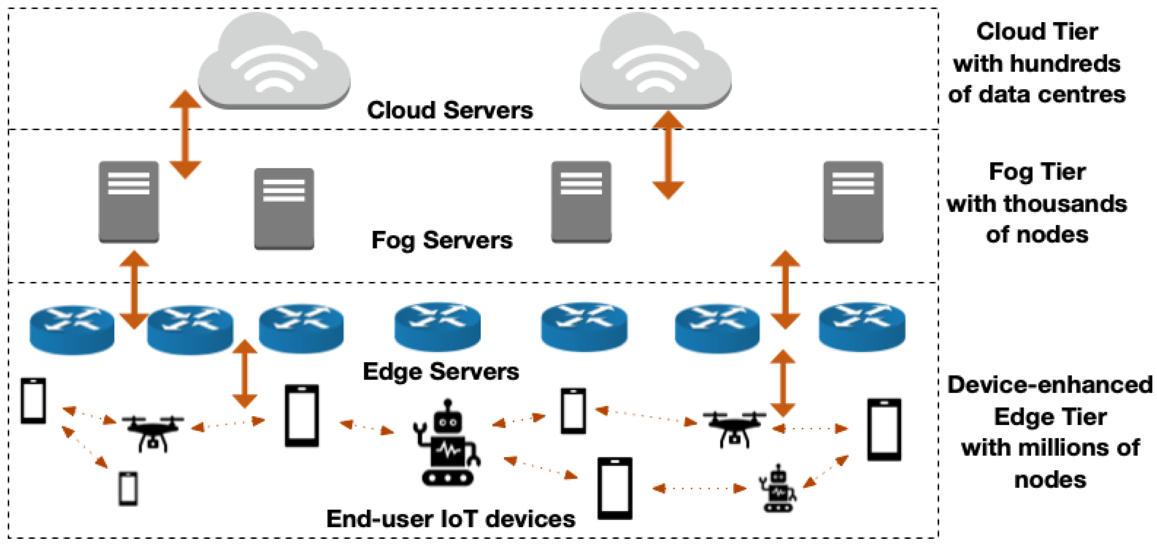
Fog and Edge Computing Completing the Cloud

Slide 38
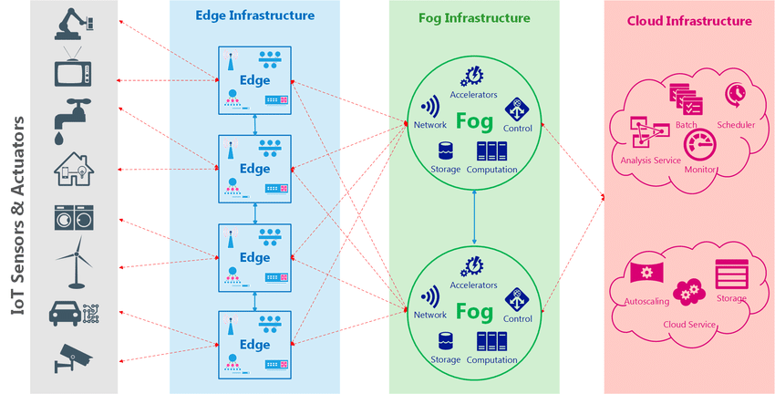
Fog and Edge Computing Completing the Cloud

Slide 39
Hierarchy of Fog and Edge Computing
The hierarchy of fog and edge computing represents how data processing, storage, and communication are distributed across various layers in a network. This hierarchy bridges the gap between the cloud and the data sources (IoT devices), enabling efficient, scalable, and real-time data handling.

Slide 40
Hierarchy of Fog and Edge Computing
Cloud Layer
Role: Centralized data storage, large-scale processing, and long-term analytics.
Key Features
High computational power and storage capacity.
Handles non-time-sensitive tasks like historical analysis, machine learning model training, and backups.
Supports global services and applications requiring a unified data view.

Slide 41
Hierarchy of Fog and Edge Computing
Examples: Data centers of AWS, Microsoft Azure, and Google Cloud.
Communication: Receives data from fog nodes for aggregation and provides updates or advanced analytics to fog and edge layers.

Slide 42
Hierarchy of Fog and Edge Computing
Fog Layer
Role: Intermediate layer between the cloud and edge, performing localized processing, filtering, and aggregation.
Key Features
Processes data from multiple edge devices or nodes.
Reduces latency by minimizing data sent to the cloud.
Scales horizontally by deploying multiple fog nodes in a network.

Slide 43
Hierarchy of Fog and Edge Computing
Handles moderately complex tasks like pre-processing, encryption, and local analytics.
Examples
Gateways, routers, and base stations in a smart city or industrial setup.
Fog nodes in transportation systems optimizing local traffic flow.
Communication: Interfaces with both the edge layer (upstream) and cloud layer (downstream).

Slide 44
Hierarchy of Fog and Edge Computing
Edge Layer
Role: The closest layer to the data source, performing real-time processing and decision-making.
Key Features
Operates on IoT devices or their immediate surroundings.
Low-power and resource-constrained but highly responsive.
Often runs lightweight software or specialized hardware accelerators.
Processes time-sensitive tasks locally, reducing dependency on external systems.

Slide 45
Hierarchy of Fog and Edge Computing
Examples
Smart thermostats, cameras, and wearables analyzing sensor data.
Autonomous vehicles processing LiDAR or camera data locally for navigation.
Communication: Connects directly to fog nodes for additional processing and cloud services when necessary.

Slide 46
Hierarchy of Fog and Edge Computing
Data Source Layer (IoT Devices)
Role: The bottom-most layer that generates raw data for the entire hierarchy.
Key Features
Contains various IoT devices, sensors, and actuators.
Collects data from the environment or user interactions.
Often lacks computational capabilities and depends on edge or fog for processing

Slide 47
Hierarchy of Fog and Edge Computing
Examples
Environmental sensors, RFID tags, fitness trackers, and industrial robots.
Communication: Sends raw data to edge devices or fog nodes.

Slide 48
Hierarchy of Fog and Edge Computing
Key Relationships and Workflows
Data Flow
IoT devices generate raw data.
Edge devices handle immediate, real-time processing.
Fog nodes aggregate and analyze data from multiple edge devices.
Processed data or insights are sent to the cloud for further analytics, storage, or global decision-making.

Slide 49
Hierarchy of Fog and Edge Computing
Task Distribution
Edge Layer: Handles latency-critical tasks (e.g., obstacle detection in autonomous vehicles).
Fog Layer: Processes and aggregates regional data (e.g., smart city traffic patterns).
Cloud Layer: Performs intensive computations like predictive analytics (e.g., future traffic trend forecasting).

Slide 50
Hierarchy of Fog and Edge Computing
Communication Hierarchy
Vertical: Between layers (e.g., edge to fog to cloud).
Horizontal: Within layers for redundancy and load balancing (e.g., fog node to fog node).

Slide 51
Hierarchy of Fog and Edge Computing
Benefits of a Hierarchical Approach
Scalability: Distributes workloads across layers to support billions of devices.
Latency Reduction: Processes time-critical tasks closer to the source.
Bandwidth Efficiency: Filters data locally before transmission to reduce network load.
Cost-Effectiveness: Reduces reliance on expensive cloud resources for all tasks.
Resilience: Localized decision-making ensures system functionality during connectivity issues.

Slide 52
Hierarchy of Fog and Edge Computing
The hierarchy of fog and edge computing creates a layered architecture where each level complements the others, addressing the growing demands of IoT, real-time applications, and big data. By integrating these layers with the cloud, organizations achieve a balanced, efficient, and resilient computing ecosystem.

Slide 53
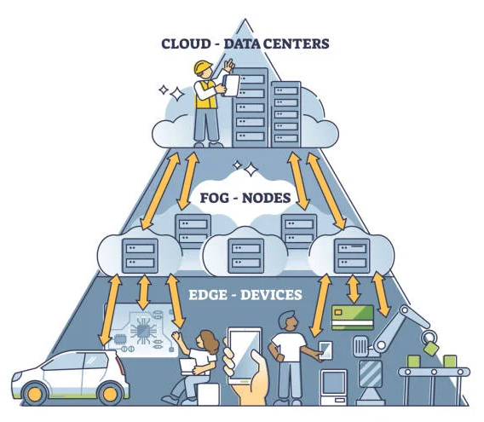
Hierarchy of Fog and Edge Computing

Slide 54
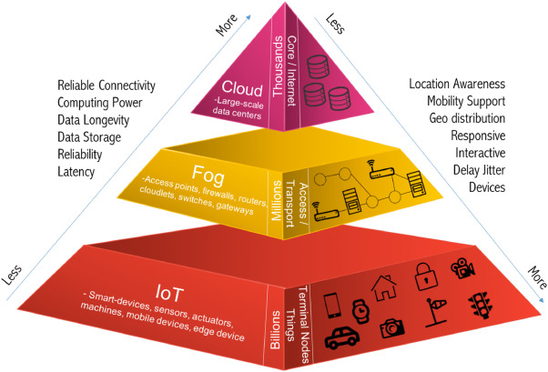
Hierarchy of Fog and Edge Computing

Slide 55
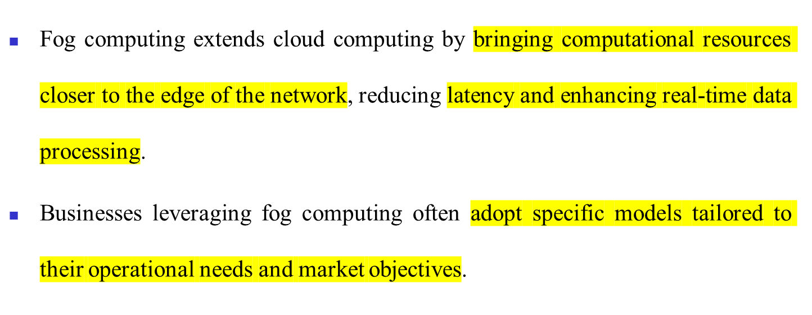
Business Models of Fog Computing

Slide 56
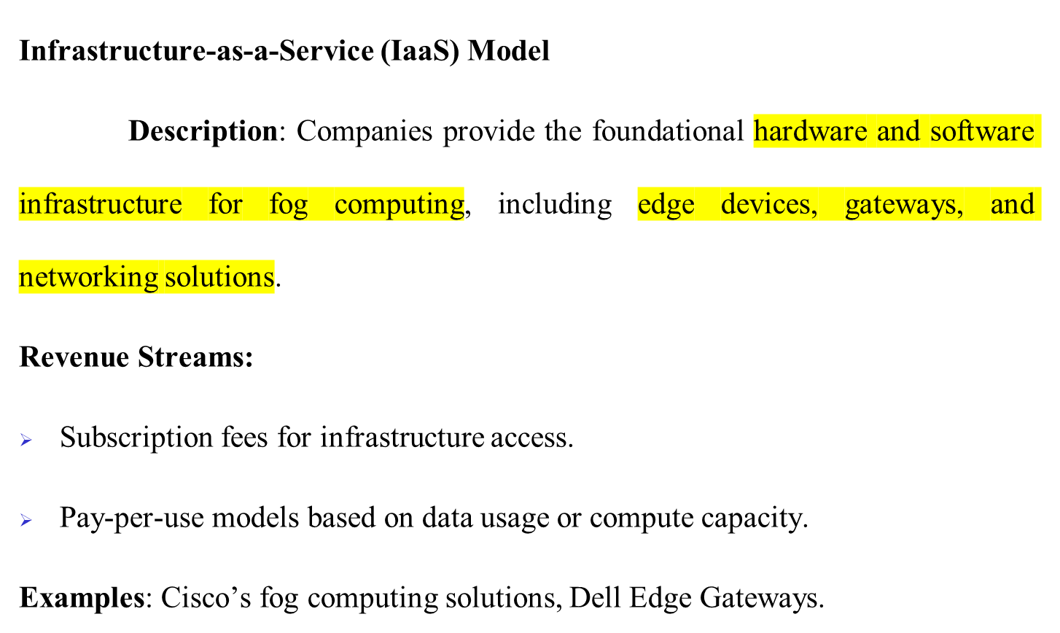
Business Models of Fog Computing

Slide 57
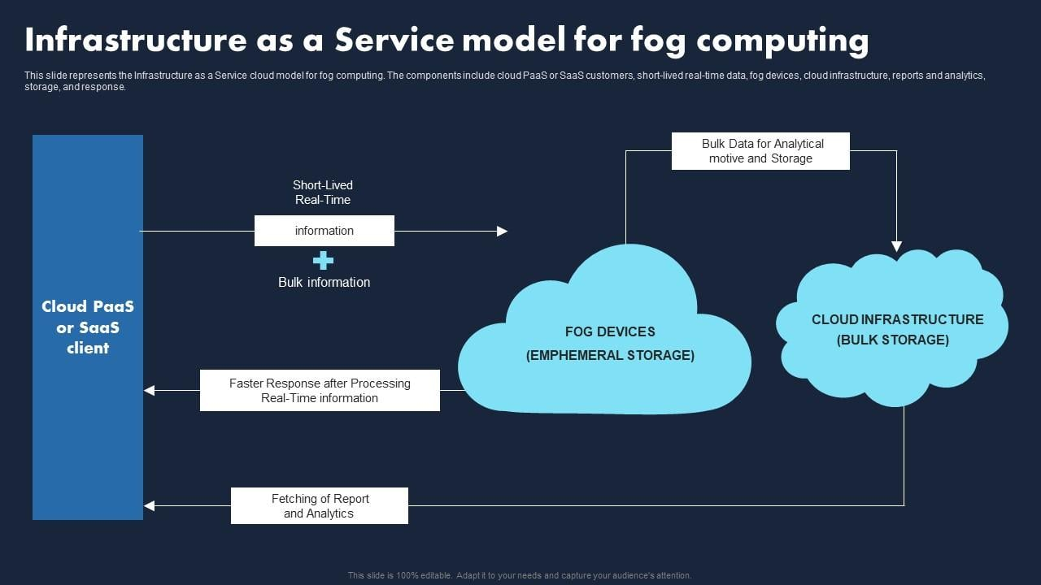
Business Models of Fog Computing
Notes:
Core Components:
Cloud PaaS/SaaS Client: This represents the end-user or application that leverages the Fog Computing services. They could be using Platform as a Service (PaaS) or Software as a Service (SaaS) offerings provided by the cloud provider.
Fog Devices: These are the computing and storage resources deployed at the edge of the network, closer to the data sources. Examples include edge servers, gateways, and IoT devices.
Cloud Infrastructure: This represents the central cloud infrastructure, including data centers, servers, and storage resources.
Data Flow:
Data Collection: Data is generated by various sources, such as sensors, IoT devices, and other edge devices.
Initial Processing at Fog Devices: Fog devices collect and perform initial processing on the data, such as filtering, aggregation, and basic analytics. This reduces the amount of data transmitted to the cloud and improves latency.
Short-Lived Real-Time Data: Time-sensitive data is processed by the Fog devices and used for real-time applications, such as controlling industrial equipment or responding to sensor readings.
Bulk Data for Analysis: Data that does not require immediate processing is sent to the cloud for further analysis, storage, and long-term archiving.
Faster Response after Processing: Processed data from the Fog devices is used to provide faster responses to real-time information requests.
Fetching of Reports and Analytics: The cloud infrastructure provides access to reports and analytics generated from the processed data.
Key Characteristics of IaaS for Fog Computing:
Resource Provisioning: The cloud provider offers on-demand provisioning of computing, storage, and networking resources for deploying and managing Fog devices.
Scalability and Flexibility: The IaaS model allows for easy scaling of resources up or down to meet changing demands.
Pay-as-you-go Pricing: Users typically pay for the resources they consume, making it a cost-effective solution.
Management Tools: IaaS providers often offer tools and APIs for managing and monitoring Fog devices and applications.
Benefits of IaaS for Fog Computing:
Reduced Latency: Processing data closer to the source reduces latency and improves response times.
Improved Bandwidth Utilization: Edge processing reduces the amount of data transmitted to the cloud, optimizing network bandwidth.
Enhanced Scalability: IaaS enables easy scaling of resources to accommodate fluctuating demands.
Cost-Effectiveness: Pay-as-you-go pricing models can help optimize costs.

Slide 58
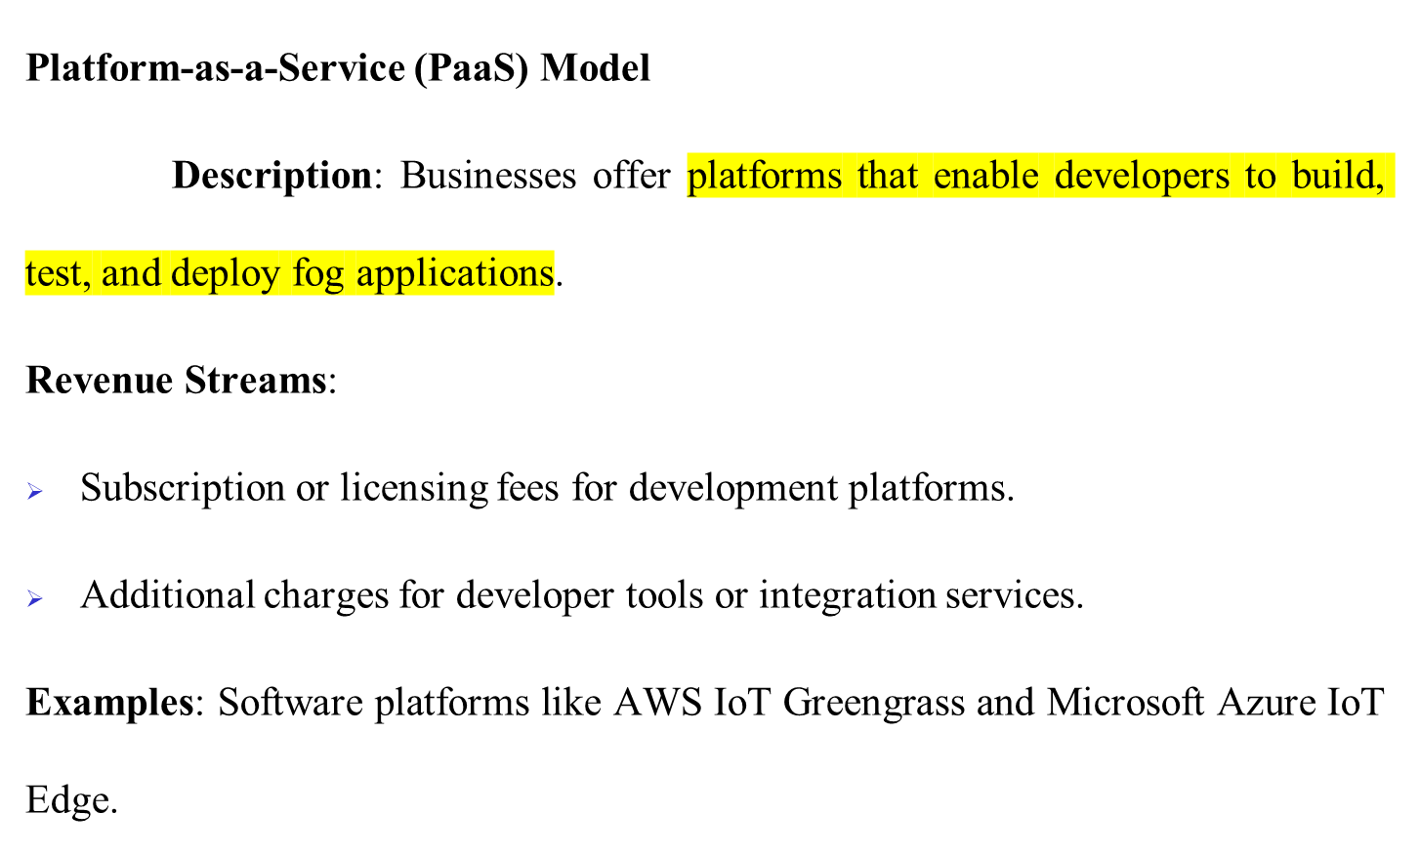
Business Models of Fog Computing

Slide 59
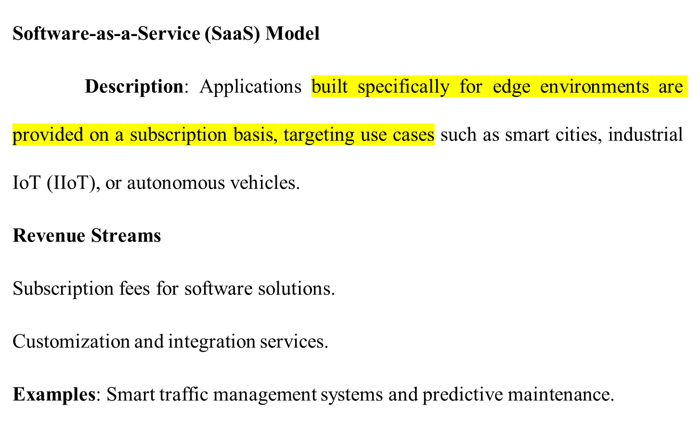
Business Models of Fog Computing

Slide 60
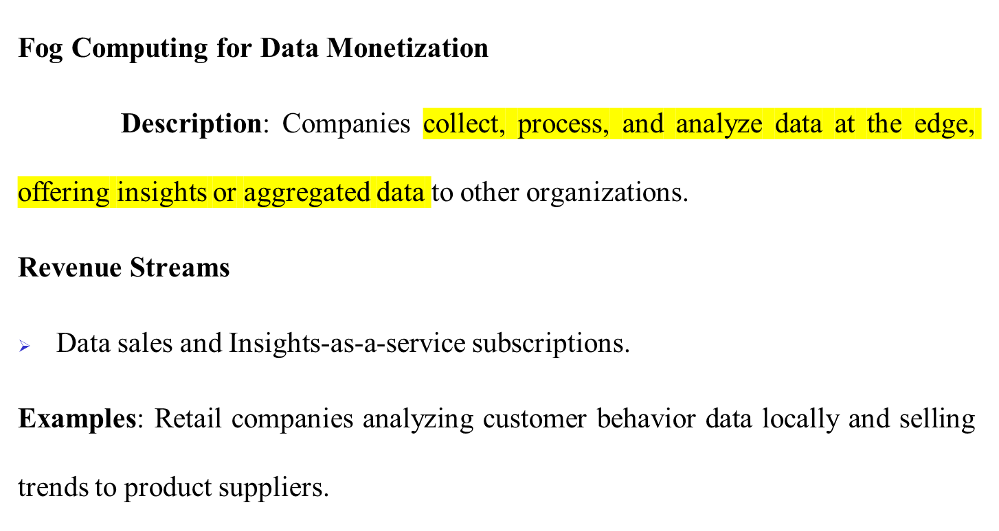
Business Models of Fog Computing

Slide 61
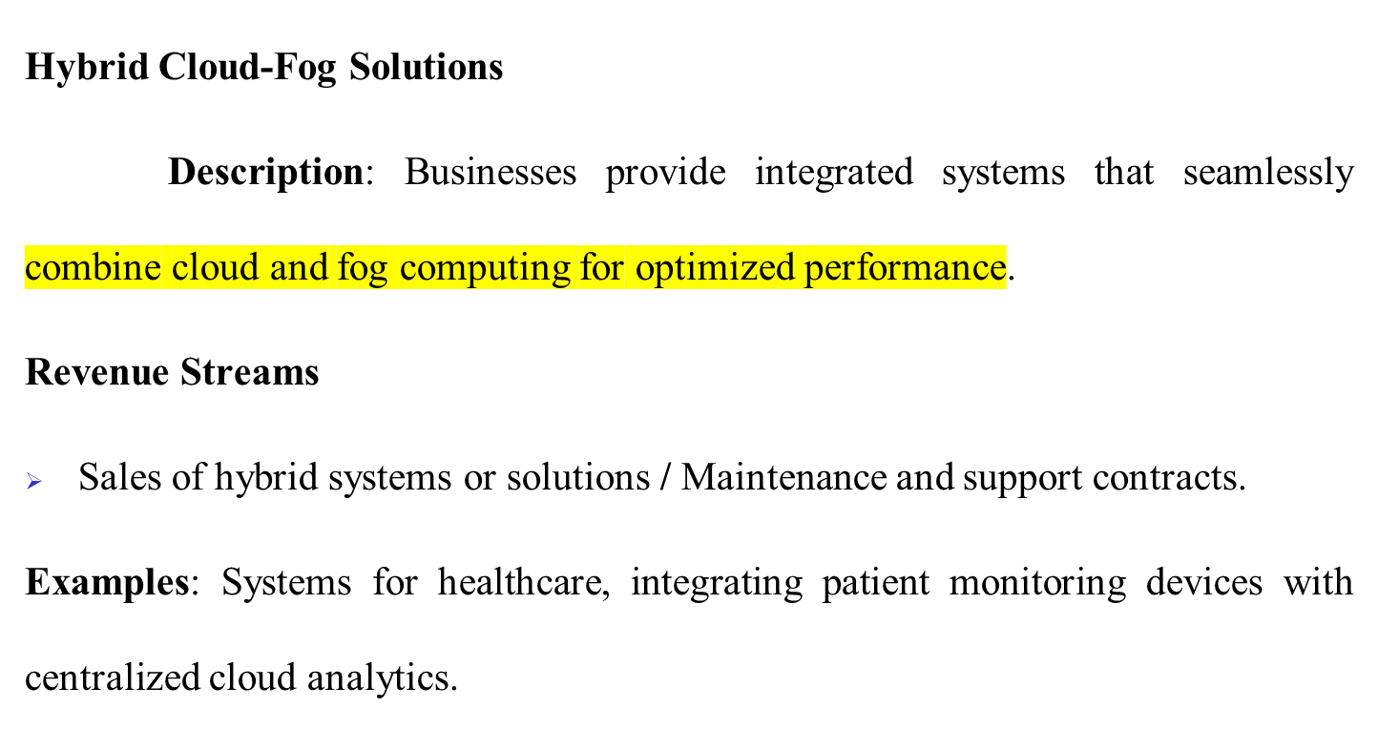
Business Models of Fog Computing

Slide 62
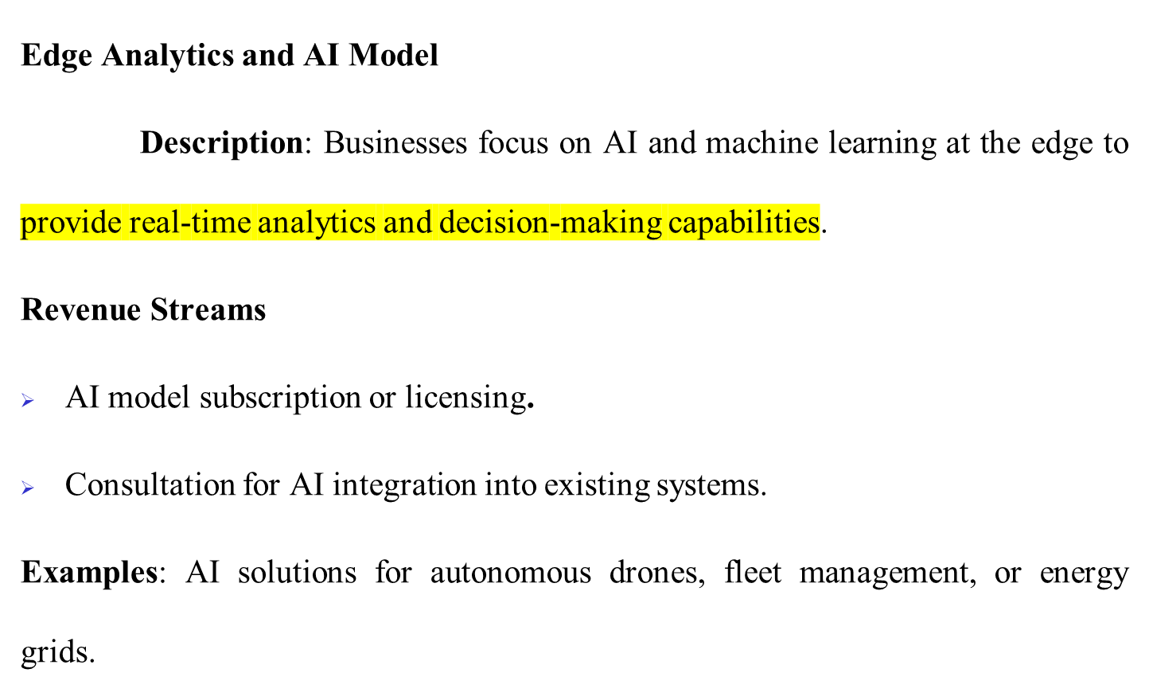
Business Models of Fog Computing

Slide 63
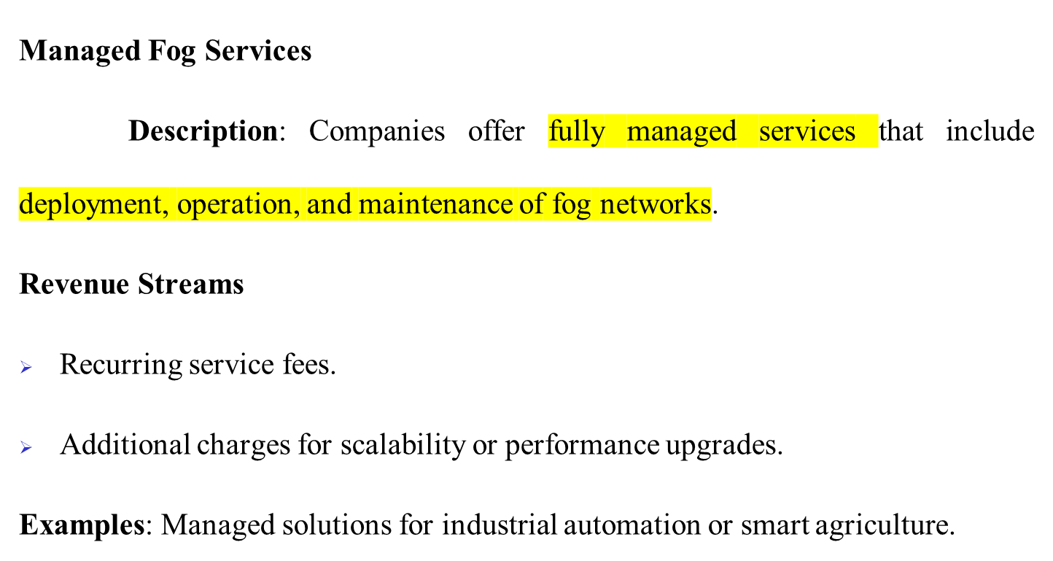
Business Models of Fog Computing

Slide 64
Business Models of Fog Computing
Industry-Specific Fog Solutions
Description: Businesses provide customized fog computing solutions tailored to specific industries like healthcare, manufacturing, transportation, or agriculture.
Revenue Streams
Initial system sales / Ongoing support and service contracts.
Industry-specific analytics or monitoring subscriptions.
Examples: Real-time patient monitoring in healthcare, precision farming solutions.

Slide 65
Business Models of Fog Computing
Hardware Sales Model
Description: Companies manufacture and sell specialized edge hardware for fog computing, such as smart sensors, gateways, and edge servers.
Revenue Streams
Direct hardware sales.
Maintenance and extended warranties.
Examples: Providers of IoT sensors and gateways like HPE Edgeline and NVIDIA Jetson.

Slide 66
Business Models of Fog Computing
Partnership and Ecosystem Model
Description: Companies form ecosystems of hardware providers, software developers, and cloud platforms to deliver end-to-end fog solutions.
Revenue Streams
Revenue sharing among ecosystem partners.
Joint ventures and co-branding opportunities.
Examples: Collaborations between telecom providers and IoT platform developers.

Slide 67
Business Models of Fog Computing
Advantages of Fog Computing Business Models
Reduced Latency: Supports real-time decision-making in critical applications.
Scalability: Facilitates modular growth across industries.
Customization: Provides tailored solutions for diverse industries and use cases.
Cost Efficiency: Minimizes data transfer and processing costs by handling tasks locally.

Slide 68
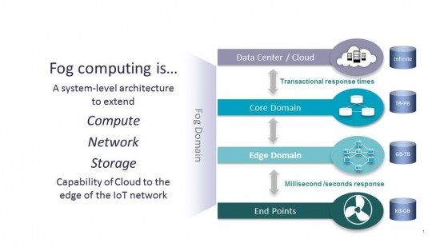
Business Models of Fog Computing

Slide 69
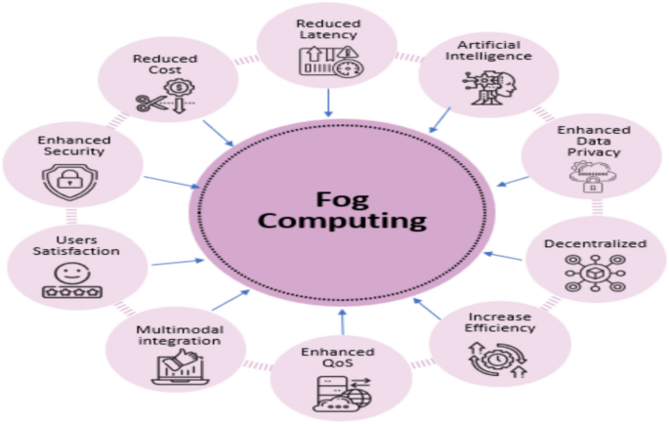
Business Models of Fog Computing

Slide 70
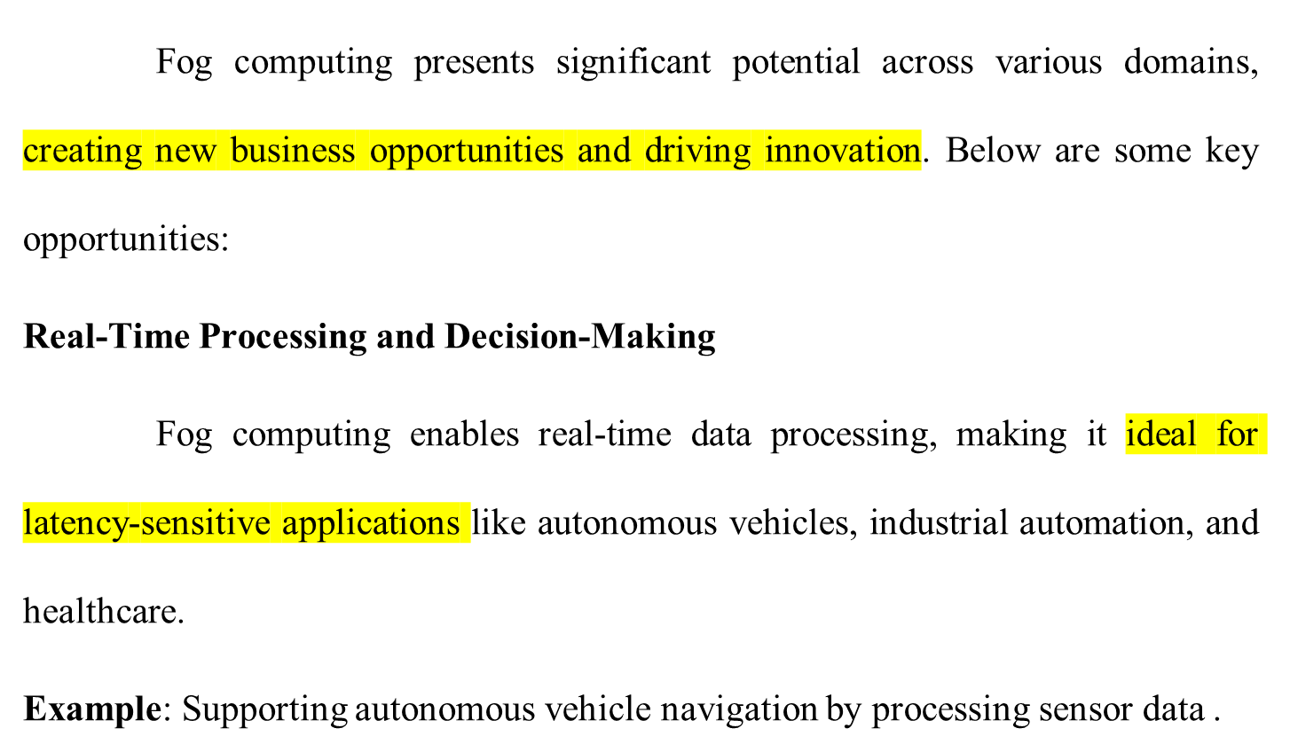
Opportunities and Challenges in Fog Computing

Slide 71
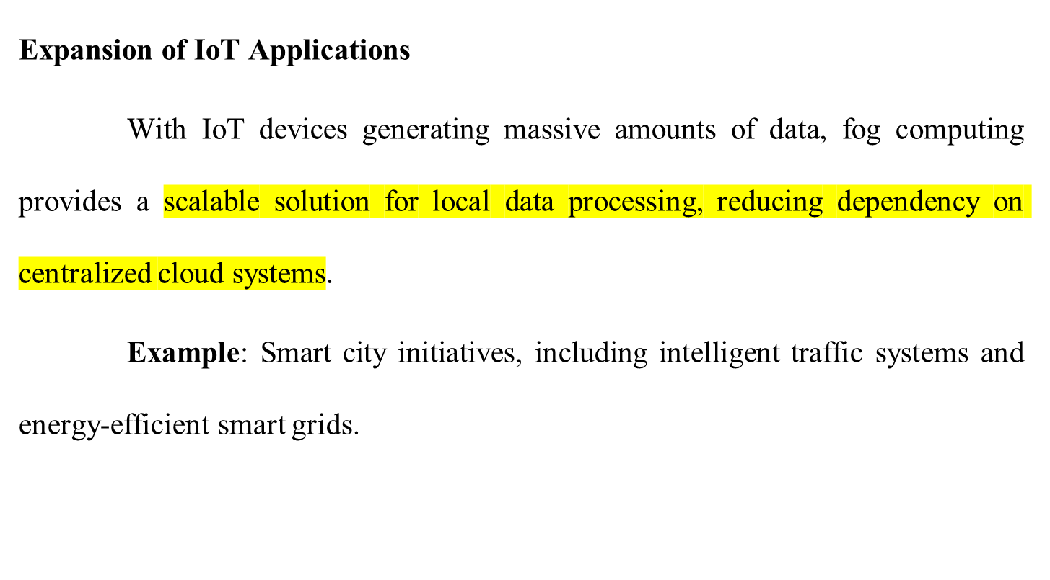
Opportunities and Challenges in Fog Computing

Slide 72
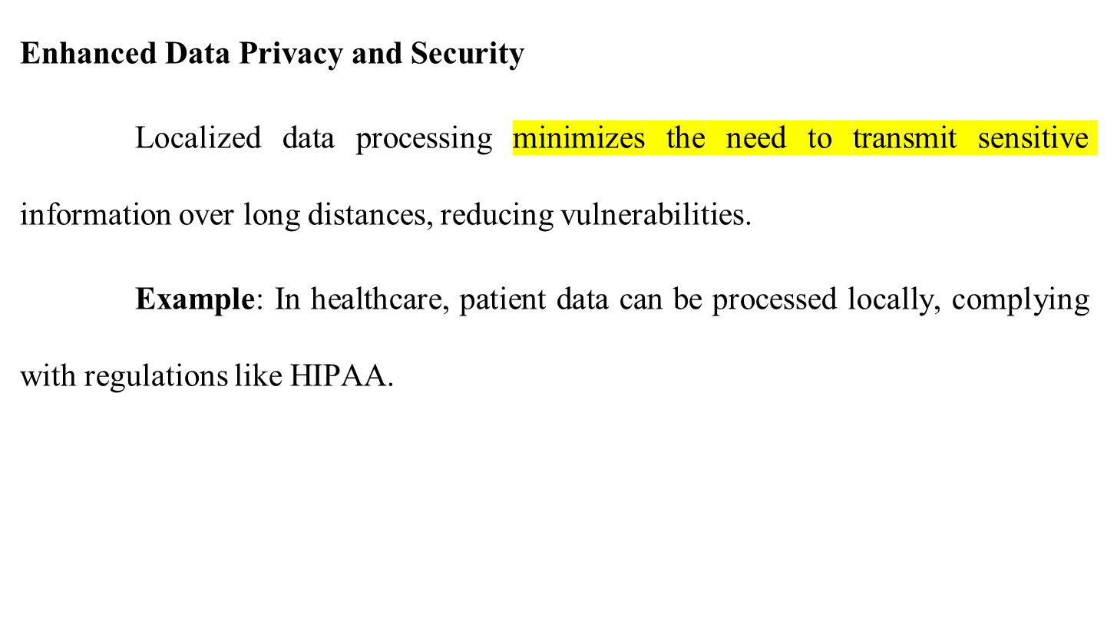
Opportunities and Challenges in Fog Computing

Slide 73
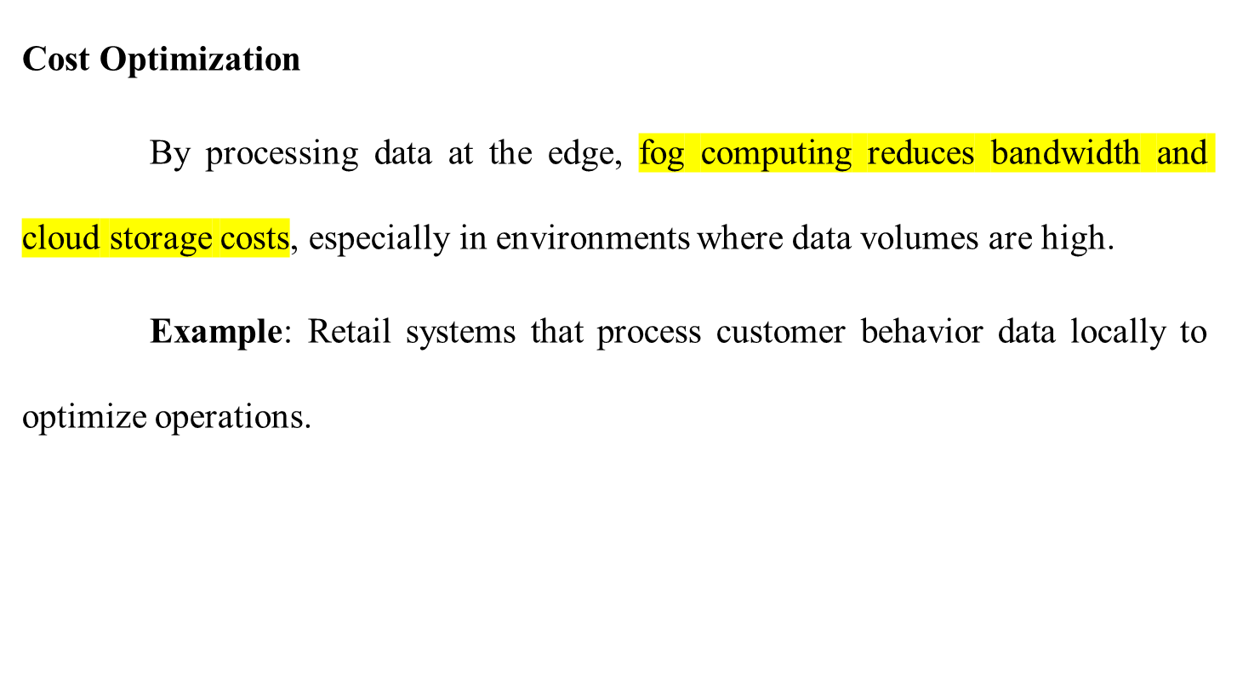
Opportunities and Challenges in Fog Computing

Slide 74
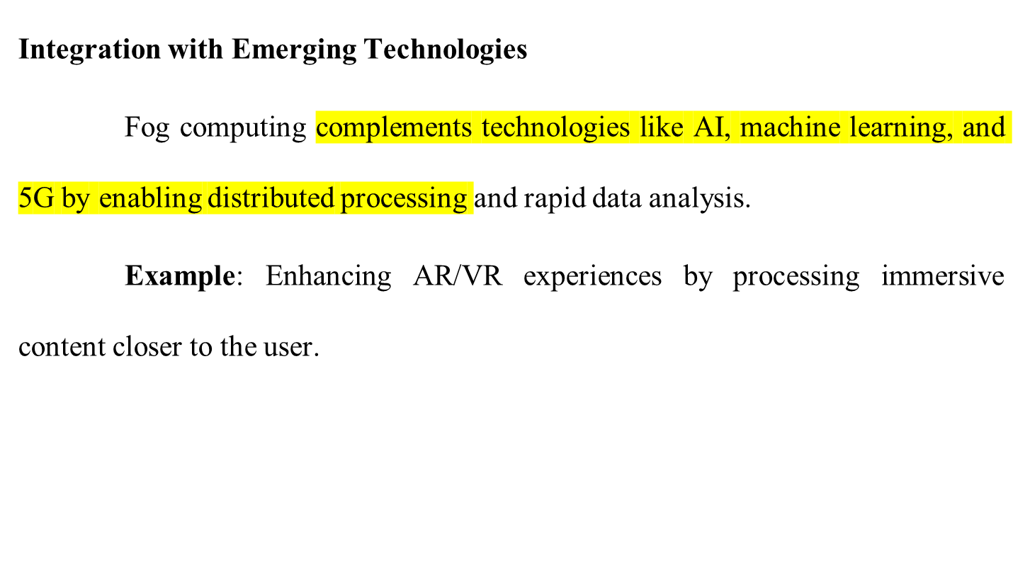
Opportunities and Challenges in Fog Computing

Slide 75
Opportunities and Challenges in Fog Computing
Industry-Specific Customization
Fog computing supports specialized solutions tailored to industries like agriculture, manufacturing, and logistics.
Example: Precision farming applications that process real-time sensor data for irrigation and fertilization.

Slide 76
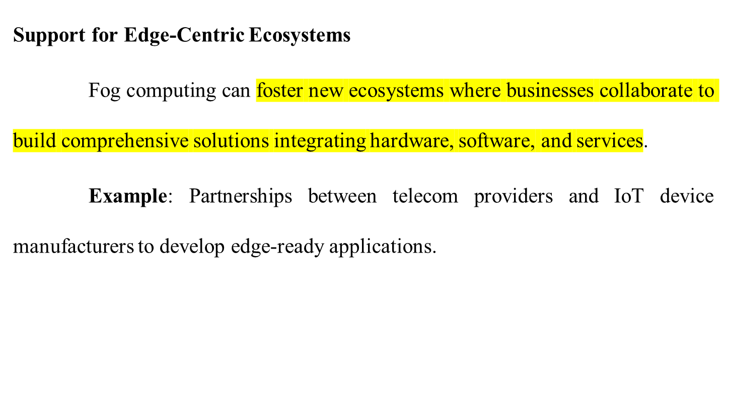
Opportunities and Challenges in Fog Computing

Slide 77
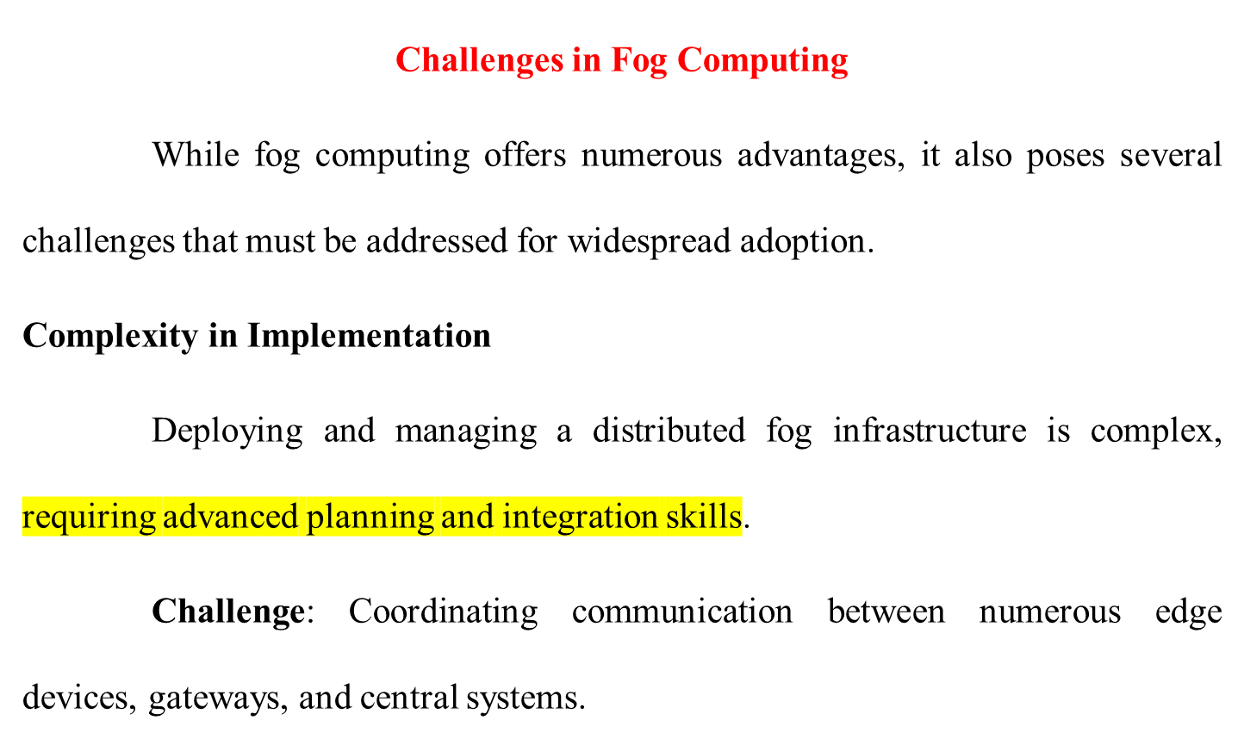
Opportunities and Challenges in Fog Computing

Slide 78
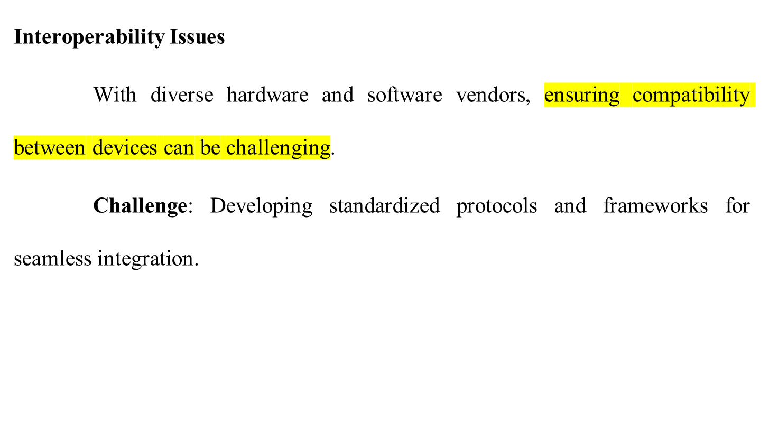
Opportunities and Challenges in Fog Computing

Slide 79
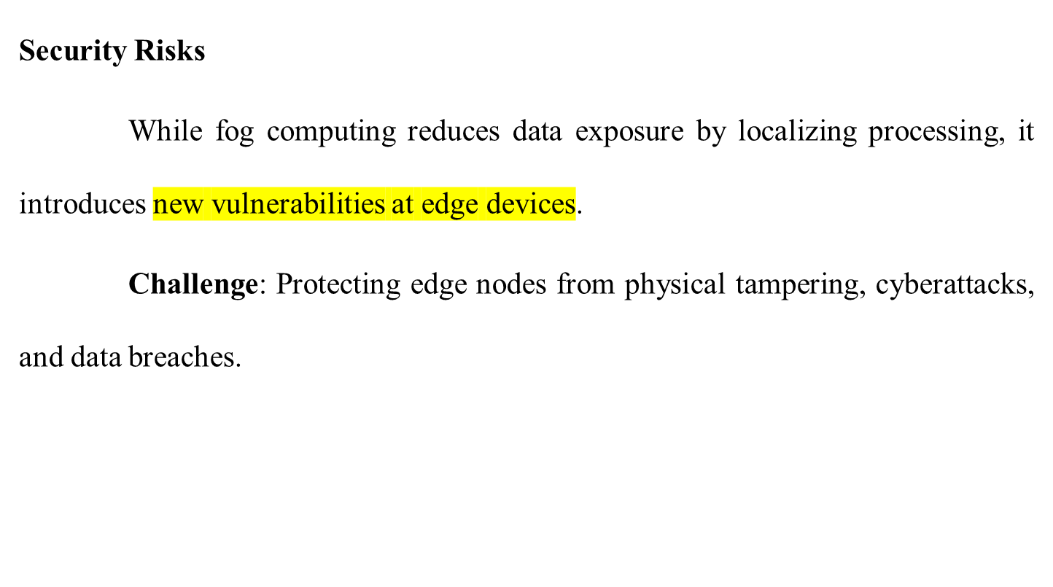
Opportunities and Challenges in Fog Computing

Slide 80
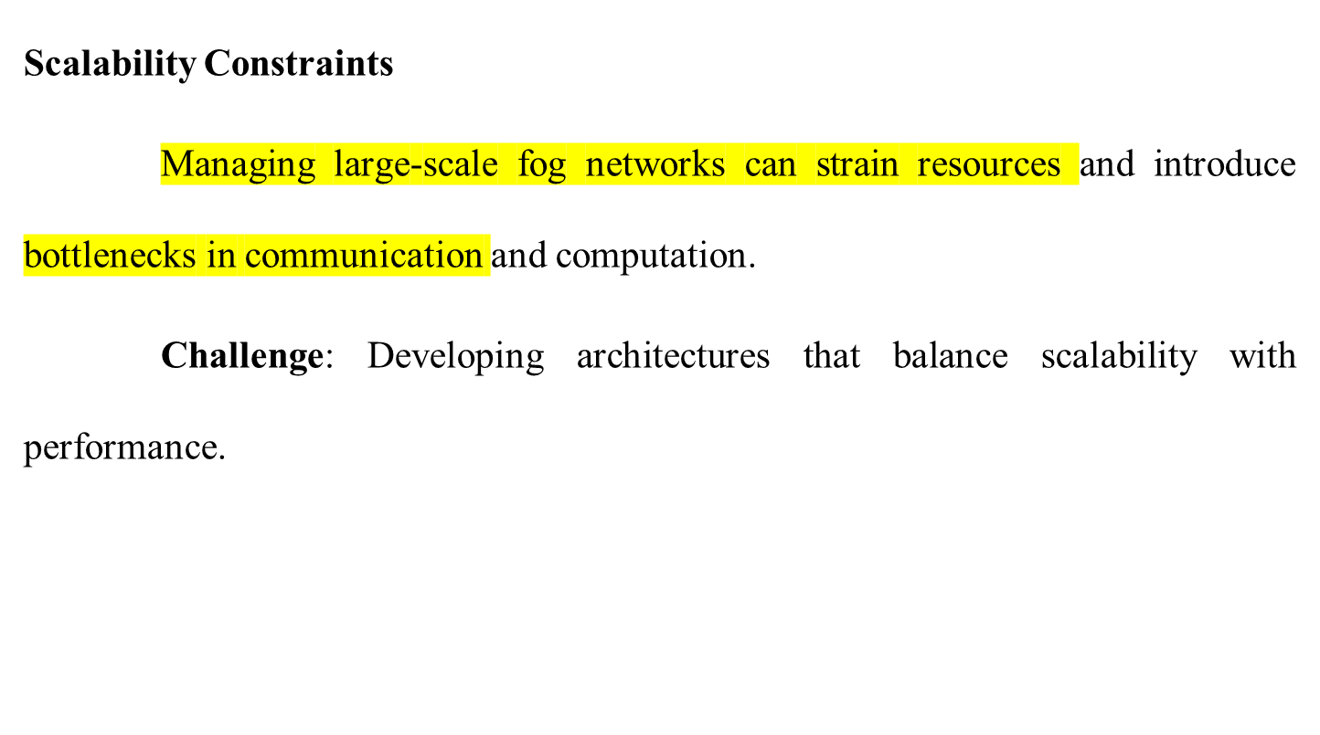
Opportunities and Challenges in Fog Computing

Slide 81
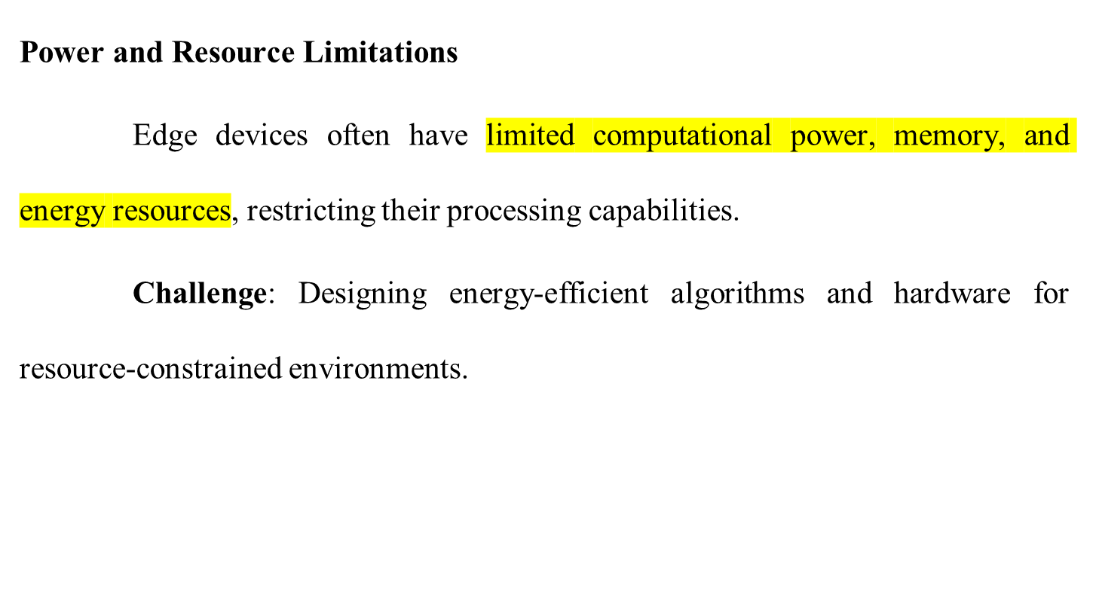
Opportunities and Challenges in Fog Computing

Slide 82
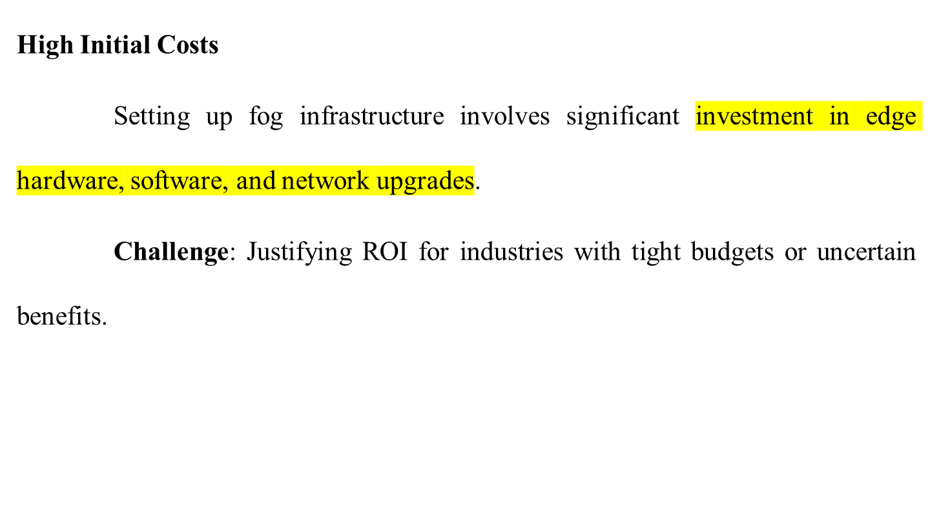
Opportunities and Challenges in Fog Computing

Slide 83
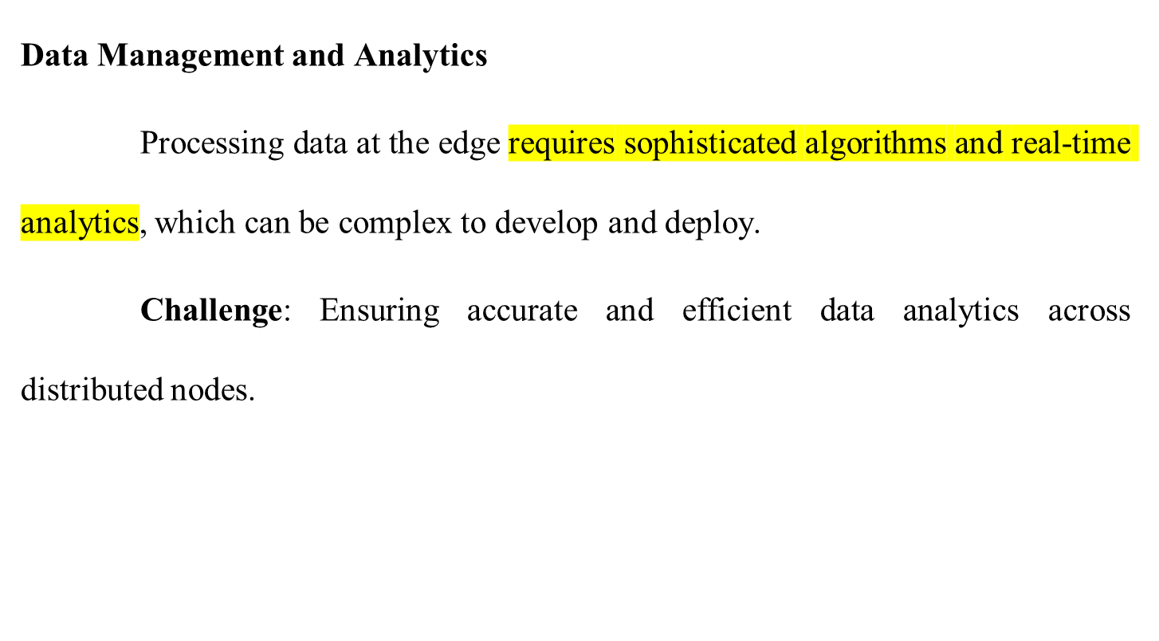
Opportunities and Challenges in Fog Computing

Slide 84
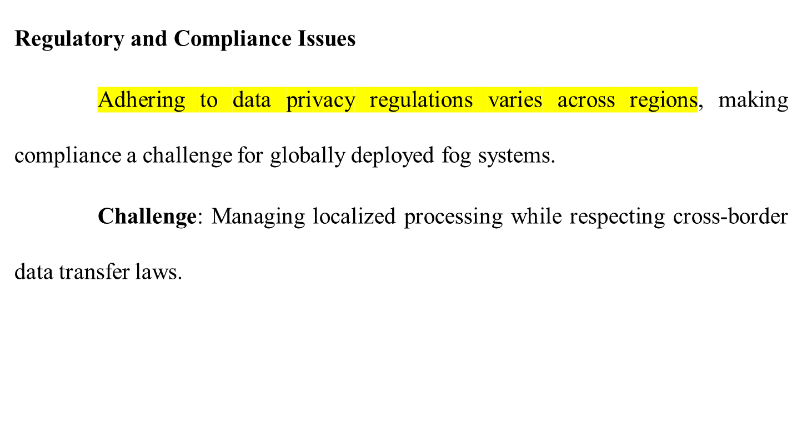
Opportunities and Challenges in Fog Computing

Slide 85
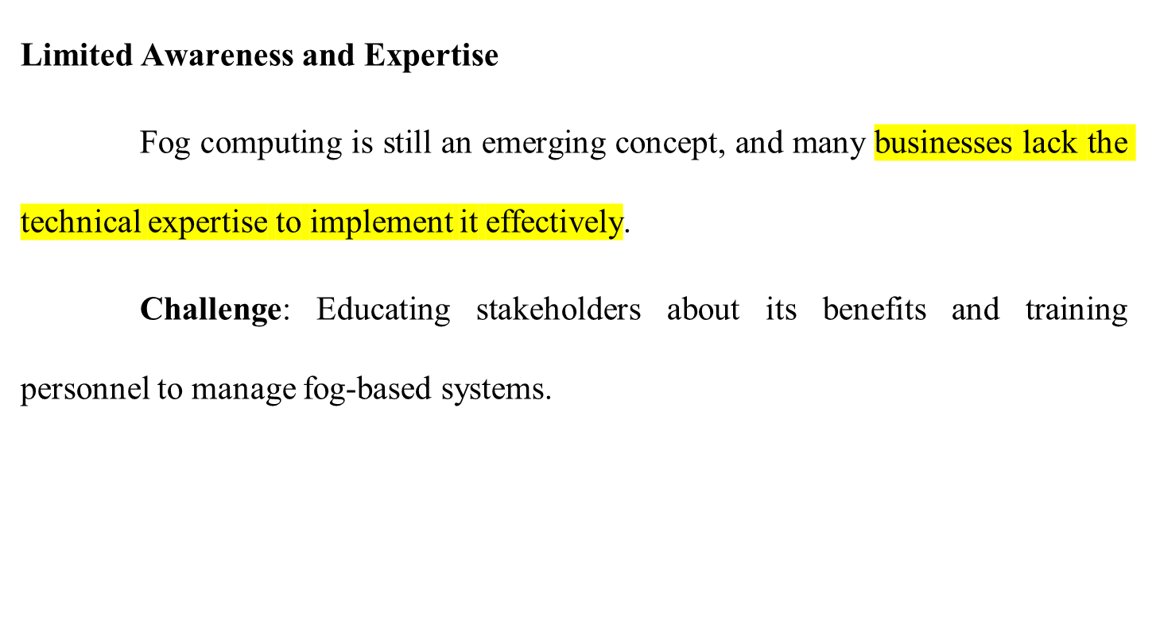
Opportunities and Challenges in Fog Computing

Slide 86
Opportunities and Challenges in Fog Computing
Balancing Opportunities and Challenges
To capitalize on the opportunities while overcoming the challenges, businesses can adopt the following strategies:
Standardization Efforts: Collaborate with industry bodies to develop open standards and protocols.
Edge AI Integration: Leverage lightweight AI models to enhance decision-making at resource-constrained edge devices.

Slide 87
Opportunities and Challenges in Fog Computing
Security Enhancements: Focus on robust encryption, authentication, and device management practices.
Ecosystem Partnerships: Build alliances with vendors, developers, and service providers for comprehensive solutions.
Incremental Adoption: Start with pilot projects to validate fog computing’s ROI before scaling.

Slide 88
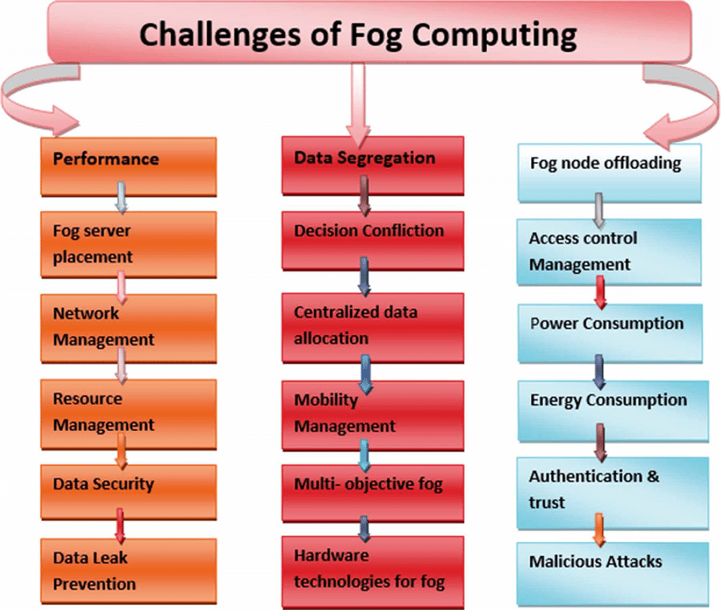
Opportunities and Challenges in Fog Computing

Slide 89
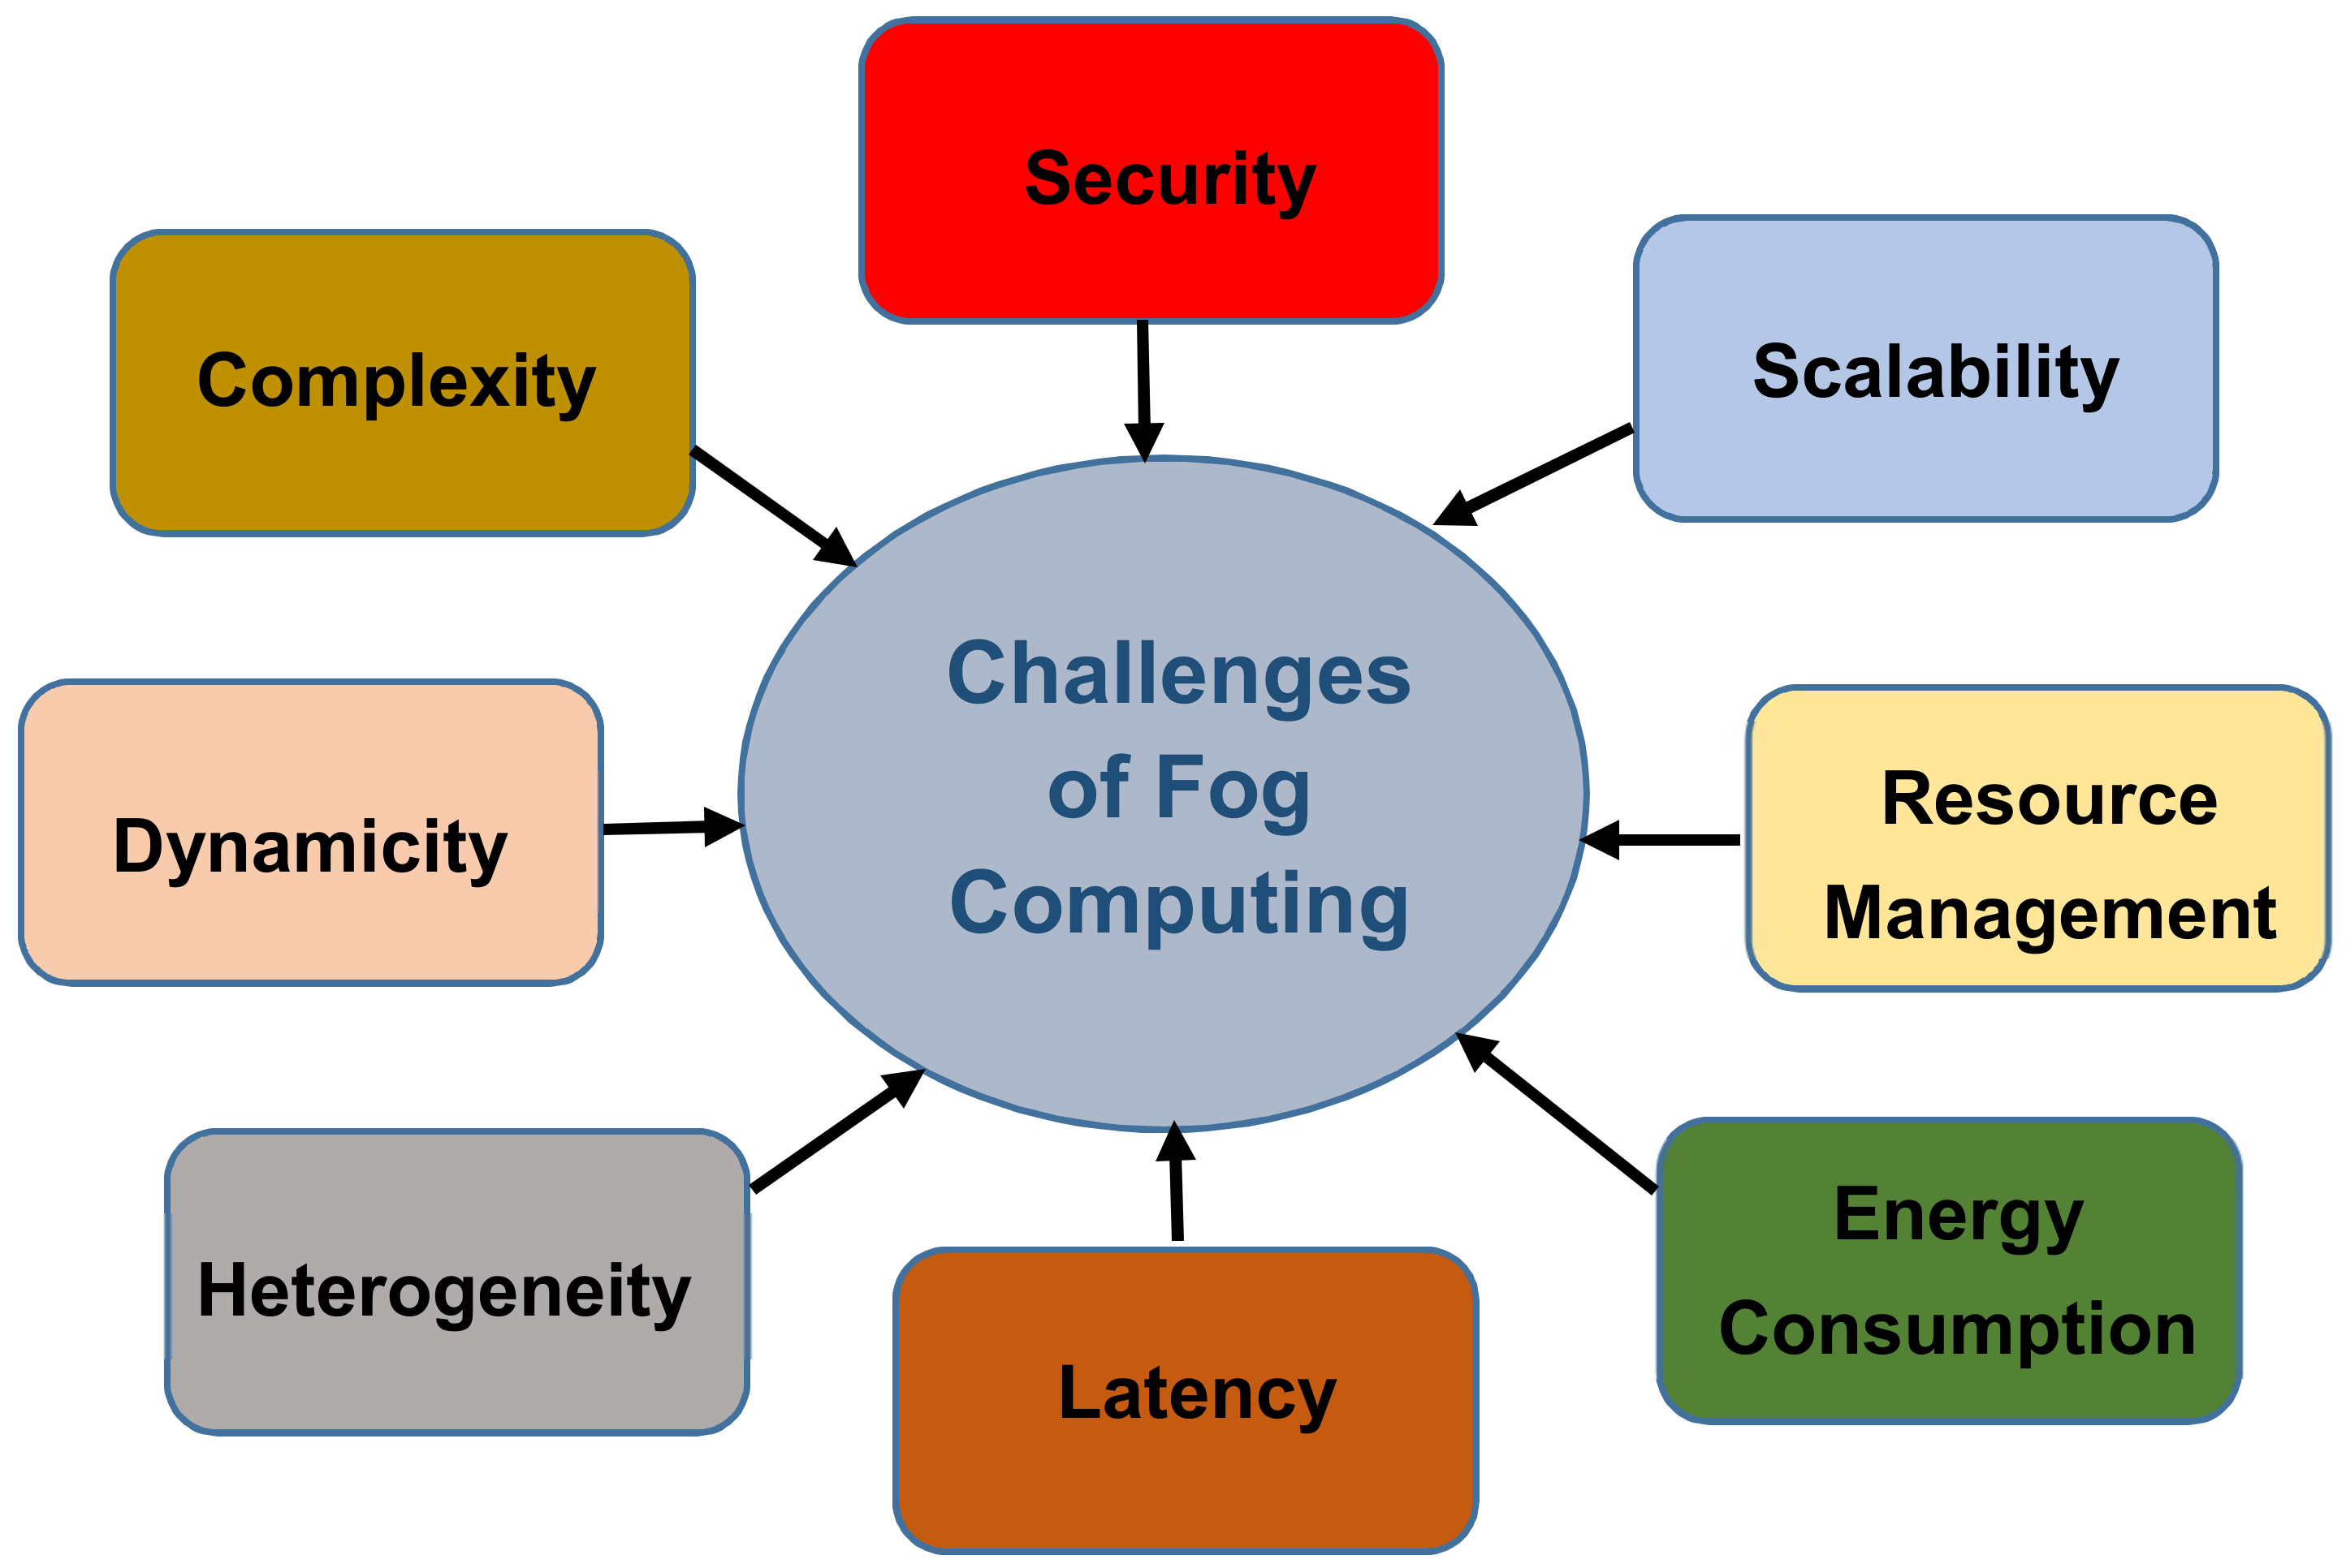
Opportunities and Challenges in Fog Computing

Slide 90
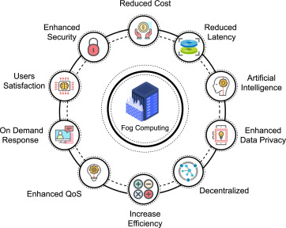
Opportunities and Challenges in Fog Computing

Slide 91
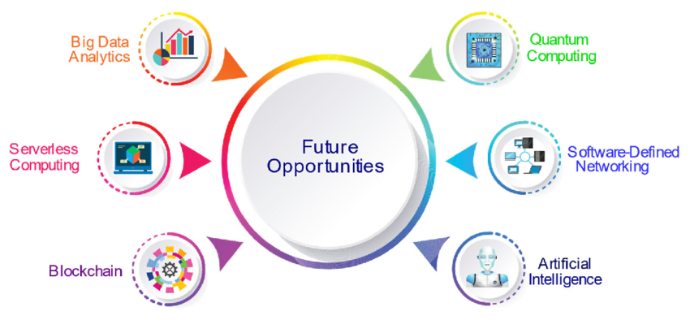
Opportunities and Challenges in Fog Computing

Slide 92
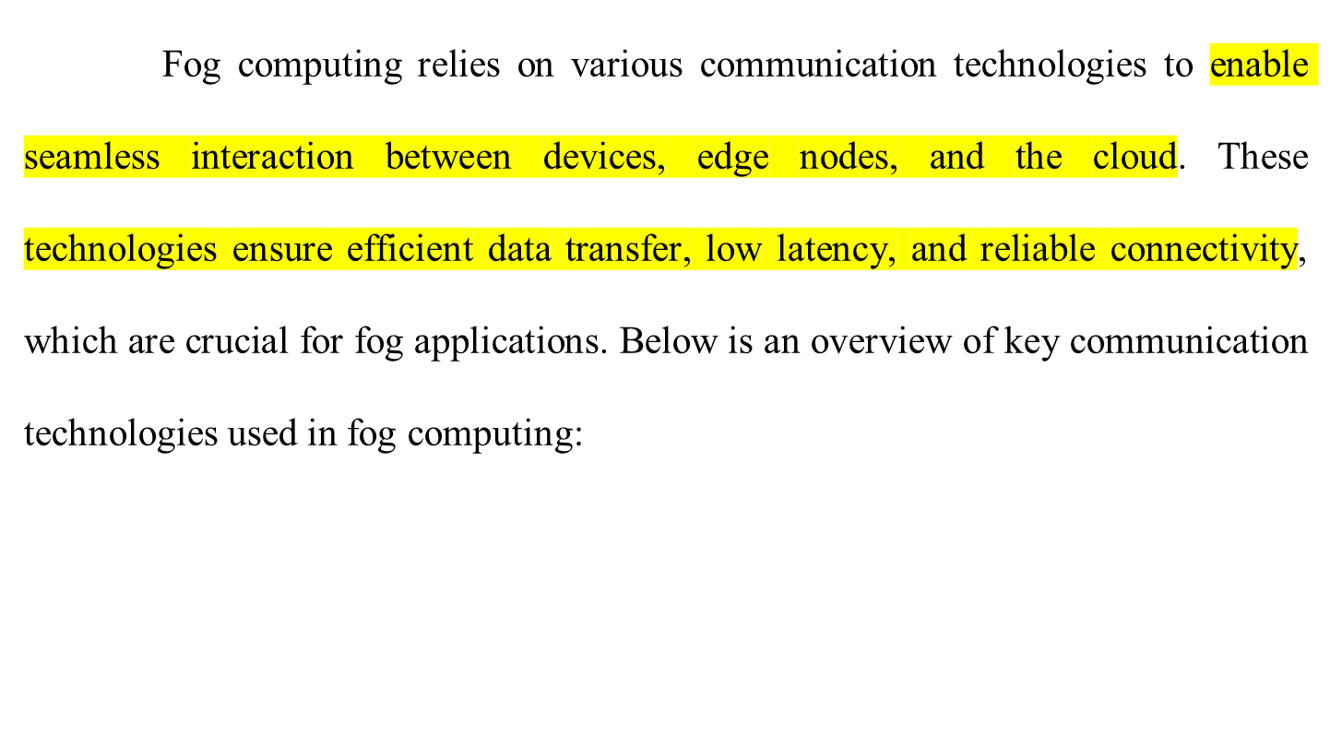
Fog Computing Communication Technologies

Slide 93
Fog Computing Communication Technologies
Wired Communication Technologies
Ethernet
Description: A high-speed wired communication standard commonly used in industrial and enterprise networks.
Advantages
High data transfer rates (e.g., Gigabit Ethernet).
Low latency and reliable connections.
Applications: Industrial automation / Data centers and local fog nodes.

Slide 94
Fog Computing Communication Technologies
Optical Fiber
Description: Uses light to transmit data over long distances at high speeds.
Advantages
Extremely high bandwidth and low latency.
Immune to electromagnetic interference.
Applications
Connecting data centers, core networks, and edge devices.

Slide 95
Fog Computing Communication Technologies
Wireless Communication Technologies
Wi-Fi
Description: A widely adopted wireless communication standard for short-to-medium-range connectivity.
Advantages
Easy deployment and widespread availability.
Speeds of up to 10 Gbps (Wi-Fi 6).
Applications: Retail and small-scale industrial environments.

Slide 96
Fog Computing Communication Technologies
Bluetooth and BLE (Bluetooth Low Energy)
Description: Short-range wireless communication technologies optimized for low power consumption.
Advantages
Energy-efficient for IoT devices. / Ideal for device-to-device communication.
Applications
Wearable devices and health monitoring systems.
Smart home automation.

Slide 97
Fog Computing Communication Technologies
Zigbee
Description: A low-power, low-data-rate wireless technology designed for IoT networks.
Advantages
Energy-efficient and supports mesh networking / Reliable in dense environments.
Applications
Smart grids and home automation / Environmental monitoring.

Slide 98
Fog Computing Communication Technologies
LoRaWAN (Long Range Wide Area Network)
Description: A low-power, wide-area network technology designed for long-range IoT communication.
Advantages
Long-range communication (up to 10 km in rural areas) / Low power consumption
Applications
Smart agriculture / Logistics and supply chain tracking

Slide 99
Fog Computing Communication Technologies
Cellular Networks (3G, 4G & 5G)
Description: Mobile communication standards for wide-area, high-speed connectivity.
Advantages
High bandwidth and global coverage (especially with 4G/5G)
Ultra-low latency with 5G for real-time applications.
Applications: Remote healthcare monitoring and connected transportation.

Slide 100
Fog Computing Communication Technologies
Industrial IoT-Specific Technologies
MQTT (Message Queuing Telemetry Transport)
Description: A lightweight messaging protocol for IoT devices.
Advantages
Optimized for low-bandwidth, high-latency networks.
Publish-subscribe model supports flexible communication.
Applications: Industrial automation / Real-time monitoring systems.

Slide 101
Fog Computing Communication Technologies
CoAP (Constrained Application Protocol)
Description: A lightweight protocol designed for constrained devices and networks.
Advantages
Low power consumption.
Simple RESTful architecture for IoT devices
Applications: Smart Energy Systems / Sensor Networks

Slide 102
Fog Computing Communication Technologies
OPC UA (Open Platform Communications Unified Architecture)
Description: A protocol specifically for industrial automation and process control.
Advantages:
Platform-independent and secure.
Supports integration of real-time and historical data.
Applications:
Manufacturing and factory automation / Predictive maintenance.

Slide 103
Fog Computing Communication Technologies
Short-Range Communication Technologies
NFC (Near Field Communication)
Description: A short-range wireless technology for data exchange over a few centimeters.
Advantages: Secure and low-power communication.
Applications: Contactless payments / Asset tracking and authentication.

Slide 104
Fog Computing Communication Technologies
RFID (Radio-Frequency Identification)
Description: Wireless technology using radio waves to identify and track objects.
Advantages:
No line-of-sight required
Passive tags require no internal power source.
Applications: Inventory management / Asset tracking.

Slide 105
Fog Computing Communication Technologies
Satellite Communication
Description: Enables connectivity in remote or rural areas where traditional networks are unavailable.
Advantages: Global coverage / Reliable in disaster recovery scenarios.
Applications:
Remote mining operations / Environmental and wildlife monitoring.

Slide 106
Fog Computing Communication Technologies
Hybrid Communication Models
Fog computing often employs hybrid communication technologies, combining wired and wireless methods for optimized performance.
Example: A smart city deployment may use optical fiber for backhaul connectivity and LoRaWAN for sensor communication.

Slide 107
Fog Computing Communication Technologies
Selection Criteria for Communication Technologies
Latency: Applications requiring real-time responses prefer low-latency options like 5G or Ethernet.
Range: Long-range applications may use LoRaWAN or satellite communication, while short-range systems rely on Zigbee or Bluetooth.
Bandwidth: High-bandwidth needs are addressed by technologies like Wi-Fi, optical fiber, or 5G.

Slide 108
Fog Computing Communication Technologies
Energy Efficiency: Battery-powered devices favor low-power options like BLE or Zigbee.
Scalability: Systems like MQTT or LoRaWAN are preferred for large-scale IoT deployments.

