Slide 2
UNIT III
ASSESSMENT TECHNIQUES IN EIA
(Prediction and Impact Assessment of various Environments)

Slide 3
LIST OF PROJECTS REQUIRING AN EIA
(A) Energy
1. Hydroelectric power generation over 50 MW.
2. Thermal power generation over 200 MW.
3. Transmission lines (11 KV and above) and grid stations.
4. Nuclear Power plants.
5. Petroleum refineries.
(B) Manufacturing and Processing
1. Cement Plants.
2. Chemicals projects.
3. Fertilizers plants.
4. Food processing industries including sugar mills, beverages, milk and dairy products with total cost of Rs. 100 Million and above.
5. Industrial Estates (including export processing zones)
6. Man-made fibers and resin projects with total cost of Rs. 100 Million and above.
7. Pesticides (manufacture or formulation).
8. Petrochemicals complex.
9. Synthetic resins, plastic and man-made fibers, paper and paperboard, paper pulping, plastic products, textile (except apparel), printing and publishing, paints and dyes, oils and fats and vegetable ghee projects with a total cost more than Rs. 10 Million.
10. Tanning and lather finishing projects.

Slide 4
(C) Mining and Mineral Processing.
1. Mining and processing of coal, gold, copper, sulphur and precious stones.
2. Mining and processing of major non-ferrous metals, iron and steel rolling.
3. Smelting plants with total cost of Rs. 50 Million and above.
(D)Transport
1. Airports.
2. Federal or provincial highways (except maintenance, rebuilding or reconstruction of existing roads) with total cost of Rs.50 million and above.
3. Ports and harbors development for ships 500 gross tons and above.
4. Railway works.
(E)Water Management, Dams, Irrigation and Flood Protection..
1. Dams and reservoirs with storage volume 50 million cubic meters and above or surface area of 08 square kilometers and above.
2. Irrigation and drainage projects serving 15,000 hectares and above.
(F)Water supply schemes and treatment.
Water supply schemes and treatment plants with total cost of Rs. 25 million and above

Slide 5
Rules and Legislation
Water
The water (prevention and control of pollution) Act, 1974
The water (prevention and control of pollution) Rules, 1975
BIS Standards
IS: 10500:2012. Bureau of Indian Standards, New Delhi

Slide 6
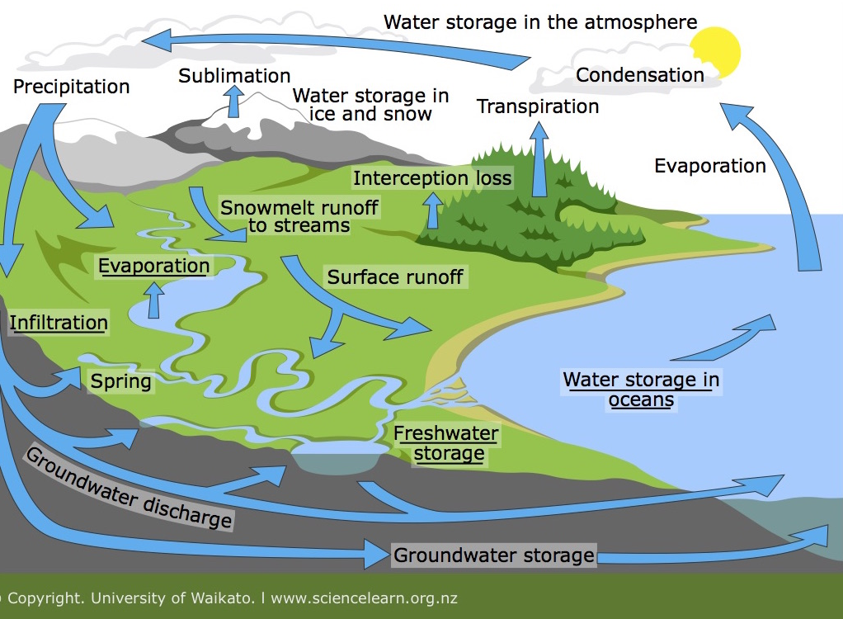
Hydrological Cycle

Slide 7
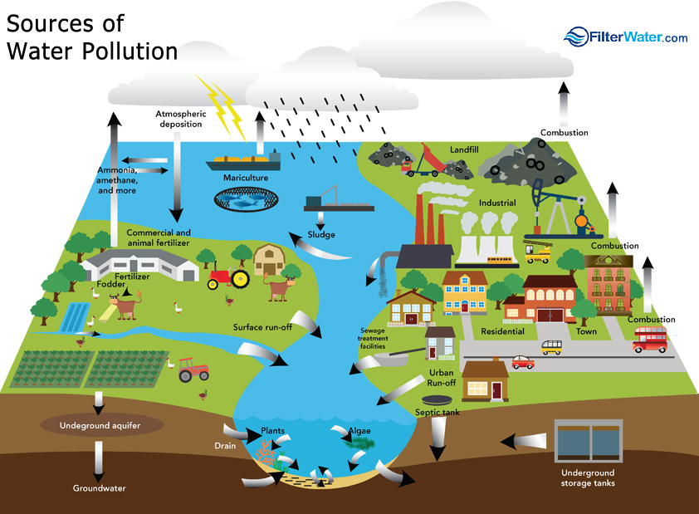

Slide 8
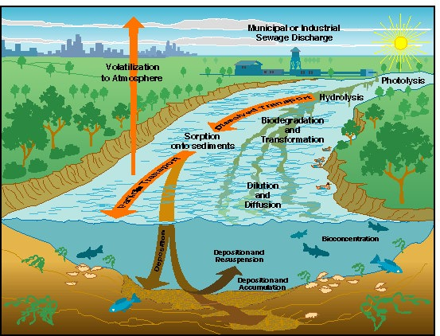

Slide 9
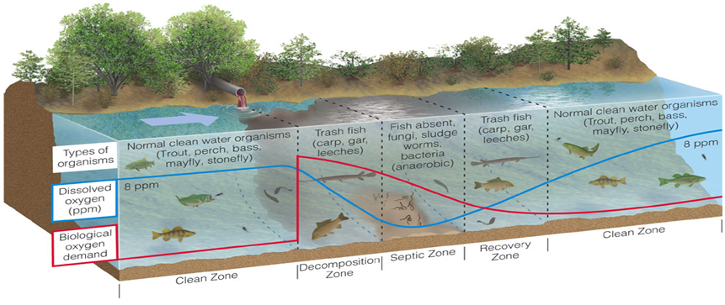

Slide 10
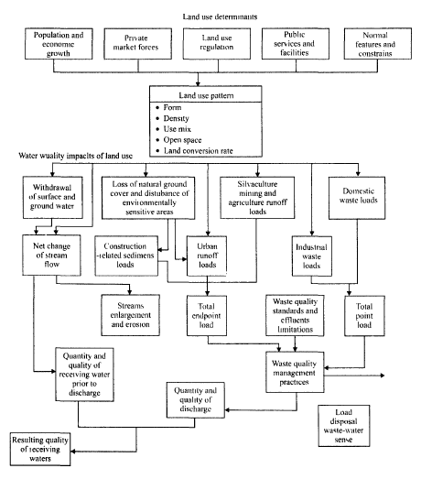

Slide 11
Projects Which Create Impact Concerns for the Surface-Water Environment
Industrial power plants withdrawing surface water for cooling (this may be of particular concern during low- flow conditions).
Power plants discharging heated waste water from cooling cycles
Industries discharging process waste waters from either routine operations or as a result of accidents and spills.
Municipal waste water treatment plants discharging primary, secondary or treated waste waters.
Dredging projects in rivers, harbors, estuaries and or coastal area (increased turbidity and release of sediment contaminants may occur)
Projects involving "fill" or creation of "fast lands" along rivers, lakes. estuaries and coastal area.
Surface mining projects with resultant changes in surface water hydrology and nonpoint pollution.
Construction of dams for purposes of water supply. flood control or hydropower production.
River canalization projects for flow improvements
Deforestation and agricultural development
Commercial hazardous waste disposal sites and/or sanitary landfills, with resultant run-off water and non-point-source pollution; and
Tourism projects adjacent to estuaries or coastal area with concerns related to bacterial pollution.

Slide 12
The environmental effects on surface water are given below.
Shoreline
Bottom interface
Flow
Water quality
Drainage pattern
Water balance
Flooding
Existing Use

Slide 13
Impacts on surface waters are usually caused by:
Physical disturbances (for example, the construction of banks, dams, dikes, and other natural or manmade drainage systems)
Changes in climatic conditions
The addition or removal of substances, heat, or microorganisms (for example, the discharge of effluents and deposition of air pollutants into water).
These activities and processes lead to effects which is evident by
Changes in surface water hydrology
Changes in surface water quality, and
Consequently to higher order effects that are reflected by changes in sediment behavior, changes in salinity, and changes in aquatic ecology.

Slide 14
List of various developmental activities which cause significant impacts on surface water resources for which a detailed EIA is required:
Industrial power plants withdrawing surface water for cooling
Power plants discharging heated waste water from cooling cycles
Industries discharging waste waters from either routine operations or as a result of accidents and spills.
Municipal waste water treatment plants discharging primary, secondary or treated waste waters.
Dredging projects in rivers, harbors, estuaries and or coastal area
Projects involving "fill" or creation of "fast lands" along rivers, lakes. estuaries and coastal area.
Surface mining projects with resultant changes in surface water hydrology and nonpoint pollution.
Construction of dams for purposes of water supply. flood control or hydropower production.
River canalization projects for flow improvements
Deforestation and agricultural development resulting in non-point source pollution associated with nutrients and pesticides and irrigation projects, leading to turn flows laden with nutrients and pesticides.
Commercial hazardous waste disposal sites and/or sanitary landfills, with resultant run-off water and non-point-source pollution; and
Tourism projects adjacent to estuaries or coastal area with concerns related to bacterial pollution

Slide 15
Identification of Surface Water Quantity or Quality Impacts of Proposed Projects
The focus of this step is on identifying potential impacts of the project.
This early qualitative identification of anticipated impacts can help in refining subsequent steps.
The first activity is to determine the features of the proposed project, the need for the project, and the potential alternatives
The key information relative to the proposed project includes such items as
The type of project and how it functions or operates in a technical context, particularly with regard to water usage and waste water generation, or the creation of changes in water quality or quantity,
The proposed location of the project,
The time period required for project construction,
The potential environmental outputs from the project during its operational phase, including information relative to water usage and water pollutant emissions, and waste-generation and disposal needs.
The identified need for the proposed project in the particular location (could be related to flood control, industrial development, economic development and many other requirements), and
Any alternatives which have been considered, with generic alternatives for factors including site location, project size, project design features and pollution control measures, and project timing relative to construction and operational phases

Slide 16
Description of Existing Surface - Water Resource Conditions
involves describing existing (background) conditions of the surface water resource(s) potentially impacted by the project
Compilation of Water Quantity - Quality Information
Information should be assembled on both the quantity (flow variations) and quality of the surface water in the river reach of concern, and potentially in relevant downstream
Procurement of relevant surface-water Quantity/Quality standards
To determine the severity of the impact that may result from a project, it is necessary to make use of institutional measures for determining the impact significance
Surface-water quantity and quality standards, regulations, or policies are examples of these measures.
Thus determination of the specific requirements for a given surface water will require contacting governing agencies in one or several regions.
The standards designated by Central Pollution Control Boards CCPCB) will be based on the use or uses to be made of the water and set criteria necessary to protect the water resources and environment
Water quality standards and water-use restrictions are related to low-flow periods in the' river system. For example, dissolved oxygen (DO) minima may be applicable during the 7-day, 10-yr low-flow conditions.

Slide 17
Impact prediction
“Impact prediction” refers to the quantification (or, at least, the qualitative description), of the anticipated impacts of the proposed project on various surface water environment factors
Because of the complex and dynamic nature of hydrological systems accurate prediction of impacts is often difficult and there are bound to be some uncertainities which have to be recorded in the EIS
The following considerations may be relevant to the prediction of surface water quantity/ quality impacts
Frequency distribution of decreased quality and quantity;
Effects of sedimentation on the stream-bottom ecosystem;
Fate of nutrients by incorporation into biomass;
Reconcentration of metals, pesticides, or radionuclides into the food web;
Chemical precipitation or oxidation-reduction of inorganic chemicals; and
Anticipated distance downstream of decreased water quality and the implications for water users and related raw-water quality requirements
Depending upon the particular impact technically demanding mathematical models might be required for prediction
Other approaches include the conduction of laboratory testing, such as, leachate testing for degraded material and for solid or hazardous waste materials or sludges
Assessment of impact significance
Identification and incorporation of mitigation measures
Mitigation measures might consist of decreasing the magnitude of the surface - water impacts or including the features that will compensate for the surface water impacts
The specific mitigation measures depends upon the particular project type and location

Slide 18
mitigation measures that should be adopted to various water related issues
Decrease surface-water usage and waste water generation
Minimize erosion during the construction and operational phases of the project
In projects involving the use of agricultural chemicals, consider measures that could be used to plan better the timing of chemical applications, the rate of application, and the extent of such applications in an effort to minimize erosion and chemical transport to surface-water systems.
Manage non-point-source pollution through the application of Best Management Practices (BMPs) as determined by a state or a designated area-wide planning agency
Develop a non-point-pollution-control program for coastal waters
Use constructed wetlands to control non-point-source pollution involving nutrients, pesticides and sediments.
Consider alternative wastewater treatment schemes to achieve treatment goals in a cost-effective manner
For point sources, the treatment schemes could include primary, secondary and/ or tertiary processes involving physical. biological and for chemical principles of pollutant removal
Consider project operational modes that minimize detrimental impacts
Use techniques such as sediment removal and macrophyte (weed) harvesting for restoring lakes and reservoirs from water quality deterioration and eutrophication

Slide 19
Prediction and Assessment of Impacts on Soil and Ground Water Environment

Slide 26
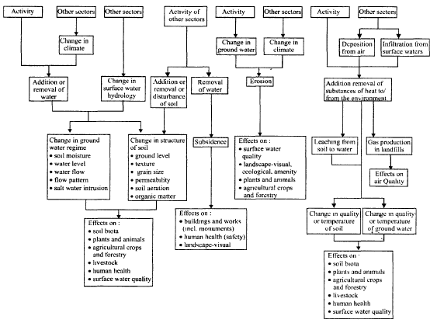
Soil and groundwater effects.

Slide 27
Systematic approach for the study of Impacts on Soil and Ground water:
Delineation of study area
The study area should reflect the full reach of possible effects within the particular impact discipline that is being considered
The proposed or future land-use map along with committed land-use policies, zoning, and development projects should be included in the study area.
The map should clearly distinguish between developed and undeveloped land.
Categories shown on land-use map, should be
Residential
Commercial and industrial
Institutional and parks or recreation
Non-urban mixed
The map could include further divisions, such as separate commercial and industrial activity centers and public vacant lands.
The categories to be used will depend largely on the type of project or action being evaluated, the characteristics of the local land area, and the geographic extent of the affected study area.
Identification of activities of the project, which will have different types of impacts on soil and/or groundwater quantity- quality

Slide 28
Preparation of description of existing soil and/or groundwater resource condition:
Background Information on the Soil Environment
Soil Characteristics
Soil characteristics in a given geographical area at a given point of time are a function of both natural influences and human activities.
The soil and geological environments are typically associated with the physical and chemical environment
The relationship between shallow, alluvial aquifers and the flow of surface streams and rivers may need to be explored
Unique Soil or Groundwater Problems
Many geographical areas exhibit special or unique problems that should be addressed in the description of baseline conditions for the soil or groundwater resources in the study area
Examples: saline seeps, groundwater supplies relative to existing bacteriological or other quality constituents, poor natural quality, and the presence of hazardous waste sites
Pollution Sources and Groundwater Users
It is appropriate to consider which other potential and actual sources of soil and/or groundwater pollution may exist in the study area
Consideration of current and potential future usage of the groundwater resource for purposes of water supply techniques

Slide 29
Procurement of relevant soil and/or groundwater quantity/quality standards:
Land-use restrictions, soil quality standards, soil reclamation requirements, and groundwater quantity - quality standards, regulations, or policies are examples of institutional measures, which can be used to determine impact significance and required mitigation measures.
Thus, to determine the specific requirements for a given project area will require contacting appropriate governmental agencies with jurisdiction
Impact prediction for soil and/or groundwater environment:
The prediction of the impacts of a project - activity on the soil and/or ground – water environment(s), or conversely, the potential influence of the environment(s) on a proposed project, can be approached from three perspectives.
Qualitative
Simple quantitative, and
Specific quantitative
Efforts should be made to quantify the anticipated impacts
However, in many cases this will be impossible and reliance must be given to qualitative trend
Through the spreading of excess sub-soil over the right - of - way during clean-up.
Qualitative Approaches-Groundwater Impacts
A qualitative approach for groundwater - impact prediction involves the fundamental subsurface environmental processes
Can be examined relative to their hydrodynamic (physical), biotic (chemical) aspects.

Slide 30
Assessment of impact significance:
Leaching into Soil and Groundwater
The volume of leachate percolating through a site can be predicted using mathematical models such as the water balance method in sites above the water table.
For predicting long-term effects
Change in storage can be assumed to be zero
Evapotranspiration can be based on existing data or experiments
Run-off can be calculated using an empirical model based on surface conditions and slopes
Changes in Groundwater Flow
The effects of physical disturbances and discharge of liquid effluents on groundwater include changes in the availability of soil moisture for soil microorganisms and plants, reducing the available yield for abstraction which can lead to saltwater intrusion to underground water1sources or a change in the hydrology of surface waters
Mathematical models are primarily based on analytical or numerical solution of equations for conservation of mass using Darcy's law.
The groundwater system can be divided into one. two, or three segments depending on the directions of flows within the system
The flows into and out of each segment are then balanced using Darcy's equation.
Changes in Groundwater Quality
Superimposing models of chemical conversion. biological breakdown, system process, etc. can simulate the behavior of non- conservative pollutants
Tracer experiments may be used to predict dispersion of pollutants in groundwater.

Slide 31
Identification and incorporation of mitigation measures
Mitigation Measures to Prevent Soil Erosion, Compaction and Ground Water Pollution During and After Execution of Any Developmental Project
Use of techniques to decrease soil erosion during either the construction or operational phase of the project.
Where possible gentle gradients should be treated and steep slopes avoided.
Suitable drainage systems to direct water ways from slopes should be installed
Creating large open expanses of bare soil should be avoided. These are more susceptible to wind erosion. If such large areas are created then wind breaks may be a useful mitigation procedure.
If the development is near to a water body siltation traps may need to be installed to trap sediment and prevent any damage to the fresh water ecosystem
Driving over the soil should be avoided or use wide tyres to spread the weight of vehicles thereby avoiding compaction
Few tracks too should bring vehicles to the working area
Cultivate the area after compaction has taken place. Rotation of land-use practices in the project area can be adopted to permit natural recovery without the continuing stress related to anyone land-use practice. Examples include the rotation of military training areas, agricultural crops in given geographical areas, and grazing patterns in areas permitted by pertinent governmental agencies.
The project can be designed to exhibit greater earthquake resistance if this is a potential concern for the project area. Examples include structural designs for withstanding shocks associated with the occurrence of earthquake
For projects involving usage of the groundwater resource, groundwater usage could be decreased.
If the potential impact of concern is land subsidence management, techniques to minimize groundwater usage in the area where subsidence is expected to occur could be implemented. These could encompass water conservation measures so as to reduce groundwater requirements.
Development of comparative information to enable more systematic site selections, which will, in turn, make maximum usage of the natural attenuation capacity of given environmental settings to prevent groundwater contamination
For projects, which may be of concern because of leachate generation, measures could be taken to immobilize the constituents and prevent their generation.

